Slide 1
Case Study of Reader/Writer System
Moonzoo Kim
School of Computing
KAIST

Slide 2
Outlines
System Description
Formal Requirement Specification
Formal Design Specification
Formal Verification
Testing
System
Description
Requirement
Specification
Design
Specification
Design
Verification
System
Implementation
Testing

Slide 3
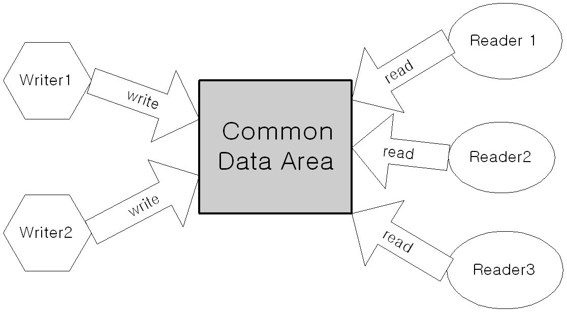
Multiple Reader/Writer System
System requirement
Concurrency (CON)
Exclusive writing (EW)
High priority of writer (HPW)
Notes:
1.Concurrency
Multiple reader reads data concurrently for maximum throughput
2. Exclusive writing
Only one writer can write into the data area at one time for consistent data.
Similarly, when a writer writes, no reader can read.
3. High priority of writer over reader
If there is a waiting writer, the writer has a higher priority than waiting readers to access the data area
It’s for most fresh data for reader to read.

Slide 4
Multiple Reader/Writer System
2 versions of HPW
HPW#1
While no reader is reading the common data area (CDA), if a writer has tried to write to CDA at the time instance T, no reader should read CDA after T until the writer completes writing.
HPW#2
While no reader is reading CDA, if a writer has tried to write to CDA at the time instance T and
no reader is waiting to read CDA before T, no reader should read CDA after T until the writer completes writing. Or
R_{i} is waiting to read CDA before T, R_{i} may read CDA before W writes to CDA (i.e., respecting first-come-first-serve)
Notes:
1.Concurrency
Multiple reader reads data concurrently for maximum throughput
2. Exclusive writing
Only one writer can write into the data area at one time for consistent data.
Similarly, when a writer writes, no reader can read.
3. High priority of writer over reader
If there is a waiting writer, the writer has a higher priority than waiting readers to access the data area
It’s for most fresh data for reader to read.

Slide 5
Formal Requirement Specification
1 writer and 2 readers system
Execution tree
RW system has 9 events
{ir1,rs1,re1,ir2,rs2,re2,ww,ws,we}
A state s = (n_{ir1},n_{rs1},n_{ir2},n_{rs2},n_{ww},n_{ws})
s0 = (0,0,0,0,0,0)
s1 = (0,0,0,0,1,0)
s11=(1,0,0,0,1,0)
s12= (0,0,0,0,0,1)
s0
ir1
ww
ir2
s1
ir1
ir2
ws
s11
s12
s13

Slide 6
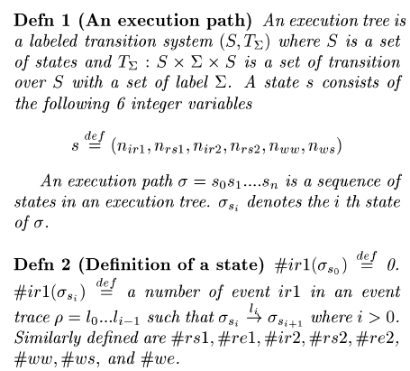
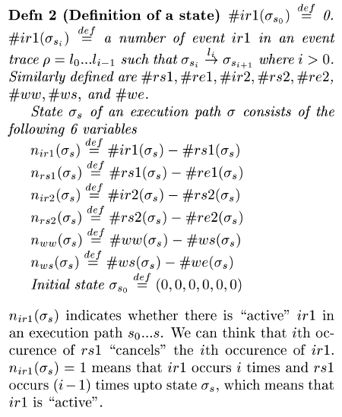
Formal Requirement Specification (cont.)
Valid execution paths

Slide 7
Formal Requirement Specification (cont.)
Valid execution path σ
An execution path σ= s₀. s₁ … s_{n}
σ_{si} denotes the i th state of σ
Definition of a state s_{i}.
#ir1(σ_{s0}) =0
#ir1(σ_{si} ) = # of ir1 in a trace l₀....l_{i-1} s.t. σ_{si} –l_{i}-> σ_{si+1}
n_{ir1} (σ_{s}) = #ir1(σ_{s} ) - #rs1(σ_{s} )
n_{rs1} (σ_{s}) = #rs1(σ_{s} ) - #re1(σ_{s} )
n_{ir2} (σ_{s}), n_{rs2} (σ_{s}), n_{ww} (σ_{s}), n_{ws} (σ_{s}) are defined similarly

Slide 8
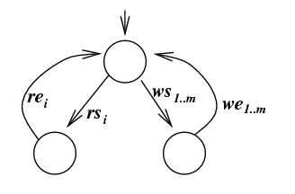
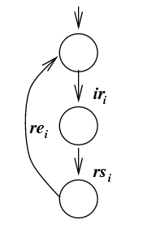
Formal Requirement Specification (cont.)
Valid execution path σ
Correct Event Ordering
For all state s_{i} in σ
n_{ir1}(s_{i})≥0 ∧ n_{rs1}(s_{i})≥0 ∧ n_{ir1}(s_{i})+n_{rs1}(s_{i}) ≤1
n_{ir2}(s_{i})≥0 ∧ n_{rs2}(s_{i})≥0 ∧ n_{ir2}(s_{i})+n_{rs2}(s_{i}) ≤1
n_{ww}(s_{i})≥0 ∧ n_{ws}(s_{i})≥0 ∧ n_{ww}(s_{i})+n_{ws}(s_{i}) ≤1
Exclusive Writing
For all state s_{i} in σ
n_{ws}(s_{i})=1 ->(n_{rs1}(s_{i})=0 ∧ n_{rs2}(s_{i})=0)

Slide 9
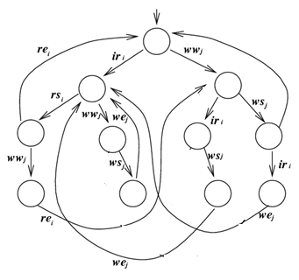
Formal Requirement Specification (cont.)
Valid execution paths
High Priority of Writer #1 (HPW#1)
(n_{ww}(s_{i})=1 ∧ n_{rs1}(s_{i})=0 ∧ n_{rs2}(s_{i})=0) -> (n_{rs1}(s_{i+1})=0 ∧ n_{rs2}(s_{i+1})=0)
Ex. HPW#1 allow ir1.ww.ws, but NOT ir1.ww.rs1
Ex1. For a state s_{a} in the right LTS,
s_{a} -ws_{j}-> s_{a+1} is valid, since n_{ww}(s_{a})=1, n_{rs1}(s_{a})=0, n_{rs2}(s_{i})=0, n_{rs1}(s_{a+1})=0, n_{rs2}(s_{a+1})=0
Ex2. For a state s_{a} in the right LTS,
s_{a} -rs_{i}-> s_{a’} is NOT valid, since n_{ww}(s_{a})=1, n_{rs1}(s_{a})=0, n_{rs2}(s_{i})=0, n_{rs1}(s_{a’})=1, n_{rs2}(s_{a’})=0
s_{a}
s_{b}
rs_{i}
rs_{i}
s_{a’}
s_{a+1}
s_{b’}
s_{b+1}

Slide 10
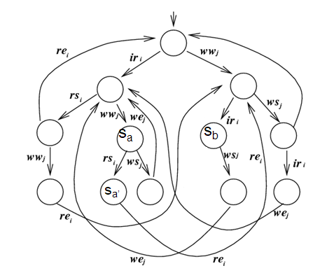

Formal Requirement Specification (cont.)
Valid execution paths
High Priority of Writer #2 (HPW#2)
Difficult to formally specify HPW#2 in the given formal framework since we need to specify an order of events in a trace
Ex. we need to distinguish ir1.ww.rs1 and ww.ir1.rs1
rs_{i}
s_{b’}

Slide 11
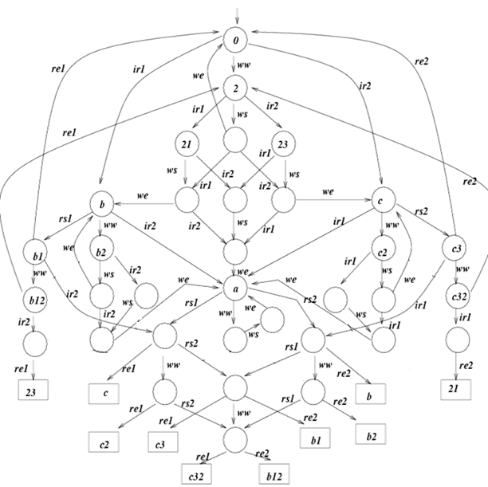
Formal Requirement Specification (cont.)
LTS for the Requirement w/ HPW#1

Slide 12
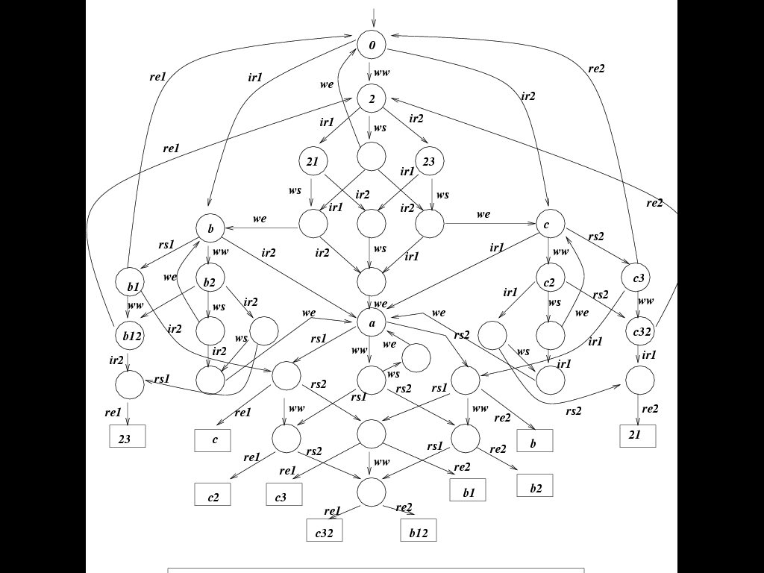
Formal Requirement Specification (cont.)
LTS for the Requirement w/ HPW#2
New transitions that are not allowed by HPW#1
rs₁

Slide 13
Formal Requirement Specification (cont.)
***************************************
* Requirement Specification w/ HPW#1 *
***************************************
proc ReqRW_HPW1 = ir1.B + ww.S2 + ir2.C
proc S2 = ir1.S21 + ws.S22 + ir2.S23
proc S21 = ws.S212 + ir2.S213
proc S22 = ir1.S212 + we.ReqRW_HPW1+ ir2.S232
proc S23 = ir1.S213 + ws.S232
proc S212 = we.B + ir2.S2123
proc S213 = ws.S2123
proc S232 = ir1.S2123 + we.C
proc S2123 = we.A
proc A = rs1.A1 + ww.A2 + rs2.A3
proc A1 = re1.C + ww.A12 + rs2.A13
proc A2 = ws.we.A
proc A3 = rs1.A13 + ww.A32 + re2.B
proc A12 = re1.C2 + rs2.A123
proc A13 = re1.C3 + ww.A123 + re2.B1
proc A32 = rs1.A123 + re2.B2
proc A123 = re1.C32 + re2.B12
proc B = rs1.B1 + ww.B2 + ir2.A
proc B1 = re1.ReqRW_HPW1 + ww.B12 + ir2.A1
proc B2 = ws.B22 + ir2.B23
proc B12 = re1.S2 + ir2.B123
proc B22 = we.B + ir2.B223
proc B23 = ws.B223
proc B123 = re1.S23
proc B223 = we.A
proc C = ir1.A + ww.C2 + rs2.C3
proc C2 = ir1.C21 + ws.C22
proc C3 = ir1.A3 + ww.C32 + re2.ReqRW_HPW1
proc C21 = ws.C221
proc C22 = ir1.C221 + we.C
proc C32 = ir1.C321 + re2.S2
proc C221 = we.A
proc C321 = re2.S21

Slide 14
Formal Requirement Specification (cont.)
***************************************
* Requirement Specification w/ HPW#2 *
***************************************
proc ReqRW_HPW2 = ir1.B + ww.S2 + ir2.C
proc S2 = ir1.S21 + ws.S22 + ir2.S23
proc S21 = ws.S212 + ir2.S213
proc S22 = ir1.S212 + we.ReqRW_HPW2+ ir2.S232
proc S23 = ir1.S213 + ws.S232
proc S212 = we.B + ir2.S2123
proc S213 = ws.S2123
proc S232 = ir1.S2123 + we.C
proc S2123 = we.A
proc A = rs1.A1 + ww.A2 + rs2.A3
proc A1 = re1.C + ww.A12 + rs2.A13
proc A2 = rs1.A12 + ws.we.A + rs2.A32
proc A3 = rs1.A13 + ww.A32 + re2.B
proc A12 = re1.C2 + rs2.A123
proc A13 = re1.C3 + ww.A123 + re2.B1
proc A32 = rs1.A123 + re2.B2
proc A123 = re1.C32 + re2.B12
proc B = rs1.B1 + ww.B2 + ir2.A
proc B1 = re1.ReqRW_HPW2 + ww.B12 + ir2.A1
proc B2 = rs1.B12 + ws.B22 + ir2.B23
proc B12 = re1.S2 + ir2.B123
proc B22 = we.B + ir2.B223
proc B23 = ws.B223 + rs1.B123
proc B123 = re1.S23
proc B223 = we.A
proc C = ir1.A + ww.C2 + rs2.C3
proc C2 = ir1.C21 + ws.C22 +rs2.C32
proc C3 = ir1.A3 + ww.C32 + re2.ReqRW_HPW2
proc C21 = ws.C221 + rs2.C321
proc C22 = ir1.C221 + we.C
proc C32 = ir1.C321 + re2.S2
proc C221 = we.A
proc C321 = re2.S21

Slide 15
Formal Design Specification
RW system designed in “Concurrent Programming in Java[Lea99]”
proc S =
(R1|R2|W|AR0|WW0|AW0|
LOCK|SLEEP0)\
{ dec_WW, inc_WW, dec_AW,inc_AW,…}
proc R1 = …
- Processes (R1, R2, W, Lock, etc) communicate each other through signals
(dec_WW, inc_WW, etc)
- variables in RW code are represented as processes (AR0, AW0, etc)
class RW {
int activeReaders_ = 0;
int activeWriters_= 0;
int waitingReaders_= 0;
int waitingWriters_ = 0;
void read() {
beforeRead();
read_();
afterRead();
}
void beforeRead() {…}
void read_() {…}
void afterRead() {…}
…
}

Slide 16
Testing using Formal Specification
Insert probe into the RW source code
Probe generates event signal
Testing RW code utilizing formal requirement spec as a test oracle
Use CWB-NC based simulation feature
Inappropriate event signal means violation
public abstract class RW{
protected int activeReaders_ = 0;
protected int activeWriters_= 0;
protected int waitingReaders_= 0;
protected int waitingWriters_ = 0;
public void read(String id) {
beforeRead();
read_(id);
afterRead();
}
protected synchronized void beforeRead(){
Event("ir“, pid);
... }
public void read_() {
Event("rs“, pid); … }
protected synchronized void afterRead(){
Event("re“, pid); ... }
… }

Slide 17
RW Java Code
public abstract class RW2 {
protected int activeReaders_ = 0; //threads executing read_
protected int activeWriters_= 0; //always 0 or 1
protected int waitingReaders_= 0; //threads not yet in read_
protected int waitingWriters_ = 0; //same for write_
protected abstract void read_(String id);
protected abstract void write_(String id);
void Event(String s){ }//System.out.println(s);}
public void read(String id) {
beforeRead();
read_(id); // Event("rs" , pid);
afterRead();
}
public void write(String id) {
beforeWrite();
write_(id); // Event("ws“, pid);
afterWrite();
}
protected boolean allowReader() {
if (waitingWriters_ == 0 && activeWriters_ == 0) {
return true;
}
else
return false;
}
protected boolean allowWriter() {
if(activeReaders_ == 0 && activeWriters_ == 0) {
return true;
} else return false; }
protected synchronized void beforeRead() {
Event("ir" , pid);
++waitingReaders_;
while(!allowReader())
try{ wait();}
catch(InterruptedException ex){}
--waitingReaders_;
++activeReaders_;}
protected synchronized void afterRead() {
Event(“re" , pid);
--activeReaders_;
notifyAll();}
protected synchronized void beforeWrite() {
Event(“ww“ , pid);
++waitingWriters_;
while(!allowWriter())
try{wait();}
catch(InterruptedException ex){}
--waitingWriters_;
++activeWriters_;}
protected synchronized void afterWrite() {
Event(“we" , pid);
--activeWriters_;
notifyAll(); }

Slide 18
RW System Design
**********************************************
* RW system design of 2 Readers and 1 Writer *
* matching to the Java Implementation *
**********************************************
proc DesignRW = (R1|R2|W|AR0|WW0|AW0|LOCK|SLEEP0)\
{dec_WW, inc_WW, dec_AW,inc_AW, dec_AR, inc_AR,
zero_WW, zero_AW, zero_AR, non_zero_WW,non_zero_AW,
non_zero_AR, lock, unlock,
zero_sleep, one_sleep, two_sleep, dec_sleep, inc_sleep,
wake_up}
proc WW0 = zero_WW.WW0 + inc_WW.WW1
proc WW1 = dec_WW.WW0 + non_zero_WW.WW1
proc AW0 = zero_AW.AW0 + inc_AW.AW1
proc AW1 = dec_AW.AW0 + non_zero_AW.AW1
proc AR0 = zero_AR.AR0 + inc_AR.AR1
proc AR1 = dec_AR.AR0 + inc_AR.AR2
+ non_zero_AR.AR1
proc AR2 = dec_AR.AR1 + non_zero_AR.AR2
proc SLEEP0 = zero_sleep.SLEEP0 + inc_sleep.SLEEP1
proc SLEEP1 = one_sleep.SLEEP1 + inc_sleep.SLEEP2 + dec_sleep.SLEEP0
proc SLEEP2 = two_sleep.SLEEP2 + dec_sleep.SLEEP1
proc R1 = 'lock.ir1.
( 'zero_WW.
('zero_AW.'inc_AR.'unlock.READ1
+ 'non_zero_AW.'inc_sleep.'unlock.R1')
+ 'non_zero_WW.'inc_sleep.'unlock.R1')
proc R1' = wake_up.'lock.
( 'zero_WW.
('zero_AW.'inc_AR.'unlock.READ1
+ 'non_zero_AW.'inc_sleep.'unlock.R1')
+ 'non_zero_WW.'inc_sleep.'unlock.R1')
proc R2 = 'lock.ir2.
( 'zero_WW.
('zero_AW.'inc_AR.'unlock.READ2
+ 'non_zero_AW.'inc_sleep.'unlock.R2')
+ 'non_zero_WW.'inc_sleep.'unlock.R2')
proc R2' = wake_up.'lock.
( 'zero_WW.
('zero_AW.'inc_AR.'unlock.READ2
+ 'non_zero_AW.'inc_sleep.'unlock.R2')
+ 'non_zero_WW.'inc_sleep.'unlock.R2')
proc W = 'lock.ww.'inc_WW.
( 'zero_AR.
('zero_AW.'dec_WW.'inc_AW.'unlock.WRITE
+'non_zero_AW.'inc_sleep.'unlock.W')
+ 'non_zero_AR.'inc_sleep.'unlock.W')
proc W' = wake_up.'lock.
( 'zero_AR.
('zero_AW.'dec_WW.'inc_AW.'unlock.WRITE
+'non_zero_AW.'inc_sleep.'unlock.W')
+ 'non_zero_AR.'inc_sleep.'unlock.W')
proc READ1 = rs1.re1.'lock.'dec_AR.
('zero_sleep.'unlock.R1 +
'one_sleep.'wake_up.'dec_sleep.'unlock.R1 +
'two_sleep.'wake_up.'dec_sleep.'wake_up.'dec_sleep.'unlock.R1)
proc READ2 = rs2.re2.'lock.'dec_AR.
('zero_sleep.'unlock.R2+
'one_sleep.'wake_up.'dec_sleep.'unlock.R2+
'two_sleep.'wake_up.'dec_sleep.'wake_up.'dec_sleep.'unlock.R2)
proc WRITE = ws.we.'lock.'dec_AW.
('zero_sleep.'unlock.W +
'one_sleep.'wake_up.'dec_sleep.'unlock.W +
'two_sleep.'wake_up.'dec_sleep.'wake_up.'dec_sleep.'unlock.W)
proc LOCK = lock.unlock.LOCK
Notes:
Note that DesignRW can perform ir1.ww.rs1, but not ww.ir1.rs1.

Slide 19
CWB-NC Simulation on RW System

Slide 20
May Preorder
May preorder (classical trace inclusion)
P ·_{may} Q iff on T’(P) µ T’(Q)
Ex. le –S may “a.nil” “a.b.nil”
Since T’(a.nil) = {a}, T’(a.b.nil) = {a,a.b}
But not le –S may “a.b.nil” “a.nil”

Slide 21
Formal Verification Result
cwb-nc>
le -S may DesignRW ReqRW_HPW1
Building automaton...
......
States: 620
Transitions: 1016
Done building automaton.
Building automaton...
States: 34
Transitions: 69
Done building automaton.
Transforming automaton...
Done transforming automaton.
FALSE...
DesignRW has trace:
ir1 ww rs1
ReqRW_HPW1 does not.
cwb-nc>
le -S may DesignRW ReqRW_HPW2
Building automaton...
......
States: 620
Transitions: 1016
Done building automaton.
Building automaton...
States: 34
Transitions: 75
Done building automaton.
Transforming automaton...
Done transforming automaton.
TRUE
DesignRW violates ReqRW_HPW1, because (as a counter example ir1.ww.rs1 indicates) R1 can read before W writes if R1 performs ir1 before W performs ww.
DesignRW satisfies ReqRW_HPW2

Slide 22
Formal Verification Result
cwb-nc>
le -S may ReqRW_HPW2 DesignRW
Building automaton...
States: 34
Transitions: 75
Done building automaton.
Building automaton...
......
States: 620
Transitions: 1016
Done building automaton.
Transforming automaton...
Done transforming automaton.
FALSE...
ReqRW_HPW2 has trace:
ir1 ww ws
DesignRW does not.
See the following Java code to figure out why RW system cannot performs ir1.ww. ws
public void write(String id) {
beforeWrite();
write_(id); // Event("ws“, pid);
afterWrite();
}
protected synchronized void beforeRead() {
Event("ir" , pid);
++waitingReaders_;
while(!allowReader())
try{ wait();}
catch(InterruptedException ex){}
--waitingReaders_;
++activeReaders_;}
protected synchronized void beforeWrite() {
Event(“ww“ , pid);
++waitingWriters_;
while(!allowWriter())
try{wait();}
catch(InterruptedException ex){}
--waitingWriters_;
++activeWriters_;}
protected boolean allowWriter() {
if(activeReaders_ == 0 && activeWriters_ == 0) {
return true;
} else return false; }

Slide 23
Formal Verification Result
Regarding ir1.ww.rs1
Can DesignRW perform it?
Does ReqRW_HPW1 allow it?
Does ReqRW_HPW2 allow it?
Regarding ir1.ww.ws
Can DesignRW perform it?
Does ReqRW_HPW1 allow it?
Does ReqRW_HPW2 allow it?
Regarding ww.ir1.ws
Can DesignRW perform it?
Does ReqRW_HPW1 allow it?
Does ReqRW_HPW2 allow it?
Regarding ww.ir1.rs1
Can DesignRW perform it?
Does ReqRW_HPW1 allow it?
Does ReqRW_HPW2 allow it?
Notes:
Regarding ir1.ww.rs1:
Can DesignRW perform it? Y
Does ReqRW_HPW1 allow it? N
Does ReqRW_HPW2 allow it? Y
Regarding ir1.ww.ws
Can DesignRW perform it? N
Does ReqRW_HPW1 allow it? Y
Does ReqRW_HPW2 allow it? Y
Regarding ww.ir1.ws
Can DesignRW perform it? Y
Does ReqRW_HPW1 allow it? Y
Does ReqRW_HPW2 allow it? Y
Regarding ww.ir1.rs1
Can DesignRW perform it? N
Does ReqRW_HPW1 allow it? N
Does ReqRW_HPW2 allow it? N

