Slide 1
Temporal Logic
- Model Checking
Moonzoo Kim
CS Dept. KAIST moonzoo@cs.kaist.ac.kr
Intro. to Logic CS402

Slide 2
Mutual exclusion example
When concurrent processes share a resource, it may be necessary to ensure that they do not have access to the common resource at the same time
  We need to build a protocol which allows only one process to enter critical section
Requirement properties
  Safety:
    Only one process is in its critical section at anytime
  Liveness:
    Whenever any process requests to enter its critical section, it will eventually be permitted to do so
  Non-blocking:
    A process can always request to enter its critical section
  No strict sequencing:
    processes need not enter their critical section in strict sequence
Intro. to Logic CS402

Slide 3
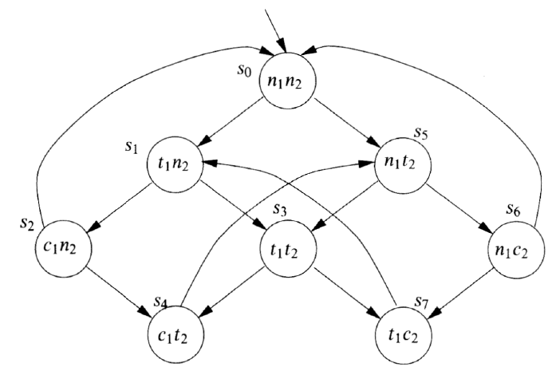
1st model
We model two processes
  each of which is in
    non-critical state (n) or
    trying to enter its critical state (t) or
    critical section (c)
  No self edges
each process executes like n! t ! c ! n ! …
  but the two processes interleave with each other
    only one of the two processes can make a transition at a time (asynchronous interleaving)
Intro. to Logic CS402

Slide 4
1st model for mutual exclusion
Safety: s₀ ² G : (c₁ Æ c₂)
Liveness s₀ 2 G(t₁ ! F c₁)
  see s₀!s₁!s₃!s₇!s₁!s₃ !s₇…
Non-blocking
  for every state satisfying n_{i},
  there is a successor satisfying t_{i}
    s₀ satisfies this property
  We cannot express this property
  in LTL but in CTL
    Note that LTL specifies that Á is satisfied for all paths
No strict ordering
  there is a path where c₁ and c₂ do not occur in strict order
  Complement of this is
    G(c₁ ! c₁ W (:c₁ Æ :c₁ W c₂))
    anytime we get into a c₁ state, either that condition persists indefinitely, or it ends with a non-c₁ state and in that case there is no further c₁ state unless and until we obtain a c₂ state
Intro. to Logic CS402

Slide 5
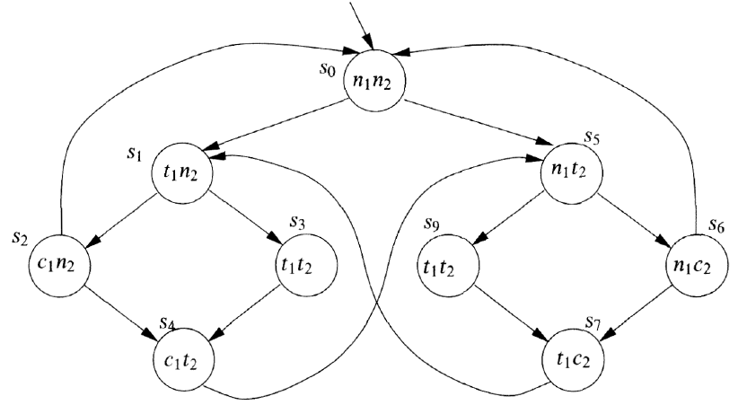
2nd model for mutual exclusion
All 4 properties are satisfied
  Safety
  Liveness
  Non-blocking
  No strict sequencing
Intro. to Logic CS402

Slide 6
NuSMV model checker
NuSMV programs consist of one or more modules.
  one of the modules must be called main
Modules can declare variables and assign to them.
Assignments usually give the initial value of a variable x (init(x)) and its next value (next(x)) as an expression in terms of the current values of variables.
  this expression can be non-deterministic
    denoted by several expressions in braces, or no assignment at all
Intro. to Logic CS402

Slide 7
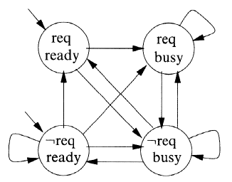
Example
request is under-specified, i.e., not controlled by the program
  request is determined (randomly) by external environment
  thus, whole program works non-deterministically
Case statement is evaluated top-to-bottom
MODULE main
VAR
request: boolean;
status: {ready,busy};
ASSIGN
init(status) := ready;
next(status) := case
request : busy;
1: {ready,busy};
esac;
LTLSPEC
G(request -> F status=busy)
Intro. to Logic CS402

Slide 8
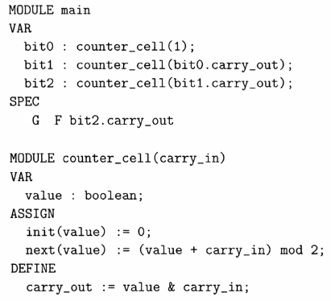
Modules in NuSMV
A module is instantiated when a variable having that module name as its type is declared.
A 3 bit counter increases from 000 to 111 repeatedly
  Req. property
    infinitely setting carry-out of most significant bit as 1
By default, modules in NuSMV are composed synchronously
  there is a global clock and, each time it ticks, each of the modules executes in parallel
  By use of the ‘process’ keyword, it is possible to compose the modules asynchronously
Intro. to Logic CS402

