Slide 1
Equivalence Hierarchy
Moonzoo Kim
School of Computing
KAIST

Slide 2
Outline
Equivalence semantics and SW design
Preliminary
Hierarchy Diagram
Trace-based Semantics
  Trace EQ
  Complete Trace EQ
  Failure EQ
Branching-based Semantics
  Simulation EQ
  Bisimulation EQ

Slide 3
Equivalence Preserving Refinement and SW Design
Design can start with a very abstract specification, representing the requirements
Then, using equivalence-preserving transformations, this specification can be gradually refined into an implementation-oriented specification.
Maintenance may require to replace some components with others, while maintaining the same system behavior (congruence property)
Notes:
Equivalence relations are a very important aspect of algebraic specification techniques. In other techniques (suc as EFSM-based) we don’t have such extensive theory of equivalence.

Slide 4
Model-driven SW Design Framework
Feature interaction verification
Horizontal
Integration
Abstract model
Comp1
Comp2
Comp3
Refinement validity verification
C_{a1}
C_{b1}
C_{a1} ‘
C_{b1} ‘
Detailed Implementation
Vertical
Refinement
C_{c1} ‘

Slide 5
Semantic Mapping
An example of small language
  Syntax
    F := 0 | 1 | F + 1 | 1 + F
    Ex. 0, 0+1+1, 1+0+1, but not 0+0
  Possible semantics
    1 + 1 == 1 + 1 + 0 ?
      Yes (interpreting formula as a natural #),
        [1 + 1] _{N1} = 2, [1 + 1 + 0]_{N1} =2 → 1 + 1 =_{N1} 1 + 1 + 0
      No (interpreting formula as string),
        [1+1] _{S}=“1+1”,[1+1+0]_{S}=“1+1+0”→ 1+1 !=_{S} 1+1+0
      No (interpreting formula as a natural # of string length)
        [1 + 1] _{N2} = 3, [1 + 1 + 0]_{N2} =5 → 1 + 1 !=_{N2} 1 + 1 + 0
Notes:
Syntax v.s. Semantics separation
Semantics domain

Slide 6
Semantic Mapping (cont.)
Syntactic representation
of systems
Language Domain
sm1
sm2
sm3
sm4
sm5
sm6
Natural #
domain
Graph
domain
PetriNet
domain
Term
domain
Mathematical Domain

Slide 7
Relation between (Equivalence) Semantics
Syntactic representation
of systems
1+1
2+2
0+1
1+2
0+1
1+2
sm1
sm2
=_{EO}
=_{NA}
domain
1
odd
even
3
0+1=_{EO}1+2
1+1=_{EO}2+2
0+1!=_{NA}1+2
P =_{NA} Q -> P =_{EO} Q but not vice versa
Therefore, =_{EO} < =_{NA}

Slide 8
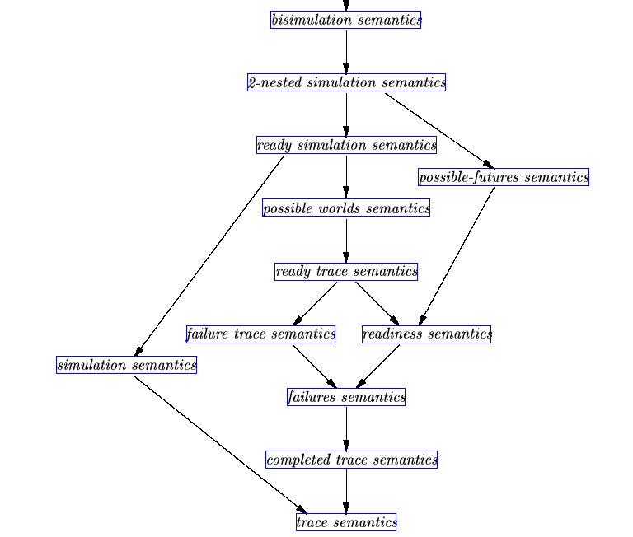
bisimulation
simulation
failure
complete
trace
trace

Slide 9
Labeled Transition System
Process Theory
  A process represents behavior of a system
  Two main activities of process theory are modeling and verification
    The semantics of equalities is required to verify system
    Determine which semantics is suitable for which applications
Labeled Transition System (LTS)
  Act: a set of actions which process performs
  LTS: (P,→)
    Where P is a set of processes and →⊆ P x Act x P
  In this presentation, we deal with only finitely branching, concrete, sequential processes
Useful notations
  Equivalence notation for each semantics
    =_{T}, =_{CT}, =_{F}, =_{R}, =_{FT}, =_{RT},=_{S},=_{RS},=_{B}
    I(p) is {a ∈Act | ∃q. p -a->q}

Slide 10
Trace v.s. Complete Trace
Trace semantics (T)
  σ ∈ Act* is a trace of a process p if there is a process q s.t. p -σ-> p
  T(p) is a set of traces of a process p
  p =_{T} q iff T(p) = T(q)
Complete trace semantics (CT)
  σ ∈ Act* is a complete trace of a process p if there is a process q s.t. p -σ-> q and I(q) = ∅
  CT(p) is a set of complete traces of a process p
  p =_{CT} q iff T(p) = T(q) and CT(p) = CT(q)
  Note that CT(p) = CT(q) does not imply T(p) = T(q)
=_{T} < =_{CT}
  p =_{CT} q implies p =_{T} q, but not vice versa
p
q
b
a
a
c

Slide 11
Counter Example 1
p
q
coin
coin
coin
cola
cola
p =_{T} q
  T(p) = {coin.cola, coin}
  T(q) = {coin.cola, coin}
p ≠_{CT} q
  CT(p) = {coin.cola}
  CT(q) = {coin.cola, coin}

Slide 12
Failure Semantics
Failure Semantics (F)
  <σ,X> ∈ Act* x (Act) is a failure pair of p if ∃q s.t. p –σ-> q and I(q) ∩ X =∅
  F(p) is a set of failure pairs of p
  p =_{F} q iff F(p) = F(q)
=_{CT} < =_{F}
  p =_{F} q implies p =_{CT} q
    σ ∈ CT(p) iff <σ,Act> ∈ F(p)
    σ ∈ T(p) iff <σ,X> ∈ F(p) for some X s.t. X ∩ I(q) =∅ Where p–σ-> q
  not vice versa
Notes:
Main equivalence semantics for CSP

Slide 13
Counter Example 2
p
q
coin
coin
coin
coin
cola
juice
cola
Juice
cola
p ≠_{F} q
  {<coin,{coin,cola}>} ∈ F(p)
  {<coin,{coin,cola}>} ∈ F(q)
p =_{CT} q
  CT(p)={coin.cola, coin.juice}
  CT(q)={coin.cola, coin.juice}

Slide 14
Simulation Semantics
The set F_{s} of simulation formulas over Act is defined inductively by
  True ∈ F_{s}
  If Φ,Ψ ∈ F_{s} then Φ∧Ψ ∈ F_{s}
  If Φ ∈ F_{s} and a∈ Act, then a.Φ ∈ F_{s}
The satisfaction relation ╞ ⊆P x F_{s} is defined inductively by
  p╞ True for all p ∈P
  p╞ Φ∧Ψ if p╞ Φ and p╞ Ψ
  p╞ a.Φ if for some q ∈P: p –a->q and q ╞ Φ
p =_{S} q iff S(p) = S(q) where S(p)={Φ∈F_{s}|p╞ Φ}

Slide 15
=_{T} < =_{S}
=_{T} < =_{S}
  p =_{S} q implies p =_{T} q
    =_{T} < =_{S} by σ ∈ T(p) iff σ.True ∈ S(p)
  not vice versa
p
q
coin
coin
coin
cola
juice
cola
Juice
p ≠_{S} q
  S(p)= {True, coin.True, coin.cola.True, coin.juice.True, …,
  coin.cola.True ∧ coin.juice.True}
  S(q) = {True, coin.True, coin.cola.True, coin.cola.True, …,
  coin.cola.True ∧ coin.juice.True,
  coin.(cola.True ∧juice.True) }

Slide 16
Simulation v.s. Bisimulation
A simulation is a binary relation R on processes satisfying for a ∈ Act
  If pRq and p-a->p’ , then ∃q’:q-a->q’ and p’Rq’
p =_{S} q iff there exist simulation relations R₁ and R₂ such that pR₁q and qR₂p
A bisimulation is a binary relation R on processes satisfying for a ∈ Act
  If pRq and p-a->p’ , then ∃q’:q-a->q’ and p’Rq’
  If pRq and q-a->q’ , then ∃p’:p-a->p’ and p’Rq’
P =_{B} q if there exists a bisimulation R with pRq

Slide 17
Counter Example 3
p
q
p =_{B} q
p =_{s} q
coin
coin
coin
coin
coin
cola
cola
cola
p
q
p ≠ _{B} q
p =_{s} q
coin
coin
coin
cola
Juice
juice
cola
Juice

