Slide 1
Algebra of Communicating Shared Resources (ACSR)
Moonzoo Kim
School of Computing
KAIST

Slide 2
Outline
Real-time systems
Resource-bound computation
ACSR
  Algebra, analysis techniques, examples

Slide 3
Real-time systems
Correctness and reliability of real-time systems depends on
  Functional correctness
  Temporal correctness
  Failures
Factors that affect behavior:
  Synchronization and communication
  Availability of resources and scheduling
    Computational systems are always constrained in their behavior
    Resources capture physical constraints
    Resources should be used as a primitive notion in modeling and analysis
    Resource-bound computation is a general framework of wide applicability

Slide 4
Design Issues
Time -- discrete time, dense time
Concurrency Semantics -- interleaving, synchronous lock step, true parallelism
Operators -- prefix, choice, parallel, restriction, recursion
Timed Operators -- delay, timeout, bound (deadline)
Communication -- two-synchronous, n-way
Abstraction -- hiding, restriction
Resource -- implicit, explicit, unlimited, bounded
Priorities -- static, dynamic

Slide 5
ACSR
ACSR (Algebra of Communicating Shared Resources) has two types of actions:
  Timed Actions -- represent the passage of time and resource consumption (e.g., CPUs)
  Instantaneous Events -- provide a synchronization between processes.
A labelled transition system:

Slide 6

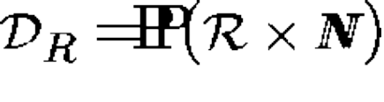
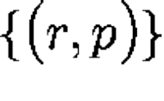
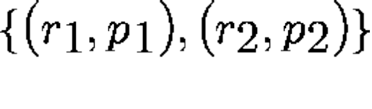
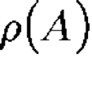
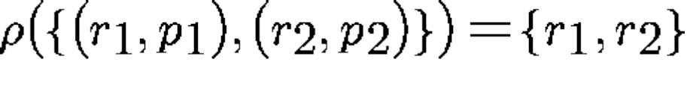
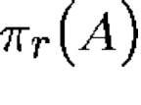
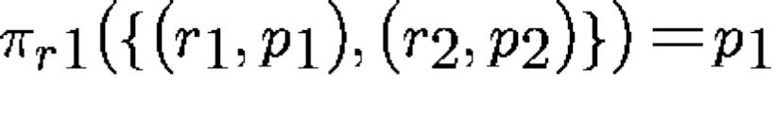

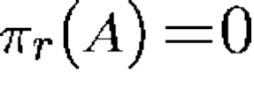

Timed Actions
A finite set of serially reusable resources, denoted by
The domain, with the restriction that each resource be represented at most once, e.g., , ,
denotes the set of resources used by the action A e.g.
denotes the priority level of the action A in the resource r; e.g., If r is not in , then
A, B, and C range over

Slide 7








Instantaneous Events
An event is denoted by a pair (a, p), where a is the label of the event, and p is its priority
Labels are drawn from the set ;
The special label, , arises when two events with inverse labels (e.g., ) are executed in parallel.
denotes the domain of events. and to represent the label and priority
e, f and g range over
The entire domain of actions is , and we let α and β range over

Slide 8
Resources
Resources capture constraints on executions
Resources can be
  Serially reusable:
    processors, memory, communication channels
  Consumable
    power
Resource capacities
  Single-capacity resources
  Multiple-capacity resources
  Time-sliced, etc.

Slide 9
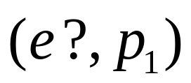
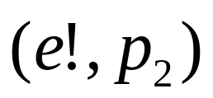
Events
Events represent communication
  events are instantaneous
  point-to-point communication across channels
  prioritized access to channels
  input and output events

Slide 10
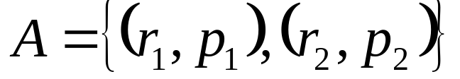


Actions
Actions represent computation
  actions take time
  require access to resources
  each resource has priority of access
  each resource can be used at most once
  resources of action A:
  idling action:

Slide 11





Computation model
A specification is composed of processes
Processes evolve by performing events and actions

Slide 12
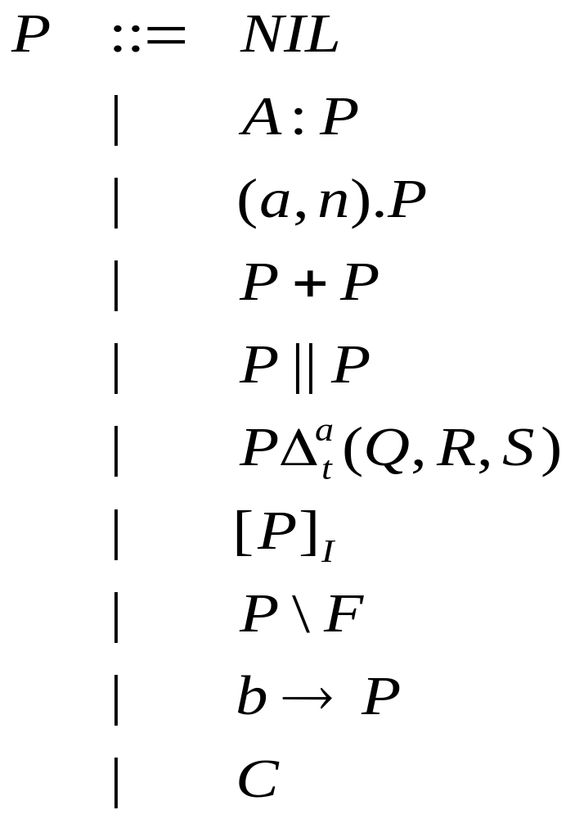
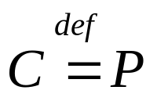
Syntax for ACSR processes
Process terms
Process names

Slide 13
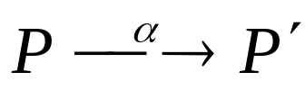
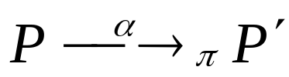
ACSR semantics
Two-level semantics:
  A collection of inference rules gives unprioritized transition relation
  A preemption relation on actions and events disables some of the transitions, giving a prioritized transition relation

Slide 14
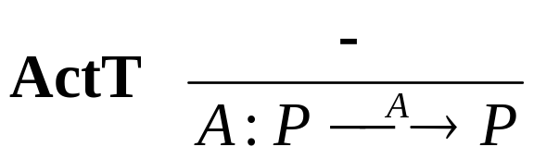
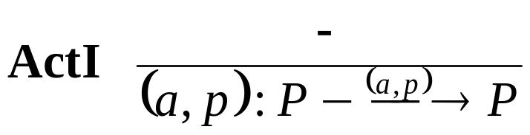
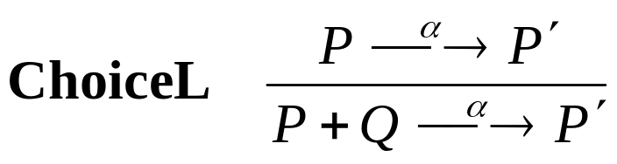

Unprioritized transition relation
Prefix operators
Choice
Parallel

Slide 15
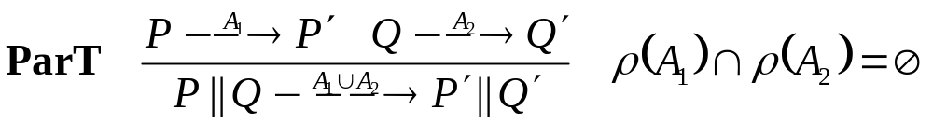
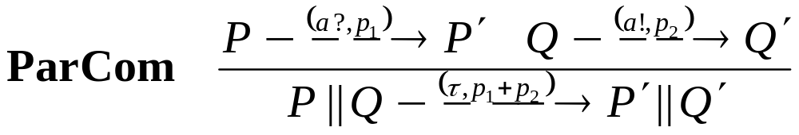
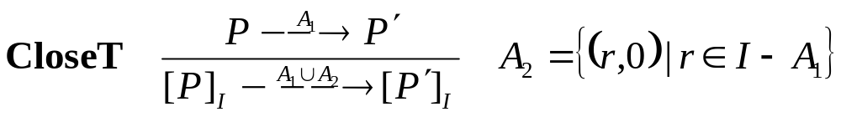
Unprioritized transition relation (II)
Resource-constrained execution
Priority-based communication
Resource reservation

Slide 16
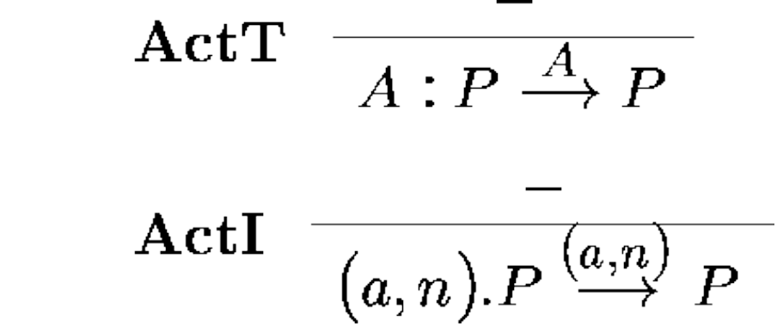
Prefix
E.g., The process {(r_{1,} p₁), (r_{2,} p₂)}:P simultaneously uses resources r₁ and r₂ for one time unit, and then executes P.
The process (a,p).P executes the event “(a, p)” and proceeds to P

Slide 17
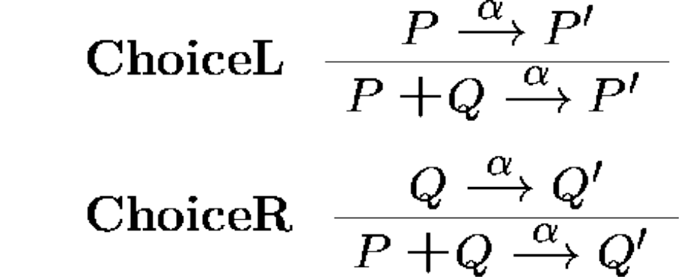
Choice
E.g., (a,7).P + {(r₁, 3),(r₂, 7)}:Q may choose between executing the event (a, 7) (from ActI) or the time-consuming action {(r₁, 3),(r₂, 7)} (from ActT).

Slide 18
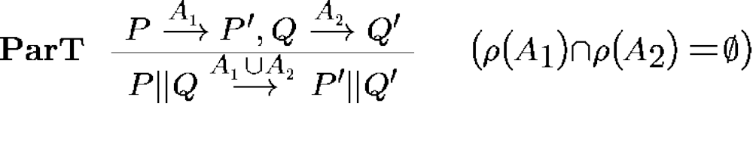

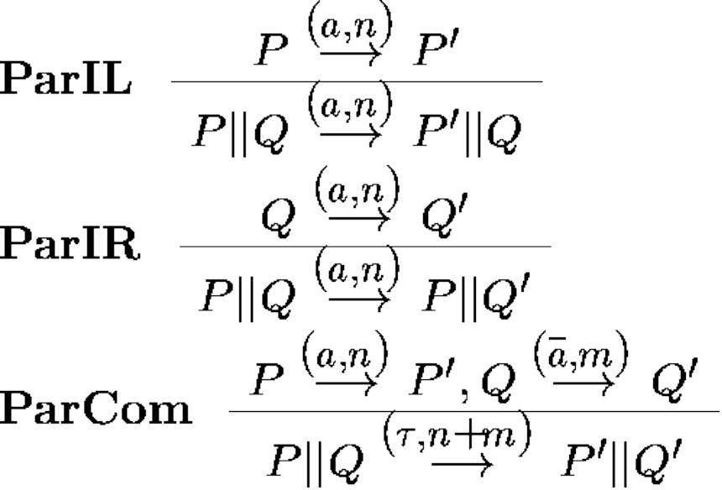
Parallel
The condition ensures that at most one process uses a single resource during any time step.

Slide 19
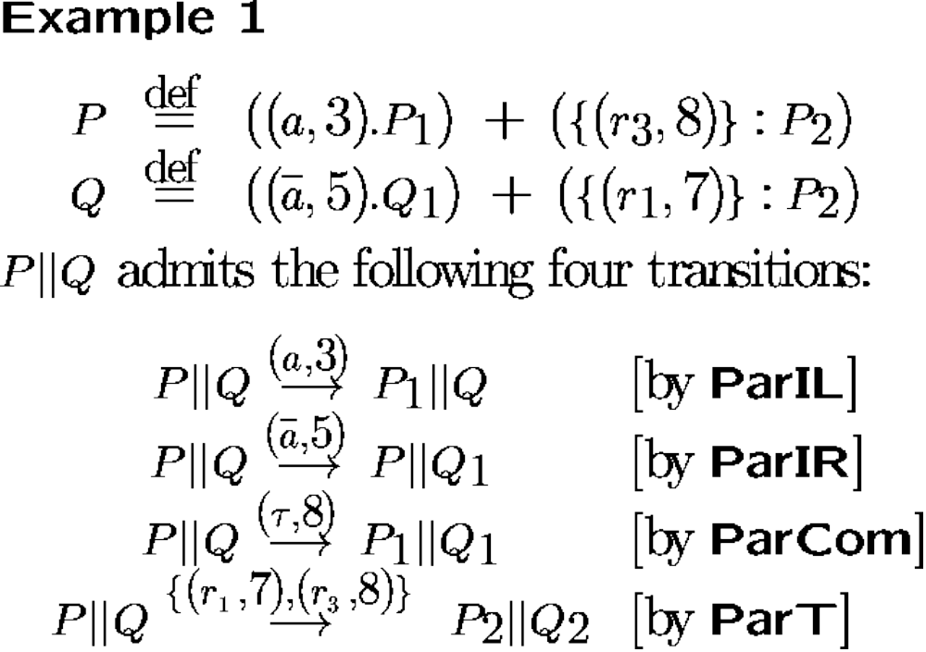

Slide 20
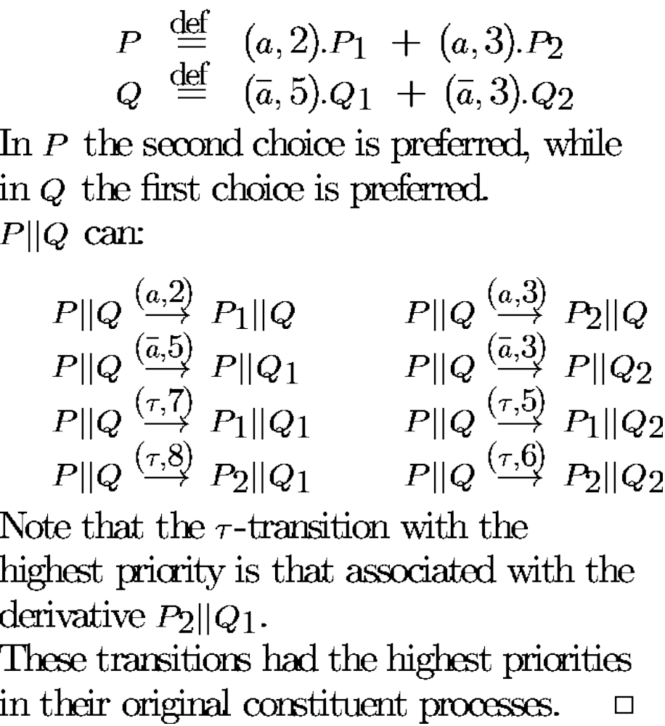
Example 2(Why add priorities in ParCom?)

Slide 21
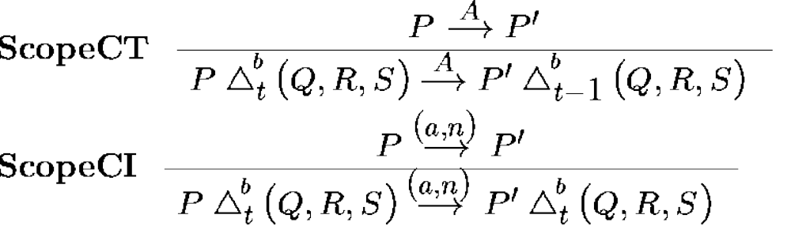
Scope(sequential composition, timeout and interrupt)
for “continue”
(t>0)
(t > 0)

Slide 22
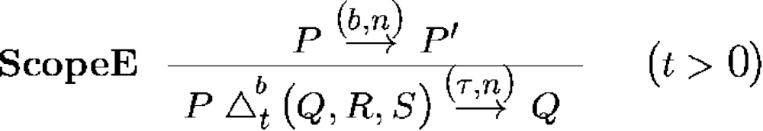
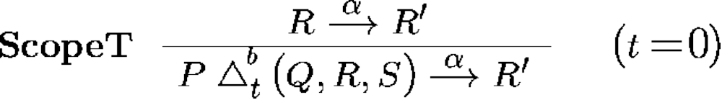
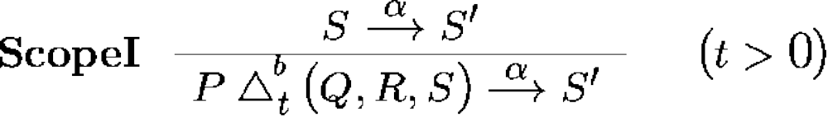
Scope
for “end”
for “timeout”
for “interrupt”

Slide 23







Preemption relation
α is preempted by β :
action preempts action
  no lower priorities:
  some higher priorities:
event preempts event
  same label, higher priority
event preempts action
  τ with non-zero priority preempts all actions

Slide 24
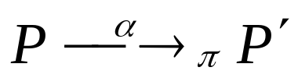
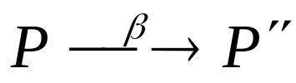

Prioritized transition relation
We define
when
  there is an unprioritized transition
  there is no such that

Slide 25












Example
Resource conflict:
Processes must provide for preemption
Unprioritized and prioritized transitions:
π
π

Slide 26




Example (cont.)
Resource reservation enforces progress
π

Slide 27
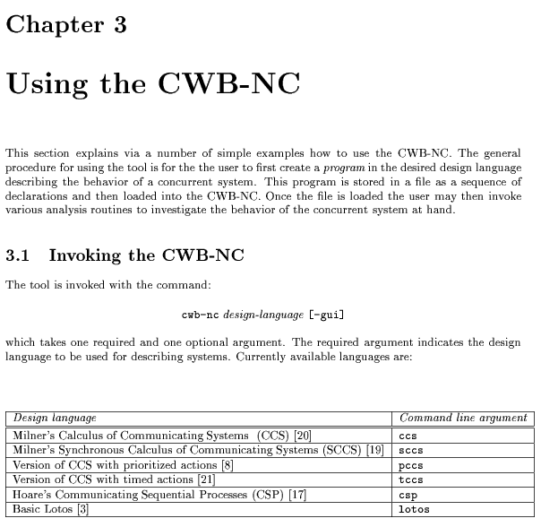
Various Process Algebraic Languages
CWB-NC handles the following set of process algebraic descriptions
  CCS
  SCCS
  T-CCS
  P-CCS
  CSP
  Lotos

