Slide 1


Formal Verification of a Flash Memory Device Driver
- an Experience Report
Moonzoo Kim, Yunho Kim
Provable Software Lab. CS Dept. KAIST
Yunja Choi
School of EECS, Kyungpook National Univ.
Hotae Kim
Samsung Electronics

Slide 2



Summary of the Talk
File
System
Demand
Paging
Manager
Unified
Storage
Platform
Sector
Translation
Flash
Translation Layer
OS
Adapt-
ation
Module
Block
Management
Low Level
Device Driver
OneNAND® Flash Memory Devices
In 2007, Samsung requested to debug the device driver for the Samsung OneNAND™ flash memory, by using model checkers, for 6 months. This presentation describes a part of the result from the project.
Notes:
Samsung was not happy with traditional testing.
Samsung asked to analyze their device driver for OneNAND flash memory in 2007.
They gave us 6 months and asked to appply model checking techniques. The reason was that
Samsung was not happy with conventional testing, since they suffered bugs even after intensive testing.
So they wanted to try new techniques. We got several results from this project and one of them I will present today.

Slide 3
Overview
Background
  Overview of the Unified Storage Platform (USP)
  Sector Translation Layer (STL)
  Multi-Sector Read operation (MSR)
Model Checking MSR
  Reports on the following three aspects
    Target system modeling
    Environment modeling
    Performance analysis on the verification
Three different types of model checkers are used
  BDD based symbolic model checking (NuSMV)
  Explicit model checking (Spin)
  C-bounded model checking (CBMC)
Notes:
This talk consists of two parts. The first part, I will explain the background of USP, which is a device driver for OneNAND flash memory. USP has a STL which maps between logical data and physical sectors.
Among the various functionality of STL, we focus on MSR.
Then, I will explain the model checking results by using three different model checkers.
I will describe the verification task in three different aspects
What’s interesting with this case study?
Real-world example, not dining philosopher, mutual exclusion algorithm
Modeling from exisisting code, which is very realistic situation in real world
Interesting comparison between three popular model checker empirically
poor symbolic but Good working of CBMC,

Slide 4
PART I: Background
Unified Storage Platform (USP)
  Block diagram
  Code statistics
Logical-to-physical sector translation
  Example of possible data distributions
Multi-Sector Read operation (MSR)
  Pseudo structure

Slide 5
Overview of the OneNAND® Flash Memory
App₁
App₂
App₃
Source:
Software Center
of Samsung
Electronics ‘06
Characteristics of OneNAND®
  Each memory cell can be written limited number of times only
    Logical-to-physical sector mapping
    Bad block management
    Wear-leveling
  Performance enhancement
    Multi-sector read/write
    Asynchronous operations
    Deferred operation result check
File
System
Demand
Paging
Manager (DPM)
[ASE 08] “Unit Testing of Flash Memory Device Driver through a SAT-based Model Checker”
Unified
Storage
Platform
Flash
Translation Layer
OS
Adapt-
ation
Module
Sector
Translation (STL)
Block
Management (BML)
Low Level (LLD)
Device Driver
OneNAND® Flash Memory Devices

Slide 6
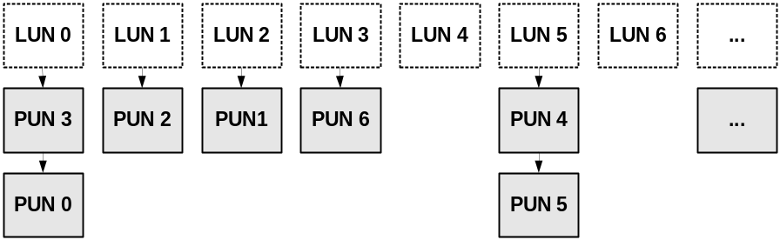
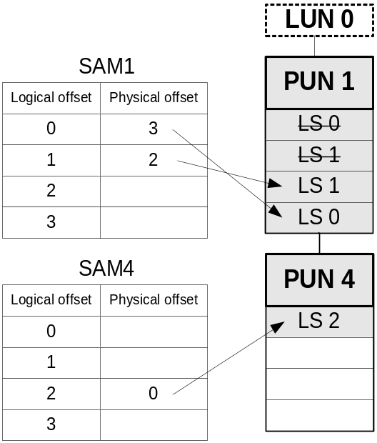
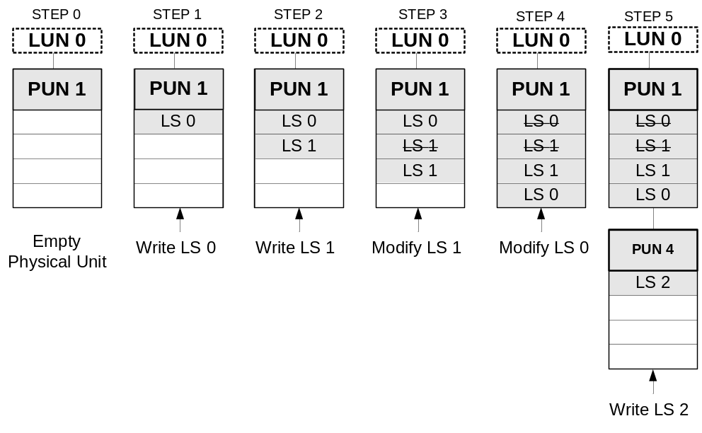
Logical to Physical Sector Mapping
1:N mapping from a LUN to PUNs
Sector Allocation Map (SAM)
In flash memory, logical data are distributed over physical sectors.
Sector mapping
Notes:
Each logical unit is mapped to a linked list of physical units because one logical sector may consume several physical sectors through updates. So there is 1:N mapping from a logical unit to physical units. A simple sector mapping example is as follows. First logical unit has an empty physical unit. A new logical sector, LS0, is written in the physical sector0. Similarly LS1 is written in LS1. Then when LS1 is updated, PS1 is invalidated and LS1 is written in PS2 and so on. Sector allocation map keeps the Logical sector to physical sector mapping. SAM have information what physical sector stores a given logical sectors. for example when we read logical sector 0, then we find the physical sector offset from the logical sector offset 0 from SAM. If the physical offset is empty, then read operation traverse a linked list until find a physical offset or traverse all physical sector in a linked list.

Slide 7
Examples of Possible Data Distribution
SAM0~SAM4
PU0~PU4
SAM0~SAM4
PU0~PU4
SAM0~SAM4
PU0~PU4
Sector 0
Sector 1
Sector 2
Sector 3
1 |  |  | 0
 | 1 |  |  | 1
 | 2
 |  | 3
 |  |  | E
A | B |  |  | F
 | C
 |  | D
 | 3 |  |  | 3
0 |  |  | 2
 |  | 3
 | 1
B
 | D
 |  |  | F
 | A | C |  | E
1 |  |  | 0
 | 1 |  |  | 1
 | 2
 |  | 3
 |  |  | B
F | E |  |  | A
 | D
 |  | C
(a) A distribution of “ABCDEF”
(b) Another distribution of “ABCDEF”
(c) A distribution of “FEDCBA”
Assumptions
  there are 5 physical units
  each unit has 4 sectors
  each sector is 1 byte long

Slide 8
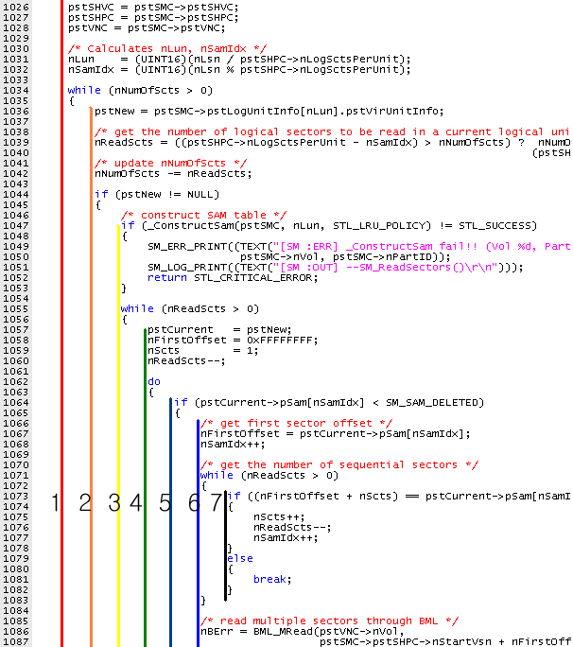
Multi-Sector Read Operations (MSR)
MSR reads consecutive physical sectors together for improving read performance
Statistics
  157 lines long
  4 level nested loops
  4 parameters to specify logical data to read (from where, to where, how long, read flag )

Slide 9
Loop Structure of MSR
01:curLU = LU0;
02:while(curLU != NULL ) {
03: readScts = # of sectors to read in the current LU
04: while(readScts > 0 ) {
05: curPU = LU->firstPU;
06: while(curPU != NULL ) {
07: while(...) {
08: conScts = # of consecutive PS’s to read in curPU
09: offset = the starting offset of these consecutive PS’s in curPU
10: }
11: BML_READ(curPU, offset, conScts);
12: readScts = readScts - conScts;
13: curPU = curPU->next;
14: }
15: }
16: curLU = curLU->next;
17:}
Loop1: iterates over LUs
Loop2: iterates until the current LU is read completely
Loop3: iterates over PUs linked to the current LU
Loop4: identify consecutive PS’s in the current PU

Slide 10
PART II: Model Checking Results
Verification of MSR by using NuSMV, Spin, and CBMC
  NuSMV: BDD-based symbolic model checker
  Spin: Explicit model checker
  CBMC: C-bounded model checker
The requirement property is to check
  after_MSR -> (∀i. logical_sectors[i] == buf[i])
We compared these three model checkers empirically

Slide 11
Verification by NuSMV
NuSMV was the first choice as a verification tool, since
  BDD-based symbolic model checkers have been known to handle large state spaces
  MSR operates with a semi-random environment (i.e. all possible configurations of PUs and SAMs analyzed)
  Data structure of MSR can be abstracted in a simple array form with assignments and equality checking operations only
  MSR is a single-threaded program

Slide 12
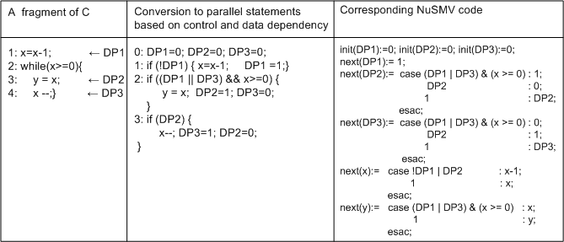
Target Model Creation in NuSMV
We had to introduce control points variables, since
  C is control-flow based
  NuSMV modeling language is dataflow-based
Linked list is replaced by an array operation.
  Array index variables should be statically expanded, since NuSMV does not support index variables
As a result, the final NuSMV model is more than 1000 lines long
Notes:
NuSMV is a symbolic model checker. Symbolic model checker represents a system model with a compact boolean formula. Because It does not store explicit state spaces, it is believed that symbolic model checker can handle large state space That is the reason why we use NuSMV first.
The modeling language of NuSMV is quite different from C. Therefore NuSMV model is quite long and hard to make. In our project, the most difficult and time consuming job is to make a NuSMV model. Moreover the verification performance is much worse than we expected.

Slide 13
Modeling in NuSMV (2/2)
Environment model creation
  The environment of MSR (i.e., PUs and SAMs configurations) can be described by invariant rules. Some of them are
    One PU is mapped to at most one LU
    Valid correspondence between SAMs and PUs:
    If the i th LS is written in the k th sector of the j th PU, then the i th offset of the j th SAM is valid and indicates the k’th PS ,
    Ex> 3rd LS (‘C’) is in the 3rd sector of the 2nd PU, then SAM1[2] ==2
    i=3 k=3 j=2
    3. For one LS, there exists only one PS that contains the value of the LS:
    The PS number of the i th LS must be written in only one of the (i mod 4) th offsets of the SAM tables for the PUs mapped to the corresponding LU.
SAM0~SAM4
PU0~PU4
Sector 0
Sector 1
Sector 2
Sector 3
1 |  |  | 0
 | 1 |  |  | 1
 | 2
 |  | 3
 |  |  | E
A | B |  |  | F
 | C
 |  | D
Notes:
NuSMV is a symbolic model checker. Symbolic model checker represents a system model with a compact boolean formula. Because It does not store explicit state spaces, it is believed that symbolic model checker can handle large state space That is the reason why we use NuSMV first.
The modeling language of NuSMV is quite different from C. Therefore NuSMV model is quite long and hard to make. In our project, the most difficult and time consuming job is to make a NuSMV model. Moreover the verification performance is much worse than we expected.

Slide 14
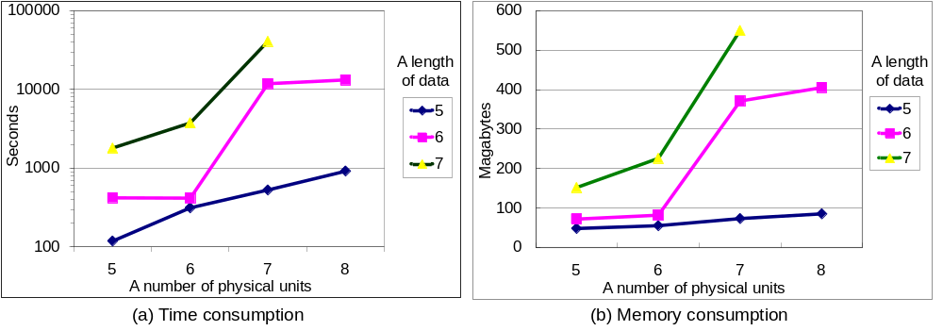
Verification Performance of NuSMV
Verification was performed on the machine equipped with Xeon5160 (3Ghz, 32Gbyte Memory), 64 bit Fedora Linux 7, NuSMV 2.4.3
The requirement property was proved correct for all the experiments (i.e., MSR is correct in this small model)
    For 7 sectors long data that are distributed over 7 PUs consumes more than 11 hours while consuming only 550 mb memory

Slide 15
Performance Analysis
The MSR model (5 LS’s and 5 PUs) has 365 BDD variables for its symbolic representation
  At least 240 BDD variables are required for PUs and SAMs
    5 (# of PUs) x 4 (sectors/PU) x 2 (current/next) x 3 (bits)
The same MSR model generated 1.2 million BDD nodes.
Dynamic reordering takes more than 90% of total verification time
  Time is the bottleneck in this NuSMV verification task
Notes:
MSR models have 37-53 iterations for the verification, mainly due to the nested loops

Slide 16
Modeling by Spin
A target model
  Translated from the MSR C code through Modex which is an automated C-to-Promela translator with embedded C statements
    Modex translates MSR into the same 4 level-nested loop control structure
An environment model
  PUs and SAMs, which takes most of memory, are tracked, but not stored in the state vector through a data abstraction technique
    c_track keyword and Unmatched parameter
    Based on the observation that SAMs and PUs are sparse
    Only a unique signature of the current state of PUs and SAMs is stored succinctly
      <(0,1),(1,1),(1,2),(2,3),(3,0),(4,1)>
      is the signature of the following
      PUs and SAMs configuration
SAM0~SAM4
PU0~PU4
Sector 0
Sector 1
Sector 2
Sector 3
1 |  |  | 0
 | 1 |  |  | 1
 | 2
 |  | 3
 |  |  | E
A | B |  |  | F
 | C
 |  | D

Slide 17
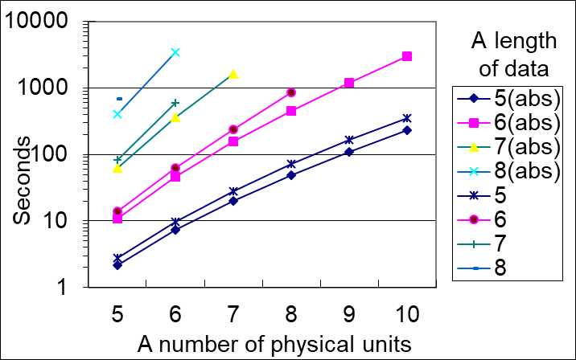
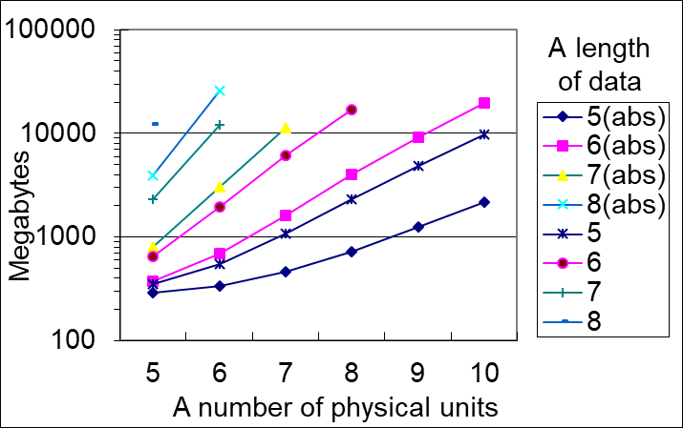
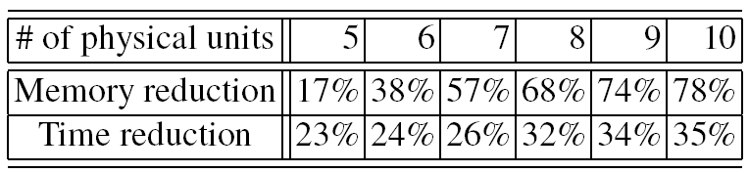
Verification Performance of Spin
(a) Time consumption
(b) Memory consumption
The requirement property was satisfied
The data abstraction technique shows significant performance improvement upto 78% of memory reduction and 35% time reduction (for 5 logical sectors data)

Slide 18
Modeling by CBMC
CBMC does not require an explicit target model creation
An environment for MSR was specified using assume statements and the environment model was similar to the environment model in NuSMV
For the loop bounds, we can get valid upper bounds from the loop structure and the environment setting
  The outermost loop: L times (L is a # of LUs)
  The 2nd outermost loop: 4 times (one LU contains 4 LS’s)
  The 3rd outermost loop: M times
  (M is a # of PUs)
  The innermost loop: 4 times
  (one PU contains 4 PS’s)
L=2, M=5
SAM0~SAM4
PU0~PU4
Sector 0
Sector 1
Sector 2
Sector 3
1 |  |  | 0
 | 1 |  |  | 1
 | 2
 |  | 3
 |  |  | E
A | B |  |  | F
 | C
 |  | D

Slide 19
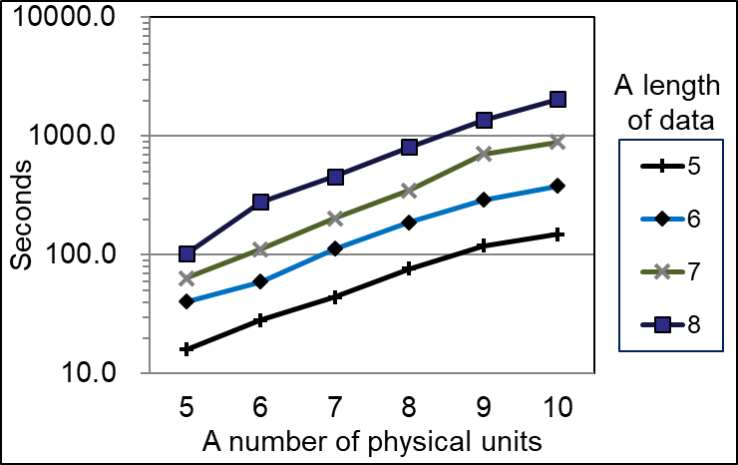
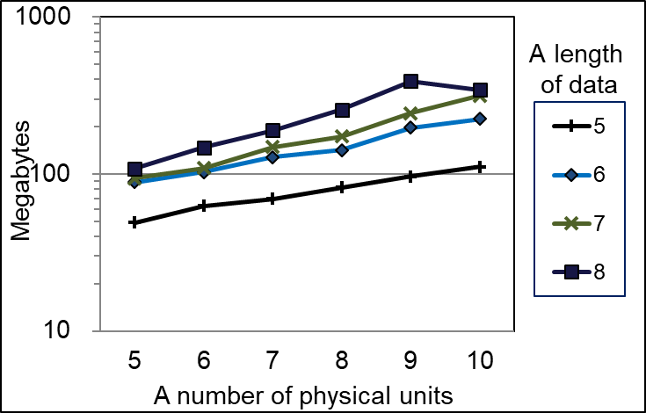
Verification Performance of CBMC
(a) Time consumption
(b) Memory consumption
Exponential increase in both time and memory. However, the slope is much lower than those of NuSMV and Spin, which makes CBMC perform better for large problems
A problem of 10 PUs and 8 LS’s has 8.6x10⁵ variables and 2.9 x 10⁶ clauses.
Notes:
1.7x10⁵ conflicts, 10⁶ decisions, and 4.8x10⁹ propagations

Slide 20
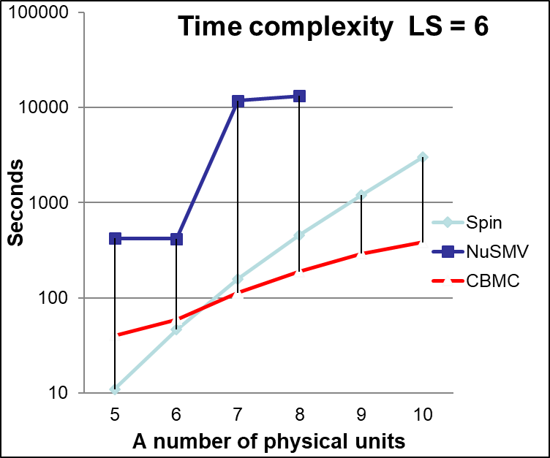
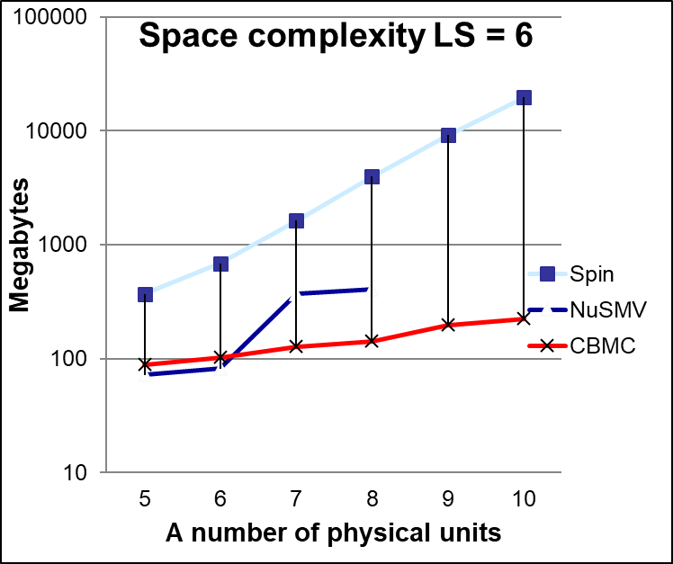
Performance Comparison

Slide 21
Conclusion
Application of Model Checking to Industrial SW Project
  Current off-the-shelf model checkers showed their effectiveness to debug a part of industrial software, if a target portion is carefully selected
  Although model checker worked on a small scale problem, it still contributes due to its exhaustive exploration which is complementary to the testing result
Comparison among the Three Model Checkers
 | Modeling Difficulty | Memory Usage | Verification Speed
NuSMV | Most difficult | Good | Slow
Spin | Medium difficult | Poor | Fast
CBMC | Easiest | Best | Fastest
Notes:
Industrial software project:
modeling effort is important; continuous modification
- off-the-shelf is important; not much specialist at company project

Slide 22


Slide 23
Requirement Elicitation
Utilizes a top-down approach
  We selected 3 functional requirements with “Very High” priority in the USP SRS document
    “2.2.1 Support prioritized read operation” (pg 14)
      Issues on synchronization
    “2.2.3 Keep data integrity” (pg 15)
      Issues on handling exceptions/failures
    “2.2.6 Manage sectors” (pg 17)
      Issues on complex sector mapping
  Focused on the above three requirements, we investigated STL/BML/LLD/DPM documents as well as C code to enumerate detailed points to check explicitly
    Reported in the 50 pgs document “Requirement Specification과 Detailed Design Specification 분석을 통한 검증기준 정리 결과”

Slide 24
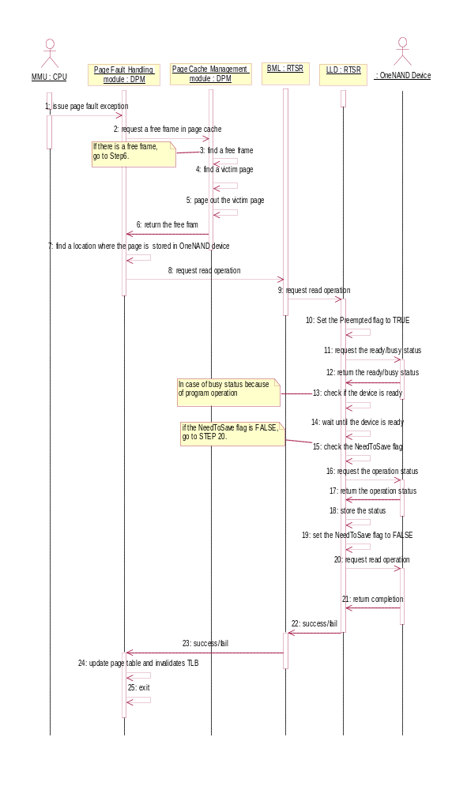
Ex> Page Fault Handling While a Device is Being Programmed (ADS 4.4 p.22)
….
13. LLD checks whether OneNAND is ready status or busy status.
- 현재 busy 상태임을 정확히 인식하는지 확인
14. If OneNAND is busy status, wait until it is ready.
- 무한 loop에 빠지는 상황발생 가능성 확인
15. After OneNAND become ready status, it checks whether the NeedToSave Flag is set to TRUE or FALSE.
16. If the NeedToSave Flag is set to TRUE, LLD checks a program or erase operation status of OneNAND.
17. OneNAND returns the program status or the erase status.
- CTRL_STAT 상태값의 정확한 반환확인
18. LLD stores the program status or the erase status.
- CTRL_STAT 상태값을 nSavedStatus에 저장여부확인
19. LLD sets the NeedToSave Flag to FALSE.
20. LLD requests OneNAND to read the desired page.
21~23. Return Success/Fail.
…

Slide 25
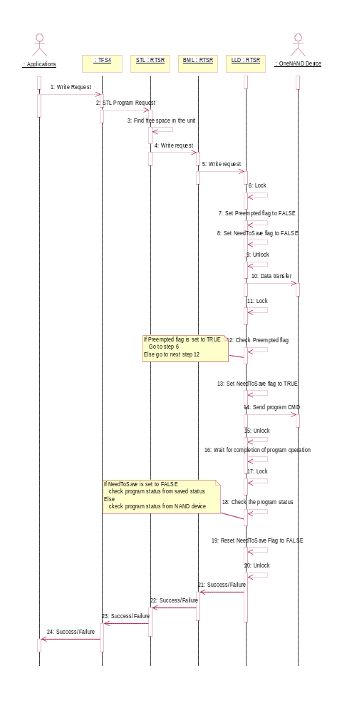
Ex 1. Inconsistencies Detected
“Data writing without page fault” ADS 4.8 28pg
  It describes a use case where repeated locking without unlocking is possible
  However, actual code (ONLD_Write()in ONLDNonAtomic.c) does not have such behavior because unlock is performed before jumping back
Lock
Unlock
If Preempted flag is set to TRUE goto step 6
Lock

Slide 26
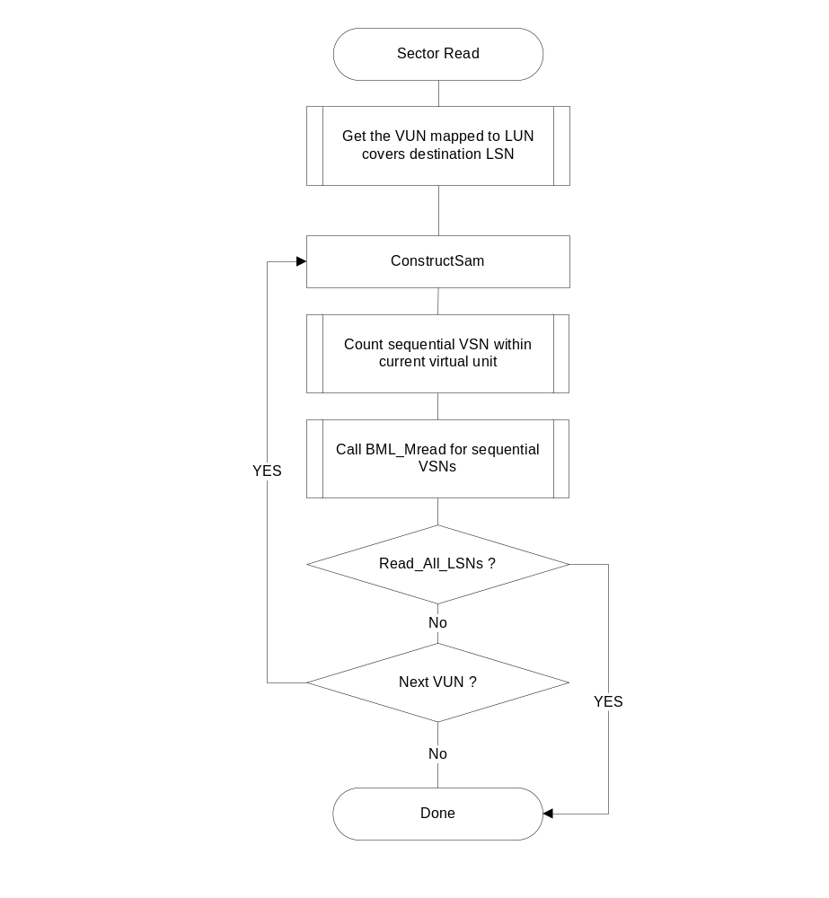
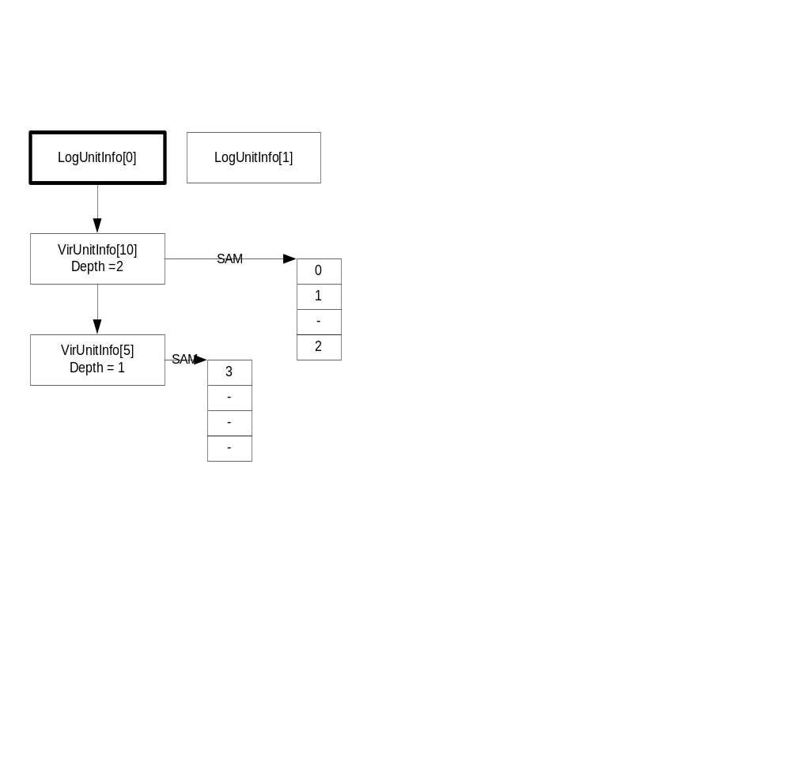
Ex 2.Inconsistencies Detected
“Sector Read” STL DDS 4.2.4 34pg
  It describes that multisector reading operation traverses a list of PU only once, which causes incomplete sector read
  However, actual code (SM_ReadSectors()in SectorMap.c) traverses a list of PU repeatedly, which enables complete sector reading with a performance penalty
Figure 4‑11 The flow chart to read sectors

Slide 27
Excerpts of the SMV Model
MODULE main
-- Variable declaration
VAR
SAM : array 0..4 of sam_type;
PU : array 0..4 of PU_type;
buf : array 0..4 of 0..5;
nScts : 0..5;
-- SPEC
INVARSPEC (after_first_do ->
PU[0].sect[0]=1 &
PU[0].sect[1]=2 &
PU[0].sect[2]=3 &
PU[0].sect[3]=4 &
PU[3].sect[0]=5)
init(buf[0]):=0;
-- if( pBuf==0 && 0 < nScts )
-- buf[0]= PU[PU_id].sect[nFirstOffset]
next(buf[0]):
case after_fourth_do :
case pBuf = 0 & 0 < nScts: -- i=0
case
PU_id=0 & nFirstOffset=0: PU[0].sect[0];
PU_id=0 & nFirstOffset=1: PU[0].sect[1];
PU_id=0 & nFirstOffset=2: PU[0].sect[2];
PU_id=0 & nFirstOffset=3: PU[0].sect[3];
…
PU_id=4 & nFirstOffset=3 : PU[4].sect[3];
esac;
esac;
init(buf[1]):=0;
next(buf[1]):= …

Slide 28
Excerpts of the Spin Model
active proctype SM_ReadSectors() {
byte buf[NUM_LS_USED];
byte nScts;
byte nFirstOffset;
byte nNumOfScts=NUM_LS_USED;
byte nReadScts=nNumOfScts;
byte nSamIdx;
do /* 1047: while (nNumOfScts >0) { */
:: nNumOfScts > 0 ->
PU_id = lui[nLun];
if /* nReadScts = ... */
:: (SECT_PER_U-nSamIdx)> nNumOfScts ->
nReadScts = nNumOfScts;
:: else->nReadScts =SECT_PER_U- nSamIdx;
fi;
nNumOfScts = nNumOfScts - nReadScts;
do /* line 1068: while (nReadScts > 0) */
:: (nReadScts > 0) -> PU_id = lui[nLun];
nFirstOffset=255;
nScts=1; nReadScts--;
do /* line 1075: do {... */
:: true;
if /* line 1077: if(pstCurrent->pSam[nSamIdx]...*/
:: SAM[PU_id].valid[nSamIdx]-> nFirstOffset = SAM[PU_id].offset[nSamIdx];nSamIdx++;
do /* line 1084:while (nReadScts > 0) { ...} */
:: (nReadScts > 0) ->
if
::FirstOffset+nScts==
SAM[PU_id].offset[nSamIdx] ->
nScts++;nReadScts--;nSamIdx++;
:: else-> break;
fi;
:: else->break;
od;
BML_MRead(PU_id,nFirstOffset,nScts,pBuf);
break;
:: else;
fi;
if /*line 1112: } while ( PU[PU_id].nil != true) */
:: PU[PU_id].nil -> break;
:: else;
fi;
PU_id++;
od;
}

Slide 29
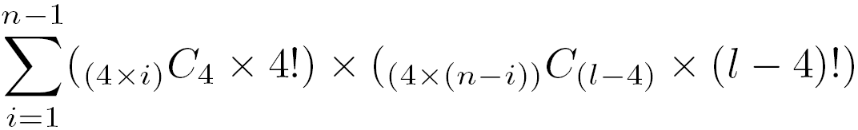
Difficulties in Testing the USP File System
Limitation of detecting bugs through actual testing
  For example, if data is l sectors long and there are n physical units, then the possible number of distribution is
  If 6 LS’s are distributed over 1000 PUs, 3.9x10²² cases exist
    Even10¹⁰ random tests only covers tiny fraction of possible cases
Lack of fine control over the USP system
  Most testings are performed at the file system level
    Subtle bugs are hard to detect, for example
PU1~PU6
PU1~PU6
PU1~PU6
Sector 1
Sector 2
Sector 3
Sector 4
A | E
B | F
C
D
A |  | E
 | C
B |  | F
 | D
B | D |  |  | F
 | A
 |  | C |  |  | E

Slide 30
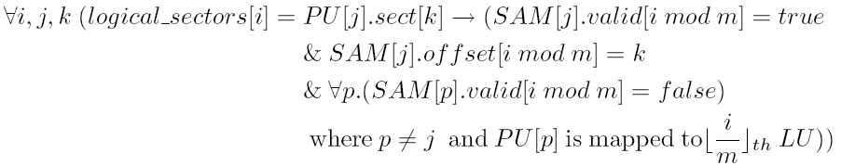
Modeling in NuSMV (2/2)
Environment model creation
  The environment of MSR (i.e., PUs and SAMs configurations) can be described by invariant rules. Some of them are
    One PU is mapped to at most one LU
    If the i th LS is written in the k th sector of the j th PU, then the (i mod 4) th offset of the j th SAM is valid and indicates the PS number k,
    The PS number of the i th LS must be written in only one of the (i mod 4) th offsets of the SAM tables for the PUs mapped to the corresponding LU.
Notes:
NuSMV is a symbolic model checker. Symbolic model checker represents a system model with a compact boolean formula. Because It does not store explicit state spaces, it is believed that symbolic model checker can handle large state space That is the reason why we use NuSMV first.
The modeling language of NuSMV is quite different from C. Therefore NuSMV model is quite long and hard to make. In our project, the most difficult and time consuming job is to make a NuSMV model. Moreover the verification performance is much worse than we expected.

Slide 31
USP Code Statistics
TFS4
DPM (2866) 30 (18, 12)
DPM Interface
DPM_Interface.c (1072) 11 (4, 7)
Page Fault Handler
DPM_PageFaultCore.s
Page Cache Manager (1183) 19 (14, 5)
DPM_PageCache.c (245) 2 (2, 0) DPM_PageCacheCore.c (172) 3 (0, 3) Clock - (199) 4 (3, 1) Mach25 - (169) 3 (3, 0) NAClock - (221) 4 (3, 1) NAMach25 - (177) 3 (3, 0)
STL(9933) 105 (43, 62)
GarbageQueue.c (360) 7 (7, 0) OpQueue.c (309) 5 (5, 0) ReadyQueue.c (255) 5 (5, 0) SamBufMgr.c (639) 10 (6, 4) SectorMap.c (3074) 33 (7, 26) STLInterface.c (2878) 22 (11, 11) VirtualNand.c (2418) 23 (2, 21)
BML(12051) 97 (36, 61)
BadBlkMgr.c (4544) 47 (9, 38) BMLInterface.c (6744) 44 (21, 23) BMLInterfaceTCM.c (160) 2 (2, 0) SWECC.c (603) 4 (4, 0)
OS Adaptation Module
Platform Adaptation Module
LLD (5552) 38 (20, 18)
ONLDAtomicr.c (1874) 16 (9, 7) ONLDNonAtomic.c (2676) 16 (9, 7) ONLDTCM.c (1002) 6 (2, 4)
RTSR (27536) 240 (99, 141)
OneNAND

