Slide 1
The Spin Model Checker : Part II

Slide 2
Review
Promela
  The system specification language of the Spin model checker
  Syntax is similar to that of C, but simplified
    No float type, no functions, no pointers etc
  Paradigm is similar to that of CCS
    Communication and concurrency
    Clear operational semantics
    Interleaved semantics
    Asynchronous process execution
    Two-way communication
  Unique features not found in programming languages
    Non-determinism (process level and statement level)
    Executability

Slide 3
6 Types of Basic Statements
Assignment: always executable
  Ex. x=3+x, x=run A()
Print: always executable
  Ex. printf(“Process %d is created.\n”,_pid);
Assertion: always executable
  Ex. assert( x + y == z)
Expression: depends on its value
  Ex. x+3>0, 0, 1, 2
  Ex. skip, true
Send: depends on buffer status
  Ex. ch1!m is executable only if ch1 is not full
Receive: depends on buffer status
  Ex. ch1?m is executable only if ch1 is not empty

Slide 4
Critical Section Example
[root@moonzoo spin_test]# ls
crit.pml
[root@moonzoo spin_test]# spin -a crit.pml
[root@moonzoo spin_test]# ls
crit.pml pan.b pan.c pan.h pan.m pan.t
[root@moonzoo spin_test]# gcc pan.c
[root@moonzoo spin_test]# a.out
pan: assertion violated (cnt<=1) (at depth 8)
pan: wrote crit.pml.trail
Full statespace search for:
never claim - (none specified)
assertion violations +
acceptance cycles - (not selected)
invalid end states +
State-vector 36 byte, depth reached 16, errors: 1
119 states, stored
47 states, matched
166 transitions (= stored+matched)
0 atomic steps
hash conflicts: 0 (resolved)
4.879 memory usage (Mbyte)
[root@moonzoo spin_test]# ls
a.out crit.pml crit.pml.trail pan.b pan.c pan.h pan.m pan.t
bool lock;
byte cnt;
active[2] proctype P() {
!lock -> lock=true;
cnt=cnt+1;
printf("%d is in the crt sec!\n",_pid);
cnt=cnt-1;
lock=false;
}
active proctype Invariant() {
assert(cnt <= 1);
}

Slide 5
Critical Section Example (cont.)
[root@moonzoo spin_test]# spin -t -p crit.pml
Starting P with pid 0
Starting P with pid 1
Starting Invariant with pid 2
1: proc 1 (P) line 5 "crit.pml" (state 1) [(!(lock))]
2: proc 0 (P) line 5 "crit.pml" (state 1) [(!(lock))]
3: proc 1 (P) line 5 "crit.pml" (state 2) [lock = 1]
4: proc 1 (P) line 6 "crit.pml" (state 3) [cnt = (cnt+1)]
1 is in the crt sec!
5: proc 1 (P) line 7 "crit.pml" (state 4) [printf('%d is in the crt sec!\\n',_pid)]
6: proc 0 (P) line 5 "crit.pml" (state 2) [lock = 1]
7: proc 0 (P) line 6 "crit.pml" (state 3) [cnt = (cnt+1)]
0 is in the crt sec!
8: proc 0 (P) line 7 "crit.pml" (state 4) [printf('%d is in the crt sec!\\n',_pid)]
spin: line 13 "crit.pml", Error: assertion violated
spin: text of failed assertion: assert((cnt<=1))
9: proc 2 (Invariant) line 13 "crit.pml" (state 1) [assert((cnt<=1))]
spin: trail ends after 9 steps
#processes: 3
lock = 1
cnt = 2
9: proc 2 (Invariant) line 14 "crit.pml" (state 2) <valid end state>
9: proc 1 (P) line 8 "crit.pml" (state 5)
9: proc 0 (P) line 8 "crit.pml" (state 5)
3 processes created

Slide 6
Revised Critical Section Example
bool lock;
byte cnt;
active[2] proctype P() {
atomic{ !lock -> lock=true;}
cnt=cnt+1;
printf("%d is in the crt sec!\n",_pid);
cnt=cnt-1;
lock=false;
}
active proctype Invariant() {
assert(cnt <= 1);
}
[root@moonzoo revised]# a.out
Full statespace search for:
never claim - (none specified)
assertion violations +
acceptance cycles - (not selected)
invalid end states +
State-vector 36 byte, depth reached 14, errors: 0
62 states, stored
17 states, matched
79 transitions (= stored+matched)
0 atomic steps
hash conflicts: 0 (resolved)
4.879 memory usage (Mbyte)

Slide 7
Deadlocked Critical Section Example
[[root@moonzoo deadlocked]# a.out
pan: invalid end state (at depth 3)
(Spin Version 4.2.7 -- 23 June 2006)
Warning: Search not completed
+ Partial Order Reduction
Full statespace search for:
never claim - (none specified)
assertion violations +
acceptance cycles - (not selected)
invalid end states +
State-vector 36 byte, depth reached 4, errors: 1
5 states, stored
0 states, matched
5 transitions (= stored+matched)
2 atomic steps
hash conflicts: 0 (resolved)
4.879 memory usage (Mbyte)
bool lock;
byte cnt;
active[2] proctype P() {
atomic{ !lock -> lock==true;}
cnt=cnt+1;
printf("%d is in the crt sec!\n",_pid);
cnt=cnt-1;
lock=false;
}
active proctype Invariant() {
assert(cnt <= 1);
}

Slide 8
Deadlocked Critical Section Example (cont.)
[root@moonzoo deadlocked]# spin -t -p deadlocked_crit.pml
Starting P with pid 0
Starting P with pid 1
Starting Invariant with pid 2
1: proc 2 (Invariant) line 13 "deadlocked_crit.pml" (state 1) [assert((cnt<=1))]
2: proc 2 terminates
3: proc 1 (P) line 5 "deadlocked_crit.pml" (state 1) [(!(lock))]
4: proc 0 (P) line 5 "deadlocked_crit.pml" (state 1) [(!(lock))]
spin: trail ends after 4 steps
#processes: 2
lock = 0
cnt = 0
4: proc 1 (P) line 5 "deadlocked_crit.pml" (state 2)
4: proc 0 (P) line 5 "deadlocked_crit.pml" (state 2)
3 processes created

Slide 9
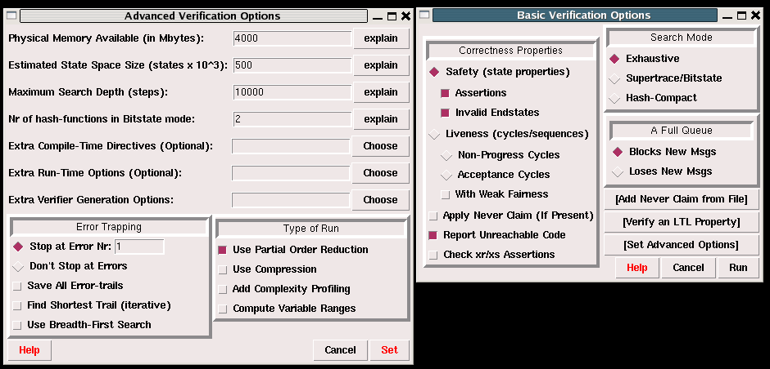
Options in XSPIN
Now you have learned all necessary techniques to verify common problems in the SW development

Slide 10
Communication Using Message Channels
Spin provides communications through various types of message channels
  Buffered or non-buffered (rendezvous comm.)
  Various message types
  Various message handling operators
Syntax
  chan ch1 = [2] of { bit, byte};
    ch1!0,10;ch1!1,20
    ch1?b,bt;ch1?1,bt
  chan ch2= [0] of {bit, byte}
Sender (1,20) (0,10) Receiver

Slide 11
Operations on Channels
Basic channel inquiry
  len(ch)
  empty(ch)
  full(ch)
  nempty(ch)
  nfull(ch)
Additional message passing operators
  ch?[x,y]: polling only
  ch?<x,y>: copy a message without removing it
  ch!!x,y: sorted sending (increasing order)
  ch??5,y: random receiving
  ch?x(y) == ch?x,y (for user’s understandability)
Be careful to use these operators inside of expressions
  They have side-effects, which spin may not allow

Slide 12
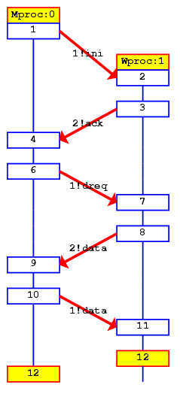
Faulty Data Transfer Protocol
(pg 27, data switch model proposed at 1981 at Bell labs)
mtype={ini,ack, dreq,data, shutup,quiet, dead}
chan M = [1] of {mtype};
chan W = [1] of {mtype};
active proctype Mproc()
{
W!ini; /* connection */
M?ack; /* handshake */
timeout -> /* wait */
if /* two options: */
:: W!shutup; /* start shutdown */
:: W!dreq; /* or request data */
do
:: M?data -> W!data :: M?data-> W!shutup;
break
od
fi;
M?shutup;
W!quiet;
M?dead;
}
active proctype Wproc() {
W?ini; /* wait for ini*/
M!ack; /* acknowledge */
do /* 3 options: */
:: W?dreq-> /* data requested */
M!data /* send data */
:: W?data-> /* receive data */
skip /* no response */
:: W?shutup->
M!shutup; /* start shutdown*/
break
od;
W?quiet;
M!dead;
}
Channel W
Mproc
Wproc
Channel M

Slide 13
The Sieve of Eratosthenes (pg 326)
/*
The Sieve of Eratosthenes (c. 276-196 BC)
Prints all prime numbers up to MAX
*/
#define MAX 25
mtype = { number, eof };
chan root = [0] of { mtype, int };
init
{ int n = 2;
run sieve(root, n);
do
:: (n < MAX) -> n++; root!number(n)
:: (n >= MAX) -> root!eof(0); break
od
}
proctype sieve(chan c; int prime)
{ chan child = [0] of { mtype, int };
bool haschild; int n;
printf("MSC: %d is prime\n", prime);
end: do
:: c?number(n) ->
if
:: (n%prime) == 0 -> printf("MSC: %d = %d*%d\n", n, prime, n/prime)
:: else ->
if
:: !haschild -> /* new prime */
haschild = true;
run sieve(child, n);
:: else ->
child!number(n)
fi;
fi
:: c?eof(0) -> break
od;
if
:: haschild -> child!eof(0)
:: else
fi
}

