Slide 1
Case Study of Reader/Writer System
Moonzoo Kim
School of Computing
KAIST

Slide 2

Outlines
System Description
Formal Requirement Specification
Formal Design Specification
Formal Verification
Testing
System
Description
Requirement
Specification
Design
Specification
Design
Verification
System
Implementation
Testing

Slide 3
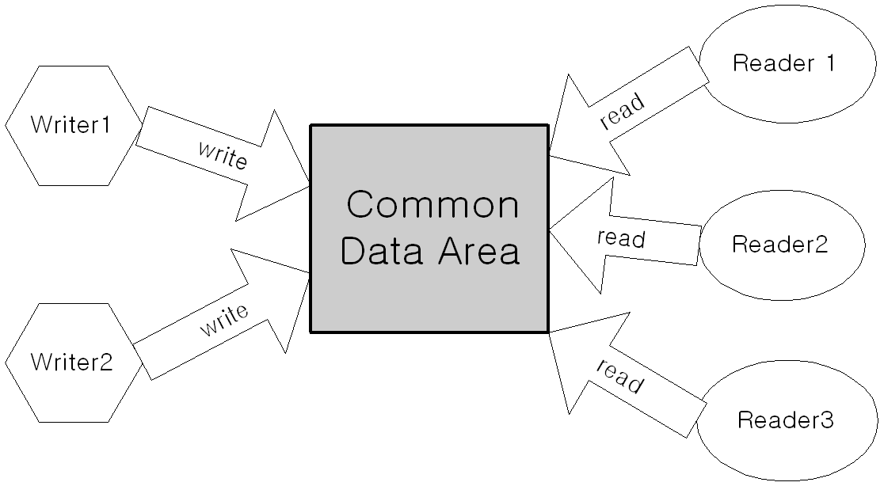
Multiple Reader/Writer System
System requirement
  Concurrency (CON)
  Exclusive writing (EW)
  High priority of writer (HPW)
Notes:
1.Concurrency
Multiple reader reads data concurrently for maximum throughput
2. Exclusive writing
Only one writer can write into the data area at one time for consistent data.
Similarly, when a writer writes, no reader can read.
3. High priority of writer over reader
If there is a waiting writer, the writer has a higher priority than waiting readers to access the data area
It’s for most fresh data for reader to read.

Slide 4
Formal Requirement Specification
1 writer and 2 readers system
  Execution tree
  RW system has 9 events
    {ir1,rs1,re1,ir2,rs2,re2,ww,ws,we}
  A state s = (n_{ir1},n_{rs1},n_{ir2},n_{rs2},n_{ww},n_{ws})
    s0 = (0,0,0,0,0,0)
    s1 = (0,0,0,0,1,0)
    s11=(1,0,0,0,1,0)
    s12= (0,0,0,0,0,1)
s0
ir1
ww
ir2
s1
ir1
ir2
ws
s11
s12
s13

Slide 5
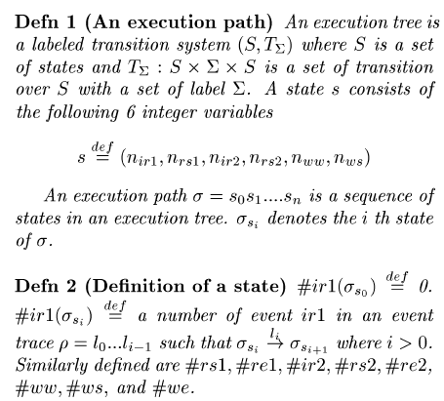
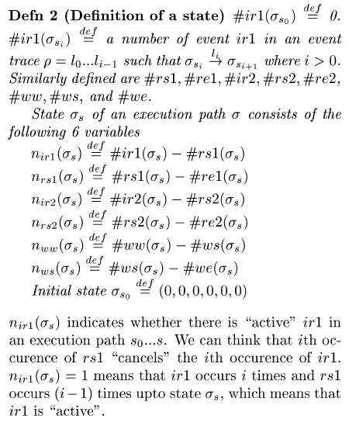
Formal Requirement Specification (cont.)
Valid execution paths

Slide 6
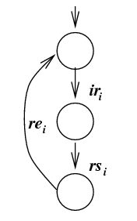
Formal Requirement Specification (cont.)
Valid execution path σ
  An execution path σ= s₀. s₁ … s_{n}
    σ_{si} denotes the i th state of σ
  Definition of a state s_{i}.
    #ir1(σ_{s0}) =0
    #ir1(σ_{si} ) = # of ir1 in a trace l₀....l_{i-1} s.t. σ_{si} –l_{i}-> σ_{si+1}
    n_{ir1} (σ_{s}) = #ir1(σ_{s} ) - #rs1(σ_{s} )
    n_{rs1} (σ_{s}) = #rs1(σ_{s} ) - #re1(σ_{s} )
  Correct Event Ordering
    For all state s_{i} in σ
      n_{ir1}(s_{i})≥0 ∧ n_{rs1}(s_{i})≥0 ∧ n_{ir1}(s_{i})+n_{rs1}(s_{i}) ≤1
      n_{ir2}(s_{i})≥0 ∧ n_{rs2}(s_{i})≥0 ∧ n_{ir2}(s_{i})+n_{rs2}(s_{i}) ≤1
      n_{ww}(s_{i})≥0 ∧ n_{ws}(s_{i})≥0 ∧ n_{ww}(s_{i})+n_{ws}(s_{i}) ≤1

Slide 7
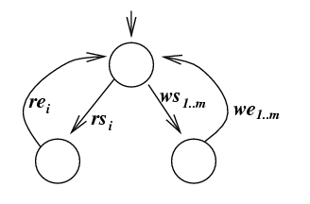
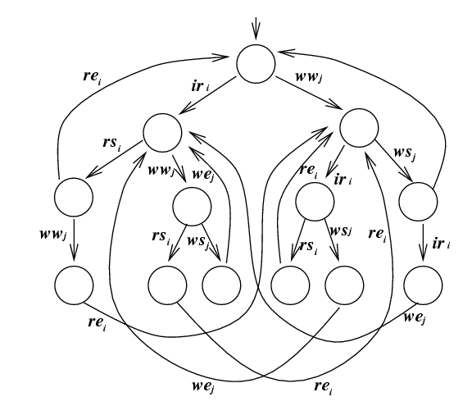
Formal Requirement Specification (cont.)
Valid execution paths
  Exclusive Writing
    n_{ws}(s_{i})=1 ->(n_{rs1}(s_{i})=0 ∧ n_{rs2}(s_{i})=0)
  High Priority of Writer
    (n_{ww}(s_{i})=1 ∧ n_{rs1}(s_{i})=0 ∧ n_{rs2}(s_{i})=0)
    -> (n_{rs1}(s_{i+1})=0 ∧ n_{rs2}(s_{i+1})=0)

Slide 8
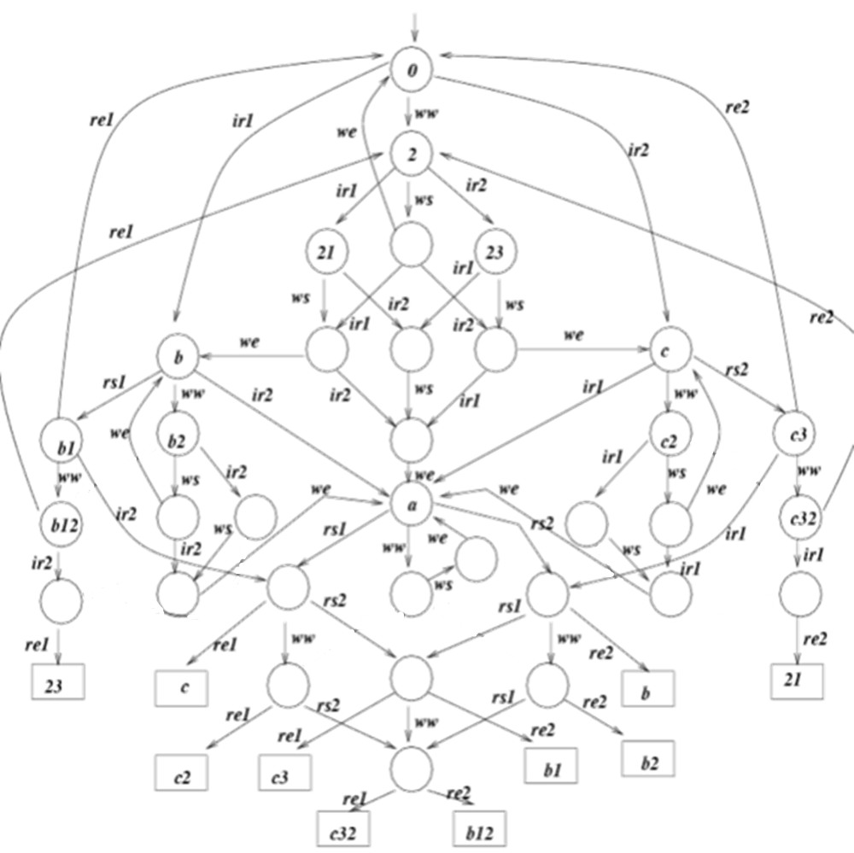
Formal Requirement Specification (cont.)

Slide 9
Formal Requirement Specification (cont.)
*****************************
* Requirement Specification *
*****************************
proc S0 = ir1.B + ww.S2 + ir2.C
proc S2 = ir1.S21 + ws.S22 + ir2.S23
proc S21 = ws.S212 + ir2.S213
proc S22 = ir1.S212 + we.S0+ ir2.S232
proc S23 = ir1.S213 + ws.S232
proc S212 = we.B + ir2.S2123
proc S213 = ws.S2123
proc S232 = ir1.S2123 + we.C
proc S2123 = we.A
proc A = rs1.A1 + ww.A2 + rs2.A3
proc A1 = re1.C + ww.A12 + rs2.A13
proc A2 = ws.we.A
proc A3 = rs1.A13 + ww.A32 + re2.B
proc A12 = re1.C2 + rs2.A123
proc A13 = re1.C3 + ww.A123 + re2.B1
proc A32 = rs1.A123 + re2.B2
proc A123 = re1.C32 + re2.B12
proc B = rs1.B1 + ww.B2 + ir2.A
proc B1 = re1.S0 + ww.B12 + ir2.A1
proc B2 = ws.B22 + ir2.B23
proc B12 = re1.S2 + ir2.B123
proc B22 = we.B + ir2.B223
proc B23 = ws.B223
proc B123 = re1.S23
proc B223 = we.A
proc C = ir1.A + ww.C2 + rs2.C3
proc C2 = ir1.C21 + ws.C22
proc C3 = ir1.A3 + ww.C32 + re2.S0
proc C21 = ws.C221
proc C22 = ir1.C221 + we.C
proc C32 = ir1.C321 + re2.S2
proc C221 = we.A
proc C321 = re2.S21

Slide 10
Formal Design Specification
RW system designed in “Concurrent Programming in Java[Lea99]”
proc S =
(R1|R2|W|AR0|WW0|AW0|
LOCK|SLEEP0)\
{ dec_WW, inc_WW, dec_AW,inc_AW,…}
proc R1 = …
- Processes (R1, R2, W, Lock, etc) communicate each other through signals
(dec_WW, inc_WW, etc)
- variables in RW code are represented as processes (AR0, AW0, etc)
class RW {
int activeReaders_ = 0;
int activeWriters_= 0;
int waitingReaders_= 0;
int waitingWriters_ = 0;
void read() {
beforeRead();
read_();
afterRead();
}
void beforeRead() {…}
void read_() {…}
void afterRead() {…}
…
}

Slide 11
Testing using Formal Specification
public abstract class RW{
protected int activeReaders_ = 0;
protected int activeWriters_= 0;
protected int waitingReaders_= 0;
protected int waitingWriters_ = 0;
public void read(String id) {
beforeRead();
read_(id);
afterRead();
}
protected synchronized void beforeRead(){
Event("ir");…
}
public void read_() {
Event(“rs");…
}
protected synchronized void afterRead(){
Event(“re");…
}
…
}
Insert probe into the RW source code
  Probe generates event signal
Testing RW code utilizing formal requirement spec as a test oracle
  Use CWB-NC based simulation feature
  Inappropriate event signal means violation

Slide 12
RW Java Code
public abstract class RW2 {
protected int activeReaders_ = 0; //threads executing read_
protected int activeWriters_= 0; //always 0 or 1
protected int waitingReaders_= 0; //threads not yet in read_
protected int waitingWriters_ = 0; //same for write_
protected abstract void read_(String id);
protected abstract void write_(String id);
void Event(String s){ }//System.out.println(s);}
public void read(String id) {
/*Event("ir" + id);*/ beforeRead();
/*Event("rs" + id);*/ read_(id);
/*Event("re" + id);*/ afterRead();
}
public void write(String id) {
/*Event("ww");*/ beforeWrite();
/*Event("ws");*/ write_(id);
/*Event("we");*/ afterWrite();
}
protected boolean allowReader() {
if (waitingWriters_ == 0 && activeWriters_ == 0) {
return true;
}
else
return false;
}
protected boolean allowWriter() {
if(activeReaders_ == 0 && activeWriters_ == 0) {
return true;
} else return false;
}
protected synchronized void beforeRead() {
++waitingReaders_;
while(!allowReader())
try{ wait();}
catch(InterruptedException ex){}
--waitingReaders_;
++activeReaders_;
}
protected synchronized void afterRead() {
--activeReaders_;
notifyAll();
}
protected synchronized void beforeWrite() {
++waitingWriters_;
while(!allowWriter())
try{wait();}
catch(InterruptedException ex){}
--waitingWriters_;
++activeWriters_;
}
protected synchronized void afterWrite() {
--activeWriters_;
notifyAll();
}

Slide 13
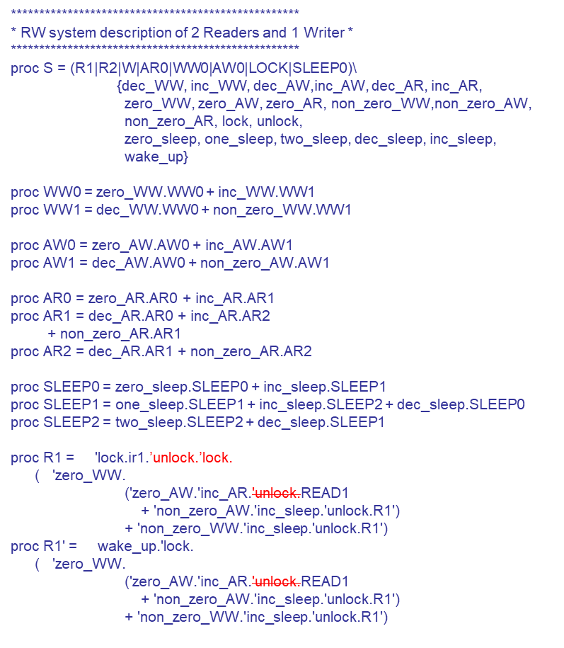
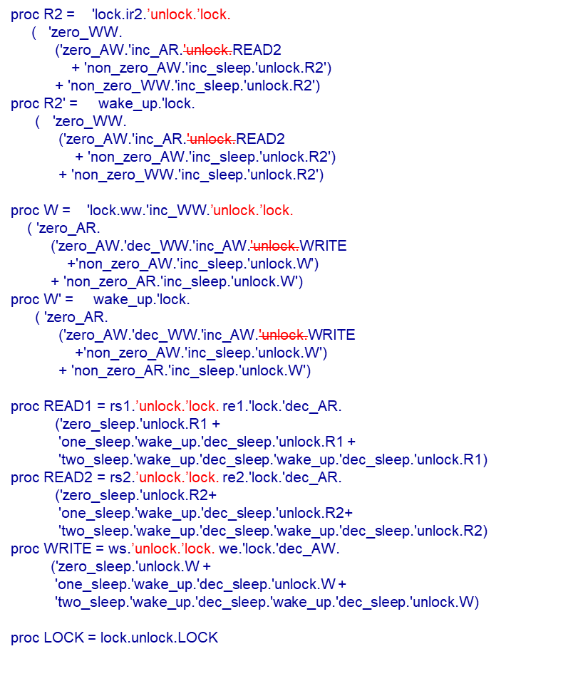
RW System Design

Slide 14
May Preorder
May preorder (classical trace inclusion)
  P ·_{may} Q iff on T’(P) µ T’(Q)
    Ex. le –S may “a.nil” “a.b.nil”
      Since T’(a.nil) = {a}, T’(a.b.nil) = {a,a.b}
      But not le –S may “a.b.nil” “a.nil”

Slide 15
Formal Verification Result
01:cwb-nc> le -S may S S0
02:Building automaton...
03:States: 333
04:Transitions: 361
05:Done building automaton.
06:Building automaton...
07:States: 34
08:Transitions: 69
09:Done building automaton.
10:Transforming automaton...
11:Done transforming automaton
12:TRUE
13:cwb-nc>
01: cwb-nc> le -S may S0 S
02: Building automaton...
03: States: 34
04: Transitions: 69
05: Done building automaton.
06: Building automaton...
07: States: 333
08: Transitions: 361
09: Done building automaton.
10: Transforming automaton...
11: Done transforming automaton.
12: FALSE...
13: S0 has trace:
14: ir1 rs1 re2 ir1
15: S does not.
16: cwb-nc>

