Slide 1
Introduction to Process Algebra
Moonzoo Kim
School of Computing
KAIST

Slide 2
Review of the Previous Class
We have seen tragic accidents due to software and specification bugs
These bugs are hard to find because those bugs occurs only in “exceptional” cases
Informal system specification and requirement specification makes automatic analysis infeasible, which results in incomplete coverage
To provide better coverage, we need
  Formal requirement specification
  Formal system model
System
model
OK
Model Checking
(state exploration)
or
Requirement
properties
Counter
example
(Φ Ω)

Slide 3
Outline
Requirement specification problems
Viewpoint on “meaning”(semantics) of system
Complexity of a system
Formal modeling v.s. programming
Introduction to process algebra

Slide 4
Requirement Specification Problems
Ambiguity
  Expression does not have unique meaning, but can be interpreted as several different meaning.
    Ex. long type in C programming language
Incompleteness
  Relevant issues are not addressed , e.g. what to do when user errors occur or software faults show.
    Ex. See next slides
Inconsistency
  Contradictory requirements in different parts of the specification.

Slide 5
Example (retail chain management software)
If the sales for the current month are below the target sales, then a report is to be printed,
  unless the difference between target sales and actual sales is less than half of the difference between target sales and actual sales in the previous month
  or if the difference between target sales and actual sales for the current month is under 5 percent.

Slide 6
Viewpoint on Semantics of a System
A system execution σ is a sequence of states s₀s₁…
  A state has an environment ρ_{s}:Var-> Val
A system has its semantics as a set of system executions
x:0,y:0
s₀
x:0,y:1
s₁
x:1,y:2
x:5,y:1
s₂
s₁₁
x:1,y:3
x:5,y:2
s₃
s₁₂
x:2,y:4
x:5,y:3
x:7,y:3
s₄
s₁₃
s₂₁
x:5,y:4
x:7,y:4
s₁₄
s₂₂
Notes:
We view the program execution as a sequence of states. A state consists of variable environment rho and time stamp t. This viewpoint states that information of program remains between two consecutive states.
Furthermore, a state in the execution indicates that something happens at the time instant corresponding to the state.
As the execution has more states, more computational resource is required to analyze the execution. Therefore, to reduce the overhead, if possible, we need to abstract out unnecessary states in terms of properties. For example, for property p, we don’t need variable x. Thus removing states …
Furthermore, not every value of y is important because only s0 and s6 affects the property. Thus, we might want to remove states s1-s5. We will discuss this abstraction in more detail later

Slide 7
Complexity of Systems
The complexity of a system is sometimes more accurately expressed using semantic viewpoint (# of reachable states) rather than syntactic viewpoint (line # of source code)
  the number of different states a system can reach
    Ex> An integer has 2³² (~4000000000) possible values

Slide 8
Example
active type A() {
byte x;
again:
x++;
goto again;
}
x:0
x:1
x:2
x:255
active type A() {
byte x;
again:
x++;
goto again;
}
active type B() {
byte y;
again:
y++;
goto again;
}
x:0,y:0
x:0,y:1
x:0,y:255
x:1,y:0
x:1,y:1
x:1,y:255
x:2,y:0
x:2,y:1
x:2,y:255
x:255,y:0
x:255,y:255

Slide 9
Formal Modeling V.S. Programming
 |  | Formal Modeling | Programming
Static Aspects | Abstraction Level | High | Low
 | Development Time | Short | Long
Dynamic Aspects | Executable | Yes (model checking) No (theorem proving) | Always
 | System Semantics | Mathematically defined | Usually given by examples
 | Environment Semantics (i.e. testbeds) | Mathematically defined | Usually given by examples
 | Program State Space | Manageable (i.e. tractable state space) | Unmanageable (i.e. beyond computing power)
 | Validation | By exhaustive exploration or deductive proof | By testing (incomplete coverage)

Slide 10
Complex System Attributes
You may not need to model a simple system such as +,*, or HelloWorld.
However, you must have a scientific way of abstracting/modeling a system with complex structure, e.g.,
  Hierarchy
  Concurrency
  Communication
Also, you need to have a systematic way to analyze the correctness of your design

Slide 11
How to Define "Correctness" ?
System design vs. Requirement spec.
²
1)
(Φ Ω)
²
2)
(Φ Ω)
≈
3)
(Φ Ω)

Slide 12
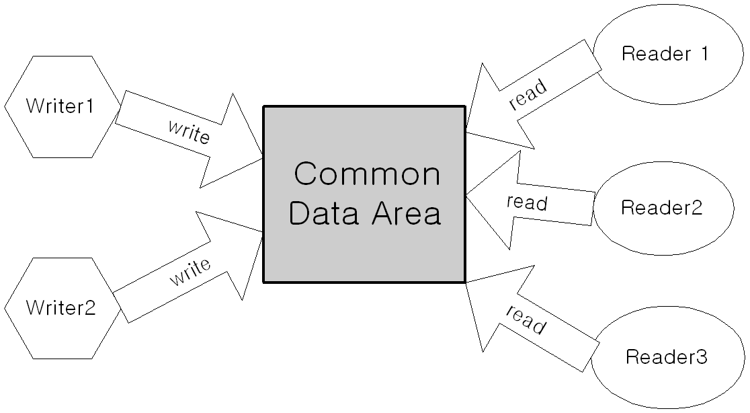
Requirement Specification
Requirement specifications are the goals that a target software must satisfy
  Ex. For a system containing 3 readers, 2 writers, and common common data area, the system should satisfy the following three requirement properties
  Concurrency (CON)
    Multiple readers can read data concurrently
  Exclusive writing (EW)
    A writer can write into the data area at an instant with no readers
  High priority of a writer (HPW)
    A writer’s request should have a higher priority than that of a reader

Slide 13
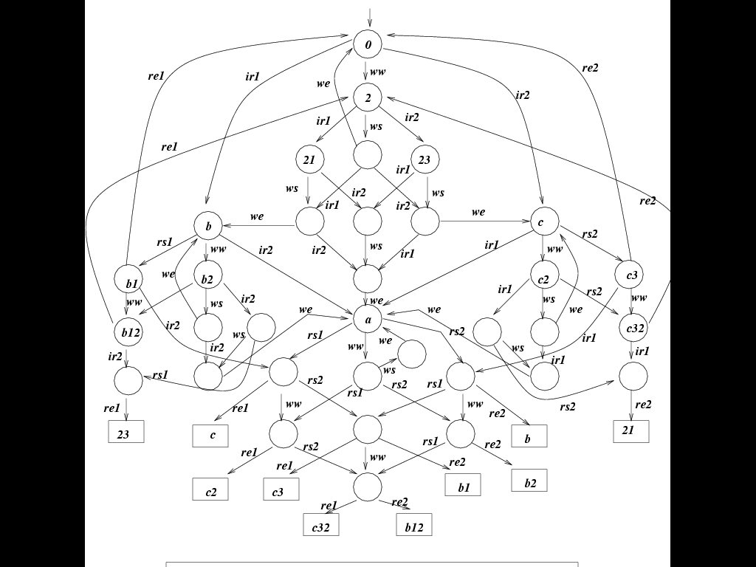
System Design Model
Abstract description of a target system
Model must have clear meaning/semantics
Ex. A system design model for 2 readers and one writer in process algebra
  RW system has 9 events
    {ir1,rs1,re1,ir2,rs2,re2,ww,ws,we}
    incoming reader 1, reader 1 starts,
    reader 1 ends
    waiting writer, writer starts, writer ends
  System = (R₁| R₂| W|D)\{…}
    R_{i}=check_lock. read_request_{i}. start_read_{i}. end_read_{i}.R_{i}
    W_{i}= check_lock. write_request. start_write. end_write.W
    D = ‘read_request₁. …

Slide 14
Design Analysis
We definitely want to guarantee/prove that a system design model M satisfies a requirement property Á
  M ² Á
System
model
OK
Model Checker
(exhaustive state
exploration)
or
Requirement
properties
Counter
example
(Φ Ω)

Slide 15
Necessity of Rigorous Req. Spec.
Specification in natural languages can be easily incomplete due to assumption of implicit “common senses” which actually do not exist
Ex. For the 3-readers and 2-writers system
  Concurrency (CON): “Multiple readers can read data concurrently.”
    What if only 2 readers can read concurrently?
  Exclusive writing (EW): “A writer can write into the data area at an instant with no readers”
    What if two writers write into the data area at the same time?
  High priority of a writer (HPW): “A writer’s request should have a higher priority than that of a reader”
    What if a writer requests one second later than a reader? Should the system wait for handling readers request? If so, how long?
Intro. to Logic CS402

Slide 16
Necessity of Rigorous Req. Spec.
Suppose that R_{i} means i th reader is reading.
The requirement Á_{CON} for concurrency can be written in propositional logic
  If it is ok for two readers to read concurrently,
  Á_{CON} should be
    (R₁∧R₂) ∨ (R₂ ∧ R₃) ∨ (R₃ ∧ R₁) for some time instant t
    Note that if it is ok for only two readers to read concurrently, Á_{CON} = (R₁ ∧ R₂ ∧ :R₃) ∨ (:R₁∧R₂ ∧ R₃) ∨ (R₁ ∧ :R₂ ∧ R₃)
  If all three readers should be able to read concurrently, Á_{CON} should be
    (R₁ ∧ R₂ ∧ R₃) for some time instant t
Intro. to Logic CS402

Slide 17
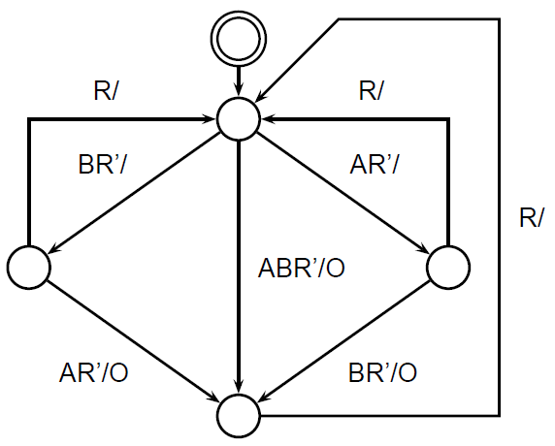
Another Example Model (1/2)
The req. spec.
  The output O should occur when inputs A and B have both arrived.
  The R input should restart this behavior.
System design.

Slide 18
Implementation of the Example (2/2)
System design.
Implementation in a synchronous language Esterel
module ABRO_example:
input A, B, R;
output O;
loop
[ await A || await B ];
emit O
each R
end module
The implementation is simple since language includes notions of signals,
waiting, and reset, etc.

Slide 19
Process Algebra
A process algebra consists of
  a set of operators and syntactic rules for constructing processes
  a semantic mapping which assigns meaning or interpretation to every process
  a notion of equivalence or partial order between processes
Advantages: A large system can be broken into simpler subsystems and then proved correct in a modular fashion.
  A hiding or restriction operator allows one to abstract away unnecessary details.
  Equality for the process algebra is also a congruence relation; and thus, allows the substitution of one component with another equal component in large systems.
Note that the model is constructed in a component-based way, but the analysis is not.

Slide 20
Calculus of Communicating Systems (CCS)
Developed by R.Milner (Univ. of Cambridge)
  ACM Turing Awardee in 1991
Provides many interesting paradigms
  Emphasis on communication and concurrency
    Provides compact representation on both communication and concurrency
      Ex> a (receive) and a’ (send)
      Ex> | (parallel operator)
  Provides observation based abstraction
    Hiding internal behaviors using \ (restriction) operator, i.e., considering all internal behaviors as an invisible special action τ
  Provides correctness claim based on equivalence
    Branching time based equivalence
      Strong equivalence v.s. weak equivalence

Slide 21
Overview on CCS Syntax and Semantics
CCS describes a system as a set of communicating Processes
Behavior of a process is expressed using actions
  Act =input_actions U output_actions U {τ}
Each process is built based on the following 7 operators
  Nil (null-ary opeartor): 0
  Prefix: a.P
  Definition: P = a.b.Q
  Choice: a.P + b.P
  Parallel: P | Q
  Restriction: P \ {a,b}
  Relabelling: P[a/b]
Each operator has a clear formal semantics via inference rules (premises-conclusion rules)
  Based on these inference rules, a meaning/semantincs of a process is given as a labelled transition system

Slide 22
Example of a CCS System
A set of actions Act = {a,a’,b,τ}
We define a CCS system Sys as
  Sys = (a.E + b.0) | a’.F
Sys can executes one of the following 4 actions
  Sys –a-> E | a’F
  Sys –a’-> (a.E + b.0)|F
  Sys –b-> 0 | a’.F
  Sys - τ-> E|F
Prefix
a.E –a-> E
Choice_{L}
(a.E + b.0)) –a-> E
Par_{L}
(a.E + b.0)) | a’.F –a-> E | a’.F
Sys =(a.E + b.0) | a’.F
a
a’
b
τ
E | a’.F
(a.E + b.0)|F
0 | a’.F
E | F
b
a’
a
a’
0 | F

Slide 23
Example: Scheduler
Action and Process Def.
a_{i}: start task_{i}
b_{i}: stop task_{i}
Requirements:
a₁,...,a_{n} to occur cyclically
a_{i}/b_{i} to occur alternately beginning with a_{i}
Sched_{i,X} for X ⊆ {1,...,n}
i to be scheduled
X pending completion
Scheduler = Sched_{i,∅}
Sched_{i,X}
= Σ_{j∈X} b_{j}.Sched_{i,X-{j}}, if i ∈ X
= Σ_{j∈X} b_{j}.Sched_{i,X-{j}}
+ a_{i}.Sched_{i+1,X∪{i}}, if i ∉ X

