Slide 1
Information Extraction for
Run-time Formal Analysis
Moonzoo Kim
KAIST
26年 11月 8日
Notes:
Thank you for coming. I will present my thesis dissertation of title “Information Extraction for Run-time Formal Analysis”

Slide 2
Outline
WHY?
  Motivation
Motivation: Weaknesses of
Formal Methods and Testing
WHAT?
  Run-time Formal Analysis
Run-time Formal Analysis
HOW?
  High-level: the Monitoring and Checking (MaC) Architecture
The MaC architecture
  Low-level: a MaC Prototype for Java programs (Java-MaC)
Java-MaC
26年 11月 8日
Notes:
As the usage of software grows in this modern information ages from video game to nuclear reactor controllers, the reliability of software becomes more and more important. Two traditional methods for increasing the reliability of the software are formal methods and testing. However, these two methods have its own weaknesses. So that at run-time, the correctness of the execution is hard to guarantee.
Therefore, we suggest analyzing program execution formally at run-time to check whether the current execution is correct or not. We call this approach “run-time formal analysis”.
We have developed Monitoring and Checking architecture as an architecture for run-time formal analysis.
Furthermore, we implemented the MaC prototype for Java-Program to demonstrate the effectiveness of the architecture.
Let’s start with looking at the weaknesses of formal methods and testing.

Slide 3
Motivation
Weaknesses of formal verification and testing
  formal verification:
    gap between an abstract model and the implementation
    lack of scalability
  testing:
    lack of complete guarantee
26年 11月 8日
Notes:
First, formal verification is performed on the abstract model, not the implementation. Therefore, even though we verify that the design is correct, it does not necessarily mean the system implementation is correct.
Second, formal verification can not handle a big model due to huge computational resource requirement.
Testing is performed on the implementation. But it does not provide the formal guarantee because exhaustive testing is impossible.
Naturally, correctness of run-time execution is NOT guaranteed even after we applied these two traditional methods.

Slide 4
Outline
Motivation: Weaknesses of
Formal Methods and Testing
WHY?
  Motivation
WHAT?
  Run-time Formal Analysis
HOW?
  High-level: The Monitoring and Checking (MaC) Architecture
  Low-level: a MaC Prototype for Java programs
Summary
Run-time Formal Analysis
The MaC architecture
Java-MaC
26年 11月 8日
Notes:
Therefore, we suggest to monitor the execution of program and check its correctness at run-time as a solution to the weaknesses of formal methods and testing

Slide 5
Run-time Formal Analysis
Motivation:
  Run-time correctness is not guaranteed
The goal of run-time formal analysis
  to give confidence in the run-time compliance of an execution of a system w.r.t formal requirements
The analysis validates properties on the current execution of application.
Run-time formal analysis helps user to detect errors and prevent system crash.
26年 11月 8日
Notes:
For achieving this goal, we monitor the execution of target program at run-time and checks its correctness w.r.t formal requirement specification.
It seems that run-time formal analysis is not very useful because detecting system crash is easy.
A point is that in many cases, a violation of requirements does not results in system crash immediately.
If we detect such a violation, before system crashes, human operator or steerer can recover the program from the error to prevent system crash. Furthermore, such violation is sometimes so subtle that without thorough monitoring and checking, we cannot detect the violation. Therefore, run-time formal analysis helps users to detect and correct errors.
Let’s think about issues for run-time formal analysis.

Slide 6
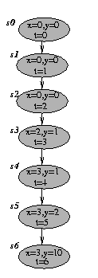
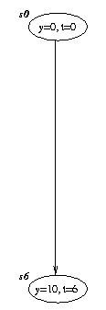
Program Execution
A program execution σ is a sequence of states s₀s₁…
  A state s consists of
    an environment ρ_{s}:V-> R
    a timestamp t_{s} s.t. t_{si} < t_{si+1}
We may abstract out state information unnecessary to detect requirements.
property p =
3 < y && y < 11
26年 11月 8日
Notes:
We view the program execution as a sequence of states. A state consists of variable environment rho and time stamp t. This viewpoint states that information of program remains between two consecutive states.
Furthermore, a state in the execution indicates that something happens at the time instant corresponding to the state.
As the execution has more states, more computational resource is required to analyze the execution. Therefore, to reduce the overhead, if possible, we need to abstract out unnecessary states in terms of properties. For example, for property p, we don’t need variable x. Thus removing states …
Furthermore, not every value of y is important because only s0 and s6 affects the property. Thus, we might want to remove states s1-s5. We will discuss this abstraction in more detail later

Slide 7
Monitorable Properties
An execution of a program is an infinite sequence of program states S
A property is a set of program executions
Properties
Safety
Properties
Liveness
Properties
Monitorable
Properties
26年 11月 8日

Slide 8
Evaluation of Properties
Complexity of evaluating properties based on a given trace
  Trace Validity Problem
    Input: a process P and a string s ∈ L*
    Output: is s a valid trace of P
When properties are given in non-deterministic way, this problem becomes NP-complete
  reduction of 3SAT to the trace validity problem
26年 11月 8日

Slide 9
Outline
Motivation: Weaknesses of
Formal Methods and Testing
WHY?
  Motivation
WHAT?
  Run-time Formal Analysis
HOW?
  High-level:
    the Monitoring and Checking (MaC) Architecture
  Low-level: a MaC Prototype for Java programs
Summary
Run-time Formal Analysis
The MaC architecture
Java-MaC
26年 11月 8日
Notes:
We have seen various issues on run-time formal analysis in the previous slides.
Now we will see the solutions for the issues contained in the MaC architecture.
TIME LIMIT : 10 MIN.

Slide 10
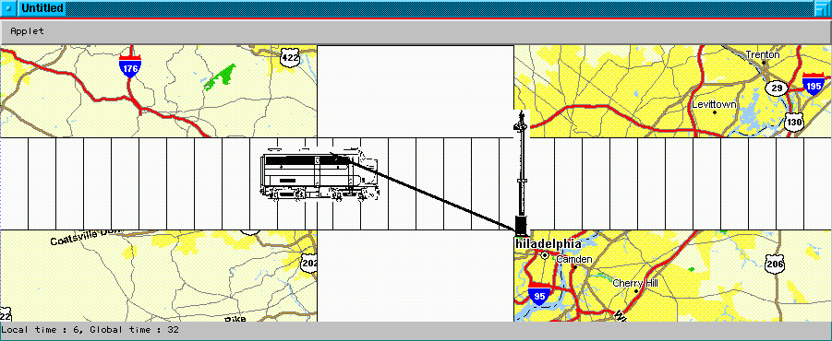
Relation Between Execution and Requirements
Program
Requirements
Instrumented
Pgm
Formal Requirement
Specification
Property safeCrossing
= InCrossing -> GateDown;
train_pos :20.5
crossing_pos:50
gate_angle:15
InCrossing =
train_pos > crossing_pos;
GateDown =
gate_angle == 0;
26年 11月 8日
Notes:
what do we need to perform run-time formal analysis?
First,we need requirements.
Second, we need a target program, of course.
Also, we need to extract the execution of target program to compare with the requirements in some way.
However, the target program is not designed originally to do that. Therefore, the target program should be modified so that the information on the execution can be extracted and checked w.r.t the requirements.
Furthermore, requirements should be formalized so that the checking procedure can be performed mechanically.
There still be issues to be solved. The execution of target program is low-level activity. However, the formal specification is written in high-level. Thus, there should be some relational mapping between these two activities.
In order to define such mapping, First, we have to define the execution of target program formally.
Second, we have to define the mapping between low-level program activity to high-level requirement
For example, in Railroad crossing, the target program execution consists of variable values such as train_pos and gate_angle. But requirement is specified as when train is in the crossing, the gate must be down. We need to map these variables to primitive events in the requirements such as …

Slide 11
Overview of the MaC Architecture
Program
Informal
Requirement
Spec
Input
Human
Formal Requirement Spec
Low-level
Specification
High-level
Specification
Automatic
Instrumentation
Automatic
Translation
Automatic
Translation
Static Phase
Program
Filter
low-level
behavior
Event
Recognizer
high-level
behavior
Run-time
Checker
Run-time Phase
26年 11月 8日
Notes:
Given a target program and informal requirement spec, a user writes down formal requirement specification.
And this specification is written in two parts. First, high-level specification which is requirement specification.
Second, low-level specification which is a mapping between low-level program execution to the requirements by defining primitive events of requirement in terms of program variables.
…
Here, the role of event recognizer is a thin interface between target program and requirements specification.
Thus, event recognizer should be as simple as possible. Heavy Computation should be done at run-time checker.
As you see in the picture, the core of the architecture is “Formal Requirement Spec”.
For the formal requirement specification, the target program is instrumented, event-recognizer and run-time checker are generated. Therefore, how to describe formal requirement specification is crucial issues in the MaC architecture. We need to specify temporal behavior of program such as event1 happens earlier than event2 as well as information of program such as values of variables. The language of the MaC architecture can express such relations.

Slide 12
Design of the MaC Languages
reqLock_{A}
acqLock_{A}
relLock_{A}
InCritSec_{A}
InCritSec_{B}
Time
reqLock_{B}
acqLock_{B}
relLock_{B}
Must be able to reason about both time instants and information that holds for a duration of time in a program execution.
Need temporal operators combining events and conditions in order to reason about traces.
26年 11月 8日
Notes:
Let us see the mutual exclusion example first. There are two thread, thread A and thread B. Thread A requests the lock earlier than thread B. Thus theread A acquires lock and enters critical section. When thread A leaves out the critical section, thread B enters. We can check two properties in this example.
First come first serve property
If thread A request lock earlier than thread B, thread A acquires the lock earlier than thread B
Mutual exclusion
InCritSecA and InCritSecB must not be true at the same time.
We can describe FCFS using the order of events.
We can describe mutual exclusion using the condition InCritSecA and InCritSecB.
Based on this distinction of events and condition, we can express various things using logical operator on events and conditions

Slide 13
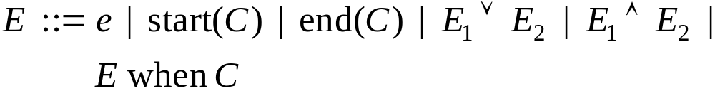

Logical Foundation
conditions interpreted over 3 values
  true, false and undefined.
pairs a couple of events to define an interval.
start and end define the events corresponding to the instant when conditions change their value.
26年 11月 8日
Notes:
The logic is two sort logic consisting of conditions and events. These are syntax for conditions and events. Primitive condition is a boolean expression over the program variables. Conditions can have one of true, false and undefined. A condition is undefined when a program variable of the condition is undefined in the execution of the program yet. Suppose there is a condition c = a.x > 10.
If the program does not created an object a yet, a.x is undefined. Thus, condition c = a.x > 10 is also undefined.
Condition is either primitive condition or defined by predicate DEFINED() which returns false when C is undefined and returns true otherwise. Or condition is a pair of two events e1 and e2 meaning duration from when E1 happens until E2 happens. Natural logical connectives are allowed.
Primitive events are defined by program variable updates and start and end of method invocation. Events are either primitive events or start and end of the conditions.
Let us look at the MaC language which has bases on this logic.

Slide 14
The MaC Languages
Meta Event Definition Language(MEDL)
  Describes the safety requirements of the system, in terms of conditions that must always be true, and alarms (events) that must never be raised.
  Target program implementation independent.
Primitive Event Definition Language (PEDL)
  Defines primitive events/conditions in terms of program entities
    Provides primitives to refer to values of variables and to certain points in the execution of the program.
  Depends on target program implementation
26年 11月 8日

Slide 15
Meta Event Definition Language (MEDL)
ReqSpec <spec_name>
/* Import section */
import event <e>;
import condition <c>;
/*Auxiliary variable */
var int <aux_v>;
/*Event and condition */
event <e> = ...;
condition <c>= ...;
/*Property and violation */
property <c> = ...;
alarm <e> = ...;
/*Auxiliary variable update*/
<e> -> { <aux_v'> := ... ; }
End
Expresses requirements using the events and conditions
Expresses the subset of safety languages.
Describes the safety requirements of the system
  property safeRRC = IC -> GD;
  alarm violation = start (!safeRRC);
Auxiliary variables may be used to store history.
  endIC-> { num_train_pass’ = num_train_pass + 1; }
26年 11月 8日

Slide 16
Monitoring Script for Railroad Crossing
MonScr RailRoadCrossing
export event startIC, endIC, gEndDown,gStartUp;
monobj float RRC.train_x;
monobj int RRC.train_length;
monobj int RRC.cross_x;
monobj int RRC.cross_length;
monmeth void Gate.gd(int);
monmeth int Gate.gu();
condition IC =
RRC.train_x + RRC.train_length > RRC.cross_x &&
RRC.train_x <= RRC.cross_x + RRC.cross_length;
event startIC = start(IC);
event endIC = end(IC);
event gEndDown = endM(Gate.gd(int));
event gStartUp = startM(Gate.gu());
End
ReqSpec RailRoadCrossing
import event startIC, endIC, gEndDown, gStartUp;
condition IC = [startIC, endIC);
condition GD = [gEndDown, gStartUp);
property safeRRC = IC -> GD;
End
RRC.train_x + RRC.train_length
RRC.train_x
RRC.cross_x
RRC.cross_x +
RRC.cross_length
26年 11月 8日
Notes:
The left script is PEDL script. The right script is MEDL script.
Program variables and method names are colored as green. As you see, green letters are only at the PEDL script, which means MEDL script is independent from the program.
Event are colored blue. Conditions are colored orange. And the property is colored red.
The interface between PEDL script and MEDL script is a set of exported events and imported events.
Let us look at how to define event and condition. Condition IC means a train is in the crossing. As you see the figure, the head of train is ...
The tail of the train is ... The left end of crossing is ... The right end of crossing is... Therefore, IC is expressed by head of train is more than the left end of the crossing and the tail of the train is less than the right end of the crossing.
Event gEndDown indicates the gate is completely down which happens when Gate.gd(int) method finishes. Event gStartUp indicates the gate starts moving up which happens when Gate.gu() starts.

Slide 17
Outline
Motivation: Weaknesses of
Formal Methods and Testing
WHY?
  Motivation
WHAT?
  Run-time Formal Analysis
HOW?
  High-level: The Monitoring and Checking (MaC) Architecture
  Low-level: a MaC Prototype for Java programs
Summary
Run-time Formal Analysis
The MaC architecture
Java-MaC
26年 11月 8日

Slide 18
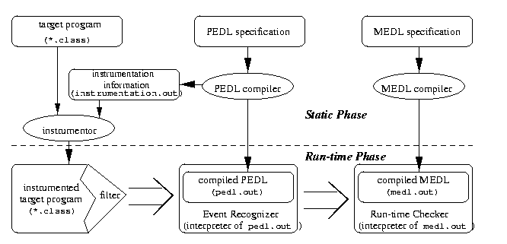
The MaC Prototype for Java Programs
26年 11月 8日
Notes:
Inputs to the MaC prototype for Java programs are program and PEDL script and MEDL script. PEDL compiler compiles PEDL script and generates instrumentation information and compiled PEDL script. Instrumentor instruments java bytecode which is executable code following the instrumentation information. Instrumented code has a filter as additional components. Event recognizer interprets the compiled PEDL script. Run-time checker interprets the compiled MEDL script similarly. Pedl.out

Slide 19
PEDL for Java
Provides primitives to refer to
  primitive variables
  beginnings/endings of methods
Primitive conditions are constructed from
  boolean-valued expressions over the monitored variables
    ex> condition IC = (position == 100);
Primitive events are constructed from
  update(x)
  startM(f)/endM(f)
    ex>event raiseGate= startM(Gate.gu());
MonScr <spec_name>
/* Export section */
export event <e>;
export condition <c>;
/* Monitored entities */
monobj <var>;
monmeth <meth>;
/* Event and condition*/
event <e> = ...;
condition <c>= ...;
End
26年 11月 8日
Notes:
The reason Java-MaC monitors primitive variables, not object itself is that to monitor object causes large overhead. One object may contains other objects through references.
Tracking all the subnodes modification cost too much.
Furthermore, actually, primitive variables constitute an object. Thus, this restriction is not severe one.
PEDL describes system execution in two different forms - conditions and events. PEDL provides a way to express the program language detail such as variables names and method signatures. Based on these detail, PEDL defines the event and conditions.

Slide 20
PEDL for Java (cont.)
Events can have two attributes - time and value
time(e) gives the time of the last occurrence of event e
  used for expressing temporal properties
value(e,i) gives the i th value in the tuple of values of e
  value of update(var) : a tuple containing a current value of var
  value of startM(f) : a tuple containing parameters of the method f
  value of endM(f) : a tuple containing parameters and a return value of the method f
26年 11月 8日
Notes:
Events can have two attributes - time and value.
Time(e) means the time of the last occurence of event e. The time indicates the target system’s time when e occurs at the target systems. Using this time attribute of events, we can describe temporal properties.
Value(e) means the value associated to events. Let us look at how to define values for primitive events. Value of update(var) is a single tuple containing a current value of var.
Value of startM(f) is a tuple containing parameters of the method f. Similarly value of endM(f) is a tuple containing parameters of the method f and return value. We define values to only primitive events. It is because it’s not clear what value should be associated with the compound events like e1 || e2. And we did not come up with the cases which requires the value of compound events.
So for simplicity, we only allow value to the primitive events

Slide 21
Sample Probe
Monitoring a field variable Var.val
; >> METHOD 8 <<
.method public run()V
.limit stack 4
.limit locals 2
...
getfield DigitalVar.v I
putfield Var.val I
...
.end Method
; >> METHOD 8 <<
.method public run()V
.limit stack 7
.limit locals 2
...
getfield DigitalVar.v I
getstatic mac.filter.Filter.lock Ljava.lang.Object;
monitorenter
dup2
ldc “val”
invokestatic mac.filter.SendMethods.sendObjMethod(
Ljava/lang/Object;Ijava/lang/String;)V
putfield Var.val I
getstatic mac.filter.Filter.lock Ljava.lang.Object;
monitorexit
...
.end Method
26年 11月 8日
Notes:
Detect an instruction updating monitored variables

Slide 22
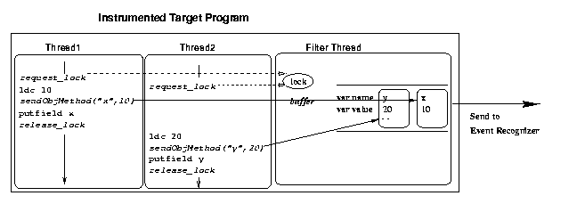
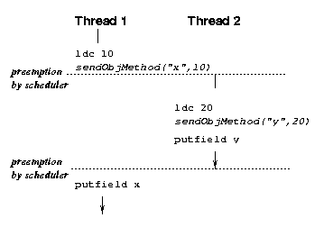
Filter
A filter consists of
  a communication channel to the event recognizer
  probes inserted into the target system
  a filter thread which flushes the content of communication buffers to the event recognizer
Filter uses global lock for consistent snapshot ordering in spite of arbitrary preemption
26年 11月 8日
Notes:
We need a guard against the race condition due to multi threads in order to ensure the correct order of event reports. Without synchronization, the order of reports can be incorrect. We use a lock for synchronization mechanism.

Slide 23
Event Recognizer/Run-time Checker
Event recognizer
  evaluates pedl.out whenever it receives snapshots from the filter.
  If an event or a condition changing its value is detected, the event recognizer sends the event or the condition to the run-time checker
Run-time checker
  evaluates medl.out whenever it receives events and conditions from the event recognizer.
  detects a violation defined as alarm or property and raises a signal.
26年 11月 8日

Slide 24
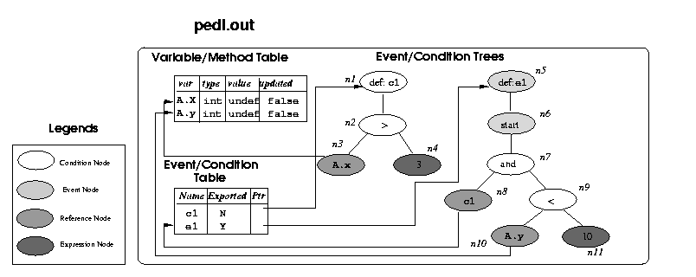
Event Recognizer/Run-time Checker (cont)
Ex> condition c1 = A.x > 3;
  event e1 = start(c1 && A.y < 10);
26年 11月 8日
Notes:
There is variable/method table and event condition table and evetn condition trees. Events and condition reference are connected through event/condition table.

Slide 25
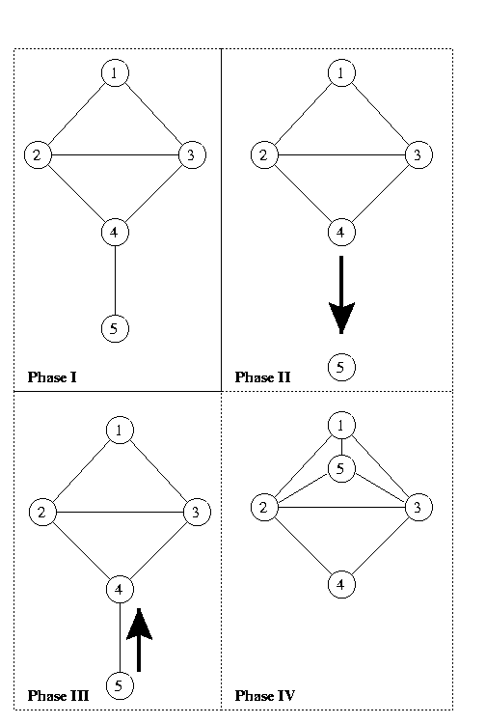
Case Study: Routing Protocol Validation
Ad-hoc On Demand Vector (AODV) routing protocol used in packet radio networks consisting of mobile nodes
Detect violations of properties such as loop invariant in AODV routing protocol implemented using NS2 simulator [IEEE TSE ‘02]
26年 11月 8日
Notes:
AODV establishes routses ‘on-demand’
Trace size:
9 properties are specified such as “loop invariant”

Slide 26
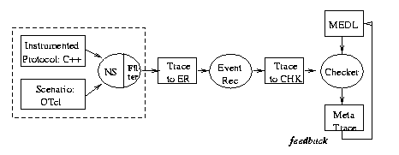
Case Study: Routing Protocol Validation (cont.)
NS2 simulator is used instead of target Java program
Execution trace containing packets delivered among nodes is analyzed repeatedly with different property descriptions without running the simulation again
26年 11月 8日
Notes:
50 nodes
6 million packets sending
1.4 MB property description
9 properties
With various abstraction,

Slide 27
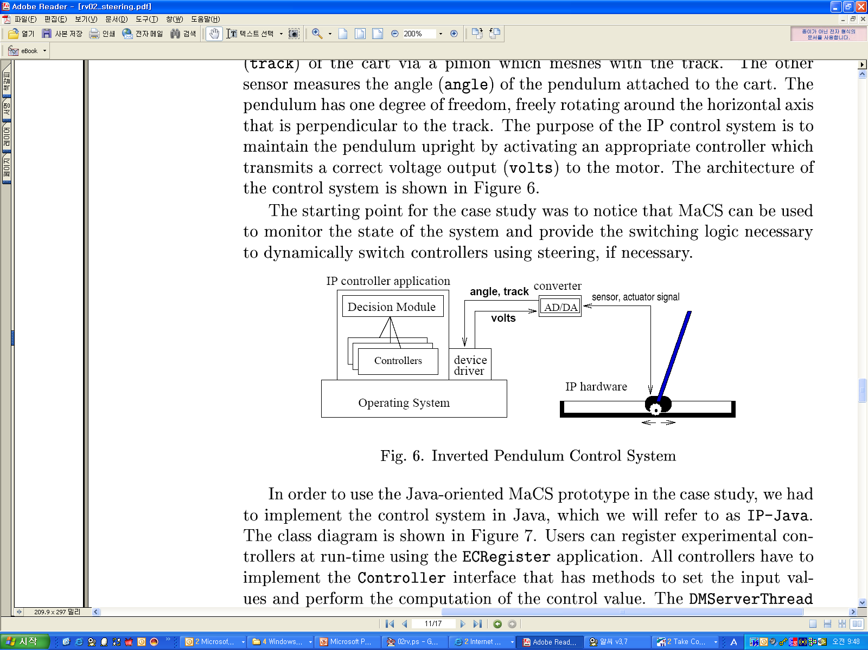
Case Study: Simplex Architecture
Simplex Architecture [L.Sha ‘01]
  dynamic reconfiguration of the system in order to improve performance w/o sacrificing safety
Implement a fault-tolerance layer for an inverted pendulum (IP) controller using Java-MaC, called IP-Java [Run-time Verification ‘02]
26年 11月 8日

Slide 28
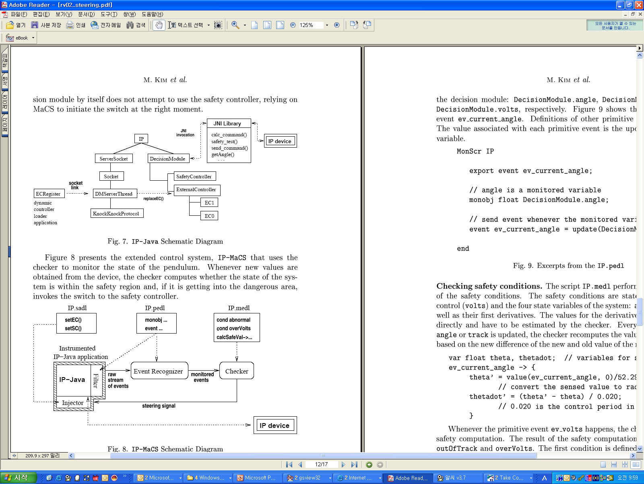
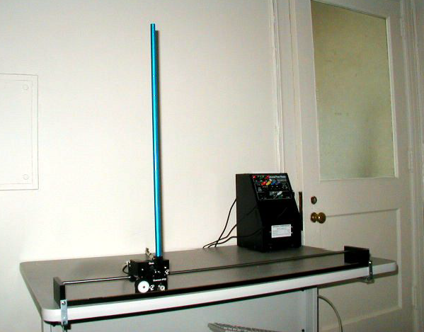
Case Study: Simplex Architecture (cont)
IP-Java
  Raw values are extracted from device driver via JNI
  Experimental controller (EC) registered at run-time
  Checker computes safety conditions and when the safety conditions are violated, switch to safe controller (SC) through injector
26年 11月 8日

Slide 29
Future Works
Loosen the restriction on monitoring objects in Java-MaC
  Combined approach of instrumenting classfiles and modified Java virtual machine
Apply value abstraction in more general way to gain the benefit of abstraction broadly
Language extension for easy property description
Systematic steering activities
Application areas
26年 11月 8日
Notes:
The first one is public release of the MaC prototype.
We need more documentation and friendly user interface like error message and more command line options.
The MaC prototype inserts new code into the program. Thus the execution might be different from the original execution.
-----------------------
Main contribution
Confirming the idea that run-time formal analysis can assure a user of the correctness of program execution in a practical manner through the implementation of the MaC architecture.
Technical contributions
Rigorous analysis
Flexibility
Automation
Easy of use

Slide 30
References
”Information extraction for run-time formal analysis”
  Ph.D Thesis M. Kim 2001
“Java-MaC: a Rigorous Run-time Assurance Tool for Java Programs”
  M. Kim, etc Kluwer Formal Methods in System Design, 2004 (vol 24, no 2)
“End-to-end Deployment of Formal Methodology – a case study on multiple reader/writer program”
  M. Kim and I. Kang, Letters of Software Engineering, Korea Information Processing Society, 2002 (vol 15, no 2)
“Monitoring, checking, and steering of real-time systems”
  M. Kim, etc. Runtime Verification, Copenhagen Denmark July 2002
“Computational Analysis of Run-time Monitoring – Fundamentals of Java-MaC”
  M. Kim, etc. Runtime Verification, Copenhagen Denmark July 2002
Verisim: Formal Analysis of Network Simulations”
  K. Bhargavan, etc IEEE Transaction on SW Engineering, 2002 (vol. 28, no. 2)
“Java-MaC: a Run-time Assurance Tool for Java Programs”
  M. Kim, etc, Runtime Verification Paris France July 2001
26年 11月 8日

