Slide 1
The Spin Model Checker : Part II

Slide 2
Review
Promela
  The system specification language of the Spin model checker
  Syntax is similar to that of C, but simplified
    No float type, no functions, no pointers etc
  Paradigm is similar to that of CCS
    Communication and concurrency
    Clear operational semantics
    Interleaved semantics
    Asynchronous process execution
    Two-way communication
  Unique features not found in programming languages
    Non-determinism (process level and statement level)
    Executability

Slide 3
6 Types of Basic Statements
Assignment: always executable
  Ex. x=3+x, x=run A()
Print: always executable
  Ex. printf(“Process %d is created.\n”,_pid);
Assertion: always executable
  Ex. assert( x + y == z)
Expression: depends on its value
  Ex. x+3>0, 0, 1, 2
  Ex. skip, true
Send: depends on buffer status
  Ex. ch1!m is executable only if ch1 is not full
Receive: depends on buffer status
  Ex. ch1?m is executable only if ch1 is not empty

Slide 4
Critical Section Example
[root@moonzoo spin_test]# ls
crit.pml
[root@moonzoo spin_test]# spin -a crit.pml
[root@moonzoo spin_test]# ls
crit.pml pan.b pan.c pan.h pan.m pan.t
[root@moonzoo spin_test]# gcc pan.c
[root@moonzoo spin_test]# a.out
pan: assertion violated (cnt<=1) (at depth 8)
pan: wrote crit.pml.trail
Full statespace search for:
never claim - (none specified)
assertion violations +
acceptance cycles - (not selected)
invalid end states +
State-vector 36 byte, depth reached 16, errors: 1
119 states, stored
47 states, matched
166 transitions (= stored+matched)
0 atomic steps
hash conflicts: 0 (resolved)
4.879 memory usage (Mbyte)
[root@moonzoo spin_test]# ls
a.out crit.pml crit.pml.trail pan.b pan.c pan.h pan.m pan.t
bool lock;
byte cnt;
active[2] proctype P() {
!lock -> lock=true;
cnt=cnt+1;
printf("%d is in the crt sec!\n",_pid);
cnt=cnt-1;
lock=false;
}
active proctype Invariant() {
assert(cnt <= 1);
}

Slide 5
Critical Section Example (cont.)
[root@moonzoo spin_test]# spin -t -p crit.pml
Starting P with pid 0
Starting P with pid 1
Starting Invariant with pid 2
1: proc 1 (P) line 5 "crit.pml" (state 1) [(!(lock))]
2: proc 0 (P) line 5 "crit.pml" (state 1) [(!(lock))]
3: proc 1 (P) line 5 "crit.pml" (state 2) [lock = 1]
4: proc 1 (P) line 6 "crit.pml" (state 3) [cnt = (cnt+1)]
1 is in the crt sec!
5: proc 1 (P) line 7 "crit.pml" (state 4) [printf('%d is in the crt sec!\\n',_pid)]
6: proc 0 (P) line 5 "crit.pml" (state 2) [lock = 1]
7: proc 0 (P) line 6 "crit.pml" (state 3) [cnt = (cnt+1)]
0 is in the crt sec!
8: proc 0 (P) line 7 "crit.pml" (state 4) [printf('%d is in the crt sec!\\n',_pid)]
spin: line 13 "crit.pml", Error: assertion violated
spin: text of failed assertion: assert((cnt<=1))
9: proc 2 (Invariant) line 13 "crit.pml" (state 1) [assert((cnt<=1))]
spin: trail ends after 9 steps
#processes: 3
lock = 1
cnt = 2
9: proc 2 (Invariant) line 14 "crit.pml" (state 2) <valid end state>
9: proc 1 (P) line 8 "crit.pml" (state 5)
9: proc 0 (P) line 8 "crit.pml" (state 5)
3 processes created

Slide 6
Revised Critical Section Example
bool lock;
byte cnt;
active[2] proctype P() {
atomic{ !lock -> lock=true;}
cnt=cnt+1;
printf("%d is in the crt sec!\n",_pid);
cnt=cnt-1;
lock=false;
}
active proctype Invariant() {
assert(cnt <= 1);
}
[root@moonzoo revised]# a.out
Full statespace search for:
never claim - (none specified)
assertion violations +
acceptance cycles - (not selected)
invalid end states +
State-vector 36 byte, depth reached 14, errors: 0
62 states, stored
17 states, matched
79 transitions (= stored+matched)
0 atomic steps
hash conflicts: 0 (resolved)
4.879 memory usage (Mbyte)

Slide 7
Deadlocked Critical Section Example
[[root@moonzoo deadlocked]# a.out
pan: invalid end state (at depth 3)
(Spin Version 4.2.7 -- 23 June 2006)
Warning: Search not completed
+ Partial Order Reduction
Full statespace search for:
never claim - (none specified)
assertion violations +
acceptance cycles - (not selected)
invalid end states +
State-vector 36 byte, depth reached 4, errors: 1
5 states, stored
0 states, matched
5 transitions (= stored+matched)
2 atomic steps
hash conflicts: 0 (resolved)
4.879 memory usage (Mbyte)
bool lock;
byte cnt;
active[2] proctype P() {
atomic{ !lock -> lock==true;}
cnt=cnt+1;
printf("%d is in the crt sec!\n",_pid);
cnt=cnt-1;
lock=false;
}
active proctype Invariant() {
assert(cnt <= 1);
}

Slide 8
Deadlocked Critical Section Example (cont.)
[root@moonzoo deadlocked]# spin -t -p deadlocked_crit.pml
Starting P with pid 0
Starting P with pid 1
Starting Invariant with pid 2
1: proc 2 (Invariant) line 13 "deadlocked_crit.pml" (state 1) [assert((cnt<=1))]
2: proc 2 terminates
3: proc 1 (P) line 5 "deadlocked_crit.pml" (state 1) [(!(lock))]
4: proc 0 (P) line 5 "deadlocked_crit.pml" (state 1) [(!(lock))]
spin: trail ends after 4 steps
#processes: 2
lock = 0
cnt = 0
4: proc 1 (P) line 5 "deadlocked_crit.pml" (state 2)
4: proc 0 (P) line 5 "deadlocked_crit.pml" (state 2)
3 processes created

Slide 9
Communication Using Message Channels
Spin provides communications through various types of message channels
  Buffered or non-buffered (rendezvous comm.)
  Various message types
  Various message handling operators
Syntax
  chan ch1 = [2] of { bit, byte};
    Sender: ch1!0,10;ch1!1,20
    Receiver: ch1?b,bt;ch1?1,bt
  chan ch2= [0] of {bit, byte}
Sender (1,20) (0,10) Receiver

Slide 10
Operations on Channels
Basic channel inquiry
  len(ch)
  empty(ch)
  full(ch)
  nempty(ch)
  nfull(ch)
Additional message passing operators
  ch?[x,y]: polling only
  ch?<x,y>: copy a message without removing it
  ch!!x,y: sorted sending (increasing order)
    Sender: ch1!7;ch1!2 vs ch1!!7;ch1!!2
  ch??5,y: random receiving
  ch?x(y) == ch?x,y (for user’s understandability)
Be careful to use these operators inside of expressions
  They have side-effects, which spin may not allow

Slide 11
Spin's Runtime Options
moonzoo@verifier4:~/spin$ spin --help
use: spin [-option] ... [-option] file
Note: file must always be the last argument
-A apply slicing algorithm
-a generate a verifier in pan.c
-B no final state details in simulations
-b don't execute printfs in simulation
-C print channel access info (combine with -g etc.)
-c columnated -s -r simulation output
-d produce symbol-table information
-Dyyy pass -Dyyy to the preprocessor
-Eyyy pass yyy to the preprocessor
-e compute synchronous product of multiple never claims
-f "..formula.." translate LTL into never claim
-F file like -f, but with the LTL formula stored in a 1-line file
-g print all global variables
-h at end of run, print value of seed for random nr generator used
-i interactive (random simulation)
-I show result of inlining and preprocessing
-J reverse eval order of nested unlesses
-jN skip the first N steps in simulation trail
-k fname use the trailfile stored in file fname, see also -t
-L when using -e, use strict language intersection
-l print all local variables
-M generate msc-flow in tcl/tk format
-m lose msgs sent to full queues
-N fname use never claim stored in file fname
-nN seed for random nr generator
-O use old scope rules (pre 5.3.0)
-o1 turn off dataflow-optimizations in verifier
-o2 don't hide write-only variables in verifier
-o3 turn off statement merging in verifier
-o4 turn on rendezvous optiomizations in verifier
-o5 turn on case caching (reduces size of pan.m, but affects reachability reports)
-o6 revert to the old rules for interpreting priority tags
-o7 revert to the old rules for semi-colon usage (pre version 6.3)
-Pxxx use xxx for preprocessing
-p print all statements
-pp pretty-print (reformat) stdin, write stdout
-qN suppress io for queue N in printouts
-r print receive events
-replay replay an error trail-file found earlier
if the model contains embedded c-code, the ./pan executable is used
otherwise spin itself is used to replay the trailfile
note that pan recognizes different runtime options than spin itself
-S1 and -S2 separate pan source for claim and model
-s print send events
-T do not indent printf output
-t[N] follow [Nth] simulation trail, see also -k
-Uyyy pass -Uyyy to the preprocessor
-uN stop a simulation run after N steps
-v verbose, more warnings
-w very verbose (when combined with -l or -g)
-[XYZ] reserved for use by xspin interface
-V print version number and exit

Slide 12
-run (or -search) generate a verifier, and compile and run it
options before -search are interpreted by spin to parse the input
options following a -search are used to compile and run the verifier pan
valid options that can follow a -search argument include:
-bfs perform a breadth-first search
-bfspar perform a parallel breadth-first search
-dfspar perform a parallel depth-first search, same as -DNCORE=4
-bcs use the bounded-context-switching algorithm
-bitstate or -bit, use bitstate storage
-biterateN,M use bitstate with iterative search refinement (-w18..-w35)
perform N randomized runs and increment -w every M runs
default value for N is 10, default for M is 1
(use N,N to keep -w fixed for all runs)
(add -w to see which commands will be executed)
(add -W if ./pan exists and need not be recompiled)
-swarmN,M like -biterate, but running all iterations in parallel
-link file.c link executable pan to file.c
-collapse use collapse state compression
-noreduce do not use partial order reduction
-hc use hash-compact storage
-noclaim ignore all ltl and never claims
-p_permute use process scheduling order random permutation
-p_rotateN use process scheduling order rotation by N
-p_reverse use process scheduling order reversal
-rhash randomly pick one of the -p_... options
-ltl p verify the ltl property named p
-safety compile for safety properties only
-i use the dfs iterative shortening algorithm
-a search for acceptance cycles
-l search for non-progress cycles
similarly, a -D... parameter can be specified to modify the compilation
and any valid runtime pan argument can be specified for the verification

Slide 13
Spin's Simulation Feature
spin -p -n<random seed#> *.pml
moonzoo@verifier4:~/spin$ spin -p -n1 faulty_protocol.pml
0: proc - (:root:) creates proc 0 (Mproc)
0: proc - (:root:) creates proc 1 (Wproc)
1: proc 0 (Mproc:1) faulty_protocol.pml:7 (state 1) [W!ini]
2: proc 1 (Wproc:1) faulty_protocol.pml:25 (state 1) [W?ini]
3: proc 1 (Wproc:1) faulty_protocol.pml:26 (state 2) [M!ack]
4: proc 0 (Mproc:1) faulty_protocol.pml:8 (state 2) [M?ack]
5: proc 1 (Wproc:1) faulty_protocol.pml:38 (state 11) [.(goto)]
timeout
6: proc 0 (Mproc:1) faulty_protocol.pml:10 (state 3) [(timeout)]
7: proc 0 (Mproc:1) faulty_protocol.pml:12 (state 4) [W!shutup]
8: proc 1 (Wproc:1) faulty_protocol.pml:33 (state 7) [W?shutup]
9: proc 0 (Mproc:1) faulty_protocol.pml:19 (state 15) [.(goto)]
10: proc 1 (Wproc:1) faulty_protocol.pml:34 (state 8) [M!shutup]
11: proc 1 (Wproc:1) faulty_protocol.pml:35 (state 9) [goto :b1]
12: proc 0 (Mproc:1) faulty_protocol.pml:19 (state 16) [M?shutup]
13: proc 0 (Mproc:1) faulty_protocol.pml:20 (state 17) [W!quiet]
14: proc 1 (Wproc:1) faulty_protocol.pml:38 (state 13) [W?quiet]
15: proc 1 (Wproc:1) faulty_protocol.pml:39 (state 14) [M!dead]
15: proc 1 (Wproc:1) terminates
16: proc 0 (Mproc:1) faulty_protocol.pml:21 (state 18) [M?dead]
16: proc 0 (Mproc:1) terminates
2 processes created
moonzoo@verifier4:~/spin$

Slide 14
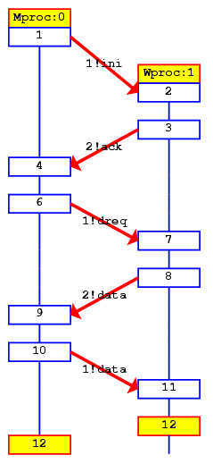
Faulty Data Transfer Protocol
(pg 27, data switch model proposed at 1981 at Bell labs)
mtype={ini,ack, dreq,data, shutup,quiet, dead}
chan M = [1] of {mtype};
chan W = [1] of {mtype};
active proctype Mproc()
{
W!ini; /* connection */
M?ack; /* handshake */
timeout -> /* wait */
if /* two options: */
:: W!shutup; /* start shutdown */
:: W!dreq; /* or request data */
do
:: M?data -> W!data :: M?data-> W!shutup;
break
od
fi;
M?shutup;
W!quiet;
M?dead;
}
active proctype Wproc() {
W?ini; /* wait for ini*/
M!ack; /* acknowledge */
do /* 3 options: */
:: W?dreq-> /* data requested */
M!data /* send data */
:: W?data-> /* receive data */
skip /* no response */
:: W?shutup->
M!shutup; /* start shutdown*/
break
od;
W?quiet;
M!dead;
}
Channel W
Mproc
Wproc
Channel M

Slide 15
The Sieve of Eratosthenes (pg 326)
/*
The Sieve of Eratosthenes (c. 276-196 BC)
Prints all prime numbers up to MAX
*/
#define MAX 25
mtype = { number, eof };
chan root = [0] of { mtype, int };
init
{ int n = 2;
run sieve(root, n);
do
:: (n < MAX) -> n++; root!number(n)
:: (n >= MAX) -> root!eof(0); break
od
}
proctype sieve(chan c; int prime)
{ chan child = [0] of { mtype, int };
bool haschild; int n;
printf("MSC: %d is prime\n", prime);
end: do
:: c?number(n) ->
if
:: (n%prime) == 0 -> printf("MSC: %d = %d*%d\n", n, prime, n/prime)
:: else ->
if
:: !haschild -> /* new prime */
haschild = true;
run sieve(child, n);
:: else ->
child!number(n)
fi;
fi
:: c?eof(0) -> break
od;
if
:: haschild -> child!eof(0)
:: else
fi
}

Slide 16


Slide 17
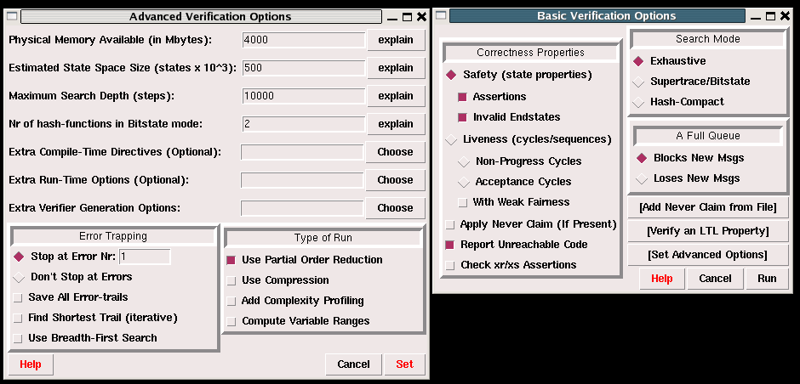
Options in XSPIN
Now you have learned all necessary techniques to verify common problems in the SW development

