Slide 1
Linear Temporal Logic
Moonzoo Kim
School of Computing
KAIST

Slide 2
Motivation for verification
There is a great advantage in being able to verify the correctness of computer systems
  This is most obvious in the case of safety-critical systems
    ex. Cars, avionics, medical devices
  Also applies to mass-produced embedded devices
    ex. handphone, USB memory, MP3 players, etc
Formal verification can be thought of as comprising three parts
  a system description language
  a requirement specification language
  a verification method to establish whether the description of a system satisfies the requirement specification.

Slide 3
Model checking
Model checking
  In a model-based approach, the system is represented by a model M . The specification is again represented by a formula Φ.
    The verification consists of computing whether M satisfies Φ M ╞Φ
      Caution: M ╞Φ represents satisfaction, not semantic entailment
In model checking,
  The model M is a transition systems and
  the property Φ is a formula in temporal logic
    ex. p, q, } q, } q
p
p
p,q

Slide 4
Linear time temporal logic (LTL)
LTL models time as a sequence of states, extending infinitely into the future
  sometimes a sequence of states is called a computation path or an execution path, or simply a path
Def 3.1 LTL has the following syntax
  Φ ::= T | ? | p | : Φ | Φ ∧ Φ | Φ ∨ Φ | Φ ! Φ
    | X Φ | F Φ | G Φ | Φ U Φ | Φ W Φ | Φ R Φ
    where p is any propositional atom from some set Atoms
  Operator precedence
    the unary connectives bind most tightly. Next in the order come U, R, W, ∧, ∨, and !
F p ! G r Ç : q U p
!
F
Ç
p
G
U
r
:
p
q

Slide 5
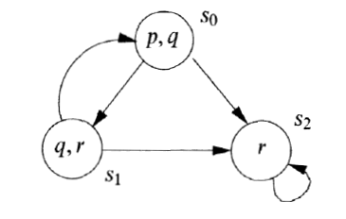
Semantics of LTL (1/3)
Def 3.4 A transition system (called model) M = (S, !, L)
  a set of states S
  a transition relation ! (a binary relation on S)
    such that every s 2 S has some s’ 2 S with s ! s’
  a labeling function L: S ! P (Atoms)
Example
  S={s₀,s₁,s₂}
  !={(s₀,s₁),(s₁,s₀),(s₁,s₂),(s₀,s₂),(s₂,s₂)}
  L={(s₀,{p,q}),(s₁,{q,r}), (s₂,{r})}
Def. 3.5 A path in a model M = (S, !, L) is an infinite sequence of states s_{i1}, s_{i2}, s_{i3},… in S s.t. for each j¸ 1, s_{ij}! s_{ij+1}. We write the path as s_{i1}! s_{i2} ! …
  From now on if there is no confusion, we drop the subscript index i for the sake of simple description
We write ¼^{i} for the suffix of a path starting at s_{i.}
  ex. ¼³ is s₃ ! s₄ ! …

Slide 6
Semantics of LTL (2/3)
Def 3.6 Let M = (S, !, L) be a model and ¼ = s₁ ! … be a path in M. Whether ¼ satisfies an LTL formula is defined by the satisfaction relation ╞as follows:
  Basics: ¼ ²>, ¼ 2?, ¼ ²p iff p 2 L(s₁) , ¼ ╞:Φ iff ¼ 2 Φ
  Boolean operators: ¼ ╞p ∧ q iff ¼ ╞p and ¼ ╞q
    similar for other boolean binary operators
  ¼ ╞X Φ iff ¼² ╞Φ (next °)
  ¼ ╞G Φ iff for all i ¸ 1, ¼^{i} ╞Φ (always )
  ¼ ╞F Φ iff there is some i ¸ 1, ¼^{i} ╞Φ (eventually })
  ¼ ╞Φ U Ã iff there is some i ¸ 1s.t. ¼^{i} ╞Ã and for all j=1,…,i-1 we have ¼^{j} ╞Φ (strong until)
  ¼ ╞Φ W Ã iff either (weak until)
    either there is some i ¸ 1 s.t. ¼^{i} ╞Ã and for all j=1,…,i-1 we have ¼^{j} ╞Φ
    or for all k ¸ 1 we have ¼^{k} ╞Φ
  ¼ ╞Φ R Ã iff either (release)
    either there is some i ¸ 1 s.t. ¼^{i} ╞Φ and for all j=1,…,i we have ¼^{j} ╞Ã
    or for all k ¸ 1 we have ¼^{k} ╞Ã

Slide 7
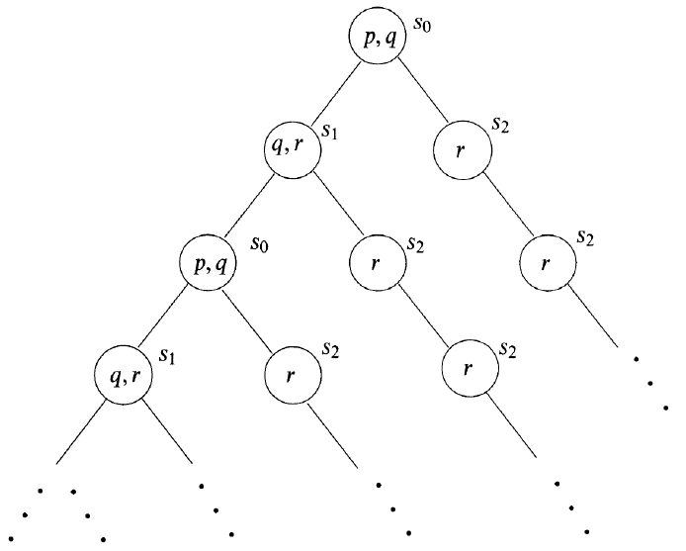
Semantics of LTL (3/3)
Def 3.8 Suppose M = (S, !, L) is a model, s 2 S, and Φ an LTL formula. We write M,s ╞Φ if for every execution path ¼ of M starting at s, we have ¼ ╞Φ
  If M is clear from the context, we write s ╞Φ
Example
  s₀ ╞p ∧ q since ¼ ╞p ∧ q for every path ¼ beginning in s₀
  s₀ ╞:r, s₀ ╞>
  s₀ ╞X r, s₀ 2 X (q ∧ r)
  s₀ ╞G :(p ∧ r), s₂ ╞G r
  For any s of M, s ╞F(:q ∧ r) ! F G r
    Note that s₂ satisfies :q ∧ r
  s₀ 2 G F p
    s₀ ! s₁ ! s₀ ! s₁ … ╞G F p
    s₀ ! s₂ ! s₂ ! s₂ … 2 G F p
  s₀ ╞G F p ! G F r
  s₀ 2 G F r ! G F p
M

Slide 8
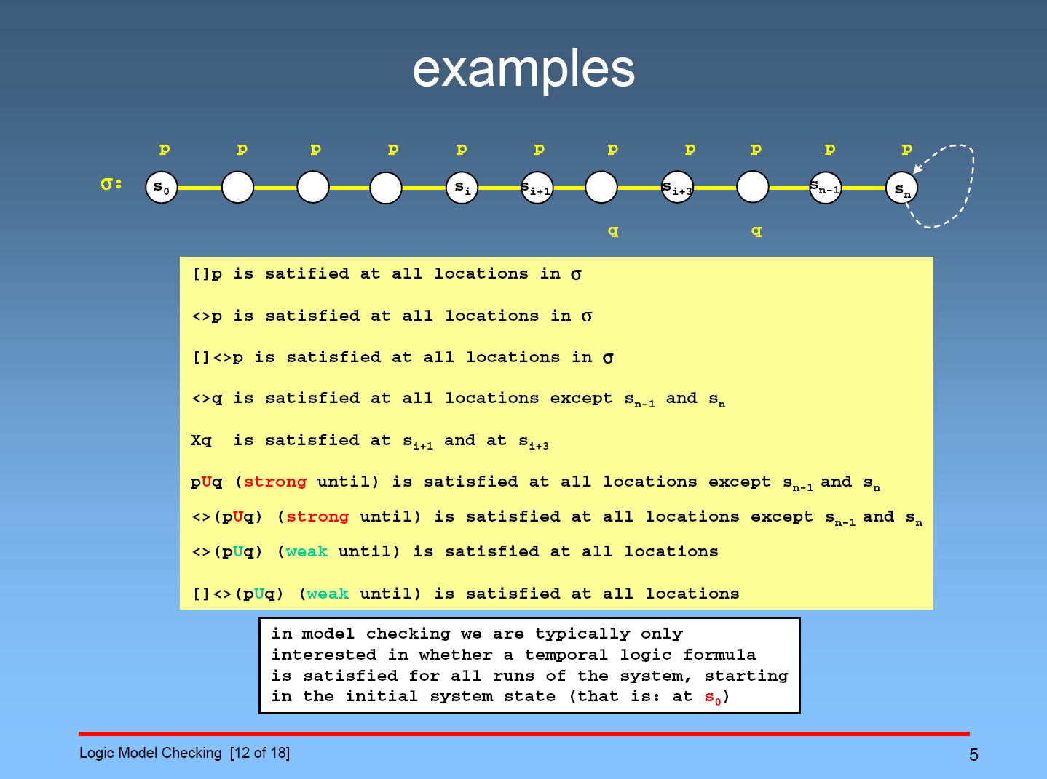
slide quoted from Caltech 101b.2 “Logic Model Checking” by Dr.G.Holzmann

Slide 9
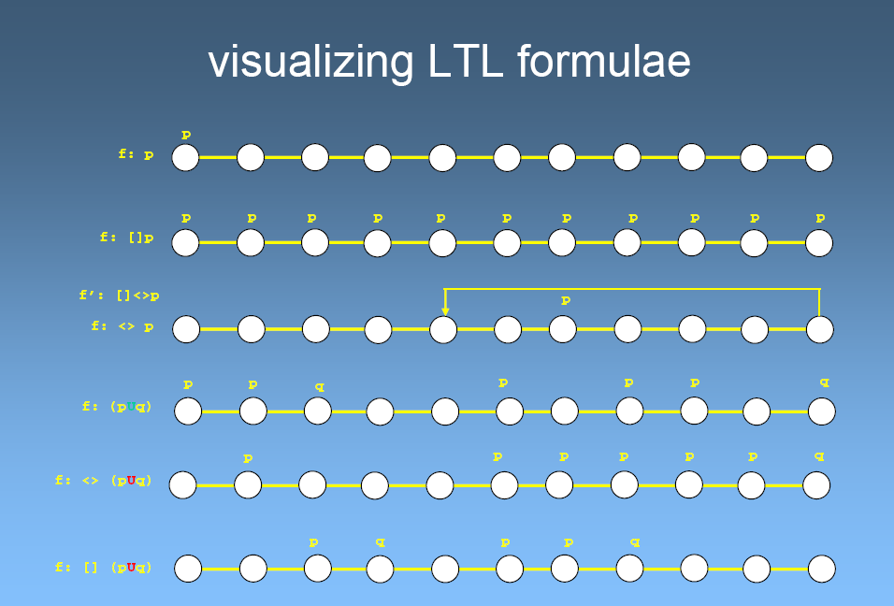
slide quoted from Caltech 101b.2 “Logic Model Checking” by Dr.G.Holzmann

Slide 10
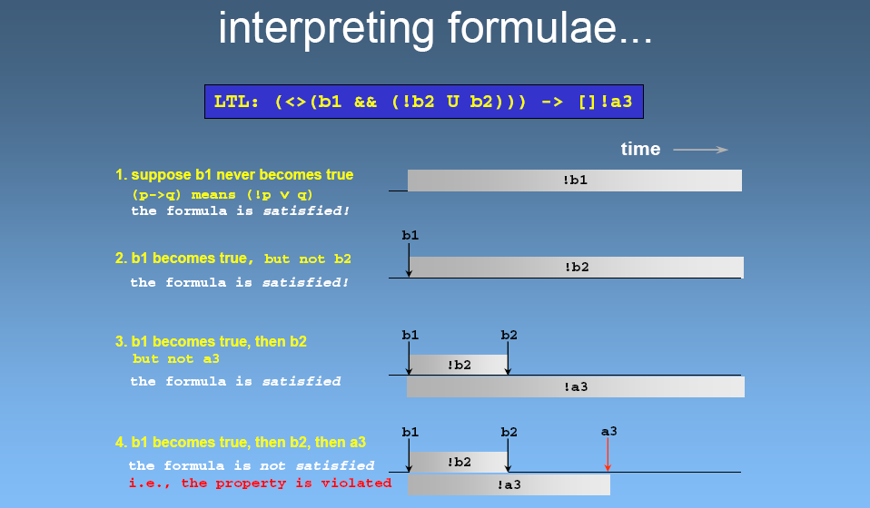
slide quoted from Caltech 101b.2 “Logic Model Checking” by Dr.G.Holzmann

Slide 11
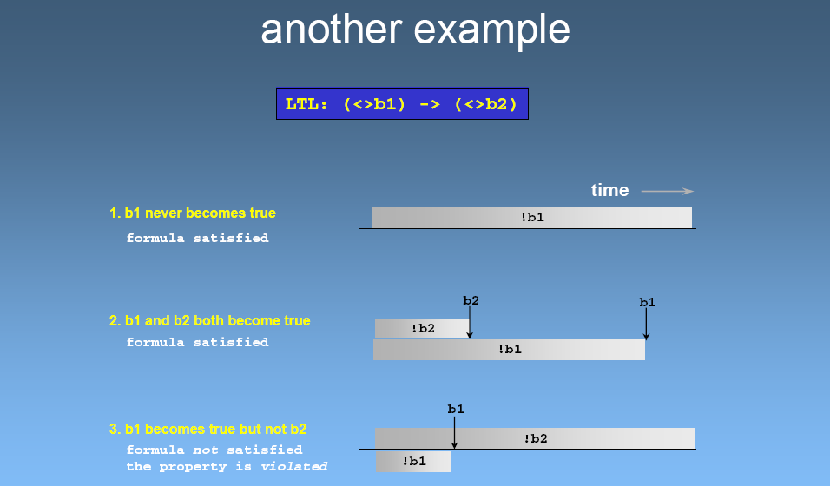
slide quoted from Caltech 101b.2 “Logic Model Checking” by Dr.G.Holzmann

Slide 12
Equivalences between LTL formulas
Def 3.9 Φ ≡ Ã if for all models M and all paths ¼ in M: ¼ ╞Φ iff ¼ ╞Ã
:G Φ ≡ F :Φ, :F Φ ≡ G :Φ, :X Φ ≡ X :Φ
: (Φ U Ã) ≡ :Φ R :Ã, :(Φ R Ã) ≡ :Φ U :Ã
F (Φ ∨ Ã) ≡ F Φ ∨ F Ã
G (Φ ∧ Ã) ≡ G Φ ∧ G Ã
F Φ ≡ T U Φ, G Φ ≡ ? R Φ
Φ U Ã ≡ Φ W Ã ∧ F Ã
Φ W Ã ≡ Φ U Ã ∨ G Φ
Φ W Ã ≡ Ã R (Φ ∨ Ã)
Φ R Ã ≡ Ã W (Φ ∧ Ã)

Slide 13
Practical patterns of specification
For any state, if a request occurs, then it will eventually be acknowledge
  G(requested ! F acknowledged)
A certain process is enabled infinitely often on every computation path
  G F enabled
Whatever happens, a certain process will eventually be permanently deadlocked
  F G deadlock
If the process is enabled infinitely often, then it runs infinitely often
  G F enabled ! G F running
An upwards traveling lift at the second floor does not change its direction when it has passengers wishing to go to the fifth floor
  G (fllor2 ∧ directionup ∧ ButtonPressed5 ! (directionup U floor5)
It is impossible to get to a state where a system has started but is not ready
  Φ = G :(started ∧ :ready)
  What is the meaning of (intuitive) negation of Φ ?
    For every path, it is possible to get to such a state (started ∧ :ready).
    There exists a such path that gets to such a state.
      we cannot express this meaning directly
LTL has limited expressive power
  For example, LTL cannot express statements which assert the existence of a path
    From any state s, there exists a path ¼ starting from s to get to a restart state
    The lift can remain idle on the third floor with its doors closed
  Computation Tree Logic (CTL) has operators for quantifying over paths and can express these properties

Slide 14
Summary of practical patterns
G p | always p | invariance
F p | eventually p | guarantee
p ! (F q) | p implies eventually q | response
p ! (q U r) | p implies q until r | precedence
G F p | always, eventually p | recurrence (progress)
F G p | eventually, always p | stability (non-progress)
F p ! F q | eventually p implies eventually q | correlation

