Slide 1
Equivalence Semantics of CCS
Moonzoo Kim
School of Computing
KAIST

Slide 2
Oultline
Trace Equivalence
Observational Trace Equivalence
Bisimulation Equivalence
Observational Bisimulation Equivalence
May Preorder and Must Preorder
Example
Usage of Concurrent Workbench

Slide 3
Trace Equivalence
Sys is a design for buffer with separated input/output ports
  Sys= (Buf₁ | Buf₂)\{comm₁,comm₂}
    Buf₁ = in.comm₁’.Buf₁’, Buf₁’ = comm₂.Buf₁
    Buf₂ = comm₁.Buf₂’,Buf₂’= out’.comm₂’.Buf₂
Spec is a requirement for the buffer design
  Spec = in.Spec’, Spec’=out’.Spec
Sys= (Buf1 | Buf2)\{comm₁,comm₂}
comm₁
in
out
Buf₁
Buf₂
comm₂
Spec= in.out.Spec
in
out
Question: Sys == Spec?
  Let us consider trace equivalence (i.e. language equivalence) =_{T}
    T(P) = { s ∈ Act*| s is an execution trace of P}
    P =_{T} Q iff T(P) = T(Q)

Slide 4
Observational Trace Equivalence
Sys =_{T} Spec?
  No. Sys has τ which Spec does not
    T(Sys) = {in, in.τ, in.τ.out’ , in.τ.out’.τ,…}
    T(Spec) = {in , in.out’ …}
  Yes. τ is an internal hidden action not visible outside (not observable). Thus, τ should not be included in an execution
    If s∈Act*, then ŝ ∈(Act –{τ})* is the action sequence obtained by deleting all occurrences of τ from s.
      Ex> s = a.τ.b.τ.c, then ŝ = a.b.c
    A set of observable execution traces: T’(P) = {ŝ | s ∈ T(P)}
    P =_{OT} Q iff T’(P) = T’(Q)
    Sys =_{OT} Spec because T’(Sys) = {in, in.out’,…}, T’(Spec) = {in, in.out’, …}
  Sys= (Buf1 | Buf2)\{comm1,comm2}
  Buf1 = in.comm1.Buf1’, Buf1’ = comm2.Buf1
  Buf2 = comm1’.Buf2’,Buf2’=out.comm2’.Buf2
    Spec = in.out.Spec
Sys = (Buf₁|Buf₂)
\{comm₁,comm₂}
in
in
τ
Spec
Spec’
τ
out’
out’
(Buf₁’|Buf₂’)\{comm₁,comm₂}

Slide 5
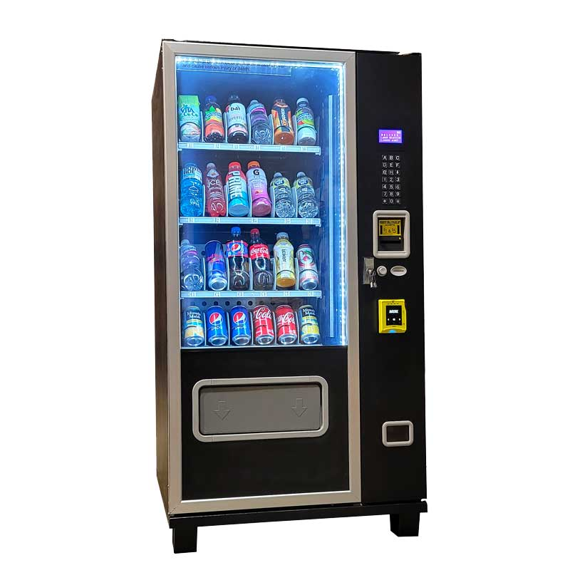
Importance of Branching Behavior
Which vending machine do you prefer?
p? q? r?
p
r
q
coin
coin
coin
coin
coin
p1
q1
q2
cola
Juice
cola
Juice
cola
cola
juice
p11
q11
q21
p12

Slide 6
Bisimulation Equivalence
P =_{BS} Q iff for all α∈Act
  Whenever P -α-> P’, then for some Q’, Q -α-> Q’ and P’ =_{BS} Q’
  Whenever Q -α-> Q’, then for some P’, P -α-> P’ and P’ =_{BS} Q’
Note
  =_{BS} is an equivalence relation (reflexive, transitive, symmetric)
  P =_{BS} Q implies P =_{T} Q, but not vice versa
Example>
  C₀ = b’.C₁+a.C₂, C₁=a.C₃,C₂=b’.C₃, C₃ = b’.C₁+a.C₂
  D₀ = b’.D₁ +a.D₂ , D₁=a.D₀, D₂=b’.D₀
  A binary relation R proves that C₀ =_{BS} D₀
    R = {(C₀,D₀), (C₁,D₁), (C₂,D₂), (C₃,D₀)}
C₀
b’
a
D₀
a
b’
a
b’
C₁
C₂
D₁
D₂
a
b’
a
b’
C₃

Slide 7
Observational Bisimulation Equivalence
We cannot simply ignore τ for observational bisimulation equivalence. Thus, we define a new observational transition =α=>
P =_{OBS} Q iff for all α∈Act
  Whenever P =α=> P’, then for some Q’, Q =α=> Q’ and P’ =_{OBS} Q’
  Whenever Q =α=> Q’, then for some P’, P =α=> P’ and P’ =_{OBS} Q’
P =α=> Q iff P (-τ->)*-α->(-τ->)* Q where α ∈Act-{τ}
  Let s∈(Act-{τ})*. Then q =s=> q’ if there exists s’ s.t. q-s’->q’ and s=ŝ’
  P = a.P + b.P, Q1=a.Q1 + τ.Q2, Q2=b.Q1
    Suppose that ’a’ means pushing button ’a’. Similarly for ’b’
      P always allows a user to push any buttons.
      Q1 allows a user to push button ’a’ sometimes, button ’b’ sometimes.
    Thus, we need to distinguish P from Q1 (P and Q1 are not observationally bisimilar), which can be done using =α=> instead of -α->
      Q1-a->Q1 implies Q1=a=>Q1. Similary Q2-b->Q1 implies Q2=b=>Q1
      Q1-a->Q1-τ->Q2 implies Q1=a=>Q2. Q2-b->Q1- τ->Q2 implies Q2=b=>Q2
a
b
a
b
P
P
a
Q1
b
Q2
a, b
Q1
b
Q2
b
τ
a,b

Slide 8
Observational Bisimulation Equivalence (cont)
Sys =_{BS} Spec? (see slide 3)
  No. Sys has τ which Spec does not (i.e. not strongly bisimilar)
Sys =_{OBS} Spec?
  Yes. Sys is observationally bismilar to Spec
    Proof: R = { (s0,Spec), (s1,Spec’),(s3,Spec),(s2,Spec’)}
      s0 –in->s1 implies s0=in=> s1. Similarly, s2-out->s3 implies s2=out=>s3
      s0 -in->s1 -τ->s2 implies s0=in=>s2.
      s2-out->s3-τ-> s0 implies s2=out=>s0
Sys = (Buf₁|Buf₂)
\{comm₁,comm₂}
in
s1
in
s1
s0
s0
out
Spec
in
out
τ
τ
out
in
in
in
out
s3
out
s2
s3
out
s2
Spec’
(Buf₁’|Buf₂’)
\{comm₁,comm₂}

Slide 9
CWB-NC Commands
load <ccs filename>
help <command>
ls
cat <process>
compile <process>
es <script file> <output file>
eq –S <trace|bisim|obseq> <proc1> <proc2>
le –S may <proc1> <proc2> /* Trace subset relation */
sim <process>
  semantics <bisim|obseq>
  random <n>
  back <n>
  break <act list>
  history
  quit
quit

