Slide 1
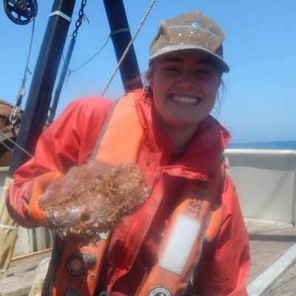
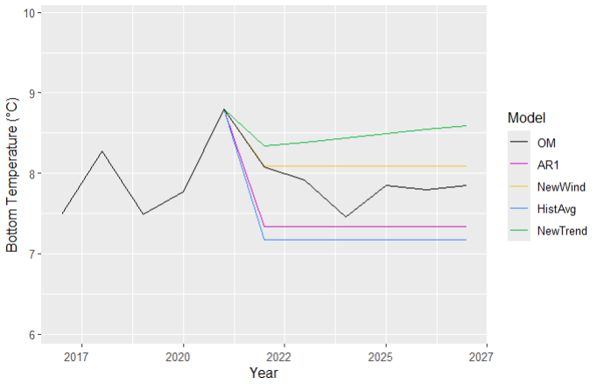
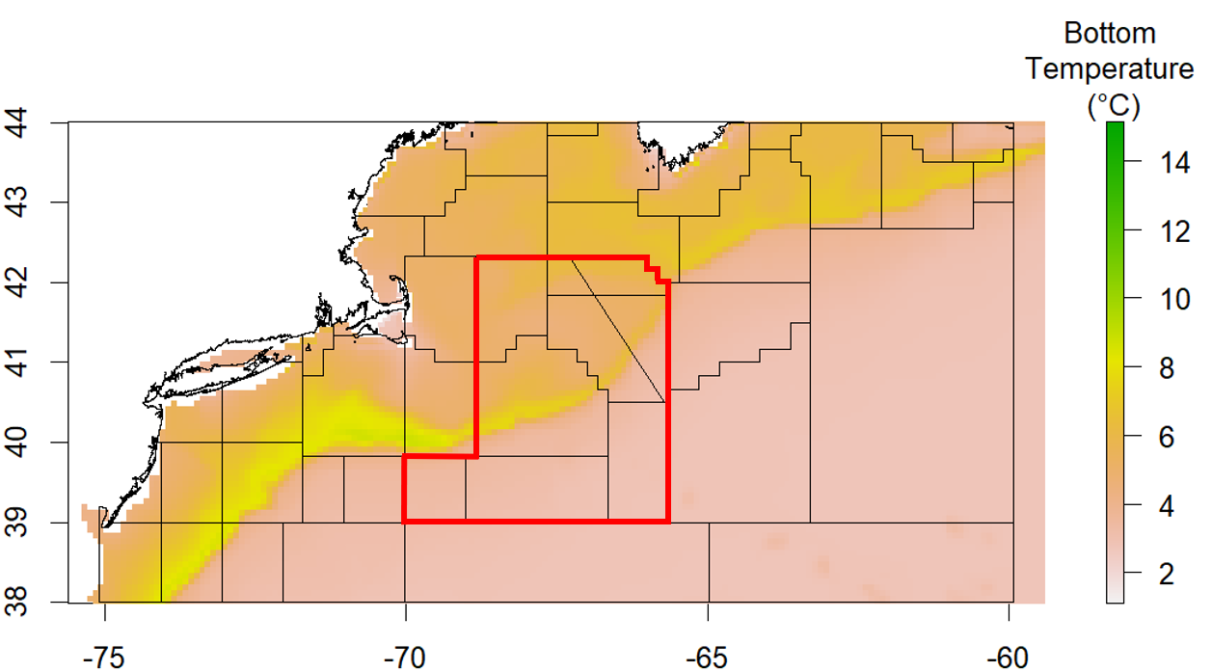
APPLYING EFFECTIVE ENVIRONMENTAL FORECASTS TO MANAGEMENT STRATEGY EVALUATION OF YELLOWTAIL FLOUNDER
Sophie Wulfing¹, Gavin Fay,¹ Scott I. Large², Vincent Saba²
¹School for Marine Science and Technology, University of Massachusetts Dartmouth, ²NOAA Northeast Fisheries Science Center
Contact: swulfing@umassd.edu
Introduction
Assessment Estimate Period
Projection Period
PROJECTIONS
Stock-specific responses to climate change creates challenges for stock assessors and the fishing industry and a need to forecast effects of climate change on fish stocks.
Management Strategy Evaluation (MSE) is a modeling framework that simulates the outcomes of management decisions.
This study’s objectives are to test how different choices for projecting environmental covariates within stock assessment affect long-term fishery outcomes.
← Figure 3: Example temperature Projections that will be used by each EM in each Evaluation Event. The red line denotes the first evaluation event, where they models now rely on temperature projections for the environmental covariate
OM Projection – Operating Model. This is the “real” condition of the fishery that will be used to simulate stock growth and ocean conditions. The estimation models will update bottom temperatures from the OM every MSE period.
AR1 – AutoRegressive(1) estimation process uses a linear regression of the current values of the time series on the previous value. This is an automatic setting in the WhamMSE package.
NewWind – Newest Window. This projection uses the average temperature from the last five years as its projection
HistAvg – Historical Average. Uses the average of the whole data series
NewTrend – Newest Trend. This projection uses the linear regression of last five years of temperature data to project temperature.
NoTemp – No temperature (not pictured). No Environmental covariate is used in this projection.
BLAH BLAH BLAH BLHA
METHODS – DATA
Using Georges Bank Yellowtail Flounder (Limanda ferruginea) as a case study, this stock is currently overfished, and their recruitment is known to be sensitive to bottom temperature (Hyun et al 2014; Chen et al 2024).
We will use temperature forecasts from the Modular Ocean Model (MOM6) (Ross et al 2021) to use as our OM environmental covariate.
Using the Wood’s Hole Assessment Model (WHAM) and the whamMSE R package (Stock & Miller 2021; Li 2025). We will update these packages such that new temperature data is incorporated with each MSE period, simulating periodic stock assessments.
NEXT STEPS
↑ Figure 1: Example of bottom temperature data from MOM6. The Yellowtail Georges Bank Stock Area is outlined in red
Once the whamMSE package has been properly updated, we will create a series of tradeoff plots to assess the benefits and disadvantages of the catch advice created in the Evaluations
This research then can be expanded to additional species which have been shown to exhibit different responses beyond recruitment (e.g. growth, natural mortality) or species that respond to different environmental covariates (e.g. Cold Pool Indices, seasonal oscillations)
Estimation Model Projections
Evaluation 1
Model fit to historical temperature data
Evaluation 2
2022-2025 temperature data incorporated from om
Evaluation 3
2025-2028 temperature data incorporated from om
Evaluation Continued…
References
Chen, Y., Maguire, J.J., Dickey-Collas, M., Kempf, A. (2022). Summary Report of the Yellowtail Flounder Research Track Stock Assessment. Northesast Fisheries Science Center, Woods Hole, Massachusetts.
Hyun, S.Y., Cadrin, S.X., Roman, S. (2014). Fixed and mixed effect models for fishery data on depth distribution of Georges Bank yellowtail flounder. Fisheries Research, 157, 186-186.
Li C (2025). _whamMSE: Management Strategy Evaluation Tool of Woods Hole Assessment Model (WHAM)_. R package version 1.0.0, commit 1397998b05eae9b4766c6fa0377114b3e675461e, <https://github.com/lichengxue/whamMSE>.
Ross, A. C., Stock, C. A., Adcroft, A., Curchitser, E., Hallberg, R., Harrison, M. J., Hedstrom, K., Zadeh, N., Alexander, M., Chen, W., Drenkard, E. J., du Pontavice, H., Dussin, R., Gomez, F., John, J. G., Kang, D., Lavoie, D., Resplandy, L., Roobaert, A., Saba, V., Shin, S.-I., Siedlecki, S., and Simkins, J.: A high-resolution physical–biogeochemical model for marine resource applications in the northwest Atlantic (MOM6-COBALT-NWA12 v1.0). (2013). Geosci. Model Dev., 16, 6943–6985, https://doi.org/10.5194/gmd-16-6943-2023.
Stock, B. C., and Miller, T. J. 2021. The Woods Hole Assessment Model (WHAM):
A general state-space assessment framework that incorporates time- and
age-varying processes via random effects and links to environmental
covariates. Fisheries Research, 240: 105967. doi:10.1016/j.fishres.2021.105967
EM projects catch advice 2022-2025
EM projects catch advice 2025-2028
EM projects catch advice 2028-2031
Operating Model Projection
↑ Figure 2: Visualization of the MSE process used in our analysis where at each evaluation, the Estimation Model (EM) incorporates the previous three years of temperature data into its assessment and catch advice for the next three years.

