Slide 1
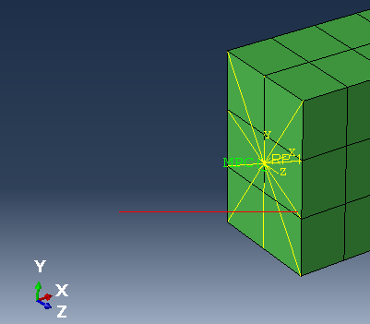
„MPC “ connecting DOFs of Node with DOFs of Reference Point RP1

