Slide 1
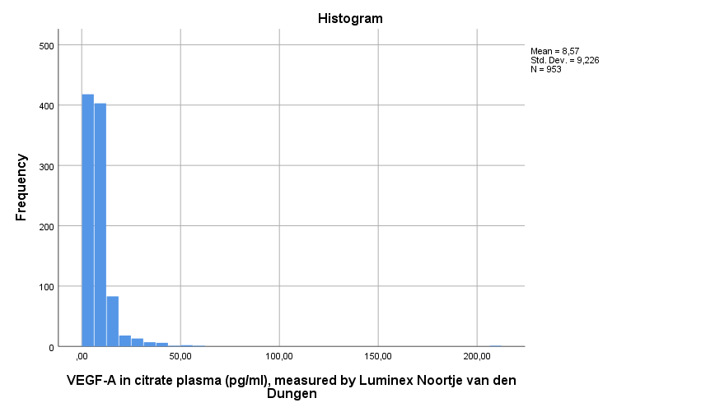
Histogram VEGF-A Noortje

Slide 2
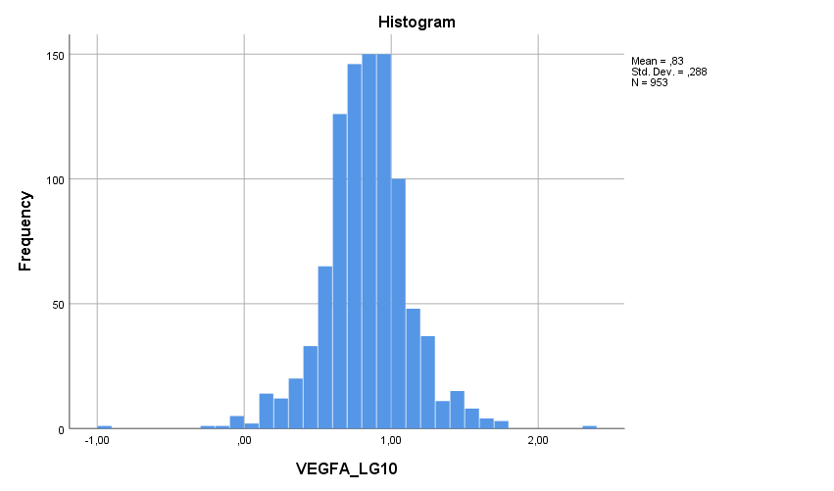
Histogram Log10_VEGFA Noortje
Tests of Normality
 | Kolmogorov-Smirnovª |  |  | Shapiro-Wilk
 | Statistic | df | Sig. | Statistic | df | Sig.
VEGFA_LG10 | ,051 | 953 | ,000 | ,972 | 953 | ,000
a. Lilliefors Significance Correction

Slide 3
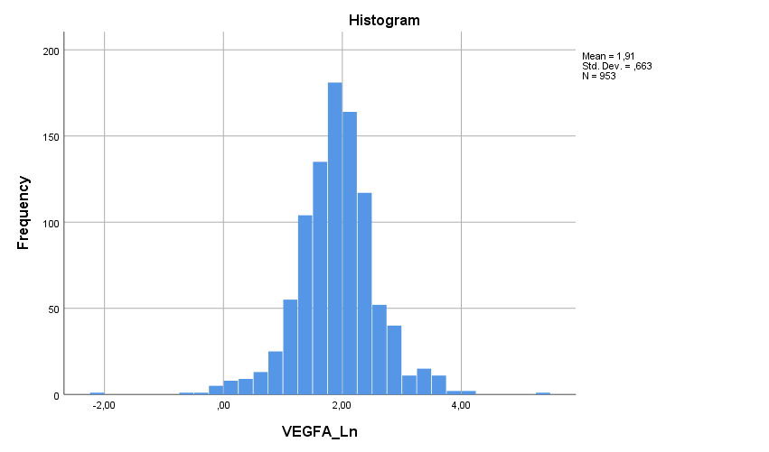
Histogram Ln_VEGFA Noortje
Tests of Normality
 | Kolmogorov-Smirnovª |  |  | Shapiro-Wilk
 | Statistic | df | Sig. | Statistic | df | Sig.
VEGFA_Ln | ,051 | 953 | ,000 | ,972 | 953 | ,000
a. Lilliefors Significance Correction

Slide 4
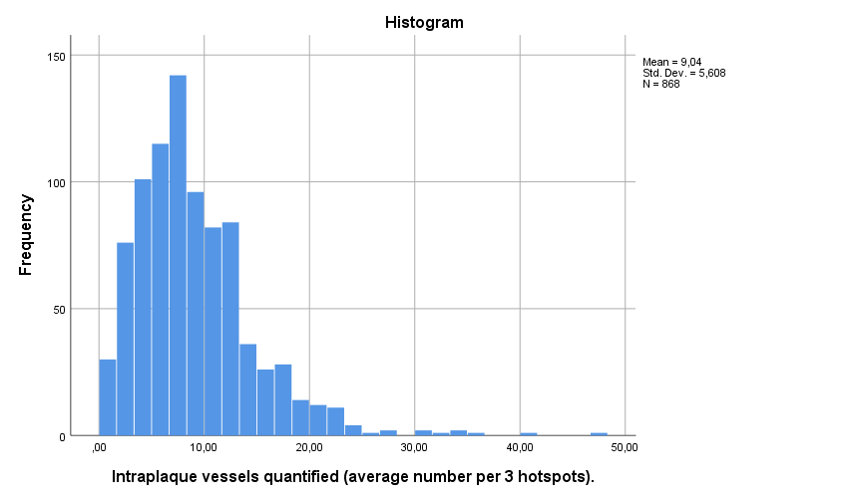
Intraplaque vessel density

Slide 5
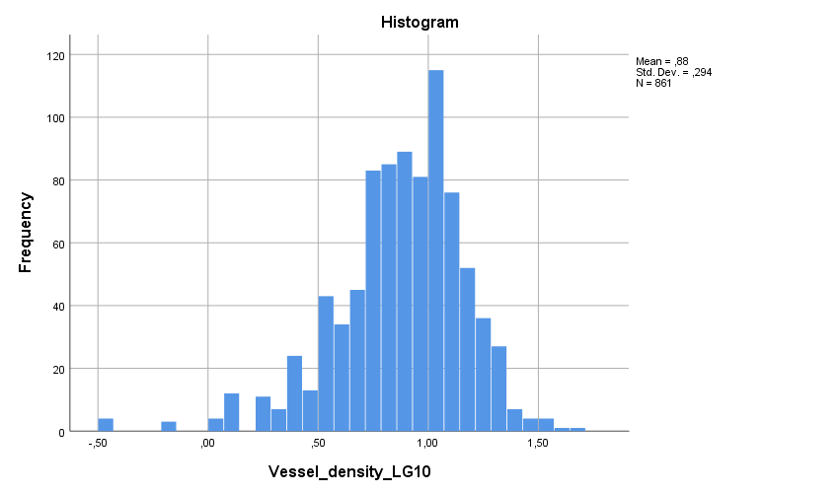
Log10_Intraplaque vessel density
Tests of Normality
 | Kolmogorov-Smirnovª |  |  | Shapiro-Wilk
 | Statistic | df | Sig. | Statistic | df | Sig.
Vessel_density_LG10 | ,074 | 861 | ,000 | ,955 | 861 | ,000
a. Lilliefors Significance Correction

Slide 6
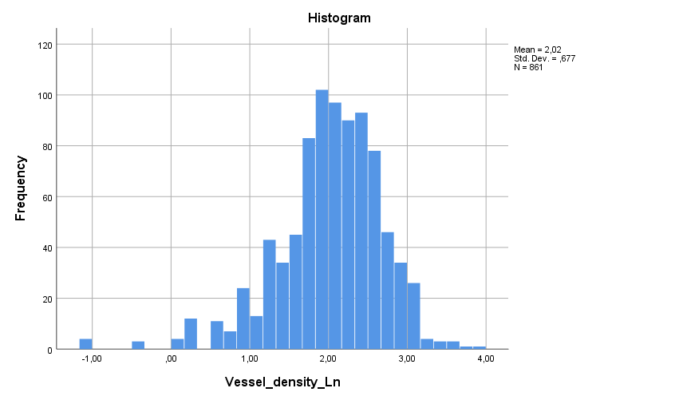
Ln_Intraplaque vessel density
Tests of Normality
 | Kolmogorov-Smirnovª |  |  | Shapiro-Wilk
 | Statistic | df | Sig. | Statistic | df | Sig.
Vessel_density_Ln | ,074 | 861 | ,000 | ,955 | 861 | ,000
a. Lilliefors Significance Correction

Slide 7
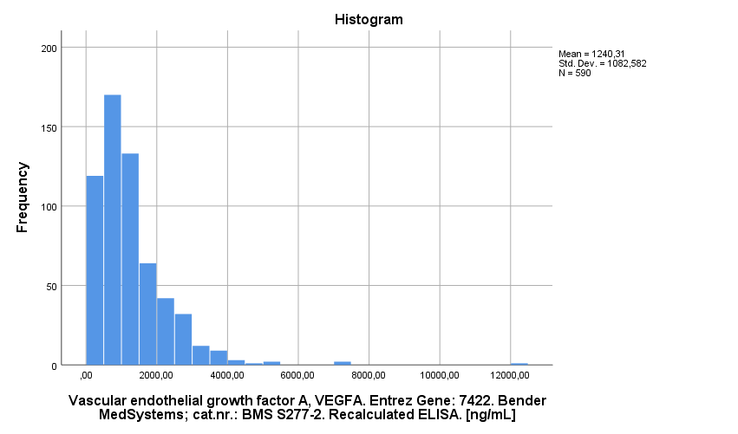
VEGFA

Slide 8
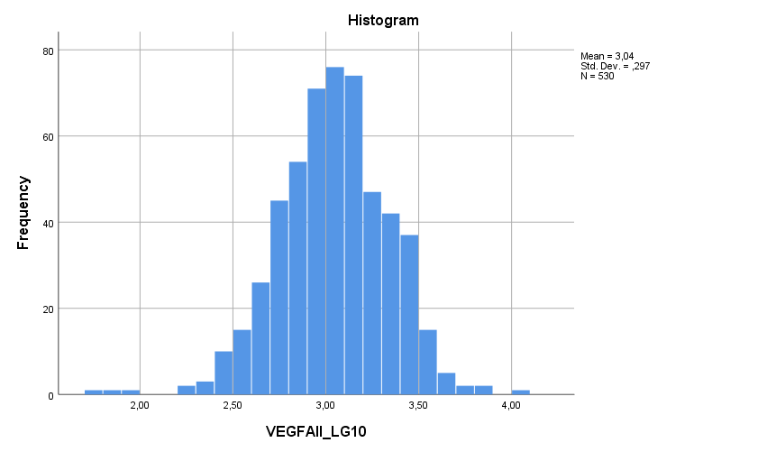
Lg10_VEGFA
Tests of Normality
 | Kolmogorov-Smirnovª |  |  | Shapiro-Wilk
 | Statistic | df | Sig. | Statistic | df | Sig.
VEGFAII_LG10 | ,033 | 530 | ,200* | ,990 | 530 | ,001
*. This is a lower bound of the true significance.
a. Lilliefors Significance Correction
Tests of Normality
 | Kolmogorov-Smirnovª |  |  | Shapiro-Wilk
 | Statistic | df | Sig. | Statistic | df | Sig.
VEGFAII_LG10 | ,033 | 530 | ,200* | ,990 | 530 | ,001
*. This is a lower bound of the true significance.
a. Lilliefors Significance Correction

Slide 9
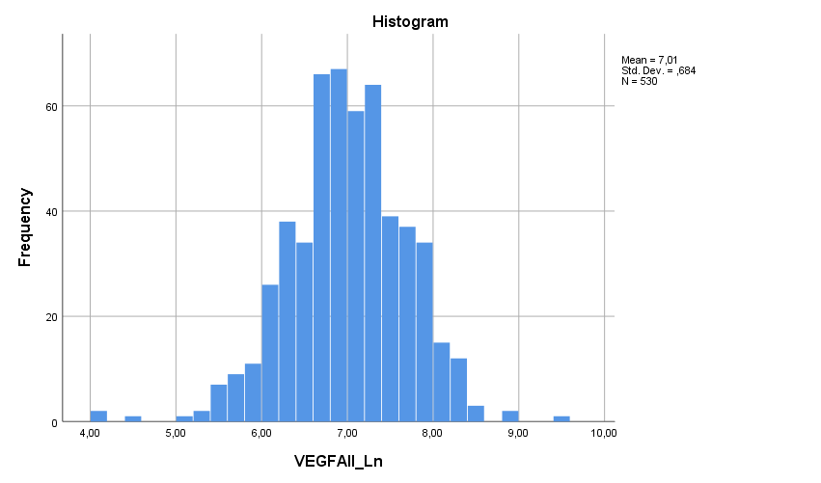
Ln_VEGFA
Tests of Normality
 | Kolmogorov-Smirnovª |  |  | Shapiro-Wilk
 | Statistic | df | Sig. | Statistic | df | Sig.
VEGFAII_Ln | ,033 | 530 | ,200* | ,990 | 530 | ,001
*. This is a lower bound of the true significance.
a. Lilliefors Significance Correction

Slide 10
AEGS Type 1

Slide 11
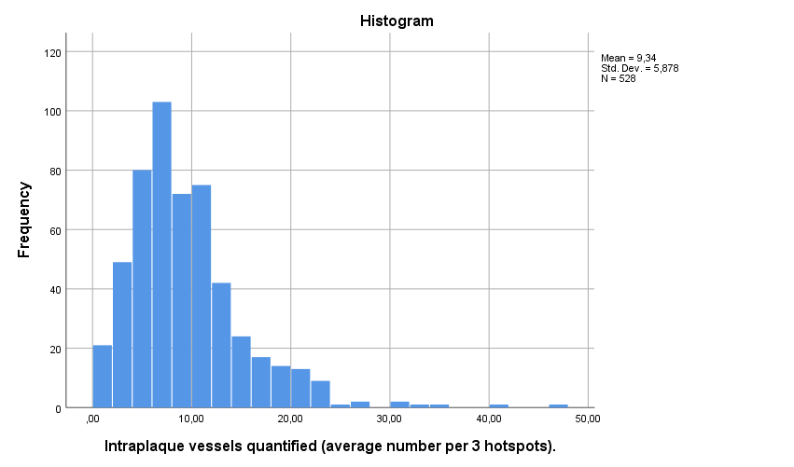
Intraplaque vessels
Tests of Normality
 | Kolmogorov-Smirnovª |  |  | Shapiro-Wilk
 | Statistic | df | Sig. | Statistic | df | Sig.
Intraplaque vessels quantified (average number per 3 hotspots). | ,110 | 528 | ,000 | ,890 | 528 | ,000
a. Lilliefors Significance Correction

Slide 12
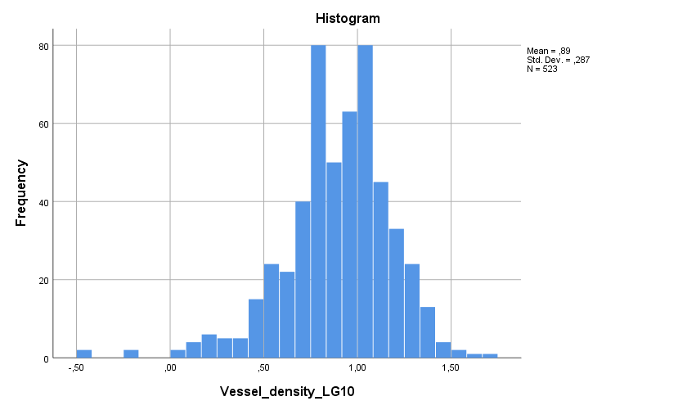
Vessel density_Log10
Tests of Normality
 | Kolmogorov-Smirnovª |  |  | Shapiro-Wilk
 | Statistic | df | Sig. | Statistic | df | Sig.
Vessel_density_LG10 | ,074 | 523 | ,000 | ,961 | 523 | ,000
a. Lilliefors Significance Correction

Slide 13
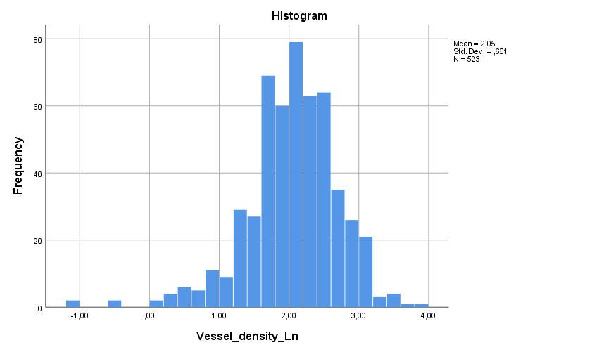
Vessel density_Ln10
Tests of Normality
 | Kolmogorov-Smirnovª |  |  | Shapiro-Wilk
 | Statistic | df | Sig. | Statistic | df | Sig.
Vessel_density_Ln | ,074 | 523 | ,000 | ,961 | 523 | ,000
a. Lilliefors Significance Correction

Slide 14
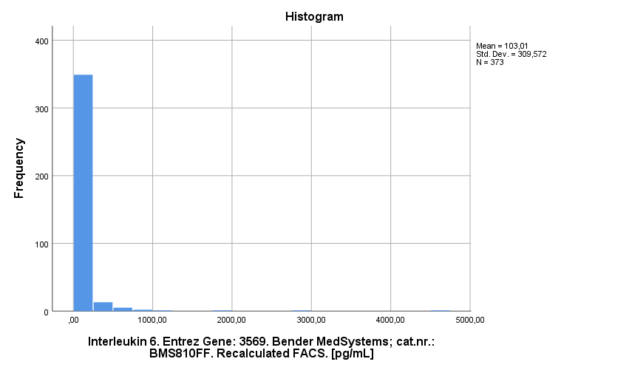
Interleukin6

Slide 15
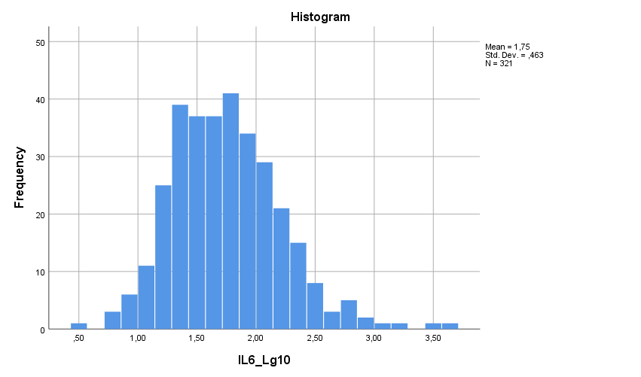
LG10_IL6
Tests of Normality
 | Kolmogorov-Smirnovª |  |  | Shapiro-Wilk
 | Statistic | df | Sig. | Statistic | df | Sig.
IL6_Lg10 | ,048 | 321 | ,077 | ,978 | 321 | ,000
a. Lilliefors Significance Correction

Slide 16
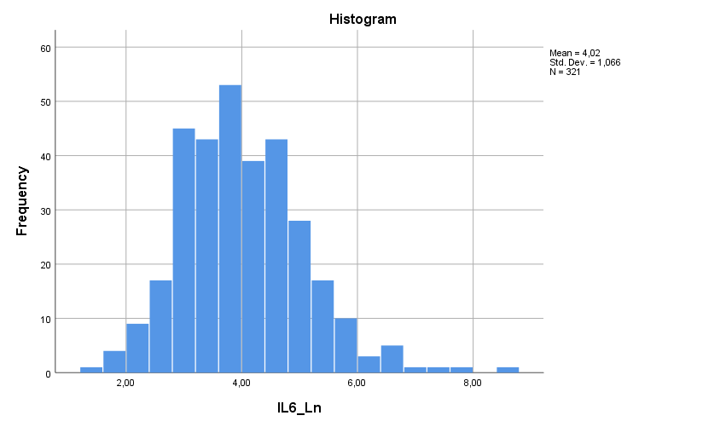
Ln_IL6
Tests of Normality
 | Kolmogorov-Smirnovª |  |  | Shapiro-Wilk
 | Statistic | df | Sig. | Statistic | df | Sig.
IL6_Ln | ,048 | 321 | ,077 | ,978 | 321 | ,000
a. Lilliefors Significance Correction

Slide 17
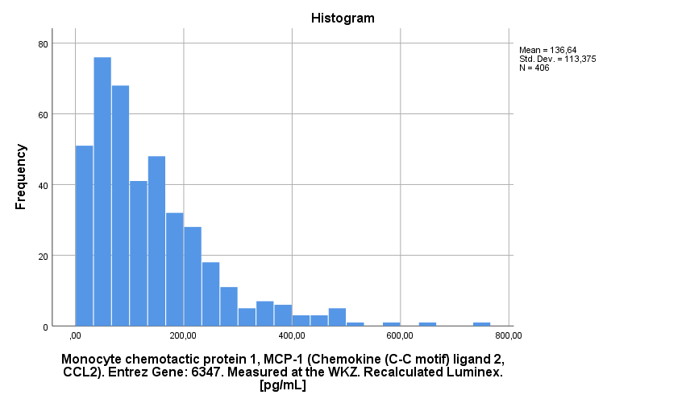
MCP1
Tests of Normality
 | Kolmogorov-Smirnovª |  |  | Shapiro-Wilk
 | Statistic | df | Sig. | Statistic | df | Sig.
Monocyte chemotactic protein 1, MCP-1 (Chemokine (C-C motif) ligand 2, CCL2). Entrez Gene: 6347. Measured at the WKZ. Recalculated Luminex. [pg/mL] | ,120 | 406 | ,000 | ,857 | 406 | ,000
a. Lilliefors Significance Correction

Slide 18
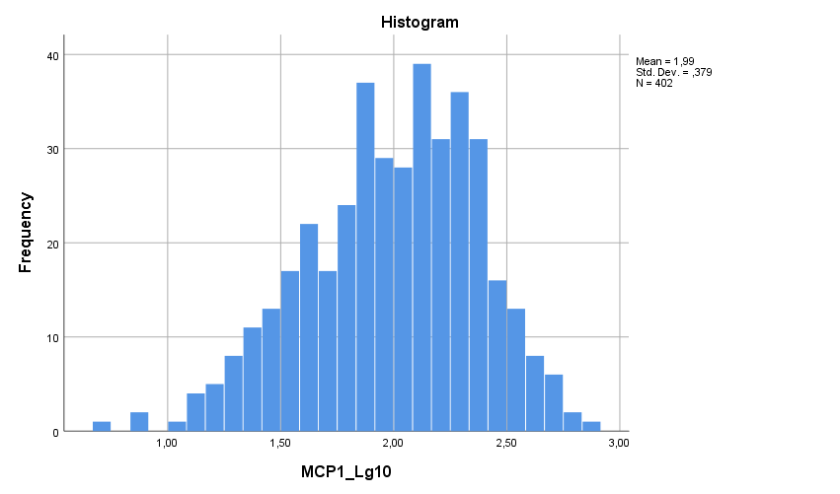
Log10_MCP1
Tests of Normality
 | Kolmogorov-Smirnovª |  |  | Shapiro-Wilk
 | Statistic | df | Sig. | Statistic | df | Sig.
MCP1_Lg10 | ,060 | 402 | ,001 | ,987 | 402 | ,001
a. Lilliefors Significance Correction

Slide 19
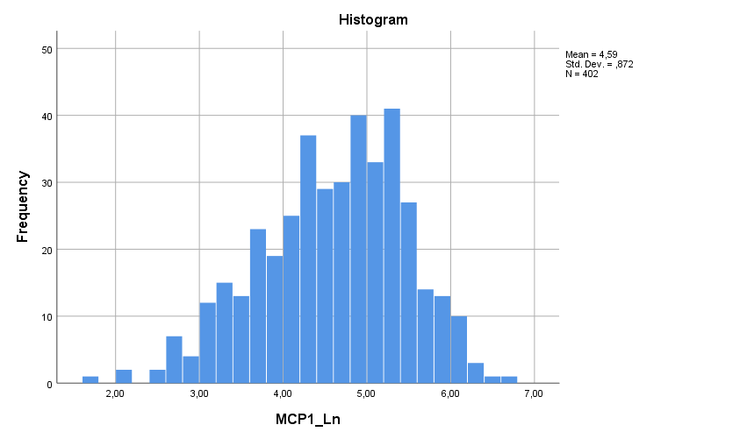
Ln_MCP1
Tests of Normality
 | Kolmogorov-Smirnovª |  |  | Shapiro-Wilk
 | Statistic | df | Sig. | Statistic | df | Sig.
MCP1_Ln | ,060 | 402 | ,001 | ,987 | 402 | ,001
a. Lilliefors Significance Correction

Slide 20
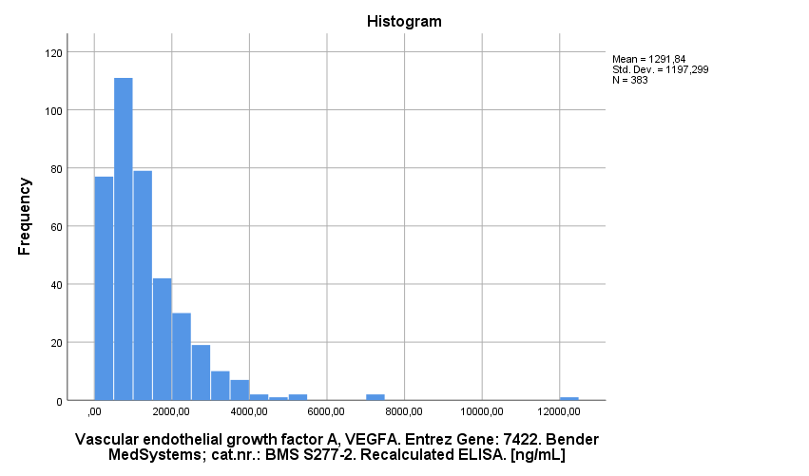
VEGFA
Tests of Normality
 | Kolmogorov-Smirnovª |  |  | Shapiro-Wilk
 | Statistic | df | Sig. | Statistic | df | Sig.
Vascular endothelial growth factor A, VEGFA. Entrez Gene: 7422. Bender MedSystems; cat.nr.: BMS S277-2. Recalculated ELISA. [ng/mL] | ,140 | 383 | ,000 | ,772 | 383 | ,000
a. Lilliefors Significance Correction

Slide 21
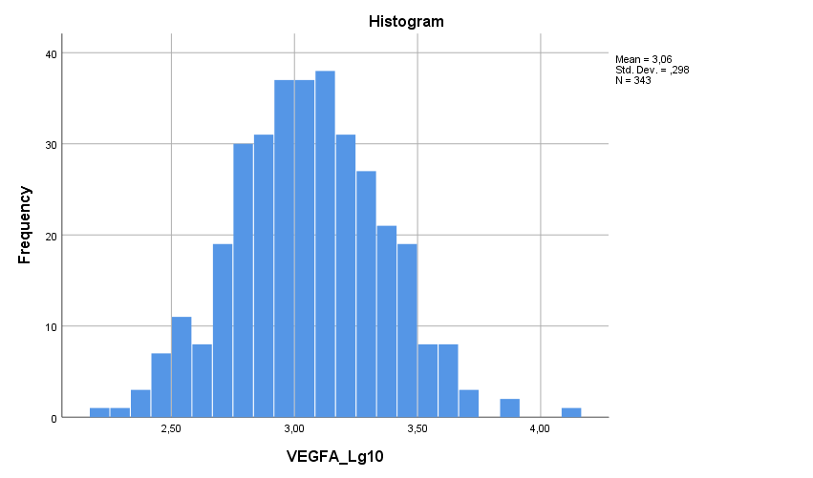
Log10_VEGFA
Tests of Normality
 | Kolmogorov-Smirnovª |  |  | Shapiro-Wilk
 | Statistic | df | Sig. | Statistic | df | Sig.
VEGFA_Lg10 | ,019 | 343 | ,200* | ,998 | 343 | ,902
*. This is a lower bound of the true significance.
a. Lilliefors Significance Correction

Slide 22
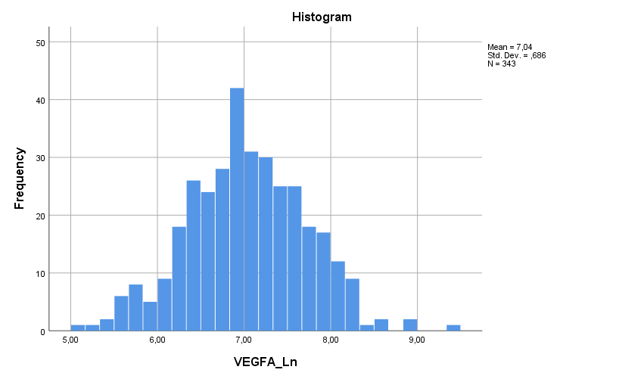
Ln_VEGFA
Tests of Normality
 | Kolmogorov-Smirnovª |  |  | Shapiro-Wilk
 | Statistic | df | Sig. | Statistic | df | Sig.
VEGFA_Ln | ,019 | 343 | ,200* | ,998 | 343 | ,902
*. This is a lower bound of the true significance.
a. Lilliefors Significance Correction

Slide 23
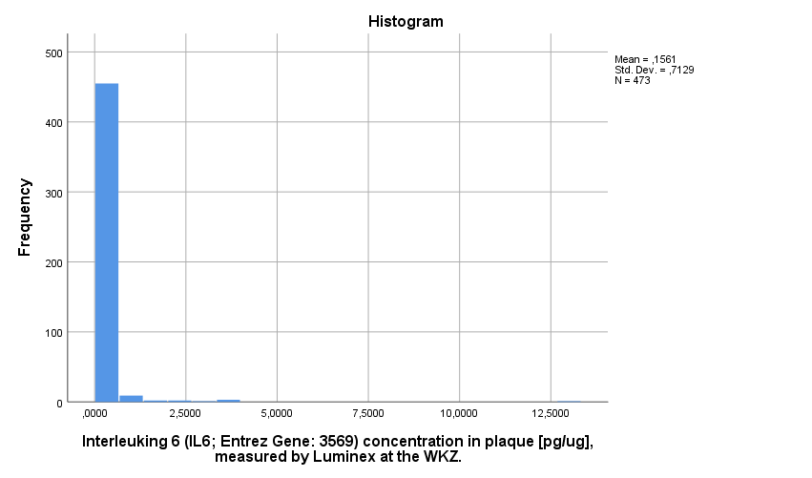
IL6 plaque
Tests of Normality
 | Kolmogorov-Smirnovª |  |  | Shapiro-Wilk
 | Statistic | df | Sig. | Statistic | df | Sig.
Interleuking 6 (IL6; Entrez Gene: 3569) concentration in plaque [pg/ug], measured by Luminex at the WKZ. | ,413 | 473 | ,000 | ,165 | 473 | ,000
a. Lilliefors Significance Correction

Slide 24
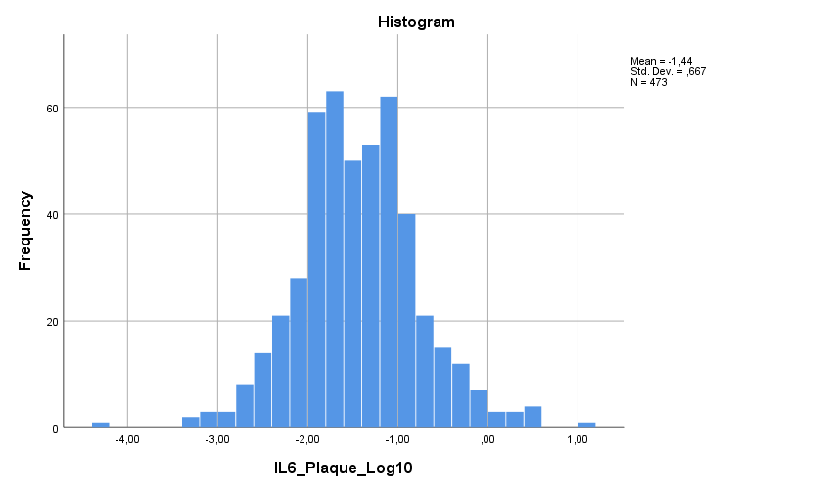
Log10_IL6 plaque
Tests of Normality
 | Kolmogorov-Smirnovª |  |  | Shapiro-Wilk
 | Statistic | df | Sig. | Statistic | df | Sig.
IL6_Plaque_Log10 | ,040 | 473 | ,069 | ,990 | 473 | ,002
a. Lilliefors Significance Correction

Slide 25
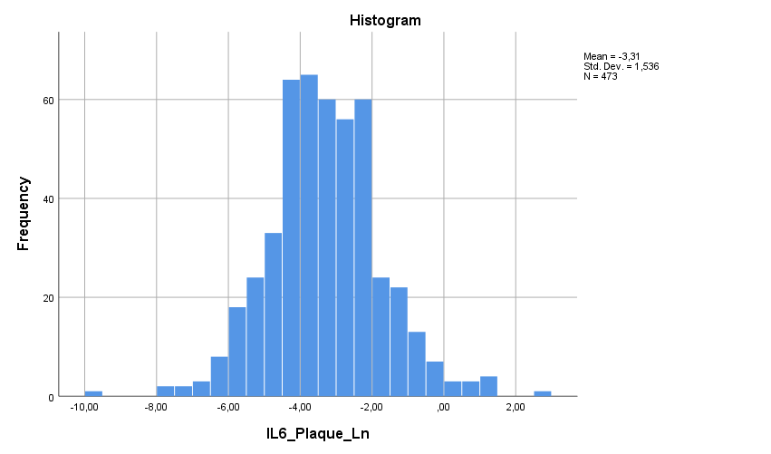
Ln_IL6 plaque
Tests of Normality
 | Kolmogorov-Smirnovª |  |  | Shapiro-Wilk
 | Statistic | df | Sig. | Statistic | df | Sig.
IL6_Plaque_Ln | ,040 | 473 | ,069 | ,990 | 473 | ,002
a. Lilliefors Significance Correction

Slide 26
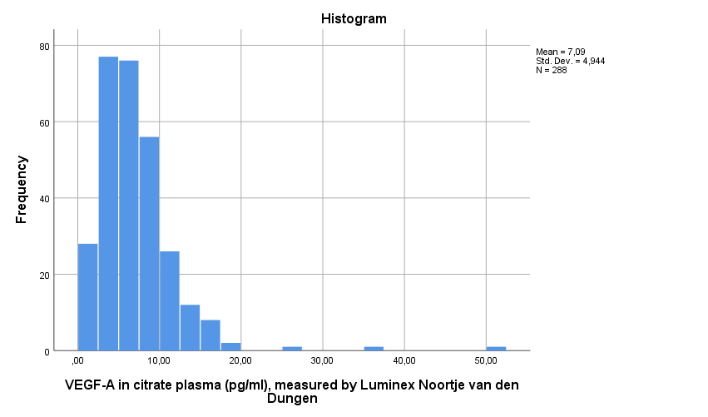
VEGFA Plasma

Slide 27
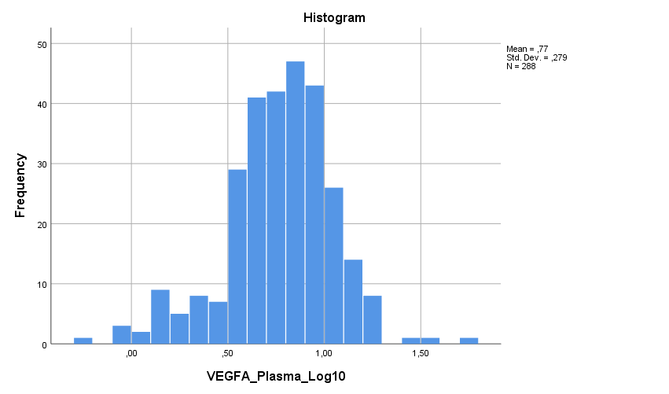
Log10_VEGFA Plasma
Tests of Normality
 | Kolmogorov-Smirnovª |  |  | Shapiro-Wilk
 | Statistic | df | Sig. | Statistic | df | Sig.
VEGFA_Plasma_Log10 | ,069 | 288 | ,002 | ,969 | 288 | ,000
a. Lilliefors Significance Correction

Slide 28
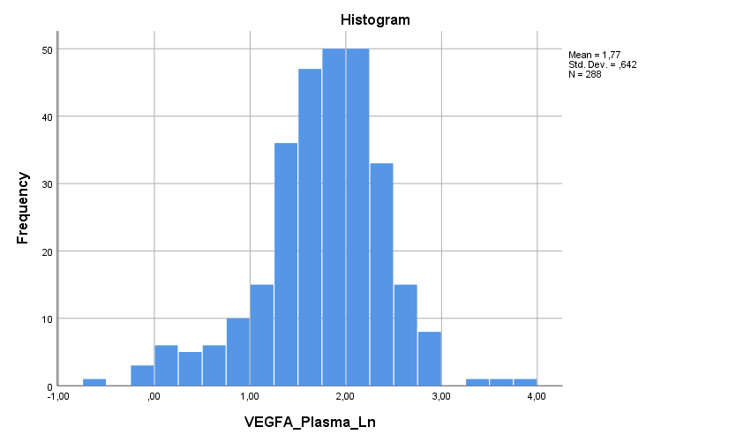
Ln_VEGFA Plasma
Tests of Normality
 | Kolmogorov-Smirnovª |  |  | Shapiro-Wilk
 | Statistic | df | Sig. | Statistic | df | Sig.
VEGFA_Plasma_Ln | ,069 | 288 | ,002 | ,969 | 288 | ,000
a. Lilliefors Significance Correction

Slide 29
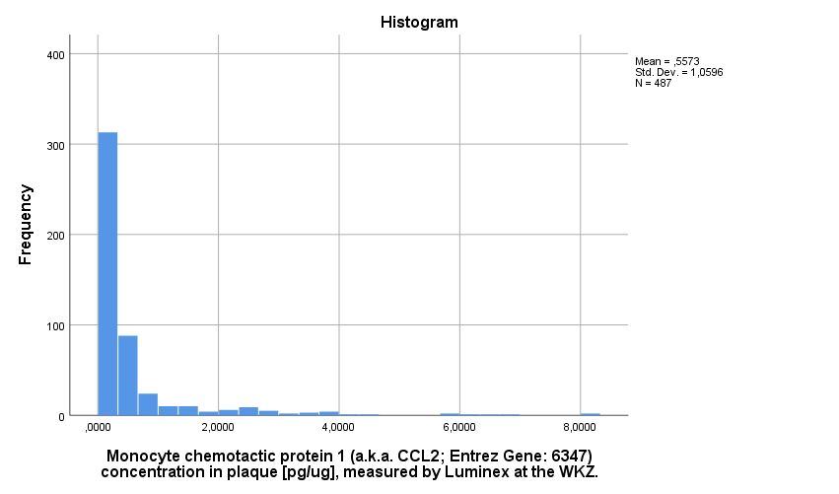
MCP1 Plaque
Tests of Normality
 | Kolmogorov-Smirnovª |  |  | Shapiro-Wilk
 | Statistic | df | Sig. | Statistic | df | Sig.
Monocyte chemotactic protein 1 (a.k.a. CCL2; Entrez Gene: 6347) concentration in plaque [pg/ug], measured by Luminex at the WKZ. | ,300 | 487 | ,000 | ,506 | 487 | ,000
a. Lilliefors Significance Correction

Slide 30
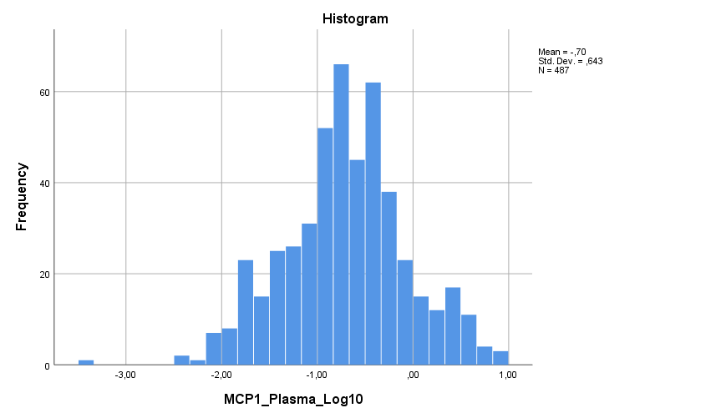
Log10_MCP1 Plaque
Tests of Normality
 | Kolmogorov-Smirnovª |  |  | Shapiro-Wilk
 | Statistic | df | Sig. | Statistic | df | Sig.
MCP1_Plasma_Log10 | ,043 | 487 | ,032 | ,992 | 487 | ,012
a. Lilliefors Significance Correction

Slide 31
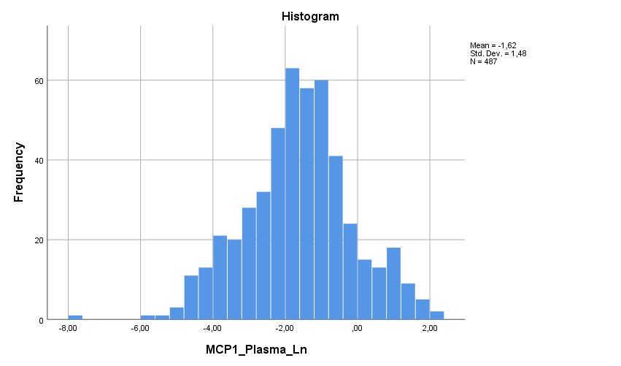
Ln_MCP1 Plaque
Tests of Normality
 | Kolmogorov-Smirnovª |  |  | Shapiro-Wilk
 | Statistic | df | Sig. | Statistic | df | Sig.
MCP1_Plasma_Ln | ,043 | 487 | ,032 | ,992 | 487 | ,012
a. Lilliefors Significance Correction

Slide 32
AEGS Type 2

Slide 33
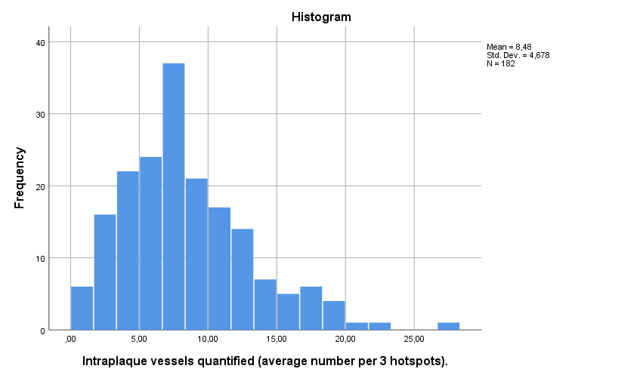
Vessel density

Slide 34
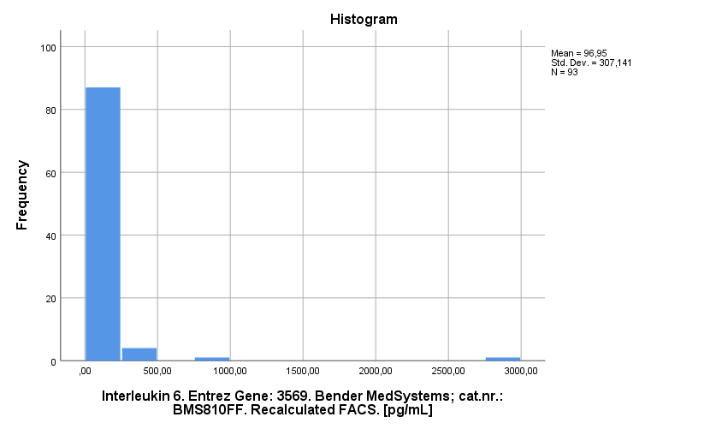
Interleukin

Slide 35
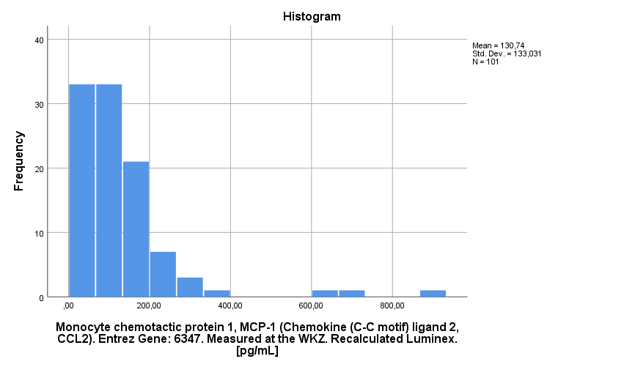
MCP1

Slide 36
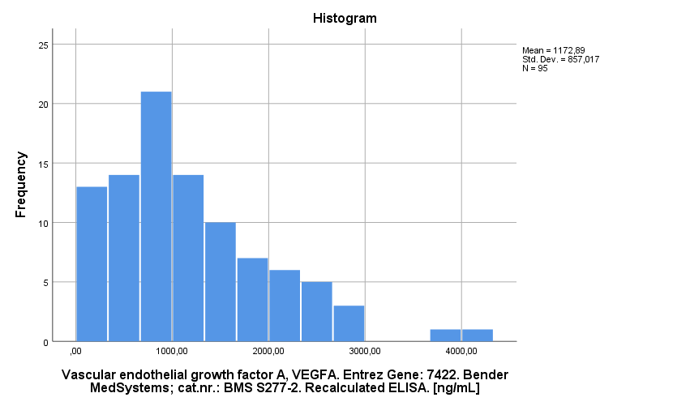
VEGFA

Slide 37
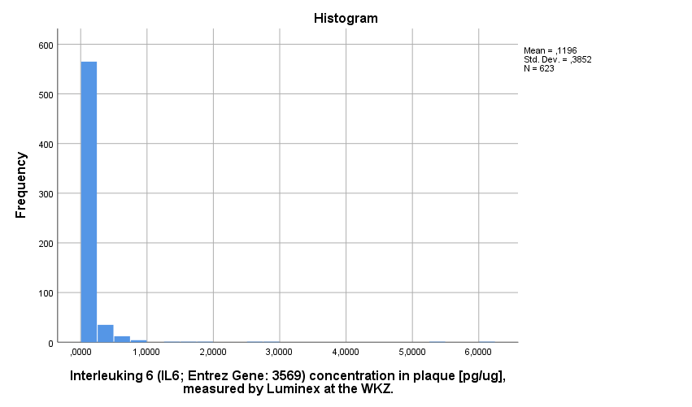
IL6 Plaque

Slide 38
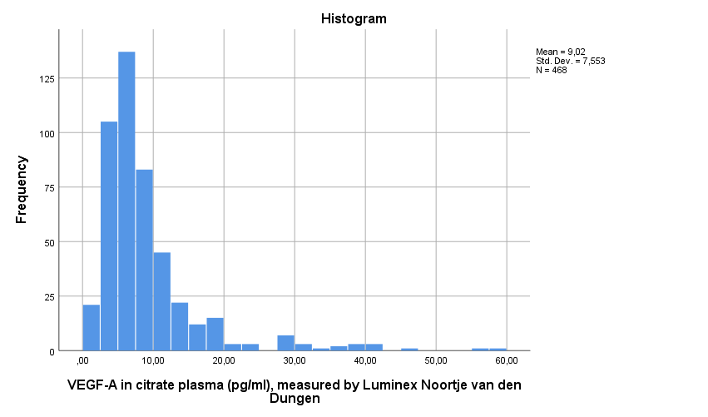
VEGF Plasma

Slide 39
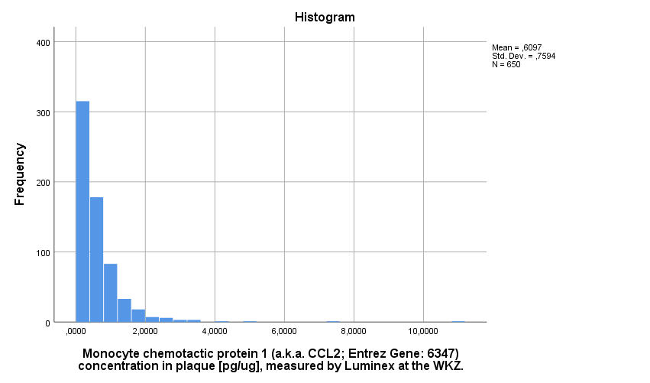
MCP1 Plaque

Slide 40
AExoS

Slide 41
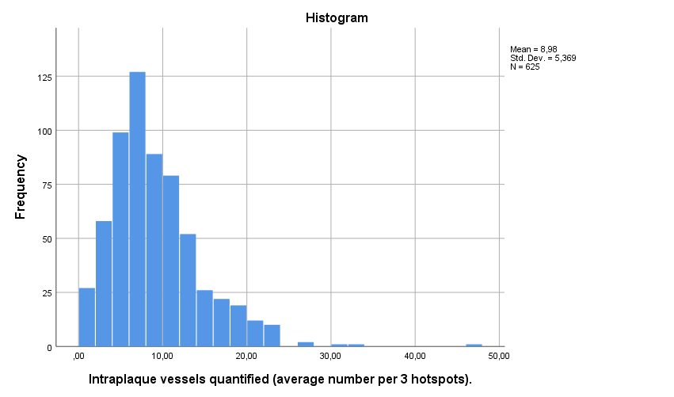
Intraplaque vessel density

Slide 42
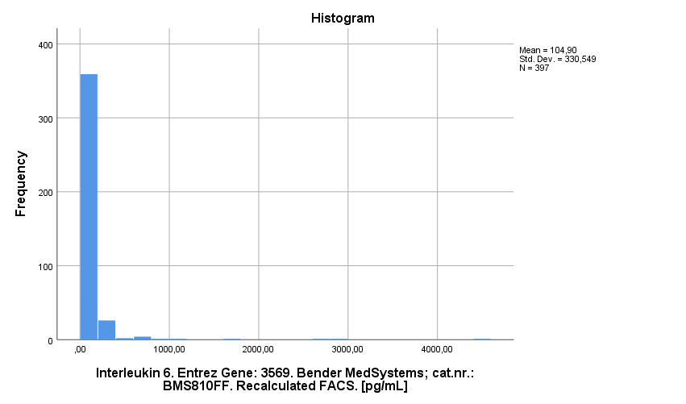
IL6

Slide 43
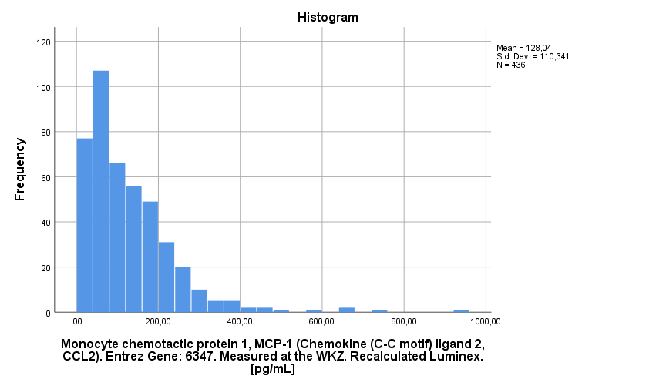
MCP1

Slide 44
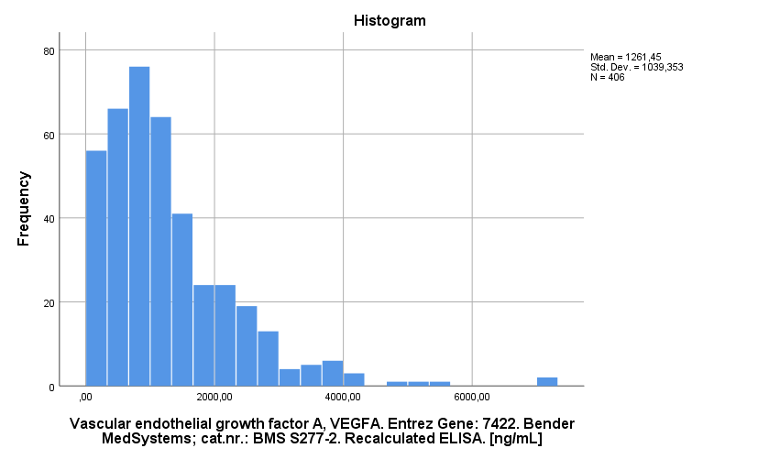
VEGFA

Slide 45
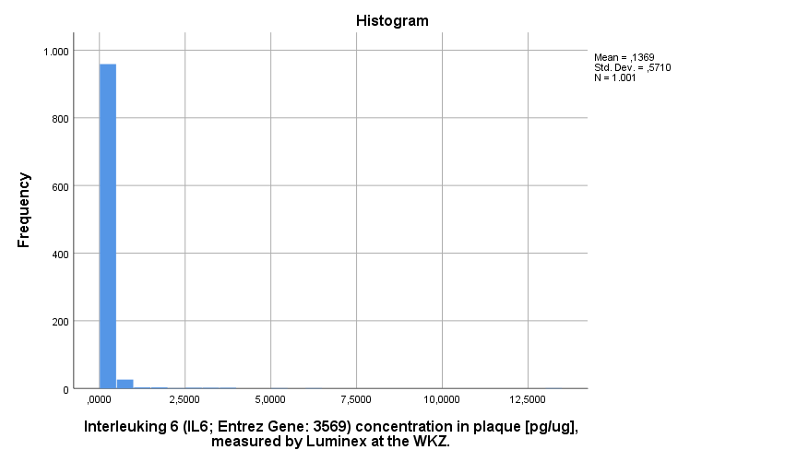
IL6 Plaque

Slide 46
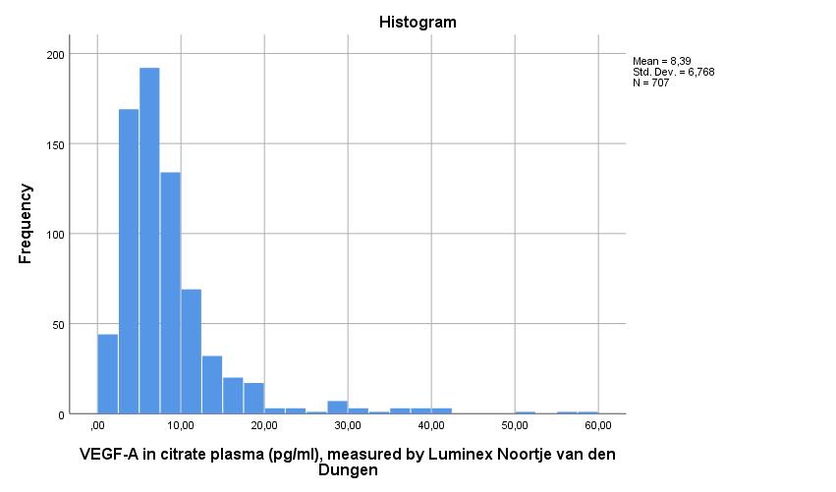
VEGF Plasma

Slide 47
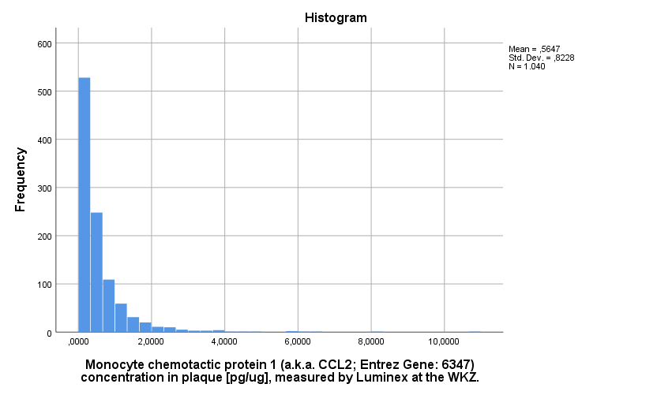
MCP1 Plaque

