Slide 1

CE/CZ2002: Object-Oriented Design & Programming
Assignment
Group 4

Slide 2
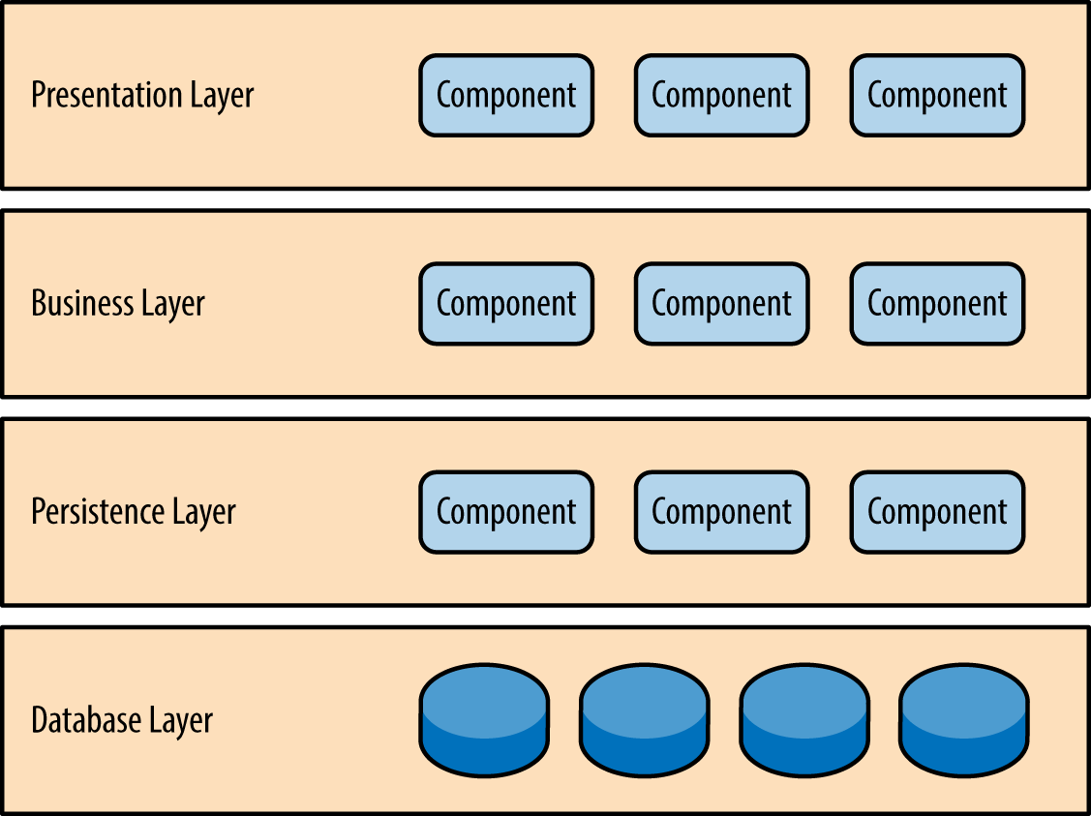
Design Consideration
Layered Architecture (has OO properties)
Flexibility
Maintainability
Reusability
Extensibility
Loosely coupled

Slide 3

Use of OOP Design Principle
Single Responsibility Principle
Open-Closed Principle
Interface Segregation Principle

