Slide 1



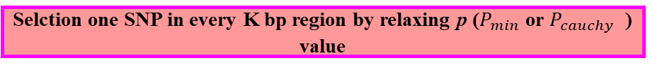
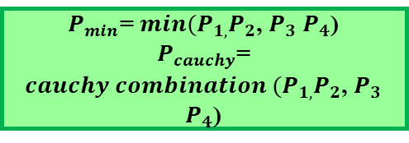
Step1:Scanning potential association locus
One hot coding for every SNP and Scanning SNP markers in the whole genome by quantile regression
The four $P_{1,}P_{2}$, $P_{3}$ $P_{4}$ value correspond to the four weights
Yes
$P_{2}$<0.01 or $P_{2}$>0.1?
No
$P_{min}$= $P_{2}$
$P_{cauchy}$= $P_{2}$
$P_{min}$= ${min⁡(P}_{1,}P_{2}$, $P_{3}$ $P_{4}$)
$P_{cauchy}$= ${cauchy combination ⁡(P}_{1,}P_{2}$, $P_{3}$ $P_{4}$)
Selction one SNP in every K bp region by relaxing p ($P_{min}$ or $P_{cauchy}$ ) value
Yes
Only exiting Bi-allele locus?
No
Step2:Multiple locus model and hypothesis test for markers
Additive and dominance encoding for markers
Effects encoding for marker
Efficient group variable selection models
Multiple-locus model and hypothesis test for candidate markers
Step3:Gene Mining
Narrow down candidate regions through LD
One-hot encoding for SNP marker
AA | 1 | 0 | 0
Aa | 0 | 1 | 0
aa | 0 | 0 | 1
Additive-dominance encoding for SNP marker
AA | 1 | 0
Aa | 0 | 1
aa | -1 | -1
Effects model Encoding for SNP marker
AA | 1 | 0
Aa | 0 | 1
aa | -1 | 0

