Slide 1
重构——
改善既有代码的设计

Slide 2
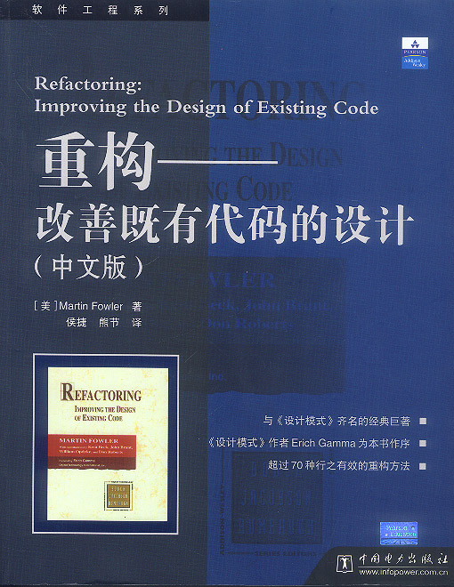


https://martinfowler.com/articles/refactoring-2nd-changes.html
——Martin Fowler
（马丁·福勒）

Slide 3
主要内容
重构介绍
重构原则
重构技巧

Slide 4
什么是重构
Refactoring是对软件内部结构的一种调整，目的是在不改变外部行为的前提下，提高其可理解性,降低其修改成本。
Notes:
（WHAT）

Slide 5
为什么重构
改进软件的设计。
程序员对代码所做的为了满足短期利益代码改动，或再没有完全清楚增个架构下的改动，都很容易是代码失去它的清晰结构，偏离需求或设计。而这些改动的积累很容易使代码偏离它原先设计的初衷而变得不可立即和无法维护。
Refactoring则帮助重新组织代码，重新清晰的体现结构和进一步改进设计。
提高代码质量，更易被理解
容易理解的代码可以很容易的维护和做进一步的开发。即使对写这些代码的程序员本身，容易理解代码也可以帮助容易地做修改。程序代码也是文档。而代码首先是写给人看的，让后才是给计算机看的

Slide 6
Refactoring帮助尽早的发现错(Bugs)
Refactoring是一个code review和反馈的过程。在另一个时段重新审视自己或别人代码，可以更容易的发现问题和加深对代码的理解。
Refactoring是一个良好的软件开发习惯。
Refactoring可以提高开发速度
Refactoring对设计和代码的改进，都可以有效的提高开发速度。好的设计和代码质量实体提高开发速度的关键。在一个有缺陷的设计和混乱代码基础上的开发，即使表面上进度较快，但本质是试延后对设计缺陷的发现和对错误的修改，也就是延后了开发风险，最终要在开发的后期付出更多的时间和代价。
项目的维护成本远高于开发成本.

Slide 7
何时重构
添加新功能时一并重构
为了增加一个新的功能，程序员需要首先读懂现有的代码。
修补错误时一并重构
为了修复一个Bug,程序员需要读懂现有的代码。
Code Review时一并重构

Slide 8
何时不该重构
代码太混乱，设计完全错误。与其Refactor，不如重写。
明天是DeadLine
永远不要做Last-Minute-Change。推迟Refactoring，但不可以忽略，即使进入Production的代码都正确的运行。
Refactoring的工作量显著的影响最后期限
一个Task的计划是３天，如果为了Refactoring，需要更多的时间（ ２天或更多）。推迟Refactoring,同步可以忽略。可以把这个Refactoring作为一个新的Task，或者安排在Refactoring的Iteration中完成。

Slide 9
代码坏味道
神秘命名(Mysterious Name)
重复的代码（Duplicated Code)
过长的函数(Long Method)
过大类(Large Class)
过长的参数列(Long Parameter List)
全局数据(Global Data)
可变数据(Mutable Data)
发散式变化(Divergent Change)
霰弹式修改(Shotgun Surgery)
依恋情结(Feature Envy)
数据泥团(Data Clumps)
基本型别偏执(Primitive Obsession)
Switch语句(Swtich Statements) ->
重复的Switch(Repleated Switch )
循环语句(Loops)
平行继承体系(Parallel Inheritance Hierarchies)->
冗赘类(Lazy Class)->
冗赘的元素(Lazy Element)
夸夸其谈未来性(Speculative Generality)
令人迷惑的暂时值域(Temporary Field)
过度遇合的消息链(Message Chains)
中间转手人(Middle Man)
狎昵关系(Inappropriate Intimacy)
异曲同工的类(Alternative Classes with Different Interfaces)
不完善的程序库类(Incomplete Library Class)×
纯粹的数据类(Data Class)
被拒绝的遗赠(Refused Bequest)
过多的注释(Comments)

Slide 10
重构技巧
https://www.refactoring.com/catalog/index.html

Slide 11
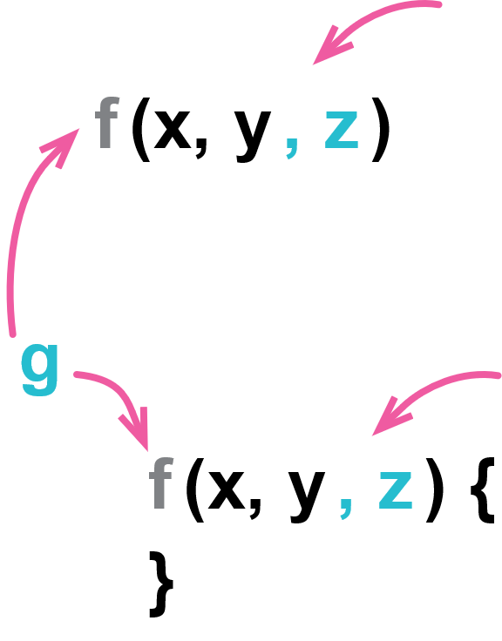
Change Function Declaration
function circum(radius){…}
function circumference(radius){…}

Slide 12
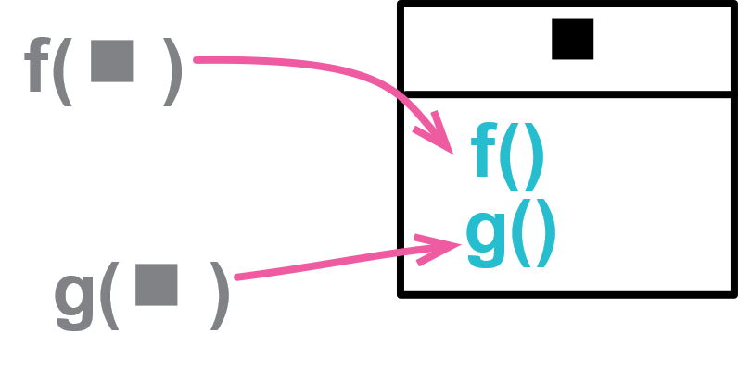
Combine Functions into Class
function base(aReading) {...}
function taxableCharge(aReading) {...}
function calculateBaseCharge(aReading) {...}
class Reading {
base() {...}
taxableCharge() {...}
calculateBaseCharge() {...}
}

Slide 13
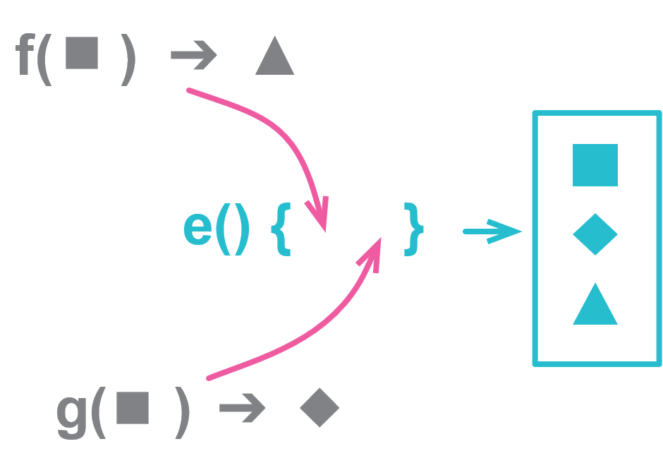
Combine Functions into Transform
function base(aReading) {...}
function taxableCharge(aReading) {...}
function enrichReading(argReading) {
const aReading = _.cloneDeep(argReading);
aReading.baseCharge = base(aReading);
aReading.taxableCharge = taxableCharge(aReading);
return aReading;
}

Slide 14
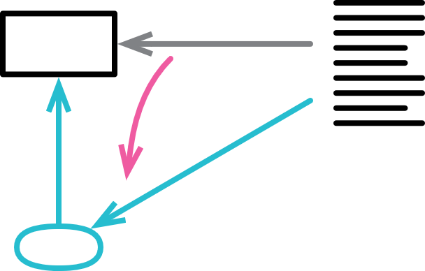
Encapsulate Variable
let defaultOwner = {firstName: "Martin", lastName: "Fowler"};
let defaultOwnerData = {firstName: "Martin", lastName: "Fowler"};
export function defaultOwner() {return defaultOwnerData;}
export function setDefaultOwner(arg) {defaultOwnerData = arg;}

Slide 15
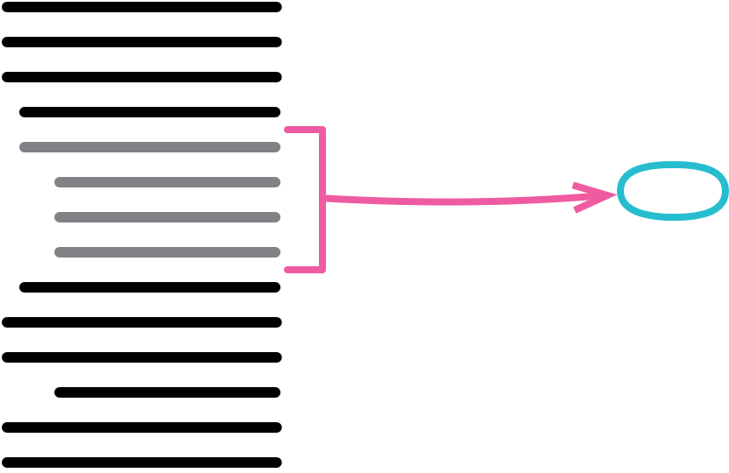
Extract Function
function printOwing(invoice) {
printBanner();
let outstanding = calculateOutstanding();
//print details
console.log(`name: ${invoice.customer}`);
console.log(`amount: ${outstanding}`);
}
function printOwing(invoice) {
printBanner();
let outstanding = calculateOutstanding();
printDetails(outstanding);
function printDetails(outstanding) {
console.log(`name: ${invoice.customer}`);
console.log(`amount: ${outstanding}`);
}
}

Slide 16

Extract Variable
return order.quantity * order.itemPrice -
Math.max(0, order.quantity - 500) * order.itemPrice * 0.05 +
Math.min(order.quantity * order.itemPrice * 0.1, 100);
const basePrice = order.quantity * order.itemPrice;
const quantityDiscount = Math.max(0, order.quantity - 500) * order.itemPrice * 0.05;
const shipping = Math.min(basePrice * 0.1, 100);
return basePrice - quantityDiscount + shipping;

Slide 17
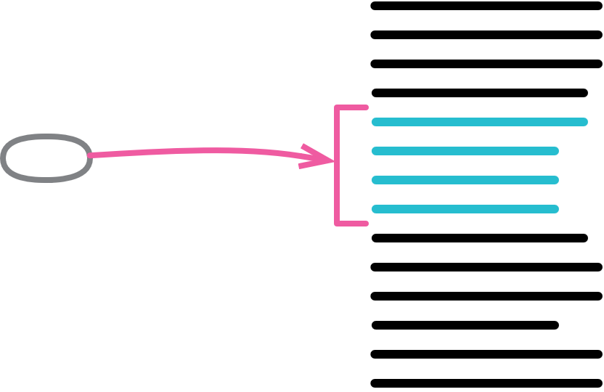
Inline Function
function getRating(driver) {
return moreThanFiveLateDeliveries(driver) ? 2 : 1;
}
function moreThanFiveLateDeliveries(driver) {
return driver.numberOfLateDeliveries > 5;
}
function getRating(driver) {
return (driver.numberOfLateDeliveries > 5) ? 2 : 1;
}

Slide 18
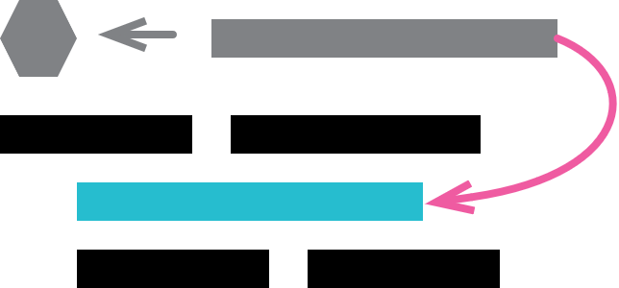
Inline Variable
let basePrice = anOrder.basePrice;
return (basePrice > 1000);
return anOrder.basePrice > 1000;

Slide 19
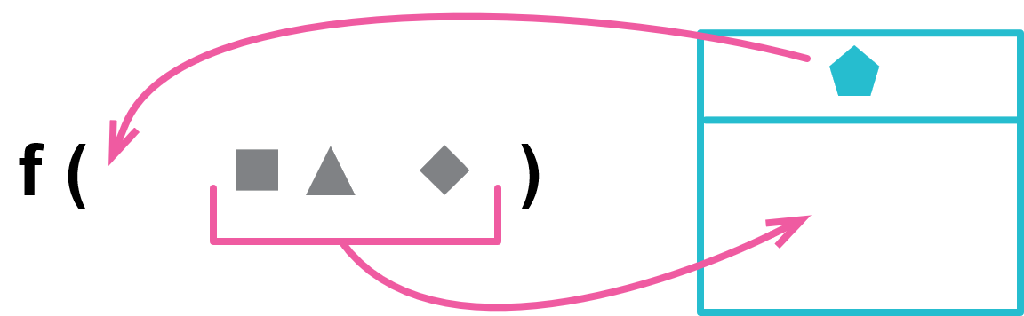
Introduce Parameter Object
function amountInvoiced(startDate, endDate) {...}
function amountReceived(startDate, endDate) {...}
function amountOverdue(startDate, endDate) {...}
function amountInvoiced(aDateRange) {...}
function amountReceived(aDateRange) {...}
function amountOverdue(aDateRange) {...}

Slide 20
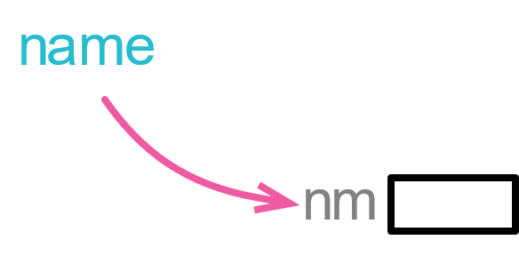
Rename Variable
let a = height * width;
let area = height * width;

Slide 21
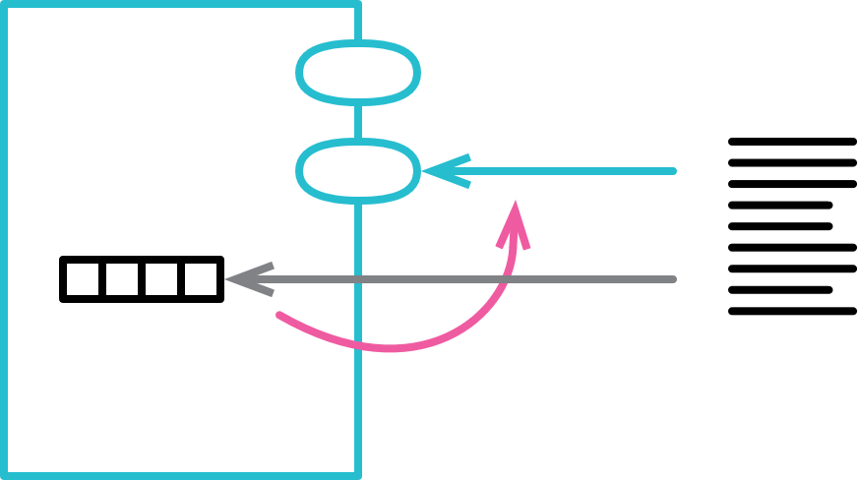
Encapsulate Collection
class Person {
get courses() {return this._courses;}
set courses(aList) {this._courses = aList;}
class Person {
get courses() {return this._courses.slice();}
addCourse(aCourse) { ... }
removeCourse(aCourse) { ... }

Slide 22
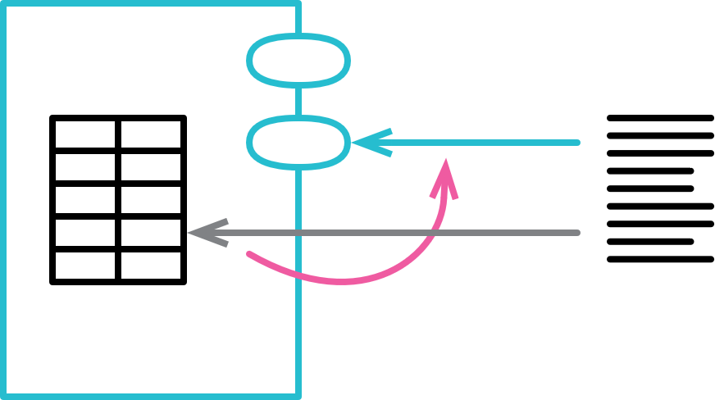
Encapsulate Record
organization = {name: "Acme Gooseberries", country: "GB"};
class Organization {
constructor(data) {
this._name = data.name;
this._country = data.country;
}
get name() {return this._name;}
set name(arg) {this._name = arg;}
get country() {return this._country;}
set country(arg) {this._country = arg;}
}

Slide 23
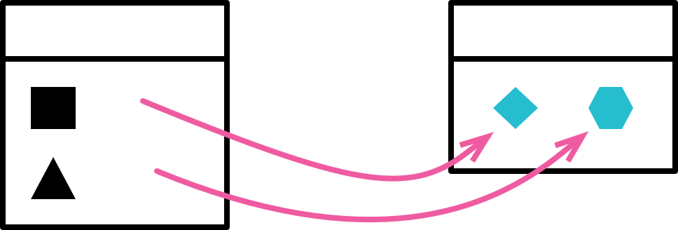
Extract Class
class Person {
get officeAreaCode() {return this._officeAreaCode;}
get officeNumber() {return this._officeNumber;}
class Person {
get officeAreaCode() {return this._telephoneNumber.areaCode;}
get officeNumber() {return this._telephoneNumber.number;}
}
class TelephoneNumber {
get areaCode() {return this._areaCode;}
get number() {return this._number;}
}

Slide 24
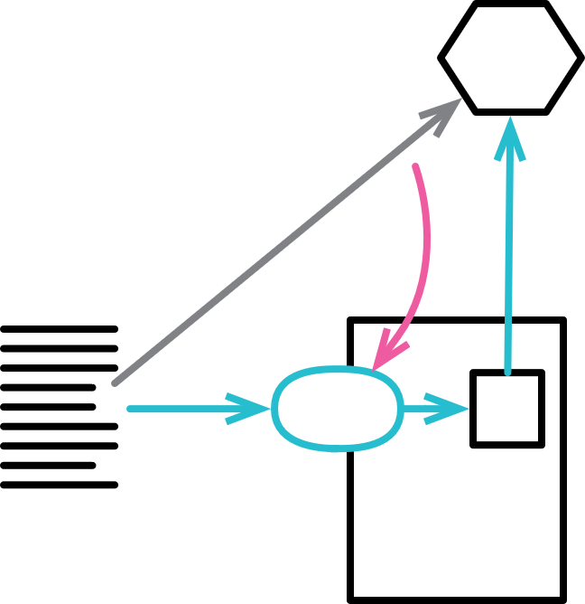
Hide Delegate
manager = aPerson.department.manager;
manager = aPerson.manager;
class Person {
get manager() {return this.department.manager;}

Slide 25
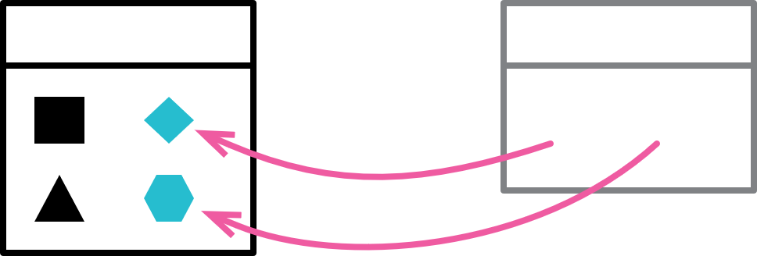
Inline Class
class Person {
get officeAreaCode() {return this._telephoneNumber.areaCode;}
get officeNumber() {return this._telephoneNumber.number;}
}
class TelephoneNumber {
get areaCode() {return this._areaCode;}
get number() {return this._number;}
}
class Person {
get officeAreaCode() {return this._officeAreaCode;}
get officeNumber() {return this._officeNumber;}

Slide 26
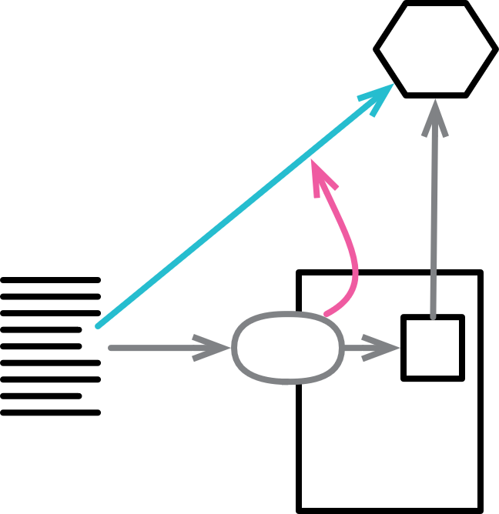
Remove Middle Man
manager = aPerson.manager;
class Person {
get manager() {return this.department.manager;}
manager = aPerson.department.manager;

Slide 27
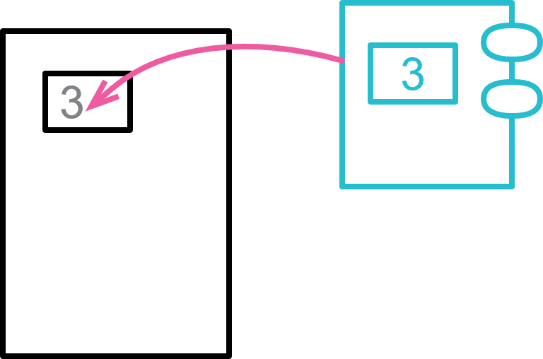
Replace Primitive with Object
orders.filter(o => "high" === o.priority
|| "rush" === o.priority);
orders.filter(o => o.priority.higherThan(new Priority("normal")))

Slide 28
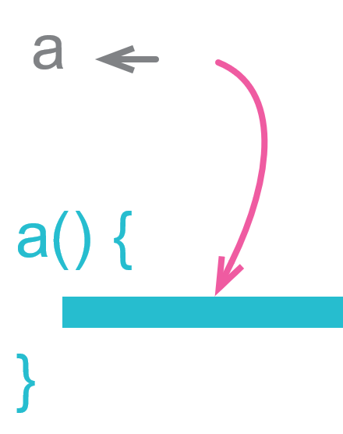
Replace Temp with Query
const basePrice = this._quantity * this._itemPrice;
if (basePrice > 1000)
return basePrice * 0.95;
else
return basePrice * 0.98;
get basePrice() {this._quantity * this._itemPrice;}
...
if (this.basePrice > 1000)
return this.basePrice * 0.95;
else
return this.basePrice * 0.98;

Slide 29
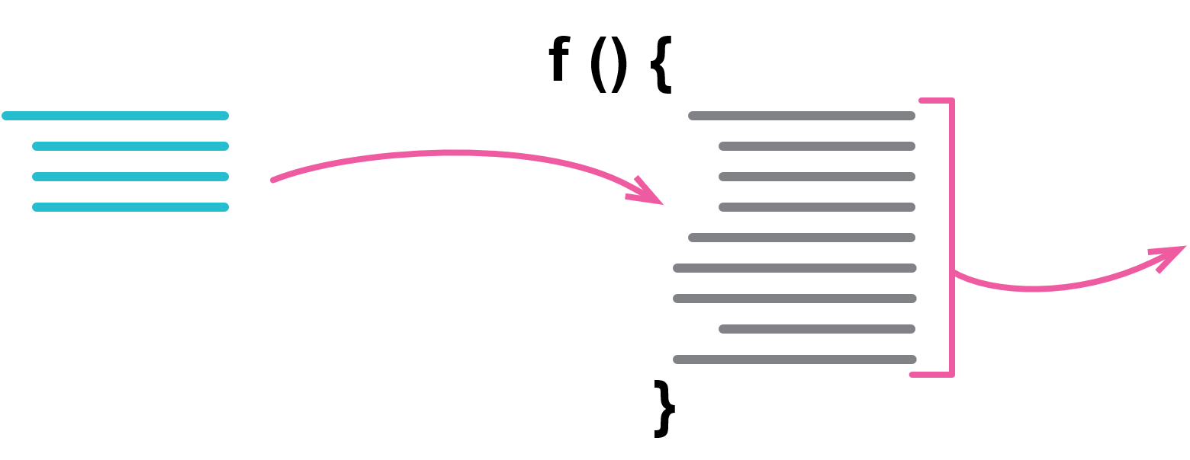
Substitute Algorithm
function foundPerson(people) {
for(let i = 0; i < people.length; i++) {
if (people[i] === "Don") {
return "Don";
}
if (people[i] === "John") {
return "John";
}
if (people[i] === "Kent") {
return "Kent";
}
}
return "";
}
function foundPerson(people) {
const candidates = ["Don", "John", "Kent"];
return people.find(p => candidates.includes(p)) || '';
}

Slide 30
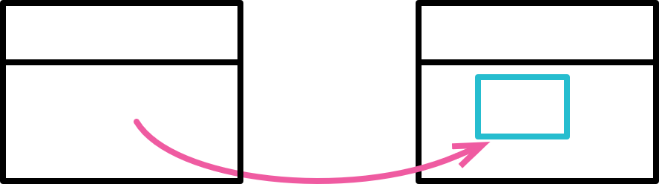
Move Field
class Customer {
get plan() {return this._plan;}
get discountRate() {return this._discountRate;}
class Customer {
get plan() {return this._plan;}
get discountRate() {return this.plan.discountRate;}

Slide 31

Move Function
class Account {
get overdraftCharge() {...}
class AccountType {
get overdraftCharge() {...}

Slide 32
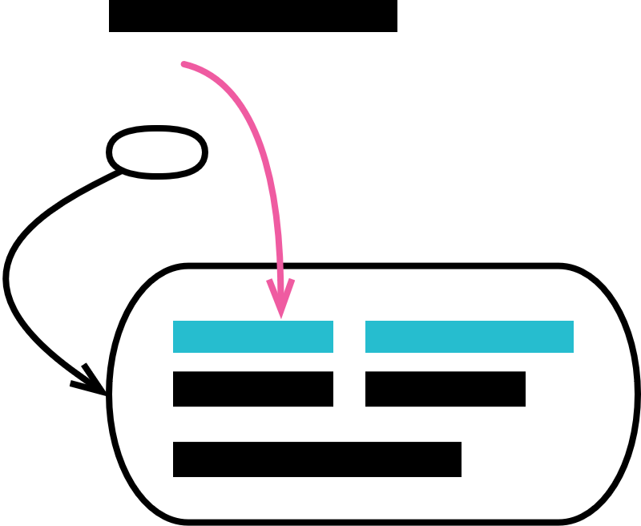
Move Statements into Function
result.push(`<p>title: ${person.photo.title}</p>`);
result.concat(photoData(person.photo));
function photoData(aPhoto) {
return [
`<p>location: ${aPhoto.location}</p>`,
`<p>date: ${aPhoto.date.toDateString()}</p>`,
];
}
result.concat(photoData(person.photo));
function photoData(aPhoto) {
return [
`<p>title: ${aPhoto.title}</p>`,
`<p>location: ${aPhoto.location}</p>`,
`<p>date: ${aPhoto.date.toDateString()}</p>`,
];
}

Slide 33
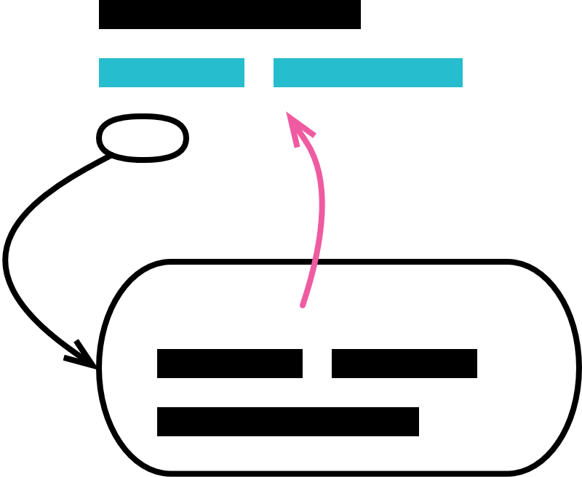
Move Statements to Callers
emitPhotoData(outStream, person.photo);
function emitPhotoData(outStream, photo) {
outStream.write(`<p>title: ${photo.title}</p>\n`);
outStream.write(`<p>location: ${photo.location}</p>\n`);
}
emitPhotoData(outStream, person.photo);
outStream.write(`<p>location: ${person.photo.location}</p>\n`);
function emitPhotoData(outStream, photo) {
outStream.write(`<p>title: ${photo.title}</p>\n`);
}

Slide 34

Remove Dead Code
if(false) {
doSomethingThatUsedToMatter();
}

Slide 35
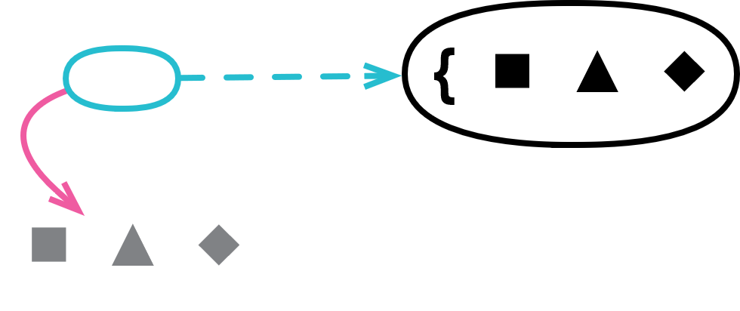
Replace Inline Code with Function Call
let appliesToMass = false;
for(const s of states) {
if (s === "MA") appliesToMass = true;
}
appliesToMass = states.includes("MA");

Slide 36
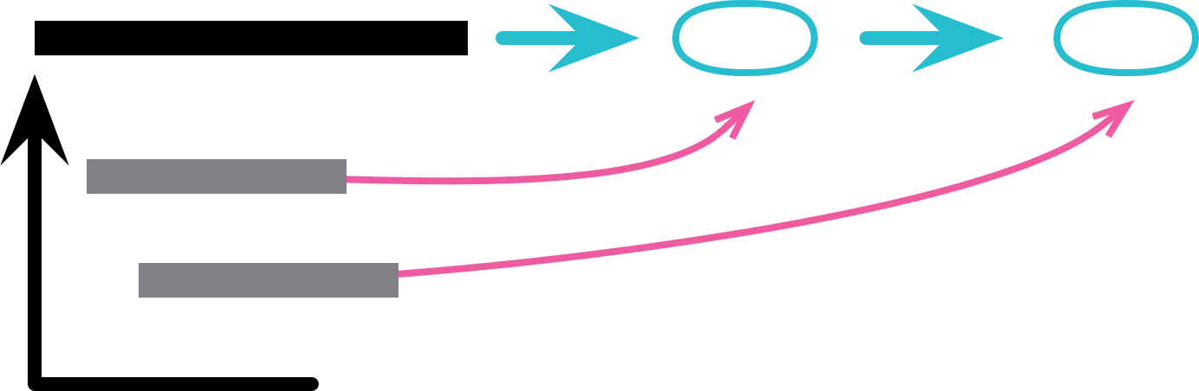
Replace Loop with Pipeline
const names = [];
for (const i of input) {
if (i.job === "programmer")
names.push(i.name);
}
const names = input
.filter(i => i.job === "programmer")
.map(i => i.name)
;

Slide 37

Slide Statements
const pricingPlan = retrievePricingPlan();
const order = retreiveOrder();
let charge;
const chargePerUnit = pricingPlan.unit;
const pricingPlan = retrievePricingPlan();
const chargePerUnit = pricingPlan.unit;
const order = retreiveOrder();
let charge;

Slide 38
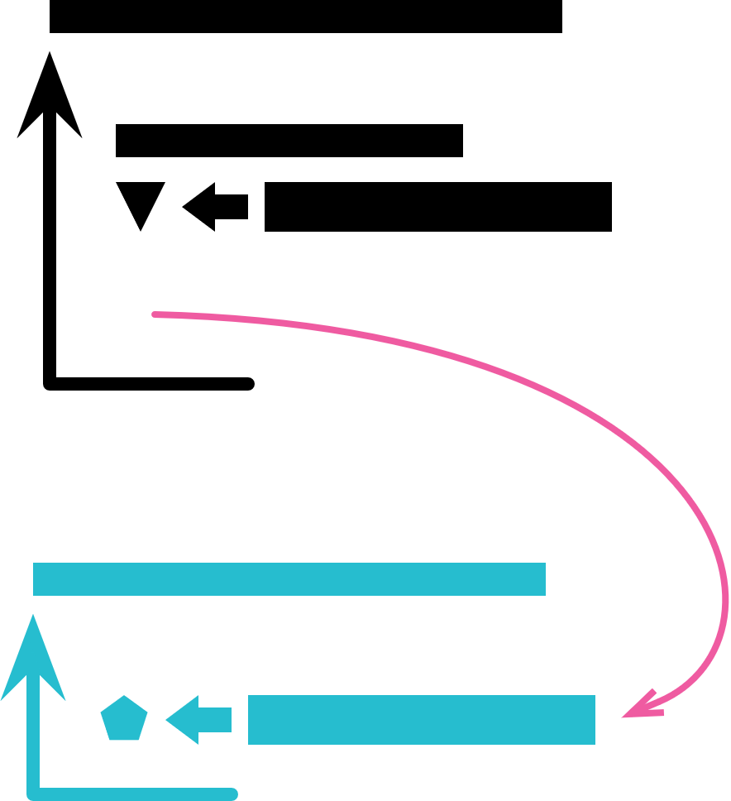
Split Loop
let averageAge = 0;
let totalSalary = 0;
for (const p of people) {
averageAge += p.age;
totalSalary += p.salary;
}
averageAge = averageAge / people.length;
let totalSalary = 0;
for (const p of people) {
totalSalary += p.salary;
}
let averageAge = 0;
for (const p of people) {
averageAge += p.age;
}
averageAge = averageAge / people.length;

Slide 39
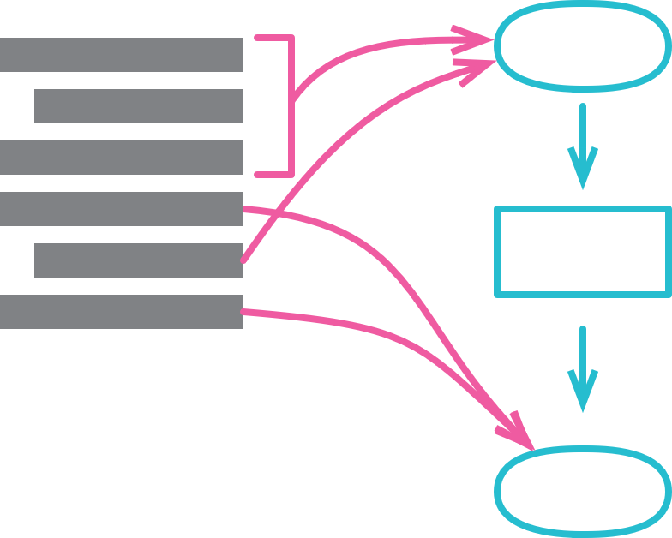
Split Phase
const orderData = orderString.split(/\s+/);
const productPrice = priceList[orderData[0].split("-")[1]];
const orderPrice = parseInt(orderData[1]) * productPrice;
const orderRecord = parseOrder(order);
const orderPrice = price(orderRecord, priceList);
function parseOrder(aString) {
const values = aString.split(/\s+/);
return ({
productID: values[0].split("-")[1],
quantity: parseInt(values[1]),
});
}
function price(order, priceList) {
return order.quantity * priceList[order.productID];
}

Slide 40
重构与设计
重构可以从很大程度上去帮助设计，通常情况下我们的设计不是能贯穿我们软件开发的全过程的，在这个过程中，我们的需求变更的可能性非常大，当需求变了，设计也得变，这时候就要依靠重构来让代码适应变化

Slide 41
重构与性能
关于重构，有一个常被提出的问题：它对程序的性能将造成怎样的影响？为了让软件易于理解，你常会作出一些使程序运行变慢的修改。这是个重要的问题。我并不赞成为了提高设计的纯洁性或把希望寄托于更快的硬件身上，而忽略了程序性能。已经有很多软件因为速度太慢而被用户拒绝，日益提高的机器速度亦只不过略微放宽了速度方面的限制而已。但是，换个角度说，虽然重构必然会使软件运行更慢，但它也使软件的性能优化更易进行。关键在于自己的理解，当你拥有了重构的经验，你也就有能力在重构的基础上来改进程序的性能。

Slide 42
谢谢！

