Slide 1
Introduction
Boston University CS 506 - Lance Galletti

Slide 2
Data Science
Collection of methods and tools that allow for extracting knowledge from data
Cross-disciplinary:
Math
Statistics
Computer Science
Domain Expertise
Know what you don’t know!

Slide 3

Knowledge = Testable Predictions

Slide 4
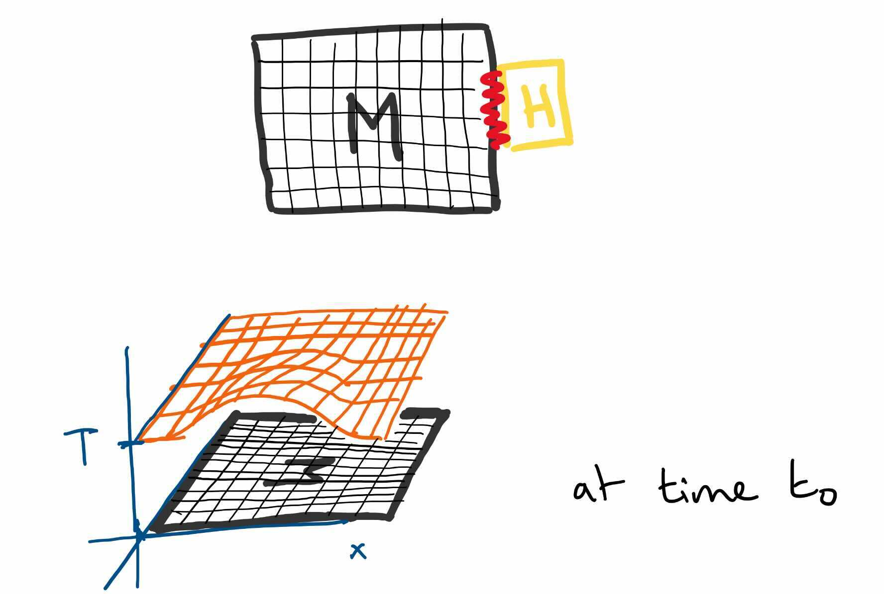
Knowledge = Testable Predictions

Slide 5
Knowledge = Testable Predictions
Model:
f(x, y, t) => temperature
VS
“Heat Diffusion”
Heat Distribution Creatures
Which theory should we use?
How to distinguish or unify them?

Slide 6
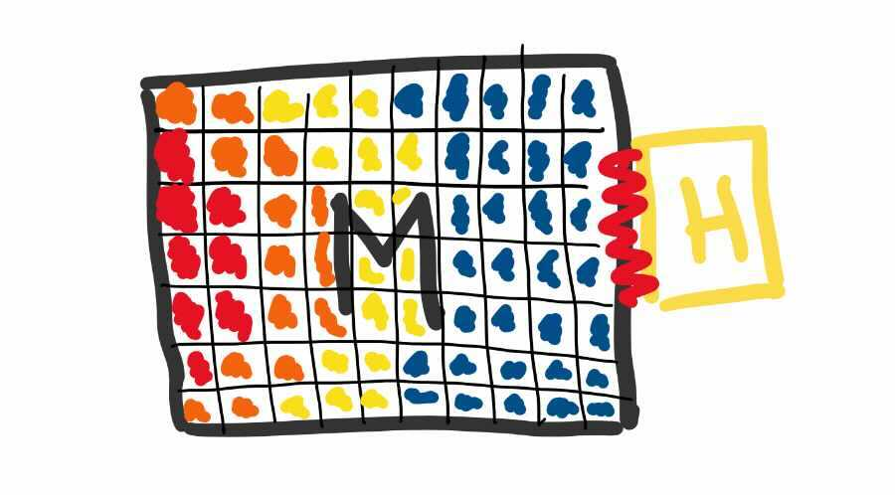
Knowledge = Testable Predictions
Scientific perspective: look at what each theory anticipates!

Slide 7
Knowledge = Testable Predictions
If you can equally well explain every outcome, how can you have a definitive / deterministic anticipation of events?
If you’re equally good at explaining every outcome, you have zero knowledge.
Notes:
Knowledge as anticipation of events allows us to distinguish and unify theories. If two theories anticipate the exact same events then they are the same theory - in math terms we’ll call these isomorphic.
In order for a theory to contain knowledge, it necessarily must be falsifiable by a specific set of outcomes. As we’ll see soon, in order to confirm a theory and gain justified confidence in a theory, we must often be willing to try to falsify it.

Slide 8
Confirmation Bias
In a class just like this one, imagine playing the following game…
Notes:
I’ll think of a rule that governs triples of integers (a, b, c) and the goal of the exercise is for students in the class to guess the rule. To do so, students are only allowed to submit example/test triples to which I will answer truthfully whether it follows the rule. They can submit as many triples as they want and, when they are confident they have uncovered the rule, they simply write it down. Later, when the rule is revealed they will know whether they got it right.

Slide 9
Confirmation Bias
I announce “(2, 4, 6) follows the rule”.
Here are the examples submitted by one of the participants:
(2, 4, 3) -> NO
(6, 8, 10) -> YES
(1, 3, 5) -> YES
After which, they proceed to write down their hypothesized rule. Would you have wanted to try more examples? If so, which and for what reason?

Slide 10
Confirmation Bias
Let’s take a poll:
(100, 102, 104)
(5, 7, 9)
(1, 2, 3)

Slide 11
Confirmation Bias
Challenges of Data Science:
Not all examples contribute similar amounts of information
A set of examples may not always be representative of the underlying rule
There may be infinitely many rules that match the examples provided
So Data Science is VERY DIFFICULT!!!
Notes:
To get intuition about 1), consider that you wouldn’t submit an example twice. To understand 2), notice that the participant’s hypothesis is most likely (x, x+2, x+4). If you were only given the above 4 data points you would most likely guess that rule as well - and you wouldn’t be at fault for it because it’s likely the best you can do with what you have. Finally, for 3) you’ll notice that there are always an infinite number of functions that can pass through finitely many points. The tricky part is actually enumerating these functions - you can imagine that some of these functions might be extremely complex
So which function is the correct one? How do we decide? Generally we follow the philosophy of Occam’s Razor which says to prefer the simplest of competing theories with the same prediction (i.e. the simplest hypothesis is best). Note that this does not extend to non-isomorphic theories: comparing hypotheses with different predictions.

Slide 12
Confirmation Bias
Positive Examples VS Negative Examples
assuming the hypothesis h is (x, x+2, x+4) which type of examples are the following:
(2, 4, 3)
(6, 8, 10)
(1, 3, 5)

Slide 13
Confirmation Bias
Both positive and negative examples can falsify a hypothesis
Tendency to choose positive ones over negative ones

Slide 14
Confirmation Bias
All possible examples
The rule
Your Hypothesis

Slide 15
Confirmation Bias
All possible examples
The rule
Your Hypothesis
+

Slide 16
Confirmation Bias
All possible examples
The rule
-
-
-
Your Hypothesis
+

Slide 17
Confirmation Bias
All possible examples
The rule
-
-
-
Your Hypothesis
+

Slide 18
Confirmation Bias
Let’s take a poll:
(100, 102, 104)
(5, 7, 9)
(1, 2, 3)

Slide 19
Confirmation Bias
The rule was ( a < b < c).
If you only tried positive examples of either (x, x + 2, x+4) or (x, 2x 3x) you would only get confirmation.
For reference, this exercise was first introduced by Wason P.C in 1960 as part of a journal in experimental psychology.
Notes:
Positive bias (or confirmation bias), is the systematic unwillingness to try negative examples. In practice, only about 20% of people succeed at finding the rule in this (2, 4, 6) exercise. This is also sometimes referred to as the inventor’s curse because of how it biases the search for information.

Slide 20
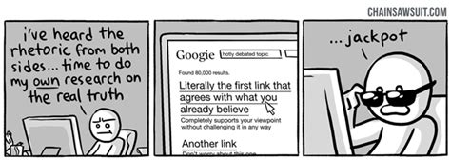
Confirmation Bias

Slide 21
Types of Data - Records
m-dimensional points / vectors
Example: (name, age, balance) -> (“John”, 20, 100)

Slide 22
Types of Data - Records
m-dimensional points / vectors
Example: (name, age, balance) -> (“John”, 20, 100)
balance
Jane
John
age

Slide 23
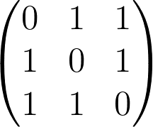
Types of Data - Graphs
Nodes connected by edges
Example:
1
2
Adjacency Matrix
1 2 3
1
2
3
3
Adjacency List
1 : {2, 3}
2 : {1, 3}
3 : {1, 2}

Slide 24
Types of Data - Images

Slide 25
Types of Data - Images

Slide 26
Types of Data - Images
Pixel

Slide 27
Types of Data - Text
---
---
------------------------------------------
----
List of words

Slide 28
Types of Data - Strings
DNA seq (A T G C C G T A …) -> list of characters

Slide 29
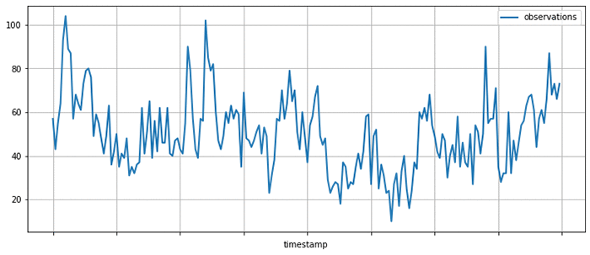
Types of Data - Time Series
List of data at specific intervals of time

Slide 30
Types of Learning
Unsupervised Learning
Supervised Learning

Slide 31
Unsupervised Learning
Goal: Find interesting structure in the data

Slide 32
Unsupervised Learning
Goal: Find interesting structure in the data
This type of unsupervised learning is referred to as clustering

Slide 33
Unsupervised Learning
Dataset: Collection of Articles
Question: Are these articles covering the same topics?

Slide 34
Unsupervised Learning
Goals:
Better understand / describe the data
Data exploration / visualization step
Recommender Systems (similar users might be recommended the same things, emails similar to those marked as spam could be spam etc.)
Provide sensible defaults to missing values
Data preprocessing step

Slide 35
Supervised Learning
cricket chirps / min | temperature
10 | 40
5 | 37
17 | 53
55 | 103
40 | 78

Slide 36
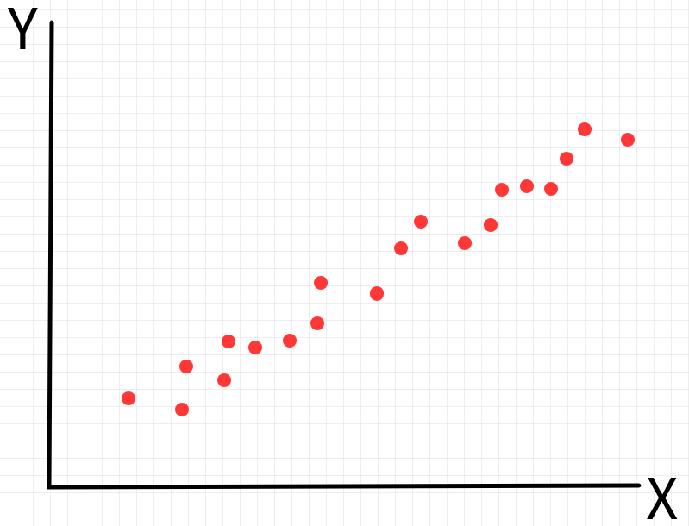
Supervised Learning
cricket chirps / min | temperature
10 | 40
5 | 37
17 | 53
55 | 103
40 | 78
cricket chirps / min
temperature

Slide 37
Supervised Learning
cricket chirps / min | temperature
10 | 40
5 | 37
17 | 53
55 | 103
40 | 78
cricket chirps / min
temperature

Slide 38
Supervised Learning
cricket chirps / min | temperature
10 | 40
5 | 37
17 | 53
55 | 103
40 | 78
cricket chirps / min
temperature

Slide 39
Supervised Learning
cricket chirps / min | temperature
10 | 40
5 | 37
17 | 53
55 | 103
40 | 78
cricket chirps / min
temperature

Slide 40
Supervised Learning
cricket chirps / min | temperature
10 | 40
5 | 37
17 | 53
55 | 103
40 | 78
cricket chirps / min
temperature

Slide 41
Supervised Learning
cricket chirps / min | temperature
10 | 40
5 | 37
17 | 53
55 | 103
40 | 78
cricket chirps / min
temperature
This type of supervised learning is referred to as regression

Slide 42
Supervised Learning
age | tumor size | malignant
20 | 12 | 0
22 | 15 | 1
47 | 20 | 1
59 | 2 | 1

Slide 43
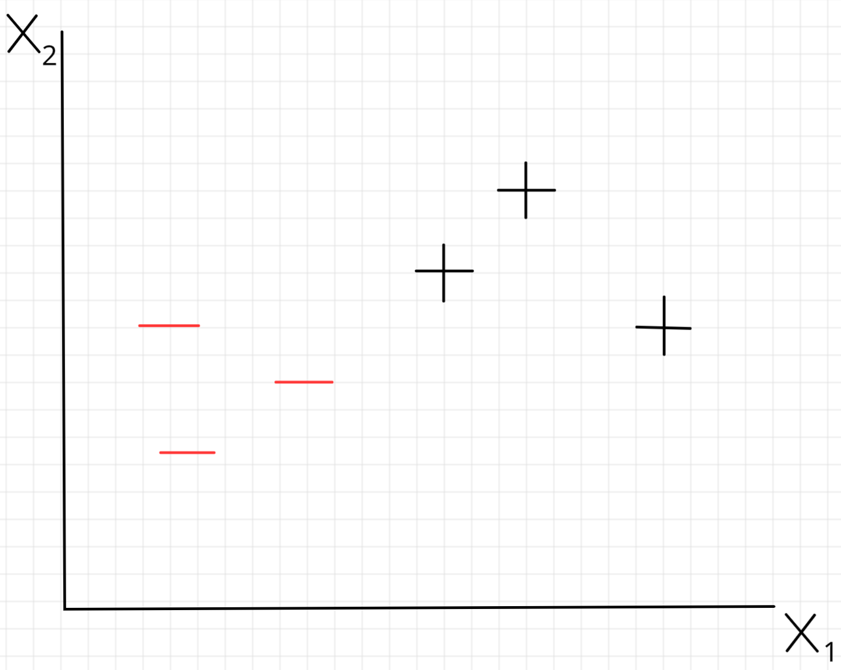
Supervised Learning
age
age | tumor size | malignant
20 | 12 | 0
22 | 15 | 1
47 | 20 | 1
59 | 2 | 1
Tumor size

Slide 44
Supervised Learning
age
age | tumor size | malignant
20 | 12 | 0
22 | 15 | 1
47 | 20 | 1
59 | 2 | 1
Tumor size

Slide 45
Supervised Learning
age
age | tumor size | malignant
20 | 12 | 0
22 | 15 | 1
47 | 20 | 1
59 | 2 | 1
Tumor size
This type of supervised learning is referred to as classification

Slide 46
Data Science Workflow (simplified)
Process Data
Explore Data
Extract Features
Create Model
Notes:
Even before this you want to make sure the problem is well-defined, solvable in a reasonable amount of time, what the definition of done is etc.

Slide 47
Data Science Workflow (simplified)
Process Data
Explore Data
Extract Features
Create Model

Slide 48
Data Processing
What data should and shouldn’t be used for the task?
What to do with missing data?
What to do with inconsistent data?
What assumptions are you making with the transformations of the data?

Slide 49
Data Science Workflow (simplified)
Process Data
Explore Data
Extract Features
Create Model

Slide 50
Exploratory Data Analysis
Describe, contextualize, and visualize the data
What might be related to what you’re trying to predict?
Are there imbalances in the data?

Slide 51
Data Science Workflow (simplified)
Process Data
Explore Data
Extract Features
Create Model

Slide 52
Feature Extraction
Are the features provided by the dataset the best features to use for the task?
What other features can be extracted?
Should existing features be transformed?

Slide 53
Data Science Workflow (simplified)
Process Data
Explore Data
Extract Features
Create Model

Slide 54
Finding the right model
Ask what and who the model is used / intended for
Is it just the general trend that is important of the exact predictions that are important?
Is this a problem that needs predictive tools to solve?
The success of this step depends entirely on the work done in previous steps - remember: garbage in, garbage out! (it’s all about the data)
Is your model easy to explain?
When your model fails, can you explain why?

