Slide 1
Clustering - Kmeans
Boston University CS 506 - Lance Galletti

Slide 2
What is a Clustering
A clustering is a grouping / assignment of objects (data points) such that objects in the same group / cluster are:
similar to one another
dissimilar to objects in other groups

Slide 3
Applications
Outlier detection / anomaly detection
Data Cleaning / Processing
Credit card fraud, spam filter etc.
Filling Gaps in your data
Using the same marketing strategy for similar people
Infer probable values for gaps in the data (similar users could have similar hobbies, likes / dislikes etc.)

Slide 4
The Clustering Problem
Given a collection of data points
Find a clustering such that:
Similar data points are in the same cluster
Dissimilar data points are in different clusters
Questions:
What does similar mean?
How do we find a clustering?
How do we know if we have found a good clustering?

Slide 5
Clusters can be Ambiguous

Slide 6
Types of Clusterings
Partitional
Each object belongs to exactly one cluster
Hierarchical
A set of nested clusters organized in a tree
Density-Based
Defined based on the local density of points
Soft Clustering
Each point is assigned to every cluster with a certain probability

Slide 7
Partitional Clustering

Slide 8
Partitional Clustering
Given n data points and a number k of clusters: partition the n data points into k clusters.

Slide 9
Partitional Clustering
Suppose we are given all possible ways of distributing these n data points into these k buckets / clusters. How would we find the best such partition?
VS
Notes:
Recall our goal: similar items should belong to the same cluster & dissimilar items should belong to different clusters.
A good partition is one where the total dissimilarity of points within each cluster is small.

Slide 10
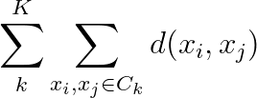
Example
VS
Clearly the clustering on the left has smaller intra-cluster distances than the one on the right. That is:
Is a smaller quantity

Slide 11
Example
VS
Given a distance function d, we can find points (not necessarily part of our dataset) for each cluster called centroids that are at the center of each cluster.

Slide 12
Example
VS
Q: When d is Euclidean, what is the centroid (also called center of mass) of m points {x₁, … , x_{m}} ?
A: The mean / average of the points

Slide 13
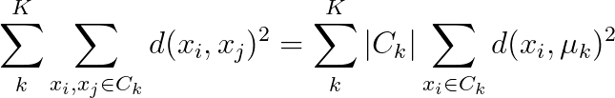
Example
VS
Turns out when d is Euclidean:

Slide 14

K-means
Given X = {x₁, … , x_{n}} our dataset and k
Find k points {𝝻₁, … , 𝝻_{k}} that minimize the cost function:
d(x, 𝜇_{i})
When k=1 and k=n this is easy. Why?
When x_{i} lives in more than 2 dimensions, this is a very difficult (NP-hard) problem

Slide 15
K-means - Lloyd’s Algorithm
Randomly pick k centers {𝝻₁, … , 𝝻_{k}}
Assign each point in the dataset to its closest center
Compute the new centers as the means of each cluster
Repeat 2 & 3 until convergence

Slide 16
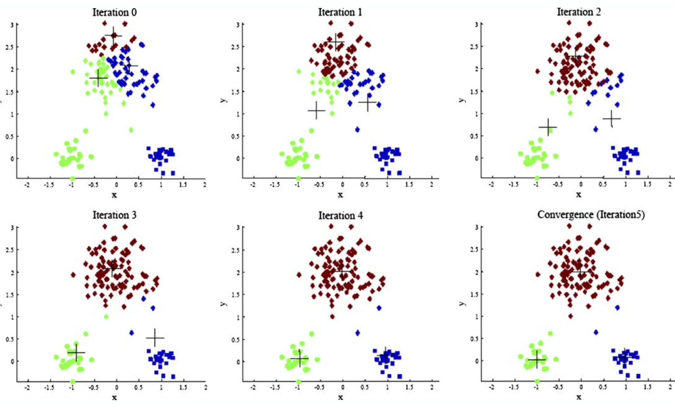
K-means - Lloyd’s Algorithm

Slide 17
K-means - Lloyd’s Algorithm
Will this algorithm always converge?
Proof (by contradiction): Suppose it does not converge. Then, either:
The minimum of the cost function is only reached in the limit (i.e. after an infinite number of iterations).
Impossible because we are iterating over a finite set of partitions
The algorithm gets stuck in a cycle / loop
Impossible since this would require having a clustering that has a lower cost than itself and we know:
If old ≠ new clustering then the cost has improved
If old = new clustering then the cost is unchanged
Conclusion: Lloyd’s Algorithm always converges!

Slide 18
K-means - Lloyd’s Algorithm
Will this always converge to the optimal solution?

Slide 19
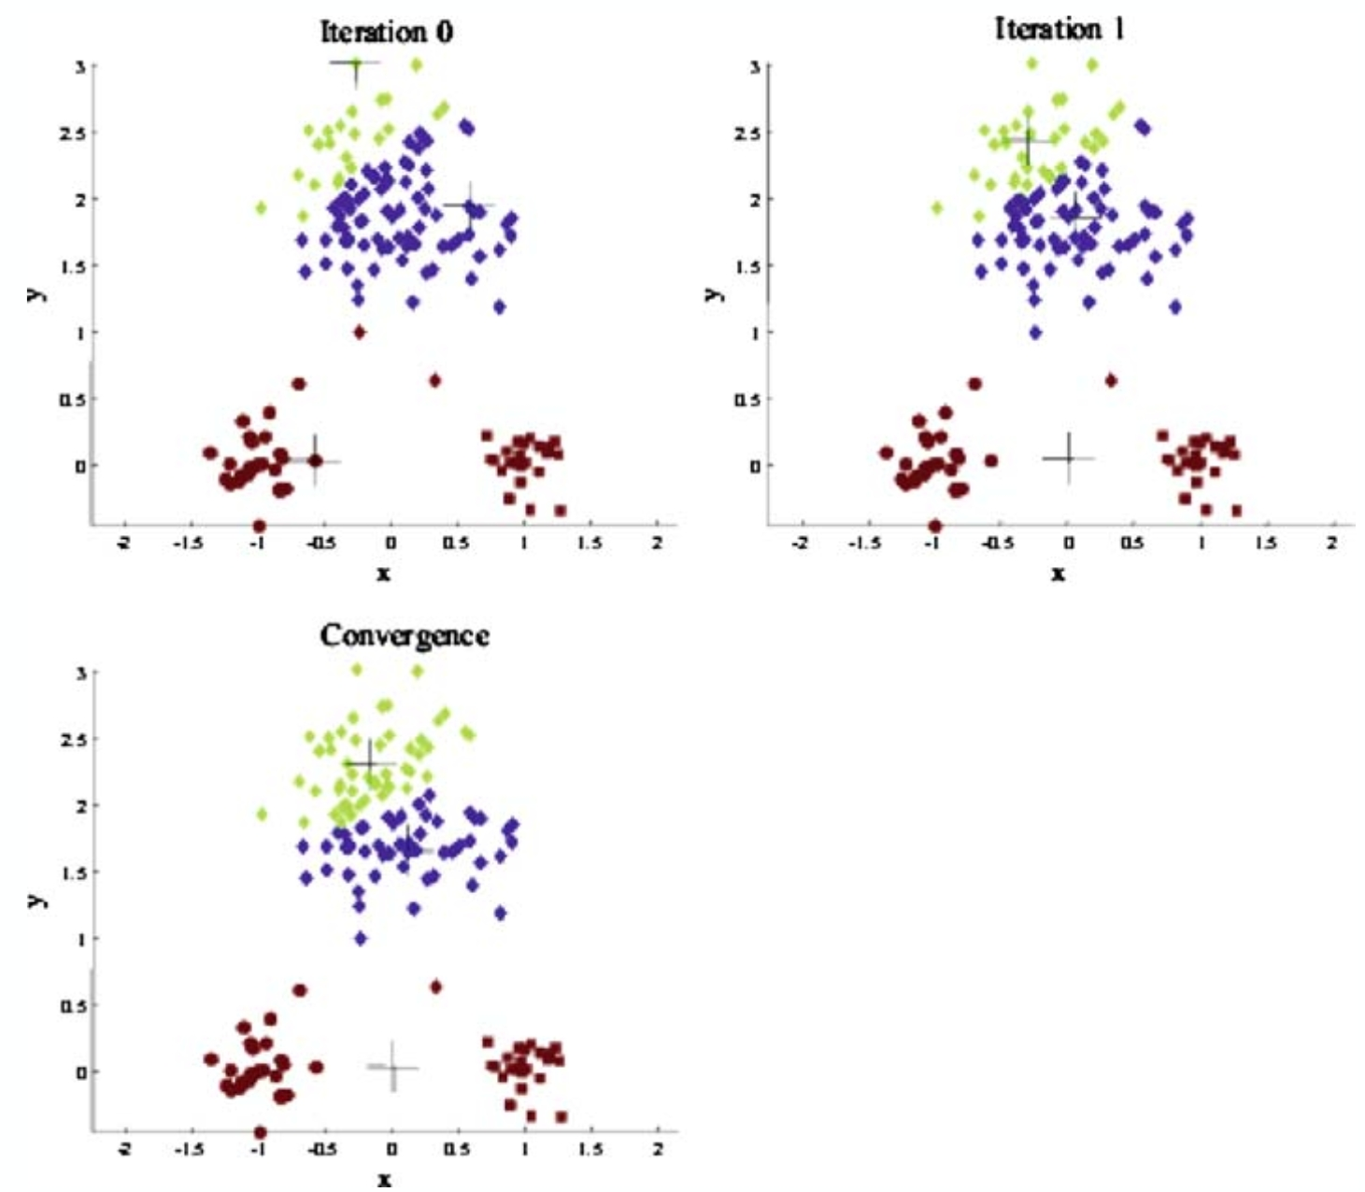
K-means - Lloyd’s Algorithm
The choice of initial points has a large influence on the resulting clustering

Slide 20
K-means - Initialization
One solution: Run Lloyd’s algorithm multiple times and choose the result with the lowest cost.
This can still lead to bad results because of randomness.
Another solution: Try different initialization methods

Slide 21
K-means - Random

Slide 22
K-means - Random
Starting with initialization points too close to each other may problematic

Slide 23
K-means - Farthest First Traversal

Slide 24
K-means - Farthest First Traversal
Pick the first center at random

Slide 25
K-means - Farthest First Traversal
Pick the next center to be the point farthest from all previous

Slide 26
K-means - Farthest First Traversal
Pick the next center to be the point farthest from all previous

Slide 27
K-means - Farthest First Traversal

Slide 28
K-means - FFT and outliers

Slide 29
K-means - FFT and outliers

Slide 30
K-means - FFT and outliers

Slide 31
K-means - FFT and outliers

Slide 32
K-means - FFT and outliers
Random might have worked better here

Slide 33
K-means++
Initialize with a combination of the two methods:
Start with a random center
Let D(x) be the distance between x and the centers selected so far. Choose the next center with probability proportional to D(x)ª
When:
a = 0 : random initialization (all points have equal probability)
a = ∞ : farthest first traversal
a = 2 : K-means++

Slide 34
K-means++

Slide 35
K-means++
No reason to use k-means over k-means++

Slide 36
K-means++
Suppose we are given a black box that will generate a uniform random number between 0 and any N. How can we use this black box to select points with probability proportional to D(x)ª?

Slide 37
K-means++
Suppose we are given a black box that will generate a uniform random number between 0 and any N. How can we use this black box to select points with probability proportional to D(x)ª?

Slide 38
K-means++
Suppose we are given a black box that will generate a uniform random number between 0 and any N. How can we use this black box to select points with probability proportional to D(x)²?
Let’s set a = 2
x
D(x)² = 3² = 9
D(y)² = 2² = 4
D(z)² = 1² = 1
y
z

Slide 39
K-means++
Suppose we are given a black box that will generate a uniform random number between 0 and any N. How can we use this black box to select points with probability proportional to D(x)²?
Let’s set a = 2
x
D(x)² = 3² = 9
D(y)² = 2² = 4
D(z)² = 1² = 1
y
z
0
N

Slide 40
K-means++
Suppose we are given a black box that will generate a uniform random number between 0 and any N. How can we use this black box to select points with probability proportional to D(x)²?
Let’s set a = 2
x
D(x)² = 3² = 9
D(y)² = 2² = 4
D(z)² = 1² = 1
y
z
z
0
N

Slide 41
K-means++
Suppose we are given a black box that will generate a uniform random number between 0 and any N. How can we use this black box to select points with probability proportional to D(x)²?
Let’s set a = 2
x
D(x)² = 3² = 9
D(y)² = 2² = 4
D(z)² = 1² = 1
y
z
z
y
y
y
y
0
N

Slide 42
K-means++
Suppose we are given a black box that will generate a uniform random number between 0 and any N. How can we use this black box to select points with probability proportional to D(x)²?
Let’s set a = 2
x
D(x)² = 3² = 9
D(y)² = 2² = 4
D(z)² = 1² = 1
y
z
z
y
y
y
y
x
x
x
x
x
x
x
x
x
0
N

Slide 43
K-means++
Suppose we are given a black box that will generate a uniform random number between 0 and any N. How can we use this black box to select points with probability proportional to D(x)²?
Let’s set a = 2
x
D(x)² = 3² = 9
D(y)² = 2² = 4
D(z)² = 1² = 1
y
z
z
y
y
y
y
x
x
x
x
x
x
x
x
x
0
N
= D(x)² + D(y)² + D(z)² = 14

Slide 44
K-means++
Suppose we are given a black box that will generate a uniform random number between 0 and any N. How can we use this black box to select points with probability proportional to D(x)²?
Using the black box, we can generate a number between 0 and N to determine which point to pick next. It will be chosen with probability proportional to D(x)².
z
y
y
y
y
x
x
x
x
x
x
x
x
x
0
N
= D(x)² + D(y)² + D(z)² = 14

Slide 45
K-means++
What happens if the black box can only generate numbers between 0 and 1?

Slide 46
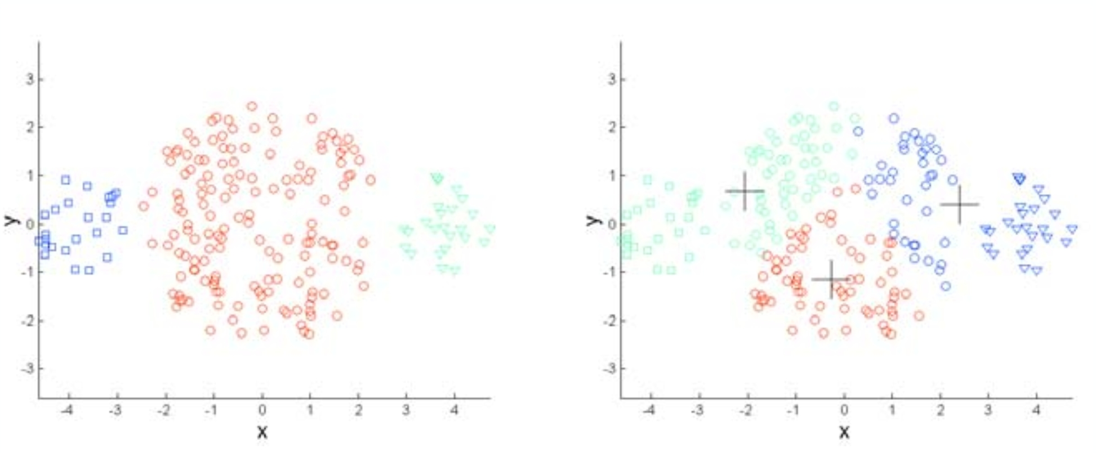
K-means - Limitations

Slide 47
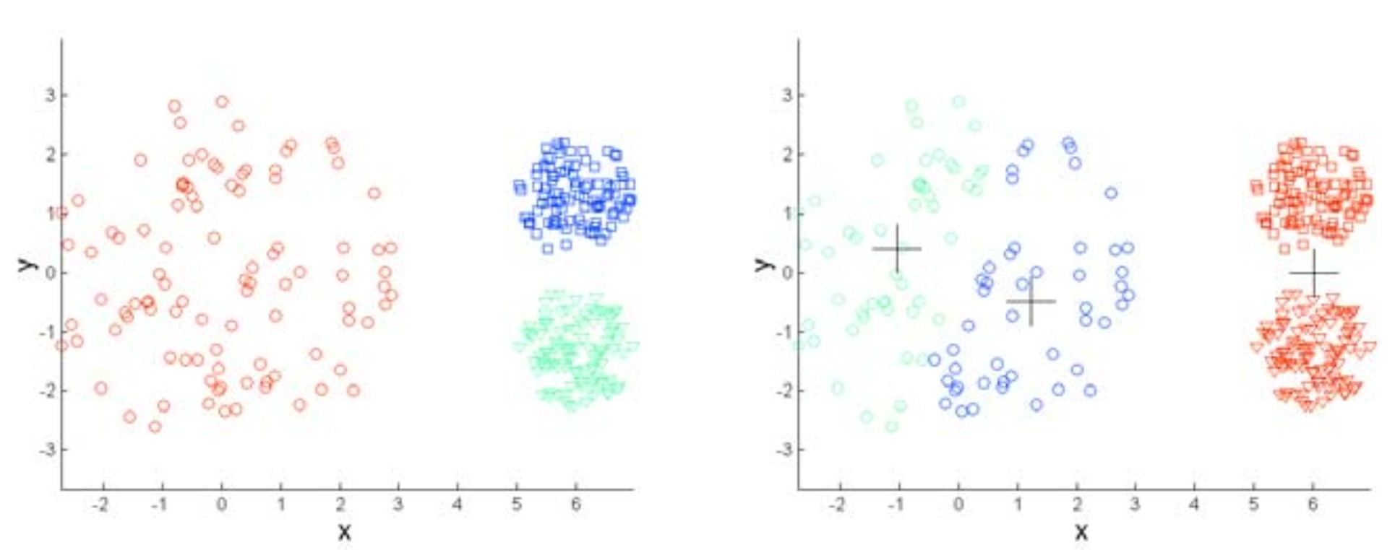
K-means - Limitations

Slide 48
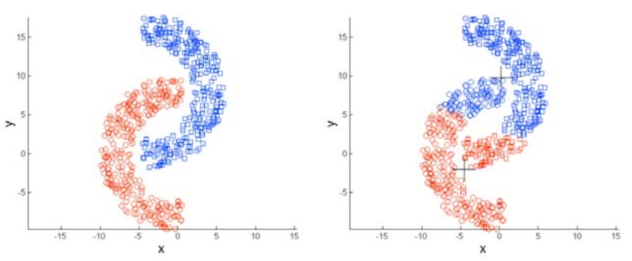
K-means - Limitations

Slide 49
How to choose the right k?
Iterate through different values of k (elbow method)
Use empirical / domain-specific knowledge
Example: Is there a known approximate distribution of the data? (K-means is good for spherical gaussians)
Silhouette scores

Slide 50
K-means Variations
K-medians (uses the L₁ norm / manhattan distance)
K-medoids (any distance function + the centers must be in the dataset)
Weighted K-means (each point has a different weight when computing the mean)

