Slide 1
Colored Petri Nets (CPN)
Yasser Ganji Saffar
Mohsen Jamali
Mahmoud Neshati

Slide 2
Outline
Motivation
Introduction
Semantics
Tools and Applications

Slide 3
Motivation: From Petri Nets to CPN
Dining Philosophers Example

Slide 4
Dining Philosophers
ready
take_right
Eat
has_right
has_both
take_left

Slide 5
phil3_take_left
phil1_take_right
phil3_has_both
phil1_ready
phil3_has_right
phil1_finished
phil1_has_right
phil3_finished
fork1
phil3_take_right
phil1_has_both
phil1_take_left
phil3_ready
fork3
fork2
phil2_has_both
phil2_ready
phil2_finished
phil2_has_right
phil2_take_left
phil2_take_right

Slide 6
Using Colored Tokens
forks
fork1
fork3
fork2

Slide 7
phil3_take_left
1
1
phil1_take_right
phil3_has_both
phil1_ready
phil3_has_right
1
phil1_finished
phil1_has_right
phil3_finished
1
fork1
3
2
phil3_take_right
phil1_has_both
phil1_take_left
phil3_ready
3
fork3
fork2
2
3
2
3
2
phil2_has_both
phil2_ready
phil2_finished
phil2_has_right
phil2_take_left
phil2_take_right

Slide 8
phil3_take_left
1
1
phil1_take_right
phil3_has_both
phil1_ready
phil3_has_right
phil1_finished
phil1_has_right
phil3_finished
1
1
forks
phil3_take_right
3
2
1
phil1_has_both
phil1_take_left
3
phil3_ready
3
2
2
3
3
2
2
phil2_has_both
phil2_ready
phil2_finished
phil2_has_right
phil2_take_left
phil2_take_right

Slide 9
Folded Philosophers
forks
f
f
if p=3 then 1 else p+1
p
phil_has_both
phil_ready
p
p
phil_finished
p
p
phil_has_right
phil_take_left
p
p
phil_take_right
f == (if p=3 then 1 else p+1)
f == p

Slide 10
CPN Model
val n=3;
color PH = index ph with 1.. n;
color FK = index fk with 1.. n;
var p: PH;
forks(ph(i)) = 1`fk(i)++1`fk(if i=n then 1 else i+1);
PH.all()
Think
PH
p
Take Forks
forks(p)
p
p
FK.all()
Unused forks
Eat
FK
PH
p
Demo
Put down Forks
forks(p)

Slide 11
What is a CPN?
Modeling language for systems where synchronization, communication, and resource sharing are important.
Combination of Petri Nets and Programming Language:
Control structures, synchronization, communication, and resource sharing are described by Petri Nets.
Data and data manipulations are described by functional programming language.
Colored Petri Nets is developed at University of Aarhus, Denmark over the last 30 years.

Slide 12
CP-nets versus Petri Nets
Each CPN can be transformed into an equivalent Petri Net and vice versa.
If the CPN has infinite types, such as the integers, text strings or reals, the equivalent Petri Net may become infinite.
Since the expressive power of the two formalisms are the same, there is no theoretical gain by using CP-nets.
However, in practice, CP-nets constitute a more compact, and much more convenient, modeling language than PT-nets – in a similar way as high-level programming languages are much more adequate for practical programming than assembly code and Turing machines.

Slide 13
A Real Example of Colored Petri Nets

Slide 14
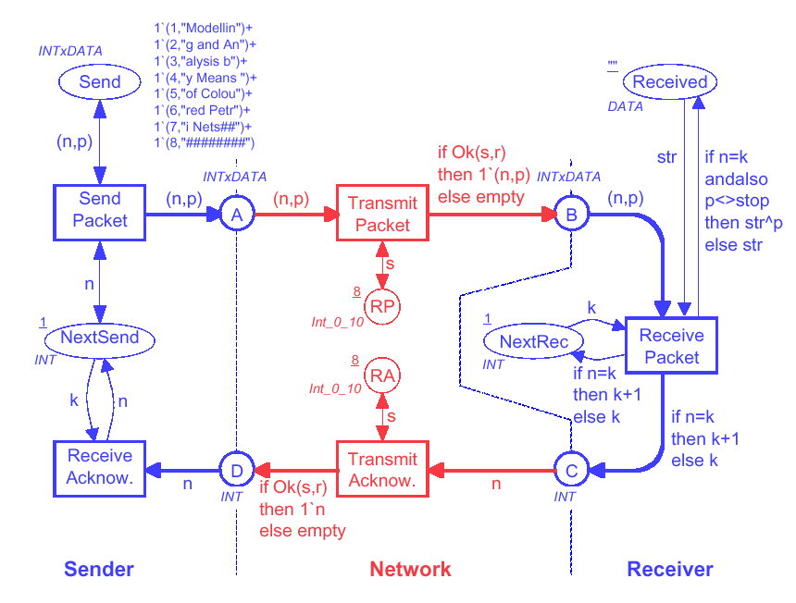
Simple protocol

Slide 15
Simple protocol
Places

Slide 16
Simple protocol
Transitions

Slide 17
Simple protocol
Place
Type (colour set)

Slide 18
Simple protocol
Place
Initial Marking

Slide 19
Marking of Send
1 ` (1,"Modellin") ++
1 ` (2,"g and An") ++
INTxDATA
8
1 ` (3,"alysis b") ++
1 ` (4,"y Means ") ++
Send
1 ` (5,"of Colou") ++
1 ` (6,"red Petr") ++
1 ` (7,"i Nets##") ++
1 ` (8,"########")
Number of tokens
Multi-set of
token colours

Slide 20
Simple protocol
Arc Inscriptions

Slide 21
Simple protocol

Slide 22
Simple protocol
Buffer places
Interface

Slide 23
Simple protocol
Packets to be sent

Slide 24
Simple protocol
Counter

Slide 25
Simple protocol
Counter

Slide 26
Simple protocol
Data received

Slide 27
Simple protocol

Slide 28
Send packet
p = "Modellin"
The binding <n=1,p="Modellin">
is enabled.
(1,p)
When the binding occurs it adds a token to place A.
This represents that the packet (1,"Modellin") is sent to the network.
1
1`(1,"Modellin")
The packet is not removed from place Send and the NextSend counter is not changed.
n = 1

Slide 29
Simple protocol

Slide 30
Transmit packet
R 1. .10
if Ok(s,r)
INTxDATA
then 1`(n,p)
INTxDATA
(n,p)
Transmit
else empty
A
B
Packet
1
1`(1,"Modellin")
s
s = 8
n = 1,
p = "Modellin"
8
RP
1
1`8
Int_0_10
All enabled bindings are on the form:
<n=1,p= "Modellin",s=8,r=...>
where r 1. .10

Slide 31
Loss of packets
if Ok(s,r)
then 1`(n,p)
else empty
The function Ok(s,r) checks whether r s.
For r 1. .8, Ok(s,r)=true. The token is moved from A to B. This means that the packet is successfully transmitted over the network.
For r 9. .10, Ok(s,r)=false. No token is added to B. This means that the packet is lost.
The CPN simulator makes random choices between bindings: 80% chance for successful transfer.

Slide 32
Simple protocol

Slide 33
Receive packet
The number of the incoming packet n and the number of the expected packet k are compared.

Slide 34
Correct packet number
The data in the packet is concatenated to the data already received.
The NextRec counter is increased by one.
An acknowledgement is sent. It contains the number of the next packet the receiver wants to get.

Slide 35
Wrong packet number
The data in the packet is ignored.
The NextRec counter is unchanged.
An acknowledgement is sent. It contains the number of the next packet the receiver wants to get.

Slide 36
Simple protocol

Slide 37
Transmit acknowledgement
This transition works in a similar way as Transmit Packet.
The marking of RA determines the success rate.

Slide 38
Simple protocol

Slide 39
Receive acknowledgement
When an acknowledgement arrives to the Sender it is used to update the NextSend counter.
In this case the counter value becomes 2, and hence the Sender will begin to send packet number 2.

Slide 40
Modules

Slide 41
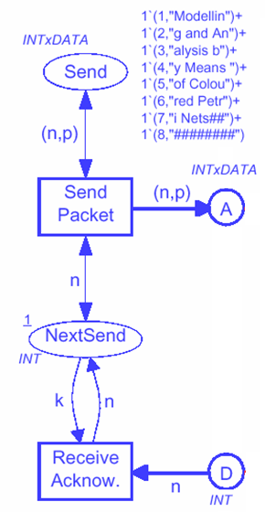
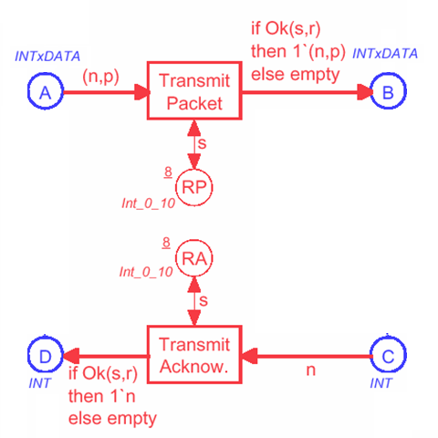
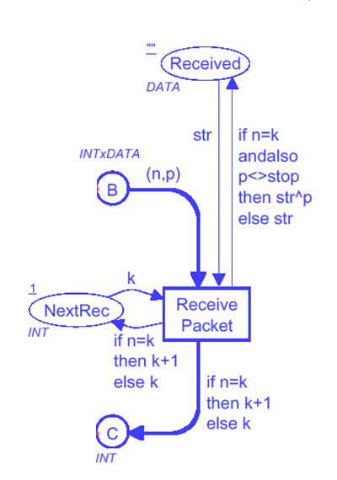
Three different modules
Sender
Receiver
I/O
Network
Out
In
Out
In
In
Out
In
Out
Port places are used to exchange tokens between modules.

Slide 42
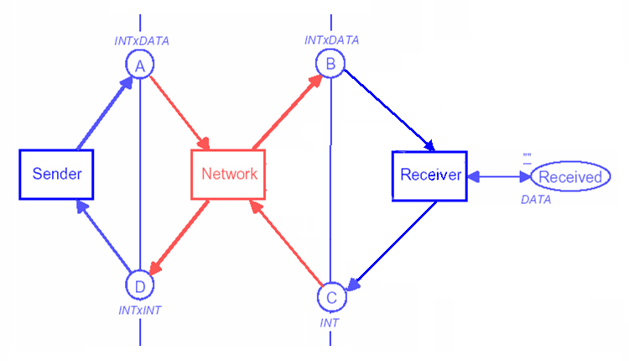
Abstract view
Protocol
HS
HS
HS
Sender
Network
Receiver
Substitution transitions refer to modules.
Socket places are related to port places.

Slide 43
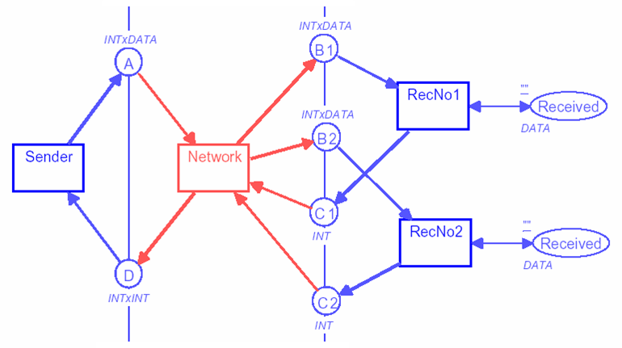
Modules can be reused
Protocol
HS
Receiver
HS
HS
Sender
Network
HS
Receiver

Slide 44
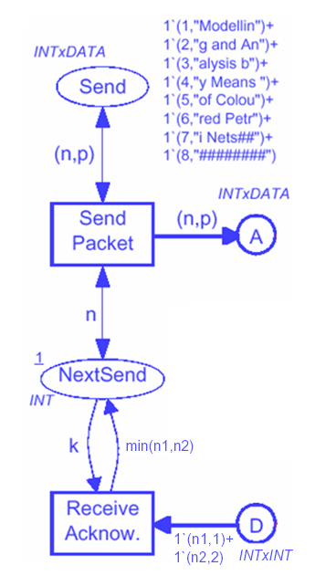
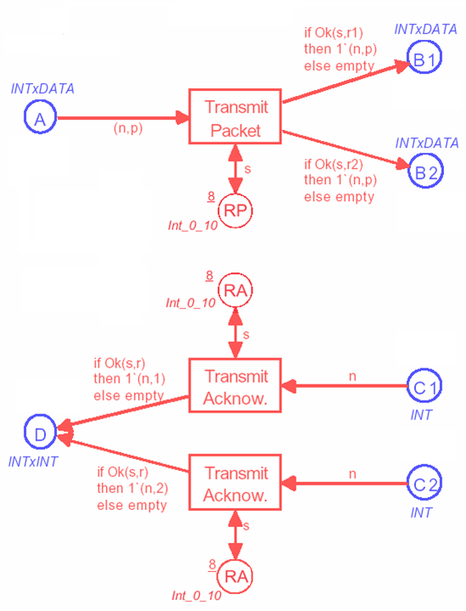
Protocol with multiple receivers
Network
Sender
Receiver
Out
I/O
In
Out
Out
In
In
Out
In
Out
In

Slide 45
Tools and Applications

Slide 46
Tools
Design/CPN was developed in the late 80'ies and early 90'ies.
Until recently, it was the most widely used Petri net package.
Used by 1000 different organizations in more than 60 countries – including 200 commercial companies.
CPN Tools is the next generation of tool support for Coloured Petri Nets.
It has now replaced Design/CPN with 1250 users in more than 75 countries.
It is a tool for editing, simulating and analyzing Colored Petri Nets.

Slide 47
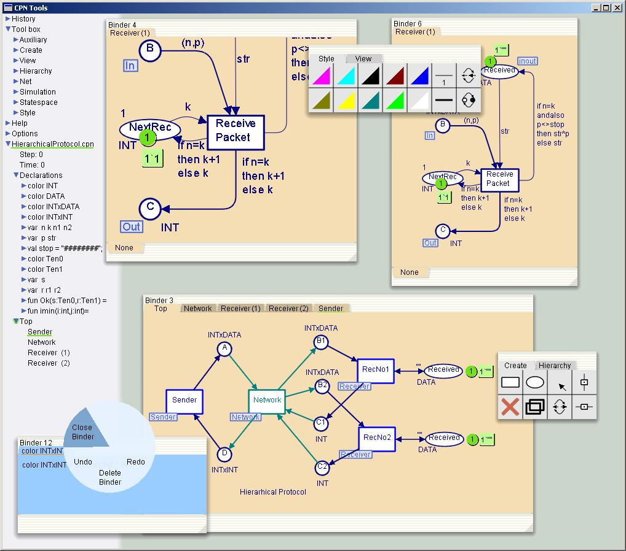

Slide 48
CPN Tools and Design/CPN
The functionality of the two tools is the same:
Editing and syntax check of CP-nets.
Interactive and automatic simulation.
Construction and analysis of state spaces.
Communication with other tools.
Simulation based performance analysis.
Graphical animation of simulation results.

Slide 49
Application Areas
Protocols and Networks
Intelligent Networks at Deutsche Telekom
IEEE 802.6 Configuration Control at Telstra Research Labs
Allocation Policies in the Fieldbus Protocol in Japan
ISDN Services at Telstra Research Laboratories
Protocol for an Audio/Video System at Bang & Olufsen
TCP Protocols at Hewlett-Packard
Local Area Network at University of Las Palmas
UPC Algorithms in ATM Networks at University of Aarhus
BRI Protocol in ISDN Networks
Network Management System at RC International A/S
Interprocess Communication in Pool IDA at King's College

Slide 50
Application Areas
Software
Mobile Phones at Nokia
Bank Transactions & Interconnect Fabric at Hewlett-Packard
Mutual Exclusion Algorithm at University of Aarhus
Distributed Program Execution at University of Aarhus
Internet Cache at the Hungarian Academy of Science
Electronic Funds Transfer in the US
Document Storage System at Bull AG
ADA Program at Draper Laboratories
Hardware
Superscalar Processor Architectures at Univ. of Newcastle
VLSI Chip in the US
Arbiter Cascade at Meta Software Corp.

Slide 51
Application Areas
Control of Systems
Security and Access Control Systems at Dalcotech A/S
Mechatronic Systems in Cars at Peugeot-Citroën in France
European Train Control System in Germany
Flowmeter System at Danfoss
Traffic Signals in Brazil
Chemical Production in Germany
Model Train System at University of Kiel
Military Systems
Military Communications Gateway in Australia
Influence Nets for the US Air Force
Missile Simulator in Australia
Naval Command and Control System in Canada

Slide 52
References
Kurt Jensen. A brief introduction to colored Petri nets. In: Proc. Workshop on the Applicability of Formal Models, 2 June 1998, Aarhus, Denmark, pages 55-58. 1998.
Kurt Jensen. An Introduction to the Theoretical Aspects of Coloured Petri Nets. In Lecture Notes in Computer Science (803), pp. 230-272. SpringerVerlag, 1994.
Kurt Jensen, Coloured Petri Nets, Department of Computer Science University of Aarhus, Denmark, Powerpoint Presentation
http://wiki.daimi.au.dk/cpntools/cpntools.wiki
Anne Vinter Ratzer, Lisa Wells, Henry Michael Lassen, Mads Laursen, Jacob Frank Qvortrup, Martin Stig Stissing, Michael Westergaard. CPN Tools for Editing, Simulating, and Analysing Coloured Petri Nets. 2000
Michel Beaudouin-Lafon, Wendy E. Mackay, Peter Andersen, Paul Janecek, Mads Jensen, Michael Lassen, Kasper Lund, Kjeld Mortensen, Stephanie Munck. CPN/Tools: A Post-WIMP Interface for Editing and Simulating Coloured Petri Nets. 2000

Slide 53
Formal Definition

