Slide 1
Machine Learning Applied to Electrified Vehicle Battery State of Charge and State of Health Estimation : State-of-the-Art
2020.07.08
Youngjo Cha
Mobile & Network Intelligence Laboratory

Slide 2
2. Battery State of Charge Estimation
This is not an easy task due to the nonlinear nature of the battery.
An accurate estimation of the SOC is crucial to improve vehicle performance, safety, passenger comfort, and to minimize costs associated with over design or oversizing of the pack.
Notes:
[1] The battery SOC is the equivalent of a fuel gauge used in traditional gasoline vehicles. Although, unlike the fuel gauge, to determine the percentage of useful energy left inside the battery, it is necessary to perform an indirect measurement of the SOC via estimation.
[2] This is done by a great variety of methods and techniques which use measurable signals such as the battery terminal voltage, current, and temperature.

Slide 3
2. Battery State of Charge Estimation
ML SOC estimation methods
A. Feedforward neural network (FNN)
B. Radial basis function (RBF) neural network
C. Extreme learning machine (ELM)
D. Support vector machine (SVM)
E. Recurrent neural network (RNN)

Slide 4
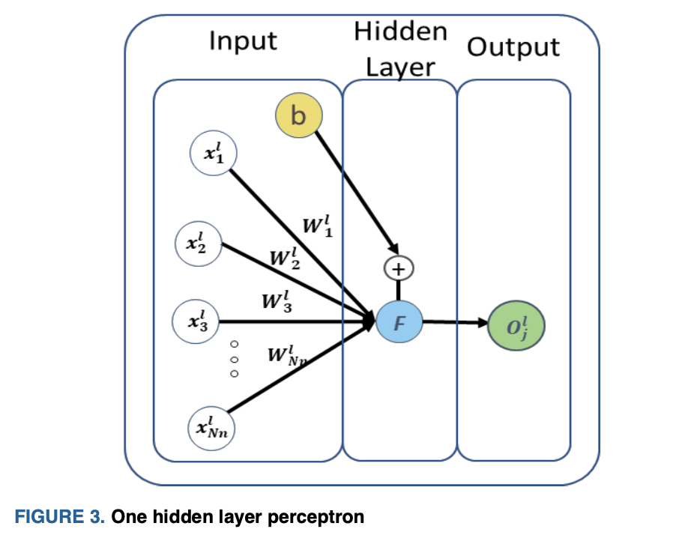
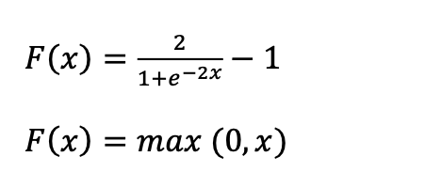
A. Feedforward Artificial Neural Network
Notes:
[1] A FNN implements non-linear mappings with an arbitrary number of inputs and outputs.
It is one of the simplest neural networks(NNs) to apply.
[2] Fig 3. shows a simple one hidden layer perceptron FNN structure with multiple inputs and a single output.
Besides the structure of the FNN, a nonlinear activation function F must also be selected a priori.
A common choice is the hyperbolic tangent function, which limits the output to values between 1 and -1.
Alternatively, a rectified linear unit(RELU), can be chosen and consists of a function that sets all negative input values to zero.
The training process aims to find the values of the learnable parameters, the weights and bias for the one layer perceptron, to minimize a sum of the squared error loss function.

Slide 5
1) FNN Combined With Filters And Other Models
[14] : a hybrid approach, which has combined the use of an ECM and FNN. which, instead of using a lookup table(LUT) to correlate the battery SOC to the battery OCV, an FNN model was trained to make this correlation.
[14] X. Dang, L. Yan, H. Jiang, X. Wu, and H. Sun, “Open-circuit voltage- based state of charge estimation of lithium-ion power battery by combining controlled auto-regressive and moving average modeling with feedforward-feedback compensation method,” Int. J. Electr. Power Energy Syst., vol. 90, pp. 27–36, 2017.

Slide 6
1) FNN Combined With Filters And Other Models
[15] : and FNN was built to estimate the SOC of an LFP battery and an Unscented Kalman filter was then used to improve the SOC estimation accuracy.
The FNN presented in [15] is a supervised ML algorithm, which is characterized by the use of known reference or target employed to calculate the ML output estimation error.
[15] W. He, N. Williard, C. Chen, and M. Pecht, “State of charge estimation for Li-ion batteries using neural network modeling and unscented Kalman filter-based error cancellation,” Int. J. Electr. Power Energy Syst., vol. 62, pp. 783–791, 2014.

Slide 7
2) FNN Directly Used For SOC Estimation
A work using an FNN, but without the use of Kalman filter, was presented in [11] for a 12V hybrid energy storage system.
An FNN was developed to simultaneously estimate the SOC of both batteries using the same neural network structure.
[11] C. Vidal, M. Haussman, D. Barroso, P. Mahvelatishamsabadi, A. Biswas, E. Chemali, R. Ahmed, and A. Emadi, “Hybrid energy storage system State-Of-Charge estimation using artificial neural network for micro- hybrid application,” in Proc. 2018 IEEE Transportation Electrification
Notes:
This system was composed of a 12V LFP battery and a 12V lead-acid battery
to power a belt starter generator system
where the electric machine functioned as either a motor or generator according to the control strategy,
which kept the Li-ion battery cycling within a partial SOC window.

Slide 8
2) FNN Directly Used For SOC Estimation
However, a benchmark comparison with two separate single-output NN models that estimate SOC of each cell type was not performed.

Slide 9
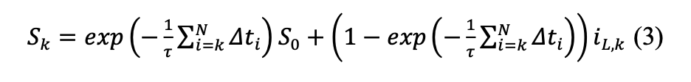
2) FNN Directly Used For SOC Estimation
Because different sources influence the Li-ion batteries’ characteristics, e.g., SOC, SOH, current, and temperature, the authors in [17], have considered the use of the battery polarization states as inputs for an FNN model trained to estimate battery SOC.
C. Chen, R. Xiong, R. Yang, W. Shen, and F. Sun, “State-of-charge estimation of lithium-ion battery using an improved neural network model and extended Kalman filter,” J. Clean. Prod., vol. 234, no. 5, pp. 1153– 1164, 2019.
Notes:
The polarization states can have a significant influence on battery terminal voltage and can be calculated from the battery current using equation.

Slide 10
2) FNN Directly Used For SOC Estimation
In [13], the authors have shown that the FNN is capable of estimating battery SOC at different temperatures, including temperatures as low as -20℃.
E.Chemali,P.J.Kollmeyer,M.Preindl,andA.Emadi,“State-of-charge estimation of Li-ion batteries using deep neural networks: A machine learning approach,” J. Power Sources, vol. 400, pp. 242–255, Oct. 2018.
Notes:
Although FNNs are not capable of storing and using past information from a time series,
it is possible to encode this information partially by creating new input features based on the moving average of the battery terminal voltage and current.

Slide 11
2) FNN Directly Used For SOC Estimation
Although FNNs are not capable of storing and using past information from a time series, it it possible to encode this information partially by creating new input features based on the moving average of the battery terminal voltage and current.

Slide 12
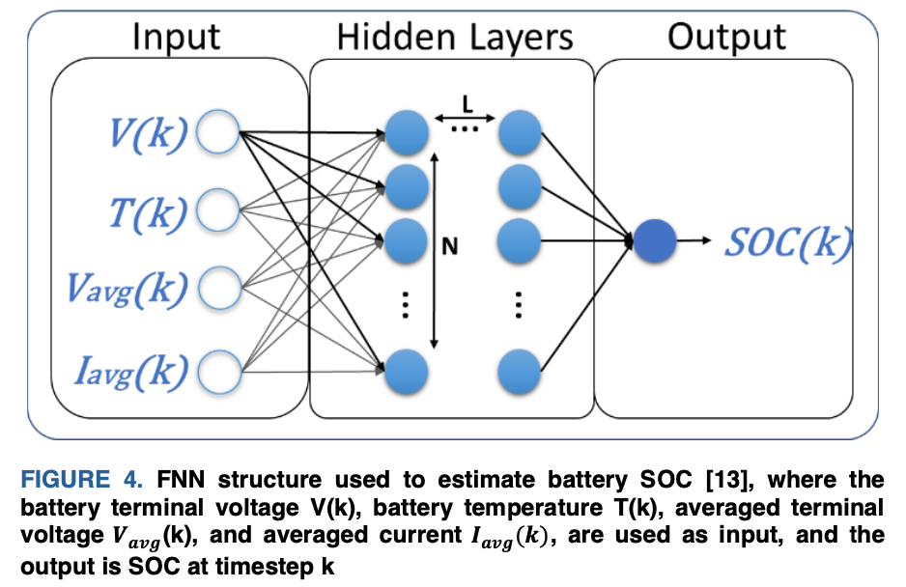
2) FNN Directly Used For SOC Estimation
Notes:
The FNN architecture used in this work is depicted Fig 4.

Slide 13
2) FNN Directly Used For SOC Estimation
In [19] the authors have used the internal resistance data, obtained from a tester in the lab, along with the voltage, current and battery temperature, to train and test an FNN to estimate SOC, although the use of the internal resistance would be a valuable input feature, not only for SOC but also for SOH estimation, its direct measurement in a vehicle would be difficult due to practical reasons.
[19] Y. Hu and Z. Wang, “Study on soc estimation of lithium battery based on improved bp neural network,” 2019 8th Int. Symp. Next Gener. Electron. ISNE 2019, pp. 1–3, 2019.
Notes:
Alternatively, using a model to estimate the battery’s internal resistance is possible and can be implemented onboard to provide real-time input information.

Slide 14
2) FNN Directly Used For SOC Estimation
Alternatively, using a model to estimate the battery’s internal resistance is possible and can be implemented onboard to provide real-time input information.

Slide 15
2) FNN Directly Used For SOC Estimation
The authors in [21] introduced a process to systemically alter the FNN structure using offline optimization algorithms to find the optimal FNN structure.
[21] M. A. Hannan, M. S. H. H. Lipu, A. Hussain, M. H. Saad, and A. Ayob, “Neural network approach for estimating state of charge of lithium-ion battery using backtracking search algorithm,” IEEE Access, vol. 6, no. c, pp. 10069–10079, 2018.
Notes:
The work has focused on the backtracking search algorithm, an optimization algorithm, which according to the authors is easier to implement, faster, and more robust when compared to other algorithms, such as a genetic algorithm(GA), particle swarm optimization(PSO), and artificial bee colony.

Slide 16
2) FNN Directly Used For SOC Estimation
The backtracking search algorithm(BSA) was set to optimize the number of neurons in the hidden layer and the learning rate value.
1) the data was collected, then filtered and normalized.
2) the SOC is estimated using a chosen primary structure to calculate the initial cost(root mean squared error) to be used in the next stage.
3) the backtracking algorithm is applied to find the number of neurons in the hidden layer, and the learning rate in which makes the SOC estimation error the lowest.
Notes:
The work has focused on the backtracking search algorithm,
an optimization algorithm, which according to the authors is easier to implement, faster, and more robust when compared to other algorithms, such as a genetic algorithm(GA), particle swarm optimization(PSO), and artificial bee colony.

Slide 17
2) FNN Directly Used For SOC Estimation
There is a great potential of using optimization algorithms to help determine the FNN structure and therefore reducing the necessity of previous engineering experience to set the “correct” FNN training parameters.

Slide 18
2) FNN Directly Used For SOC Estimation
Another unique approach was presented by the authors in [22], where they have trained a model composed of three parallel FNNs, each individually trained with distinct training data from three operation modes, idling, charging, and discharging.
[22] S. Tong, J. H. Lacap, and J. W. Park, “Battery state of charge estimation using a load-classifying neural network,” J. Energy Storage, vol. 7, pp. 236–243, 2016.
Notes:
idling - 유휴

Slide 19
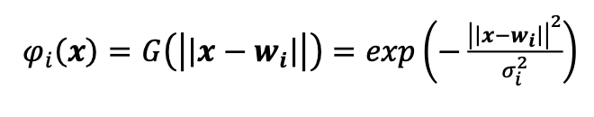
B. Radial Basis Function Neural Network
A radial basis function neural network is a class of FNN that contains only an input layer, one hidden layer, and an output layer implementing linear summation.
the hidden layer neurons in an RBF compute a Euclidean distance, multiply it by a (standard deviation related) scaling factor, and map it through a Gaussian function.
ㅇ
referred to as a radiated Gaussian kernel function
Notes:
radiated Gaussian kernel function.

Slide 20
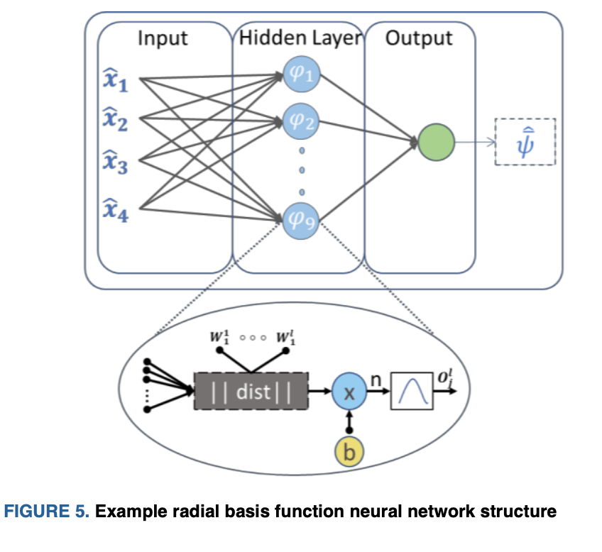
B. Radial Basis Function Neural Network
Notes:
An example RBF neural network is shown in Fig.5.
Rather than determining weight gains in the training process, centroid vectors are fitted in the RBF neural network training stage.
RBF neural networks are also typically characterized as having very fast training/learning and being good at interpolation.
The upper bound is adaptively updated by an RBF, using the structure in Fig.5, providing robust traceability and limiting the chattering magnitudes in the SOC estimation

Slide 21
B. Radial Basis Function Neural Network
In [27], the authors used the RBF to learn the dynamics of a lithium polymer battery cell trained offline with experimental battery data to estimate the SOC.
[27] X. Chen, W. Shen, M. Dai, Z. Cao, J. Jin, and A. Kapoor, “Robust Adaptive Sliding-Mode Observer Using RBF Neural Network for Lithium-Ion Battery State of Charge Estimation in Electric Vehicles,” IEEE Trans. Veh. Technol., vol. 65, no. 4, pp. 1936–1947, Apr. 2016.

Slide 22
B. Radial Basis Function Neural Network
In [29], a multi-cell Li-ion battery pack SOC estimation framework was presented, and an RBF was used to quantify the uncertainties necessary to build a response surface model of model bias.
F. Sun, R. Xiong, and H. He, “A systematic state-of-charge estimation framework for multi-cell battery pack in electric vehicles using bias correction technique,” Appl. Energy, vol. 162, pp. 1399–1409, 2016.

Slide 23
B. Radial Basis Function Neural Network
After quantifying the parameter uncertainties using the RBF, it was possible to apply the average pack model to each cell and have a better estimation of the terminal voltage.

Slide 24
C. Extreme Learning Machine
The extreme learning machine(ELM) structure is very similar to an FNN, but the main difference consists of its training algorithm, which instead of using backpropagation, the ELM uses the Moore-Penrose generalized inverse or pseudoinverse matrix.
The ELM method was compared with an RBF showing lower computational load and better SOC estimation error.

Slide 25
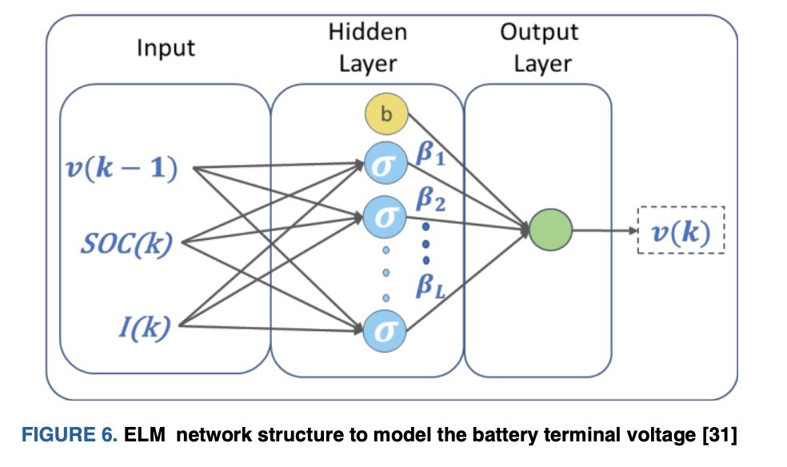
C. Extreme Learning Machine
Notes:
The extreme learning machine (ELM) structure is very similar to an FNN, but the main difference consists of its training algorithm, which instead of using backpropagation, the ELM uses the Moore-Penrose generalized inverse of pseudoinverse matrix.

Slide 26
C. Extreme Learning Machine
The ELM were up to 50% faster when compared to the RBF estimation time and have provided lower estimation error.

Slide 27
D. Support Vector Machine
The SVM was initially created to solve logistic/classification problems.
In most cases, battery SOC estimation requires a regression learning method, which sequentially minimized the error function.
The generalized regression variation of SVM, known as support vector regression (SVR), can be employed.
This technique aims to solve a regression problem for data that is not linearly separable.

Slide 28
D. Support Vector Machine
However, a crucial distinction is that SVC aims to employ simplified optimization routines such as quadratic programming with linear constraints to fit the SVR parameters.

Slide 29
D. Support Vector Machine
In [33], an SVM was applied to estimate the SOC of a 60Ah LFP.
[33] J. C. Alvarez, “Support Vector Machines Used to Estimate the Battery State of Charge,” IEEE Trans. Power Electron., vol. 28, no. 12, pp. 5919– 5926, 2013.

