Slide 1
State-of-Health Estimation of Lithium-ion Batteries Using Attention based Method
Youngjo Cha
2020.06.24
Notes:
영어. 논문 원문 작성
교수님이 ppt 자료 훑어보고도 내용 파악할 수 있게
모든 내용은 정확하게 (발표 내용에서는 모르는 내용이 없도록. 각 수식이 무엇을 의미하는지 .. 등)

Slide 2
Introduction
Lithium-ion batteries
owing to complex physical and chemical changes during use, the performance of li-ion batteries may deteriorate or malfunction.
for this reason, a lot of research has conducted on battery management system(BMS)
Notes:
리튬이온배터리 – 사용시에 물리적, 화학적 변화때문에 배터리 상태 악화
그래서 배터리 관리 시스템 등장

Slide 3
Introduction
Necessary to study the state of health(SOH) of the battery
expected life of li-ion batteries depends on the environment and the strength of use. even in the case of a battery of the same model, the battery life may be different in actual use.
Notes:
SoH estimate 연구가 필요한 이유
(논문 본문 내용 작성.)
owing to complex physical and chemical changes during use, the performance of li-ion batteries may deteriorate or malfunction.
for this reason, a lot of research has conducted on battery management system(BMS)
expected life of li-ion batteries depends on the environment and the strength of use.
even in the case of a battery of the same model, the battery life may be different in actual use.

Slide 4
Introduction
Necessary to study the state of health(SOH) of the battery
There are two types of approaches for SOH monitoring – Model based methods and data driven methods
In this paper, an attention based Gated Recurrent Unit(GRU) method for monitoring the SOH of lithium-ion batteries.
Notes:
SOH모니터링에는 두가지 방식

Slide 5
Related Work
model based methods
are principally to analyze the physical and chemical theorems of the battery and to establish a mathematical and physical model to characterize the deterioration process of the li-ion battery.
Notes:
SOH 모니터링에는 두가지 방식이 있습니다. model based, data driven
model based는 @@@ -> @@@한 점 때문에 어렵다.
data driven @@@ -> @@@하다. 더 빠르고 더 편리하다. -> 더 적절하다 (?)
data driven methods에서 using neural networks하는 연구가 최근에 많다.
@@@때문에 LSTM과 RNN을 사용하는 연구 방식이 많다.
하지만 @@@때문에 제한도 있다.

Slide 6
Related Work
data driven methods
making short-term predictions on the same battery based on data.
Recently, many methods of predicting the performance of a li-ion battery using various battery data using an artificial intelligence model have been applied.

Slide 7
Related Work
data driven methods
SOH monitoring and RUL prediction of li-ion batteries are generally materialized by analyzing previous data such as current, voltage, capacitance and impedance.
Data driven methods are faster, more convenient, and less complex when compared to model-based methods.
Notes:
기존 - RNN, LSTM
because of time series prediction
왜 GRU 우월한지
did not pay attention to the difference of contribution of each time step to the final prediction

Slide 8
Methodology
Gated Recurrent Unit
GRU is one of the variants of RNN that is a kind of neural network for learning the pattern of time series data.
better than RNN, LSTM
Notes:
traditional RNN has been applied in many fields, but the problems of gradient vanishing and gradient explosion have affected the performance of the traditional RNN.
LSTM solved this problem by adding several gating systems in the cell.
although LSTM has achieved good performance in many fields, GRU can achieve better performance on small data sets through simpler gating systems.

Slide 9

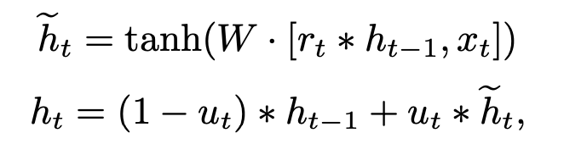

Methodology
Gated Recurrent Unit
the GRU cell only has update gate and reset gate. both can decide to ignore parts of the previous information
update gate
reset gate
Notes:
However, the update gate not only has the function of determining how much past information should be forgotten, but also has the function of determining how much new information can be added to the state.
u – update gate
r – reset gate
W – parameters to be trained
sigmoid function. tanh function
h, x – hidden state

Slide 10
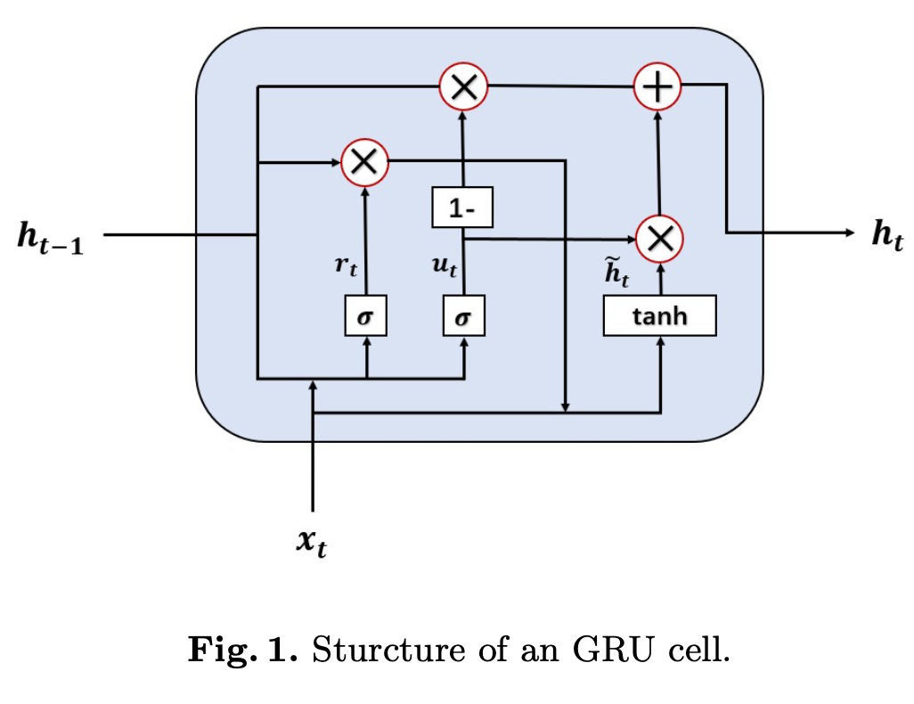
Methodology
Gated Recurrent Unit
Notes:
(수식) – 각각 @@@@을 의미한다.
(수식) – 각각 @, @, @ 을 의미한다.

Slide 11
Methodology
Proposed Attention Model
in order to make an effective estimate, we use the attention mechanism to learn which previous hidden states are closely related to the current hidden state.
to calculate the relationship between the hidden state of each time step and the current hidden state.
Notes:
For the prediction of the current time step, we believe that the most important information is the hidden state of the current time step.

Slide 12
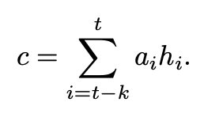

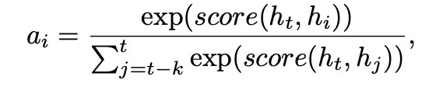
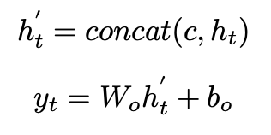
Methodology
Proposed Attention Model
scoring function
(equation)
Notes:
For the prediction of the current time step, we believe that the most important information is the hidden state of the current time step.
1)
First, we apply a scoring function to calculate the relationship between the hidden state of each time step and the current hidden state,
(scoring function)
2)
w- trainable parameters matrix, ht- the current hidden state, hi- the previous hidden state
after calculating the score, we assign weights to each hidden state to indicate its correlation with the current hidden state.
the weight of hidden state
where k is the time step length of our prediction model.
3)
use the calculated weight and hidden state at each time point to calculate the context vector as follows ( c )
4)
after the concatenation operation of the current hidden state value and the calculated context vector,
the estimated value yt is calculated by using the linear function as follows

Slide 13
Experiments
Dataset
Li-ion battery dataset from the NASA Ames Prognostics Center of Excellence(PCoE)
B0005, B0006 and B0007
Notes:
Dataset은 @@@을 이용한다.
평가지표는 RMSE이다.

Slide 14
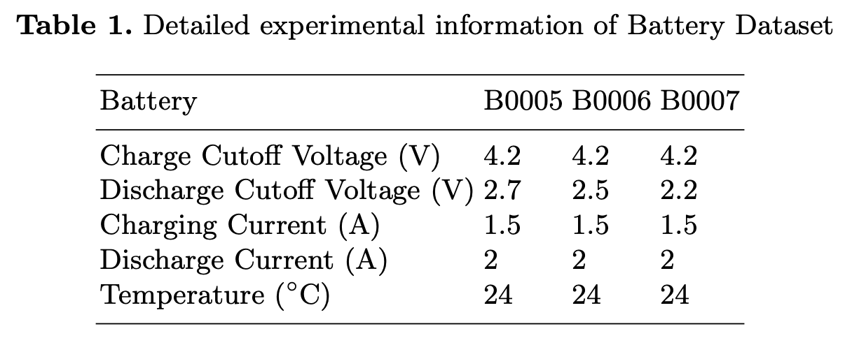
Experiments
each battery was charged and discharged at room temperature.

Slide 15
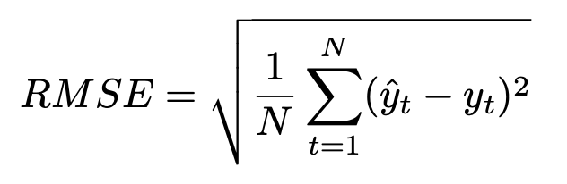
Experiments
Dataset
root mean squared error(RMSE) as the evaluation criterion.
Notes:
Dataset은 @@@을 이용한다.
평가지표는 RMSE이다.

Slide 16
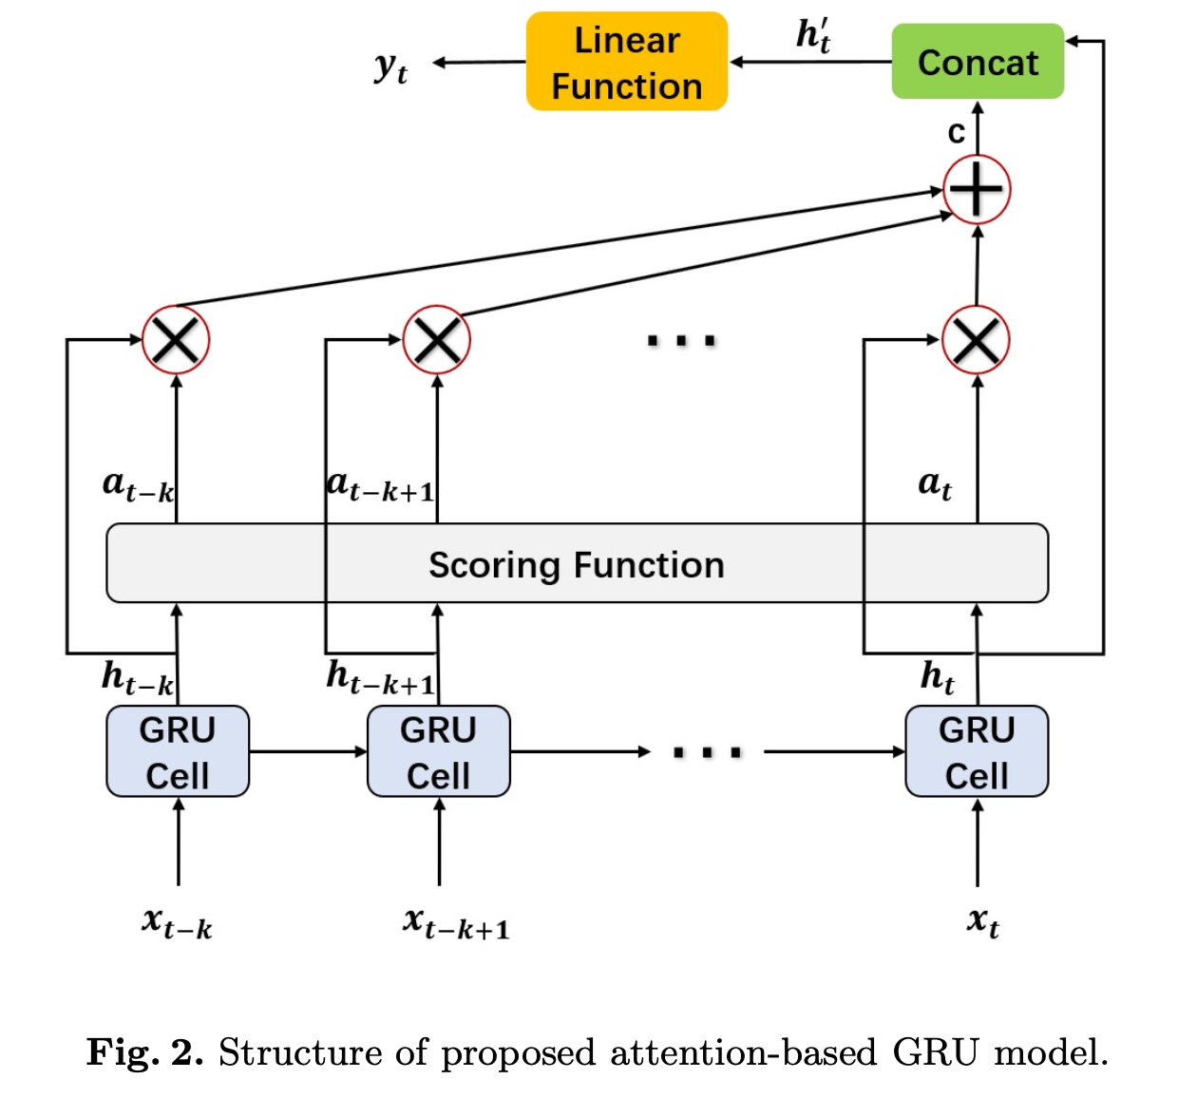
Experiments
Dataset
(Structure of proposed attention based GRU model)
Notes:
Dataset은 @@@을 이용한다.
평가지표는 RMSE이다.

Slide 17
Experiments
Comparison (general GRU and attention based GRU)
for each dataset, the data is divided into a training set, a validation set, and a training set at a ratio of 4 : 1 : 5.
parameter settings : hidden units size are among 5, 10, 15, 20; time step length are among 5, 10, 15, 20; batchsize is 32.

Slide 18
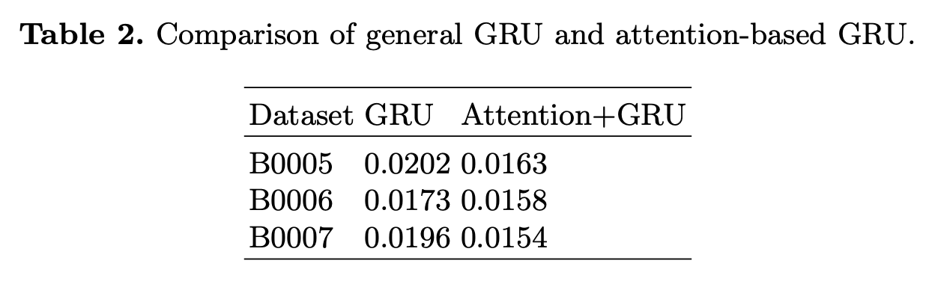
Experiments
Comparison (general GRU and attention based GRU)
(Table 2)
proposed model performs better than the general GRU in the three data sets.

Slide 19
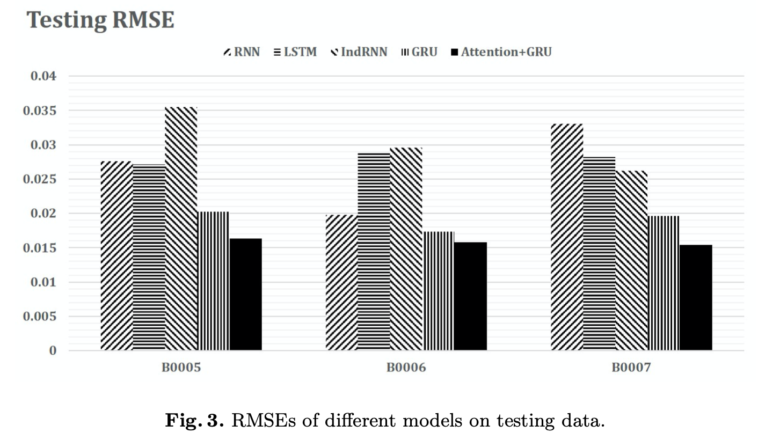
Experiments
Comparison (attention based GRU and conventional methods)
the training set, validation set, and test set are divided in proportion to the previous experiments.
Notes:
비교했을때

Slide 20
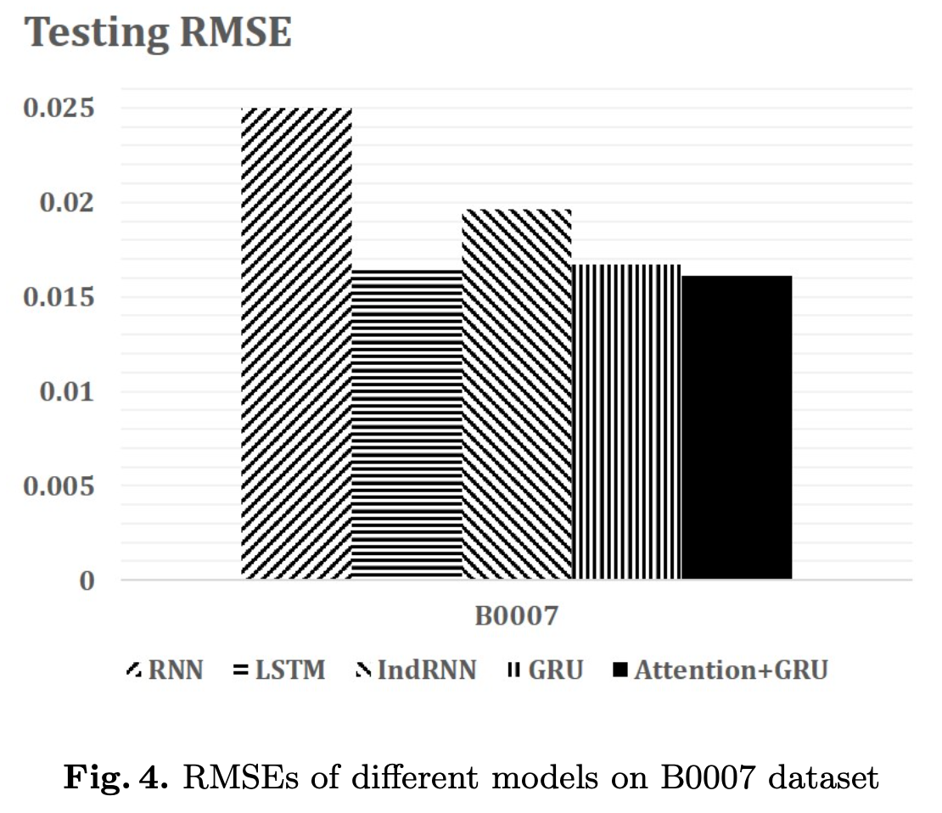
Experiments
Training (B0005, B0006) and test (B0007)

Slide 21
Conclusions
proposed model is more accurate in terms of RMSE compared to RNN, LSTM, IndRNN and GRU Networks.

