Slide 1
ParlAI : A Dialog Research Software Platform (Facebook AI: 2018)
2020.09.11
Youngjo Cha
Mobile & Network Intelligence Laboratory

Slide 2
Goals
A unified framework for development for dialog models.
General dialog involving many different skills.
Real dialog with people.
Towards a common general dialog model.
Notes:
다이얼로그 모델 개발을 위한 단일화된 프레임워크 제공
다양한 스킬을 포함하는 일반적인 다이얼로그 모델.
사람들과의 실제 대화가 가능하도록 할 것.
공통의 대화모델을 지향

Slide 3
Worlds, Agents and Teachers
Worlds | the environment vary from being very simple (just two agents conversing), to much more complex (multiple agents in an interactive environment)
Agents | an agent that can act(speak) in the world. An agent is either a learner(a machine learned system), a hard-coded bot such as one designed to interact with learners, or human(Turker)
Teachers | a type of agent that talks to the learner in order to teach it

Slide 4
코드 예제 (Fig 3)
teacher = SquadTeacher(opt) agent = MyAgent(opt) world = World(opt, [teacher, agent]) for i in range(num_exs): world.parley() print(world.display())
def parley(self): for agent in self.agents: act = agent.act() for other_agent in self.agents: if other_agent != agent: other_agent.observe(act)

Slide 5
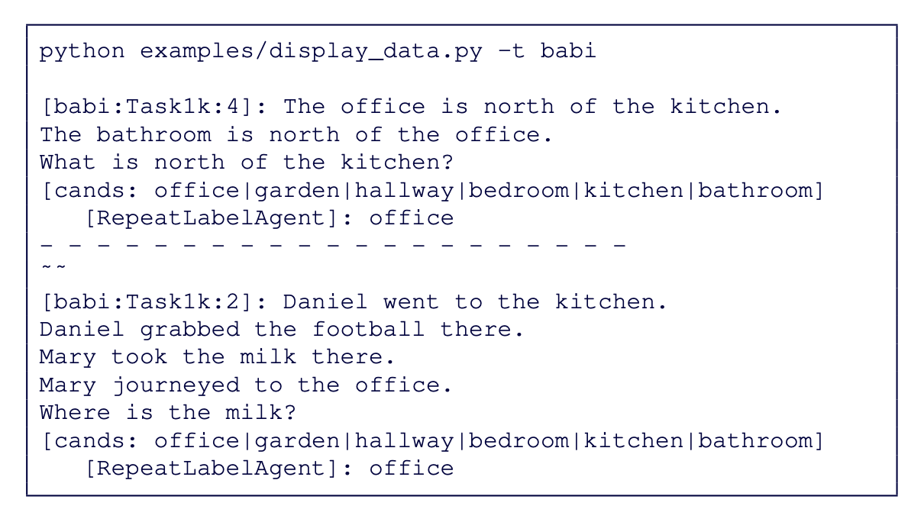
Output (Fig 4)

Slide 6
Actions and Observations
Talking (acting) / Listening (observing)
The object is returned from agent.act() and passed in to agent.observe(). (Fig 3)
def parley(self): for agent in self.agents: act = agent.act() for other_agent in self.agents: if other_agent != agent: other_agent.observe(act)

Slide 7
Code Structure - directories
core | the primary code for the platform
agents | contains agents which can interact with the worlds/tasks (learning models)
examples | contains examples of different mains(display data, training and evaluation)
tasks | contains code for the different tasks available from within ParlAI.
mturk | contains code for setting up Mechanical Turk and sample MTurk tasks.

