Slide 1
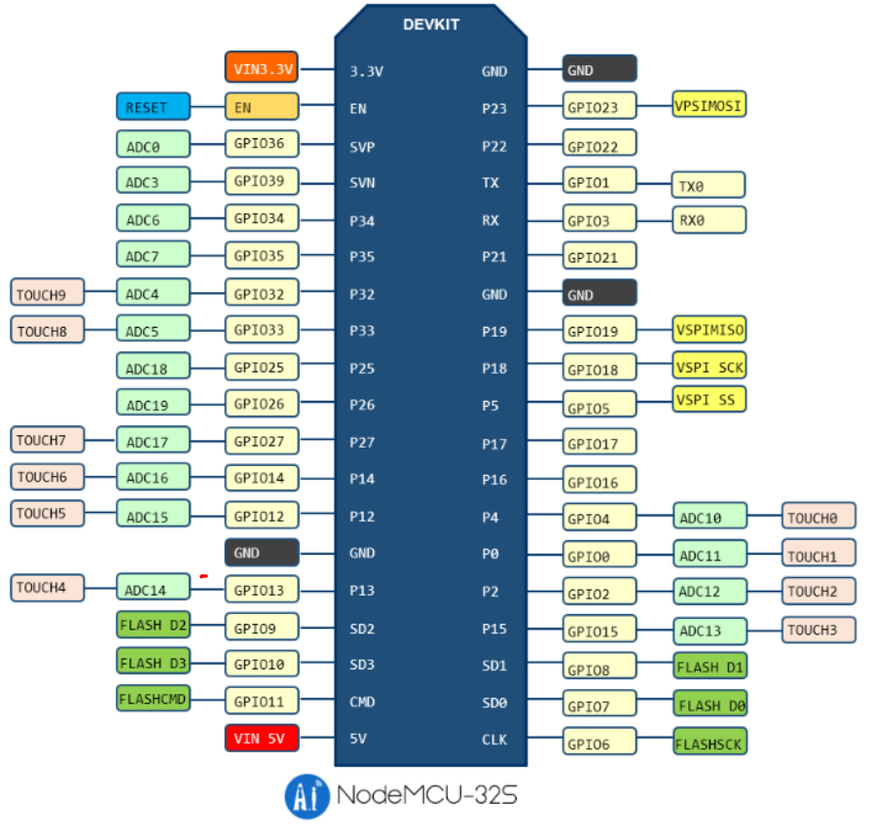
NeoPixel
Motion
AirQuality
0x28
CO2
0x31
BMP
0x76
Soil
CDS
FAN_L
PWM B
FAN_R
PWM A
Relay_IN3
Cooler
Relay_IN2
Heater
Relay_IN1
Pump
Cooler_Fan
LED
PWM B
DHT22
NeoPixel
SCL
SDA

