Slide 1
Python for Data Science
Sarah Wait Zaranek Ph.D.
Curoverse,Inc.
Boston Code Camp 26

Slide 2
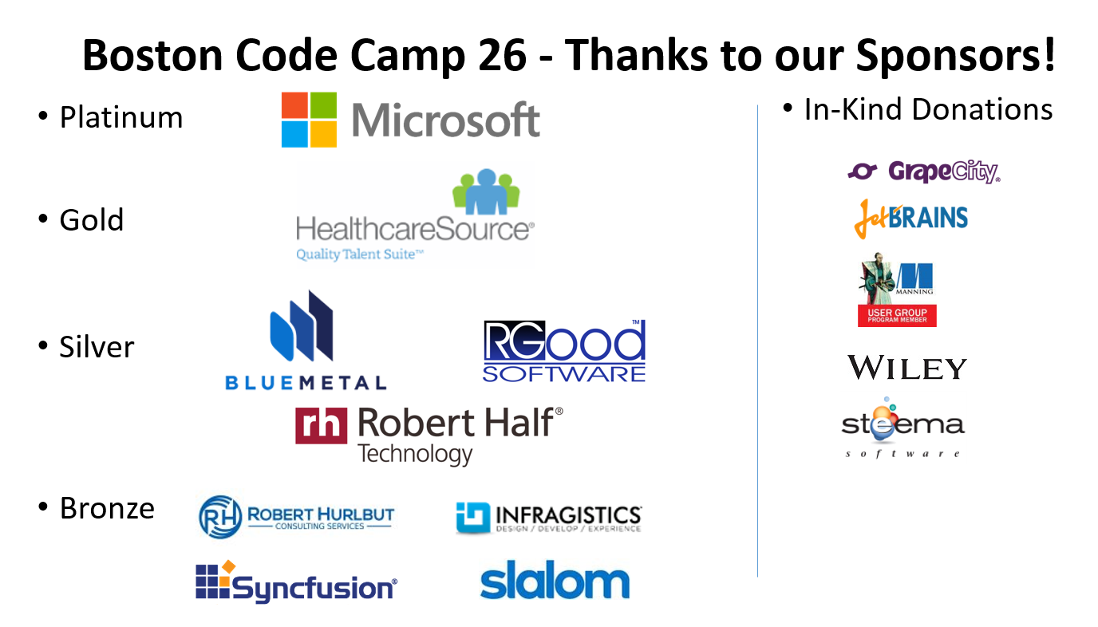
Thank You to the Sponsers

Slide 3
Goals for this session
Gain familarity with Python & Python libraries used for Data Science
Walkthrough "real world" example
Provide examples to explore, modify, and expand (GitHub)
Resources to learn more
Have some fun

Slide 4
What is Data Science ?

Slide 5
Why Consider Python?
Ease of use (high productivity)
Strong ecosystem of supporting libaries
Widely used general purpose language

Slide 6
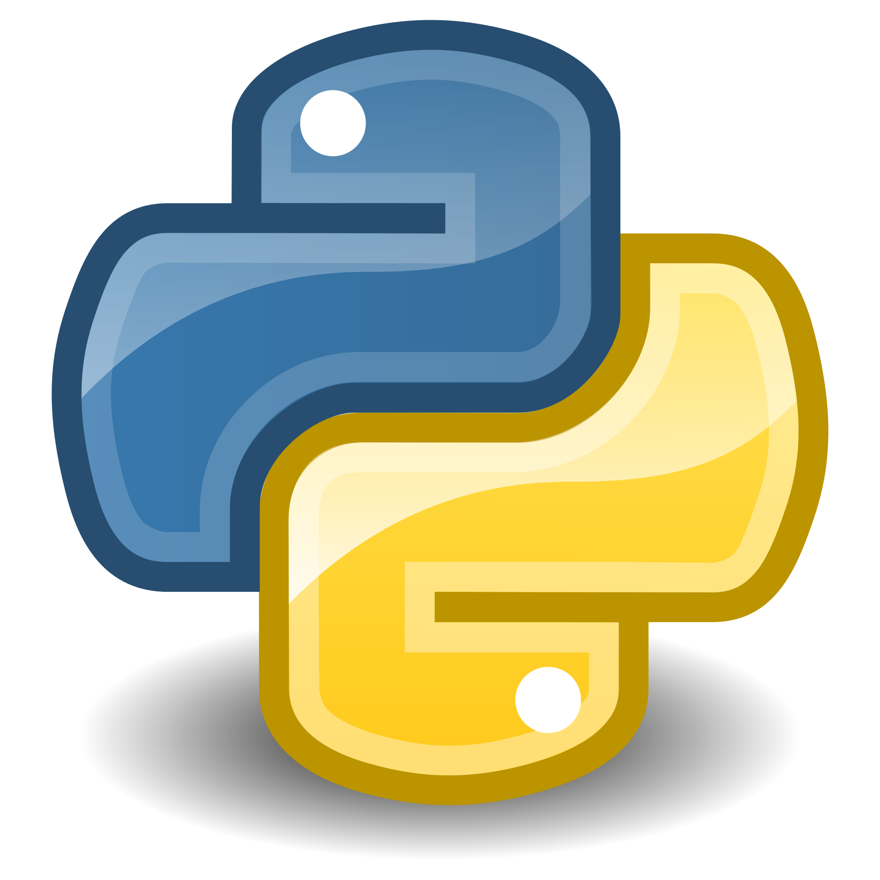


Setup
Running Linux (Ubuntu, Xenial Xerus)
Python (3.5, 64 bit) in a Jupyter Notebook
Anaconda Distribution (700+ libraries)

Slide 7



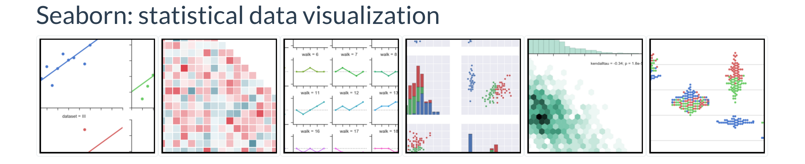

Useful Libraries
pandas
NumPy
matplotlib
Seaborn
scikit-learn

Slide 8
Example 1 : Housing Prices
--–- Data import from text files and databases
-- Data munging (cleaning, filtering, grouping, merging, etc.)
-- Performing descriptive statistics and developing models
-- Plotting including charts, graphs and maps

Slide 9
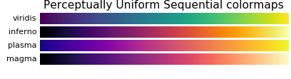
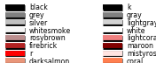
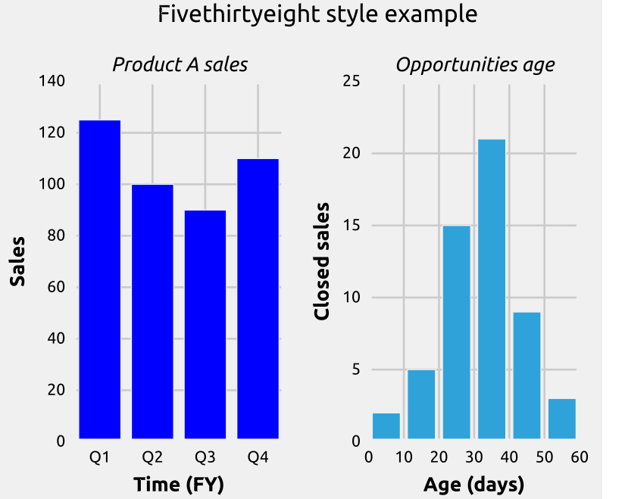
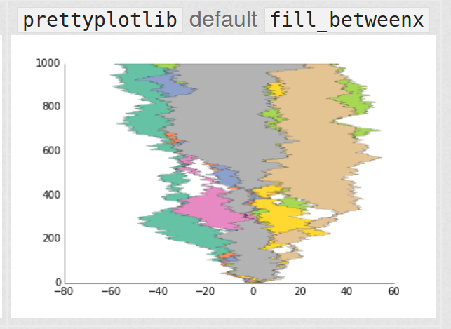
Customizing Graphs
Colormaps
    matplotlib.org/examples/color/colormaps_reference.html
Named Colors
  matplotlib.org/examples/color/named_colors.html
Style Sheets
        matplotlib.org/users/style_sheets.html
    www.futurile.net/2016/03/31/colormaps-in-matplotlib/
Custom Libraries (prettyplotlib)
blog.olgabotvinnik.com/prettyplotlib/

Slide 10
Example 2 : Volunteer Population

Slide 11
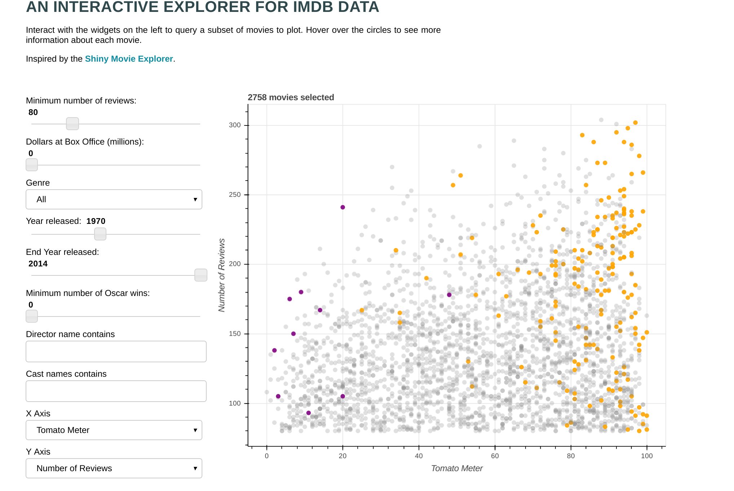
Other Capabilites
Building Interactive Graphics
Bokeh
Performance, Parallel and Large Data
  Cython (Python to C)
  multiprocessing (Python Standard Library)
  Dumbo (MapReduce with Python)
  Spark Python APIs

Slide 12
Questions ?

