Slide 1
IBM WebSphere Transformation Extender (WTX)
Steven Brock
CSP IBM Corp

Slide 2

Steven Brock – CSP IBM Corp.
Bytes don’t rust.
–System 360 team c.1960s ( Headed by Tom Watson Jr. IBM CEO )

Slide 3
Agenda
Brief History
Overview of WTX
Many places WTX is used
What makes it work
What’s New in WTX 8.4
Questions

Slide 4



WebSphere TX – A Long And Storied Road
Version | Year
V1.0 | 1994
V1.1 | 1995
V1.2 | 1995
V1.3 | 1996
V1.4 | 1997
V2.1 | 1999
V5.0 | 2000
V6.0 | 2001
V6.5 | 2002
V6.7 | 2003
V7.5 | 2004
V8.0 | 2005
V8.1 | 2006
V8.2 | 2007
V8.2.0.4 | 2008
V8.3 | 2009
V8.3.0.1 | 2010
V8.4 | 2011
8.4.0.4 | 2012
8.4.1 | 2013
Reliable
Proven
Innovative
Mature

Slide 5


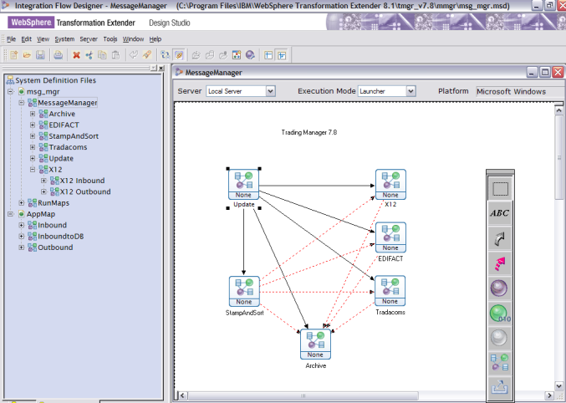






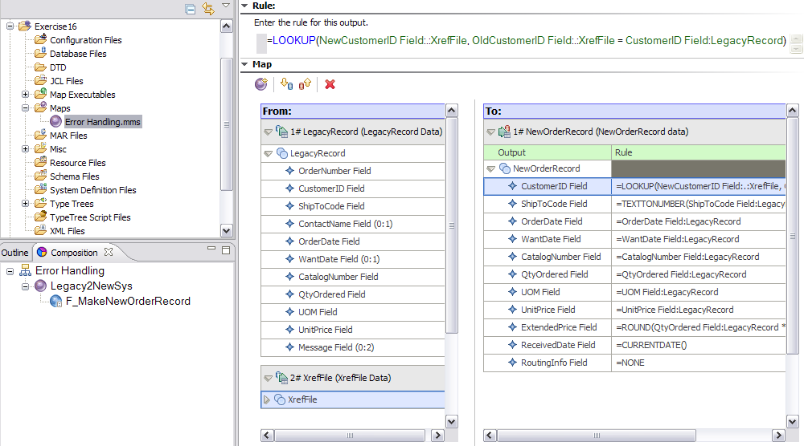

The Application Integration Problem…
Take any kinds of data from their native forms
ANY Data
Processes them together, natively, with NO CODE
Many-to-many Integration
ANY Data
And outputs them into their native target formats
Ex. - Hierarchical Data , Binary Data, Packed Data, Tabular Data, Relational Data, Nested Structures, Mixed-Type Data, and on and on…
Notes:
What is one of the benifits about TX is that it provides the ability to do all this without the need to “know the languages” of the systems being integrated.
It can deal with such “hard data types” such as : Hierarchical Data , Binary Data, Packed Data, Tabular Data, Relational Data, Nested Structures, Mixed-Type Data, and on and on…
Using the Design Studio, a business analyst or designer can build integration objects across the applications, databases and systems being integrated.
All of the extensive integration functionality is managed from an easy to use and robust Drag-and-Drop design interface.

Slide 6

WTX Universal Transformation
Deploys a Single Transformation Solution Across your Enterprise
Deploy on industry standard servers, mainframes, virtualized architectures, private clouds from IBM and other vendors
Reuse the same transformation assets throughout your enterprise
Access data directly within your SOA for improved data integrity and high throughput
Learn a single design studio environment where transformations for all platforms are imported, developed, tested and performance-tuned
Provide consistency and scalability without the need to write / re-write custom code or create / re-create maps
WebSphere
Application
Server
WebSphere
BPM
WebSphere
Message
Broker
WebSphere
DataPower
Sterling B2B
Integrator
Pure Systems
Notes:
The benefit of using WTX is Learn a single design studio environment where transformations for all platforms are imported, developed, tested and performance-tuned
Provide consistency and scalability without the need to write / re-write custom code or create / re-create maps
You now have code that is able to be executed not only in your z/os but also on other platforms and other
IBM Products such as
WAS, WBPM, WMB, Datapower Stirling B2BI, and Pure systems

Slide 7
What Benefits Makes WebSphere TX Different?
Powerful Transform capabilities with No Coding
Lowers cost to implement, maintain and re-use
High-Throughput, Complex Transformations
Natively Handles Any Data Type
Never resort to “flattening” or “re-structuring data”
Data integrity and meaning are never lost
Solve Really Hard problems, in less time, with one common design method and engine
Notes:
The WebSphere Transformation Extender product delivers the following:
connectivity to a wide range of mainframe, legacy, and enterprise applications, databases, messaging systems, and external information sources
a comprehensive library of more than 120 pre-built functions to reduce development time and simplify specification of rules for validation, transformation, and routing
multiple execution options to support right-time, right-style transformation-whether it is batch, real-time, or embedded
enterprise-class capabilities for development, deployment, and maintenance plus high-availability platform support.
This reduces on-going administration and implementation risks and delivers results sooner than hand-coding.

Slide 8
The Components of a WebSphere TX Solution
A WebSphere TX solution is composed of the following:
Adapter
Adapter
Source
Destination
An adapter is a technical connector which can be “plugged” into a source or destination - without parsing, allowing the ability to handle the protocols.
Notes:
So what do i mean by this? What is its value?
This allows for the adapter to handle the protocols of different a2a transformations.
For example it could be a queue or a new gdg the adapter gives the value of predefined protocols so that you do not have to code them manually, like chanel définitions in a queue manager.

Slide 9

The Components of a WebSphere TX Solution
A WebSphere TX solution is composed of the following:
Adapter
Type Tree
Type Tree
Adapter
Source
Destination
An adapter is a technical connector which can be “plugged” into a source or destination - without parsing!
A Type Tree is a graphical representation of meta-data
Define Fields
Build Groups as Segments of data
Defines File

Slide 10
The Components of a WebSphere TX Solution
A WebSphere TX solution is composed of the following:
Adapter
Type Tree
Rules
Type Tree
Adapter
Source
Mapping
Destination
An adapter is a technical connector which can be “plugged” into a source or destination - without parsing!
A Type Tree is a graphical representation of meta-data
Define Fields
Build Groups as Segments of data
Defines File
Rules define how a Source structure is transformed to a Destination structure

Slide 11
The Components of a WebSphere TX Solution
However…many to many mapping is also possible:
Adapter
Type Tree
Rules
Type Tree
Adapter
Adapter
Type Tree
Type Tree
Adapter
Adapter
Type Tree
Sources
Mapping
Destinations
A Map can perform many tasks :
Validation
Enrichment,
Content Based Routing
And many more …
DATABASE UPDATE
TRANSFORMED MESSAGE ON OUTPUT
SOURCE FILE
CROSS-REFERENCE
TABLE

Slide 12

Examples of Complex Transformation Challenges Addressed by WebSphere TX
Data Enhancement
Lookups
Data Logic and Routing
Data Validation
Context Based Data and Usage Rules
Many to Many Transformation
Single-Transaction, interdependent data sets, conversions and logic
Mixed Data and Source/Target Types
Dependent Result Sets, Nested Structure Dependencies
Complex Data Transformation
Nested, Semi-structured And Hierachical Data Types (X12 and Swift)
Dependent Inputs And Outputs
Binary, Packed, EBCDIC, ASCII, and Other Mixed Character Data
Notes:
We’ve been saying that WebSphere TX provides tremendous value in Complex Transformation challenges. What do we mean by that?
Here are several examples of complex transformation challenges which clients typically buy WebSphere TX for as part of their integration environment.

Slide 13
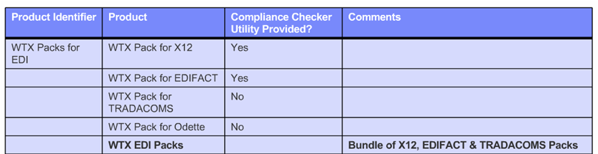
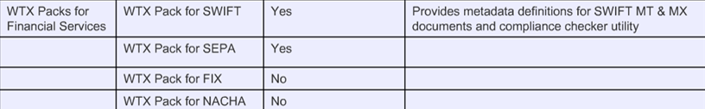
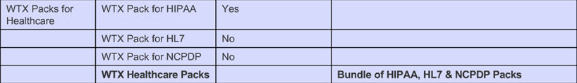
Websphere Transformation Extender Industry Pack Products

Slide 14
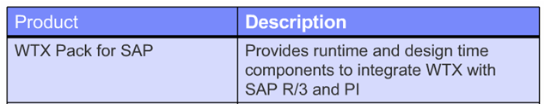



Websphere Transformation Extender – WTX Enterprise Pack Products

Slide 15

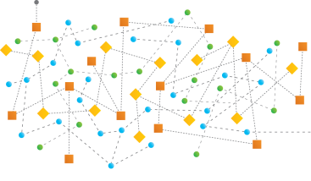

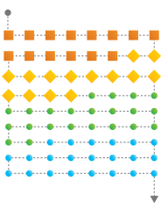

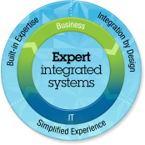

WTX The Last 18 Months: We’ve been BUSY
8.4 (Dec 2011)
Integration with Sterling B2B Integrator
System Z: XML parsing to zAAP for improved performance/ reduced cost
Launcher HVE
IBM Financial Transaction Manager (May 2012)
WTX is the on-ramp / off-ramp to integrate with your systems and transform messages to the FTM canonical format.
WTX on Pure Systems (Sep 2012)
Rapidly extend, clone & deploy
Scalability/Elastic demand
Failover
Notes:
Many enhancements to our z-based engines. XMLSS on zAAPs = few MIPS and (potentially) substantial reduced costs

Slide 16
Announcing WTX 8.4.1*
Key New Features
Launcher Hypervisor Edition on AIX (Pure Systems)
Linux on System P
Auto-mapping
Java Design-time APIs
Sterling Connect:Direct Adapter
JAXB Adapter
Cobol Importer
JSON Importer
Improved XML handling
OS updates
New

Slide 17

Summary
Brief History
Overview of WTX
Where WTX is used
What makes it work
What's New v8.4

Slide 18

Questions?

Slide 19










Thank You
Grazie
Italian
Thai
Traditional Chinese
Obrigado
Russian
Merci
Brazilian Portuguese
French
Gracias
Spanish
Arabic
Danke
German
Simplified Chinese
Japanese

