Slide 1


CAPSTONE PROJECT Advanced Software Engineering Project Spring 2015

Slide 2
Attribution-NonCommercial-NoDerivs CC BY-NC-ND
ALL INFORMATION IN THIS PPT ADHERE TO THE ABOVE LICENSE

Slide 3
A brief questionnaire

Slide 4
Questionnaire
1. Do you think searching for information is old fashioned(rather the information should search us)?
YES/NO

Slide 5
Questionnaire
2. Do you believe most UTD students have lack of information regarding the events on campus?
YES/NO

Slide 6
Questionnaire
3. Do you believe that there has to be a better way of communication other than zmail?
(real-time class schedules and real-time event updates)
YES/NO

Slide 7
Questionnaire
4. Wouldn't it be nice if the buildings we sit in talked to us and gave us real - time updates on events and schedules?
YES, IT WOULD BE NICE
NO, IT WOULD NOT BE NICE

Slide 8
Questionnaire
5. Don't you think it is time we had a few smart buildings around us which had life in them?
HELL YEAH!
NOO WAAAAY!

Slide 9
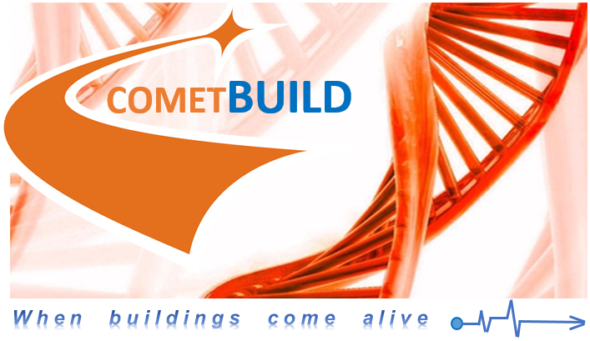

Slide 10
What?
A mobile application designed to provide location-based information to users.
For example, upon entering the ECS building, the app will update to provide information on upcoming events in the building
A platform that can be combined and integrated with other related solutions such as CometNav

Slide 11
How?
Comet Card-based location tracking. The technology is already in use in the Residence Halls and Library for similar yet distinct purposes. Since the majority of students always have their Comet Cards with them, it’s the most effective way of keeping track of students around campus

Slide 12
Predicted cost
The only projected costs are the card readers at building entrances (Estimated to be about 50 dollars each) and a server to manage the software side of things.
Therefore, the projected ROI is huge, from both the results of this single project and its extensibility and combinability with other projects such as CometNav

Slide 13
On the whole
COMETBUILD will beautifully supplement CometNav and CometPark thereby moving towards the final goal of a synergistically unified, smart & eco - friendly system capable of making campuses smart at an affordable cost.
And UTDallas Software Engineering is paving the way!

Slide 14
Questions?
By,
Danny
Scott
Trevor
Vaibhav

