Slide 1

Implementation of CNN for Covid-19 CT Image Classification
Siyuan Chen

Slide 2
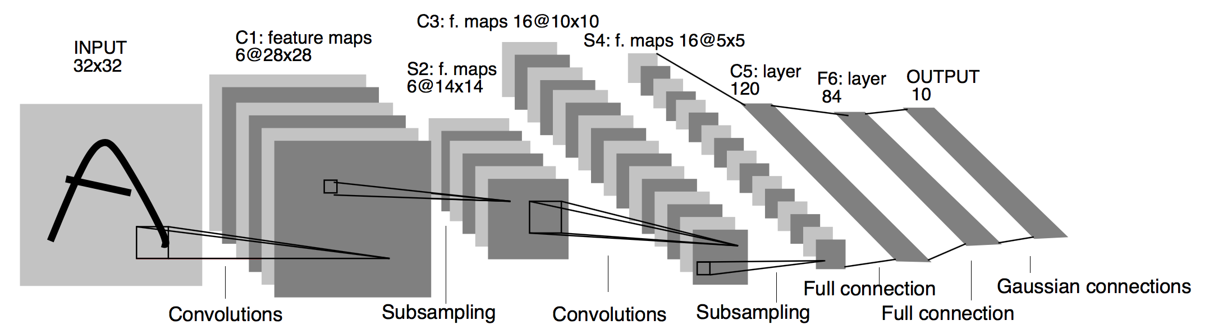
Lenet-5 the first convolutional neural network (CNN)
LeNet was used in detecting handwritten cheques by banks based on MNIST dataset. Fully connected networks and activation functions were previously known in neural networks. LeNet-5 introduced convolutional and pooling layers. LeNet-5 is believed to be the base for all other ConvNets.

Slide 3
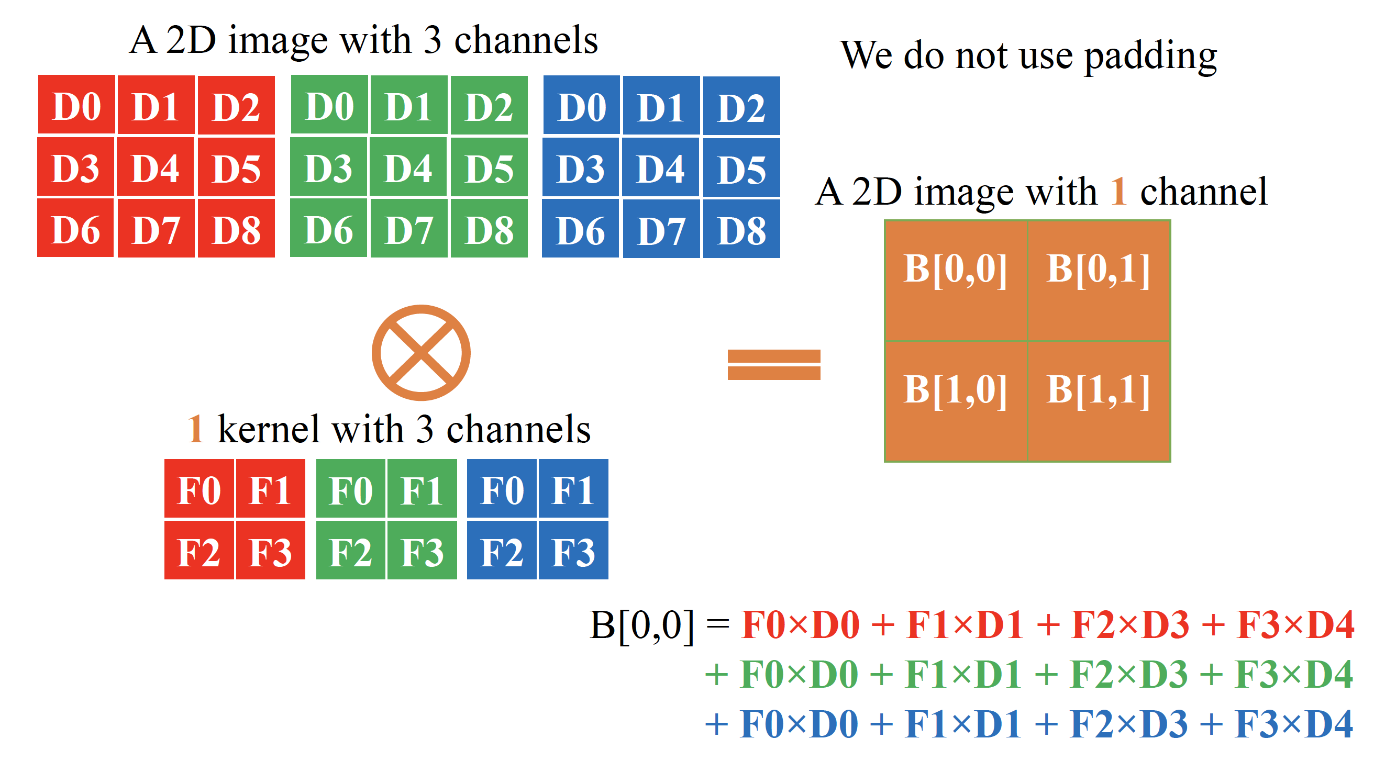
What is convolution ?

Slide 4
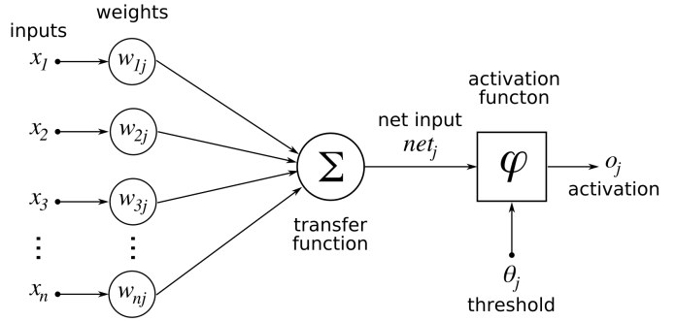
How does CNN work?
Input→ weights→ transfer function→ activation

Slide 5
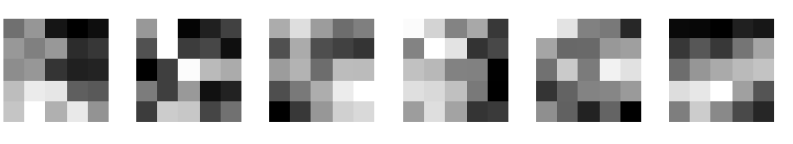
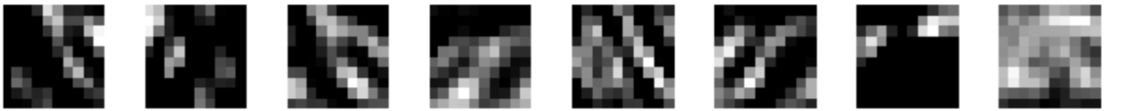
Samples of feature map
6 kernels in the first convolution layer
6 feature maps (output) of the first convolution layer
Feature map of the second layer

Slide 6
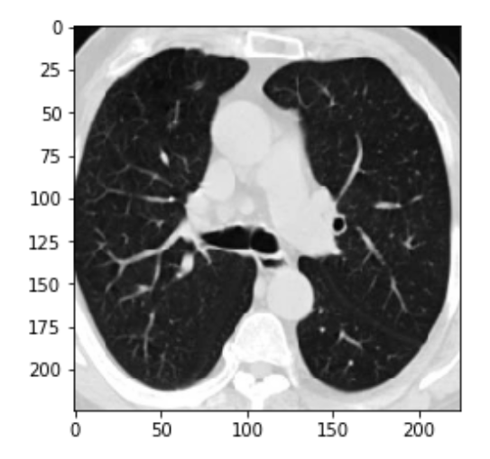
The project: CNN for CT Image Classification
A lung CT image of a patient
CNN
output: 0 or 1
0: Normal😄
1: COVID infection detected😔
The CNN is based on Resnet-18

Slide 7
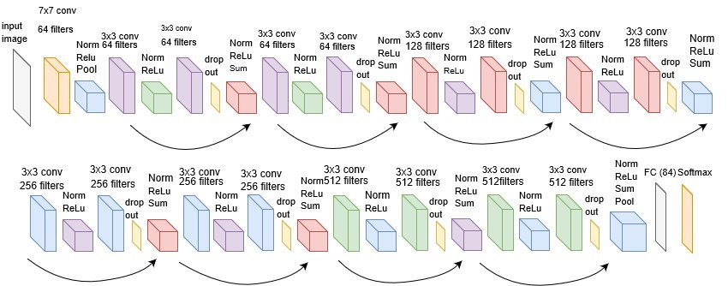
Structure of the CNN in my project – based on resnet18

Slide 8
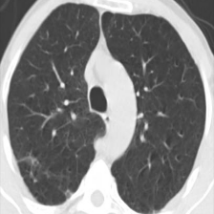
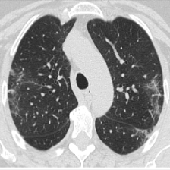
Dataset
training set:
1000 images of normal subjects
1022 images of COVID-19 patients
validation set
30 images of normal subjects
30 images of COVID-19 patients
test set
200 images of normal subjects
200 images of COVID-19 patients
Normal
Covid

Slide 9
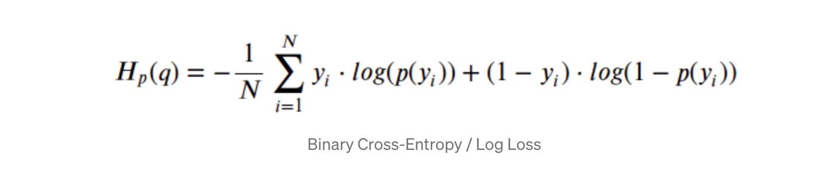
Loss function for training the CNN
binary cross entropy

Slide 10
Training Methods
My contribution is the comparison of two training methods
(1) train the CNN from scratch
(2) transfer learning with fine tuning

Slide 11
Method-1 train the CNN from scratch
Define a model with 1 initialization layer, 16 convolutional layers, and 1 full connection layer
Define Adam optimizer
Define loss function
Train the model in 16 epochs

Slide 12
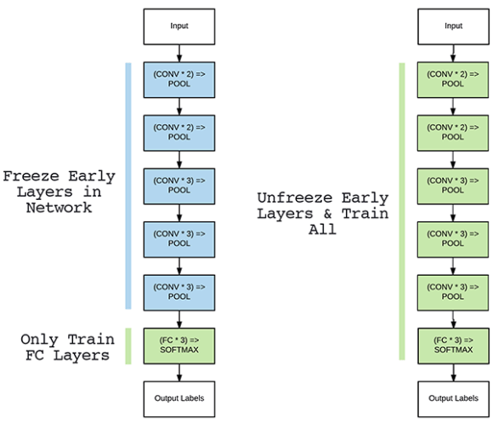
Method-2: transfer learning

Slide 13
Why use transfer learning
Transfer learning allows developers to circumvent the need for lots of new data. A model that has already been trained on a task for which labeled training data is plentiful will be able to handle a new but similar task with far less data.
Overfitting is less likely to occur in transfer learning
Run time is smaller

Slide 14
Method-2: transfer learning
•"Transfer learning is the improvement of learning in a new task through the transfer of knowledge from a related task that has already been learned."
-Handbook Of Research On Machine Learning Applications and Trends

Slide 15
Freeze layers for Transfer learning
Freeze layers:
a technique to accelerate neural network training by progressively freezing hidden layers. For instance, during transfer learning, the first layer of the network are frozen while leaving the end layers open to modification.

Slide 16
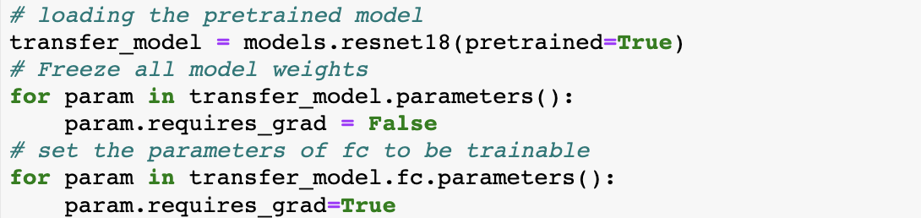
Implementation Freeze Layers

Slide 17
Fine Tuning for Transfer learning
Fine tune the full connection layer
Unfreeze a few of the top layers of a frozen model base and jointly train both the newly-added classifier layers and the last layers of the base model. This allows us to "fine-tune" the higher-order feature representations in the base model in order to make them more relevant for the specific task.

Slide 18
Implementation Fine Tuning

Slide 19
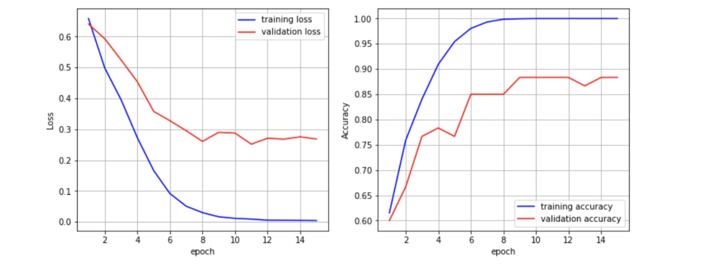
Method-1
Loss and accuracy from the CNN from scratch

Slide 20
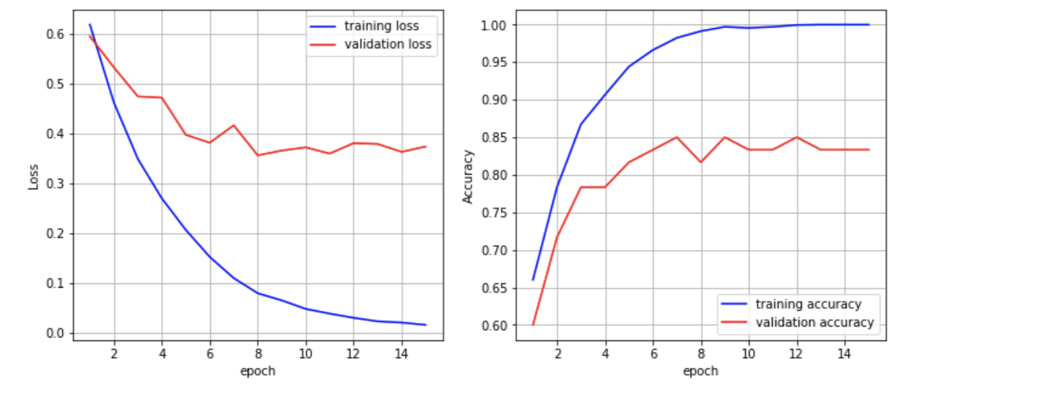
·Loss and accuracy from transferred learning
Method-2

Slide 21
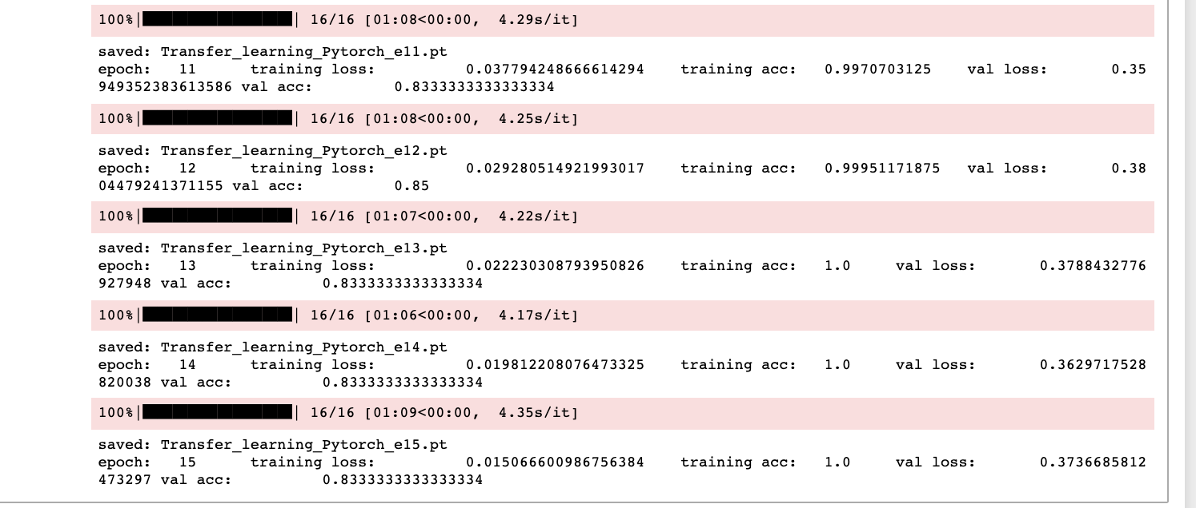
How the training increase accuracy

Slide 22
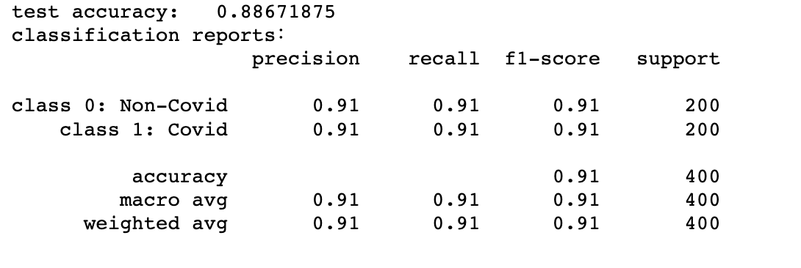
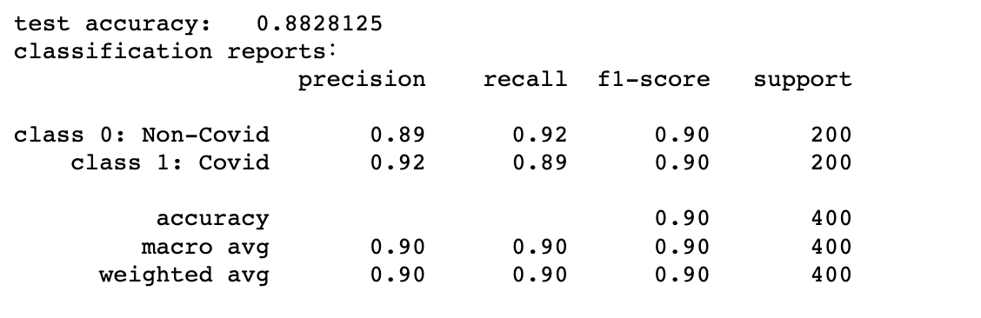
Accuracy of the application
Scratched model
Transfer learning

Slide 23
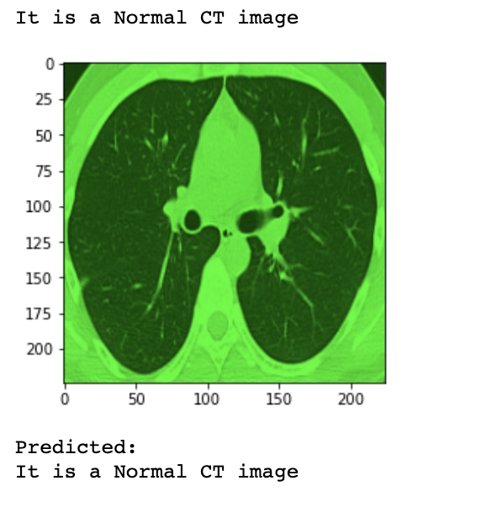
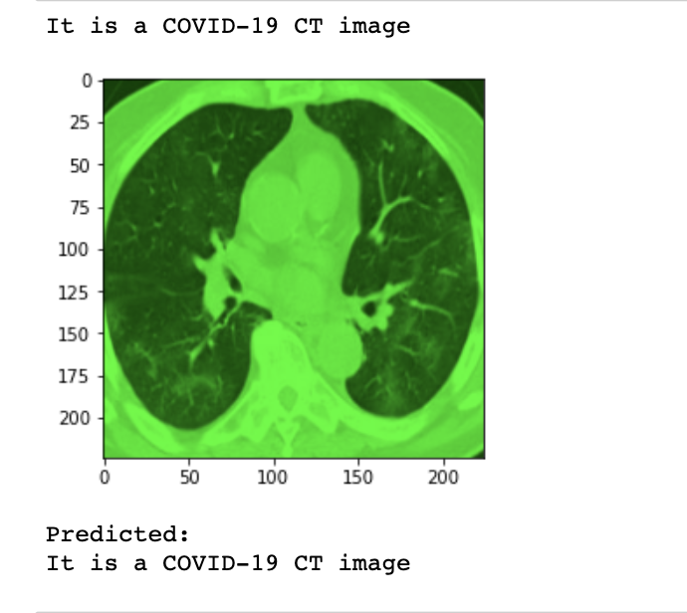
An Example of classification

Slide 24
Factors that may affect the accuracy
Selection of model
Parameters of model：Learning rate，batch size, activation function, number of filters(kernels)…
Total amount of data
Luck(initialization of weight)

Slide 25
Conclusion
Developed a CNN for COVID-19 CT image classification
fine-tuned the resnet-18 pretrained model
Compared two training methods
The accuracy of two training methods are similar based on the given dataset
Running time in transfer learning is smaller

Slide 26
Contact info
Siyuan Chen
sxc1556@Miami.edu
Stay home and stay safe!!

