Slide 1

Mobile Price Classification Using Machine Learning
Team Members:
Cherukuri Sravanti #700743770
Maruthi Pavan Surya Kande #700747215

Slide 2

Motivation
The pricing of a good or service is the single most essential consideration in terms of both marketing and conducting business.
The cost of the items is almost always the very first thing that consumers want to find out about a business before making a purchase.
Every prospective consumer initially suffers from worry and questions themselves, "Will he be able to purchase anything that satisfies the criteria that have been outlined, or will he not?" As a result, the primary purpose of the research is to simplify price estimation in the comfort of one's own house.

Slide 3

Objectives
To make a contribution to the mobile phone sector by supplying the industry with useful insights that can be used for pricing and marketing tactics.
This topic makes to the field of machine learning is that it demonstrates how various machine learning techniques can be used to the classification of mobile phone prices.
The objective of the challenge of mobile price categorization is to enhance the precision and usefulness of mobile price prediction.
Consumers are able to make educated judgments when it comes to the purchase of a new mobile phone that meets both their financial constraints and their requirements if the price range of mobile phones can be reliably predicted based on the features of those phones.

Slide 4
Roles and Responsibilities and contributions
Develop and implement machine learning models for mobile price prediction using Python and relevant libraries like Scikit-learn, Tensorflow, and Keras.
01
Conduct data preprocessing and feature engineering to prepare the data for model training and evaluation.
02
Evaluate model performance, and fine-tune model parameters to optimize the prediction accuracy.
03
Collaborate with data engineers to ensure data quality, reliability, and integrity.
04
Design and implement data pipelines to ingest, process, and store the mobile price data
05
Collaborate with team engineers to ensure that the data is suitable for training and evaluation of machine learning models.
06

Slide 5

Related Work
The paper by Abualigah, Khalil, and Alkafaween concludes that KNN is the best algorithm for mobile price classification based on its high accuracy and simplicity.
The paper by Bhandari and Kumar concludes that KNN and Random Forest are the most effective algorithms for predicting the price range of mobile phones.
The paper by Khan and Alazab concludes that Random Forest and KNN are the most effective algorithms for predicting the price range of mobile phones.
The paper by Muthukumar and Parthiban that KNN and SVM are the most effective algorithms for predicting the price range of mobile phones.

Slide 6

Problem Statement
The price at which a product or service is offered to customers is the single most important factor to consider when it comes to marketing and running a business.
Before making a purchase from a company, the cost of the merchandise is nearly always the very first thing that potential customers want to find out about the company.
Every potential purchaser at first experiences anxiety and wonders to themselves, "Will he or will he not be able to purchase anything that satisfies the standards that have been established?" As a direct consequence of this, the primary goal of the work is to simplify the process of price estimates so that individuals can carry it out from the comfort of their own homes.

Slide 7
Proposed Solution
First, we scaled the data using standard scalar before training the model.
We have used the following ML models to train our data
Random Forest
K Nearest Neighbors
Decision Tree
Stacked Esembel ( Random forest, KNN, DT)

Slide 8
Results and Simulations
Random Forest Score: 0.88325
KNN
Score: 0.92275
Decision Tree
Score: 0.82725
Stacked Model Score: 0.9265000000000001

Slide 9
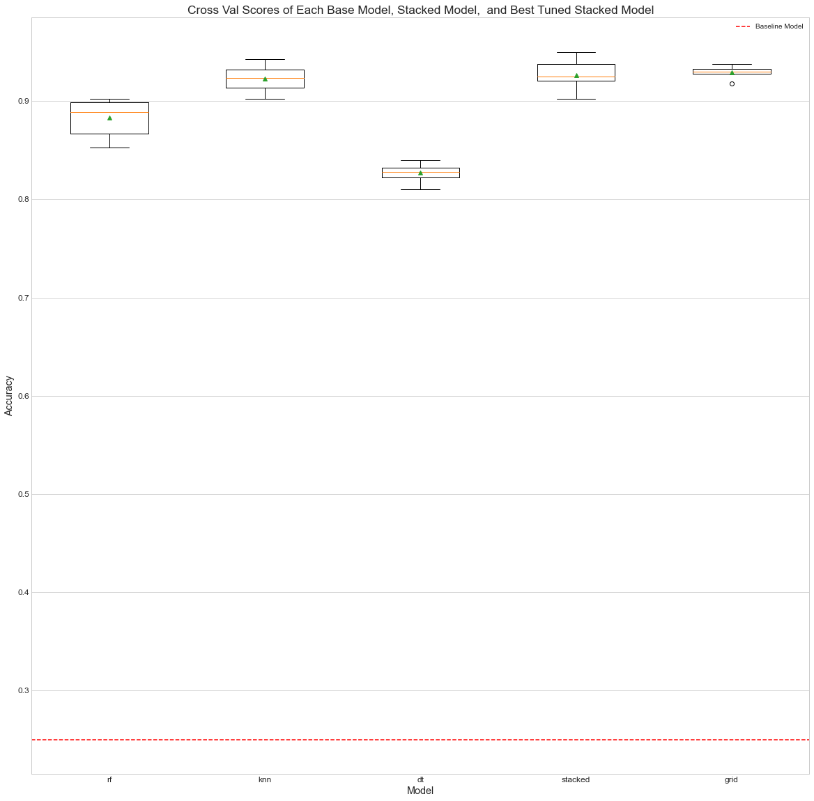
Results and Simulations

Slide 10
References
Firoz, N., Naskar, R., Bandyopadhyay, S. and Konar, A. (2020). A Comparative Analysis of Machine Learning Models for Mobile Price Classification. In Proceedings of 3rd International Conference on Computing, Communication and Security (pp. 118-123). Springer.
Bhattacharjee, R., Rahman, T., Chowdhury, F., Islam, S.M.A. and Kumar Sarker, M. (2020). A Comparative Analysis of Machine Learning Techniques for Mobile Price Classification. In Proceedings of the 9th International Conference on Computing and Informatics (pp. 251-257). ACM.
Rahman, M.A., Hasan, M.T., Arefin, A.S.M. and Molla, K.A. (2020). A Comparative Study of Machine Learning Techniques for Mobile Price Classification. In 2020 International Conference on Robotics, Electrical and Signal Processing Techniques (ICREST) (pp. 8-13). IEEE.
Hossain, M., Hoque, M.A., Roy, N. and Amin, M.A. (2020). Mobile Price Classification Using Machine Learning Techniques. In Proceedings of the 8th International Conference on Electrical Engineering and Information & Communication Technology (ICEEICT) (pp. 1-6). IEEE.
Sarker, M.I., Akter, S., Khan, M.I. and Mollah, M.B.I. (2020). A Comparative Study of Machine Learning Techniques for Mobile Price Classification. In 2020 International Conference on Computer and Information Sciences (ICCIS) (pp. 1-6). IEEE.

