Slide 1













PRESENTATION 2026
Smokey.io - Marketing Careers Chatbot in Copilot studio
Mentor Name
Student Name
Student Email
Khushi Parikh
KhushiParikh@nirmaanorg.onmicrosoft.com
Hrishikesh Sir

Slide 2


Outline
Abstract of the Project
Problem Statement
Proposed Solution
System Architecture
Live Demo of the Project
Embedded Video of Project
Conclusion
Future Scope
Notes:
2

Slide 3
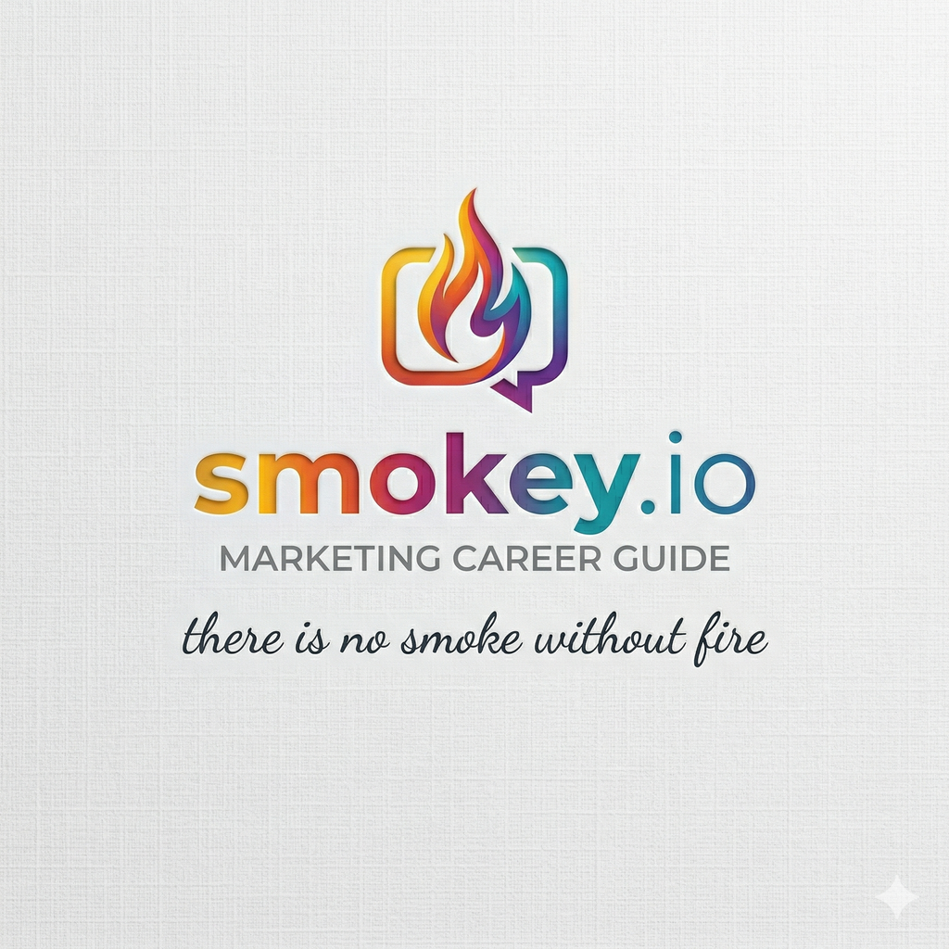
Abstract
Smokey.io is a Career Helper chatbot primarily designed to aid marketing aspirants of different domains in refining their resumes and getting guidance on building projects for their portfolios.
This chatbot is a basic prototype made using CoPilot studio, using prompt assistance from Gemini AI.
The expected outcomes are to give users clarity on their career path within marketing Summarize the expected outcomes briefly.
Notes:
3

Slide 4

Problem Statement
Young professionals are currently in a volatile era of hiring - caught between a lack of experience and a lack of clarity of the vastness of the marketing field.
They may suffer from a dearth of clarity and skill matching, and thus may be limited to on-the-surface roles of social media and content creation without any in-depth insights, which may hamper their career mobility.
This is an important distinction at a time AI filters out the cream from the crop, placing more emphasis on soft skills and agency rather than a degree.
Notes:
4

Slide 5

Proposed Solution
Smokey addresses the core problem of every young marketing professional by offering clarity through a one-stop chatbot assistant that offers freshers with timely, relevant advice on which marketing career path can be pursued, along with actionable insights on specific skills and projects they can target.
Note: Smokey is currently a simple prompt-based chatbot built on a single dataset, absent of any APIs or web scraping.
Notes:
5

Slide 6
System Architecture
Data Input / Source
Processing / Analysis
Raw Kaggle dataset was AI-enriched to create marketing jobs dataset, resume dataset and projects dataset.
Data was cleaned to remove additional variables and insights such as project ideas,kpis, optimized resume bylines were added.
AI / Tool Integration
Output / Dashboard
.CSV files in Excel form the knowledge base of the document,
The final output is a conversational chatbot designed to give detailed responses based on user input for job,resume and project advice.
Notes:
6

Slide 7
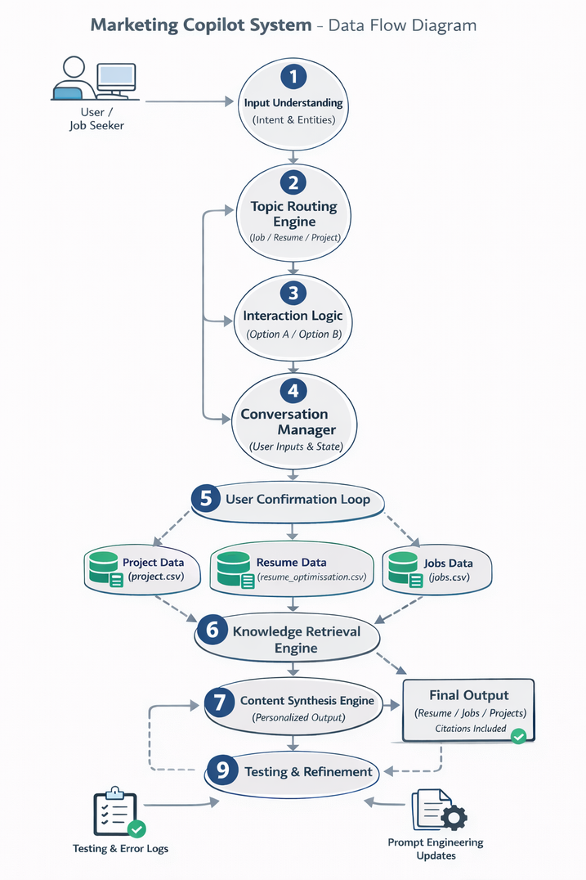
Live Demo of Project
Here are the demo versions of my project:
Demo 1
Demo 2
https://github.com/sxcbmmkxshi-code/AICW-Marketing-chatbot.git
https://canva.link/ixge2us2grfod2l
Notes:
7

Slide 8
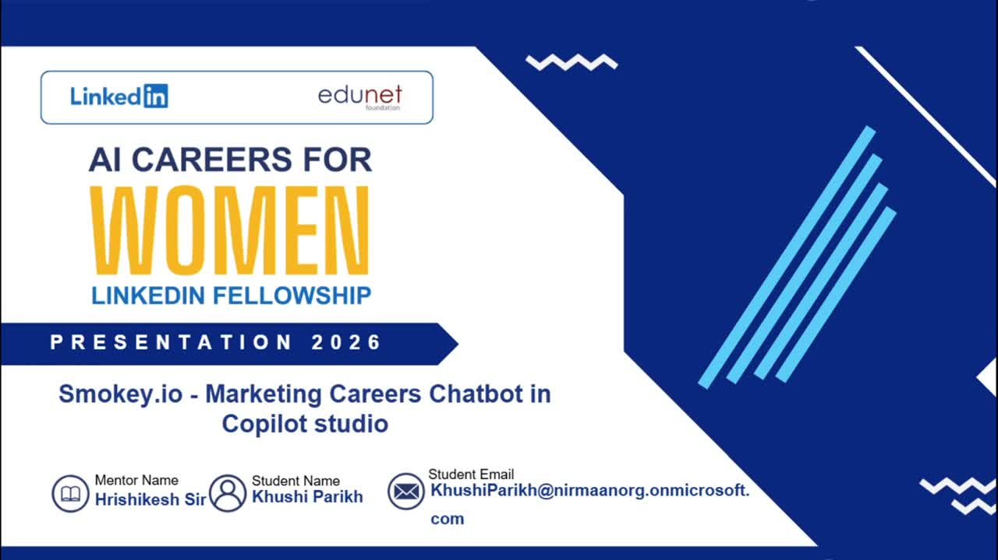
Video of Project Demo
[https://canva.link/ixge2us2grfod2l
[Insert your project demo video.
You can embed a video your live project.]
Notes:
8

Slide 9

Conclusion
The project fulfilled it’s objective of giving actionable, end-to-end marketing advice using Microsoft Copilot Studio, Claude 4.6 Sonnet, and Google Gemini, transforming detailed CSV datasets into an interactive career guide that delivers targeted career guidance, actionable portfolio project ideas, and ATS-optimized "XYZ" resume templates. By effectively bridging critical knowledge gaps, this solution provides early-career marketing professionals with the structured clarity and strategic confidence necessary to successfully navigate modern hiring systems and accelerate their career trajectories.
CONCLUSION
Notes:
9

Slide 10

Future Scope
The scope of this project can be expanded to include a broader spectrum of both linear and non-linear career paths beyond marketing.
To enhance its real-time utility, future iterations will integrate live web-scraping capabilities, allowing the chatbot to continuously update its knowledge base with the latest job market trends, salary data, and emerging skill requirements, enabling better clarity and empowerment to a larger audience.
Notes:
10

Slide 11
Thank You
AICW Fellowship | Student Project Presentation 2026
LinkedIn | Edunet Foundation
Notes:
11

