Slide 1


ML-Based Prediction of Ocean Temperature Anomalies for Early Climate Change Detection
SRM INSTITUTE OF SCIENCE AND TECHNOLOGY
SCHOOL OF COMPUTING
DEPARTMENT OF COMPUTING TECHNOLOGIES
21CSP302L - MINOR PROJECT
Guide name: Dr. Divya Mohan
Designation: Assistant Professor Department: Computing Technologies
Batch ID: B984
Student 1 Reg. No: RA2311003010827
Student 1 Name: Sawant Aarya Rajesh
Student 2 Reg. No: RA2311003010859
Student 2 Name: Siddharth Ganesh

Slide 2
Progress Since Review 1
Review 1 (Feb 28): Plan on paper
Review 2 (Today): Working System
Abstract and problem statement
Dataset identified (not processed)
Proposed methodology (no code)
Literature survey completed
Complete data pipeline (1,190 days)
RGB tensor mapping implemented
CNN (ResNet101) trained: MAE 0.1007
RF on 41 engineered features: MAE 0.1279
Ensemble beating both: MAE 0.0700
8 publication-grade visualizations
IEEE research paper drafted
Models saved to Google Drive
Key Achievement: Ensemble MAE 0.0700C — 30.45% better than CNN, 45.24% better than RF
B984 | Aarya Sawant & Siddharth Ganesh | Dr. Divya Mohan
2/16

Slide 3
Problem Statement
The Smoothing Bias Problem
Traditional ML models (LSTMs, Transformers) use loss functions that treat rare extreme thermal events as noise. They predict the average and miss the critical spikes that matter for climate monitoring.
Why This Matters
Only ~10% of ocean data contains extreme anomalies
Models optimize for the 90% normal data, ignoring the 10% that matters
No single model captures both spatial patterns AND statistical outliers
Our Solution
Hybrid CNN-RF Ensemble: CNN captures spatial patterns, RF catches statistical spikes. Together they achieve what neither can alone.
B984 | Aarya Sawant & Siddharth Ganesh | Dr. Divya Mohan
3/16

Slide 4
Dataset
Parameter | Details
Source | Copernicus Marine Service (CMEMS)
Dataset 1 | Raw SST (thetao) at surface depth
Dataset 2 | SST Anomaly (pre-computed)
Region | North Indian Ocean: 4.83N-24.58N, 67.08E-89.33E
Time Range | July 18, 2022 - February 2, 2026 (1,296 days)
Grid Resolution | 0.083 degrees (~9 km) | 238 x 268 pixels
Total Size | ~600 MB (two NetCDF files)
Synchronized | 1,190 aligned time steps
Target Variable | Spatial mean SST anomaly per day (scalar)
B984 | Aarya Sawant & Siddharth Ganesh | Dr. Divya Mohan
4/16

Slide 5
Preprocessing Pipeline
Step | Name | Description
Step A | Anomaly Extraction | Copernicus pre-computed SST anomaly (equivalent to STL residual, 1991-2020 baseline)
Step B | Min-Max Normalization | Scale raw SST grids to [0,1] range globally across all time steps
Step C | RGB Tensor Mapping | 3-day window: Day T-2=Red, T-1=Green, T=Blue. Output: (238,268,3) tensor
Step D | Feature Engineering | 41 statistical features for RF: spatial stats, temporal deltas, gradients, acceleration
Step E | Oversampling | Top 10% extremes duplicated 3x with Gaussian noise (sigma=0.005). Size: 949 to 1,234
B984 | Aarya Sawant & Siddharth Ganesh | Dr. Divya Mohan
5/16

Slide 6
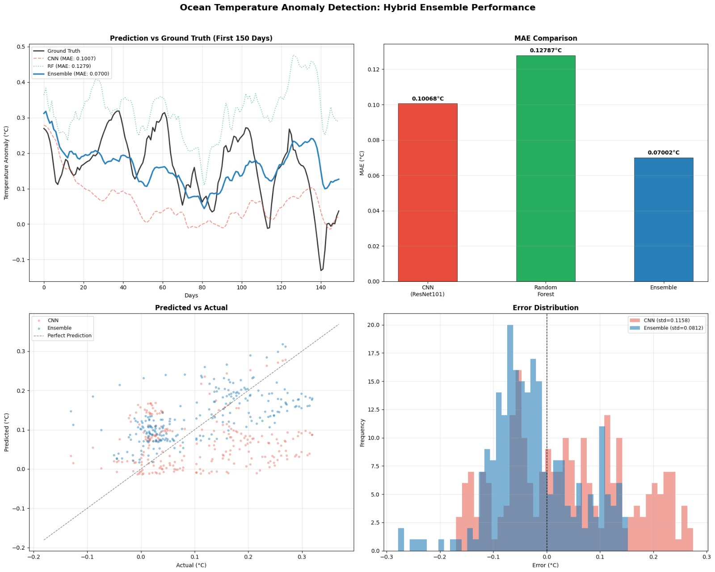
RGB Tensor Mapping: Temporal to Spatial Encoding
3 consecutive days encoded as RGB color channels. Temperature changes appear as color gradients that CNN convolutional filters naturally detect as thermal motion patterns.
B984 | Aarya Sawant & Siddharth Ganesh | Dr. Divya Mohan
6/16

Slide 7
Model Architecture
CNN Branch: ResNet101
RF Branch: Random Forest
345 layers, last 20 unfrozen
Input: (238, 268, 3) RGB tensors
Head: GAP > Dense(512) > BN > Drop(0.3) > Dense(128) > Drop(0.2) > Dense(1)
Loss: MSE (not Huber)
Optimizer: Adam (lr=0.0001)
44M params, 10M trainable
500 trees, unlimited depth
Input: 41 engineered features
Features: spatial stats, deltas, gradients, acceleration
NOT raw pixels (63K failed)
Training: 6 seconds on CPU
Ensemble: Final = 0.61 x CNN + 0.39 x RF = MAE 0.0700C
B984 | Aarya Sawant & Siddharth Ganesh | Dr. Divya Mohan
7/16

Slide 8
Why the Ensemble Works: Complementarity
Metric | CNN | Random Forest | Ensemble
Overall MAE | 0.1007C | 0.1279C | 0.0700C
Spike MAE (top 10%) | 0.2089C (BAD) | 0.0589C (EXCELLENT) | 0.1114C
Strength | Spatial patterns | Statistical outliers | Both combined
Weakness | Misses extreme spikes | No spatial awareness | Balanced
CNN sees the ocean as an image — detects fronts, eddies, gradients.
RF sees the ocean as statistics — detects when values are unusually extreme.
The ensemble gets the best of both worlds.
B984 | Aarya Sawant & Siddharth Ganesh | Dr. Divya Mohan
8/16

Slide 9
Final Results: Complete Leaderboard
Model | MAE (C) | RMSE (C) | Spike MAE | Accuracy | F1-Score
CNN (ResNet101) | 0.1007 | 0.1152 | 0.2089 | 58.40% | 54.79%
Random Forest | 0.1279 | 0.1623 | 0.0589 | 57.56% | 54.30%
MLP Baseline | 2.5874 | - | - | - | -
Ensemble (61/39) | 0.0700 | 0.0849 | 0.1114 | 70.59% | 32.69%
Ensemble vs CNN: +30.45% improvement
Ensemble vs RF: +45.24% improvement
MLP vs CNN: 37x worse (proves spatial convolutions essential)
B984 | Aarya Sawant & Siddharth Ganesh | Dr. Divya Mohan
9/16

Slide 10
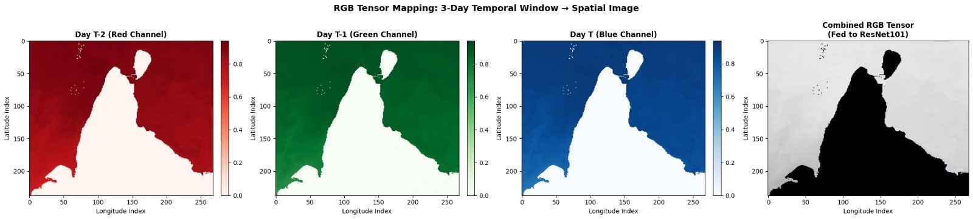
Prediction vs Ground Truth
4-panel: time-series comparison, MAE bars, predicted vs actual scatter, error distribution
B984 | Aarya Sawant & Siddharth Ganesh | Dr. Divya Mohan
10/16

Slide 11
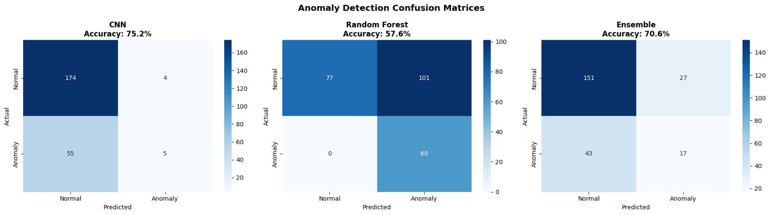
Confusion Matrices
Anomaly detection classification: CNN (75.2% acc), RF (57.6%), Ensemble (70.6%)
B984 | Aarya Sawant & Siddharth Ganesh | Dr. Divya Mohan
11/16

Slide 12
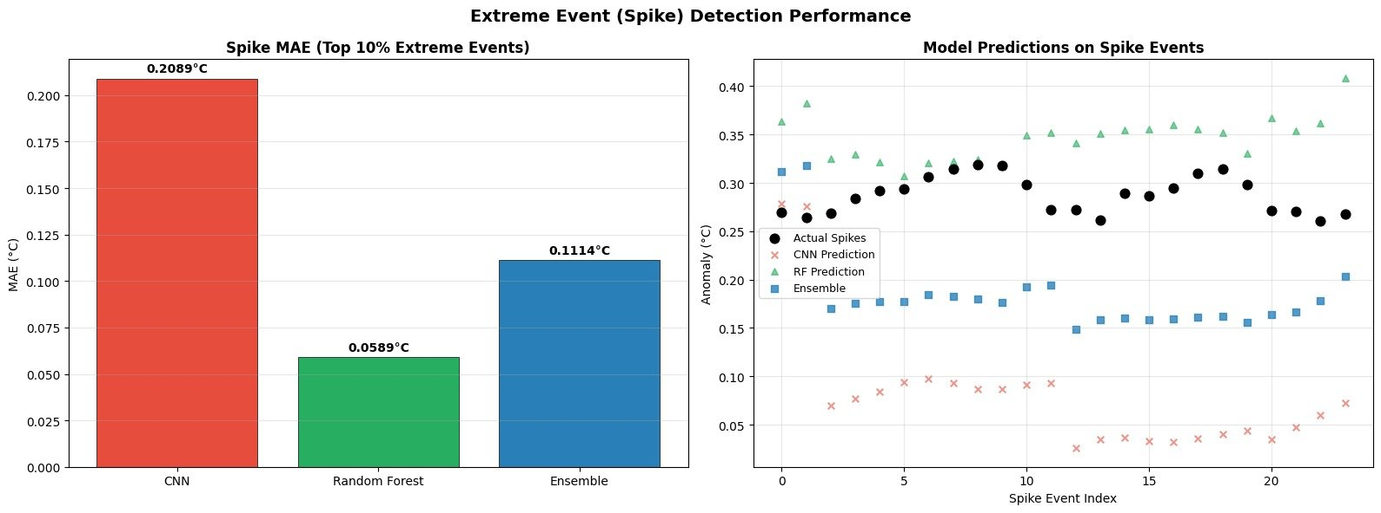
Spike Detection Performance
CNN fails on extremes (0.2089). RF excels (0.0589). Ensemble balances (0.1114).
B984 | Aarya Sawant & Siddharth Ganesh | Dr. Divya Mohan
12/16

Slide 13
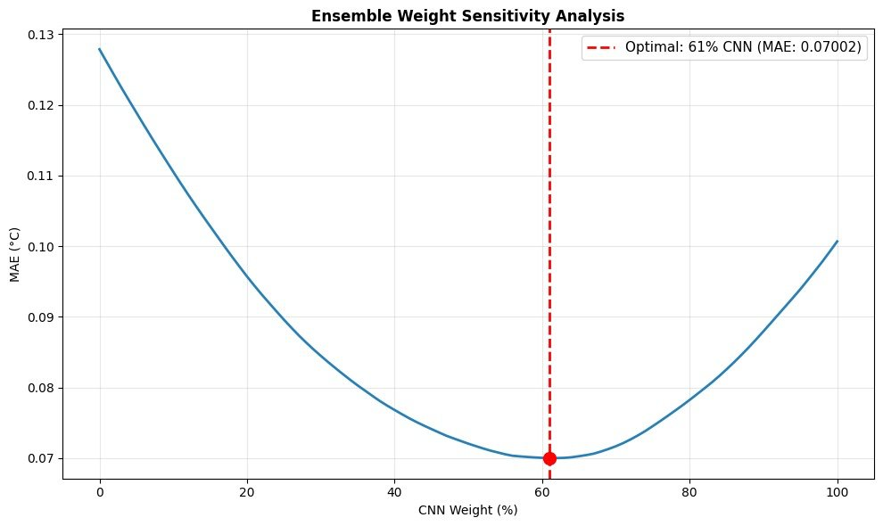
Ensemble Weight Sensitivity
Grid search reveals minimum MAE at 61% CNN + 39% RF. Convex curve confirms complementarity.
B984 | Aarya Sawant & Siddharth Ganesh | Dr. Divya Mohan
13/16

Slide 14
What Worked vs What Didn't
Attempt | Change | Result | Verdict
v1 | Basic CNN, single channel x3 | MAE ~0.076 | No temporal context
v2 | Huber loss | Worse | Huber forgives outliers
v3 | RF on 63K raw pixels | MAE 0.126 | RF drowns in noise
v4 | 3-day RGB sliding window | Better | Good direction
v5 | Augmentation (top 10% x4) | Helped | Kept
v6 | MSE loss + augmentation | MAE 0.083 | Best individual
v7 | 50/50 ensemble (bad RF) | MAE 0.119 | Worse than CNN alone
v8 | 41 engineered RF features | RF usable | Breakthrough
v9 | Optimized ensemble (61/39) | MAE 0.070 | FINAL WINNER
B984 | Aarya Sawant & Siddharth Ganesh | Dr. Divya Mohan
14/16

Slide 15
Next Steps
Phase 2 Validation (Notebook Ready)
Seasonal robustness (monsoon/winter/summer)
El Nino 2023-24 event validation
Ablation study (prove both models needed)
7-day recursive forecast with drift analysis
Research Paper
IEEE format draft complete, incorporating review feedback
Target: World Ocean Science Congress 2026
Final Viva
Live Colab demo with saved models
Complete presentation with all results and validations
B984 | Aarya Sawant & Siddharth Ganesh | Dr. Divya Mohan
15/16

Slide 16
References
[1] Parasyris et al., Attention U-Net for MHW spatial forecasting, Mediterranean, 2023
[5] Bonino et al., RF/LSTM/CNN comparative benchmark, Mediterranean SST, 2024
[14] Zrira et al., BiLSTM + Attention for Moroccan Sea SST, 2023
[22] Xie et al., 3D U-Net spatiotemporal learning, South China Sea, 2024
[25] Song et al., STL + SAM-LSTM seasonal decomposition, China Seas, 2023
[29] Chen et al., ConvTrans-CL global SST forecasting, 2024
Dataset: Copernicus Marine Service (CMEMS) - GLOBAL_ANALYSISFORECAST_PHY_001_024
Thank You
B984 | Aarya Sawant & Siddharth Ganesh | Dr. Divya Mohan
16/16

