Slide 1
IDENTIFICATION OF BRAIN TUMOR USING DEEP LEARNING ALGORITHMS BASED ON CT-SCANNED IMAGES
Divya Sai Ajay Jasti - 700741296
Prathyusha Rayabaram - 700747674
Sowmya Ganipineni - 700747116
Shiva Godesala – 700733582

Slide 2
CONTENTS
ROLE/RESPONSIBILITIES AND CONTRIBUTION
ABSTRACT
INTRODUCTION
PROBLEM STATEMENT
OBJECTIVE
PROPOSED SYSTEM
RELATED WORK
MODULES
RESULTS
CONCLUSION
REFERENCES

Slide 3
Role/Responsibilities and Contribution
Divya Sai Ajay Jasti
worked on UI, dataset and algorithms
Prathyusha Rayabaram
worked on UI, dataset and algorithms
Sowmya Ganipineni
worked on algorithms and report
Shiva Godesala
worked on algorithms and report

Slide 4
ABSTRACT
The human brain is one of the essential parts of the human being. It is crucial to perform a few medical procedures on it frequently. If there is any abnormality identified in the brain, it must be spotted and taken care of regularly. Brain diseases can be identified through many techniques. To identify a brain tumor in a human body, we use some diagnosis processes like MRI, CT scan, and X-ray to trace the disease.
Identifying these diseases would be easier and more accurate if we had the proper equipment. In this work, Identifying brain tumors with deep learning algorithms, this work proposes a system that detects brain tumors and gives results—a more precise and thorough brain diagnosis results in a more effective accuracy rate.

Slide 5
INTRODUCTION
If any noise is superimposed on the item, the brain tumor on CT scan images cannot be identified. The CT scan-based brain tumor detection technology allows for a more accurate diagnosis.
Preprocessing, feature extraction, and classification are the three categories of operations followed by any medical image processing technique. Segmentation, transformation, and filtration are all available at the preprocessing stage. Adaptive median filtration is used as a preprocessor in this study. For classification and feature extraction, CNN and GBML were chosen.

Slide 6
PROBLEM STATEMENT
Recognition of brain tumor in CT scanned images is a difficult task due to complexity of size and location variability. In this research brain tumor is detected using deep learning algorithms irrespective of size and shape of the CT scanned image.

Slide 7
OBJECTIVE
The objective of this project is to build a robust CT scan based brain diagnosis system using convolutional neural networks.
To implement the system in hospitals for easy results and with high accuracy.

Slide 8
PROPOSED SYSTEM
All existing techniques such as median filtration or Gaussian filtration has limitation in smoothing image pixels so I am overcoming such limitation by applying Adaptive Median Filtration (AMF).
AMF algorithm will adjust image resolution by finding maximum and minimum intensity pixels. After adjusting pixels by applying AMF, CNN networks are used which will extract deeper features from image vector which can helps in detecting minute features for accurate prediction.
The extracted features will be passed to gradient boosting classifier to predict given image is normal or abnormal.

Slide 9
RELATED WORK
The brain tumor detection technology based on CT scans provides a more accurate diagnosis. Preprocessing, feature extraction, and classification are the three categories of operations followed by any medical image processing technique. Segmentation, transformation, and filtration are all available at the preprocessing stage.
To categorize a dataset comprising various numbers of brain diseases, a couple of profound learning classifiers were utilized in conjunction with discrete wavelet change and head parts examination. Moreover, brain tumor image segmentation is used in numerous BTS applications to classify pixels.
The advantages of already existing systems which were implemented using convolutional neural networks includes the accuracy of the predicted disease by using segmentation. Few papers produced the prediction by performing some segmentation techniques.

Slide 10
MODULES
FILTERS:-There are a lot of methods for realizing the classifiers. We select machine learning algorithms to build our classifiers. “Gaussian filter”, “Adaptive median Filter”, “CNN filter”. These filters are applied on the data set to predict the disease.
ACCURACY GRAPH:-This module is used to identify the filter which is efficient to other filters using a comparison graph for both accuracy and error prediction.
ERROR GRAPH: This module is used to identify the error using a comparison graph for all three filters.
PREDICT DISEASE:-This module displays whether the uploaded image is normal or not.

Slide 11
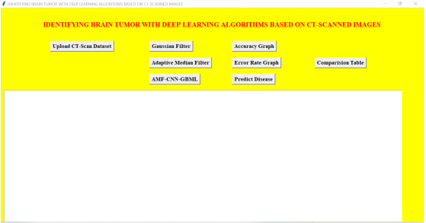

RESULTS

Slide 12
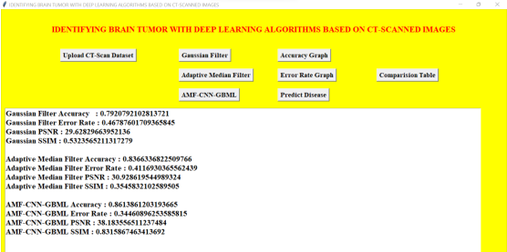
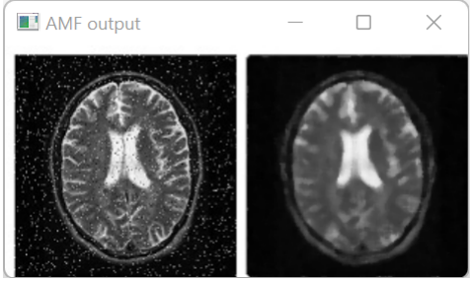

Slide 13
CONCLUSION
After implementing three different algorithms, as the result shows, the convolutional neural network gradient boosting machine learning algorithm has got the highest accuracy and the least error rate and also the peak signal-to-noise ratio is 38, which is relatively higher. This increases the hope in advancing the learning in convolutional neural networks for this kind of project.

Slide 14
REFERENCES
Saba, T., Mohamed, A. S., El-Affendi, M., Amin, J., & Sharif, M. (2020). Brain tumor detection using fusion of hand crafted and deep learning features. Cognitive Systems Research, 59, 221-230.
Toğaçar, M., Ergen, B., & Cömert, Z. (2020). BrainMRNet: Brain tumor detection using magnetic resonance images with a novel convolutional neural network model. Medical hypotheses, 134, 109531.
Abdalla, H. E. M., & Esmail, M. Y. (2018, August). Brain tumor detection by using artificial neural network. In 2018 International Conference on Computer, Control, Electrical, and Electronics Engineering.
Woźniak, M., Siłka, J., & Wieczorek, M. (2021). Deep neural network correlation learning mechanism for CT brain tumor detection. Neural Computing and Applications, 1-16.

