Slide 1
Introduction to PHP

Slide 2
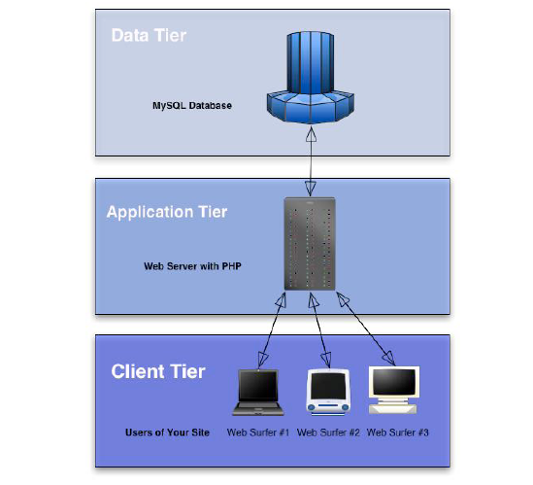
Three Tier Web Applications

Slide 3
Dynamic websites
Every client makes a request for a page.
The server checks what the client has asked for and based on that constructs a page for him based on an existing template.
The template is a page which contains HTML code and server-side code that will end up as HTML code as well, but a different HTML each time.

Slide 4
Server-Side Scripting
In order to generate dynamic pages we use a server-side scripting language.
There are different types of server-side scripting languages such as PHP, ASP, ASP.NET, ColdFusion, JavaServer Pages, Perl and others.
The application which interprets the server-side script is installed on the sever just like any other application.

Slide 5
Server-Side Scripting & Databases
When there is a need to store and retrieve information (user names, items in stock etc.) a database will be used to contain the data.
Sever-side script can communicate to a database using a structured query language (SQL) which manipulates the database (add, remove, update etc.)

Slide 6
What is PHP?
PHP stands for PHP: Hypertext Preprocessor
PHP is a server-side scripting language
PHP scripts are executed on the server
PHP supports many databases (MySQL, Oracle, PostgreSQL, Generic ODBC, etc.)
PHP is an open source software (OSS)
PHP is free to download and use

Slide 7
What is PHP?
PHP files may contain text, HTML tags and scripts.
PHP files are returned to the browser as plain HTML.
PHP files have a file extension of ".php", ".php3", or ".phtml".
PHP can be written in any text editor.

Slide 8
What is PHP?
PHP script will be located inside special tags, much like JavaScript e.g. <?php //php script here ?>
PHP code can be located any where in the page.
PHP is case sensitive.
Every variable in PHP will have the $ symbol as a prefix e.g. $myName =“John”;
Every line of code MUST be terminated with a ; symbol.

Slide 9
What is MySQL?
MySQL is a small database server
MySQL is ideal for small and medium applications
MySQL supports standard SQL
MySQL compiles on a number of platforms
MySQL is free to download and use

Slide 10
Syntax, Variables & Strings
Basic PHP Syntax
You cannot view the PHP source code by selecting "View source" in the browser – you will only see the output from the PHP file, which is plain HTML.
The scripts are executed on the server before the result is sent back to the browser.
A PHP scripting block always starts with <?php and ends with ?>. A PHP scripting block can be placed anywhere in the document.

Slide 11
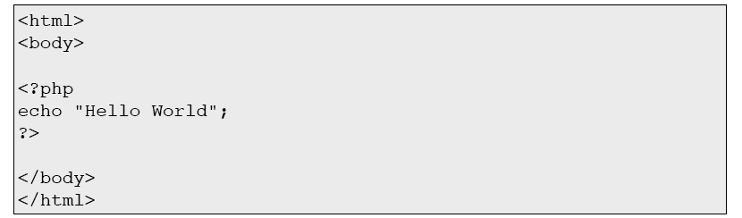
Basic PHP Syntax
An example of a simple PHP script which sends the text "Hello World“ to the browser:
Each code line in PHP must end with a semicolon. The semicolon is a separator and is used to distinguish one set of instructions from another.
There are two basic statements to output text with PHP: echo and print.

Slide 12
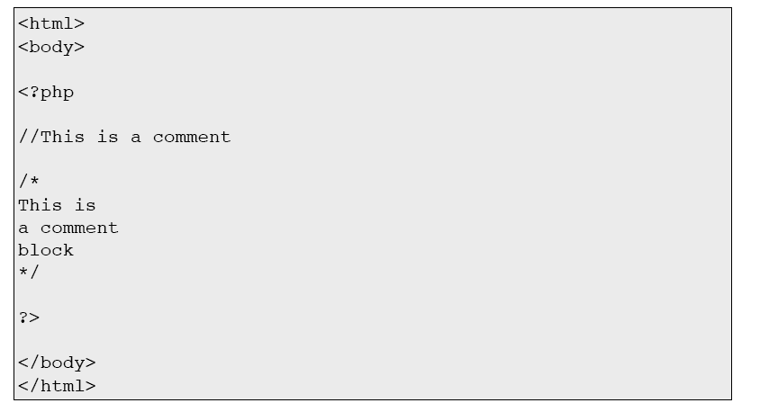
Basic PHP Syntax
Comments In PHP

Slide 13
PHP Variables
Variables are used for storing a values, like text strings, numbers or arrays.
When a variable is set it can be used over and over again in your script
All variables in PHP start with a $ sign symbol.
The correct way of setting a variable in PHP:

Slide 14
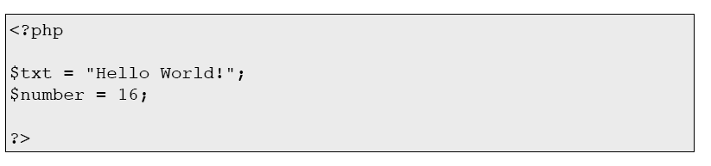
PHP Variables
Creating a variable with a string and a variable with a number:

Slide 15
PHP is a Loosely Typed Language
In PHP a variable does not need to be declared before being set.
In the previous example, you see that you do not have to tell PHP which data type the variable is.
PHP automatically converts the variable to the correct data type, depending on how they are set.
In PHP the variable is declared automatically when you use it.

Slide 16
Variable Naming Rules
A variable name must start with a letter or an underscore "_“
A variable name can only contain alpha-numeric characters and underscores (a-Z, 0-9, and _ )
A variable name should not contain spaces. If a variable name is more than one word, it should be separated with underscore ($my_string), or with capitalization ($myString)

Slide 17
Strings In PHP
String variables are used for values that contains character strings.
We are going to look at some of the most common functions and operators used to manipulate strings in PHP.
After we create a string we can manipulate it. A string can be used directly in a function or it can be stored in a variable.

Slide 18
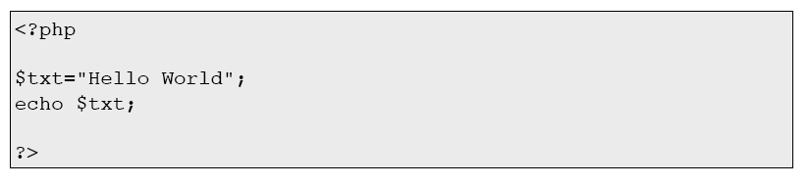
Strings In PHP
Below, the PHP script assigns the string "Hello World" to a string variable called $txt:
The output will be:

Slide 19
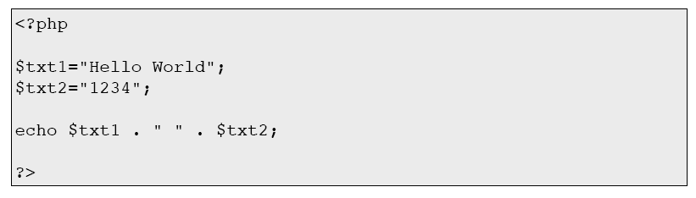
Strings In PHP
The Concatenation Operator
The concatenation (dot) operator “.” is used to put two string values together.
The output will be:

Slide 20
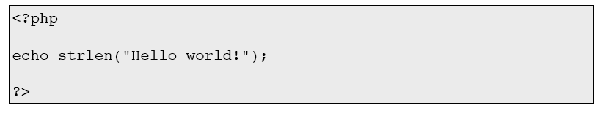
Using the strlen() function
The strlen() function is used to find the length of a string.
The output will be:

Slide 21
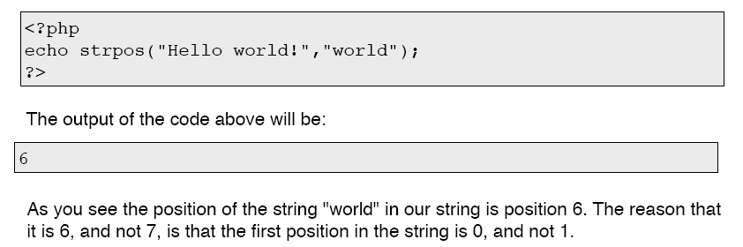
Using the strpos() function
The strpos() function is used to search for a string or character within a string.
If a match is found in the string, this function will return the position of the first match. If no match is found, it will return FALSE.

Slide 22
Complete PHP String Reference
For a complete reference of all string functions, go to the W3C complete PHP String Reference.
http://w3schools.com/php/php_ref_string.asp
The reference contains a brief description and examples of use for each function!

Slide 23
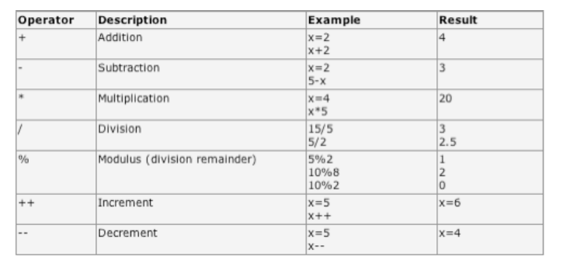
PHP Operators - Arithmetic Operators

Slide 24
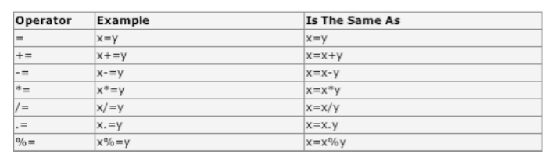
PHP Operators - Assignment Operators

Slide 25
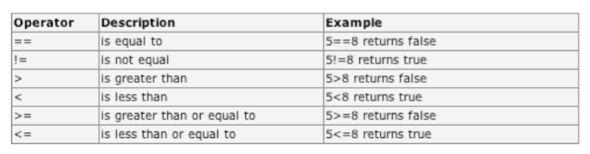
PHP Operators - Comparison Operators

Slide 26
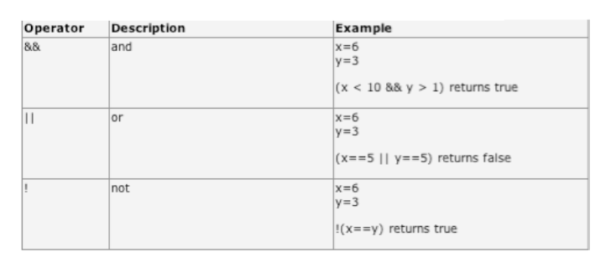
PHP Operators - Logical Operators

Slide 27
Conditional Statements
if...else statement - use this statement if you want to execute a set of code when a condition is true and another if the condition is not true
elseif statement - is used with the if...else statement to execute a set of code if one of several condition are true

Slide 28
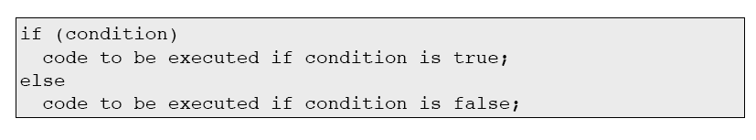
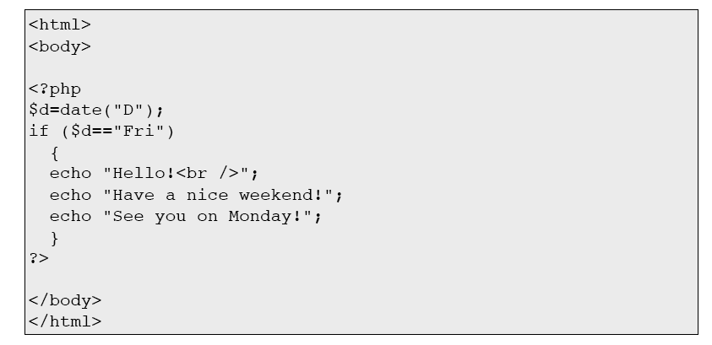
The If...Else Statement

Slide 29
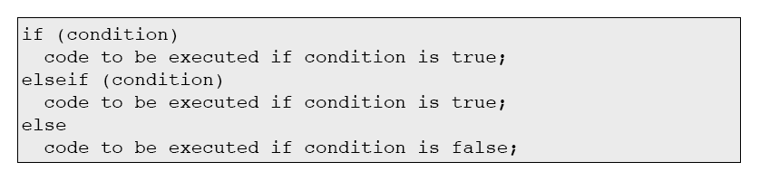
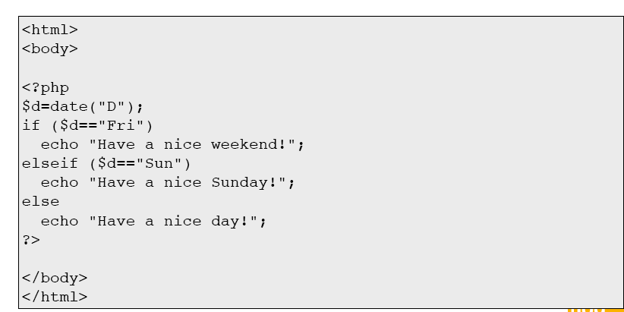
The ElseIf Statement

Slide 30
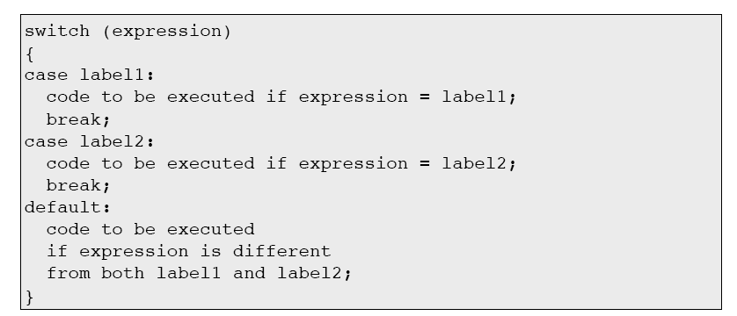
The Switch Statement - Syntax
If you want to select one of many blocks of code to be executed

Slide 31
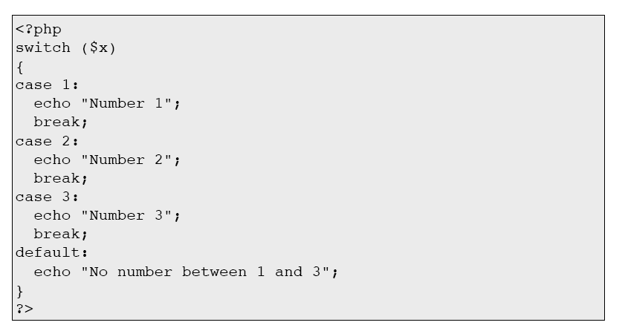
The Switch Statement - Example

Slide 32
Arrays & Loops
PHP Arrays
An array can store one or more values in a single variable name.
Each element in the array has its own ID so that it can be easily accessed.
There are three different kind of arrays:
- Numeric array - An array with a numeric ID key
- Associative array - An array where each ID key is
associated with a value
- Multidimensional array - An array containing one
or more arrays

Slide 33
Numeric Arrays
A numeric array stores each element with a numeric ID key.
There are different ways to create a numeric array.

Slide 34
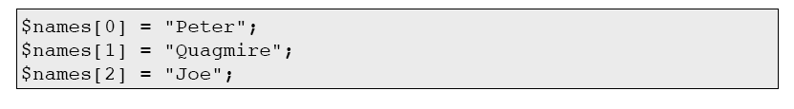
Numeric Arrays
In this example the ID key is automatically assigned:
In this example we assign the ID key manually:

Slide 35
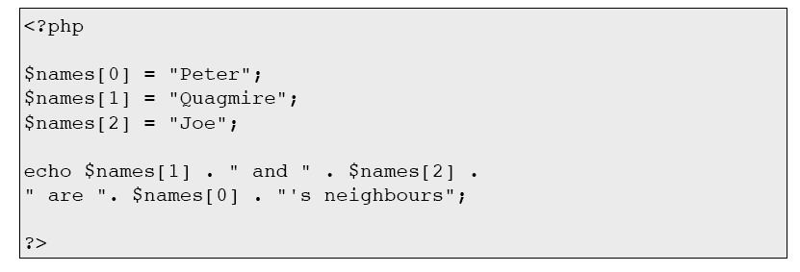
Arrays – Examples

Slide 36
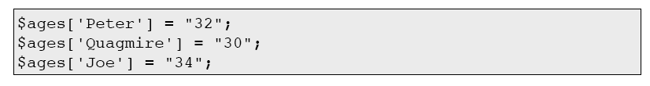
Associative Arrays
Each ID key is associated with a value.
With associative arrays we can use the values as keys and assign values to them.
In this example we use an array to assign ages to the different persons:
A different way of creating the array

Slide 37
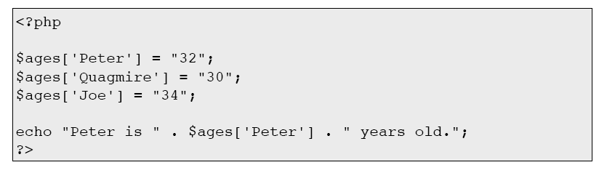
Associative Arrays - Example

Slide 38
Multidimensional Arrays
In a multidimensional array, each element in the main array can also be an array and each element in the sub-array can be an array, and so on.
In the next example we create a multidimensional array, with automatically assigned ID keys:

Slide 39
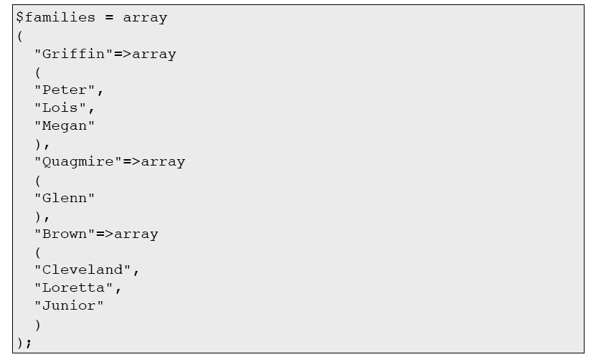
Multidimensional Arrays

Slide 40
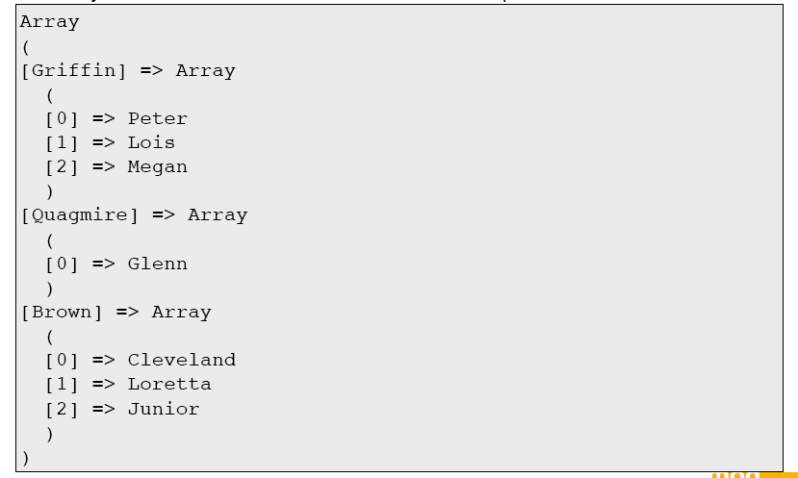
Multidimensional Arrays
The array above would look like this if written to the output:

Slide 41
Multidimensional Arrays
The code above will output:

Slide 42
PHP Looping
while - loops through a block of code if and as long as a specified condition is true
do...while - loops through a block of code once, and then repeats the loop as long as a special condition is true
for - loops through a block of code a specified number of times
foreach - loops through a block of code for each element in an array

Slide 43

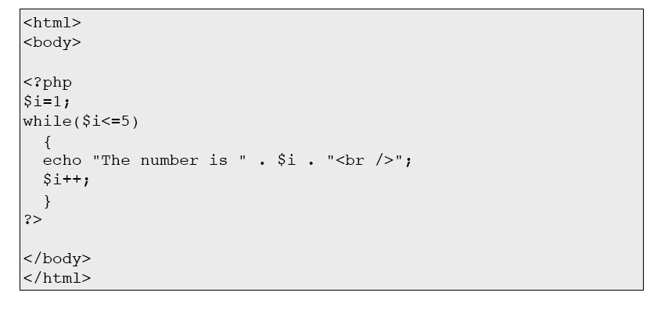
The while Statement
The example below demonstrates a loop that will continue to run as long as the variable i is less than, or equal to 5. i will increase by 1 each time the loop runs:

Slide 44
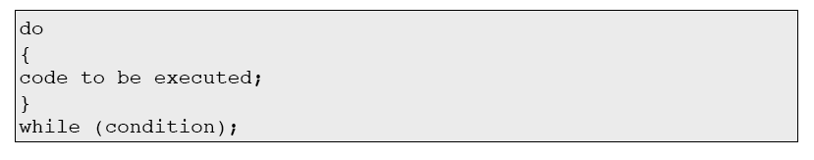
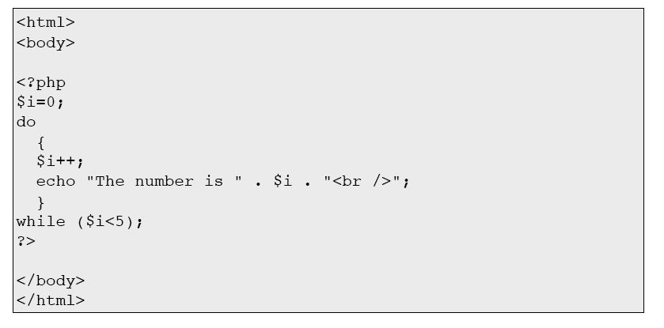
The do...while Statement
The following example will increment the value of i at least once, and it will continue incrementing the variable i as long as it has a value of less than 5:

Slide 45
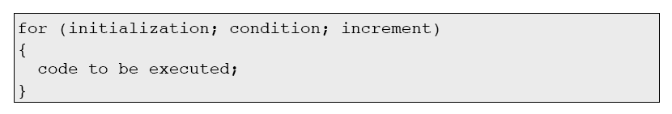
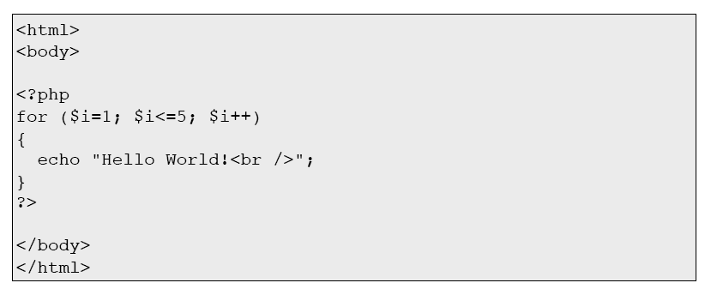
The for Statement
The following example prints the text "Hello World!" five times:

Slide 46
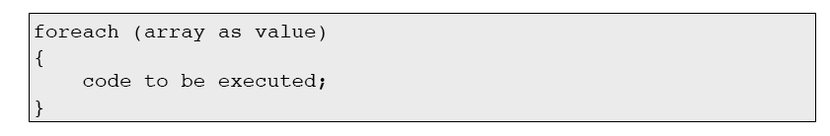
The foreach Statement
The foreach statement is used to loop through arrays
For every loop, the value of the current array element is assigned to $value (and the array pointer is moved by one) - so on the next loop, you'll be looking at the next element.

Slide 47
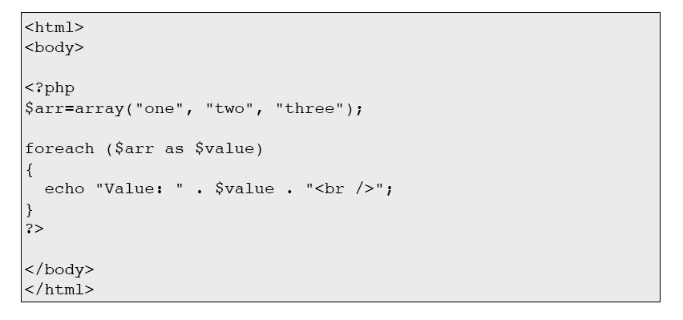
The foreach Statement
The following example demonstrates a loop that will print the values of the given array:

Slide 48
PHP Functions
For a reference and examples of the built-in functions, please visit the W3C functions list,
http://w3schools.com/php/default.asp

Slide 49
Creating PHP functions
All functions start with the word "function()"
Name the function - The name can start with a letter or underscore (not a number)
Add a "{" - The function code starts after the opening curly brace
Insert the function code
Add a "}" - The function is finished by a closing curly brace

Slide 50
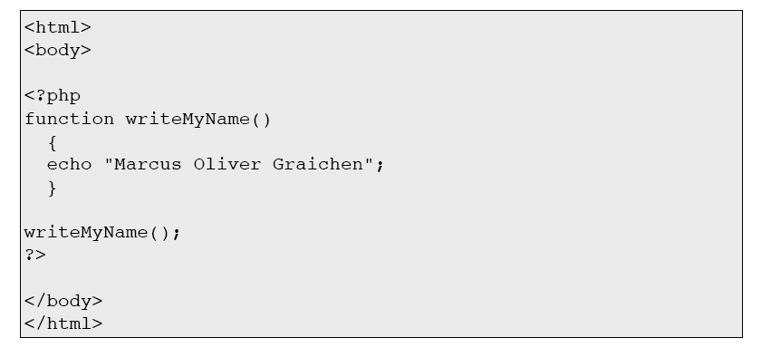
Create a PHP Function
A simple function that writes the string “Marcus Oliver Graichen” when called:

Slide 51
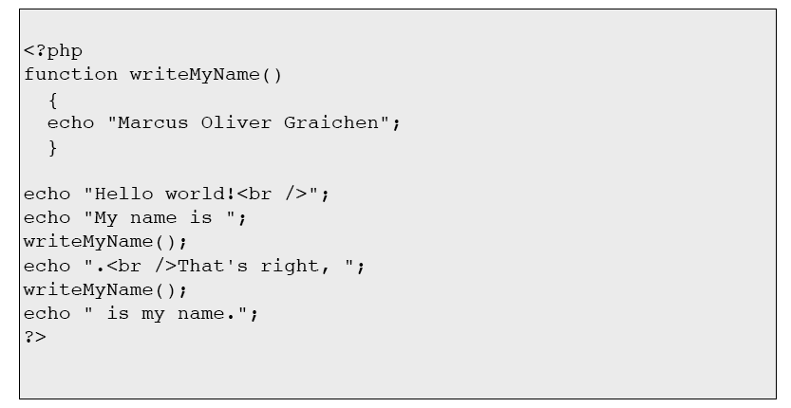
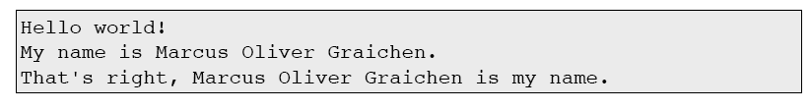
Use a PHP Function
The output of the code will be:

Slide 52
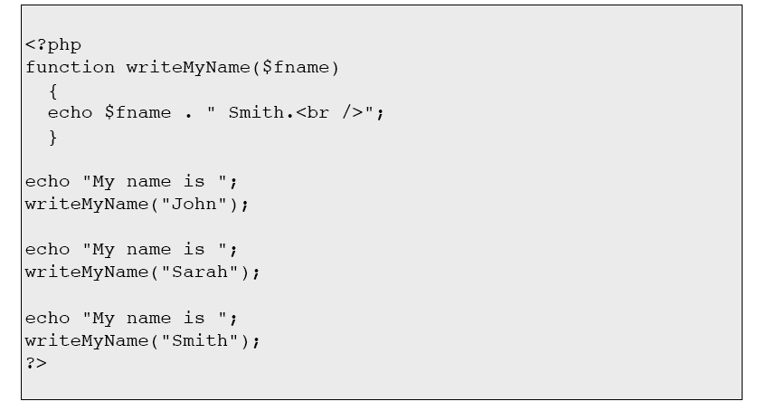
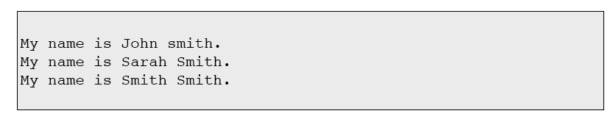
PHP Functions - Adding parameters

Slide 53
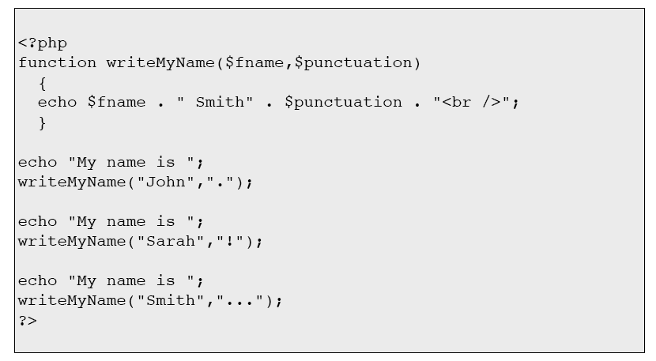
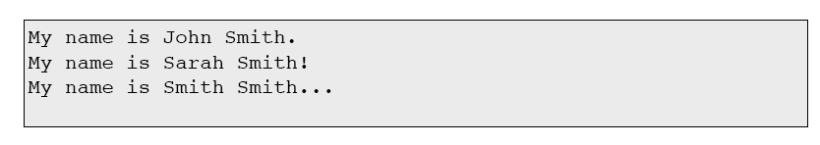
PHP Functions - Adding parameters

Slide 54
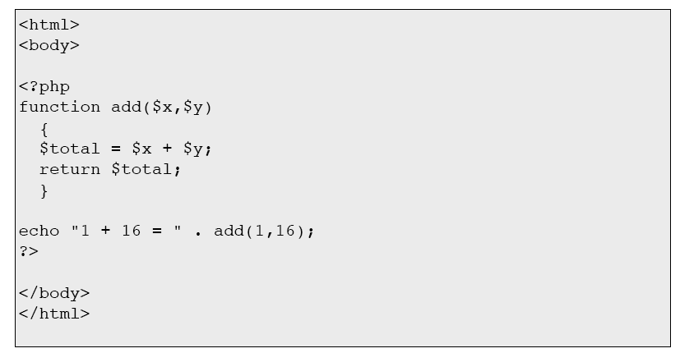
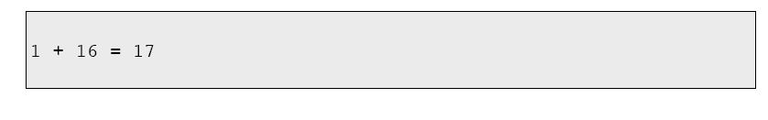
PHP Functions - Return values

Slide 55
PHP Forms & User Input
The PHP $_GET and $_POST variables are used to retrieve information from forms, like user input.
The most important thing to notice when dealing with HTML forms and PHP is that any form element in an HTML page will automatically be available to your PHP scripts.

Slide 56
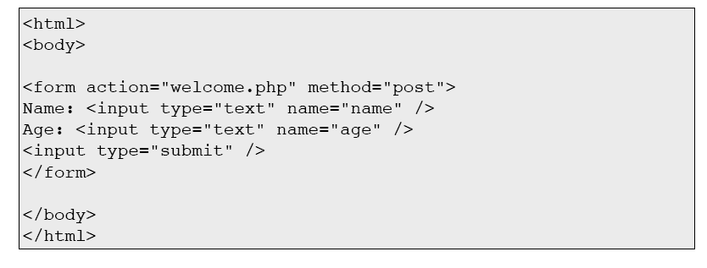
Form Example
This example HTML page contains two input fields and a submit button. When the user fills in this form and clicks on the submit button, the form data is sent to the "welcome.php" file.

Slide 57
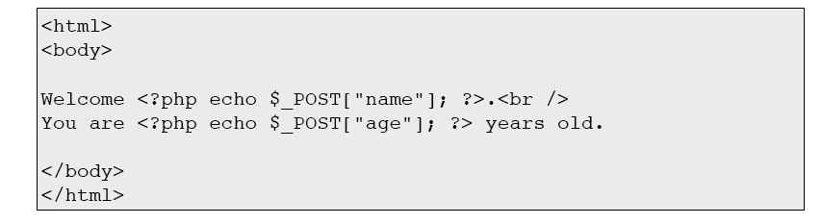
Form Example
The "welcome.php“ file might look like this:
A sample output of the above script might be:

Slide 58
Form Validation
User input should be validated whenever possible. Client side validation is faster, and will reduce server load.
However, any site that gets enough traffic to worry about server resources, may also need to worry about site security. You should always use server side validation if the form accesses a database.
A good way to validate a form on the server is to post the form to itself, instead of jumping to a different page. The user will then get the error messages on the same page as the form. This makes it easier to discover the error.

Slide 59
$_GET & $_POST
The $_GET Variable
The $_GET variable is used to collect values from a form with method="get".
The $_GET variable is an array of variable names and values sent by the HTTP GET method.
Information sent from a form with the GET method is visible to everyone (it will be displayed in the browser's address bar) and it has limits on the amount of information to send (max. 100 characters).

Slide 60
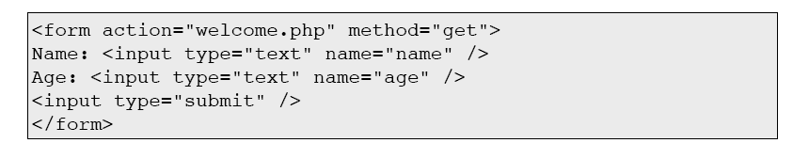
The $_GET Variable
The $_GET Variable
When the user clicks the "Submit" button, the URL sent could look something like this:

Slide 61

The $_GET Variable
The "welcome.php" file can now use the $_GET variable to catch the form data
(notice that the names of the form fields will automatically be the ID keys in the
$_GET array):

Slide 62
Why Use $_GET
Note: When using the $_GET variable all variable names and values are displayed in the URL.
So this method should not be used when sending passwords or other sensitive information! However, because the variables are displayed in the URL, it is possible to bookmark the page. This can be useful in some cases.
Note: The HTTP GET method is not suitable on large variable values; the value cannot exceed 100 characters.

Slide 63
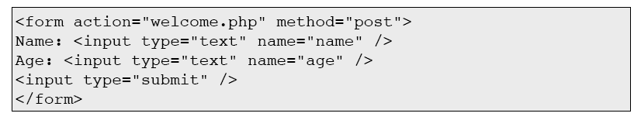
The $_POST Variable
When the user clicks the "Submit" button, the URL will not contain any form data, and will look something like this:

Slide 64
The $_POST Variable
The "welcome.php" file can now use the $_POST variable to catch the form data (notice that the names of the form fields will automatically be the ID keys in the $_POST array):

Slide 65
Why Use $_POST
Variables sent with HTTP POST are not shown in the URL
Variables have no length limit
However, because the variables are not displayed in the URL, it is not possible to bookmark the page.

Slide 66

The $_REQUEST Variable
The PHP $_REQUEST variable contains the contents of both $_GET, $_POST, and
$_COOKIE.
The PHP $_REQUEST variable can be used to get the result from form data sent with both the GET and POST methods.

Slide 67
Cookies & Sessions
What is a Cookie?
A cookie is often used to identify a user.
A cookie is a small file that the server embeds on the user's computer.
Each time the same computer requests a page with a browser, it will send the cookie too.
With PHP, you can both create and retrieve cookie values.

Slide 68

How to Create a Cookie?
The setcookie() function is used to set a cookie.
Note: The setcookie() function must appear BEFORE the <html> tag.

Slide 69
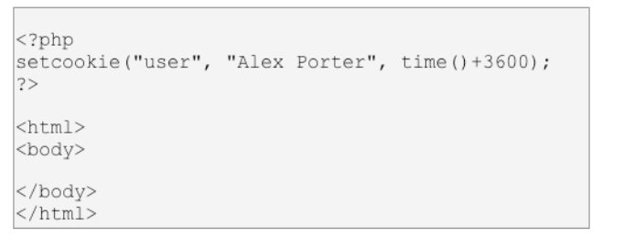
How to Create a Cookie?
In the example below, we will create a cookie named "user" and assign the value "Alex Porter" to it.
We also specify that the cookie should expire after one hour:
Note: The value of the cookie is automatically URLencoded when sending the cookie, and automatically decoded when received (to prevent URLencoding, use setrawcookie() instead).

Slide 70
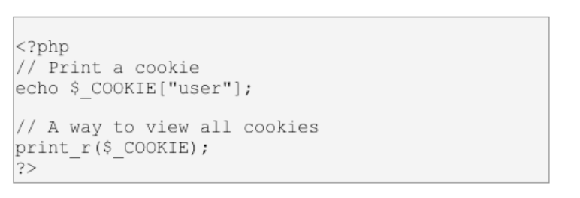
How to Retrieve a Cookie Value?
The PHP $_COOKIE variable is used to retrieve a cookie value.
In the example below, we retrieve the value of the cookie named "user" and display it on a page:

Slide 71
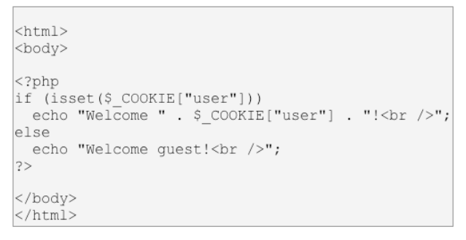
How to Retrieve a Cookie Value?
In the following example we use the isset() function to find out if a cookie has been set:

Slide 72
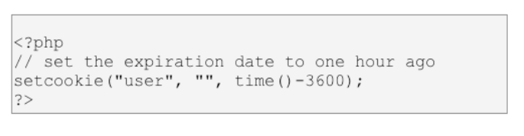
How to Delete a Cookie?
When deleting a cookie you should assure that the expiration date is in the past.
Delete example:

Slide 73
PHP Session Variables
A PHP session allows you to store user information on the server for later use (i.e. username, shopping items, etc).
However, session information is temporary and will be deleted after the user has left the website.

Slide 74
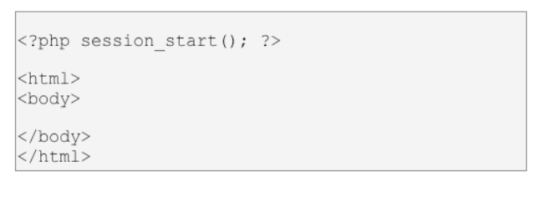
Starting a PHP Session
Before you can store user information in your PHP session, you must first start up the session.
Note: The session_start() function must appear BEFORE the <html> tag:
The code above will register the user's session with the server, allow you to start saving user information, and assign a UID for that user's session.

Slide 75
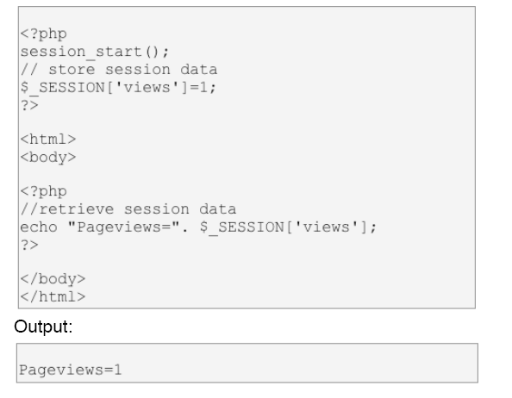
Storing a Session Variable
The correct way to store and retrieve session variables is to use the PHP $_SESSION variable:

Slide 76

Storing a Session Variable
In the example below, we create a simple page-views counter.
The isset() function checks if the "views" variable has already been set.
If "views" has been set, we can increment our counter.
If "views" doesn't exist, we create a "views“ variable, and set it to 1:

Slide 77

Destroying a Session

Slide 78


The PHP Date() Function

Slide 79

Format the Date

Slide 80

Format the Date

Slide 81

Adding a Timestamp

Slide 82
Company Database Example Application
FILE: dbinfo.php
<?php
$username = 'xxxxxxxxxxxxxx';
$password = 'xxxxxxxxxxx';
$host = 'localhost';
$database = 'cs4400_example';
?>

Slide 83
File: index.php
<?php
include 'dbinfo.php' ;
?>
<html>
<title>Corporate Administration Login </title>
<body bgcolor="#000000">
<center>
<font color="#ffffff">
<p>CORPORATE ADMINISTRATION SYSTEM FOR DEPARTMENT MANAGERS</p>
<br /><br />
<b><p>SECURE LOGIN</p></b>
<br /><br />
<?php
//always start the session before anything else!!!!!!
session_start();
if(isset($_POST['ssn'])) {
$ssn = $_POST['ssn']; //ssn of the text field for employee ssn
// store session data
$_SESSION['manager']=$ssn;
//connect to the db
mysql_connect($host,$username,$password) or die( "Unable to connect");;
mysql_select_db($database) or die( "Unable to select database");
//Our SQL Query
$sql_query = "Select dname,dnumber,mgrssn,mgrstartdate From department Where mgrssn = $ssn";
//Run our sql query
$result = mysql_query ($sql_query) or die(mysql_error());
//this is where the actual verification happens
if(mysql_num_rows($result) == 1){
//the ssn matches the ssn of a manager of a department
//move them to the page to which they need to go
header('Location: menu.php');
}else{
$err = 'Incorrect SSN for Manager' ;
}
//then just above your login form or where ever you want the error to be displayed you just put in
echo "$err";
}
echo "<html>";
echo "<head>";
echo "</head>";
echo "<body>";
echo "<form action=\"\" method=\"POST\">";
echo "<p>Employee Number:";
echo "<input name=\"ssn\" size=\"9\" maxlength=\"9\"/>";
echo "</p>";
echo "<input type=\"submit\" name=\"login\" value=\"Login\" />";
echo "</form>";
echo "</body>";
echo "</html>";
?>
</font>
</center>
</body>
</html>

Slide 84

Index.php

Slide 85
File: menu.php
<?php
//retrieve session data
session_start();
//echo "Manager SSN is ". $_SESSION['manager'] . "<br />";
$mgrssn = $_SESSION['manager'];
?>
<?php
include 'dbinfo.php' ;
?>
<html>
<head>
<title>Corporate Administration System Main Menu </title>
<body bgcolor="#000000">
<center>
<font color="#ffffff">
</head>
<body>
<p><b>CORPORATE ADMINISTRATION SYSTEM -- MAIN MENU</b></p>
<br /><br />
<!-- ************************************************************* -->
<?php
mysql_connect($host,$username,$password) or die( "Unable to connect");;
mysql_select_db($database) or die( "Unable to select database");
//Our SQL Query
$sql_query = "Select fname,lname From employee Where ssn = $mgrssn";
//Run our sql query
$result = mysql_query ($sql_query) or die(mysql_error());
$num = mysql_numrows($result);
//Close Database Connection
mysql_close ();
// echo "The Query returns $num rows <br>" ;
($
// while($row = mysql_fetch_arrayresult))
$row = mysql_fetch_array($result);
// {
// echo $row['fname'] . " " . $row['lname'];
$first = $row['fname'];
$last = $row['lname'];
// echo "<br />";
// }
?>
<!-- ************************************************************* -->
<p>WELCOME <font color="#ffff00" face="Arial, Helvetica, sans-serif"> <?php echo $first." ". $last?> </font></p>
<br /><br />
<p>PLEASE CHOOSE ONE OF THE FOLLOWING OPTIONS:</p>
<br /><br />
<form action="edQueryData.php" method="post">
<!-- Employee Query :<input type="radio" value="Employee" name="qtype"> -->
Employee Query
<input type="submit" value="submit" name="submit">
</form>
<form action="pjQueryData.php" method="post">
<!-- Department Query:<input type="radio" value="Department" name="qtype"> -->
Project Query
<input type="submit" value="submit" name="submit">
</form>
<form action="logout.php" method="post">
Logout
<input type="submit" value="submit" name="submit">
</form>

Slide 86

Menu.php

Slide 87
File: edQueryData.php
<?php
//retrieve session data
session_start();
//echo "Manager SSN is ". $_SESSION['manager'] . "<br />";
?>
<html>
<head>
<title>Enter Data for Employee Query </title>
</head>
<body bgcolor="#000000">
<center>
<font color="#ffffff">
<p>RETRIEVE male OR female EMPLOYEES FROM YOUR DEPARTMENT <br /> WHO HAVE DEPENDENTS OF EITHER son OR daughter OR spouse </p>
<br /><br />
<!-- Manager SSN is <?php echo $_SESSION['manager'] ?> -->
<form action="edQueryResult.php" method="post">
<!-- <form method="post" action="<?php echo $PHP_SELF;?>"> -->
Gender:<br />
Male:<input type="radio" value="M" name="gender"><br />
Female:<input type="radio" value="F" name="gender"><br /><br />
<!-- <textarea rows="5" cols="20" name="quote" wrap="physical">Enter your favorite quote!</textarea><br /><br /> -->
Select a Relationship Type:<br />
<select name="relations">
<option value="Son">Son</option>
<option value="Daughter">Daughter</option>
<option value="Spouse">Spouse</option></select><br /><br />
<input type="submit" value="submit" name="submit">
</form>
<br />
<br />
<br />
<form action="menu.php" method="post">
<input type="submit" value=" Return to Main Menu" name="submit">
</form>

Slide 88

edQueryData.php

Slide 89
File: edQueryResult.php
<?php
//retrieve session data
session_start();
//echo "Manager SSN is ". $_SESSION['manager'] . "<br />";
$manager = $_SESSION['manager'];
?>
<?php
include 'dbinfo.php' ;
?>
<html>
<head>
<title>Employee Query Result </title>
</head>
<body bgcolor="#000000">
<center>
<font color="#ffffff">
<p>EMPLOYEES FOR YOUR DEPARTMENT QUERY RESULTS </p>
<br /><br />
<!-- Manager SSN is <?php echo $_SESSION['manager'] ?> -->
<?php
$gender = $_POST["gender"];
$relations = $_POST["relations"];
if ($gender =="M")
$sex = 'Male';
else
if ($gender =="F")
$sex = 'Female';
else
$sex = 'All';
mysql_connect($host,$username,$password) or die( "Unable to connect");;
mysql_select_db($database) or die( "Unable to select database");
//Our SQL Query
if ($sex == 'All')
$sql_query = "Select fname,lname,address,salary,dno From employee,department,dependent
Where ssn = essn And relationship = '$relations' And dno = dnumber
And mgrssn = $manager";
else
$sql_query = "Select fname,lname,address,salary,dno From employee,department,dependent
Where ssn = essn And employee.sex = '$gender' And relationship = '$relations' And dno = dnumber
And mgrssn = $manager";
//Run our sql query
$result = mysql_query ($sql_query) or die(mysql_error());
$num = mysql_numrows($result);
//Close Database Connection
// mysql_close ();
// echo "The Query returns $num rows <br>" ;
?>
<?php
$dno = mysql_result($result,0,"dno");
?>
Refer to the edQueryResult.php file for the remainder of the code

Slide 90

File: edQueryResult.php
<b><font color="#ffff00" face="Arial, Helvetica, sans-serif"> <?php echo $sex; ?> </font> EMPLOYEES from your department<font color=
"#ffff00" face="Arial, Helvetica, sans-serif"> <?php echo $dno; ?> </font> with Dependent(s) of <font color="#ffff00" face="Arial,
Helvetica, sans-serif"> <?php echo $relations; ?> </font> </b><br><br>
<table border="1" cellspacing="2" cellpadding="2">
<tr>
<th><font color="#ffffff" face="Arial, Helvetica, sans-serif">First Name </font></th>
<th><font color="#ffffff" face="Arial, Helvetica, sans-serif">Last Name </font></th>
<th><font color="#ffffff" face="Arial, Helvetica, sans-serif">Address</font></th>
<th><font color="#ffffff" face="Arial, Helvetica, sans-serif">Salary</font></th>
</tr>
<?php
$i=0;
while ($i < $num) {
// echo "Iteration number $i<br>" ;
$first = mysql_result($result,$i,"fname");
$last = mysql_result($result,$i,"lname");
$address= mysql_result($result,$i,"address");
$salary = mysql_result($result,$i,"salary");
?>
<tr>
<td><font color="#ffffff" face="Arial, Helvetica, sans-serif"><?php echo $first; ?></font></td>
<td><font color="#ffffff" face="Arial, Helvetica, sans-serif"><?php echo $last; ?></font></td>
<td><font color="#ffffff" face="Arial, Helvetica, sans-serif"><?php echo $address; ?></font></td>
<td><font color="#ffffff" face="Arial, Helvetica, sans-serif"><?php echo $salary; ?></font></td>
</tr>
<?php
$i++;
}
?>
</table>
<?php

Slide 91
File: pjQueryData.php
<?php
include 'dbinfo.php' ;
?>
<?php
//retrieve session data
session_start();
//echo "Manager SSN is ". $_SESSION['manager'] . "<br />";
$manager = $_SESSION['manager'];
?>
<?php
mysql_connect($host,$username,$password) or die( "Unable to connect");;
mysql_select_db($database) or die( "Unable to select database");
//SQL Query
$sql_query = "Select Distinct plocation From project,department
Where dnum = dnumber And mgrssn = $manager";
//Run our sql query
$result = mysql_query ($sql_query) or die(mysql_error());
$num = mysql_numrows($result);
//Close Database Connection
mysql_close ();
// echo "The Query returns $num rows <br>" ;
?>
<html>
<head>
<title>Choose Data for Project Query </title>
</head>
<html>
<body bgcolor="#000000">
<center>
<font color="#ffffff">
<p>CHOOSE DATA FOR PROJECT QUERY </p>
<br /><br />
<body>
<form action="pjQueryResult.php" method="post">
<b> Choose Project Cities : </b><br />
<?php
$i=0;
while ($i < $num) {
$plocation = mysql_result($result,$i,"plocation");
?>
<?php echo $plocation; ?>:<input type="checkbox" value= "<?php echo $plocation ?>" name="ploc[]"><br />
<?php
$i++;
}
?>
<input type="submit" value="submit" name="submit">
</form>
<br />
<br />
<br />
<form action="menu.php" method="post">
<input type="submit" value=" Return to Main Menu" name="submit">
</form>

Slide 92

pjQueryData.php

Slide 93
File: pjQueryResult.php
<?php
//retrieve session data
session_start();
//echo "Manager SSN is ". $_SESSION['manager'] . "<br />";
$manager = $_SESSION['manager'];
?>
<?php
include 'dbinfo.php' ;
?>
<html>
<head>
<title>Project Query Result </title>
</head>
<body bgcolor="#000000">
<center>
<font color="#ffffff">
<p>PROJECT QUERY RESULT </p>
<br /><br />
<p>LOCATIONS CHOSEN:
<?php
$ploc = $_POST["ploc"];
$numlocs = count($ploc);
if ($numlocs > 0) {
$i=0;
while ($i < $numlocs) {
?>
<font color="#ffff00" face="Arial, Helvetica, sans-serif"> <?php echo " " . $ploc[$i]; ?> </font>
<?php
$i++;
if ($i < $numlocs) { echo ", "; }
}
}
else {
?>
<font color="#ffff00" face="Arial, Helvetica, sans-serif"> <?php echo " NONE "; } ?> </font>
</p>
<?php
mysql_connect($host,$username,$password) or die( "Unable to connect");;
mysql_select_db($database) or die( "Unable to select database");
switch ($numlocs)
{
case 1:
$sql_query = "Select pname,pnumber,plocation,dnum,Count(*) As numemps,Sum(Hours) As tothours From project,department,works_on Where mgrssn = $manager And dnumber = dnum And plocation = '$ploc[0]' And pnumber = pno Group By pname,pnumber,plocation,dnum";
break;
case 2:
$sql_query = "Select pname,pnumber,plocation,dnum,Count(*) As numemps,Sum(Hours) As tothours From project,department,works_on Where mgrssn = $manager And dnumber = dnum And (plocation = '$ploc[0]' Or plocation = '$ploc[1]') And pnumber = pno Group By pname,
pnumber,plocation,dnum";
break;
case 3:
$sql_query = "Select pname,pnumber,plocation,dnum,Count(*) As numemps,Sum(Hours) As tothours From project,department,works_on Where mgrssn = $manager And dnumber = dnum And (plocation = '$ploc[0]' Or plocation = '$ploc[1]' Or plocation = '$ploc[2]') And pnumber = pno Group By pname,pnumber,plocation,dnum";
break;
default:
$sql_query = "Select dnum,Count(*) As numemps,Sum(Hours) As tothours From project,department,works_on Where mgrssn = $manager And dnumber = dnum And pnumber = pno Group By dnum";
//echo "No Projects chosen <br /> ";
}
$result = mysql_query ($sql_query) or die(mysql_error());
$num = mysql_numrows($result);
mysql_close ();
?>

Slide 94
File:pjQueryResult.php
<br><br><br><br>
<?php
if ($numlocs > 0) {
?>
<b>Project Query Result </b><br><br>
<table border="1" cellspacing="2" cellpadding="2">
<tr>
<th><font color="#ffffff" face="Arial, Helvetica, sans-serif">Project Name </font></th>
<th><font color="#ffffff" face="Arial, Helvetica, sans-serif">ProjectNumber </font></th>
<th><font color="#ffffff" face="Arial, Helvetica, sans-serif">Location </font></th>
<th><font color="#ffffff" face="Arial, Helvetica, sans-serif">Department Number </font></th>
<th><font color="#ffffff" face="Arial, Helvetica, sans-serif">Number of Employees </font></th>
<th><font color="#ffffff" face="Arial, Helvetica, sans-serif">Total Number of Hours </font></th>
</tr>
<?php
$i=0;
while ($i < $num) {
$pname = mysql_result($result,$i,"pname");
$pnumber = mysql_result($result,$i,"pnumber");
$plocation = mysql_result($result,$i,"plocation");
$dnum = mysql_result($result,$i,"dnum");
$numemps = mysql_result($result,$i,"numemps");
$tothours = mysql_result($result,$i,"tothours");
?>
<tr>
<td><font color="#ffffff" face="Arial, Helvetica, sans-serif"><?php echo $pname; ?></font></td>
<td><font color="#ffffff" face="Arial, Helvetica, sans-serif"><?php echo $pnumber; ?></font></td>
<td><font color="#ffffff" face="Arial, Helvetica, sans-serif"><?php echo $plocation; ?></font></td>
<td><font color="#ffffff" face="Arial, Helvetica, sans-serif"><?php echo $dnum; ?></font></td>
<td><font color="#ffffff" face="Arial, Helvetica, sans-serif"><?php echo $numemps; ?></font></td>
<td><font color="#ffffff" face="Arial, Helvetica, sans-serif"><?php echo $tothours; ?></font></td>
</tr>
<?php
$i++;
}
?>
</table>
<?php
}
else {
?>
<b>Project Query Result Summary </b><br><br>
<table border="1" cellspacing="2" cellpadding="2">
<tr>
<th><font color="#ffffff" face="Arial, Helvetica, sans-serif">Department Number </font></th>
<th><font color="#ffffff" face="Arial, Helvetica, sans-serif">Number of Employees </font></th>
<th><font color="#ffffff" face="Arial, Helvetica, sans-serif">Total Number of Hours </font></th>
</tr>

Slide 95

File: pjQueryResult.php
<?php
$i=0;
while ($i < $num) {
$dnum = mysql_result($result,$i,"dnum");
$numemps = mysql_result($result,$i,"numemps");
$tothours = mysql_result($result,$i,"tothours");
?>
<tr>
<td><font color="#ffffff" face="Arial, Helvetica, sans-serif"><?php echo $dnum; ?></font></td>
<td><font color="#ffffff" face="Arial, Helvetica, sans-serif"><?php echo $numemps; ?></font></td>
<td><font color="#ffffff" face="Arial, Helvetica, sans-serif"><?php echo $tothours; ?></font></td>
</tr>
<?php
$i++;
}
?>
</table>
<?php
}
?>
<br><br>
<form action="pjQueryData.php" method="post">
<input type="submit" value="Return to Project Query" name="submit">
</form>

Slide 96

File: logout.php
<html>
<head>
<title>Corporate Administration Ssytem Logout </title>
</head>
<body bgcolor="#000000">
<center>
<font color="#ffffff">
<p>CORPORATE ADMINISTRATION SYSTEM LOGOUT </p>
<br /><br />
<b><p>Thank you for using the Corporate Administration System</p></b>
<br /><br />

