Slide 1


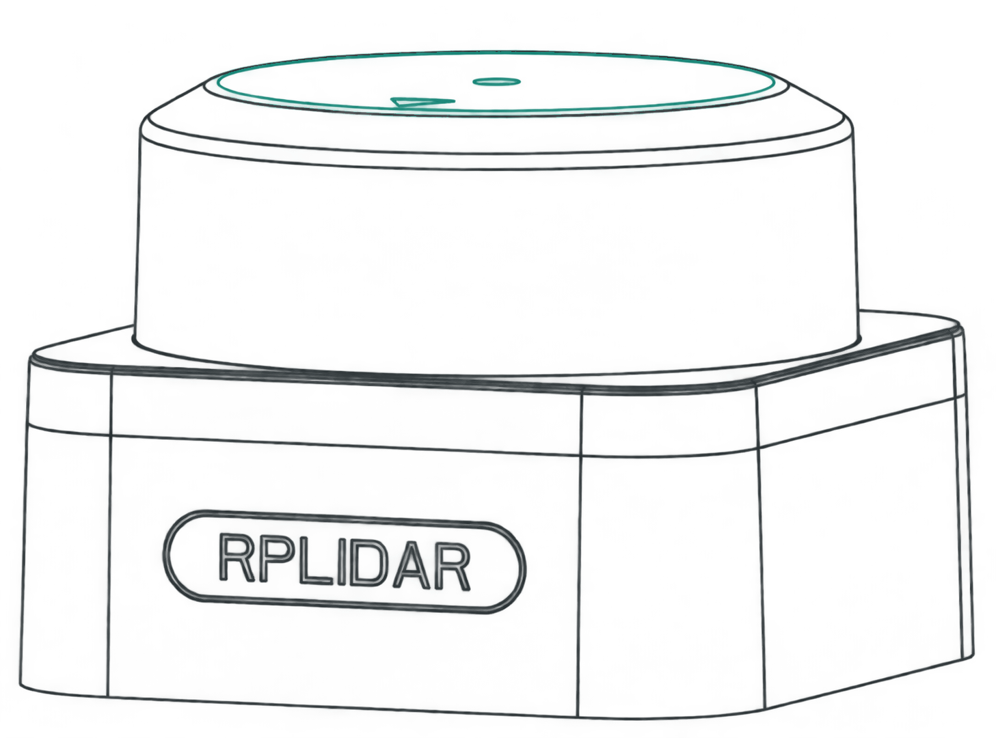
Dayananda Sagar College of Engineering
Department of Electronics and Telecommunication Engineering
An autonomous institute under Visvesvaraya Technological University, Belagavi
Shavige Malleshwara Hills, Kumaraswamy Layout, Bengaluru 560111
Phase-I presentation / 22ETP76 / 2026-27
On-board SLAM for
GPS-Denied
Indoor Search
LiDAR reference illustration
Naman Singh
Shivansh Kumar Pandey
Guide
1DS23ET072
1DS23ET104
Jayanth C, Assistant Professor
Sai Shourya Inguru
Shraddha Upadhyay
Co-guide
1DS23ET094
1DS23ET105
Dr. Smitha Sasi, Associate Professor
Phase-I presentation
01
Notes:
Speaking time: 45 seconds
Good morning. We are presenting our Phase-I work on On-board SLAM for GPS-Denied Indoor Search: a low-cost payload that maps indoor spaces without GPS and listens for people who need help. Our team is Naman Singh, Shivansh Kumar Pandey, Sai Shourya Inguru and Shraddha Upadhyay. Jayanth C is our guide, with Dr. Smitha Sasi as co-guide.
The review establishes the research direction. Our development work begins with a sensing payload on a bench, where we can study the capture and mapping pipeline before adding flight. This presentation explains the literature, our proposed system and the design and software evidence available for Phase I.
Sources
Supplied revised review paper, title and author block.
Existing Synopsis Major Project.pdf, cover: guide Jayanth C, Assistant Professor; co-guide Dr. Smitha Sasi, Associate Professor.
https://www.dsce.edu.in/telecom/telecom-faculty
Cover line art derives from the manufacturer S3 datasheet drawing, converted to an ivory/teal illustration. https://static.generation-robots.com/media/SLAMTEC_rplidar_datasheet_S3_.pdf
Icons: Lucide, ISC licence. https://lucide.dev/license

Slide 2
Contents
01
Context and
objectives
04
CAD, components
and PCB
Slides 03-05
Slides 11-13
02
Literature
survey
05
Results, dashboard
and USPs
Slide 06
Slides 14-16
03
Architecture and
methodology
06
Progress, roadmap
and references
Slides 07-10
Slides 17-20
Phase-I presentation
02
Notes:
Speaking time: 25 seconds
We will begin with the indoor-search problem and our objectives, then look at the papers that shaped the design. Next come the block diagram and development method. We will show the CAD mechanism and the documented Phase-I results. The later project-progress and publication pages remain available for the team's next update.
Sources
Source structure: supplied PHASE 1 TEMPLATE.pptx, slides 2-11.
Icons: Lucide, ISC licence. https://lucide.dev/license

Slide 3
Introduction
Indoor search
with limited sensing
and compute
SLAM
Estimate sensor motion while building a map of an unknown environment.
A useful payload must describe the space and surface acoustic cues that an operator can investigate.
Acoustic sensing
Detect sounds of interest and estimate their bearing relative to the sensor.
Review scope: embedded SLAM, 3-D collaboration, loop closure and drone acoustics
Phase-I presentation
03
Notes:
Speaking time: 65 seconds
A damaged building can be difficult to enter and difficult to map. GPS may be unavailable indoors. Dust, poor lighting and occlusion can reduce the usefulness of cameras, while communication links may be unreliable. A rescue team still needs a description of the space and evidence that could indicate where a person is located.
SLAM means simultaneous localisation and mapping. The system estimates its own movement while building a map from sensor observations. Acoustic sensing addresses a different question: whether a sound of interest is present and which direction it comes from. An acoustic event is a cue for an operator to investigate. It does not, by itself, confirm a survivor.
Our review covers embedded SLAM, extensions to collaborative 3-D mapping, loop closure and drone acoustics. The practical starting point is a LiDAR payload with controlled tilt and repeatable data capture.
Sources
Supplied revised review paper, Sections I-II.
https://arxiv.org/abs/2407.03136
https://doi.org/10.1016/j.dsp.2024.104881
Icons: Lucide, ISC licence. https://lucide.dev/license

Slide 4
Problem statement
Develop and evaluate a low-cost system that maps GPS-denied indoor spaces and provides acoustic cues for survivor search.
Combined sensing
Low-cost mapping needs a practical acoustic-search path.
Measured performance
Map appearance alone cannot establish accuracy.
Limited resources
Compute, power and rotor noise constrain the design.
Phase-I presentation
04
Notes:
Speaking time: 60 seconds
The project asks how to build and evaluate a low-cost system that can map an indoor environment without GPS and provide acoustic cues that could help an operator locate survivors. The difficult part is making the sensing and computation work within a limited budget, while still producing results we can measure.
The literature suggests several constraints. Low-cost nano-aerial mapping studies establish that embedded mapping is possible, but their sensing and evaluation differ from larger rescue robots. Field systems demonstrate search capability with much larger resources. Rotor noise creates a separate challenge for acoustic sensing.
Our response is to make evaluation part of the design. We plan to compare maps with measured room geometry, retain the raw data, and measure acoustic performance under stated noise conditions. A convincing demonstration needs those measurements in addition to a map that looks plausible.
Sources
Supplied revised review paper, Sections III, VI-VIII.
https://arxiv.org/abs/2309.02834
https://doi.org/10.1126/scirobotics.abp9742
https://doi.org/10.1016/j.dsp.2024.104881
Icons: Lucide, ISC licence. https://lucide.dev/license

Slide 5
Objectives
Targets for the complete project
01
02
Onboard indoor mapping
Spatial and collaborative mapping
Develop a mapping pipeline suited to constrained sensing and compute.
Extend planar scans to height maps and study offline 3-D / multi-agent methods.
03
04
Acoustic event detection and bearing
Reproducible quantitative evaluation
Characterise performance with background noise and, later, rotor noise.
Measure map error, sensor-fidelity effects and acoustic false-alarm rates.
Phase-I presentation
05
Notes:
Speaking time: 65 seconds
These are objectives for the complete project. First, we want indoor mapping that can ultimately operate on constrained onboard hardware. Our present bench pipeline processes the data on a laptop, which makes it easier to inspect the raw data and validate the geometry.
Second, we want depth beyond a single horizontal scan. The tilt mechanism supports spatial point capture and a 2.5D height representation. Dense 3-D reconstruction and collaborative map merging are further extensions identified by the review.
Third, we want to detect acoustic events and estimate their direction, while measuring how background and rotor noise affect the result. Finally, we want reproducible evaluation: mapping error against a reference, sensor-fidelity comparisons using the same recorded data, and acoustic detection and false-alarm rates. These targets guide the work. The Phase-I evidence shown later covers the design and software preparation completed so far.
Sources
Supplied revised review paper, Sections II and VIII.
Existing Synopsis Major Project.pdf, objectives and project outcomes.
Second-brain project status, 24 October 2026.
Icons: Lucide, ISC licence. https://lucide.dev/license

Slide 6
Literature survey
Selected studies from the 26-work review
Work | Reported contribution | Implication for this project
Steux & El Hamzaoui 2010 [1] | Compact occupancy-grid SLAM | Start with a small mapping baseline
Markdahl & Vikgren 2023 [2] | tinySLAM on nano-UAVs | Evaluate mapping error quantitatively
Niculescu et al. 2024 [3] | Collaborative mapping in 1.5 MB | Embedded mapping is feasible
Tranzatto et al. 2022 [4] | Autonomous exploration and artifact search | Field reference with larger resources
Lajoie & Beltrame 2024 [5] | Sparse decentralized map sharing | Control communication cost
Sun et al. 2025 [6] | Beamforming to suppress rotor noise | Test acoustics under stated noise
Phase-I presentation
06
Notes:
Speaking time: 100 seconds
The revised review examines twenty-six works. This slide selects six that directly inform the proposed testbed.
Steux and El Hamzaoui's tinySLAM provides a compact occupancy-grid baseline. Markdahl and Vikgren take tinySLAM into nano-UAV exploration, which makes their work relevant to the limits of small aerial platforms. Niculescu and colleagues demonstrate onboard collaborative mapping within 1.5 megabytes of memory. That result supports the feasibility of embedded mapping, while leaving us to validate our own sensing and hardware.
CERBERUS provides a field reference for autonomous exploration and artifact search. Its resource requirements are very different from our low-cost testbed. Swarm-SLAM addresses sparse decentralized collaboration, particularly the cost of sharing information across robots. Sun and colleagues study rotor-noise suppression using beamforming before acoustic event detection.
The design implications are to begin with a compact mapping baseline, preserve data for quantitative evaluation, control communication cost if collaboration is added, and test acoustics under stated noise conditions. We treat these as separate capabilities to validate rather than assuming that combining the components automatically produces a complete rescue system.
Sources
[1] Steux & El Hamzaoui (2010). tinySLAM: A SLAM algorithm in less than 200 lines C-language program. https://doi.org/10.1109/ICARCV.2010.5707402
[2] Markdahl & Vikgren (2023). tinySLAM-based exploration with a swarm of nano-UAVs. https://arxiv.org/abs/2309.02834
[3] Niculescu et al. (2024). Ultra-Lightweight Collaborative Mapping for Robot Swarms. https://arxiv.org/abs/2407.03136
[4] Tranzatto et al. (2022). CERBERUS in the DARPA Subterranean Challenge. https://doi.org/10.1126/scirobotics.abp9742
[5] Lajoie & Beltrame (2024). Swarm-SLAM: Sparse Decentralized Collaborative Simultaneous Localization and Mapping Framework for Multi-Robot Systems. https://arxiv.org/abs/2301.06230
[6] Sun et al. (2025). Acoustic event detection for drone search and rescue system based on bi-directional long and short-term memory beamforming method to remove rotor noise. https://doi.org/10.1016/j.dsp.2024.104881
Icons: Lucide, ISC licence. https://lucide.dev/license

Slide 7
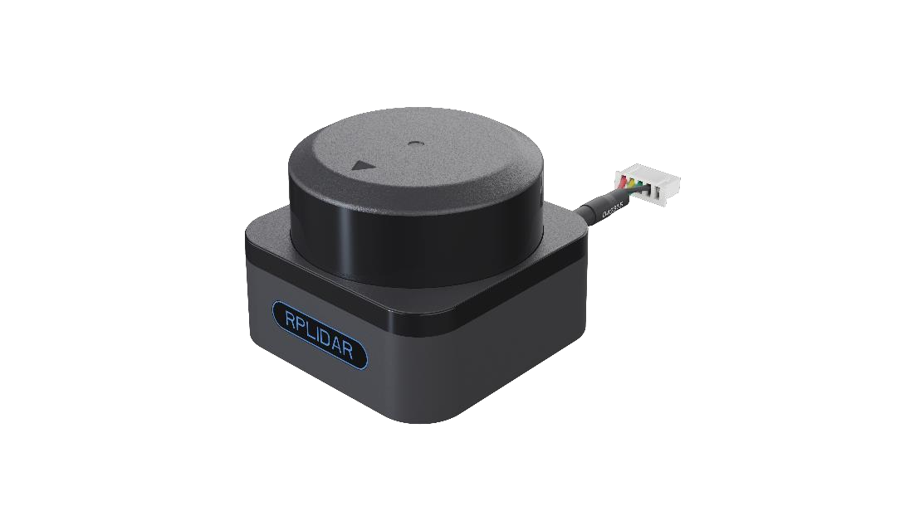
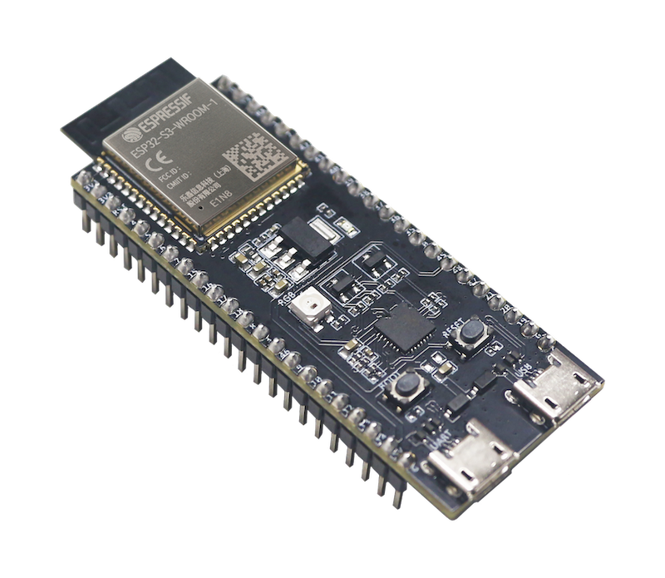
Block diagram
Phase-I bench pipeline
UART ranges
Wi-Fi relay
Decode
Transform
Elevation grid
Range + tilt
ESP32-S3
Laptop processing
LiDAR and cradle
Acquisition and Wi-Fi relay
Slamtec SDK and Python
Map, saved session and replay
Hardware images are references. LiDAR model confirmation pending.
Planned complete-system architecture
Sensor inputs
Embedded processing
Offline and collaborative
LiDAR, motion sensors and microphone array
Onboard SLAM and acoustic event / bearing
Dense 3-D reconstruction and map merging
Phase-I presentation
07
Notes:
Speaking time: 90 seconds
The upper lane shows the Phase-I bench architecture. Range data comes from the LiDAR, while the tilt mechanism supplies the orientation of each scan plane. The ESP32-S3 handles the sensor and tilt interface and relays the data over Wi-Fi. On the laptop, the Slamtec driver decodes the ranges and the processing service applies the geometry, builds the height map and manages sessions. The dashboard displays the output and allows recorded data to be replayed.
The lower lane shows the planned target architecture from the review. This adds motion and acoustic sensing to an embedded mapping and acoustic-processing stage. Stored data can then support offline reconstruction and later collaborative map merging.
The difference between these lanes matters. The title describes the research and final-system direction. The Phase-I bench implementation deliberately uses laptop processing so that we can inspect the pipeline before moving more computation onboard. Both stages retain recorded data so that later algorithm changes can be compared on the same measurements.
Sources
Supplied revised review paper, Figure 5 and Section VIII.
https://github.com/sxivansx/major-project/blob/main/README.md
https://github.com/sxivansx/major-project/blob/main/docs/team-plan-alignment.md
Second-brain project status, 24 October 2026.
ESP32-S3 manufacturer image: https://docs.espressif.com/projects/esp-dev-kits/en/latest/esp32s3/esp32-s3-devkitc-1/user_guide_v1.1.html
Slamtec S3 product image extracted with its original alpha from the manufacturer datasheet, page 3: https://static.generation-robots.com/media/SLAMTEC_rplidar_datasheet_S3_.pdf
The product image is an S3 reference, as requested. The physical device is labelled generically here because the project record contains conflicting S3 and device-reported S2M1 identities.
Icons: Lucide, ISC licence. https://lucide.dev/license

Slide 8
System architecture
Rig
Backend · Python FastAPI (laptop)
AI models · cloud
RPLIDAR S3
2D laser · UART
ESP32-S3
firmware
own Wi-Fi
SLAM-Test
LiDAR bridge
C++ · Slamtec SDK
Rig control
tilt sweeps, limits
voice clip
Sarvam Saaras v4
speech → text, 22 Indian languages
Servo + cradle
tilt ±60° · PWM
Mapping
room map · 2.5D grid
Findings
voids · obstacles · route
transcript
Wi-Fi
findings
Jev (TypeSafe)
yes / no: call for help? rank findings
4 × INMP441
mics · I²S
TCP / UDP
Acoustics
GCC-PHAT direction
Sound sources
bearing + map cells
summary
Gemini 3.5 Flash
written situation report
MPU-6050
tilt + motion · I²C
Speech gate
voice segments only
Sessions
save · replay · export
5 V power bank · servo on its own supply
called only when needed
Operator dashboard
React · live WebSocket
Phase-I presentation
08
Notes:
Speaking time: 60 seconds
The system has three layers. On the left is the rig: the LiDAR, the tilt servo, four microphones and a motion sensor all connect to one ESP32-S3, which sends everything over its own Wi-Fi. In the middle is the Python backend on the laptop: the LiDAR bridge feeds mapping, mapping produces findings such as voids, the acoustics module turns sounds into directions and looks up what lies along them, and the speech gate passes on only real voice. Everything is saved for replay. On the right are the AI models, used sparingly: Sarvam turns speech into text in Indian languages, Jev answers yes/no questions such as 'is this a call for help', and Gemini writes the final situation report. Everything else is deterministic maths, so it is fast, free and explainable.

Slide 9
From the ESP32 to the backend
One Wi-Fi link carries everything; the backend splits it into simple modules
ESP32-S3 firmware
Backend server: Python 3.12 + FastAPI
LiDAR relay
UART 1 Mbaud in, TCP port 8899 out
LiDAR bridge
C++ on the Slamtec SDK
Rig control
tilt sweeps, safety limits
Mapping
numpy: room map, 2.5D grid
Tilt control
servo PWM, commands on port 8900
Wi-Fi
Acoustics
GCC-PHAT direction finding
Speech
Sarvam + Jev, help calls
Sessions
save, replay, PLY / CSV
Microphones
4 × I²S at 16 kHz, port 8901 / 8902
Own Wi-Fi
network SLAM-Test, 192.168.4.1
Dashboard: React in the browser, live over a WebSocket
Phase-I presentation
09
Notes:
Speaking time: 60 seconds
The ESP32-S3 is the only electronics on the rig with any logic. It relays the LiDAR's serial stream over Wi-Fi, drives the tilt servo and streams the four microphones. It also creates its own Wi-Fi network, so the rig works anywhere without a router.
The backend is a Python FastAPI server. A small C++ bridge built on Slamtec's SDK decodes the LiDAR. Rig control runs the tilt sweeps with safety limits. Mapping, acoustics and speech are separate modules, and every capture is saved so it can be replayed and exported. The browser dashboard gets live updates over a WebSocket.

Slide 10
Methodology
01
02
03
04
05
Review and define evidence
Calibrate the sensor and mount
Capture controlled sweeps
Reconstruct and replay
Evaluate, then extend
Choose baselines and set the evaluation protocol.
Check range bias, tilt zero, direction and geometric offsets.
Move the cradle, wait for settling, then capture each scan.
Transform points, build an elevation grid and retain raw sessions.
Compare with room measurements before acoustic, cart and flight trials.
Phase-I presentation
10
Notes:
Speaking time: 80 seconds
Development follows a payload-first sequence. We first select a baseline from the literature and define which measurements will count as evidence. Then we calibrate the sensor and the mount: range bias, the tilt centre, axis direction and offsets all affect where a point lands in the map.
A sweep follows a move, settle and capture sequence. The sensor moves to a tilt angle, waits for motion to settle, and records a scan. Range, scan angle, tilt and the mount transform locate each return in three dimensions. The software can then reduce those points to an elevation grid. A 2.5D grid stores height information over a floor plane, so it has limits for overhangs and stacked surfaces.
We retain raw sessions so that calibration and algorithms can be changed without repeating the capture. Evaluation starts against measured room geometry. Acoustic tests progress from quiet conditions to controlled noise. Cart and flight trials follow only after the sensing pipeline has been characterised.
Sources
Second-brain project status and original payload-first plan.
https://github.com/sxivansx/major-project/blob/main/docs/bringup.md
https://github.com/sxivansx/major-project/blob/main/core/README.md
Supplied revised review paper, Section VIII-B.
Icons: Lucide, ISC licence. https://lucide.dev/license

Slide 11
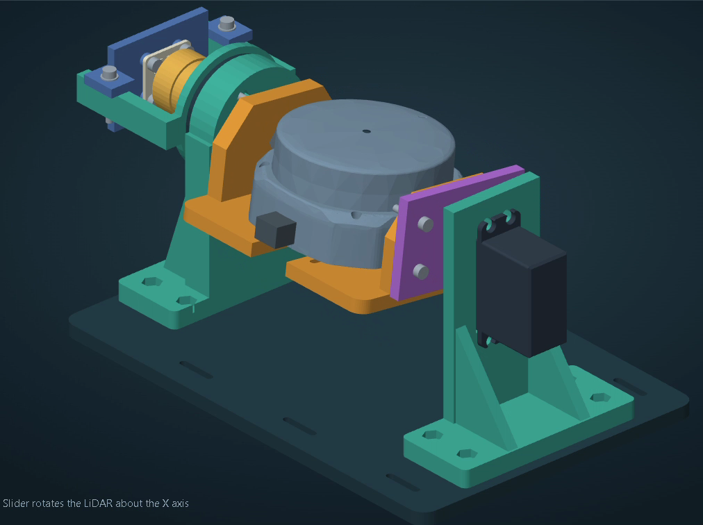
CAD tilt mechanism
Controlled tilt
adds spatial samples
The cradle rotates the LiDAR scan plane about the X axis.
Move, settle, capture
Collect each scan after the mechanism has settled.
CAD design evidence, 5.5-second animation
Phase-I presentation
11
Notes:
Speaking time: 60 seconds
This animation shows the proposed tilt mechanism. The LiDAR sits in a cradle supported on an axle, and a servo changes the cradle angle about the X axis. The scanner still measures within its own rotating scan plane. Tilting the cradle changes the orientation of that plane, which gives the processing pipeline samples at different heights.
The bearings support the axle while the servo provides the commanded motion. In the capture method, we allow the mechanism to settle before collecting points, because measurements taken during an unsettled move can distort the reconstructed surface.
The clip is design evidence. It shows the intended assembly and movement, but it does not establish the measured tilt angle, mechanical stiffness or accuracy of a physical sweep. Those require calibration and tests on the assembled rig.
Sources
User-supplied WhatsApp Video 2026-10-24 at 02.11.21.mp4, 5.533 seconds.
Second-brain tilt CAD description.
Icons: Lucide, ISC licence. https://lucide.dev/license

Slide 12
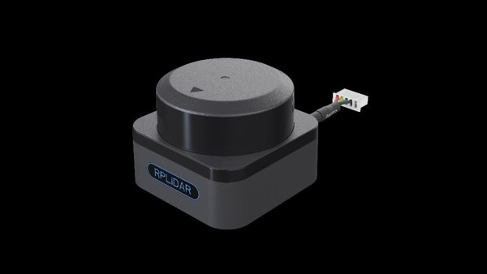
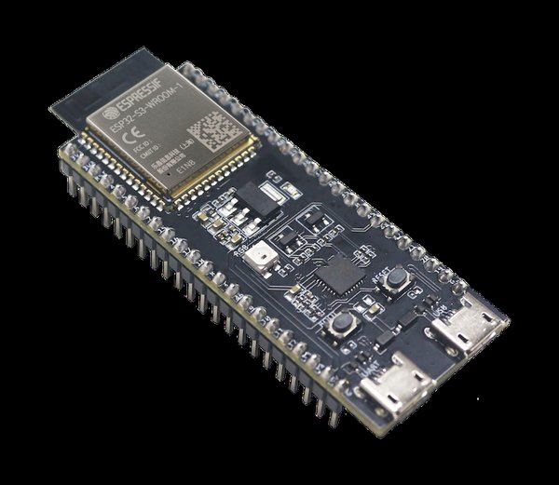
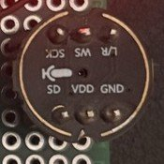
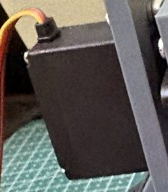
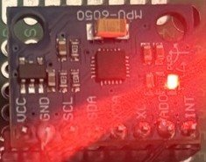
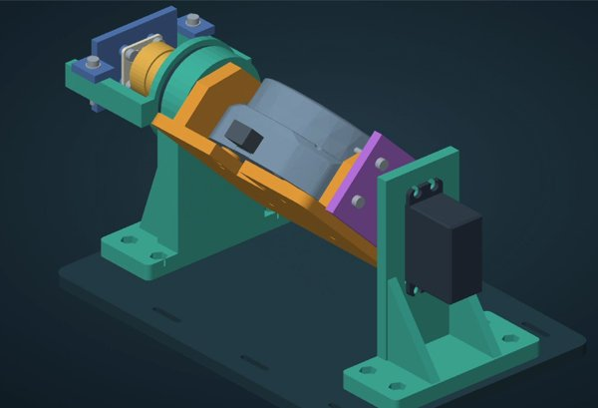
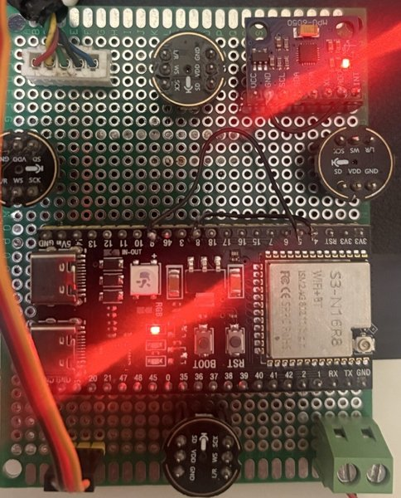
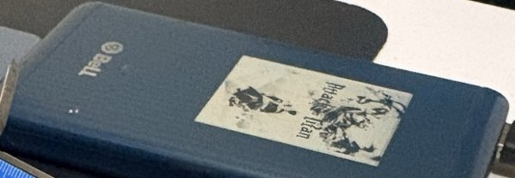
Components
Low-cost, off-the-shelf parts
RPLIDAR S3
ESP32-S3 N16R8
4 × INMP441
13 kg·cm servo
2D laser · 10 Hz · 40 m
Measures distances all around in one plane
240 MHz · 8 MB PSRAM · Wi-Fi
Brain of the rig: relays data, drives the servo
I²S MEMS microphones
Find the direction of knocks and voices
metal gear · 50 Hz PWM
Tilts the LiDAR to add height
MPU-6050 IMU
3D-printed cradle
Carrier board
Power
accelerometer + gyro · I²C
Senses tilt and motion (AS5600 encoder next)
bearings on the X axis
Holds the LiDAR and tilts it smoothly
perfboard · screw terminals
Wires the ESP32, mics and connectors
5 V power bank + servo supply
Runs the rig without cables to a laptop
Phase-I presentation
12
Notes:
Speaking time: 50 seconds
Everything is off-the-shelf. The RPLIDAR S3 is the main sensor. The ESP32-S3 handles the LiDAR stream, the servo and the microphones. Four INMP441 MEMS microphones form the acoustic array. A metal-gear servo tilts the 3D-printed cradle, and an MPU-6050 motion sensor on the same board senses tilt; an AS5600 magnetic encoder will add the exact tilt angle in the next phase. A perfboard carrier board holds the ESP32 and the connectors, and a power bank runs the rig without a cable to the laptop.

Slide 13

PCB and connections
Carrier board: every sensor lands on one ESP32-S3
ESP32-S3 pin
Connected to
Signal
GPIO 13 / 14
LiDAR TX / RX
UART, 1 Mbaud
GPIO 17
Servo signal
PWM, 50 Hz
GPIO 4 / 5
All mics: clock / word select
I²S
GPIO 7
Mic 1 + 2 data (left / right)
I²S
GPIO 6
Mic 3 + 4 data (left / right)
I²S
GPIO 11 / 12
IMU SDA / SCL (AS5600 next)
I²C
5 V / 3.3 V / GND
LiDAR 5 V · mics 3.3 V
power bank
Perfboard carrier: ESP32-S3 at the bottom, four microphones around it, the IMU top right, screw terminals for power.
Servo power comes from its own 5–6 V supply, ground shared with the ESP32.
USB-C: flashing and debug · BOOT + RESET buttons: hold BOOT, tap RESET to flash.
Phase-I presentation
13
Notes:
Speaking time: 60 seconds
This is our carrier board. The ESP32-S3 sits in the middle. The LiDAR talks to it over a 1 Mbaud UART on GPIO 13 and 14. The servo gets a 50 Hz PWM signal on GPIO 17. All four microphones share one I²S clock and word-select pair on GPIO 4 and 5; each data line carries two microphones, one as the left channel and one as the right, on GPIO 7 and GPIO 6. The MPU-6050 motion sensor uses I²C on GPIO 11 and 12; the AS5600 encoder will share that bus.
The servo draws large current peaks, so it gets its own 5 to 6 volt supply with a shared ground. The board's USB-C port is for flashing and debugging, using the BOOT and RESET buttons.

Slide 14
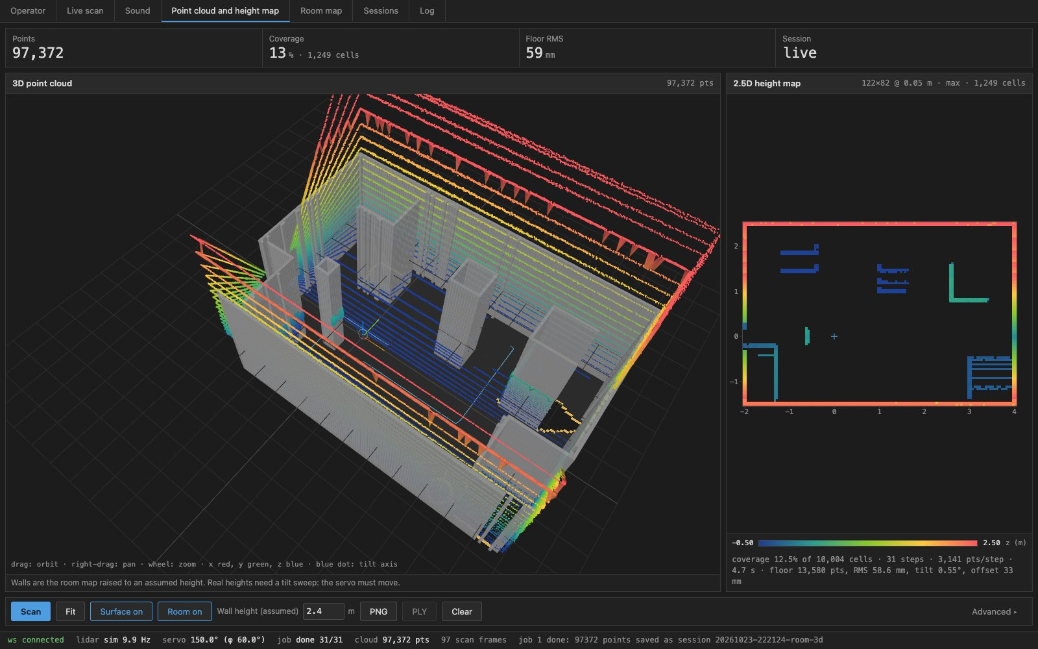
Phase-I results
Design and software evidence
Literature and architecture
Review-based design and an evaluation plan.
Tilt mechanism and pipeline
CAD plus capture, mapping and display software.
Repeatable analysis
Raw sessions, replay and PLY / CSV export.
3D point cloud and 2.5D height map in the dashboard
Synthetic soak, 22 October
10 min
Run duration
38
Completed sweeps
9.46 M
Points processed
0
Failed starts
0 WebSocket parse errors. These synthetic results do not establish physical accuracy or acoustic performance.
Phase-I presentation
14
Notes:
Speaking time: 65 seconds
The documented Phase-I work gives us a design baseline and an implemented software pipeline. The literature review and system architecture establish what we intend to evaluate. The CAD describes the tilt mechanism. The bench software supports scan capture, spatial transformation and 2.5D display, with raw sessions available for replay and export.
The numeric evidence on this slide comes from the synthetic soak recorded on 22 October. It ran for ten minutes, completed thirty-eight sweeps and processed approximately 9.46 million points. The log records zero failed starts and zero WebSocket parse errors.
These results show that the simulated capture and processing path can run repeatedly through a complete sweep sequence. They do not measure physical map accuracy, servo performance or acoustic detection. Those results belong to a separate hardware evaluation. For Phase I, the useful outcome is a pipeline that supports repeatable comparisons with hardware measurements.
Sources
Second-brain project status: literature/design baseline, CAD and implemented bench software.
https://github.com/sxivansx/major-project/blob/main/docs/soak-2026-10-22.md
Synthetic soak: 38 sweeps; 9,464,671 points; failed_starts=0; WebSocket parse_errors=0.
Icons: Lucide, ISC licence. https://lucide.dev/license

Slide 15
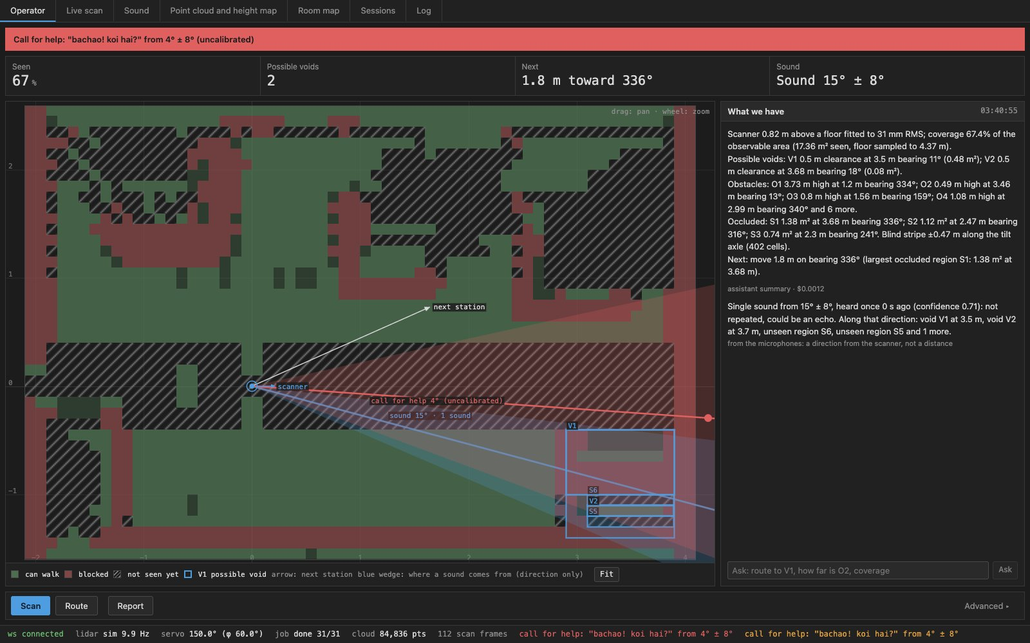
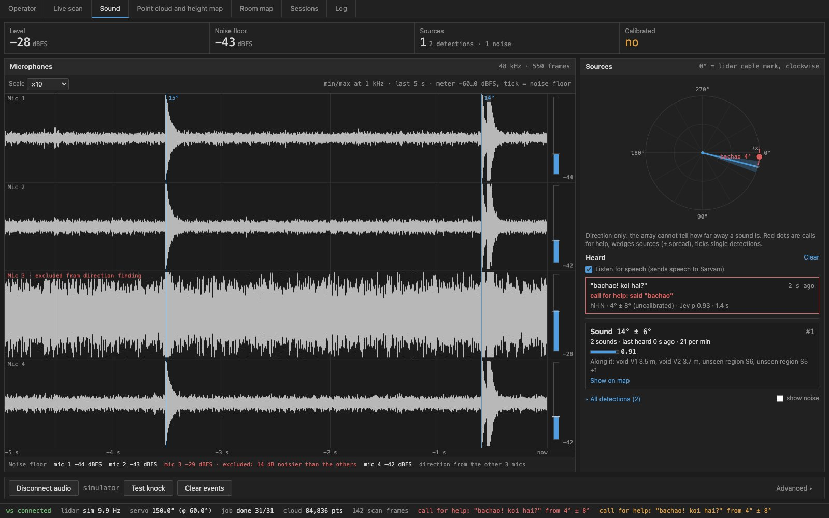
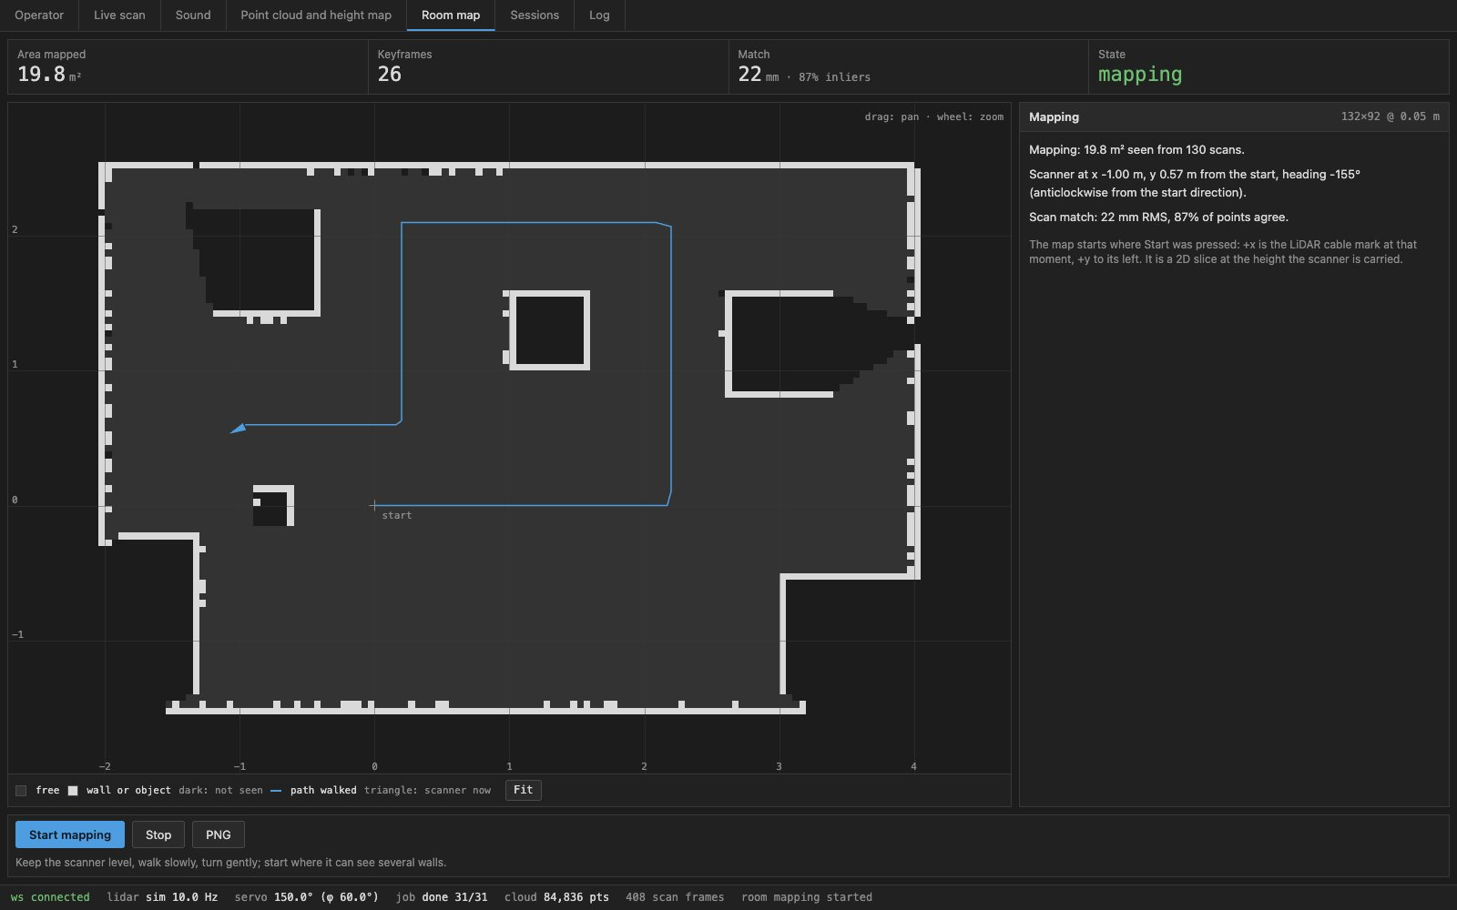
The dashboard
What each screen gives the operator
Operator
Map of walkable floor, obstacles and possible voids; next scan spot; calls for help as a red line.
Sound
Live 4-mic waveforms, direction dial with red dots for calls for help, what was heard.
Point cloud and height map
3D view of the scanned room and the 2.5D height map below it.
Room map
Floor plan built by moving the scanner from spot to spot, with the path walked.
Phase-I presentation
15
Notes:
Speaking time: 75 seconds
The Operator screen is what a rescuer looks at: green is walkable floor, red is blocked, hatched is not yet seen, and blue boxes are possible voids where a person could fit. It suggests where to move the scanner next, and a call for help appears as a red line in its direction.
The Sound screen shows the four microphones live, a direction dial, and the speech it heard, with calls for help as red dots.
The Point cloud screen shows the room in 3D with the 2.5D height map beside it. The Room map builds a floor plan as we move the scanner from spot to spot.

Slide 16
What makes our system different
4 mics
$0.00002
≈ ₹5k
Hearing where people are
AI only where it pays
Low-cost 3D
Four ₹250 MEMS mics time each sound to the microsecond and turn it into a direction in about 3 ms.
A noisy mic is dropped automatically; one clap test calibrates the array.
“Save me”, “bachao”, “kaapadi” are flagged even when misheard, and shown as a red dot.
Maps and directions are plain maths: no AI, no cost, fully explainable.
Speech is sent only when someone talks, never for knocks or noise.
Jev answers one yes/no question (“is this a call for help?”) instead of a chat model; Gemini only writes the final report.
A servo tilts a 2D LiDAR into a 3D scanner, instead of a 3D LiDAR costing lakhs.
An ESP32-S3 replaces an onboard computer; the laptop does the heavy work.
Electronics besides the LiDAR cost about ₹5,000. The same rig maps rooms by hand.
Jev: $0.00002 per call-for-help check, measured. Prices approximate, October 2026.
Phase-I presentation
16
Notes:
Speaking time: 90 seconds
Three things set our system apart.
First, hearing. Four cheap MEMS microphones are enough to find the direction of a knock or a voice: we measure the tiny time differences between the mics and solve for the direction in about three milliseconds. If one mic is noisy it is left out automatically, and one clap test calibrates the array. Spoken calls for help in English, Hindi or Kannada are recognised even when the transcription is slightly wrong, and they appear as a red dot in that direction.
If asked how four cheap mics can find a direction: sound reaches each mic at a slightly different time. The delay is the mic spacing times the cosine of the angle, divided by the speed of sound. With our 70 mm spacing the largest delay is only about 200 microseconds, and one audio sample at 16 kHz is 62.5 microseconds, so counting samples is far too coarse. We cross-correlate the mic pairs with GCC-PHAT, which keeps only the phase so echoes and loud low-frequency noise matter less, and interpolate the correlation peak to about one microsecond. Six mic pairs then give the direction by least squares, with a confidence from how well the six delays agree.
Second, cost-aware AI. Mapping and direction finding are plain maths. Audio leaves the rig only when someone is speaking. Instead of asking a chat model, we ask Jev one typed yes/no question, which costs about two thousandths of a cent, and Gemini is used only for the final written report.
Third, hardware cost. Tilting a 2D LiDAR with a servo gives 3D data without a 3D LiDAR that costs lakhs. An ESP32-S3 replaces an onboard computer, and the rest of the electronics cost about five thousand rupees.

Slide 17
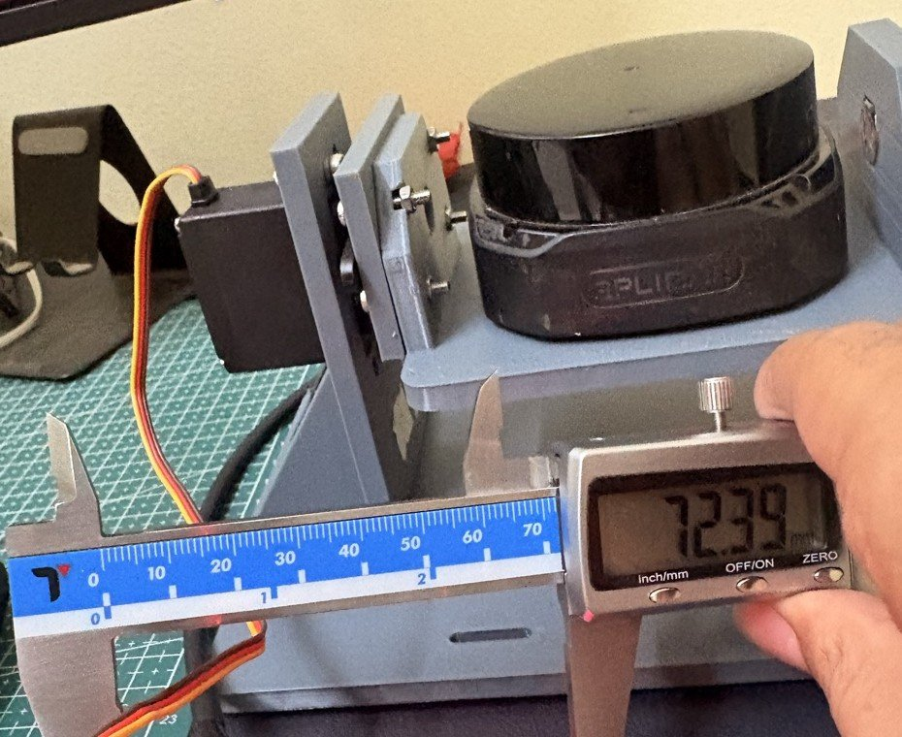
Project progress
Completed
LiDAR and 4 mics streaming over the rig's own Wi-Fi · dashboard with 7 screens · call-for-help detection with direction · room mapping from 6 spots · 125 automated tests
Measured
10 Hz, ~2,860 points per turn · range noise 0.9 mm under 1 m, 4.8 mm at 2–4 m · call for help flagged in ~2 s · map drift under 1 cm
Blockers
Servo stalls on the shared power bank: needs its own 6 V / 3 A supply · one mic picks up servo noise
Next
Separate servo supply → full 2.5D sweep at every spot · calibrate the mic array · field test in a mock collapsed room
Bench rig: RPLIDAR on the 3D-printed tilt cradle, with its servo.
Phase-I presentation
17
Notes:
Speaking time: 75 seconds
The rig is built and streaming. The LiDAR and all four microphones stream to the laptop over the rig's own Wi-Fi. The dashboard has seven screens, calls for help are detected with their direction, and we can build a floor plan by moving the scanner between six spots. The software has 125 automated tests.
On the bench the LiDAR gives about 2,860 points per turn at 10 Hz, with sub-millimetre noise below one metre. A spoken call for help is flagged in about two seconds.
The main blocker is power: the servo stalls when it shares the power bank, so it needs its own supply. That is the next step, followed by full 2.5D sweeps at every spot, microphone calibration and a field test.

Slide 18
Phase-II roadmap
From a bench rig to a field-tested 2.5D search payload
01
02
03
04
05
Nov 2026
Servo power fix
Own 6 V / 3 A supply; confirm the tilt with the IMU.
Dec 2026
2.5D at every station
A tilt sweep at each of the 6 spots, merged into one room model.
Jan 2027
Mic calibration
Clap test fixes channel order, yaw and timing; target ≤ 5° bearing error.
Feb 2027
Mock-rubble field test
Debris room with hidden knocks and voices; measure map error and detection rate.
Mar–Apr 2027
Onboard SLAM
Mapping moves onto the embedded board, toward the drone payload.
Phase-II goal:
a 2.5D room model with marked voids and call-for-help directions, checked against the real room.
Phase-I presentation
18
Notes:
Speaking time: 60 seconds
Phase II has five steps. First, the servo gets its own supply, and we confirm the actual tilt with the IMU. Second, a full tilt sweep at every station, merged into one 2.5D room model; the software for this already exists. Third, a clap-test calibration of the microphone array, with a target bearing error of five degrees or less. Fourth, a field test in a mock rubble room with hidden knocks and voices, where we measure map error and detection rate. Finally, we move mapping onto the embedded board, toward the drone payload.
The goal for Phase II is a 2.5D room model with voids and call-for-help directions marked, checked against the real room.

Slide 19
References
[1] Steux & El Hamzaoui (2010)
[4] Tranzatto et al. (2022)
tinySLAM: A SLAM algorithm in less than 200 lines C-language program
CERBERUS in the DARPA Subterranean Challenge
ICARCV, pp. 1975-1979
Science Robotics 7, eabp9742
[2] Markdahl & Vikgren (2023)
[5] Lajoie & Beltrame (2024)
tinySLAM-based exploration with a swarm of nano-UAVs
Swarm-SLAM: Sparse Decentralized Collaborative SLAM Framework
SWARM 2023 / arXiv:2309.02834
IEEE RA-L 9(1), 475-482
[3] Niculescu et al. (2024)
[6] Sun et al. (2025)
Ultra-Lightweight Collaborative Mapping for Robot Swarms
Acoustic event detection for drone search and rescue using rotor-noise beamforming
arXiv:2407.03136
Digital Signal Processing 157, 104881
Phase-I presentation
19
Notes:
Speaking time: 20 seconds
These are the principal sources cited in the presentation. The revised review paper contains the broader twenty-six-work bibliography. Together, these studies inform the compact SLAM baseline, collaborative mapping, the field-search comparison and acoustic processing under rotor noise.
Sources
[1] Steux & El Hamzaoui (2010). tinySLAM: A SLAM algorithm in less than 200 lines C-language program. ICARCV, pp. 1975-1979. https://doi.org/10.1109/ICARCV.2010.5707402
[2] Markdahl & Vikgren (2023). tinySLAM-based exploration with a swarm of nano-UAVs. SWARM 2023 / arXiv:2309.02834. https://arxiv.org/abs/2309.02834
[3] Niculescu et al. (2024). Ultra-Lightweight Collaborative Mapping for Robot Swarms. arXiv:2407.03136. https://arxiv.org/abs/2407.03136
[4] Tranzatto et al. (2022). CERBERUS in the DARPA Subterranean Challenge. Science Robotics 7, eabp9742. https://doi.org/10.1126/scirobotics.abp9742
[5] Lajoie & Beltrame (2024). Swarm-SLAM: Sparse Decentralized Collaborative Simultaneous Localization and Mapping Framework for Multi-Robot Systems. IEEE RA-L 9(1), 475-482. https://arxiv.org/abs/2301.06230
[6] Sun et al. (2025). Acoustic event detection for drone search and rescue system based on bi-directional long and short-term memory beamforming method to remove rotor noise. Digital Signal Processing 157, 104881. https://doi.org/10.1016/j.dsp.2024.104881
Icons: Lucide, ISC licence. https://lucide.dev/license

Slide 20
Publication details
Publication plan
Draft review paper
Venue
Review paper drafted; venue to be finalised.
Onboard SLAM, 3-D collaborative mapping and acoustic survivor detection: a review.
Status
In preparation, after Phase-II results.
Date and link
To be added on submission.
Phase-I presentation
20
Notes:
Reserved for confirmed publication information. Add the venue, submission or acceptance status, date and publication link when available. No publication claim is currently made.
Sources
Icons: Lucide, ISC licence. https://lucide.dev/license

