Slide 1
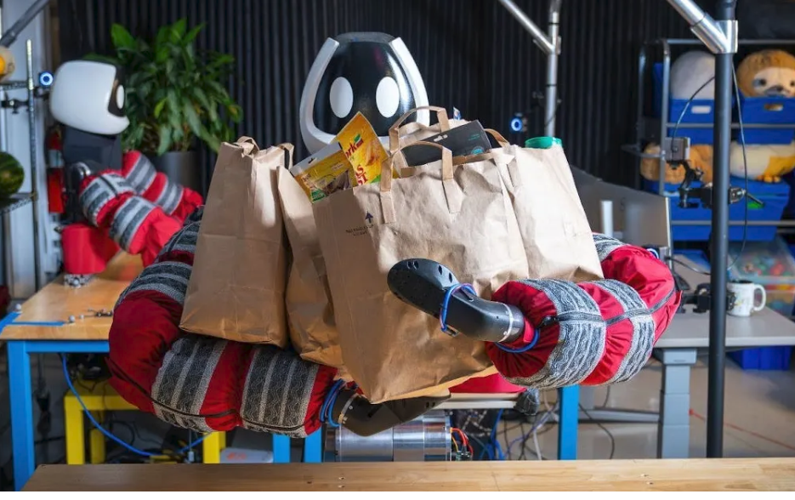
Learning contact-rich
whole-body manipulation
With example-guided reinforcement learning
Barreiros et al. • Science Robotics • 2025
Presented by Shivam Kumar
1
Notes:
DISCUSSION SCRIPT
Today I will discuss how Punyo learns to manipulate large objects using its arms and torso.
The key idea is to combine one example motion per task with reinforcement learning.
Compliance and tactile feedback help the robot handle the physical contacts.
I will explain the learning pipeline, hardware demonstrations, and experiments that support the results.

Slide 2

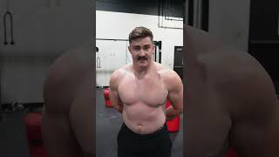
Why do we need contact rich whole body manipulation ?
We have evolved to sense through the skin across our entire body, unlike other sensory organs, which are localized.
Videos: Vince Wilkinson (YouTube); stock-video website (Pixxi)
2
Notes:
DISCUSSION SCRIPT
Think about carrying a bulky box or bringing several grocery bags inside.
We naturally support objects with our forearms and chest when our hands alone are not enough.
Those extra contacts spread the load and help stabilize the object close to the body.
The robotics challenge is to turn this everyday strategy into reliable sensing and control.

Slide 3
The problem: useful contact is difficult to plan
Large objects need support beyond fingertips
Contact modes change as the robot lifts and rotates
Uncertain geometry and friction make exact replay fragile
Question: can one example guide a robust feedback policy?
Barreiros et al. (2025), Introduction, pp. 1–3
3
Notes:
DISCUSSION SCRIPT
As an object lifts, support shifts from the table to the hands, arms, and torso.
Every contact change alters the forces and constraints that the controller must handle.
Uncertain friction and object geometry make simply replaying a motion unreliable.
The paper asks whether one example can guide learning toward a robust feedback policy.

Slide 4
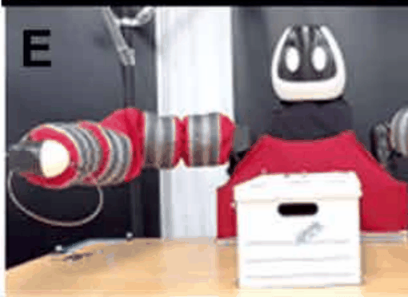
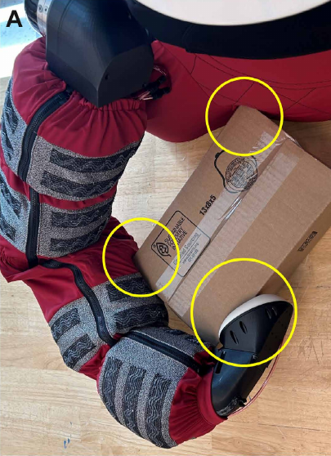
Contact planning and MPC challenges
Predict contact, optimize motion, then replan
Changing contacts
Contact switches create a discontinuous, nonconvex search space.
Uncertain models
Soft skin, friction and object properties are difficult to predict.
Limited time to replan
Pivot and lift
Soft contact
The paper reports planning times of seconds to minutes for complex motions.
Fig. 2E keyframe sequence
Fig. 4A
Motivation: learn a fast feedback policy offline
MPC implications follow from the planning challenges. The paper does not benchmark MPC.
Barreiros et al. (2025), Introduction, pp. 1-2; comparison, p. 4; Figs. 2E and 4A
4
Notes:
DISCUSSION SCRIPT
MPC predicts future motion, optimizes an action sequence, and repeats the process using feedback.
Changing contacts and soft surfaces make that prediction and optimization difficult.
The paper reports seconds-to-minutes planning times for complex motions, motivating offline learning of a fast policy.
This is an implication for MPC; the paper itself does not present an MPC benchmark.

Slide 5
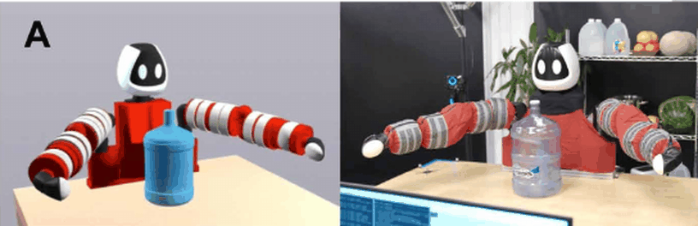
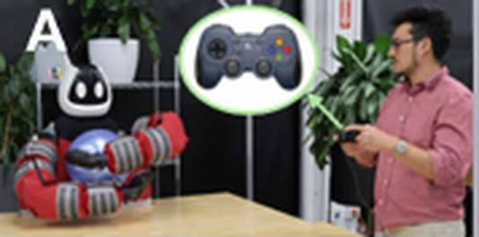
Imitation learning challenges
Data hungry
Many expert demonstrations.
Hard to teleoperate
Coordinate arms, torso, and contact.
Teleoperated example
Learned policy
Fig. 3A keyframe sequence
Slow to scale
Repeated demonstrations take time.
Coordinate
both arms
One example guides reinforcement learning
Fig. 3A shows example-guided RL.
Barreiros et al. (2025), Introduction, p. 2; teleoperation, pp. 3-4; Figs. 1A and 3A
5
Notes:
DISCUSSION SCRIPT
Imitation learning can teach useful skills, but collecting many expert demonstrations takes time.
Whole-body teleoperation also requires coordinating the arms, torso, and contact changes.
A demonstration may be difficult to produce even when the desired outcome is easy to describe.
This motivates using one example to guide reinforcement learning rather than relying on a large demonstration dataset.

Slide 6
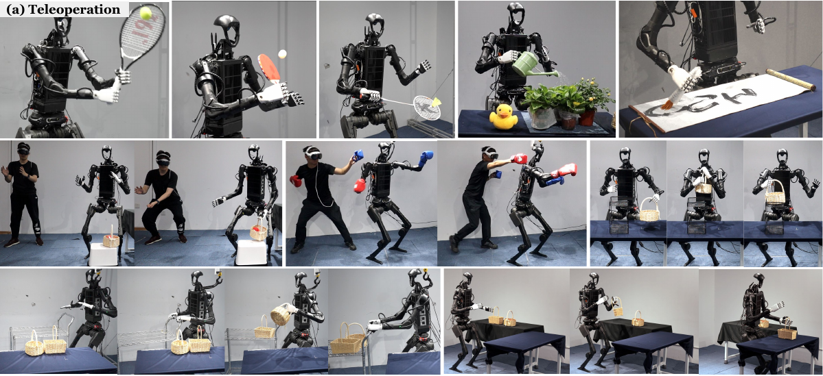
OmniH2O: demonstration data and time
~40 min
total recorded demonstration data
6 tasks
~5–10 min per task
Whole-body teleoperation on Unitree H1
The tasks includes catching, squatting, boxing, and picking and placing objects.
He et al. (2024), OmniH2O, Sec. 4.3, pp. 7-8; Appendix J, pp. 23-24; Fig. 1
6
Notes:
DISCUSSION SCRIPT
OmniH2O provides a useful comparison for whole-body teleoperation and learning.
The paper reports about 40 minutes of recorded demonstrations across six tasks.
Simple tasks use roughly five minutes of data, while more complex tasks use roughly ten minutes.
These numbers describe recorded data duration, not total collection effort or an exact demonstration count.

Slide 7
Example-guided reinforcement learning
One example guides motion style during training
State feedback
Policy π
Action
Robot + object
choose an action
simulate contact
Update
Evaluate
PPO update
Reward
Task + style
improve the policy
r = λ rᵀ + (1−λ) rˢ
On hardware: the learned policy acts from feedback
Barreiros et al. (2025), Fig. 1A; Materials and Methods, pp. 12-13, Eq. 7
7
Notes:
DISCUSSION SCRIPT
Start at the policy: it chooses an action from the current observations.
The simulated robot interacts with the object and produces the next state.
Task reward encourages success, while style reward encourages example-like motion.
PPO improves the policy through repeated rollouts; the deployed policy then acts from feedback.

Slide 8
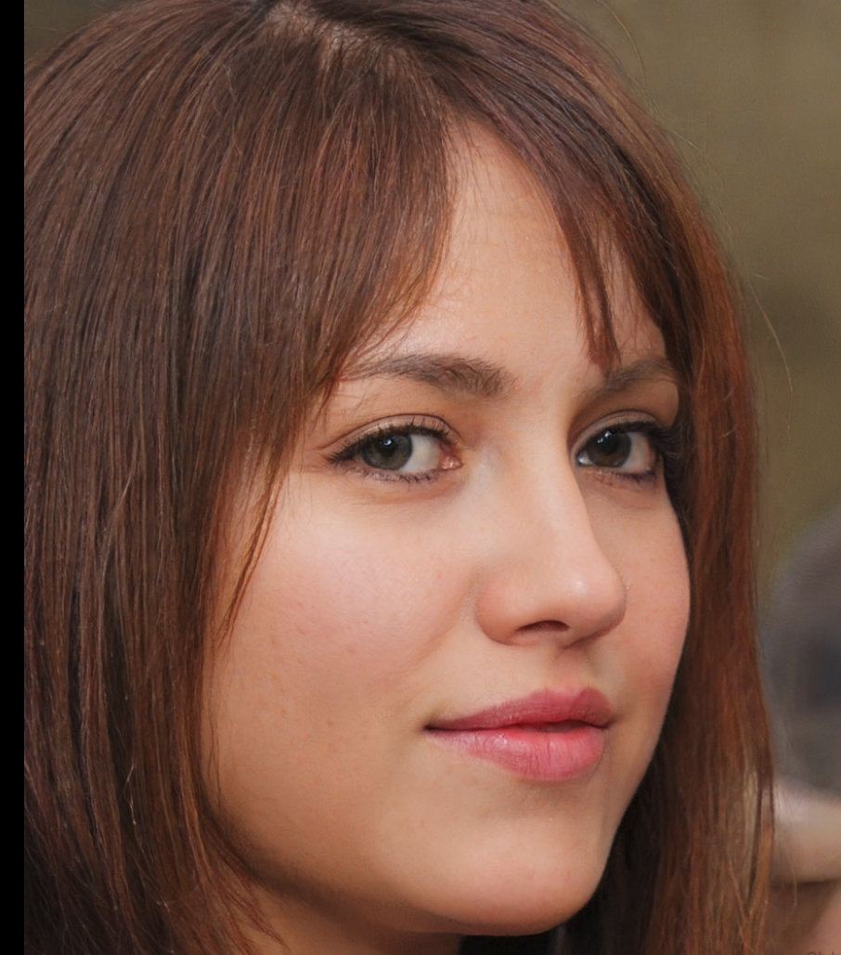
GAN idea: policy and discriminator
Adversarial Motion Priors (AMP) in the Punyo paper
Let's go to this persondoesnotexist.com website
Example motion
Target 1
state transitions
Discriminator D
Style score
example-like motion?
reward for PPO
Policy rollouts
state transitions
Target 0
Input: two consecutive states
PPO improves the policy using task + style rewards
The policy plays the generator’s role by producing motion
Diagram adapted from Barreiros et al. (2025), Eqs. 9–10 | GAN: Goodfellow et al.; AMP: Peng et al. (2021)
8
Notes:
DISCUSSION SCRIPT
The GAN analogy is a generator competing with a discriminator.
Here, the policy produces motion transitions, and the discriminator compares them with the example.
Example transitions have target score one, while policy transitions have target score zero.
The discriminator supplies a style reward, and PPO improves the policy using both style and task rewards.

Slide 9
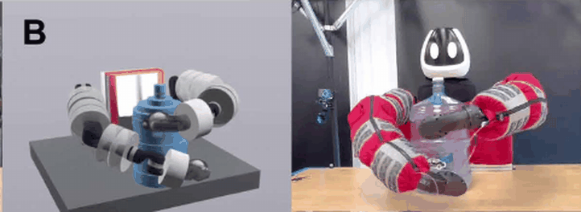
AMP: Adversarial Motion Priors
One example guides how the robot moves
Compare state transitions
Match the example’s motion style.
No example actions needed
Example states can come from a plan.
Planned example
Learned policy
Keep the task objective
Fig. 3B keyframe sequence
Combine task and style rewards.
r = λ rᵀ + (1−λ) rˢ
Task reward rᵀ + discriminator style reward rˢ
The example guides style. Feedback controls the motion.
Figures: Barreiros et al. (2025), Fig. 3B | AMP: Peng et al. (2021)
9
Notes:
DISCUSSION SCRIPT
AMP learns a motion-style reward by comparing consecutive state transitions.
It does not require the example's control actions, so the example can come from a planner.
The task reward still tells the robot what outcome to achieve.
This lets the policy retain the example's contact strategy while making corrective motions.

Slide 10
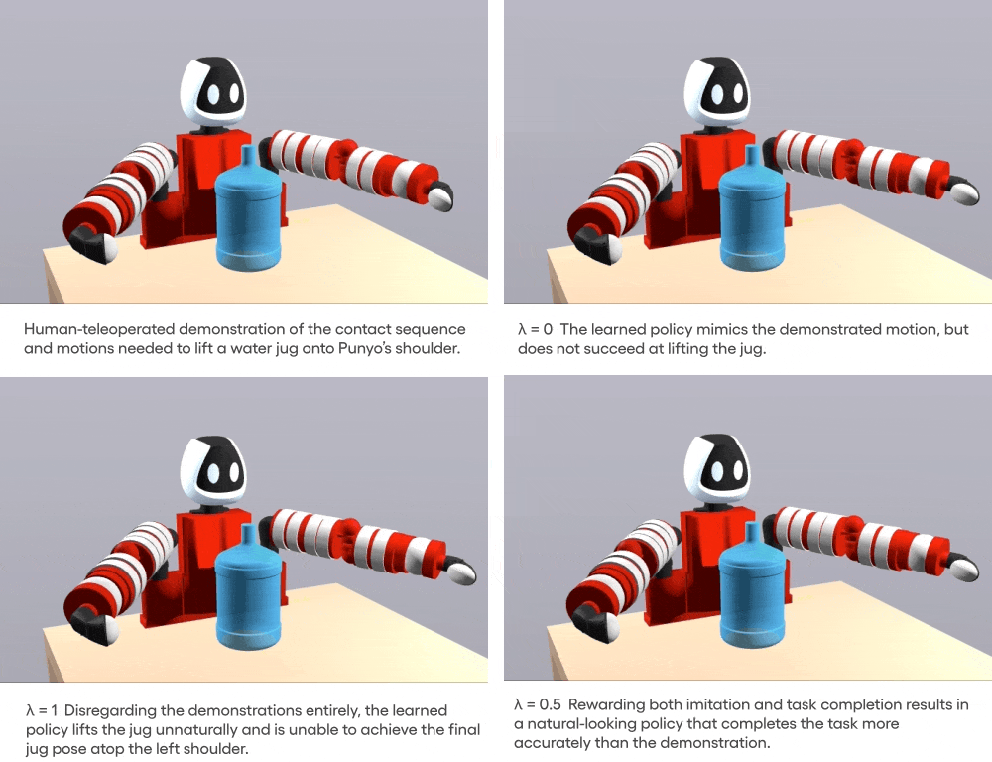
AMP: Adversarial Motion Priors
r = λ rᵀ + (1−λ) rˢ
Task reward rᵀ + discriminator style reward rˢ
Illustration: TRI, Meet Punyo (2024) | AMP: Peng et al. (2021)
10
Notes:
DISCUSSION SCRIPT
Use the two sequences to compare the example motion with the learned execution.
Look for which arm or torso surface supports the object as the contacts change.
The policy should resemble the example without reproducing every waypoint at the same instant.
The combined reward balances moving in the intended style with actually completing the task.

Slide 11
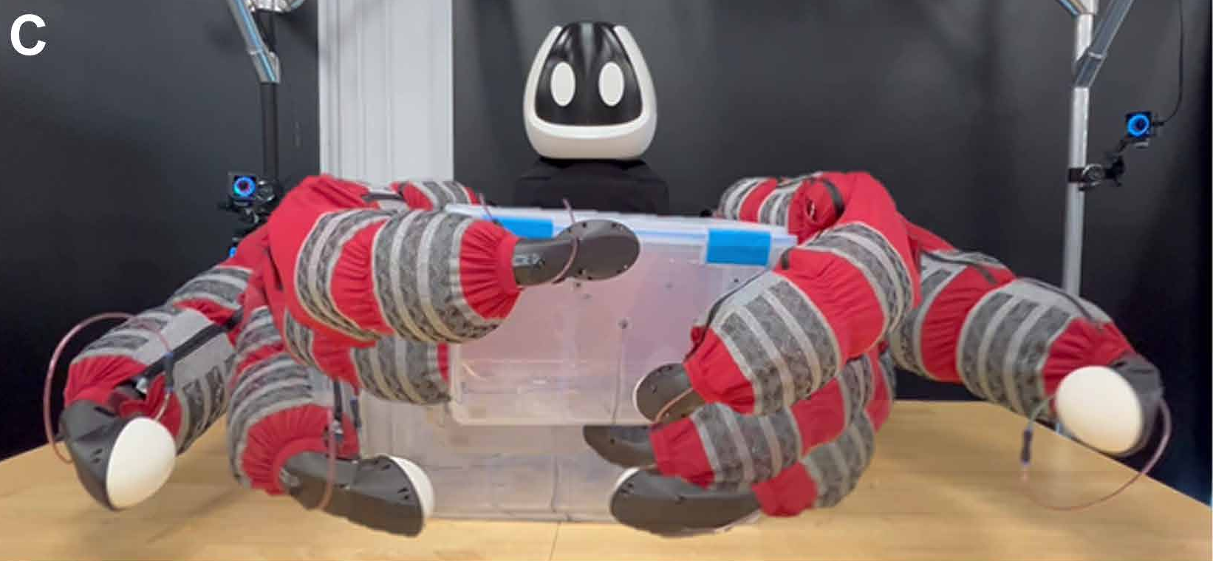
Punyo hardware
Two Kinova Jaco Gen2 arms
Soft paws and inflatable arm chambers
Fabric torso supports objects against the body
A fixed base isolates the manipulation problem
Barreiros et al. (2025), Fig. 1C; Materials and Methods, pp. 10–11
11
Notes:
DISCUSSION SCRIPT
Punyo combines two Kinova Jaco Gen2 arms with a compliant exterior.
Soft paws and inflatable arm chambers provide deformability and pressure-based sensing.
The torso provides another surface for supporting large objects close to the body.
This study uses a fixed base, so its whole-body manipulation results do not include walking.

Slide 12
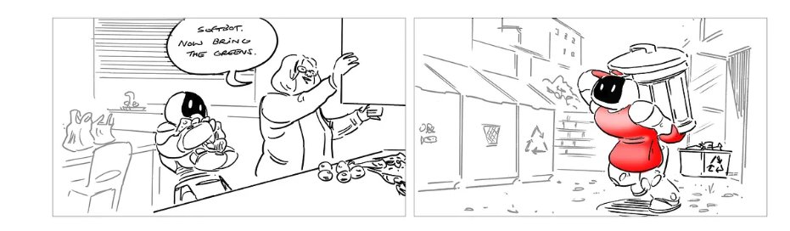
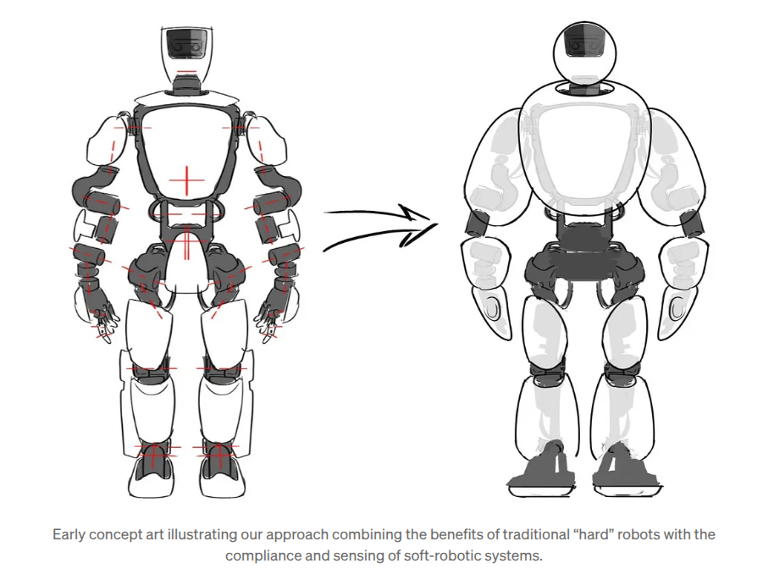
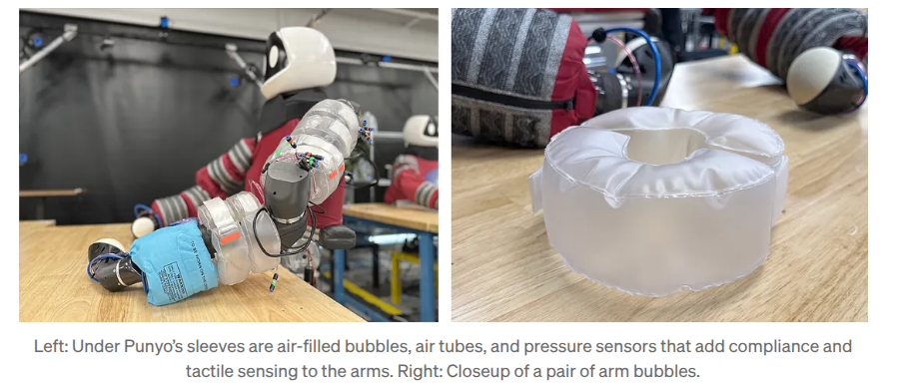
Punyo hardware (video)
https://youtu.be/FY-MD4gteeE?si=UD_l6hP0GeANlRrT
Punyo hardware: Toyota Research Institute | Video: TRI, Meet Punyo (2024)
12
Notes:
DISCUSSION SCRIPT
Introduce the hardware video as a visual explanation of the platform.
Ask the audience to watch how Punyo uses its arms and chest beyond its end effectors.
Point out that the soft exterior changes how contact forces are distributed.
Use the video to motivate the task examples and distinguish teleoperated scenes from learned-policy demonstrations.

Slide 13
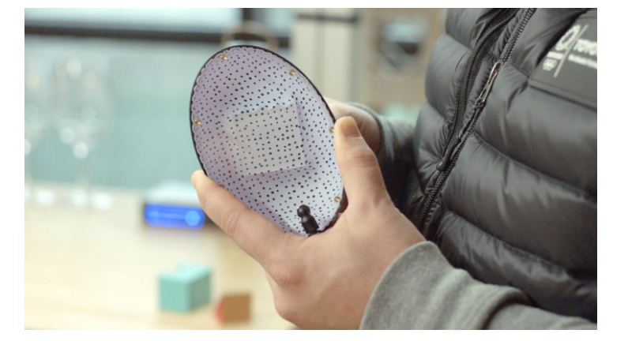
Punyo hardware (video)
https://www.facebook.com/3DPrintingDoctor/videos/i-hugged-a-real-baymax-it-was-soft-and-warm-haha-iros-baymax-robotics-ai-ieee/1356231993011254/​
IROS Video
​
Punyo hardware: Toyota Research Institute | Video: TRI, Meet Punyo (2024)
13
Notes:
DISCUSSION SCRIPT
The big monstrous,cute robot
The paw
Facebook video from iros

Slide 14
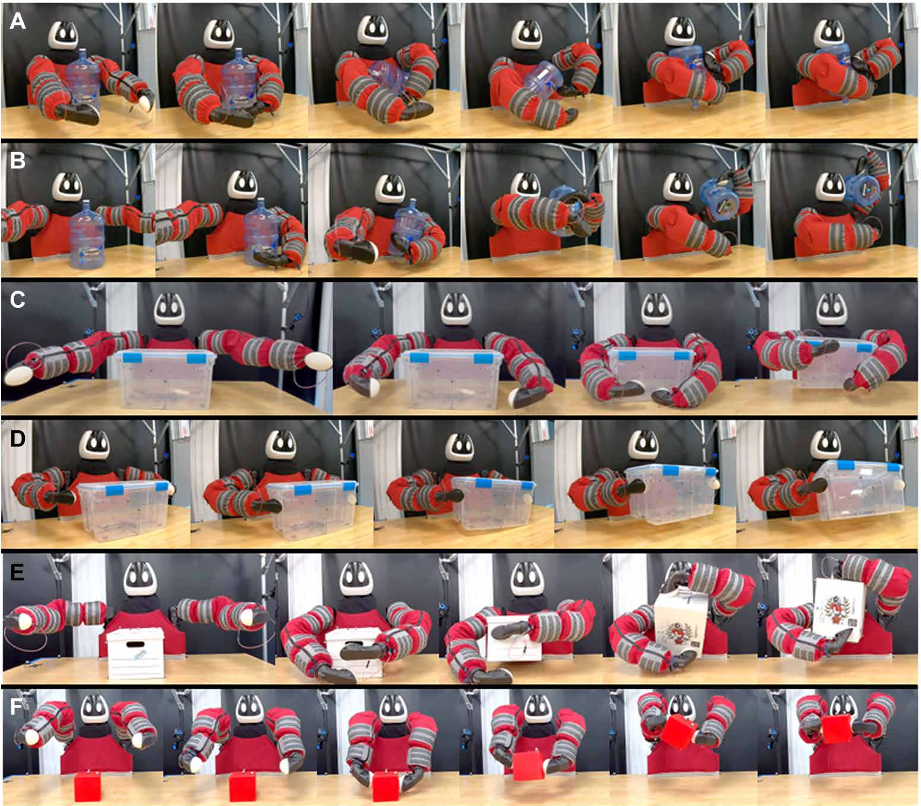
Six manipulation tasks
A Jug rotation
B Jug over shoulder
C Plastic-box hug lift
D Plastic-box paw lift
E Cardboard-box pivot and lift
F Cube lift
Barreiros et al. (2025), Fig. 2; task descriptions, pp. 10–11
14
Notes:
DISCUSSION SCRIPT
The evaluation includes jug rotation, jug over shoulder, and four box or cube tasks.
Some tasks use mainly the paws, while others depend on arm and torso contact.
The jug and cardboard-box tasks require substantial changes in support during manipulation.
These are separately trained task policies, rather than one universal policy for all six tasks.

Slide 15
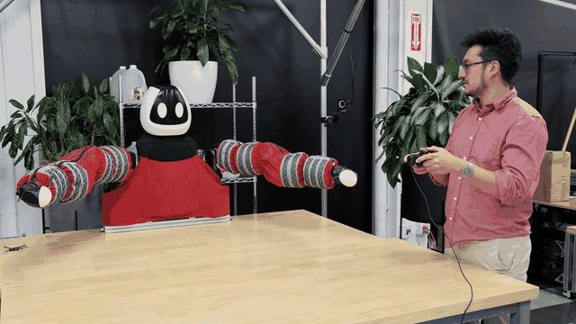
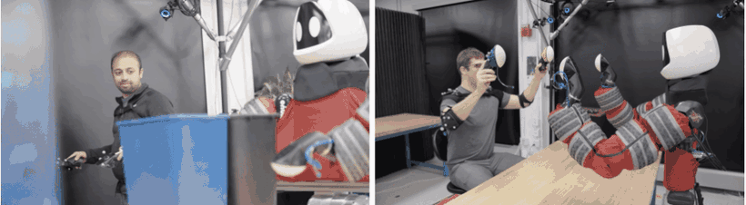
Teleoperation data and video demos
Gamepad teleoperation
Motion-capture teleoperation
Torso, elbows and paws
Paper data collection
Gamepad + Drake simulation
Log robot/object pose, commands and touch
Paper demonstrations were collected in simulation
Paper: Barreiros et al. (2025), pp. 3, 11 | Teleoperation GIFs: TRI, Meet Punyo (2024)
15
Notes:
DISCUSSION SCRIPT
The paper collects teleoperated examples in Drake simulation using a gamepad.
It records robot and object motion, commands, and tactile information for the learning pipeline.
The displayed clips from TRI's 2024 article also illustrate gamepad and motion-capture interfaces.
Keep these hardware-interface illustrations separate from the paper's specific simulation data-collection procedure.

Slide 16
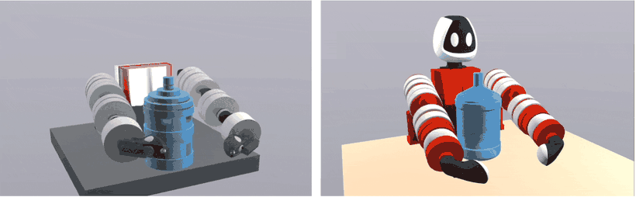
Motion plans as example data
A planner can generate the example motion
Specify start and goal
GQDP proposes a robot–object trajectory.
Plan-guided learning in simulation
Refine the trajectory
Reduce collisions and support the object.
Keep rough guidance
Rough plan
Learned policy
EGRL can learn from imperfect plans.
A useful example may still contain physically infeasible motion
Paper: Barreiros et al. (2025), pp. 3–4, 11 | Plan/learned-policy GIF: TRI, Meet Punyo (2024)
16
Notes:
DISCUSSION SCRIPT
A planner offers another way to generate the example motion.
Start with the initial and desired object configurations, then search for a contact-rich path.
Trajectory refinement improves that path, but simplified mechanics can leave it physically imperfect.
Reinforcement learning uses the rough strategy as guidance and learns a feedback policy that can execute it.

Slide 17
Teleoperation and motion plans: comparison
Aspect | Teleoperation | GQDP plans
Human input | Expert gamepad control | Initial and goal poses
Motion style | Chosen by the operator | Depends on planner heuristics
Main strength | Desired motion style | Complex contact sequences
Main limitation | Difficult arm coordination | Approximate contact physics
Time / effort | Operator skill and practice | Seconds to minutes per plan
Both provide an example; EGRL learns the feedback policy
Barreiros et al. (2025), Comparison, p. 4; Fig. 3A-B; Methods, p. 11
17
Notes:
DISCUSSION SCRIPT
Teleoperation captures an operator's intended style but can require considerable skill and coordination.
Planning can produce difficult contact sequences, though it introduces modeling assumptions and tuning.
In this paper, jug over shoulder is amenable to teleoperation, while jug rotation motivates a planned example.
Both routes provide guidance to the same learning pipeline; neither is automatically best for every task.

Slide 18
GQDP: Global Quasidynamic Planner
Search through contact, then refine the path
Quasidynamics
Smooth contact
RRT search
Refine path
configuration space
local linear models
reachability metric
trajectory optimization
Why it helps
Why it is imperfect
Role in this paper
Long contact sequences with little human supervision.
Simplified dynamics and abrupt contact changes.
Supply a motion example to guide reinforcement learning.
The plan guides motion style; the learned policy uses feedback
Barreiros et al. (2025), pp. 3-4 and 11; Pang et al. (2023), reference 14
18
Notes:
DISCUSSION SCRIPT
GQDP stands for Global Quasidynamic Planner.
Its quasidynamic model and smoothed contacts make contact-rich search more manageable.
A reachability-guided RRT searches for a path, followed by trajectory optimization.
The output supplies the contact strategy; the learned policy supplies feedback during execution.

Slide 19
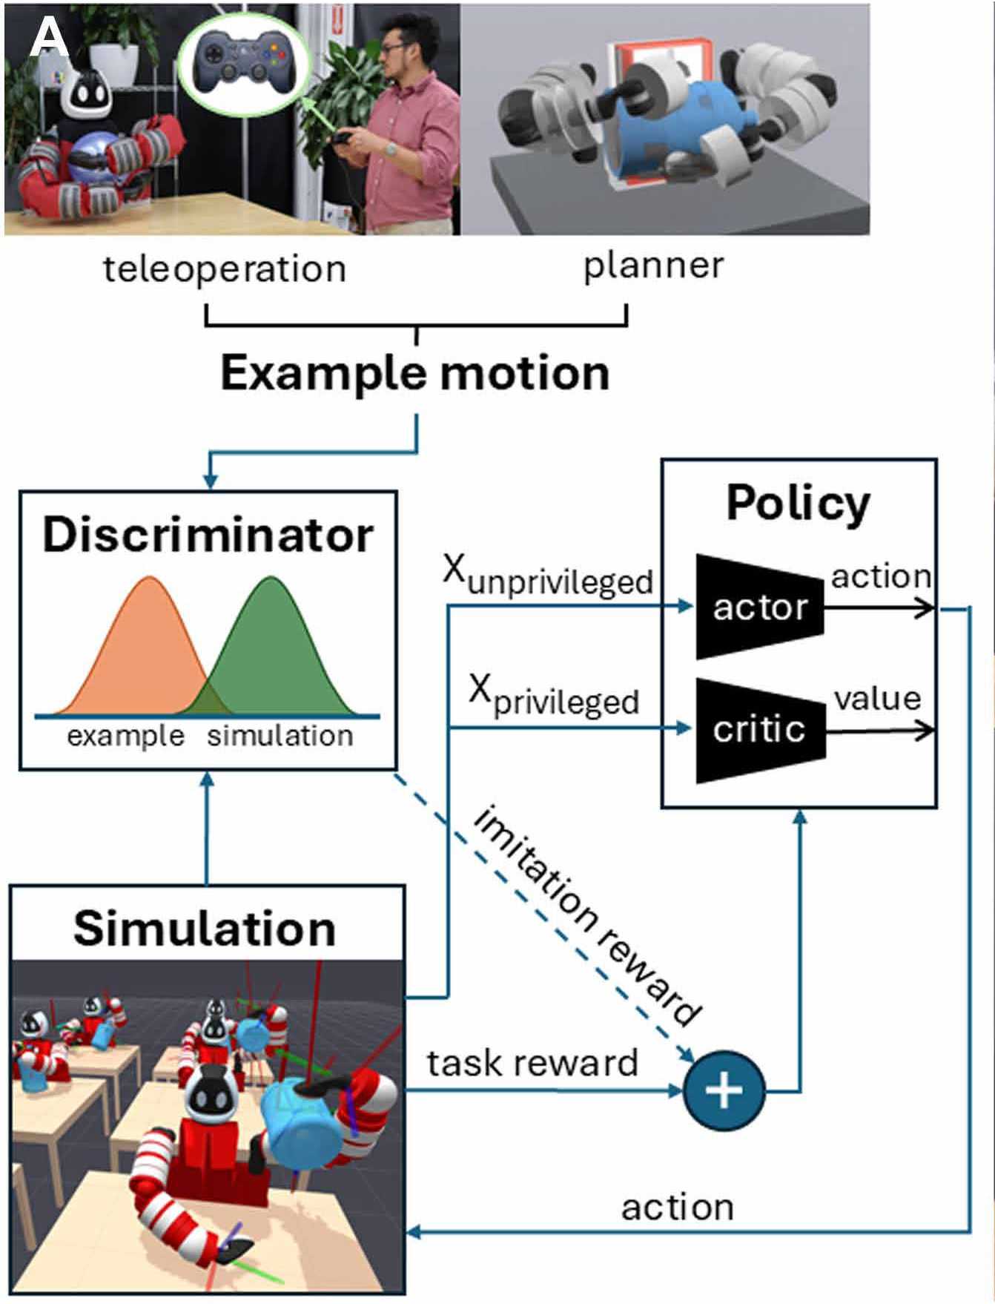
The paper’s system architecture
One example from teleoperation or planning
Discriminator learns motion-style guidance
Simulation supplies task feedback
Actor and critic learn with different information access
Barreiros et al. (2025), Fig. 1A; EGRL, p. 12
19
Notes:
DISCUSSION SCRIPT
Follow the architecture from the example to the discriminator and policy.
The discriminator learns which transitions resemble the example, while simulation supplies task feedback.
The actor learns actions and the critic learns value estimates to support training.
Actor-real world, and critic see object tracking pos as well.
The asymmetric variant allows the critic to use privileged information that the deployed actor does not receive.

Slide 20
Training architecture: how the signals connect
Example transitions
Discriminator D
example / policy comparison
Rollout pairs also train D
Simulation rollout
Task + style reward
PPO actor + critic
Actor actions generate the next rollout
The discriminator shapes training. The actor controls deployment.
Barreiros et al. (2025), Fig. 1A and Eqs. 7–10; conceptual redraw
20
Notes:
DISCUSSION SCRIPT
The discriminator trains on consecutive state pairs from the example and current policy rollouts.
Its output becomes a style reward, which is combined with the task reward.
PPO updates the actor and critic, and the improved actor generates the next rollout.
The discriminator shapes training; it is not the controller that directly commands the robot at deployment.

Slide 21
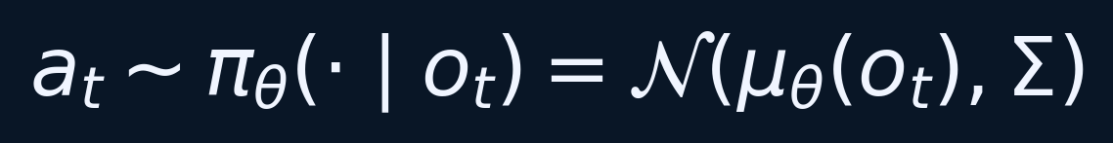
Policy architecture and action interface
A fully connected network predicts the action mean
The Gaussian policy uses fixed diagonal covariance
Actions represent desired joint-position changes
Observation access changes across experiments
Barreiros et al. (2025), EGRL, p. 12; compact notation
21
Notes:
DISCUSSION SCRIPT
The actor is a fully connected neural network that predicts the mean of a Gaussian action distribution.
The policy uses a fixed diagonal covariance in the reported formulation.
Its actions represent desired joint-position changes rather than direct motor torques.
Which observations enter the actor depends on the experiment, especially whether object tracking is available.

Slide 22
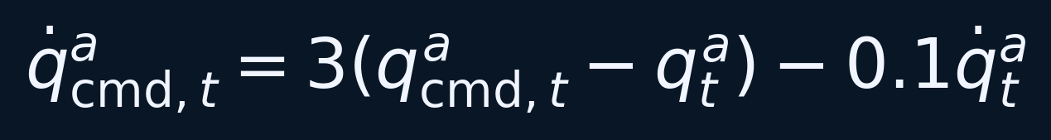
Hardware control architecture
Actor
action increment
Action
integrator
Optional
admittance
Outer PD +
Kinova controller
Eq. 2: position error and measured velocity determine the velocity reference.
Measured joint position and velocity feedback to the command computation.
Barreiros et al. (2025), Hardware control pipeline, p. 11; Eq. 2
22
Notes:
DISCUSSION SCRIPT
The actor first outputs an increment, and the integrator turns it into a joint-position reference.
An optional admittance controller adjusts that reference in response to estimated loading.
An outer PD loop produces velocity commands for the built-in Kinova controller.
Measured joint positions and velocities close the low-level feedback loop around the learned policy.

Slide 23
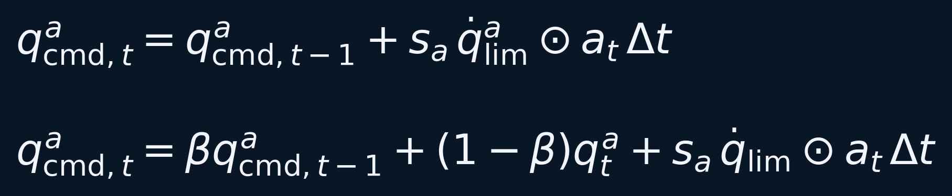
Action integration: simulation and hardware
Top: accumulate the policy increment in simulation
Bottom: blend previous command with measured position
β = 0.95 nominally limits command buildup during contact
sₐ: scale q̇lim: speed limits ⊙: element-wise product
Barreiros et al. (2025), Eqs. 3–4, p. 11
23
Notes:
DISCUSSION SCRIPT
In simulation, policy increments accumulate to form the desired joint position.
On hardware, the update also blends in the measured joint position.
The nominal beta of 0.95 helps limit command buildup when contact prevents a joint from reaching its target.
This command blending is distinct from the optional admittance controller, even though both affect contact behavior.

Slide 24
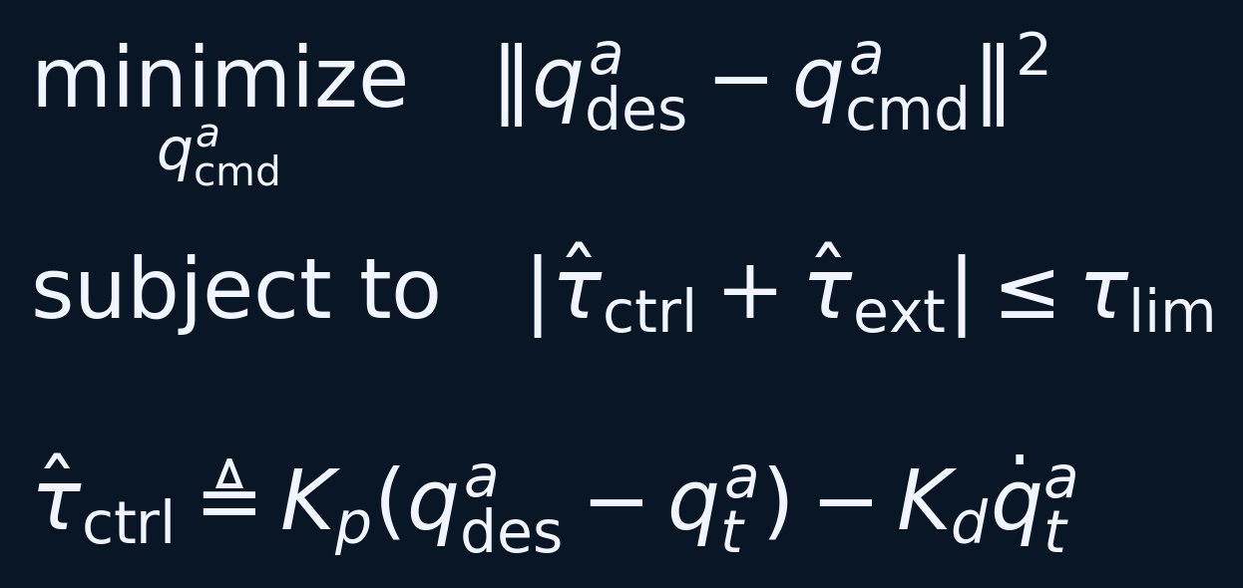
Active compliance as an optimization problem
Stay close to the desired joint position
Respect estimated control plus external torque limits
Kp = 480 and Kd = 90 in the reported implementation
Barreiros et al. (2025), Eqs. 5–6, p. 11
24
Notes:
DISCUSSION SCRIPT
The admittance controller tries to stay close to the desired joint position.
It also constrains estimated total torque, combining control effort with external loading.
This causes the commanded posture to yield when needed instead of insisting on an overloaded reference.
The reported gains belong to this implementation; the experiments separately test whether active compliance improves performance.

Slide 25
Reward combines task achievement and motion style
Task reward: reach the object goal
Style reward: resemble the example’s state transitions
λ = 0.7 for all tasks except jug rotation
A parameter sweep selects the reward balance
Barreiros et al. (2025), Eq. 7, p. 12
25
Notes:
DISCUSSION SCRIPT
The objective combines a task reward with a discriminator-based style reward.
Lambda sets how much emphasis goes to task achievement relative to imitation.
Too much emphasis on either side can sacrifice the intended style or successful completion.
The paper reports lambda 0.7 for tasks except jug rotation, with the balance selected through a parameter sweep.

Slide 26
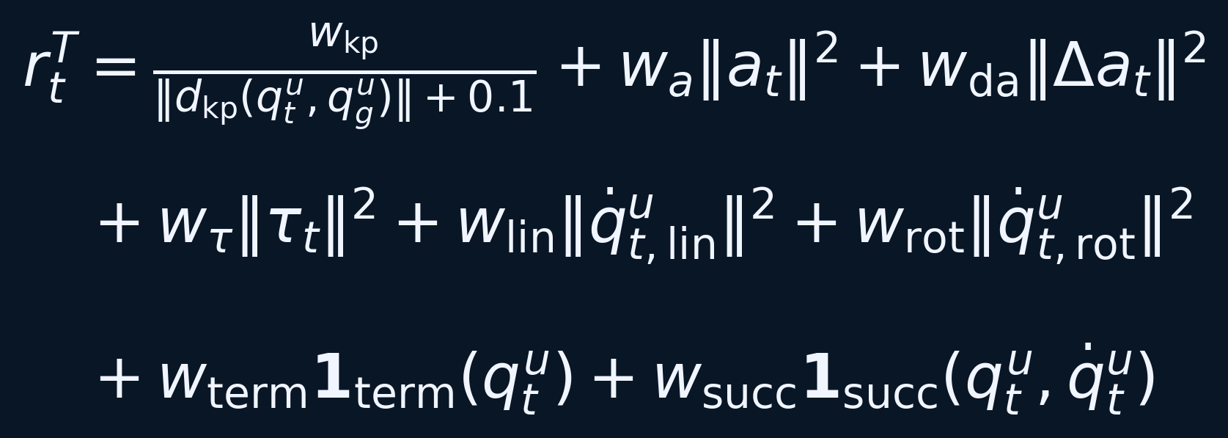
Task reward: every term has a purpose
Keypoint distance measures object-goal error
Action, action-change, torque, and velocity terms penalize undesirable behavior
Termination and success indicators shape the outcome
Barreiros et al. (2025), Eq. 8, p. 12; weights and criteria in Tables S3–S5
26
Notes:
DISCUSSION SCRIPT
The object-goal term rewards bringing object keypoints close to their target locations.
Action, action-change, torque, and object-velocity penalties discourage undesirable behavior.
Success and termination terms distinguish useful outcomes from failed or invalid rollouts.
The task reward defines what to achieve, while the example gives guidance about how to get there.

Slide 27
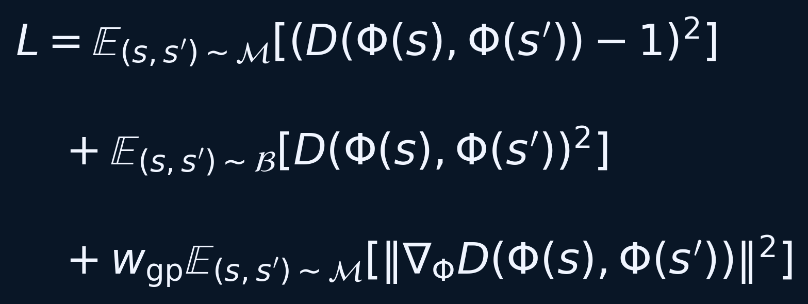
Discriminator training uses transition pairs
Example transitions have target score 1
Policy-rollout transitions have target score 0
A gradient penalty stabilizes learning
Φ selects the state features used for imitation
Barreiros et al. (2025), Eq. 9, p. 12
27
Notes:
DISCUSSION SCRIPT
The discriminator sees selected features from two consecutive states.
It is trained to score example transitions near one and policy transitions near zero.
A gradient penalty helps stabilize this adversarial learning process.
The comparison concerns local motion transitions, so exact timing alignment with every example waypoint is unnecessary.

Slide 28
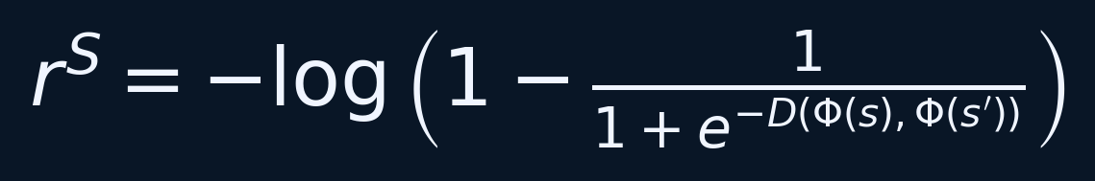
The discriminator defines a style reward
Convert the discriminator output into an imitation reward
A higher example-like score produces a higher style reward
PPO optimizes the combined task and style reward
One example supplies guidance for each task
Barreiros et al. (2025), Eq. 10, p. 12
28
Notes:
DISCUSSION SCRIPT
The discriminator's output is transformed into a style reward using the paper's equation.
A more example-like transition receives a larger style reward.
PPO optimizes this reward together with the task objective, leaving room for corrective behavior.
One example per task refers to the guidance data; learning still requires many simulated interactions.
Whole point is to state that there are different rewards used for trying to make it better.

Slide 29
Simulation, training, and domain randomization
4,096 agents run in parallel in Isaac Gym
PPO optimizes the policy with AMP-style guidance
A reported 2,000-epoch run takes about 2 hours on RTX 3090
Randomize model parameters and initial object pose
Barreiros et al. (2025), Simulation and Domain randomization, pp. 12–13
29
Notes:
DISCUSSION SCRIPT
Training uses 4,096 parallel agents in Isaac Gym.
The paper reports about two hours for a 2,000-epoch run on an RTX 3090.
Domain randomization varies model parameters and initial object poses to improve transfer. - DR
This is a reported training configuration, separate from demonstration duration and from planning time.

Slide 30
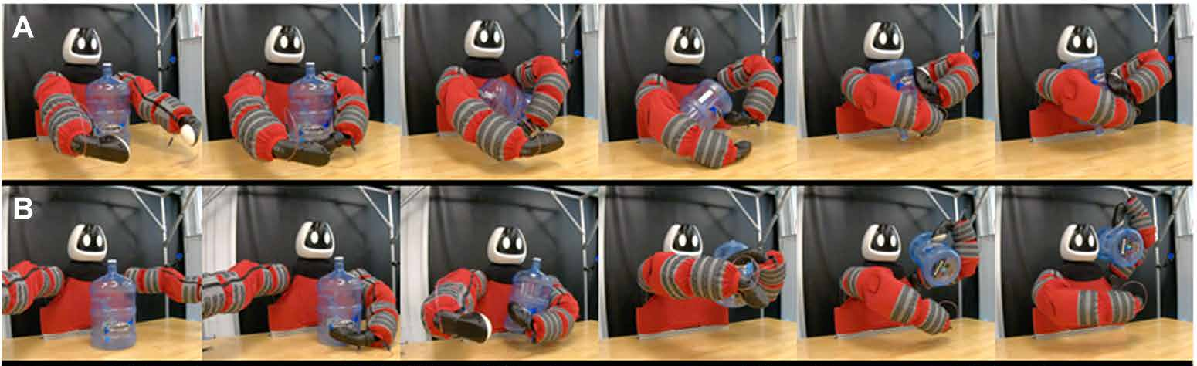
Hardware demonstration: jug manipulation
The arms change roles while the torso supports the jug
The policy uses feedback to adapt the example strategy
Each task has a separately trained policy
Open demo: Movie 2: manipulation demonstrations
Barreiros et al. (2025), Fig. 2A–B; Movie 2
30
Notes:
DISCUSSION SCRIPT
Watch the jug manipulation as a sequence of support changes rather than just an endpoint motion.
The arms reposition while the torso helps keep the jug supported.
A planned example helps organize the more demanding jug-rotation strategy.
The next two clips show learned behavior on the physical platform; each task uses its own trained policy.

Slide 31
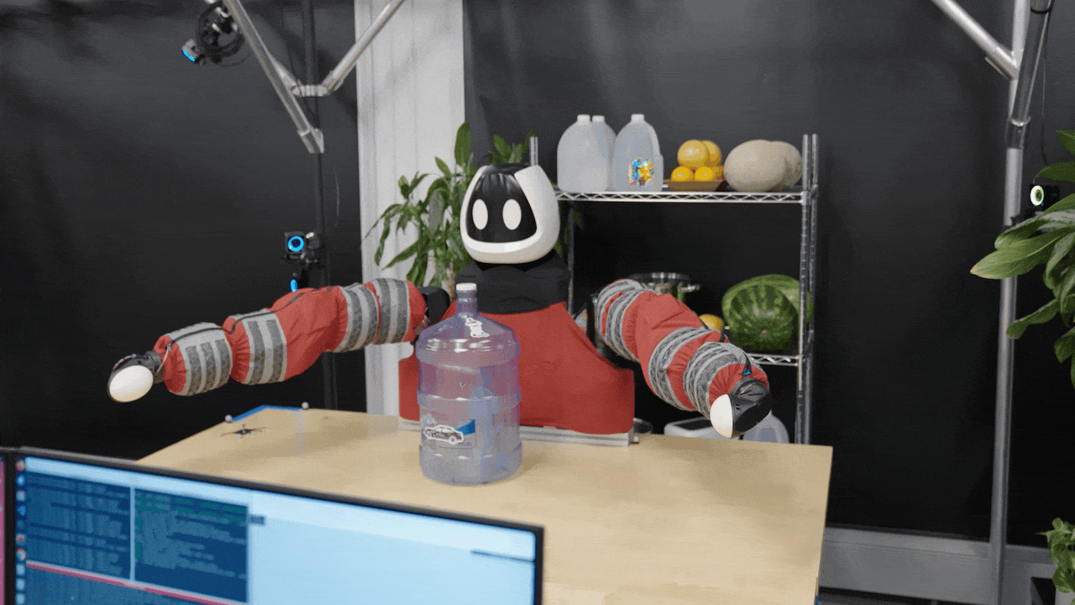
Hardware demo: lifting a jug
Arms and chest support the jug through the lift.
Paper: watch Movie 2
Hardware clip: Toyota Research Institute (2024), Meet Punyo | Paper: Barreiros et al. (2025), Movie 2
31
Notes:
DISCUSSION SCRIPT
Play the GIF and watch the robot establish contact around the jug before lifting.
The arms and chest share support as the jug moves upward.
This is execution of a learned policy, rather than a person teleoperating the shown lift.
The clip comes from TRI's 2024 article; the separate link opens Movie 2 from the 2025 paper.

Slide 32
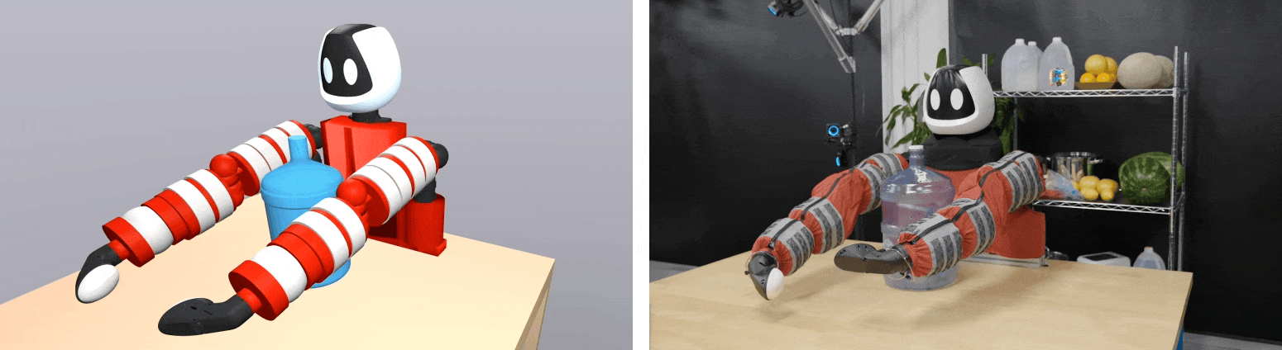
Hardware demo: rotating a jug
Simulation
Punyo hardware
A planned contact sequence becomes a feedback policy.
Paper: watch Movie 2
Hardware clip: Toyota Research Institute (2024), Meet Punyo | Paper: Barreiros et al. (2025), Movie 2
32
Notes:
DISCUSSION SCRIPT
The left panel shows simulation and the right panel shows physical Punyo.
Follow how support transfers between the arms and torso during the jug rotation.
The planned sequence supplies guidance, and reinforcement learning turns it into a feedback policy.
This comparison is from TRI's 2024 article; use the separate Movie 2 link for the 2025 paper demonstrations.

Slide 33
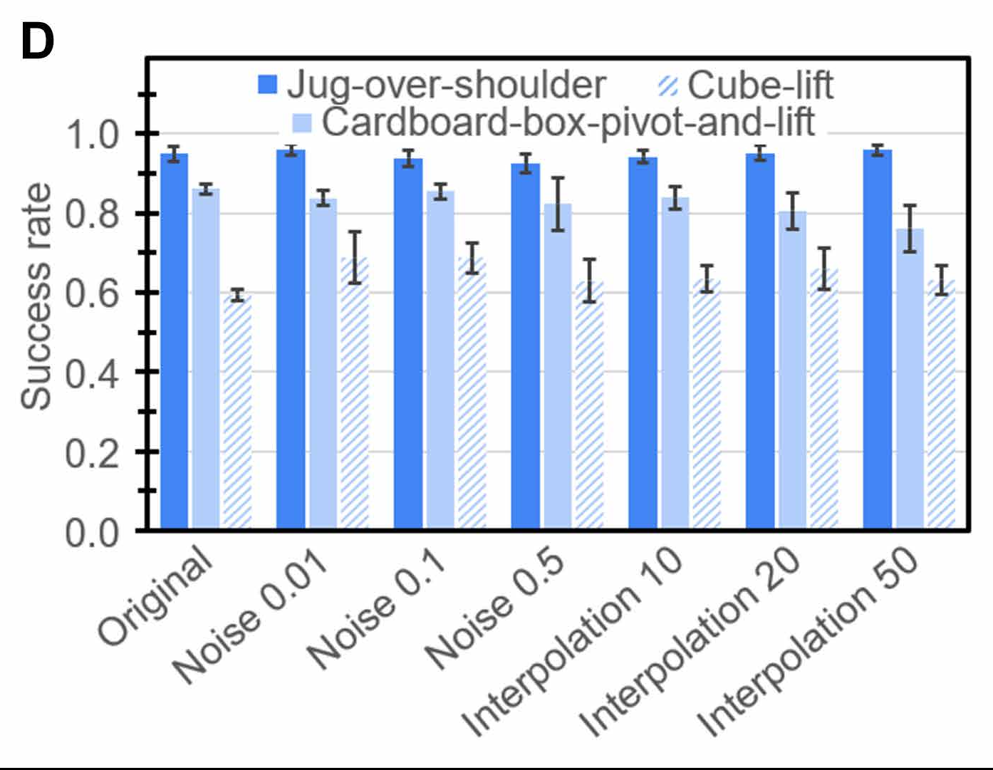
How much example quality is necessary?
Add joint noise with σ = 0.01, 0.1, or 0.5 rad
Retain every 10th, 20th, or 50th waypoint
Large corruption hurts more than moderate perturbations
Bars show variation across six training seeds
Barreiros et al. (2025), Fig. 3C–D and example-quality analysis, pp. 4–6
33
Notes:
DISCUSSION SCRIPT
The authors test how much corruption the guiding example can tolerate.
They add joint-position noise or retain only every tenth, twentieth, or fiftieth waypoint.
Moderate imperfections can still provide useful guidance, while severe corruption degrades performance.
The bars summarize variation across six training seeds, so compare both average behavior and variability.

Slide 34
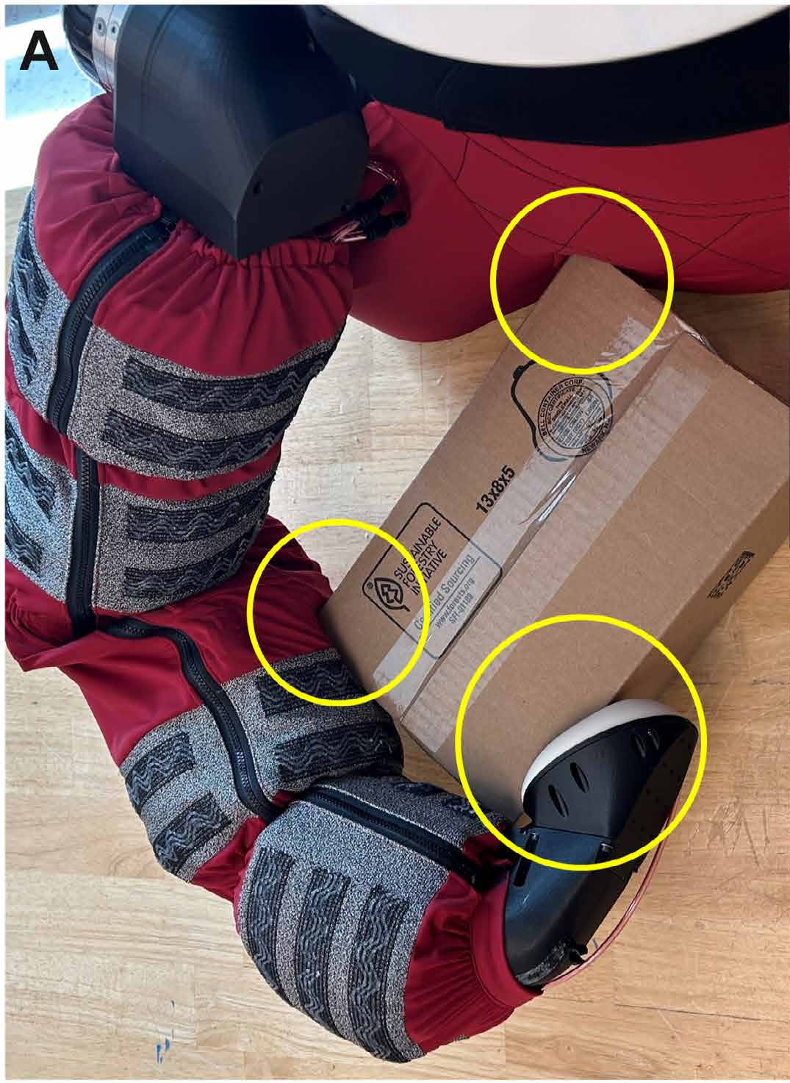
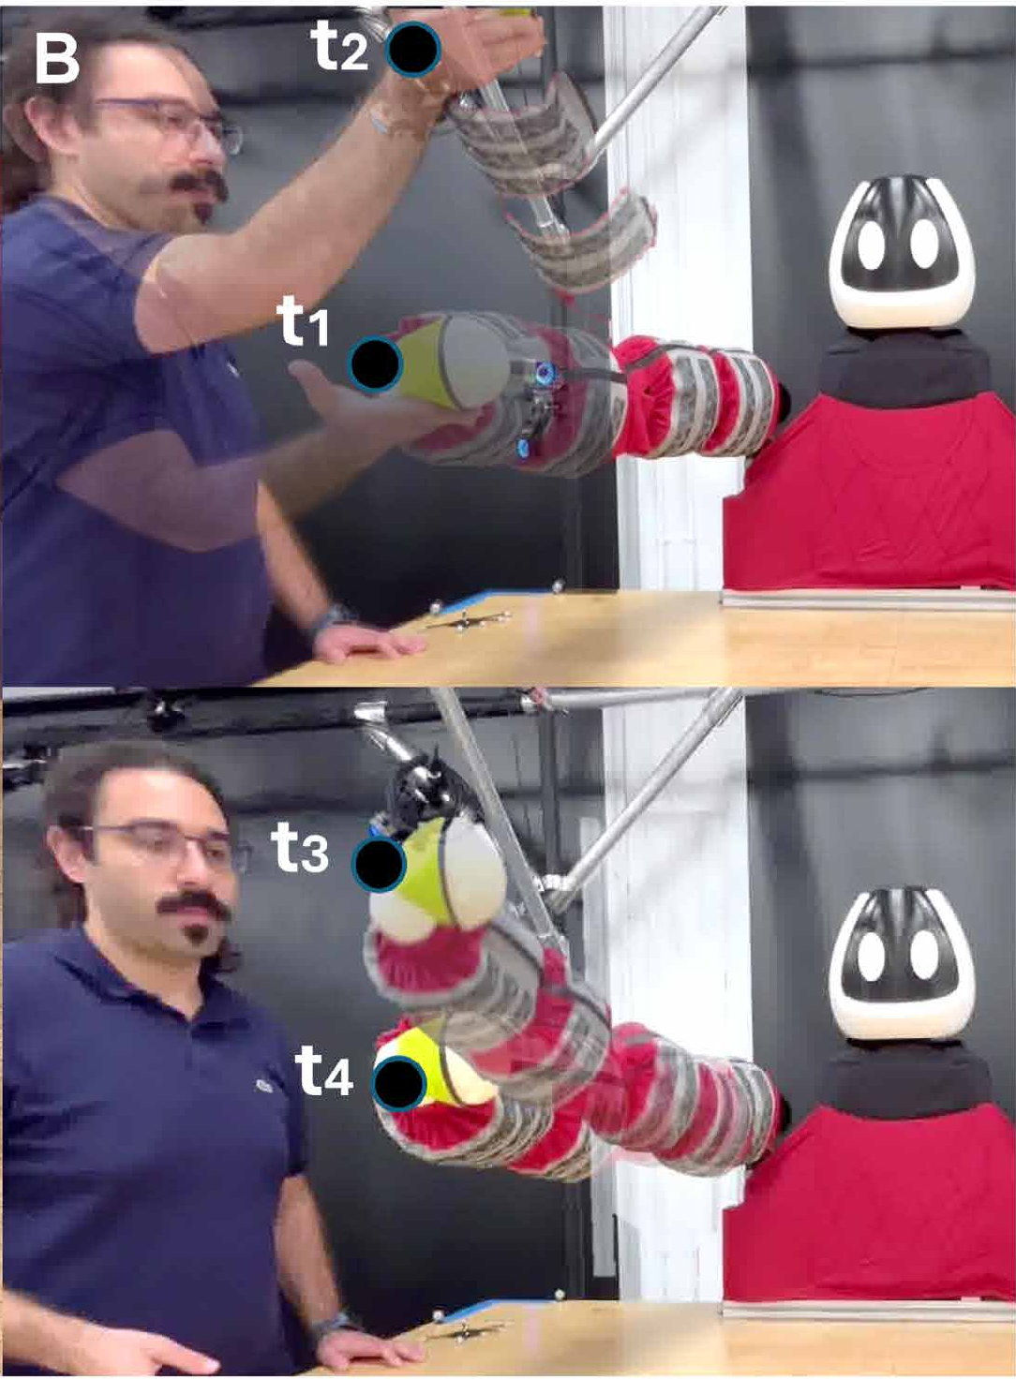
Passive and active compliance
Passive: the covering deforms at the contact
Active: joints yield through an admittance controller
Barreiros et al. (2025), Fig. 4A–B, pp. 6–7
34
Notes:
DISCUSSION SCRIPT
Passive compliance comes from the soft covering deforming at the contact.
Active compliance comes from the controller changing the commanded motion under load.
The two mechanisms can operate separately or together.
The comparison keeps the fabric covering present, helping separate these effects from simply changing the outer material.

Slide 35
Compliance experiment: four conditions
Condition | Soft surface | Active admittance
No compliance | No | No
Passive only | Yes | No
Active only | No | Yes
Passive + active | Yes | Yes
Two tasks: box hug lift and jug over shoulder
25 hardware trials per condition and task
One trained seed per hardware condition
Error bars are 95% confidence intervals
Barreiros et al. (2025), Fig. 4C; Statistical analysis, p. 13
35
Notes:
DISCUSSION SCRIPT
The compliance study compares none, passive only, active only, and both forms together.
It tests the box-hug lift and jug-over-shoulder tasks on hardware.
Each condition and task has 25 trials, using one trained seed per hardware condition.
The error bars are 95 percent confidence intervals, so avoid treating every visible difference as conclusive.

Slide 36
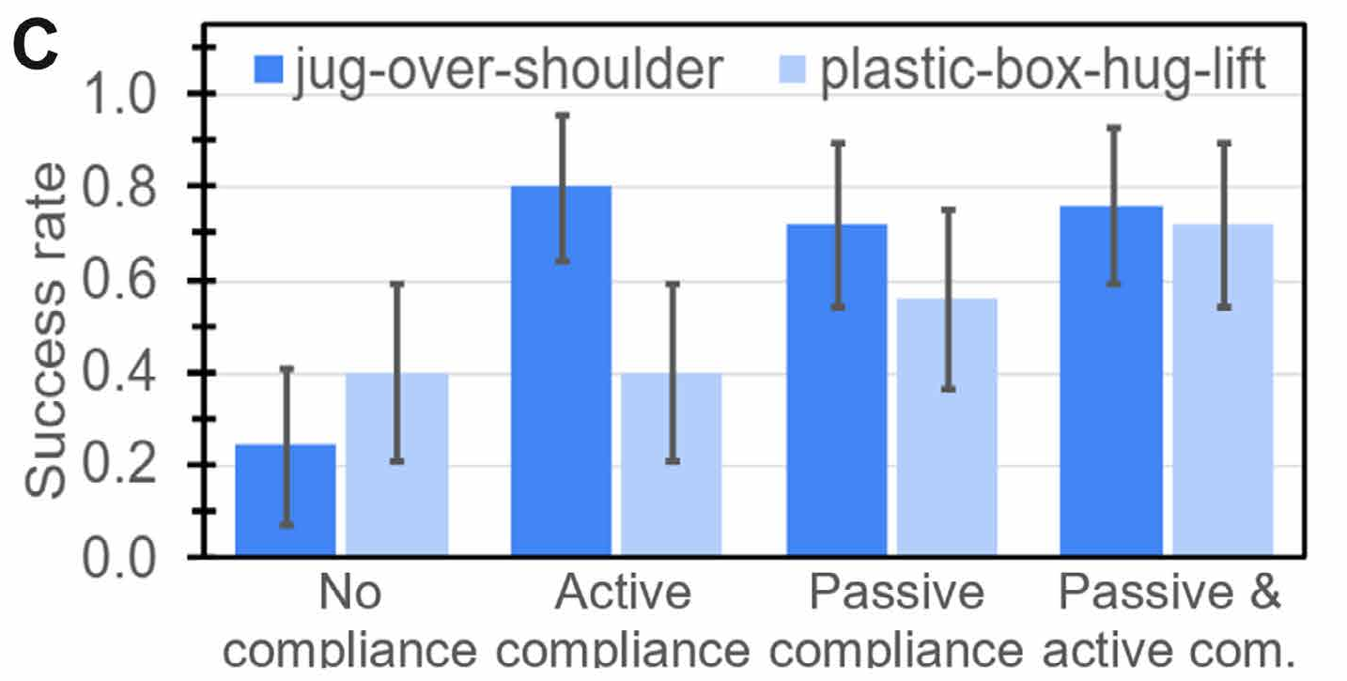
Compliance improves success and limits overload
Box hug: 40% → 56% → 72% with none, passive, and both
Active-only box-hug success remains 40%
14 of 15 rigid box-hug failures involved torque-outs
Jug confidence intervals overlap across compliant modes
Barreiros et al. (2025), Fig. 4C and hardware results, p. 7
36
Notes:
DISCUSSION SCRIPT
For box hugging, success rises from 40 percent without compliance to 56 percent with passive compliance and 72 percent with both.
Active compliance alone remains at 40 percent success in that task.
Fourteen of fifteen rigid-condition failures involve torque-outs, highlighting a hardware loading problem.
The jug confidence intervals overlap across compliant modes, so the evidence is stronger for some comparisons than others.

Slide 37
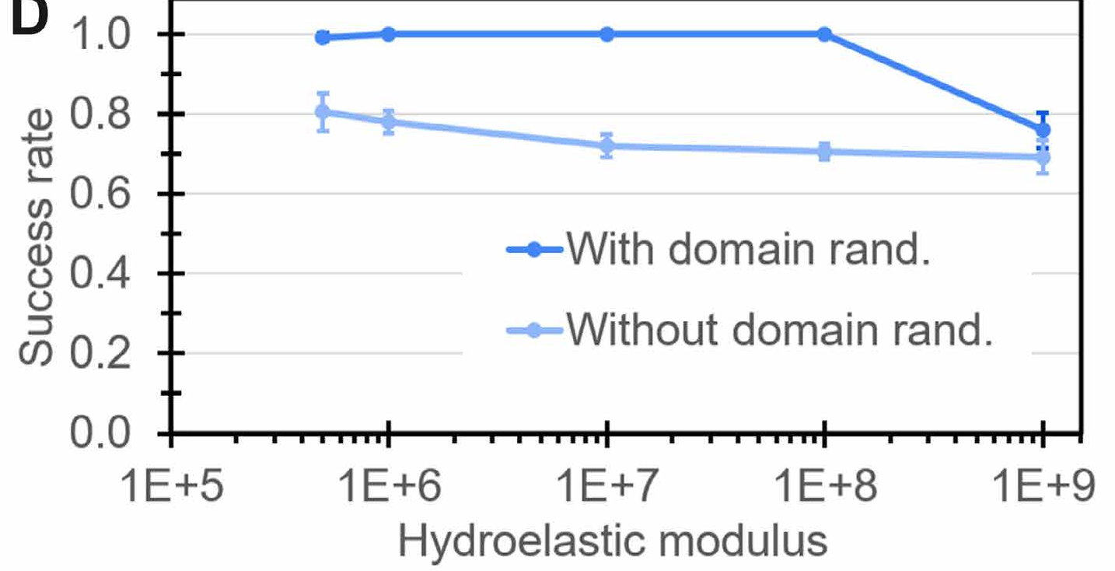
Domain randomization complements softness
Hydroelastic modulus controls test contact stiffness
Compare policies trained with and without randomization
Three seeds and 50 rollouts per policy
Initial jug position varies within a 10-cm square
Barreiros et al. (2025), Fig. 4D; Passive compliance versus DR, p. 7
37
Notes:
DISCUSSION SCRIPT
This experiment varies contact stiffness using Drake's hydroelastic modulus.
It compares policies trained with domain randomization against those trained without it.
The evaluation uses three training seeds and 50 rollouts per policy, with uncertain initial jug position.
The result motivates treating softness and randomization as complementary ways to tolerate modeling error.

Slide 38
Blind manipulation uses asymmetric learning
TRAINING
Joint positions + touch
Actor
Action
Robot + object state
Critic
Value estimates guide
policy learning
DEPLOYMENT
Joint position and touch feed the actor.
No object-pose tracking enters this actor.
Open demo: Movie 3: proprioception and touch
Barreiros et al. (2025), Fig. 1A; privileged learning, pp. 7–9
38
Notes:
DISCUSSION SCRIPT
Object tracking can become difficult when the robot's own body occludes the object.
The asymmetric critic receives privileged robot and object state during simulation training.
The actor learns from a restricted observation set, such as joint positions and binary touch.
At deployment, this actor can execute selected skills without receiving tracked object pose.

Slide 39
Which observations does the actor need?
Actor set | Joint position | Binary touch | Prior action | Object pose
O1 | No | No | Yes | No
O2 | Yes | No | No | No
O3 | Yes | No | Yes | No
O4 | Yes | Yes | No | No
O5 | Yes | Yes | Yes | No
O6 | Yes | Yes | Yes | Yes
The critic retains the privileged observation set in every condition
Barreiros et al. (2025), Observation ablation O1–O6, p. 7
39
Notes:
DISCUSSION SCRIPT
The observation ablation compares six combinations of joint position, touch, prior action, and object pose.
Start with the weaker information sets, then explain what each added signal contributes.
The full observation condition provides a tracked comparison.
The critic keeps privileged information in every condition, so this experiment isolates the actor's observations.

Slide 40
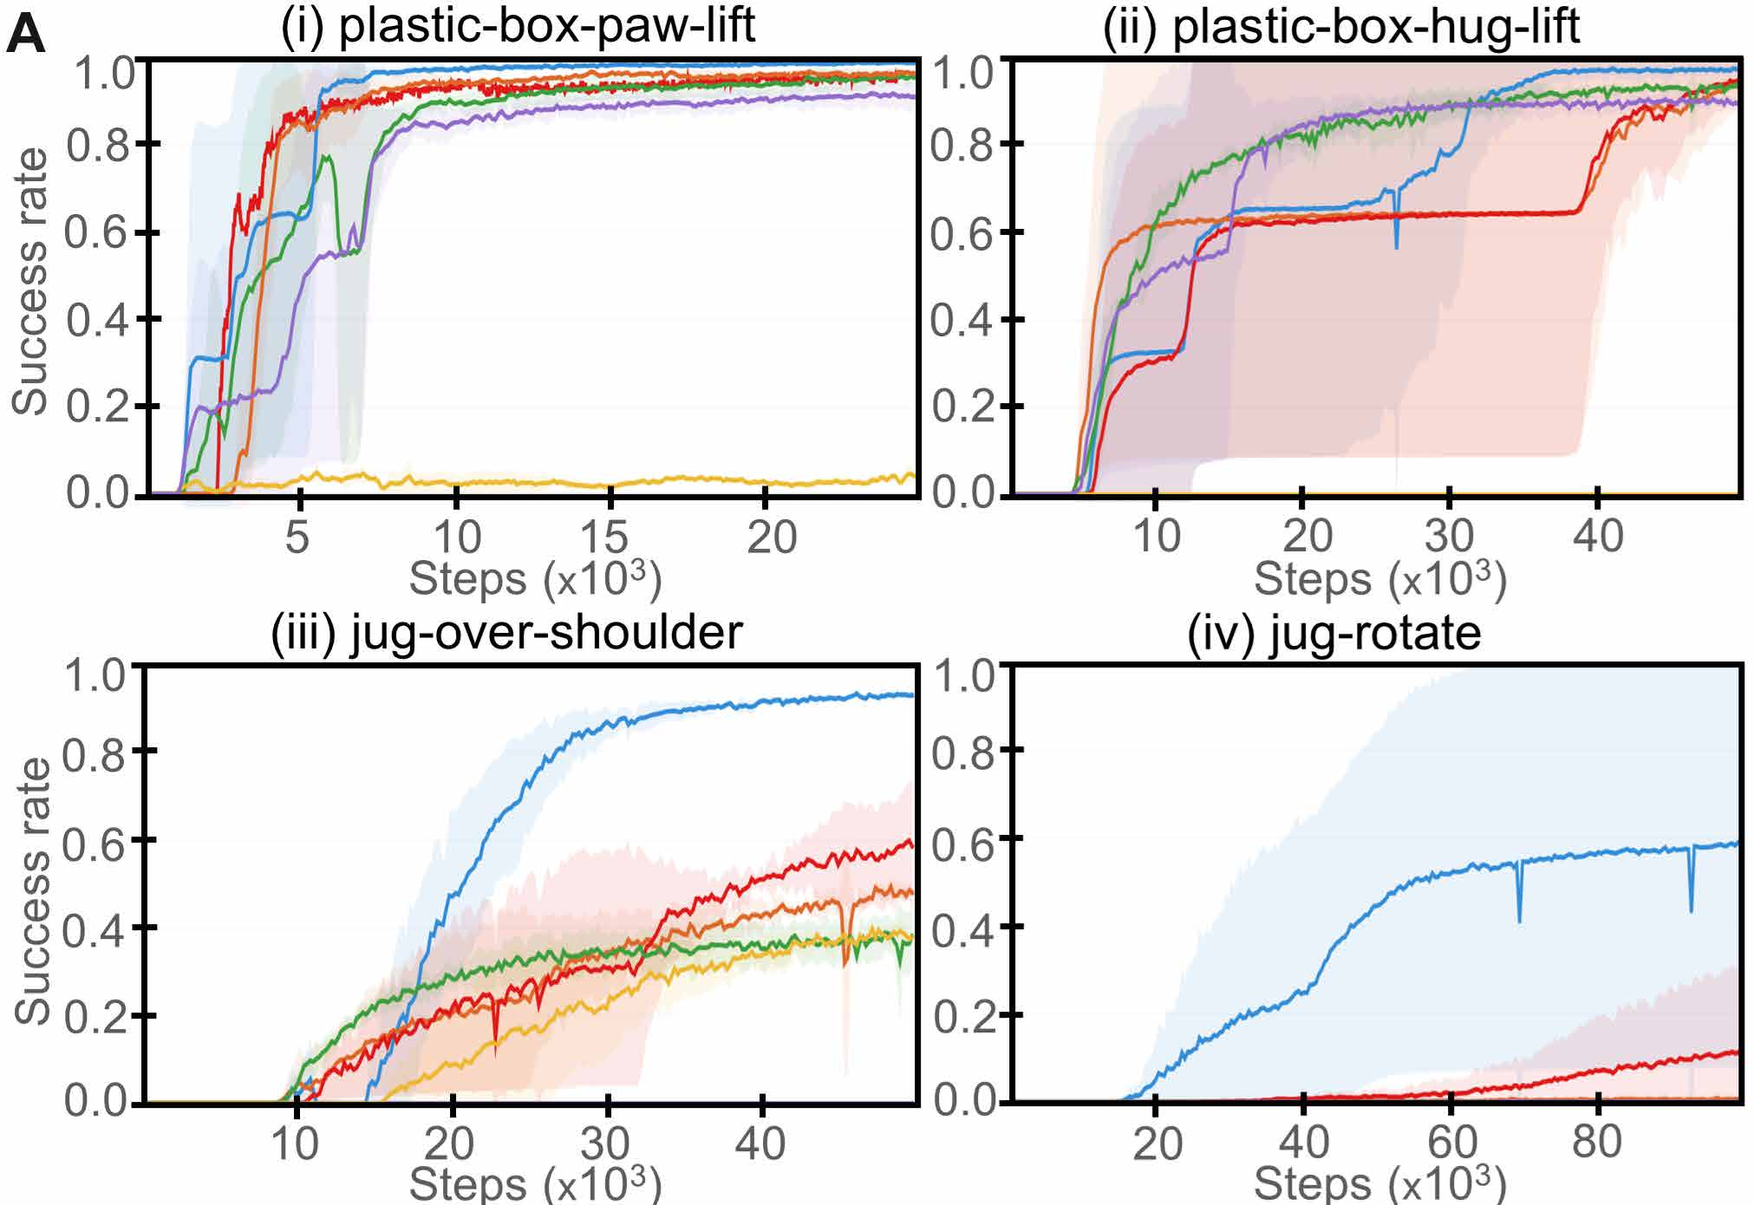
Touch helps learning across manipulation tasks
O1 Previous actions
O2 Joint position
O3 Joint position + prior action
O4 Joint position + touch
O5 Joint position + touch
+ prior action
O6 All above + object pose
Three seeds; shading is ±1 SD
Barreiros et al. (2025), Fig. 5A, p. 8; shaded regions ±1 SD
40
Notes:
DISCUSSION SCRIPT
The learning curves compare the actor observation sets across manipulation tasks.
Touch helps distinguish contact situations that can look similar from joint positions alone.
Read performance trends together with the shaded variability across three training seeds.
These results motivate a closer comparison under larger uncertainty in the object's starting position.

Slide 41
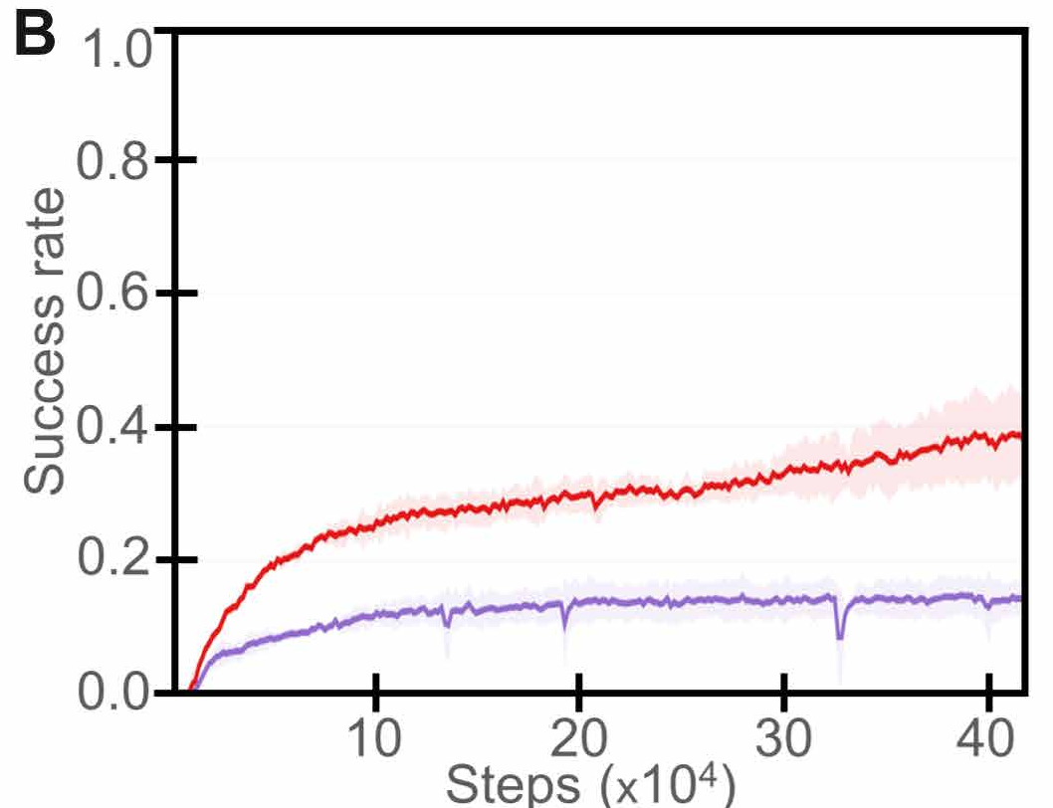
Touch matters more under pose uncertainty
Jug starts within a 50-cm square instead of 10 cm
O4 adds binary touch to joint-position feedback
The red curve learns faster and reaches higher success
Three seeds; shading shows ±1 standard deviation
Barreiros et al. (2025), Fig. 5B and caption, p. 8
41
Notes:
DISCUSSION SCRIPT
Here the jug starts within a 50-centimeter square instead of the standard 10-centimeter square.
O2 uses joint positions, while O4 adds binary contact information.
The red O4 curve learns faster and reaches higher success in this comparison.
This is a simulation learning result, with shading showing variation across three training seeds.

Slide 42
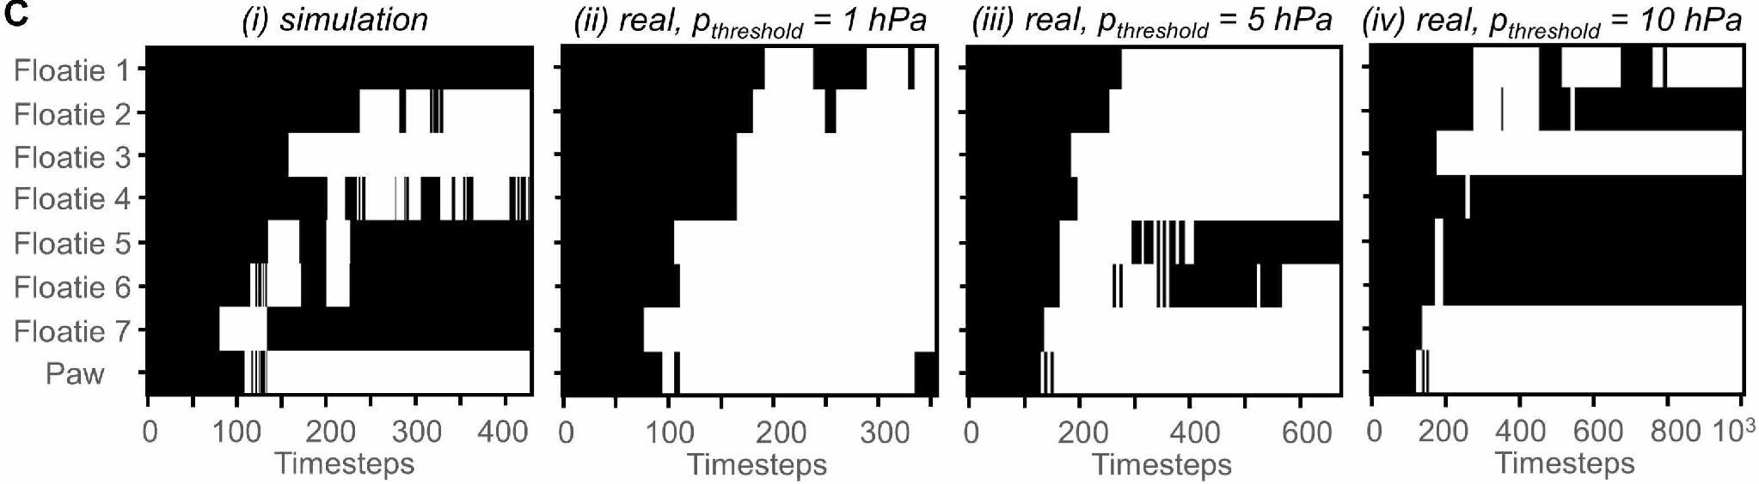
Binary tactile feedback and its threshold
White means contact; black means no contact
Hardware thresholds: 1, 5, and 10 hPa above the zeroed baseline
5 hPa worked best in the illustrated comparison
The threshold changes observations and subsequent actions
Barreiros et al. (2025), Fig. 5C; Low-fidelity tactile feedback, pp. 8–9; binary rule is explanatory notation
42
Notes:
DISCUSSION SCRIPT
Continuous pressure readings are converted into binary contact observations.
The hardware comparison tests thresholds of one, five, and ten hectopascals above the zeroed baseline.
White means contact and black means no contact; five hectopascals works best in the illustrated comparison.
Changing the threshold changes the policy's observations and therefore its later actions, not just the plotted signal.

Slide 43
What the evidence does and does not establish
Demonstrated: task policies transfer to compliant hardware
Demonstrated: coarse touch can replace object tracking for selected skills
Limits: fixed base, separate task policies, modeled objects
Open: broader object variation, precise force regulation, long-term robustness
Barreiros et al. (2025), Discussion, pp. 9–10
43
Notes:
DISCUSSION SCRIPT
The study demonstrates that example-guided policies can transfer to compliant hardware.
It also shows that coarse tactile feedback can support selected skills without object tracking at deployment.
The limits include a fixed base, separately trained task policies, and modeled objects.
Generalizing across more objects and regulating contact forces more precisely remain open directions.

Slide 44
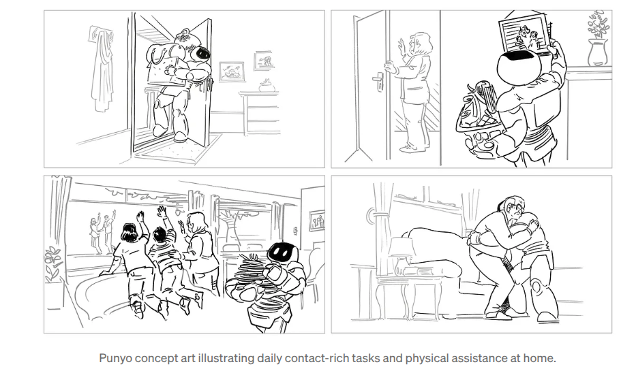
Main conclusions
One example narrows the search for a useful contact strategy
Reinforcement learning adds feedback and task-directed adaptation
Compliance and touch make the physical interaction more robust
Barreiros et al., Science Robotics 10, eads6790 (2025) | Hardware illustration: Toyota Research Institute
44
Notes:
DISCUSSION SCRIPT
One example narrows the search toward a useful contact strategy.
Reinforcement learning adds task-directed adaptation and feedback.
Compliance and touch make contact-rich physical interaction more robust.
The main contribution is the combined learning-and-hardware system, supported by the ablation experiments.

