Slide 1

Wi‑Fi CSI Spatial Mapping
Generating indoor floor layouts using Wi‑Fi signals + AI
Low‑cost, privacy‑preserving alternative to LiDAR & cameras
PROGRESS REVIEW 2 · PHASES 1–3 COMPLETE
TEAM
24WU0102055 — Maruti Nandan Jhawar
24WU0102072 — Devansh Bagaria
24WU0102059 — Sainishant Gajanand Biradar
24WU0102006 — Koushik
24WU0102036 — Sampath Bageyawadi
Mentor: << add mentor name >>

Slide 2
Introduction
Infer where things are in a room — presence, location, and the room’s boundary — from the Channel State Information (CSI) of ordinary Wi‑Fi. No cameras, minimal hardware.
The problem
Our approach
Since Review 1
• High hardware cost
• Slow, manual surveys
• Missing / outdated floor plans
• Camera privacy risks
• Wi‑Fi CSI → signal processing
• → PCA → 1D‑CNN / tomography
• → estimated spatial layout
• Privacy‑first, low‑cost
• From proposal to a working
• Phase 1–3 pipeline
• Runs end‑to‑end today
• Router now → ESP32 later
Wi‑Fi CSI Spatial Mapping · Progress Review 2
2

Slide 3
Methodology
One pipeline from raw CSI to a live spatial map. The capture backend is swappable — Wi‑Fi router now, ESP32‑S3 later — with no changes downstream.
Capture
Clean
Reduce
Model
Serve
→
→
→
→
multi‑node CSI
router · ESP32 · sim
CFO/SFO phase
Hampel · Butterworth
PCA feature
reduction
1D‑CNN (PyTorch)
+ tomography
FastAPI + WebSocket
live Canvas map
Validated on a physics‑based room simulator (direct path, wall reflections, obstacle shadowing) that yields perfectly‑labelled data before hardware. It implements the same capture interface as the router, so moving to real captures changes nothing in the pipeline.
Wi‑Fi CSI Spatial Mapping · Progress Review 2
3

Slide 4
Progress — Phases 1–3
PHASE 1
PHASE 2
PHASE 3
Single obstacle detection
Multi‑node sensing
Room boundary estimation
Detect presence and a coarse location from a single TX→RX link.
Fuse all links; crossing viewpoints triangulate the target.
Invert wall echoes (ellipse back‑projection) into a floor outline.
✓ presence 100%
✓ error 1.14 → 0.60 m
✓ boundary IoU ≈ 0.61
Roadmap: 1 Detection ✓ 2 Multi‑node ✓ 3 Boundary ✓ 4 Floor‑plan (next) 5 Real‑time (planned)
Wi‑Fi CSI Spatial Mapping · Progress Review 2
4

Slide 5
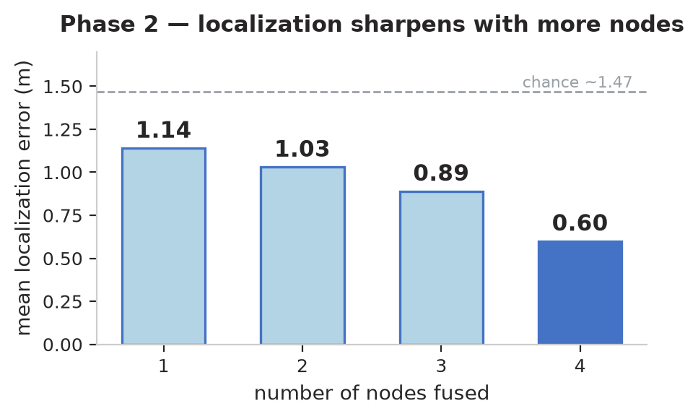
Results & Live Demo
▸ Phase 2: 4‑node fusion nearly halves single‑link error (0.60 m vs 1.14 m).
▸ Phase 3: room boundary IoU ≈ 0.61 (estimated 5.25×3.62 m vs true 5×4 m).
▸ Live demo: tracks a moving obstacle to ≈ 0.3 m — FastAPI + WebSocket + HTML5 Canvas.
Honest scope: results are validated in physics simulation. Next step is real Wi‑Fi router captures across the room.
Wi‑Fi CSI Spatial Mapping · Progress Review 2
5

Slide 6
Literature Review
▸ Adib, F., Hsu, C. Y., Mao, H., Katabi, D., & Durand, F. (2015). Capturing the Human Figure Through a Wall. ACM SIGGRAPH Asia 2015 Papers. Association for Computing Machinery.
▸ Hernandez, S. M., & Bulut, E. (2022). Lightweight and Standalone IoT Based WiFi Sensing for Active Occupancy Detection. IEEE International Conference on Communications (ICC).
▸ Wang, X., Gao, L., Mao, S., & Pandey, S. (2015). CSI‑Based Fingerprinting for Indoor Hidden Node Problem. IEEE Transactions on Vehicular Technology, 64(8), 3565–3576.
▸ Wang, X., Gao, L., Mao, S., & Pandey, S. (2015). DeepFi: Deep Learning for Indoor Fingerprinting Using Channel State Information. IEEE Wireless Communications and Networking Conference (WCNC).
Wi‑Fi CSI Spatial Mapping · Progress Review 2
6

