Slide 1
Linux中断原理分析
梁玉林liangyulin@kedacom.com
苏州科达上海研究所KEDA

Slide 2
文档面向人员对象
Linux驱动开发人员
Linux内核开发人员
Linux网络开发人员
Linux感兴趣人员

Slide 3
Outline
简介
Linux 中断处理构架
Linux 2.6 硬中断
Linux 2.6l软中断
Linux 2.6 kernel code trace

Slide 4
简介
中断： 由硬件/软件产生的用来改变处理器 指令运行顺序的事件
硬中断：由硬件产生的中断
软中断：由软件产生的中断
中断态: 运行中断处理函数ISR)或运行下半 部分时的内核状态称为中断态

Slide 5
中断处理的一般过程
Interrupt controller
Interrupt handler
Device
CPU
IRQ# interrupt
INTR
INTA
INT#
invoke the handler
service the device
end of interrupt
return from handler

Slide 6
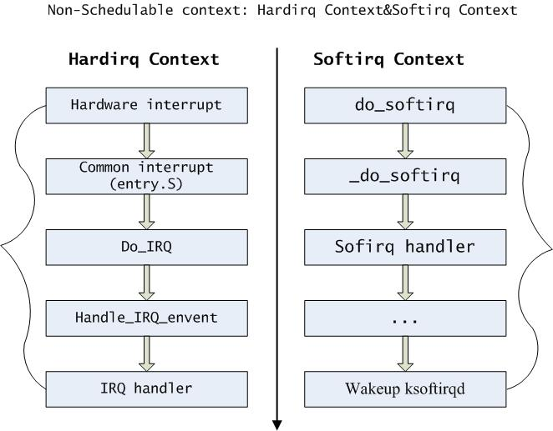
Linux的中断处理构架
Architecture

Slide 7
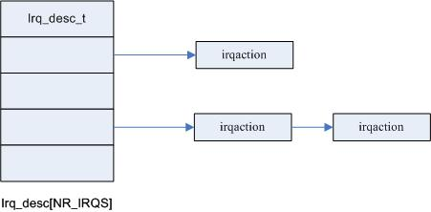
Linux的硬中断处理
Hardirq
typedef struct irq_desc {
unsigned int status;
hw_irq_controller *handler; /*中断控制器处理,如ack、end*/
struct irqaction *action; /* IRQ action list 中断处理函数*/
unsigned int depth;
unsigned int irq_count;
unsigned int irqs_unhandled;
spinlock_t lock;
}irq_desc_t;

Slide 8
Linux的硬中断处理
Linux对硬件中断处理分为：
1.体系相关的部分：如获取中断源、进程信息压入堆栈
2.体系无关的部分：此部分调用用户注册的ISR。

Slide 9
体系相关的部分
主要文件：arch\i386\entry.S
主要实现：获取中断源、保存状态、调用体系无关
example
IRQ12_interrupt:
pushl $-244
jmp common_interrupt
common_interrupt:
SAVE_ALL
CALL do_IRQ ; hardware interrupt handler
jmp return_from_intr
INT#

Slide 10
Linux的硬中断处理
体系无关的部分
do_IRQ()的处理及handle_IRQ_event()
do_IRQ是对所有设备的IRQ中断请求的处理。
通过handle_IRQ_event来完成注册的中断处理函数。
unsigned int __do_IRQ(unsigned int irq, struct pt_regs *regs)
{ irq_desc_t *desc = irq_desc + irq; //获取中断源
struct irqaction * action;
unsigned int status;
kstat_this_cpu.irqs[irq]++; //更新记录信息
代码分析。。。
}
handle_IRQ_event （）
{
}

Slide 11
asmlinkage unsigned int do_IRQ(struct pt_regs regs)
{
int irq = regs.orig_eax & 0xff; /* 从体系相关部分得到中断源 */
irq_desc_t *desc = irq_desc + irq;
struct irqaction * action;
unsigned int status;
irq_enter();
kstat_this_cpu.irqs[irq]++; /* total hw interrupt handled by this cpu */
spin_lock(&desc->lock);
desc->handler->ack(irq);
status = desc->status & ~(IRQ_REPLAY | IRQ_WAITING);
status |= IRQ_PENDING; /* we _want_ to handle it */
action = NULL; /* NULL ？此处置action为NULL*/
if (likely(!(status & (IRQ_DISABLED | IRQ_INPROGRESS)))) {
action = desc->action;
status &= ~IRQ_PENDING; /* we commit to handling */
status |= IRQ_INPROGRESS; /* we are handling it */
}
desc->status = status;
if (unlikely(!action))
goto out;
enter critical section
exit critical section
File: arch\i386\kernel\irq.c

Slide 12
for (;;) {
irqreturn_t action_ret;
spin_unlock(&desc->lock);
action_ret = handle_IRQ_event(irq, &regs, action); /* do interrupt
handler*/
spin_lock(&desc->lock);
if (!noirqdebug)
note_interrupt(irq, desc, action_ret);
if (likely(!(desc->status & IRQ_PENDING)))
break;
desc->status &= ~IRQ_PENDING;
}
desc->status &= ~IRQ_INPROGRESS;
out:
desc->handler->end(irq);
spin_unlock(&desc->lock);
irq_exit(); /* 硬件中断处理函数ISR执行完，检查软中断是否pending */
return 1;
}
exit critical section
enter critical section
exit critical section
File: arch\i386\kernel\irq.c

Slide 13
Linux的软中断
Softirq
在硬件中断产生后,Hardirq在完成最紧及的事件，触发软中断，由软中断完成后继操作
在Linux中， 可通过：
Softirq
Tasklet
Workqueue
来完成defered工作

Slide 14
软中断记录信息Softirq_Action
softirq_action
enum
{
HI_SOFTIRQ=0,
TIMER_SOFTIRQ,
NET_TX_SOFTIRQ,
NET_RX_SOFTIRQ,
SCSI_SOFTIRQ,
TASKLET_SOFTIRQ
};
include\linux\interrupt.h
softirq_vec[ ]

Slide 15
软中断主要数据结构
struct softirq_action
{
void (*action)(struct softirq_action *); /*function to run */
void *data; /*data to pass to function */
};
include\linux\interrupt.h
static struct softirq_action softirq_vec[32] __cacheline_aligned_in_smp;
kernel\softirq.c

Slide 16
软中断执行时机
在Linux中有三个地方可用来执行softirqs,执行操作函数为do_softirq()
① 在执行完成一个硬中断后
② 通过ksoftirqd内核线程，此时是通过调度器的调度。
③ 在网络子系统中NAPI主动调动do_softirq()，检查是否有pending softirq

Slide 17
do_softirq()
asmlinkage void do_softirq(void)
{
__u32 pending;
unsigned long flags;
if (in_interrupt())
return;
local_irq_save(flags); /* disable local interrupt */
pending = local_softirq_pending();
if (pending)
__do_softirq();
local_irq_restore(flags);
}
File: kernel\irq.c

Slide 18
__do_softirq()
asmlinkage void __do_softirq(void)
{
struct softirq_action *h;
__u32 pending;
int max_restart = MAX_SOFTIRQ_RESTART;
pending = local_softirq_pending();
local_bh_disable();
restart:
/* Reset the pending bitmask before enabling irqs */
local_softirq_pending() = 0;
local_irq_enable(); /* sti */
h = softirq_vec;
do {
if (pending & 1)
h->action(h);
h++;
pending >>= 1;
} while (pending); /* this loop executes at most 32 times */
禁止软中断，进入竟争区
允许中断，软中断可被中断抢占
File: kernel\irq.c

Slide 19
local_irq_disable();
pending = local_softirq_pending();
if (pending && --max_restart)
goto restart;
if (pending)
wakeup_softirqd();
__local_bh_enable();
}
禁止中断
启动softirqd线程
允许软中断，退出竟争区
File: kernel\irq.c

