Slide 1
C# Programming Language A Demonstration in Unix
SALAMAHN XMILLS

Slide 2
Brief History of C#
Developed by Anders Hejlsberg at Microsoft
Development started January 1999, finalized by July 2000
Original name was “Cool” (C-like Object Oriented Language)
Created to be used in tandem with .NET Framework
Initially considered to be a Java clone

Slide 3
The Pizza Hut Challenge
On March 14, 2016, in celebration of National Pi Day, Pizza Hut issued a challenge to math experts and pizza lovers alike to solve a math problem in order to earn a chance to win free “pie” (3.14 years of pizza)
Mathematician John H. Conway was hired to create three different problems of varying difficulty (high school, undergraduate, doctorate)
Players needed only to solve one out of the three problems and post the correct solution on the Pizza Hut blog before the end of the day (3/14/16 11:59PM)

Slide 4
The Problem
I’m thinking of a ten-digit integer whose digits are all distinct. It happens that the number formed by the first n of them is divisible by n for each n from 1 to 10. What is my number?

Slide 5

The Problem: VISUALIZED

Slide 6

The Breakdown: What Do We Know?
Basic Divisibility Rules:
An integer is divisible by 5 if its string ends in 0 or 5.
An integer is even if its string ends in 0, 2, 4, 6, or 8.
An integer is divisible by 9 if the sum of the digits in its string is divisible by 9 (works for 3 as well).
From the first rule, we can determine that the 5th position (x₄) must be a ‘0’ or a ‘5’. We also know that an integer is divisible by 10 iff its string ends in a ‘0’. Since the entirety of the string must be divisible by 10, we can conclude that the integer that holds the 10th position (x₉) must be a ‘0’. Logically this forces the integer in the 5th position to be ‘5’, since according to the rules each digit that holds a position is unique.
So far we have:

Slide 7

The Breakdown: What Do We Know?
From the second rule, we also know that the digits in the 2nd (x₁), 4th (x₃), 6th (x₅), and 8th (x₇) position must be either a ‘0’, ‘2’, ‘4’, ‘6’, or an ‘8’ due to each sub-string needing to be divisible by an even number. Since we have already used the ‘0’, that leaves us with four options to choose from. Any of these options are entirely valid, since an integer string whose value is divisible by 2 may end in either of these characters, and the same goes for one that ends in 4, 6, or 8.
So far we have:

Slide 8

The Breakdown: What Do We Know?
Since the 2nd (x₁), 4th (x₃), 6th (x₅), and 8th (x₇) positions must hold either a ‘2’, ‘4’, ‘6’, or ‘8’, this exhausts all four options to be held in at least one of all four positions. Therefore, a ‘2’, ‘4’, ‘6’, or ‘8’ could not possibly appear in the 1st (x₀), 3rd (x₂), 7th (x₆), or 9th (x₈) positions, forcing those positions to be filled with either a ‘1’, ‘3’, ‘7’, or ‘9’.
So far we have:

Slide 9


The Algorithm: Step By Step
This problem unfortunately cannot be solved by simple inspection, so let us take a look at the process needed to derive a solution.
Step 0:
Step 1:

Slide 10






The Algorithm: Step By Step
Step 2
Step 3
Step 4
Step 5
Step 6
Step 7

Slide 11






The Algorithm: Step By Step
Step 8
Step 9
Step A
Step B
Step C
Step D

Slide 12




The Algorithm: Step By Step
Step E
Step F
Step G
Step H
Step I
Step J

Slide 13





The Algorithm: Step By Step
Step K
Step L
Step M
Step N
Step O
Step P

Slide 14
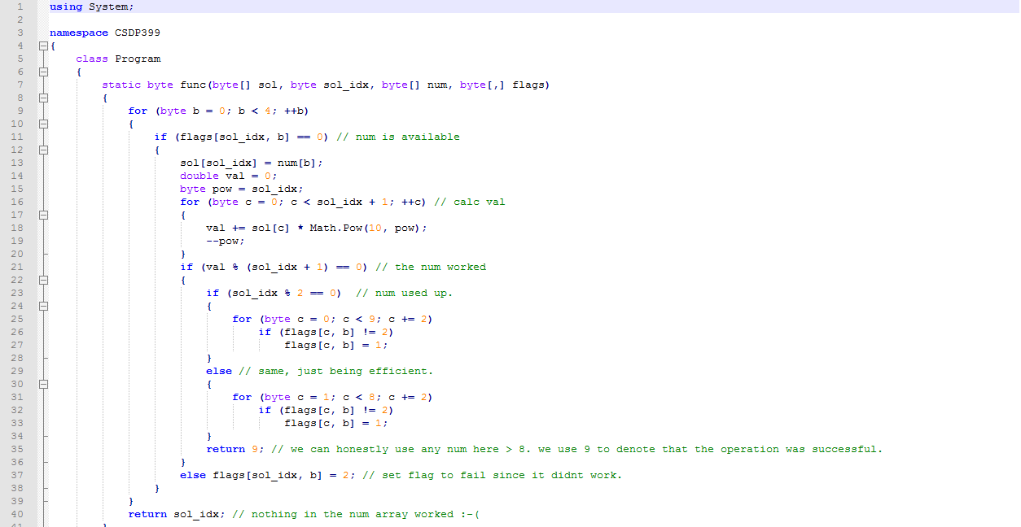
The CODE

Slide 15
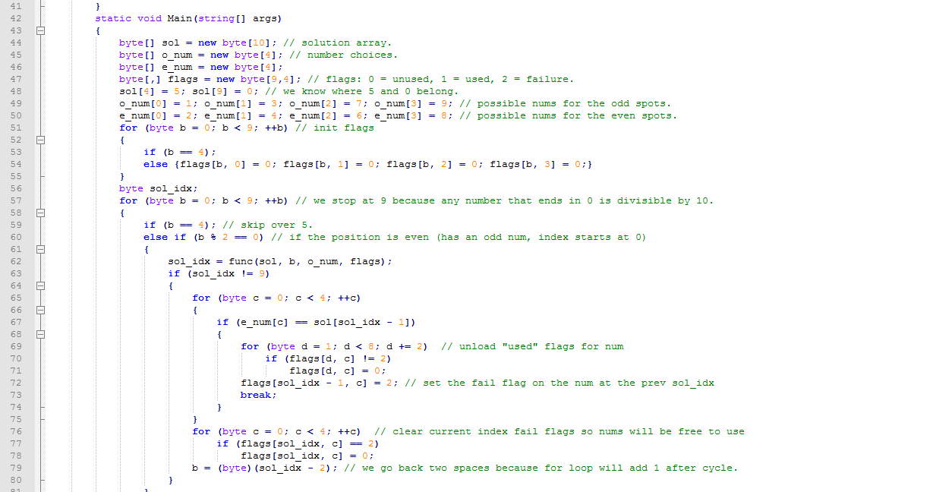
The CODE

Slide 16
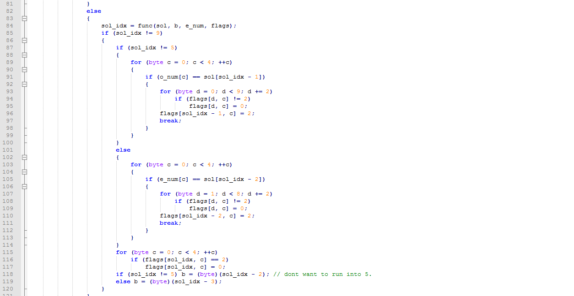
The CODE

Slide 17
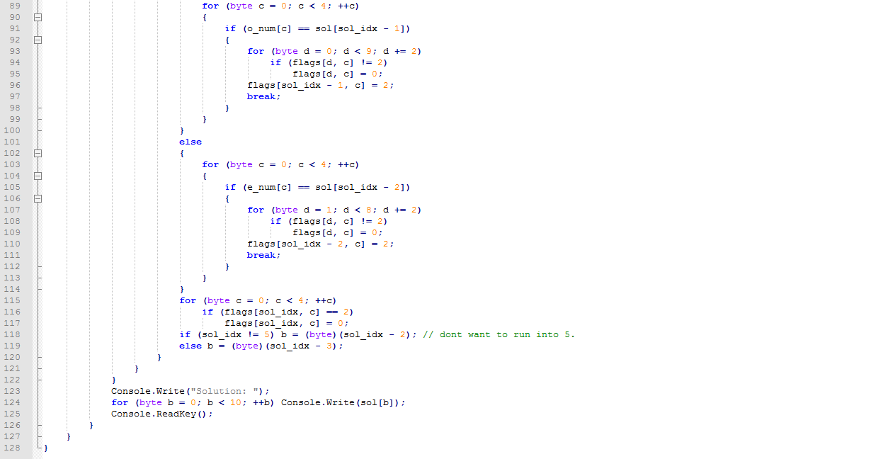
The CODE

Slide 18
The Solution
Brute force algorithm O(n¹⁰) (worst case) vs efficient implementation O(n⁴) (worst case)
My solution complete in < 1000 ms
Brute force estimated time: at most 11.574 days (worst case)

