Slide 1
Molecular Communications: Model-Based and Data-Driven Receiver Design and Optimization
Group ID : BT_S11
Group Members :
Samarth Shah (AU1841145)
Yash Arvindkumar Patel (AU1841141)
Yugamsinh Chavda (AU1841090)

Slide 2
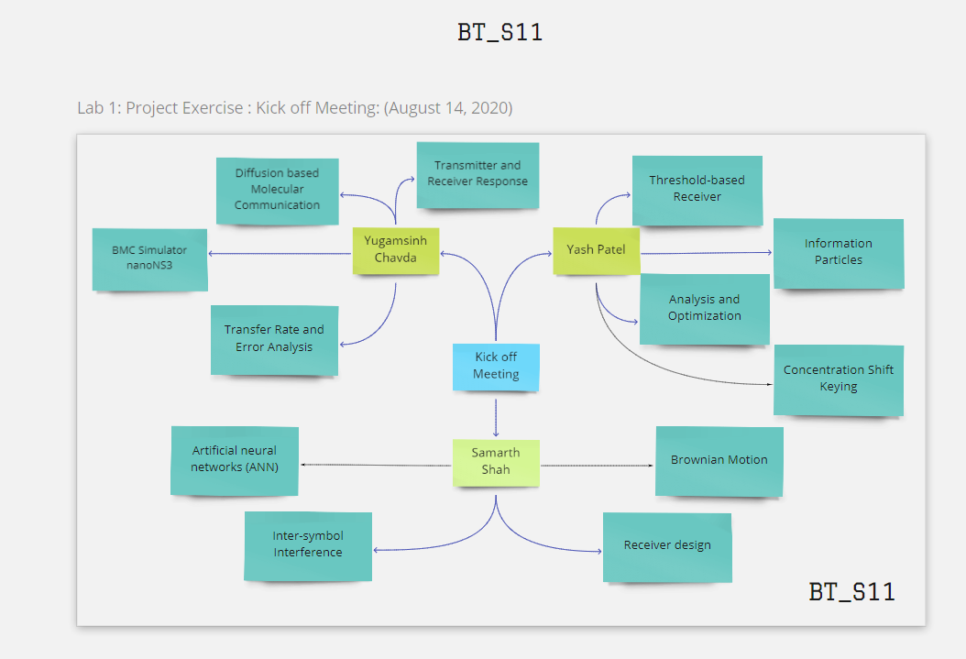

Slide 3
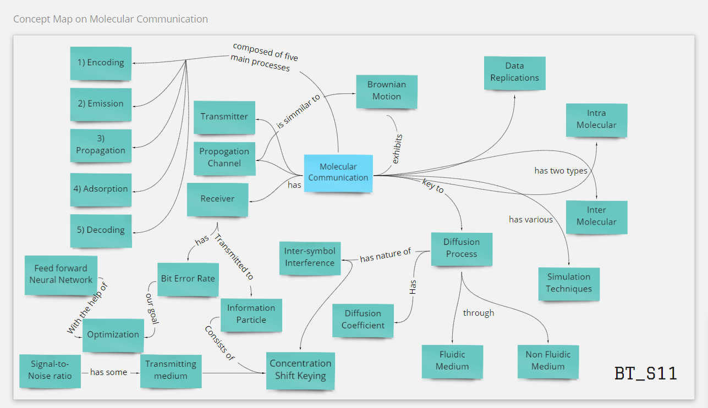

Slide 4
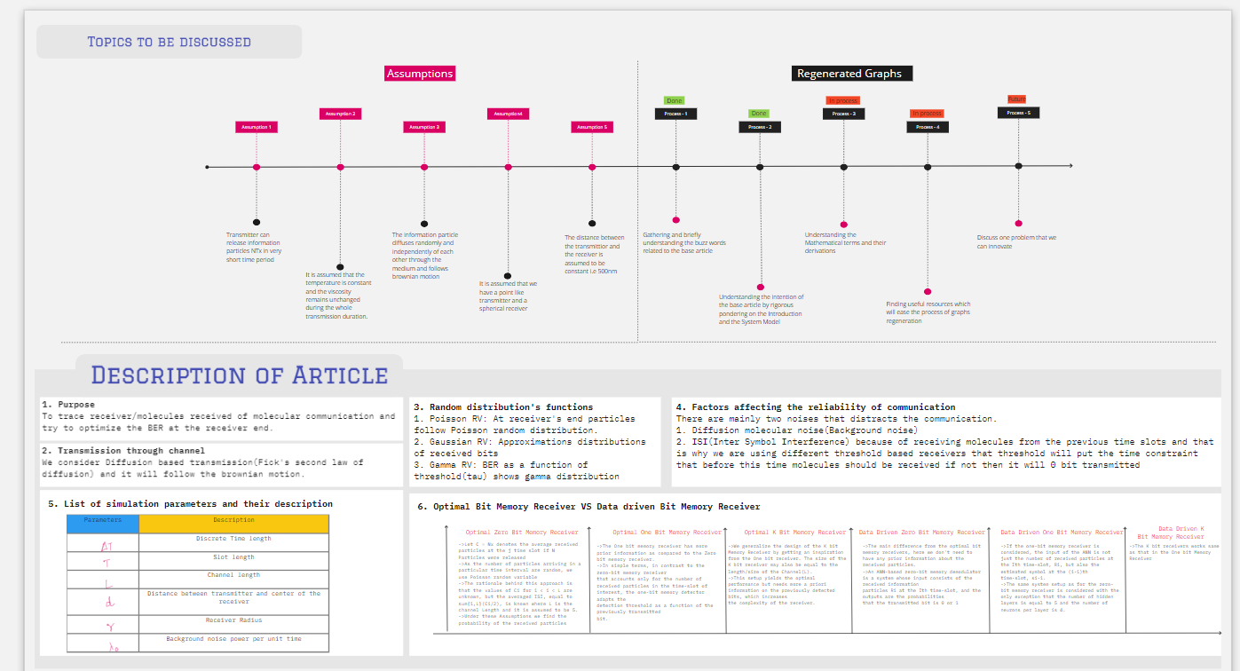

Slide 5
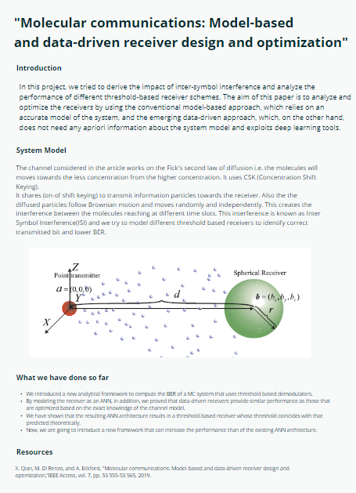

Slide 6
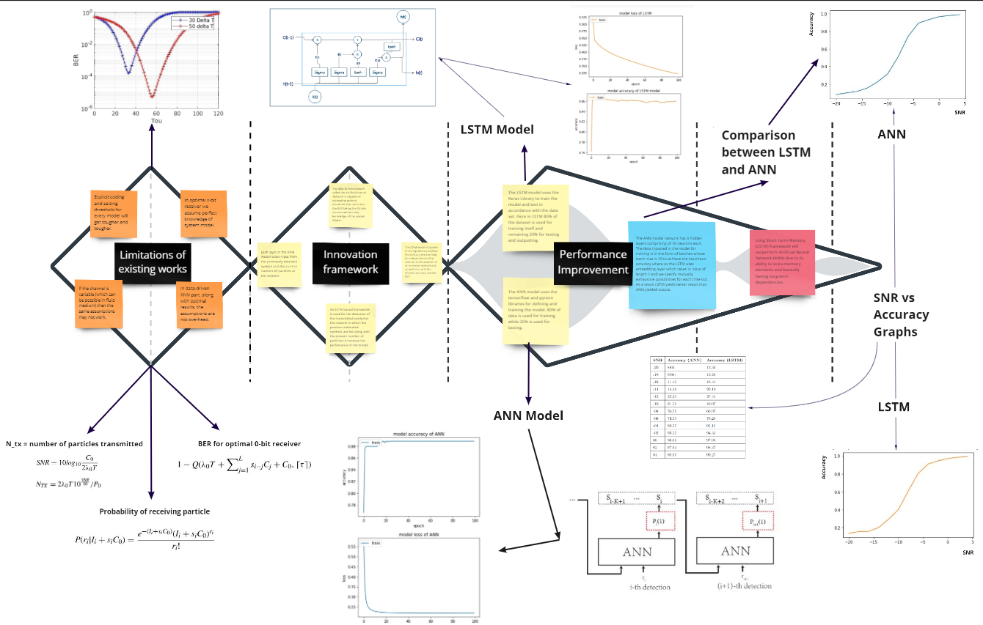

Slide 7
