Slide 1
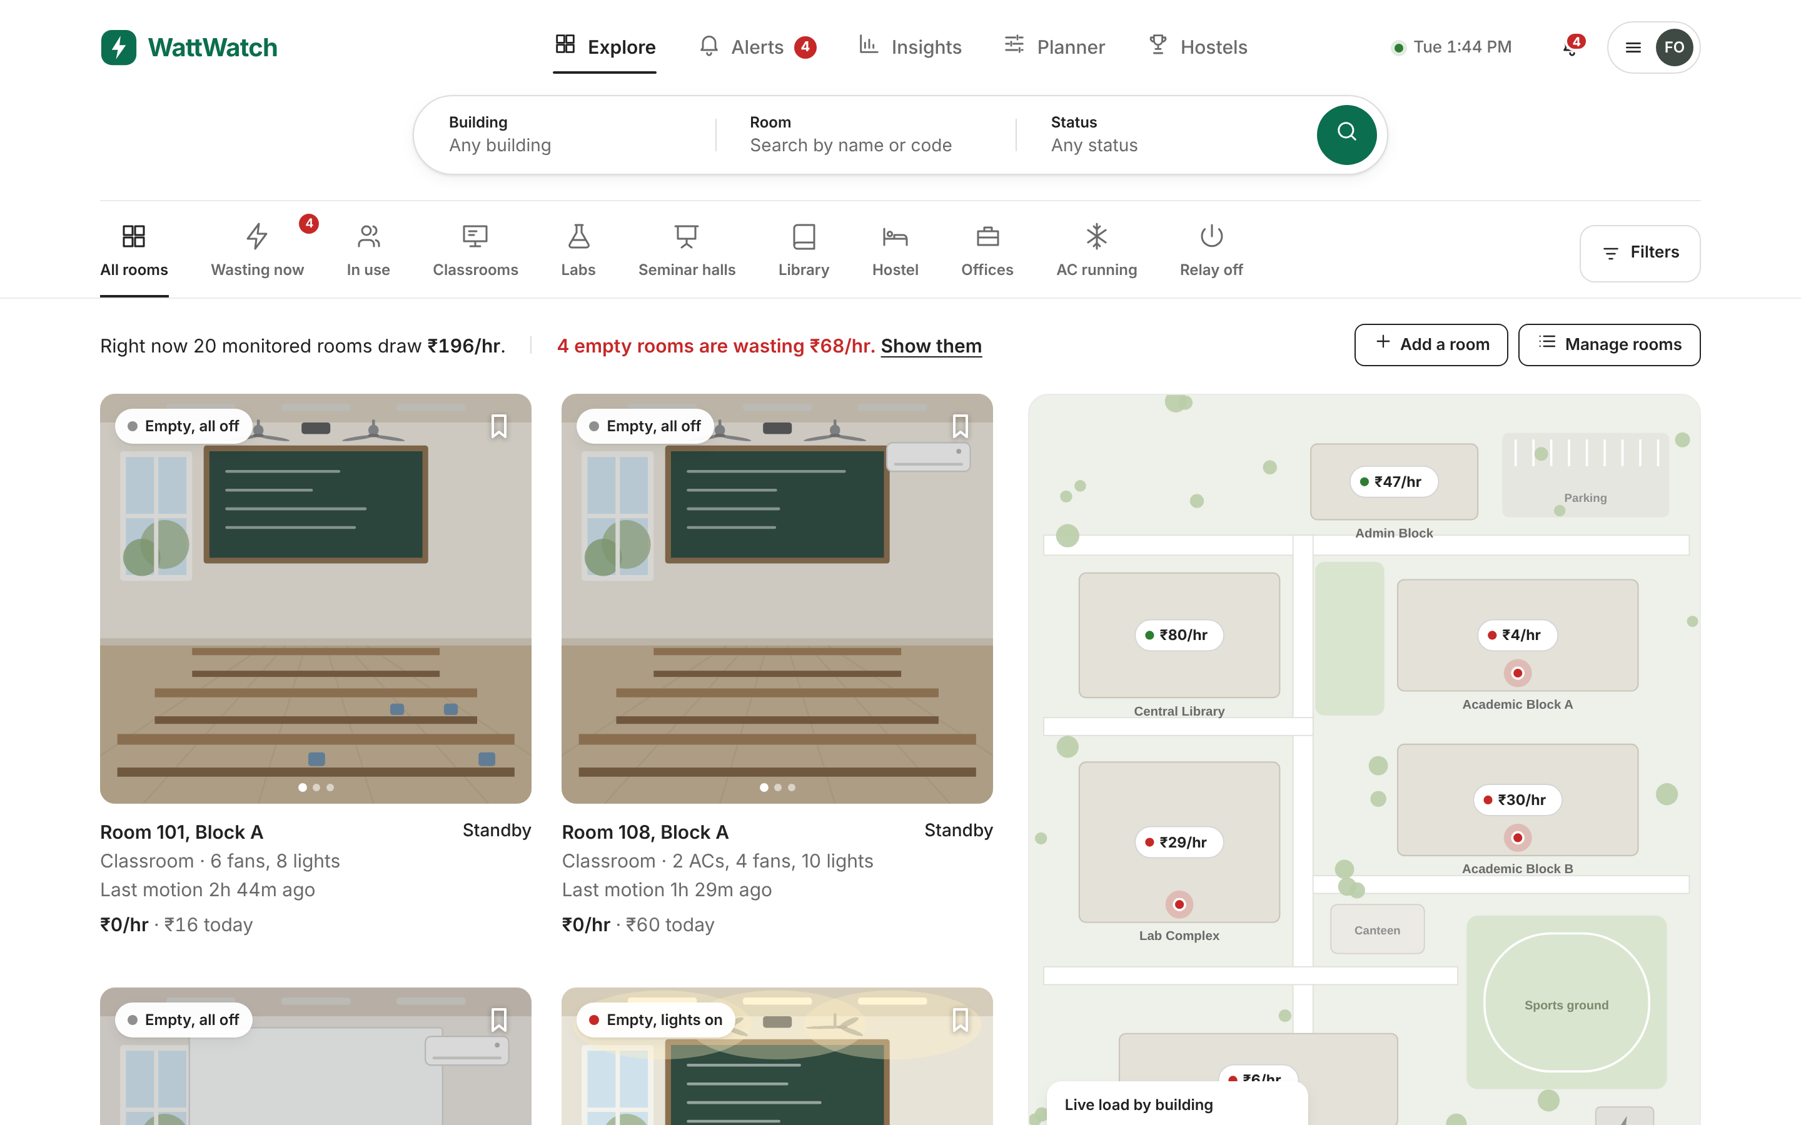
WattWatch
HACKATHON PITCH · CAMPUS ENERGY
See where campus electricity goes, and stop paying to light and cool empty rooms.
ESP32 room sensors
Live campus map
The live dashboard: every room's status, cost per hour and the campus map
Telegram alerts
Relay shutoff
Notes:
Open with the hook: every empty classroom with the lights, fans and AC running is money the campus pays for nothing. WattWatch makes that waste visible room by room and switches it off.

Slide 2




Our campus pays to light and cool empty rooms
15%
70 min
0
of the electricity bill is avoidable, mostly rooms running with no one inside
is how long a room typically stays powered after the last class ends
rooms where anyone can see live usage today. The bill arrives once a month
Room 204, Block B, 1:44 PM. Two ACs and ten lights have been running for 2 h 04 m since the 10:40 lecture ended. Nobody knows, so nobody switches them off. That one room loses about ₹35 every hour.
Figures from our pilot simulation of 20 rooms and six building feeders, at ₹9 per kWh.
Notes:
Three numbers carry the problem: the waste is real, it happens after class, and nobody can see it. Then make it concrete with Room 204.

Slide 3







A ₹800 sensor in every room, one live view of the campus
Sense
Send
Store
Learn
Act
ESP32 with an SCT-013 current clamp and a PIR presence sensor
Readings every 2 seconds over MQTT to HiveMQ Cloud
FastAPI backend with InfluxDB for the time series
Prophet forecasts tomorrow; Isolation Forest flags odd spikes
Dashboard, Telegram alert to the in-charge, relay cuts power
Presence only, no cameras. The PIR sensor reports whether a room is occupied, never who is in it. If the timetable says no class and the sensor sees no one, the room should be off.
Notes:
Walk left to right: sense, send, store, learn, act. Stress that it is cheap off-the-shelf hardware and that privacy is built in: no cameras.

Slide 4
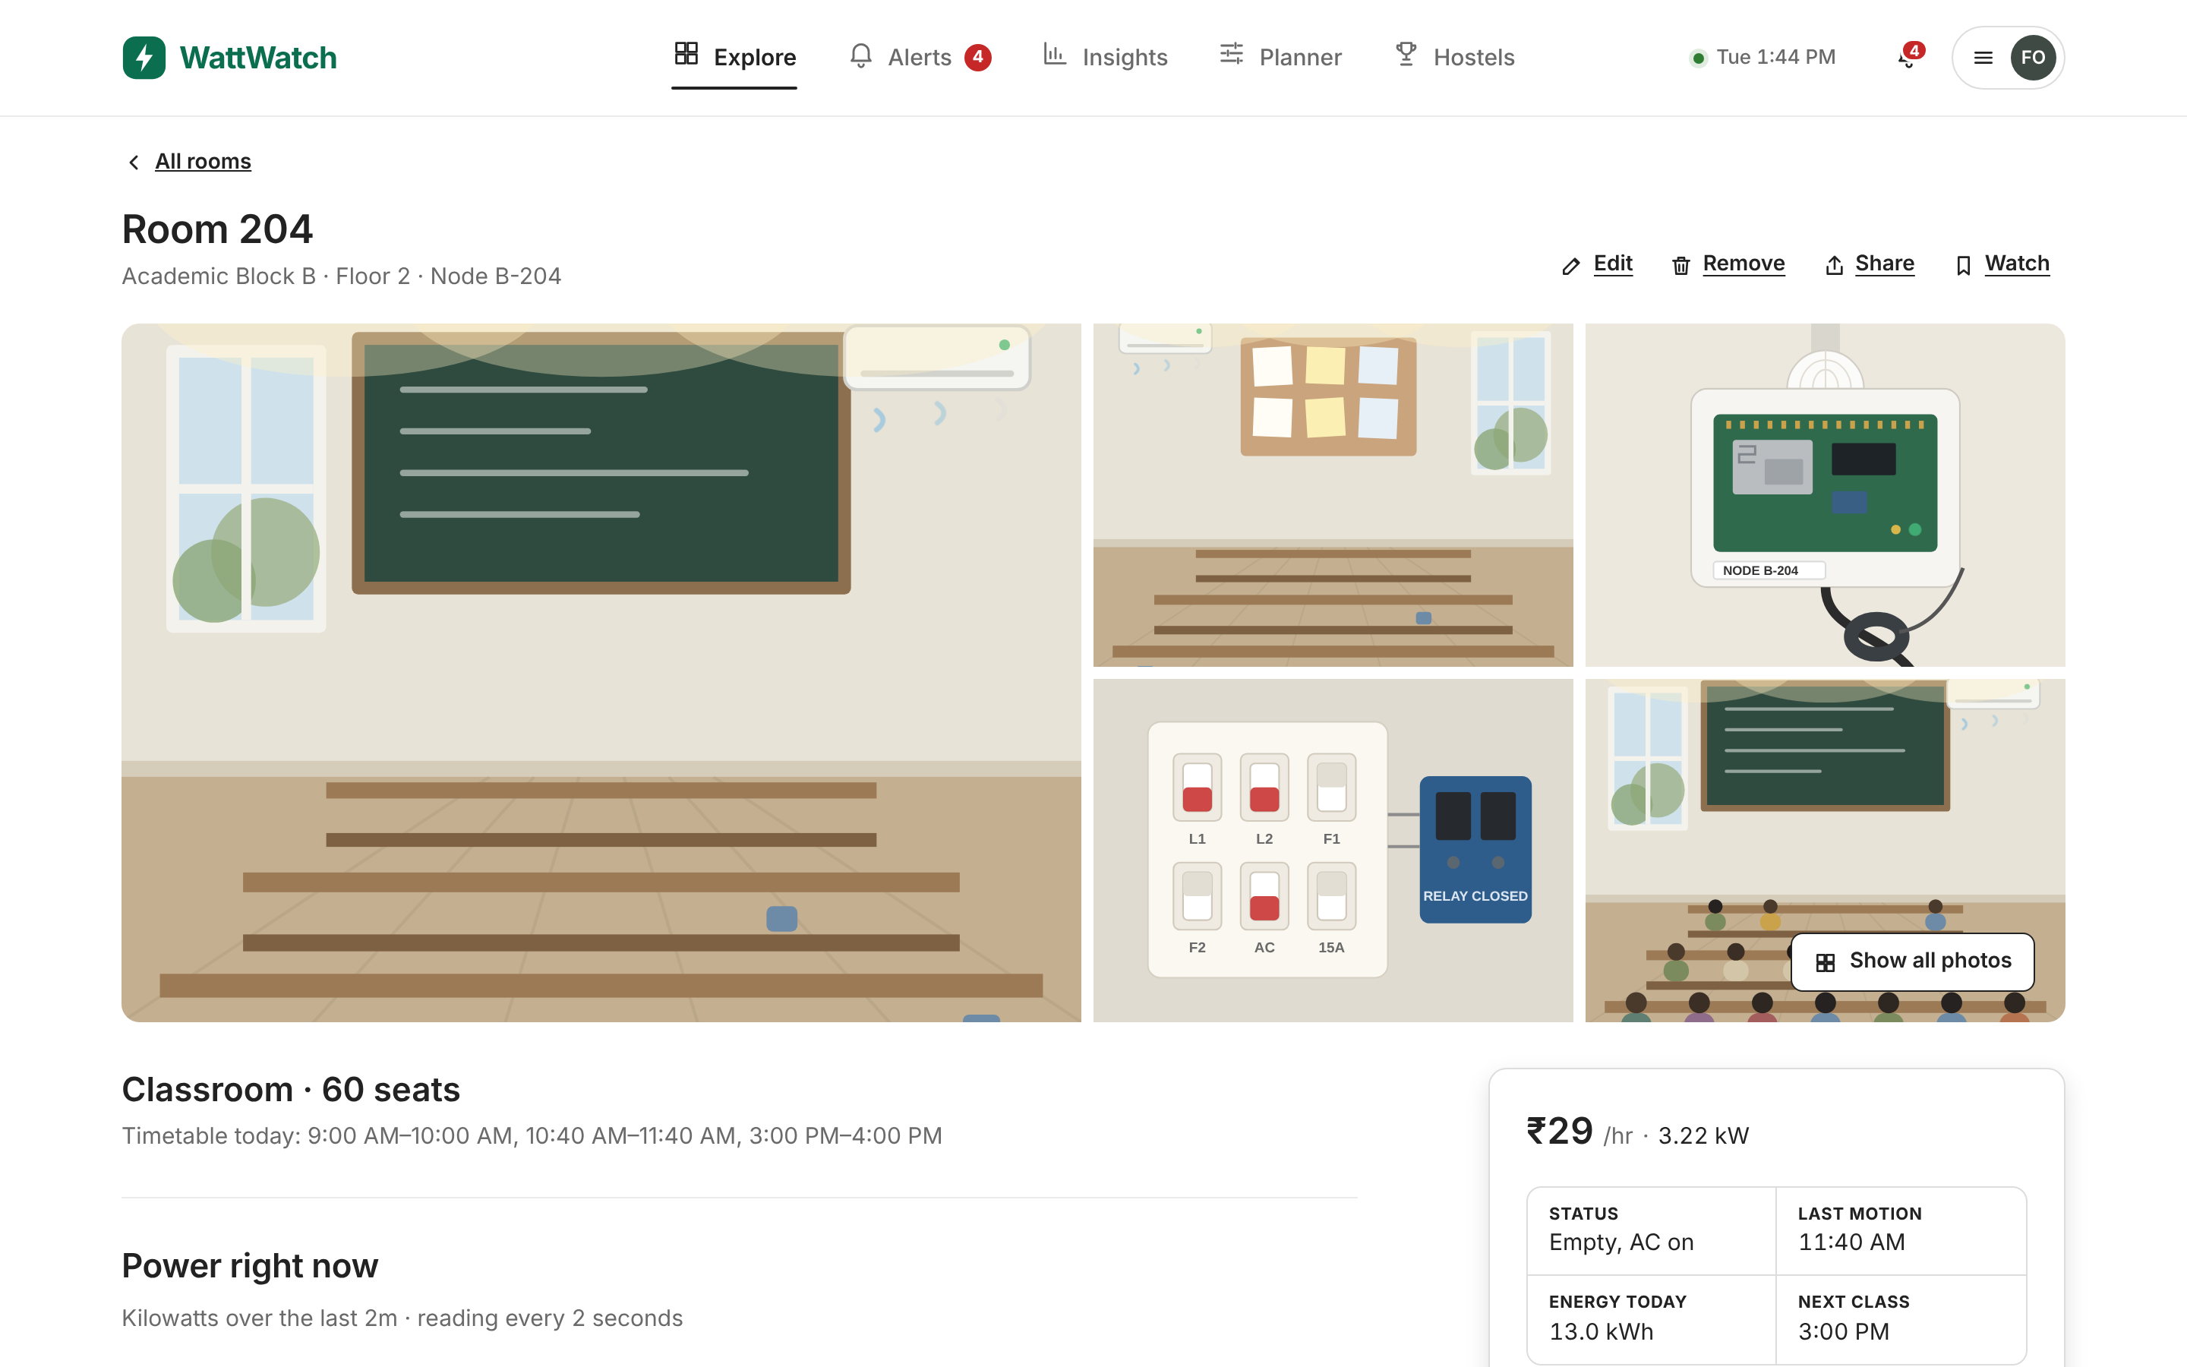



Every room, live, in one place
Live campus map
Buildings and rooms coloured by load, with cost per hour on every pin.
Waste alerts
Empty with power on for 15 minutes sends a Telegram message to the building in-charge.
One-tap shutoff
The relay cuts the AC and light circuits. Motion turns them back on.
Room page: live power, today's cost by hour and the turn-off button
Notes:
Show the room page. Then switch to the live site: open Room 204, press Turn off power, and watch the status, the drawing and the cost update.

Slide 5
It learns the campus and predicts tomorrow
617 kW
expected peak tomorrow at 11 AM. Pre-cooling Block B before 10 AM trims about ₹1,200 off it.
7 kW
drawn by Computer Lab 3 from midnight to 7 AM on Sunday. Flagged automatically: PCs and lights left on.
Notes:
Forecasting uses past load, the timetable and the weather. Anomaly detection compares each room and building with its own usual for that hour.

Slide 6
Pays for itself in under three months
₹1.59 L
12.7 t
2.3 months
₹800
saved every month
CO₂ avoided each month
hardware payback
hardware per room
Scales to any campus
420 rooms × ₹800 plus one gateway per 40 rooms comes to ₹3.6 lakh in hardware.
Start with the worst block, prove the saving in 30 days, then grow.
Notes:
Lead with rupees and CO2, not kWh. All numbers come from the planner on the website, so judges can change the sliders and see the result live.

Slide 7

See it live
1
Leave the room empty
Bulb and fan on, nobody inside. The sensor sees no motion.
What we need next
One academic block for a 30-day pilot
Last year's electricity bills from the admin office
Help from an electrician to fit the relays
2
Alert lands on the phone
Telegram message to the in-charge with the ₹ lost so far.
3
Relay cuts the power
The dashboard shows the room off and the rupees being saved.
Thank you. Questions?
Notes:
Run the live demo with the real ESP32 node: leave the room empty, show the Telegram alert, and let the relay cut power. Then ask for the pilot.

