Slide 1
Using Claude to create and solve the Hackers Challenge
DC435

Slide 2
Yes, I used Claude to create these slides

Slide 3
About Me
Santiago
Staff Security Engineer @ Praetorian
UtahSAINT member since 2019
DC435 "member" since 2019
I am not a developer
Hackers Challenge Player in 2019 (6th), 2020 (2nd), and 2021 (1st)
Hackers Challenge Staff in 2022, 2023, 2024, and 2025 (lead), … ?

Slide 4

About the HC
SAINTCON Premier Contest
Jeopardy-style
Multiple challenges:
Computer problems
Logic puzzles
Black Badge: free admission for ever

Slide 5
The “Origin” Story
I had planned not to help with the HC
Zevlag (SAINTCON Contest Committee) just asked me to help, but I didn’t answer
Help would end up being:
Logistics
Setup the infrastructure
25+ challenges across 4 categories
6.5 months to build everything
Major blocker: coding time
Pope's Advice at BSidesSLC (I’m paraphrasing):
"Cursor and Claude are a game changer. You should use it for the HC.”

Slide 6
The LLM Journey & Costs
Early Experiments (Late 2024, Mid 2025)
Local LLM with Ollama: Tried but wasn't successful (should keep investigating)
Google Gemini: Didn't like the results
Discovery: Claude Free (Mid 2025)
My prompt:
"I want to create a web version of the board game 'The Mind'. Players play cards 1-100 in ascending order without communication. Create Node.js backend with Socket.IO and React frontend."
✓ Loved the results! But Claude Free = no Claude Code, lots of copy/paste, and stingy limits

Slide 7
The LLM Journey & Costs
The Mistake 💸
Bought full year subscription
(Should have started with monthly)
The Reality
Memorial Day sprint: ~4 sessions
5 hours each
Coded SyncFlow (more on this later) MVP in two sessions
The rest of the sessions were refinement

Slide 8
How My Approach Changed
Before: Traditional Coding
After: Claude-Assisted
Come up with an idea
Write every line myself
Debug syntax errors
Search Stack Overflow
Slow progress
Bottleneck: Writing code
Come up with an Idea
Describe what I want in a prompt
Claude generates implementation
I test and validate
Iterate based on results with more prompts
Bottleneck: Testing AI output

Slide 9
What I (Claude) Built
SyncFlow - Multiplayer Game (9)
Encoding Challenges (4)
Node.js + Socket.IO + React + AI bot timing algorithms
QR codes, RGB ASCII, DTMF tones, Morse video
GraphQL Challenges (8)
CTFd Platform
Introspection, NoSQL injection, rate limiting, auth bypass, etc.
Custom theme + dynamic scoring + integration with badge backend
Middleware Challenges (5)
HTTP Header bypass

Slide 10
What I (Claude) Built
Infrastructure
Docker containers for each challenge
nginx reverse proxy
Databases
LetsEncrypt SSL/TLS automation
AWS
EC2 instances
Route 53 DNS management
Python script for deployment
26 challenges + infrastructure
Claude assistance in 4 months
Working 2 hours some nights
Working 4 hours during weekends
Sometimes two VS Code sessions to reach Claude limits faster

Slide 11
SyncFlow: The Multiplayer Challenge
The Concept
Inspired by "The Mind" board game
Play cards 1-100 in ascending order
No player communication allowed
Single-player mode with AI bot
Flags at levels 4, 8, 12
The Twist
Two dealing modes: random vs. predictable
Two card types: decimal and hex

Slide 12
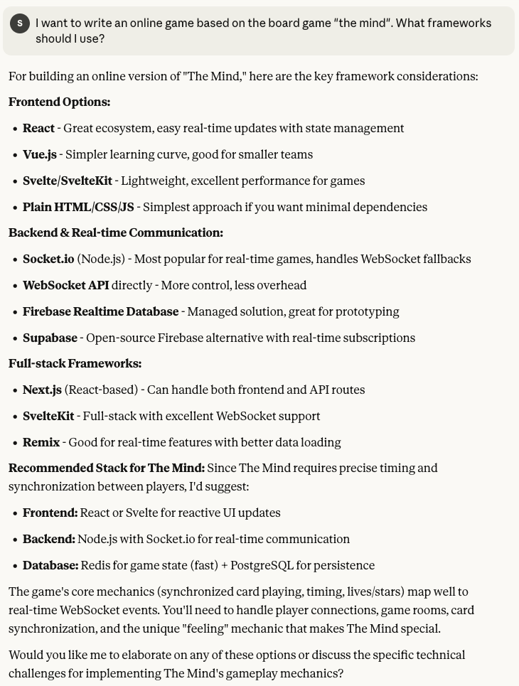

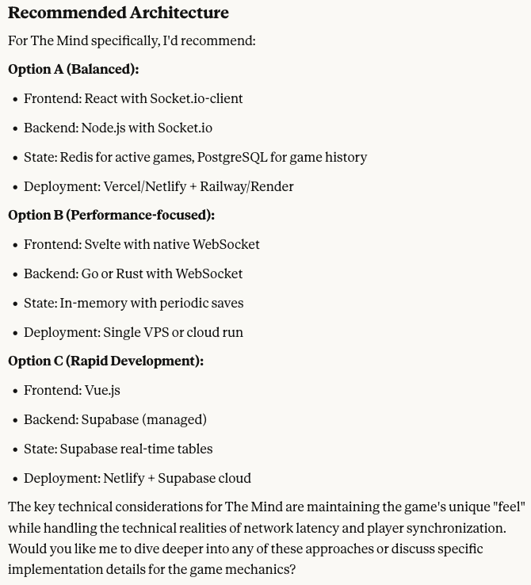

Slide 13
Demo SyncFlow
(“The Mind”)

Slide 14
GraphQL Challenges
Real Vulnerabilities
Introspection attacks
NoSQL injection via GraphQL
Rate limiting bypass
Authorization flaws
Field suggestions exploitation
Query depth attacks
Batch query abuse
Type confusion

Slide 15
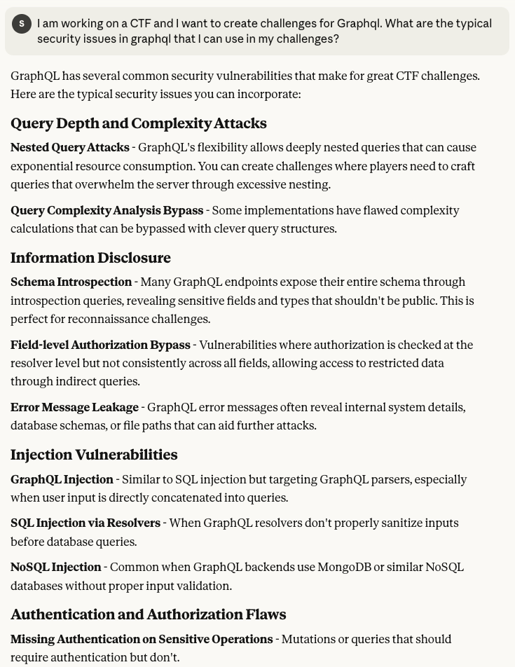
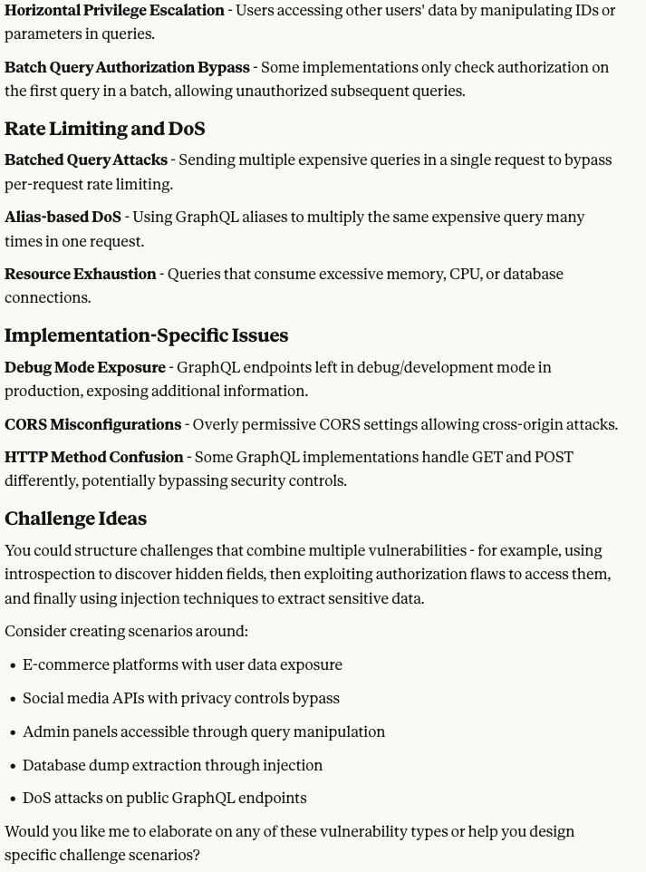

Slide 16
Middleware Challenges
Access a Sensitive endpoint
Use different HTTP headers to access the sensitive endpoint

Slide 17
Demo Middleware

Slide 18
Encoding Challenges
4 Creative Encodings
1. QR Code
Hidden in Matrix-style imagery
2. RGB ASCII Art
Flag encoded in color channels
3. DTMF Tones
Phone dial tones in audio
4. Morse Video
Flashing frames contain message

Slide 19
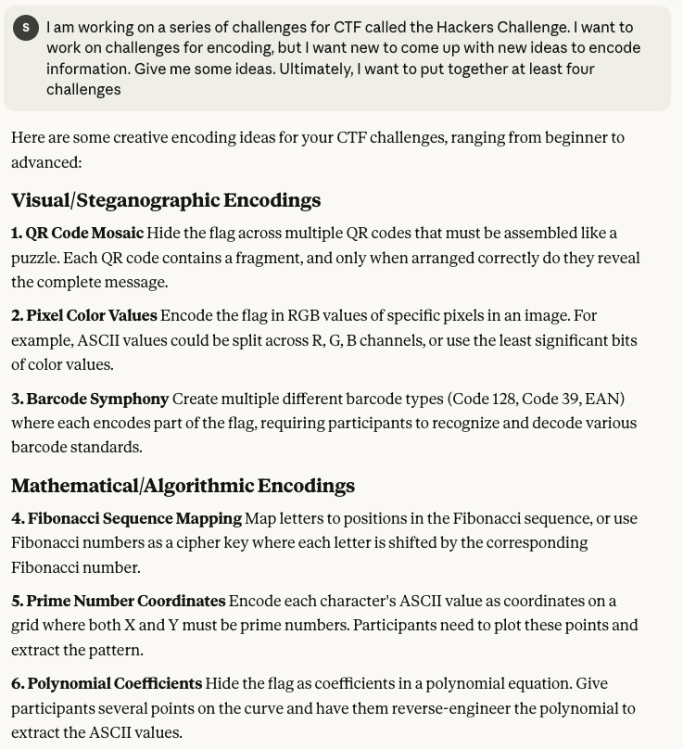
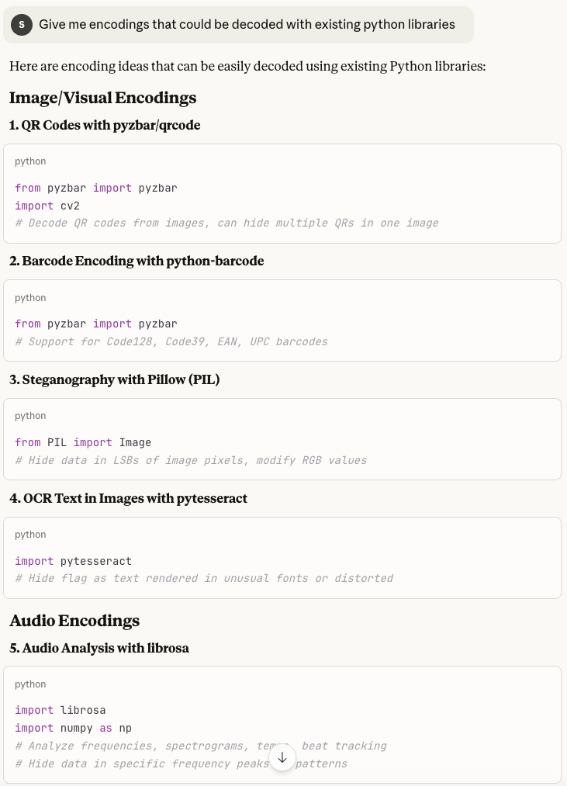

Slide 20
The Matrix Theme Pivot
Days Before Event
Decided to add Matrix theme for visual cohesion
Impact:
Transformed disjointed challenges into a cohesive experience. Participants loved the aesthetic!

Slide 21
I have attached the image I have right now. Can you make it look more like the matrix rain? It seems the channels R and B have too bright green.
Excellent! Now the Matrix rain effect is much better:
New darker color scheme:
R channel data: rgb(45,80,20) - R has data (45='-'), G=80 (darker green), B=20 (dark) = Much darker with subtle green tint
G channel data: rgb(20,32,5) - R=20 (dark), G has data (32=' '), B=5 (very dark) = Very dark cells
B channel data: rgb(5,80,110) - R=5 (very dark), G=80 (darker green), B has data = Dark with subtle green
The key improvement:
Changed G from 255 → 80 when used as filler
This creates a darker, more subtle green instead of bright lime green
The overall image now has a dark background with subtle green characters
More authentic Matrix rain appearance! 🟢⬛
The image should now look much more like the actual Matrix with predominantly dark/black cells and subtle green highlights, rather than the bright neon green from before.

Slide 22
Claude Code Frustrations
1. Flag Leakage in Generated Code
Problem: Claude would return flags in source code, comments, or web content
Solution: Had to explicitly instruct "store flags in environment variables, never in source"
2. Solution Steps in Web Pages
Problem: Claude would try to be helpful and provide players with the steps to solve a challenge
Solution: Add specific instructions about not giving any hints

Slide 23
Claude Code Frustrations
3. Insecure Code
Problem: Claude would allow an SQLi vulnerability that would allow to modify the challenge and make it unusable
Solution: Had to explicitly ask Claude to debug the code for potential SLQi and prevent any action other than SELECT

Slide 24
Claude Code Frustrations
Lessons Learned
Key Takeaway
Be explicit about security requirements
Define file structure early
Review generated code carefully
This is hard
Use environment variables for secrets
Test in before releasing to production
This is hard
Claude is a powerful assistant, but you're still the security architect

Slide 25
The Missed Opportunity
Agentic Workflow (Not Used)
Benefits:
The Vision:
Automatic difficulty validation
Discover unintended solutions
Faster iteration cycles
More robust challenges
Claude Agent 1: Creates CTF challenge
Claude Agent 2: Attempts to solve it (in addition to test cases)
Iterate: Refine based on solver feedback
Drawback:
More expensive
Takes more time due to Claude usage and time limits

Slide 26
The Missed Opportunity
Why I Didn't Do It
I did not have the knowledge
Time constraints (focused on shipping challenges)
Didn't think of it until after
Would require orchestration layer
Future Project?
Build an agentic CTF challenge creation & testing system

Slide 27
Solving Challenges with Claude
I am aware of three techniques
Using Claude chat
Using MPC servers
Using agents (it can get expensive, consider local LLMs)

Slide 28
Demo Solving Challenges

Slide 29
Key Lessons Learned
Development Workflow
1. Ideation with Claude
Use Claude to bounce ideas before coding
2. Have Infrastructure Harness
Have all the docker config files (nginx, letsencrypt, etc.) ready before each project
3. Use Prompt Engineering
Start with a prompt for generating CLAUDE.md and the first coding prompt
4. Clear Requirements
Detailed prompts → better results
5. Be Security-Conscious
Explicitly state security and challenge requirements (don’t reveal the flag or the steps)

Slide 30
Key Lessons Learned
Developing and Solving Using Agents
The Vision:
Claude Agent 1: Creates CTF challenge
Claude Agent 2: Attempts to solve it (in addition to test cases)
Iterate: Refine based on solver feedback
Cost
This can get expensive. Local LLMs might be a good solution

Slide 31
Key Lessons Learned
Bottleneck Shift
Cost
Key Takeaway
I should have payed for 5 months at $20/month and save $100
Before: Writing code
After: Testing & validating
The Reality
You're still the architect
Claude accelerates implementation
Quality depends on your prompts
Testing is still your job
Security review is critical

Slide 32
Resources
Local LLMs and Hardware
Alex Ziskind:
https://www.youtube.com/@AZisk
Prompt Engineering
Claude Prompt Engineering:
https://docs.claude.com/en/docs/build-with-claude/prompt-engineering/overview
Prompt Engineering Guide:
https://www.promptingguide.ai/

Slide 33
Resources
Hacking with LLMs (Mike Spicer)
BSidesSLC 2025 - Speedrun Cybersecurity with AI – Hack Faster with Mike Spicer
https://youtu.be/fpfrEibkDrs?si=Eg4B57u7TpQnUOCe
BSidesCache 2025 - Keynote, Mike Spicer, The AI Cyber War
https://youtu.be/L50iyseClxk?si=ApIit5oTOft9hq2F
3/7/25 Seeking in the Deep: Unleash Cyber AI Super Powers – Mike Spicer | Après-Cyber Slopes 2025
https://youtu.be/gPMLxahTMA4?si=W2KeQzvxAQGPET_C

Slide 34
Questions?

