Slide 1
106 Data Science Final Report
105356002 MIS 蔡佑晟

Slide 2
GITHUB & SHINYAPPS.IO
GitHub: https://github.com/sxrogerex/DataScienceFinal
SHINYAPPS.IO: http://sxrogerex.shinyapps.io/final

Slide 3
INPUT
Data Source: 279 online questionnaire
Input Format: csv
Preprocessing: 1. Transform Mandarin into English 2. Transform ordinal variables into numbers, ex. 非常滿意 > 5 3. Use mean to replace range of some ordinal variables, ex. $0 - $300 > $150

Slide 4
INPUT - DATA
Variable | Values
Sex | Male: 1, Female: 0
Income | [$0 - $5,000], [$5000 - $10,000], [$10,000 - $15,000] [$15,000 - $20,000], [$20,000 up]
Purchase Frequency | [1 week], [1 month], [3 months], [6 months], [6 months up]
Price of Short Sleeves | [$0 - $300], [$300 - $500], [$500 - $1000], [$1000 - $1500], [$1500 - $2000], [$2000 up]
Price of Long-Sleeved Shirt
Price of Shorts
Price of Trousers
Price of Hoodies
Price of Coats

Slide 5
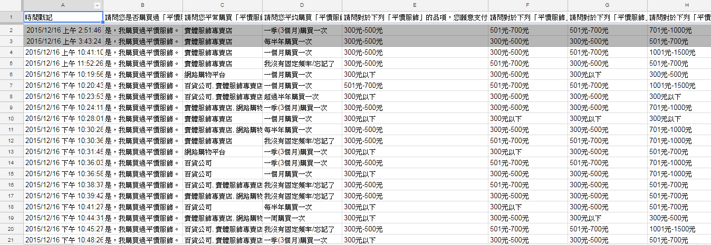
INPUT – RAW DATA

Slide 6
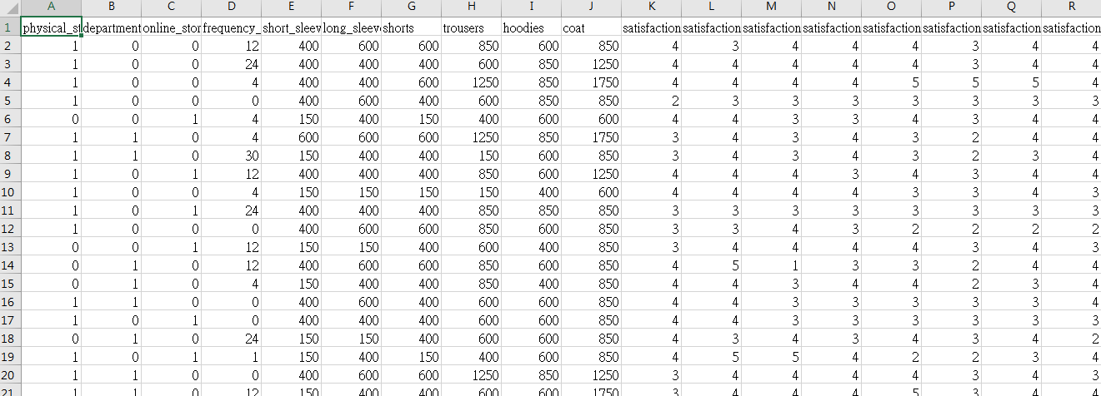
INPUT – AFTER PROCESSING

Slide 7
MODELING
Spearman rank correlation -null model: all variables have no relation between each other
Linear regression + k-fold cross validation -null model: y = a + 0 * x1 + 0 * x2 + e -5-fold cross validation -use 2 variables (income, sex) to predict the price customer willing to pay for different kinds of clothes

Slide 8
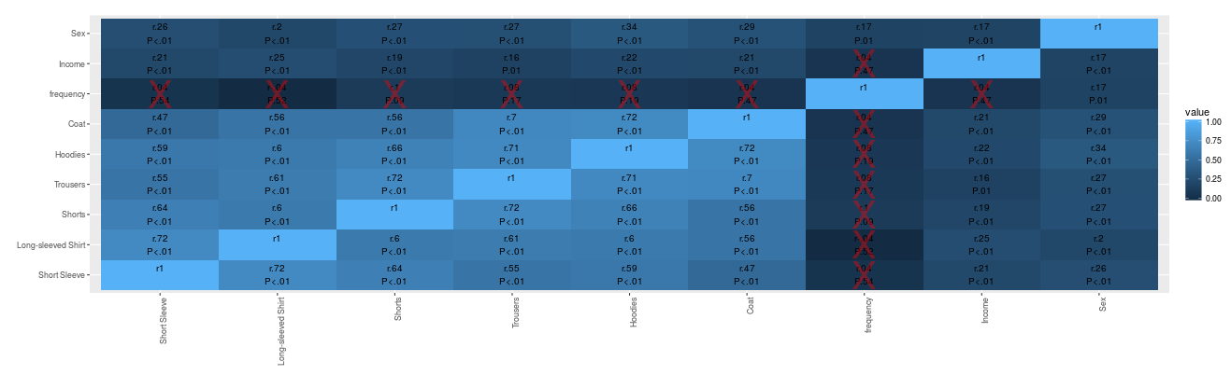
SPEARMAN RANK CORRELATION
Except of purchase frequency, the correlation between all variables are statistically significant.

Slide 9
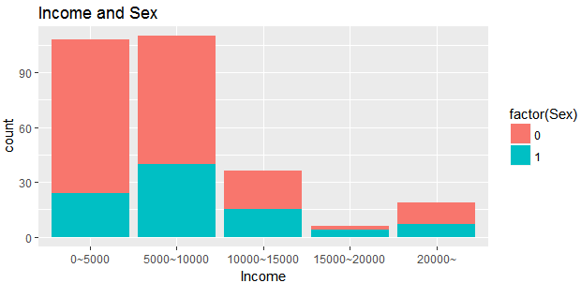
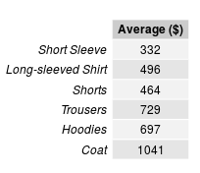
LINEAR REGRESSION
Focus on 3 variables: Income, Sex, and Price
(Which are correlated)
Income, Sex of sample data The price willing to pay

Slide 10
FORMULAS
Price of Short Sleeves = a + b1 * Sex + b2 * Income + e
Price of Long-sleeved shirts = a + b1 * Sex + b2 * Income + e
Price of Shorts = a + b1 * Sex + b2 * Income + e
Price of Trousers = a + b1 * Sex + b2 * Income + e
Price of Hoodies = a + b1 * Sex + b2 * Income + e
Price of Coats = a + b1 * Sex + b2 * Income + e

Slide 11
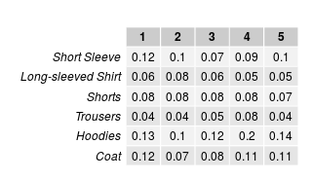
ADJUSTED R SQUARE
Low: 0.01 – 0.09
Medium: 0.09 – 0.25
High: 0.25 up

Slide 12
OUTPUT
Performance: -Spearman rank correlation: Modestly correlated -Linear regression: R-Square not high, bad predict power
Most challenging part: 1. Hard to design a good questionnaire 2. Preprocessing data takes lots of time 3. Result may be bad because of many reasons, ex. Data quality, sample size, modelling…

