Slide 1



$$φ_{g}$$
$$φ=φ_{g}−φ_{r}$$
y
$$φ_{r}$$
x
boundary
z=t
z=0
z=eye relief
y
z
x

Slide 2
layers |  | Z | material | shape | character | Sub-area
0 | Source | -1E-6 | Air | Circle | Source
1 | S1 | 0 | Glass | Circle | Fresnel | Grating | polygon
 |  |  |  |  |  | Grating | polygon
 |  |  |  |  |  | Grating | polygon
2 | S2 | 0.5 | Air | polygon | Fresnel
3 | receiver | 20.5 | Air | polygon | Dummy

Slide 3
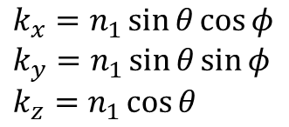
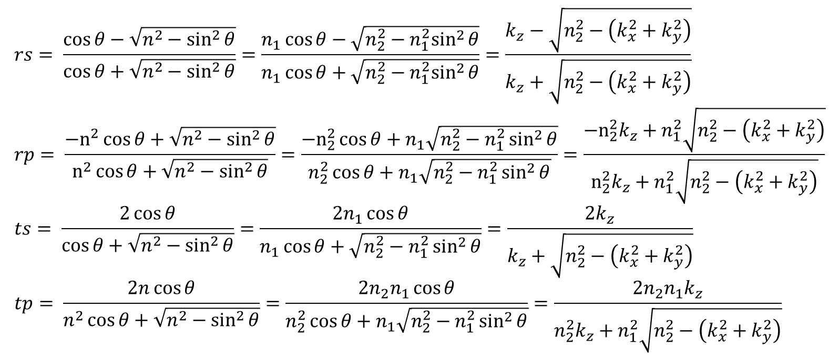
$$rs= \frac{\cos{θ}−\sqrt{n^{2}−\sin^{2}{θ}}}{\cos{θ}+\sqrt{n^{2}−\sin^{2}{θ}}}=\frac{n_{1}\cos{θ}−\sqrt{n_{2}^{2}−n_{1}^{2}\sin^{2}{θ}}}{n_{1}\cos{θ}+\sqrt{n_{2}^{2}−n_{1}^{2}\sin^{2}{θ}}}=\frac{k_{z}−\sqrt{n_{2}^{2}−\left(k_{x}^{2}+k_{y}^{2}\right)}}{k_{z}+\sqrt{n_{2}^{2}−\left(k_{x}^{2}+k_{y}^{2}\right)}} \\ rp= \frac{−n^{2}\cos{θ}+\sqrt{n^{2}−\sin^{2}{θ}}}{n^{2}\cos{θ}+\sqrt{n^{2}−\sin^{2}{θ}}}=\frac{−n_{2}^{2}\cos{θ}+n_{1}\sqrt{n_{2}^{2}−n_{1}^{2}\sin^{2}{θ}}}{n_{2}^{2}\cos{θ}+n_{1}\sqrt{n_{2}^{2}−n_{1}^{2}\sin^{2}{θ}}}=\frac{−n_{2}^{2}k_{z}+n_{1}^{2}\sqrt{n_{2}^{2}−\left(k_{x}^{2}+k_{y}^{2}\right)}}{n_{2}^{2}k_{z}+n_{1}^{2}\sqrt{n_{2}^{2}−\left(k_{x}^{2}+k_{y}^{2}\right)}} \\ ts= \frac{2\cos{θ}}{\cos{θ}+\sqrt{n^{2}−\sin^{2}{θ}}}=\frac{2n_{1}\cos{θ}}{n_{1}\cos{θ}+\sqrt{n_{2}^{2}−n_{1}^{2}\sin^{2}{θ}}}=\frac{2k_{z}}{k_{z}+\sqrt{n_{2}^{2}−\left(k_{x}^{2}+k_{y}^{2}\right)}} \\ tp= \frac{2n\cos{θ}}{n^{2}\cos{θ}+\sqrt{n^{2}−\sin^{2}{θ}}}=\frac{2n_{2}n_{1}\cos{θ}}{n_{2}^{2}\cos{θ}+n_{1}\sqrt{n_{2}^{2}−n_{1}^{2}\sin^{2}{θ}}}=\frac{2n_{2}n_{1}k_{z}}{n_{2}^{2}k_{z}+n_{1}^{2}\sqrt{n_{2}^{2}−\left(k_{x}^{2}+k_{y}^{2}\right)}}$$
$$k_{x}=n_{1}\sin{θ}\cos{φ} \\ k_{y}=n_{1}\sin{θ}\sin{φ} \\ k_{z}=n_{1}\cos{θ}$$

Slide 4



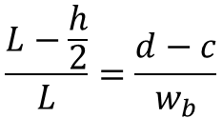


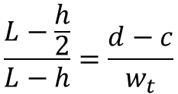

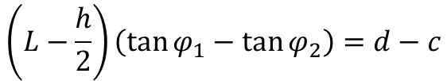

$$φ_{1}$$
$$φ_{2}$$
$$d$$
$$L$$
$$c$$
$$d−c$$
$$h$$
$$\frac{h}{2}$$
$$\left(L−\frac{h}{2}\right)\left(\tan{φ_{1}}−\tan{φ_{2}}\right)=d−c$$
$$\frac{L−\frac{h}{2}}{L−h}=\frac{d−c}{w_{t}}$$
$$\frac{L−\frac{h}{2}}{L}=\frac{d−c}{w_{b}}$$

