Slide 1
COVID-19 Detection using Chest X-Ray Images

Slide 2
Group Member Information
Venkateswara Rao Narra
Saranya Tammana
Minhaaz Ul Haq Shaik
Divya Jalaneela Prasad

Slide 3
Role/Responsibilities and Contribution in project
Description/Task | Responsibility - Person
Data Read and Preprocessing | Venkateswara Rao Narra & MinhaazUlHaq Shaik
PCA Feature Extraction | DivyaJalaneela Prasad & Saranya Tammana
SVM Implementation | Venkateswara Rao Narra & Saranya Tammana
Result Analysis | MinhaazUlHaq Shaik & DivyaJalaneela Prasad
XGBoost implementation | Venkateswara Rao Narra & MinhaazUlHaq Shaik

Slide 4
Motivation
COVID-19, Corona Virus Disease-2019, caused by a new Corona Virus 2 Severe Acute Respiratory Syndrome (SARS-CoV-2). An effective screening of this virus can enable quick and accurate COVID-19 diagnosis, reducing the burden on the healthcare system.
A detailed analysis of the provided dataset can be used to construct various types of machine learning algorithms, the performance of which can be computed and further evaluated.
XGBoost outperformed all other Machine Learning models in the following case, including SVM, XGBoost, and Bagging Classifier

Slide 5
Objectives
Create a PCA with ML model to detect COVID-19 positive patients using X-rays.
That is, to train a model using a dataset of normal and COVID-19 images. positive patient's X-Rays, and to improve its ability to successfully diagnose the patient using bullet points from their X-Ray List
To achieve maximum efficiency.
Consider large data sets.
To reduce time complexity and improve accuracy.

Slide 6
Related Work
Tulin developed an automatic model for COVID-19 detection using Chest X-ray images. This model classified using two methods: binary classification and Yolo model
Khan proposed the "CoroNet" model, a CNN model for COVID-19 diagnosis utilising chest radiography images. The "Xception Architecture," a pretrained model developed using the ImageNet dataset

Slide 7
Problem Statement
In this study, we show how Machine learning from deep learning models can be used to detect COVID-19 using images from three of the most commonly used scientific imaging modes: X-Ray, Ultrasound, and CT scan. Because Covid-19 is a potentially fatal epidemic, it is a hotly debated research topic.
By using Machine Learning technique like XGboost, SVM

Slide 8
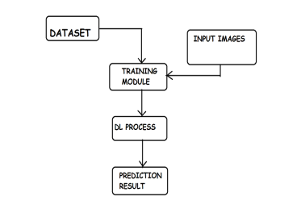
Proposed Solution

Slide 9
Proposed Solution
1) The dataset of chest x-rays with covid positive and non positive labels is used in the suggested system.
2) The proposed system can accept user input.
3) The system under consideration can perform PCA operations by dividing the data into training and testing sets.
4) The proposed system can compare the extracted feature from the user's input x-ray image with a dataset that has already been trained and contains a variety of characteristics.

Slide 10
Results/Simulations
Below Parameter consider for result analysis
Classification reports
Confusion Matrix
Accuracy Score

Slide 11
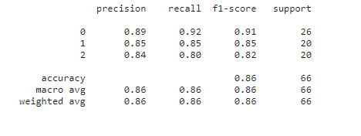
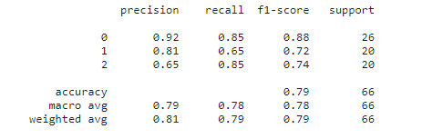
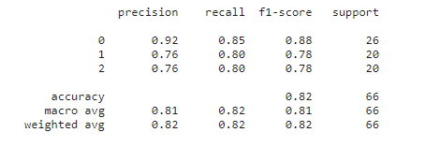
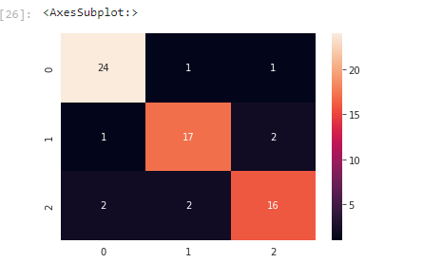
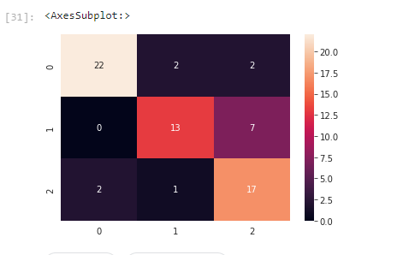
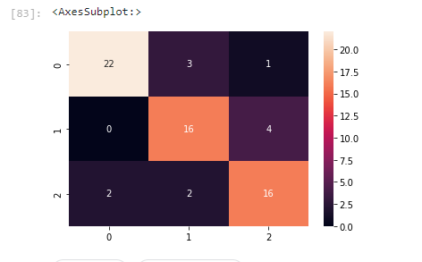
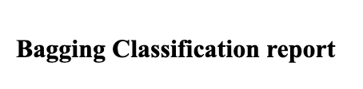
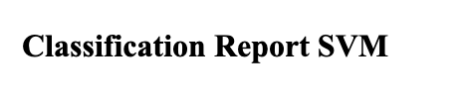

Screenshots

Slide 12
Reference
TulinOzturk, MuhammedTalo, EylulAzraYildirim, UlasBaranBaloglu, OzalYildirim, and U. RajendraAcharya, "Automated detection of COVID-19 cases using deep neural networks with X-ray images," Computer Biology and Medicine, 2020 Jun; 121: 103792. Online since April 28, 2020 4.
"CoroNet: A deep neural network for detection and diagnosis of COVID-19 from chest x-ray images," AsifIqbal Khan, JunaidLatief Shah, and Mohammad MudasirBhat, Computer Methods and Programs in Biomedicine, Volume 196, 2020,105581, ISSN 0169-2607
Sonbhadra, S.K., Agarwal, S., Nagabhushan, P.: Target specific mining of COVID-19 scholarly articles using one-class approach. Elsevier (2020)

