Slide 1
시스템보안
이정현 교수님
과제8
소프트웨어학부 20163231 신승은

Slide 2

ASLR 해제

Slide 3
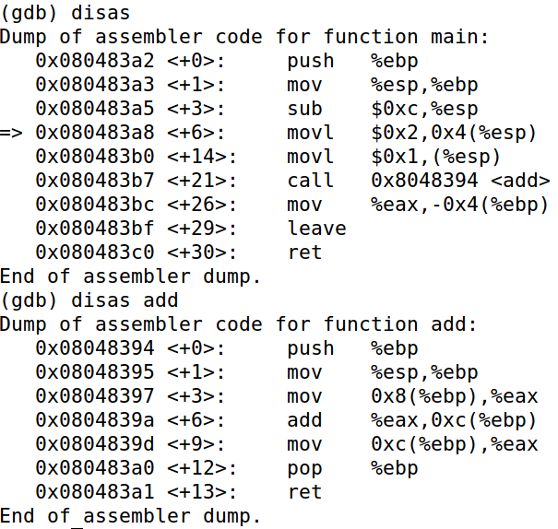
어셈블리 코드 추출

Slide 4
Main 진입 직후
Esp -> bffff33c
00145e37
00000000
Push ebp
Mov esp,ebp
Sub 0xc, esp
리턴주소
Bffff3e4
cb6fa090
1
28bff4
Bffff33c
Bffff3b8
08483a2
eax
ecx
edx
ebx
Ebp -> bffff3b8
esp
ebp
Eip -> 080483a2
eip
080483a3
CPU
STACK

Slide 5
push %ebp
Esp -> bffff338
bffff3b8
00145e37
…
00000000
Push ebp
Mov esp,ebp
Sub 0xc, esp
최초 ebp
Bffff3e4
cb6fa090
1
28bff4
Bffff338
bffff3b8
08483a3
eax
bffff33c
리턴주소
ecx
edx
ebx
Ebp -> bffff3b8
esp
ebp
080483a2
eip
Eip -> 080483a3
CPU
STACK

Slide 6
mov %esp,%ebp
Esp -> bffff338
bffff3b8
00145e37
00000000
Push ebp
Mov esp,ebp
Sub 0xc, esp
최초 ebp
Ebp ->
Bffff3e4
D11bb038
1
28bff4
Bffff338
bffff338
08483a5
eax
bffff33c
리턴주소
ecx
edx
ebx
esp
ebp
080483a2
eip
080483a3
Eip -> 080483a5
CPU
STACK

Slide 7
sub $0xc, %esp
Bffff3e4
cb6fa090
1
28bff4
Bffff32c
bffff338
08483a8
eax
ecx
Esp -> bffff32c
28bff4
bffff3b8
00145e37
…
…
Sub 0xc, esp
Movl 0x2,0x4(esp)
로컬변수 c
edx
Ebp -> bffff338
최초 ebp
ebx
bffff33c
리턴주소
esp
ebp
eip
080483a5
Eip -> 080483a8
CPU
STACK

Slide 8
movl $0x2,0x4(%esp)
Esp -> bffff32c
28bff4
2
bffff3b8
00145e37
…
…
Movl 0x2,0x4(esp)
Movl 0x1,(esp)
로컬변수 c
Bffff3e4
cb6fa090
1
28bff4
Bffff32c
bffff338
08483b0
eax
bffff330
파라미터2
ecx
edx
Ebp -> bffff338
최초 ebp
ebx
bffff33c
리턴주소
esp
ebp
eip
080483a8
Eip -> 080483b0
CPU
STACK

Slide 9
movl $0x1,(%esp)
Esp -> bffff32c
1
2
bffff3b8
00145e37
…
…
Movl $0x1,(esp)
Call 0x8048394 <add>
파라미터1
Bffff3e4
cb6fa090
1
28bff4
Bffff32c
bffff338
08483b7
eax
bffff330
파라미터2
ecx
edx
Ebp -> bffff338
최초 ebp
ebx
bffff33c
리턴주소
esp
ebp
eip
080483b0
Eip -> 080483b7
CPU
STACK

Slide 10
call 0x8048394
Esp -> bffff328
080483bc
1
2
bffff3b8
00145e37
…
Add 리턴주소
Bffff3e4
cb6fa090
1
28bff4
bffff328
bffff338
0848394
eax
bffff32c
파라미터1
ecx
bffff330
파라미터2
edx
ebx
Ebp -> bffff338
최초 ebp
esp
bffff33c
리턴주소
ebp
eip
CPU
STACK

Slide 11
push %ebp
Bffff3e4
cb6fa090
1
28bff4
bffff324
bffff338
0848395
eax
Esp-> bffff324
bffff338
080483bc
1
2
0
bffff3b8
00145e37
Main ebp
ecx
bffff328
Add 리턴주소
edx
bffff32c
파라미터1
ebx
bffff330
파라미터2
esp
bffff334
ebp
Ebp -> bffff338
최초 ebp
eip
bffff33c
리턴주소
CPU
STACK

Slide 12
mov %esp,%ebp
bffff338
080483bc
1
2
0
bffff3b8
00145e37
Bffff3e4
cb6fa090
1
28bff4
bffff324
bffff324
0848397
eax
Esp-> bffff324
Main ebp
Ebp->
ecx
bffff328
Add 리턴주소
edx
bffff32c
파라미터1
ebx
bffff330
파라미터2
esp
bffff334
ebp
bffff338
최초 ebp
eip
bffff33c
리턴주소
CPU
STACK

Slide 13
mov $0x8(%ebp),%eax
bffff338
080483bc
1
2
0
bffff3b8
00145e37
1
cb6fa090
1
28bff4
bffff324
bffff324
084839a
eax
Esp-> bffff324
Main ebp
Ebp->
ecx
bffff328
Add 리턴주소
edx
bffff32c
파라미터1
ebx
bffff330
파라미터2
esp
bffff334
ebp
bffff338
최초 ebp
eip
bffff33c
리턴주소
CPU
STACK

Slide 14
add %eax, 0xc(%ebp)
bffff338
080483bc
1
3
0
bffff3b8
00145e37
1
cb6fa090
1
28bff4
bffff324
bffff324
084839d
eax
Esp-> bffff324
Main ebp
Ebp->
ecx
bffff328
Add 리턴주소
edx
bffff32c
파라미터1
ebx
bffff330
파라미터2
esp
bffff334
ebp
bffff338
최초 ebp
eip
bffff33c
리턴주소
CPU
STACK

Slide 15
mov 0xc(%ebp),%eax
bffff338
080483bc
1
3
0
bffff3b8
00145e37
3
cb6fa090
1
28bff4
bffff324
bffff324
08483a0
eax
Esp-> bffff324
Main ebp
Ebp->
ecx
bffff328
Add 리턴주소
edx
bffff32c
파라미터1
ebx
bffff330
파라미터2
esp
bffff334
ebp
bffff338
최초 ebp
eip
bffff33c
리턴주소
CPU
STACK

Slide 16
pop %ebp
080483bc
1
3
0
bffff3b8
00145e37
3
cb6fa090
1
28bff4
Bffff328
bffff338
08483a1
eax
ecx
Esp->
bffff328
Add 리턴주소
edx
bffff32c
파라미터1
ebx
bffff330
파라미터2
esp
bffff334
ebp
Ebp->
bffff338
최초 ebp
eip
bffff33c
리턴주소
CPU
STACK

Slide 17
ret
1
3
0
bffff3b8
00145e37
3
cb6fa090
1
28bff4
Bffff32c
bffff338
08483bc
eax
ecx
edx
Esp->
bffff32c
파라미터1
ebx
bffff330
파라미터2
esp
bffff334
ebp
Ebp->
bffff338
최초 ebp
eip
bffff33c
리턴주소
CPU
STACK

Slide 18
mov %eax,-0x4(%ebp)
1
3
3
bffff3b8
00145e37
3
cb6fa090
1
28bff4
Bffff32c
bffff338
08483bf
eax
ecx
edx
Esp->
bffff32c
파라미터1
ebx
bffff330
파라미터2
esp
bffff334
ebp
Ebp->
bffff338
최초 ebp
eip
bffff33c
리턴주소
CPU
STACK

Slide 19
leave
00145e37
3
cb6fa090
1
28bff4
Bffff33c
bffff3b8
08483c0
eax
ecx
edx
ebx
esp
ebp
eip
Esp->
bffff33c
리턴주소
Ebp->
bffff3b8
CPU
STACK

Slide 20
ret
3
cb6fa090
1
28bff4
Bffff340
bffff3b8
145e37
eax
ecx
edx
ebx
esp
ebp
eip
CPU
STACK

