Slide 1
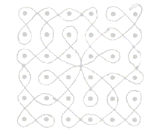
KOLAM DESIGNS BASED ON FIBONACCI NUMBERS
S. Naranan
30 January 2008
Copyright: Prof. S. Naranan, Chennai, India

Slide 2
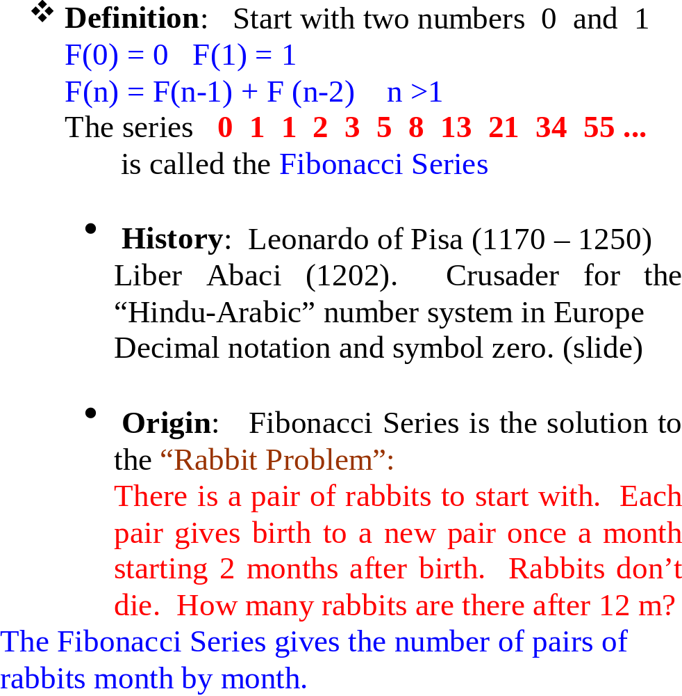
FIBONACCI SERIES

Slide 3
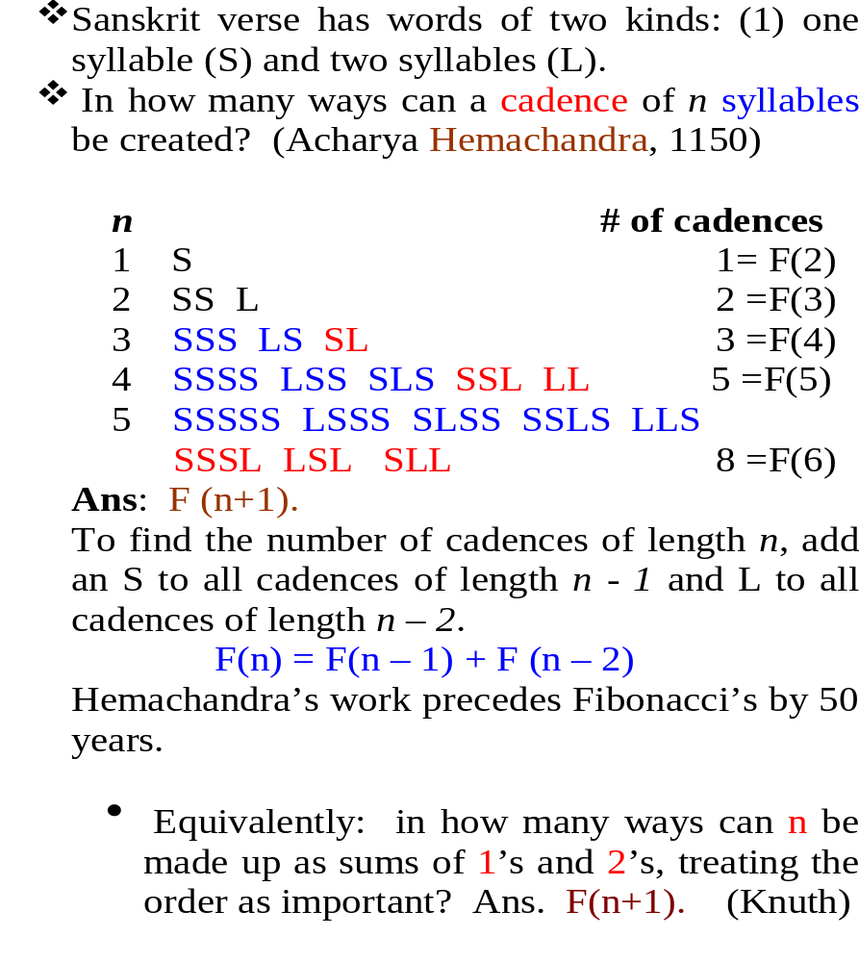
SANSKRIT PROSODY

Slide 4
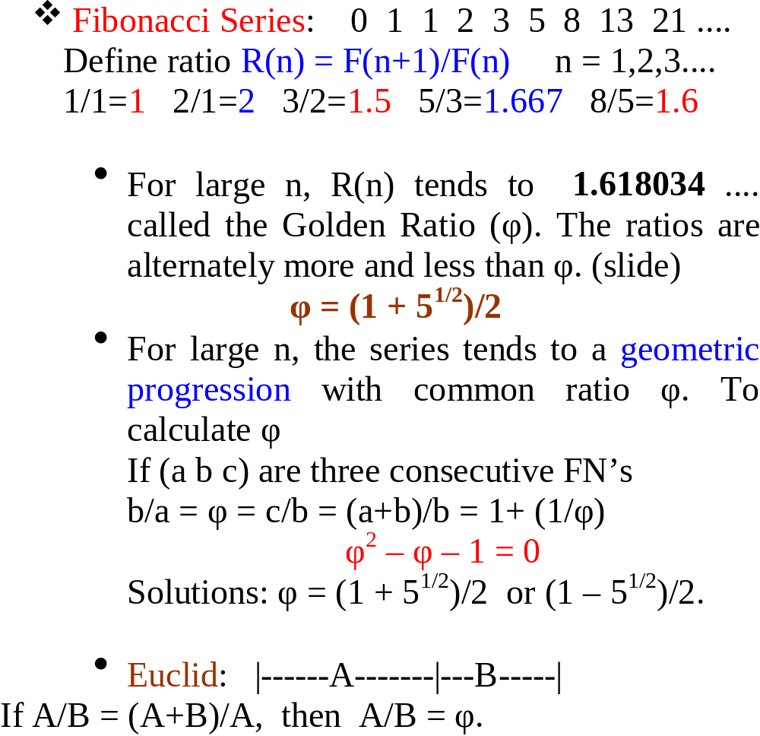
GOLDEN RATIO

Slide 5
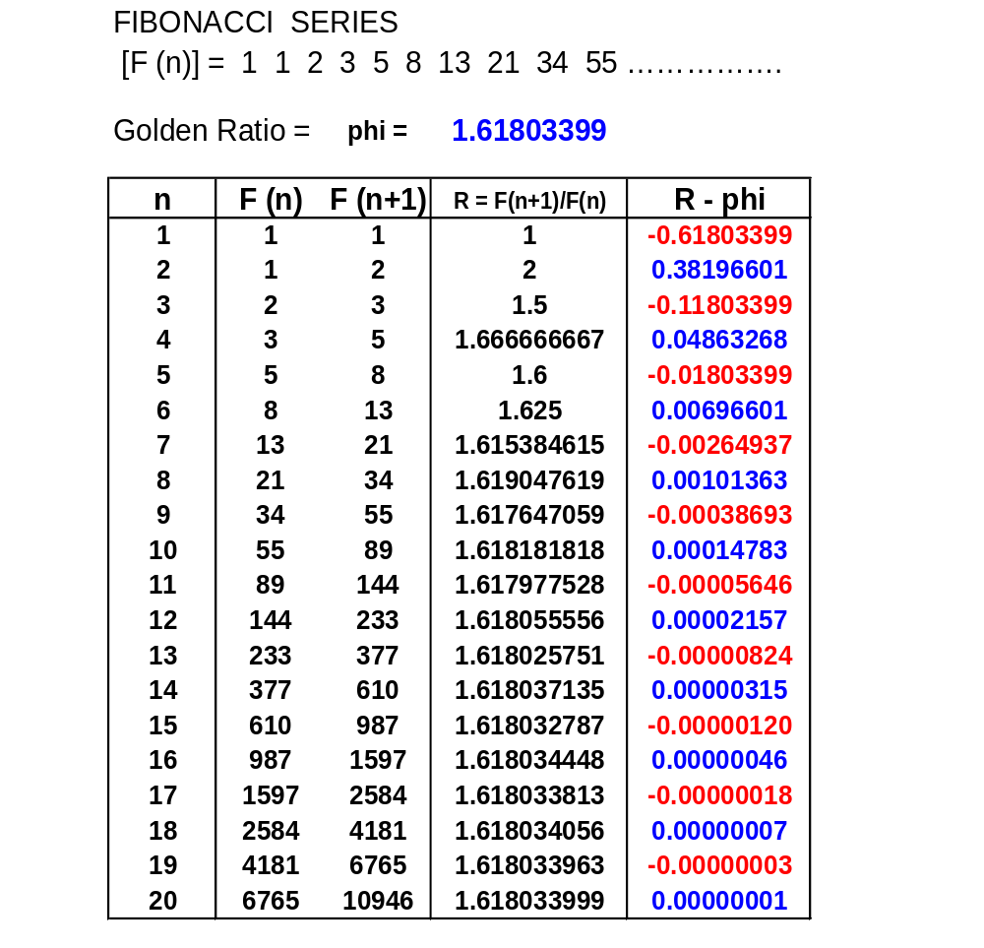

Slide 6
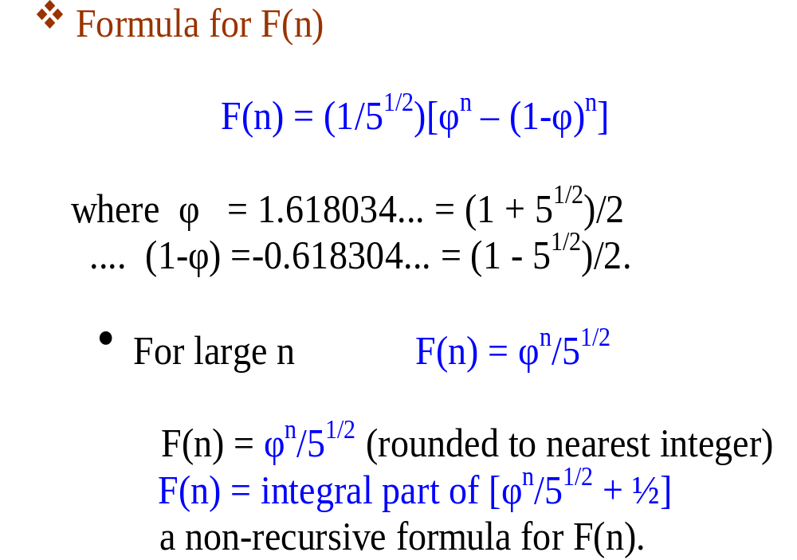
GOLDEN RATIO (contd.)

Slide 7
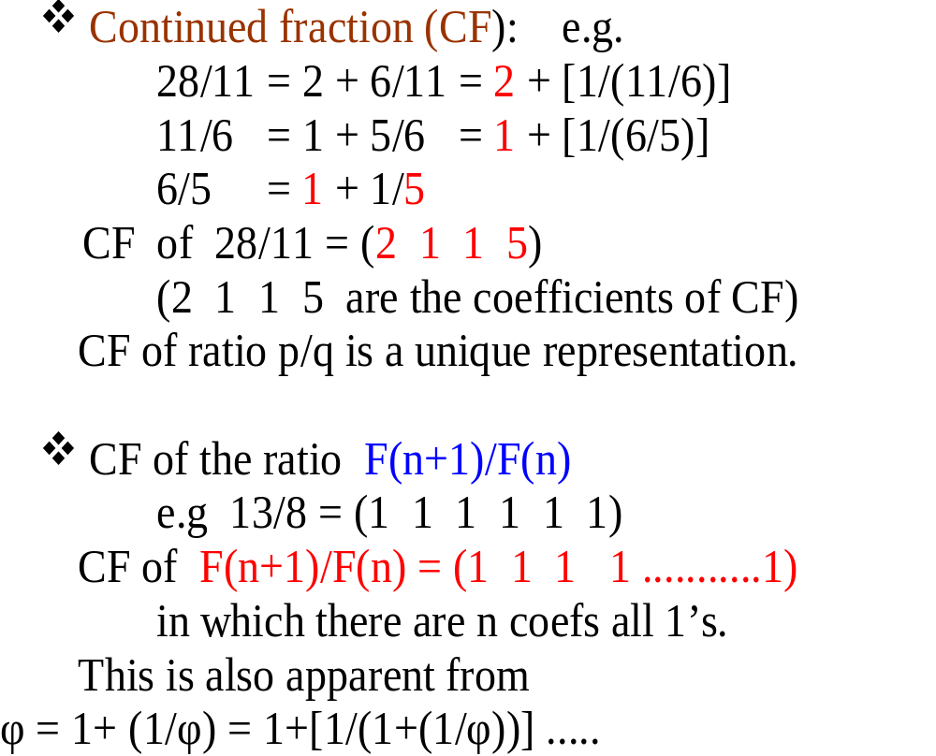
CONTINUED FRACTION EXPANSION OF φ

Slide 8
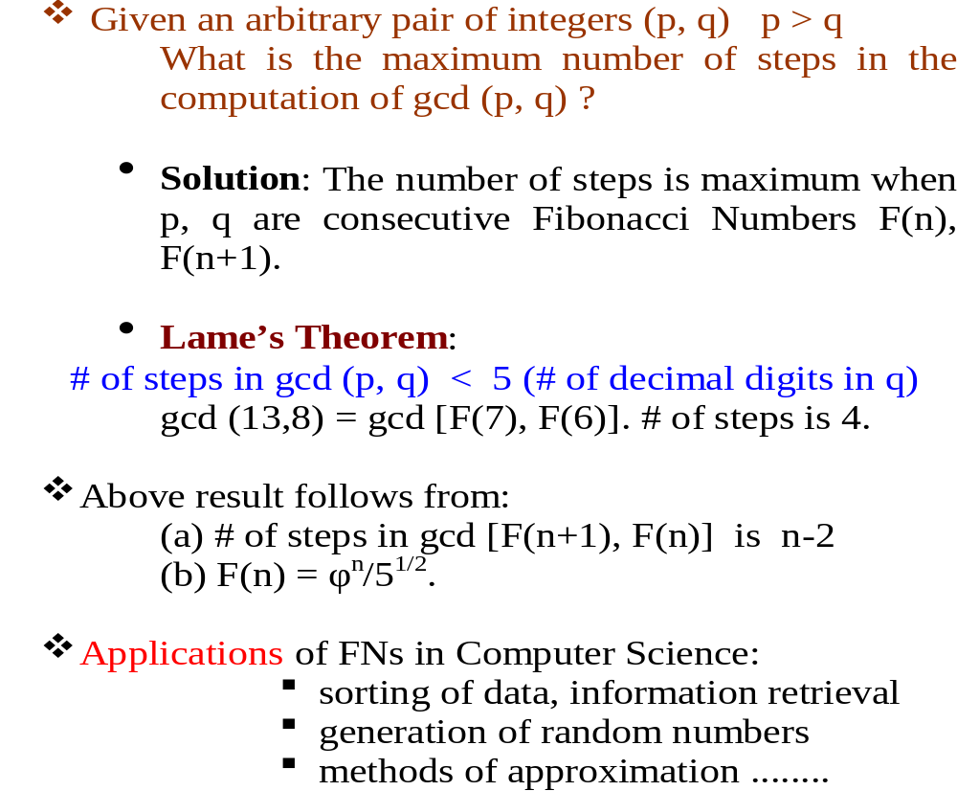
FIBONACCI NUMBERS AND THE G.C.D. ALGORITHM

Slide 9
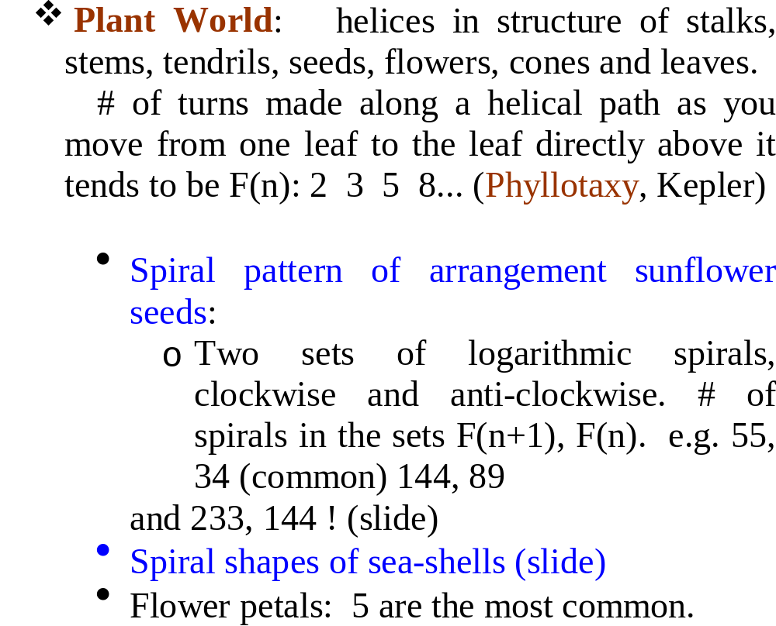
GOLDEN RATIO IN NATURE

Slide 10
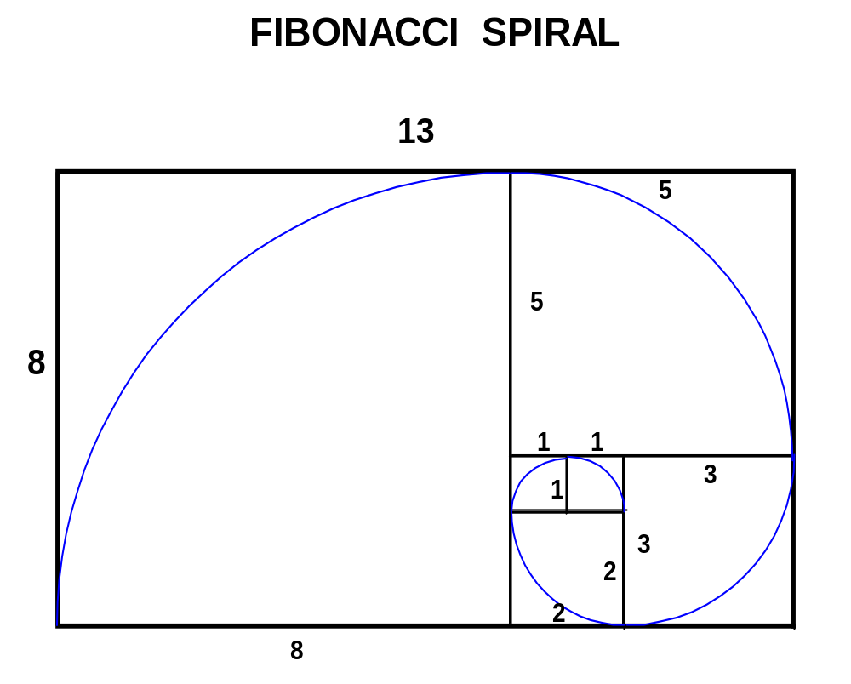

Slide 11
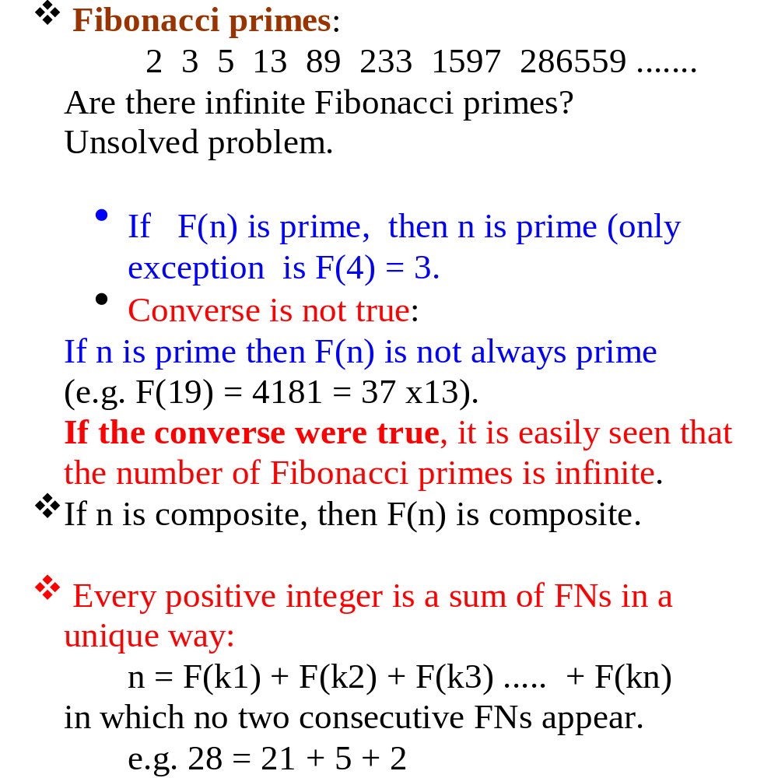
FIBONACCI NUMBERS (MISC)

Slide 12
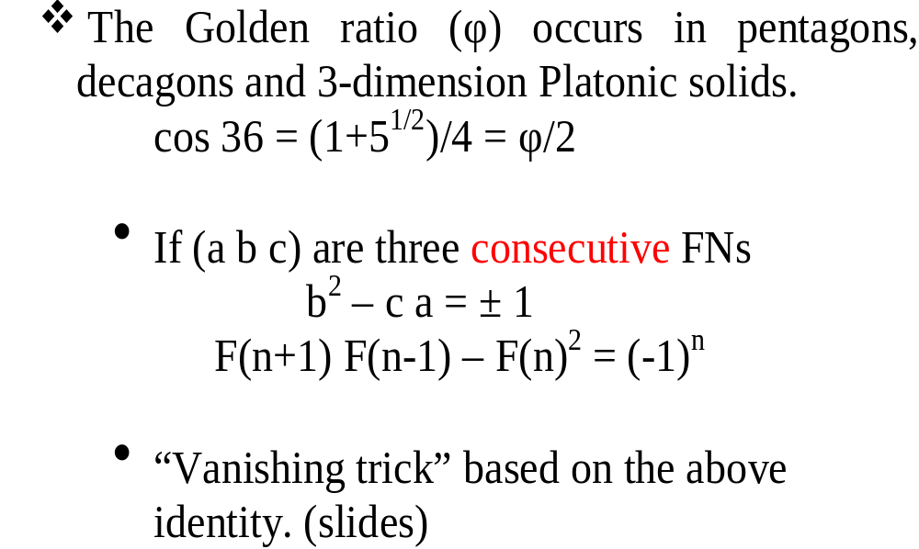
φ IN GEOMETRY

Slide 13
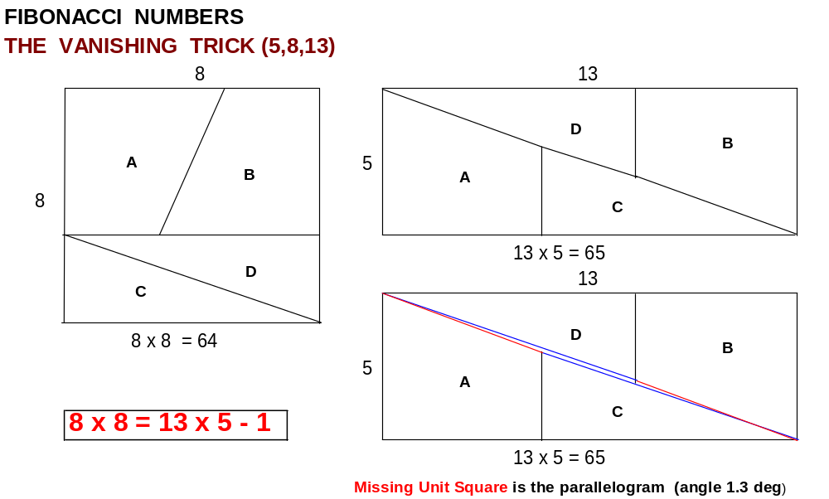

Slide 14
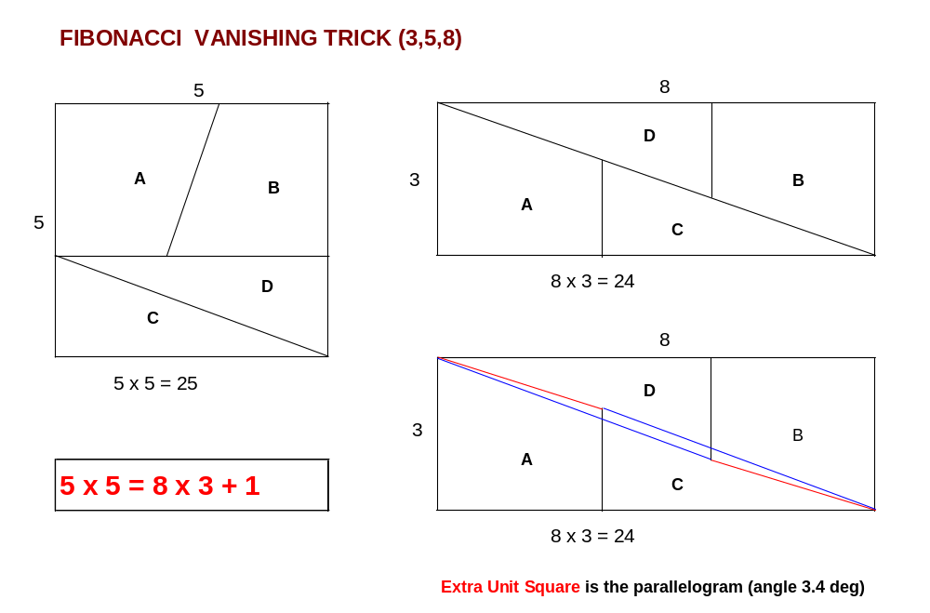

Slide 15
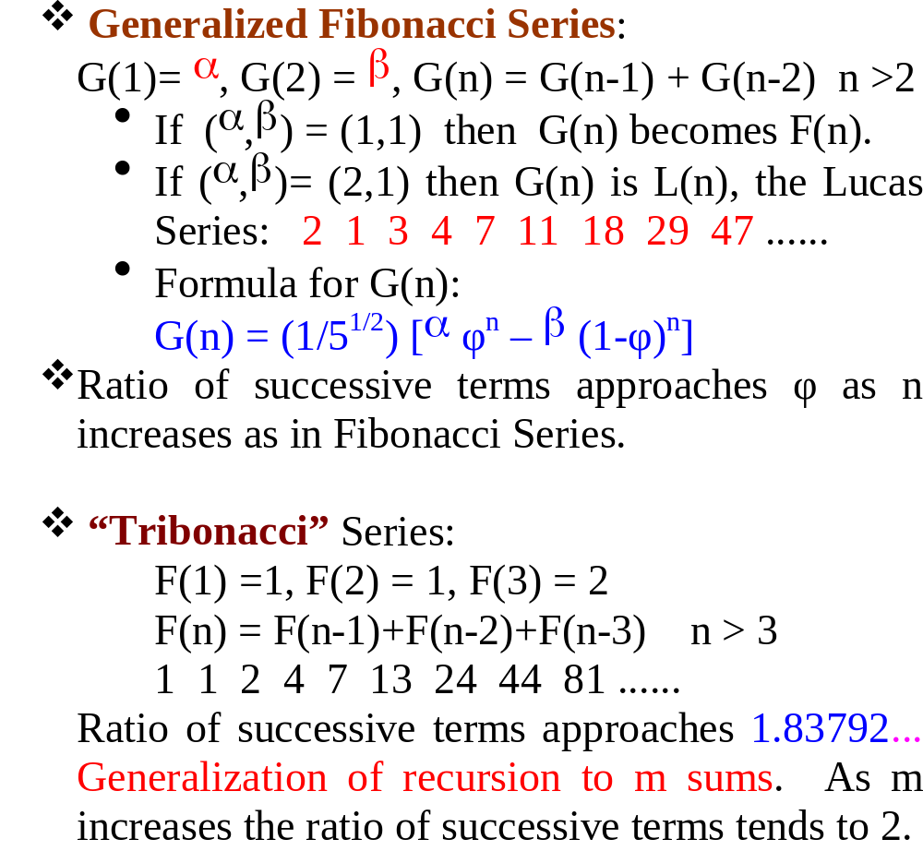
VARIANTS OF FIBONACCI RECURSION

Slide 16
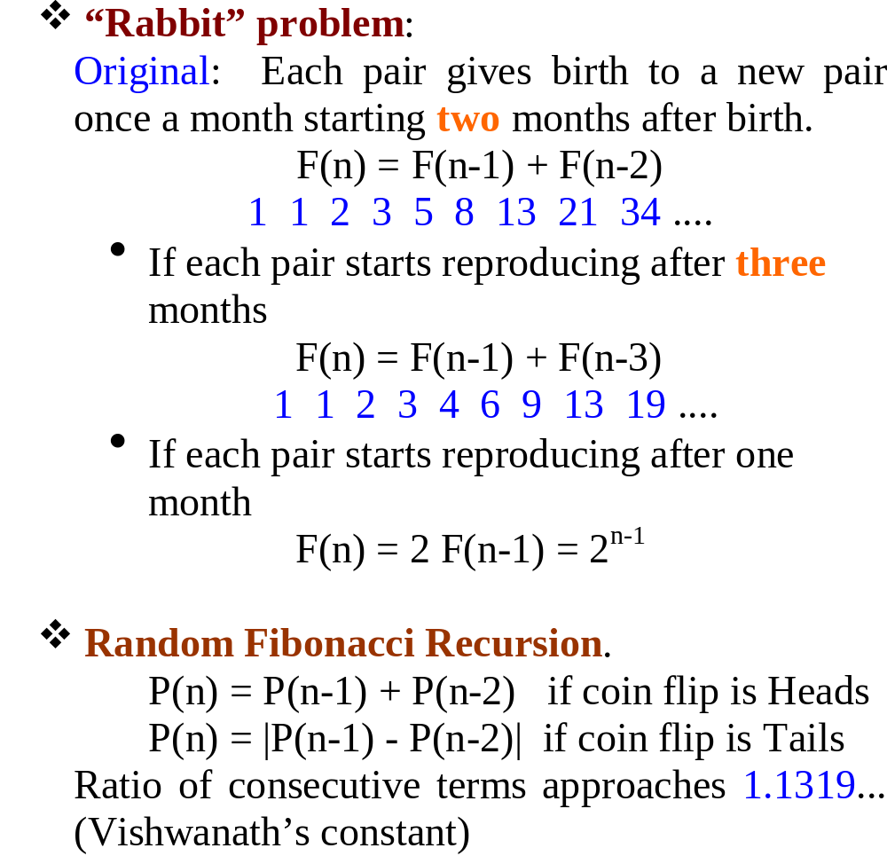
VARIANTS (contd)

Slide 17
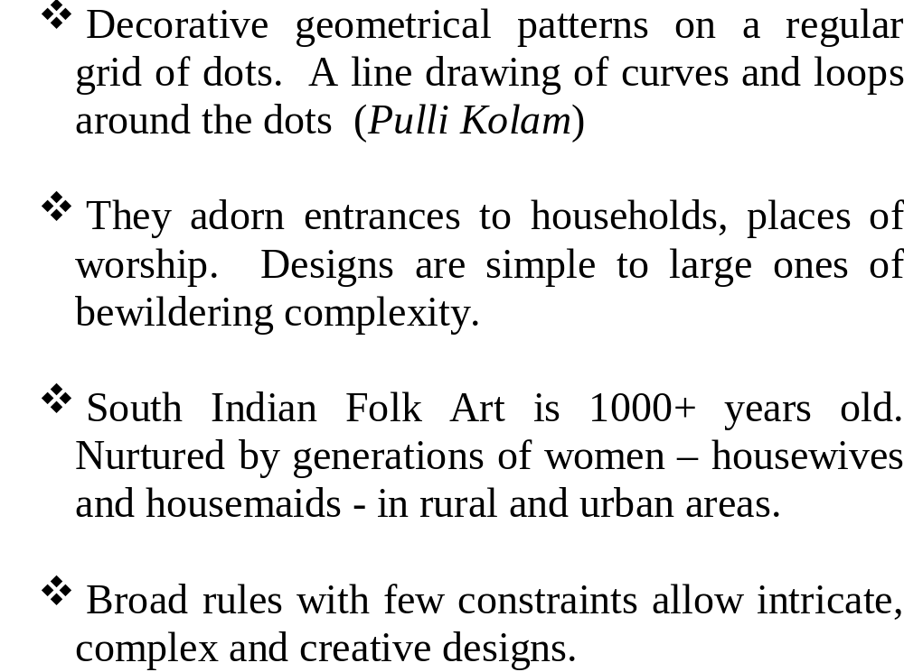
KOLAM DESIGNS

Slide 18
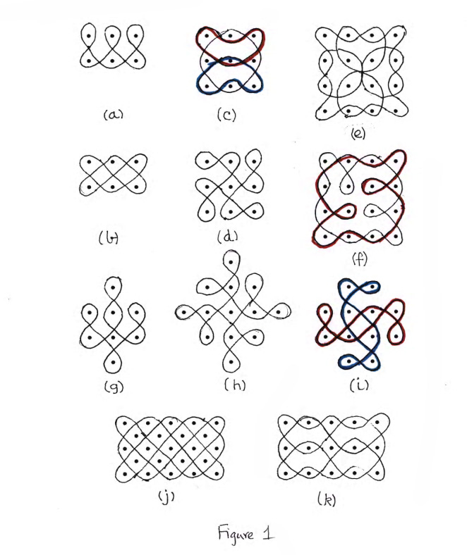
Some Small Popular Kolams

Slide 19
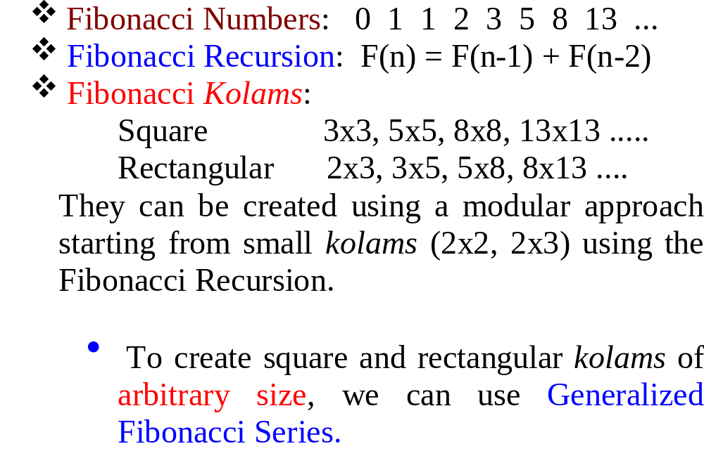
KOLAMS BASED ON FIBONACCI NUMBERS

Slide 20
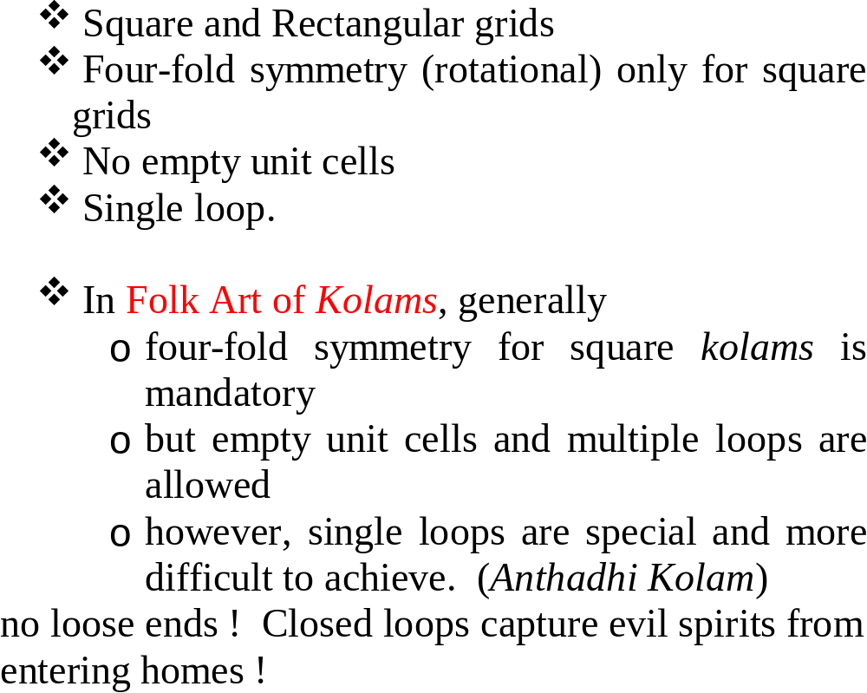
GROUND RULES

Slide 21
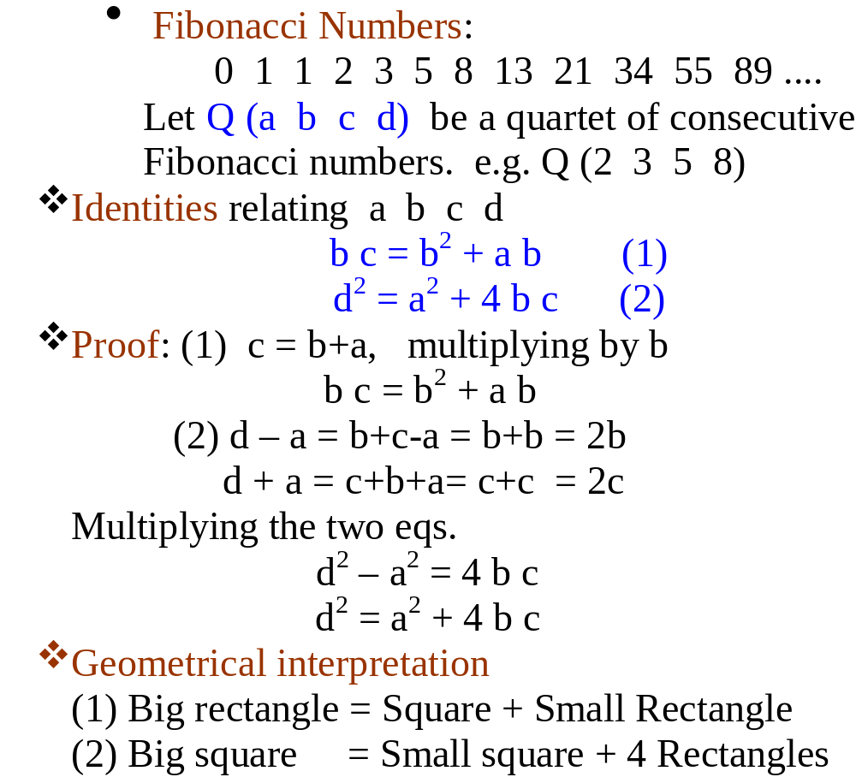
BASIC EQUATIONS

Slide 22
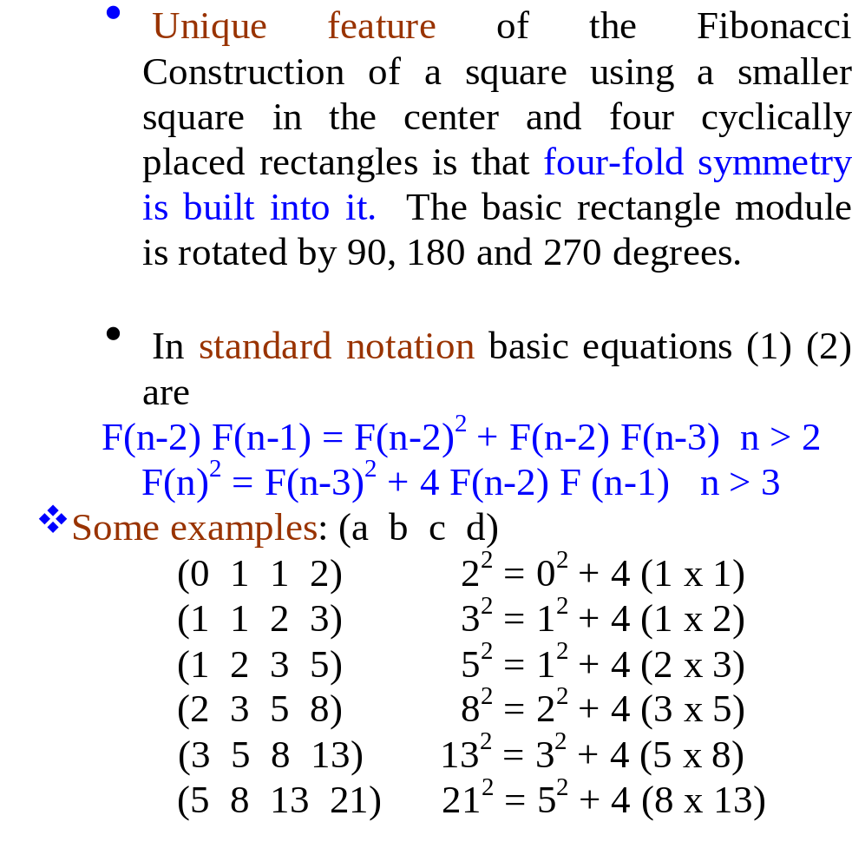
BASIC EQUATIONS (contd)

Slide 23
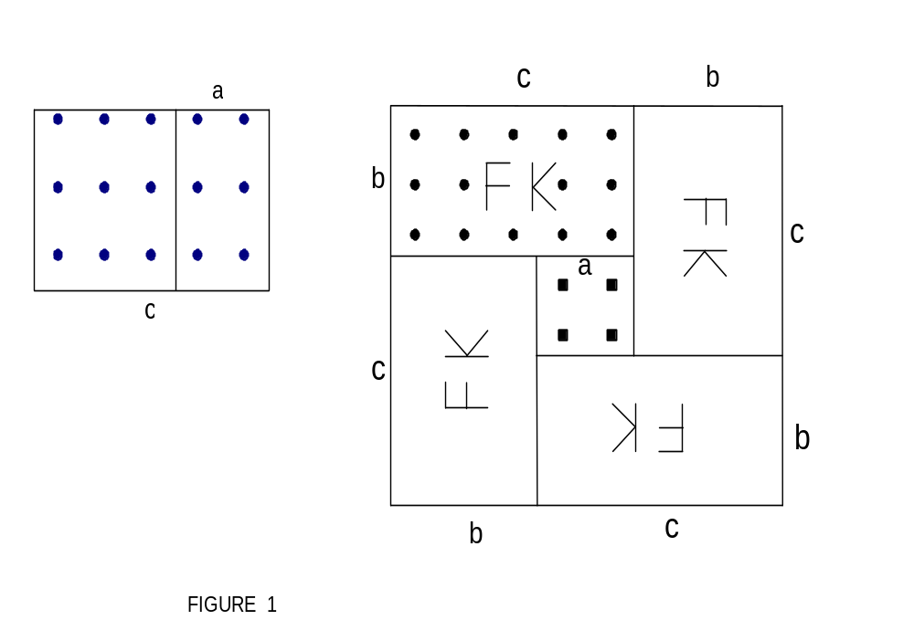
Square Fibonacci Kolam

Slide 24
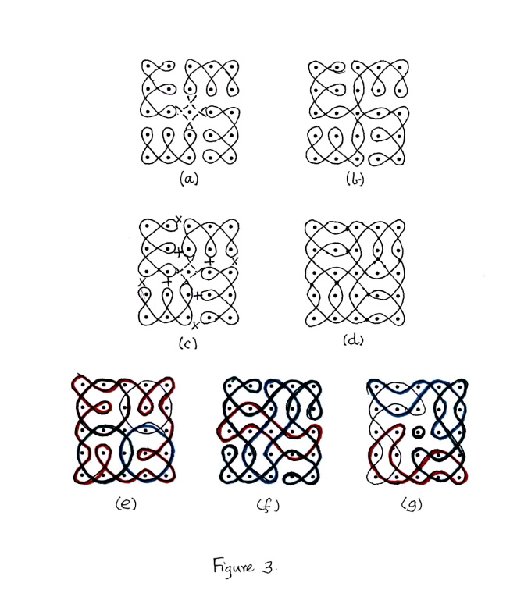
5 x 5 (1 2 3 5)

Slide 25
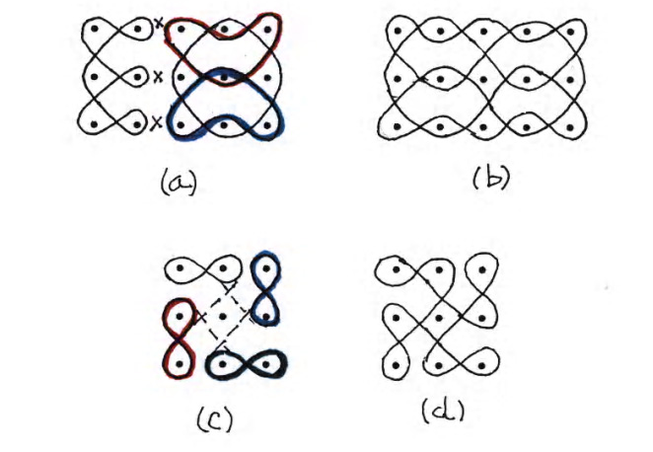
3 x 3 (1 1 2 3) and 3 x 5

Slide 26
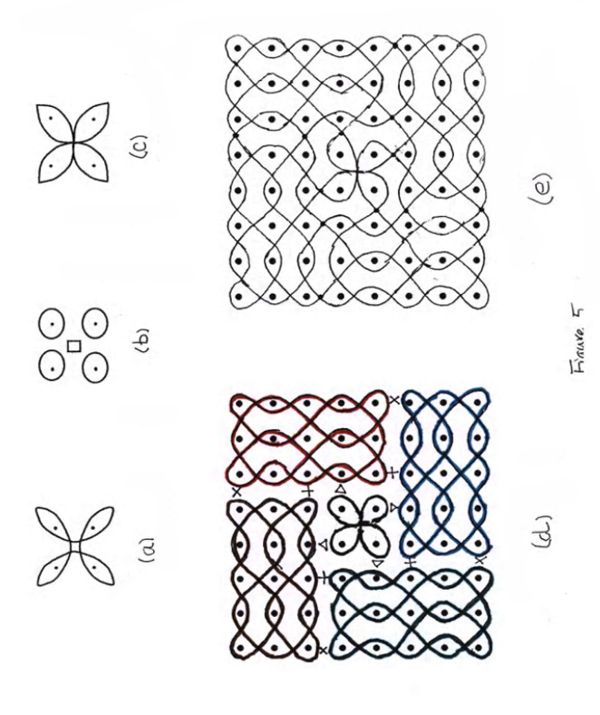
2 x 2 (0 1 1 2) and 8 x 8 (2 3 5 8)

Slide 27
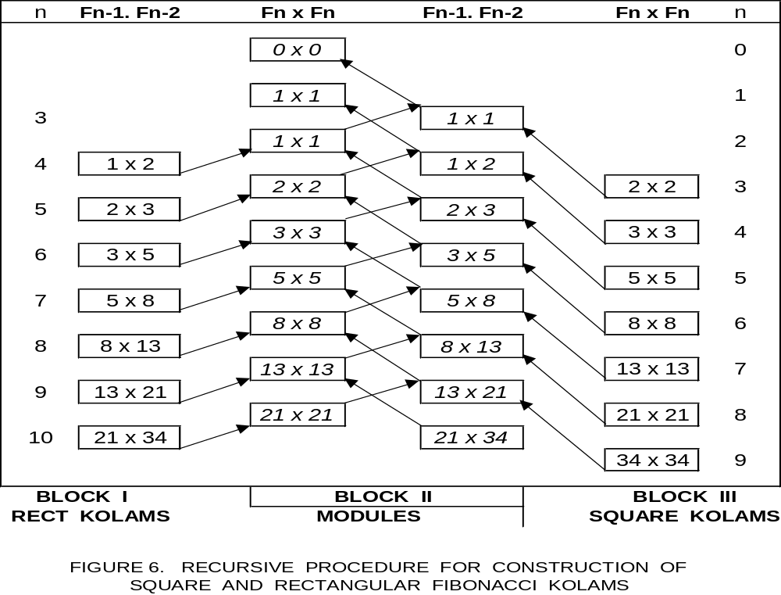
Process for Construction

Slide 28
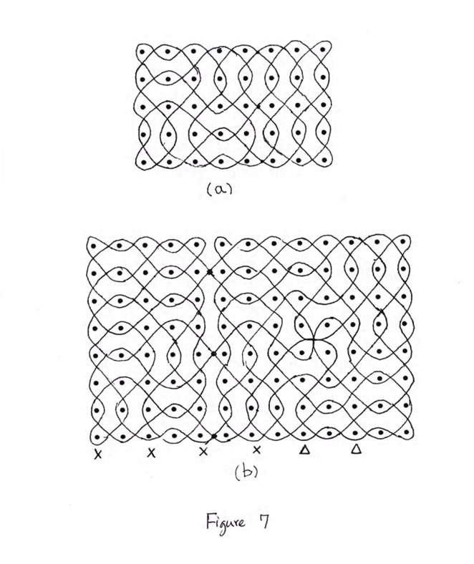
5 x 8
8 x 13

Slide 29
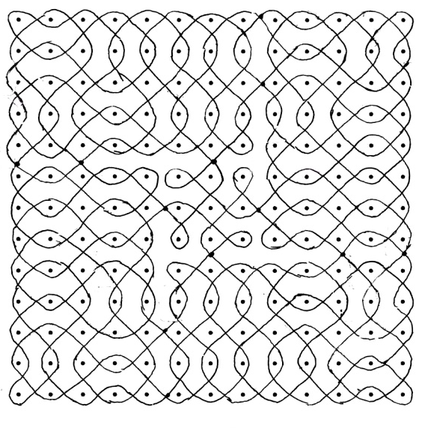
13 x 13 : ( 3 5 8 13)

Slide 30
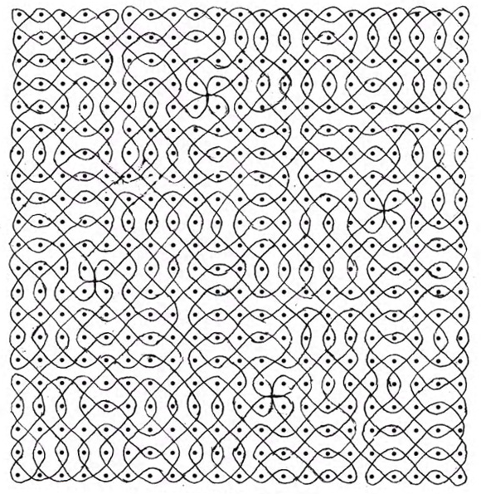
21 x 21 : ( 5 8 13 21)

Slide 31
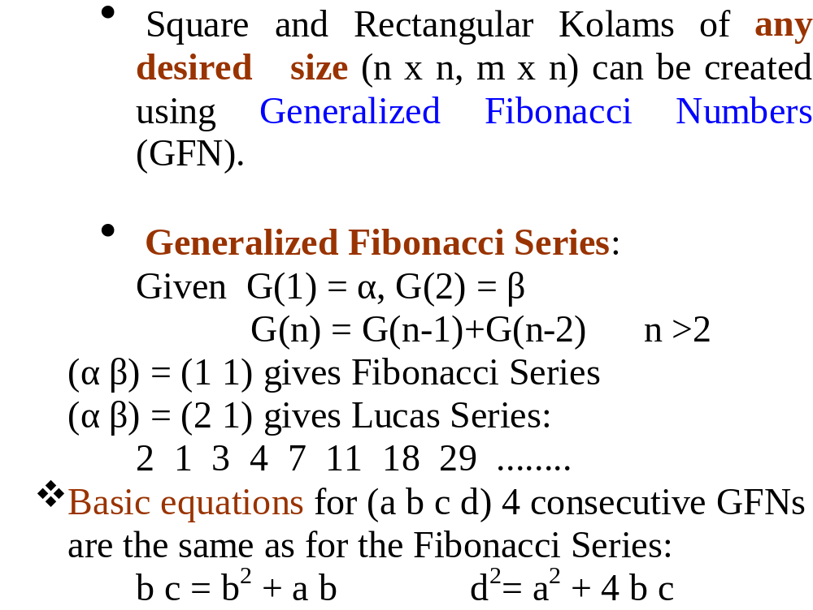
FIBONACCI KOLAMS OF ARBITRARY SIZE

Slide 32
Square Fibonacci Kolam

Slide 33
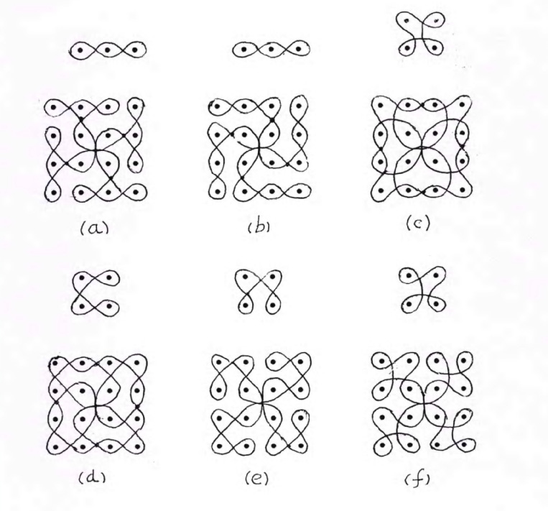
Lucas Kolam (4 x 4)
(2 1 3 4)
(0 2 2 4)

Slide 34
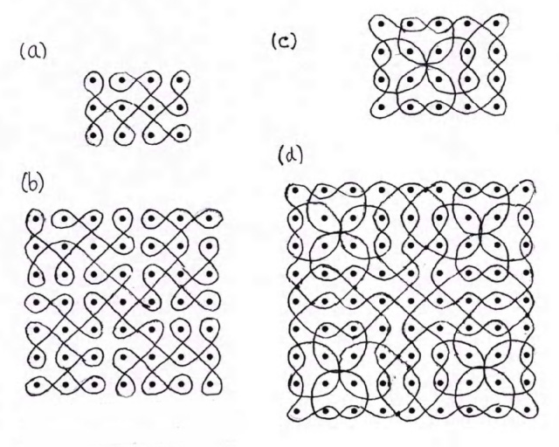
Lucas Kolams ( 7 x 7, 9 x 9)
(1 3 4 7)
(1 4 5 9)

Slide 35
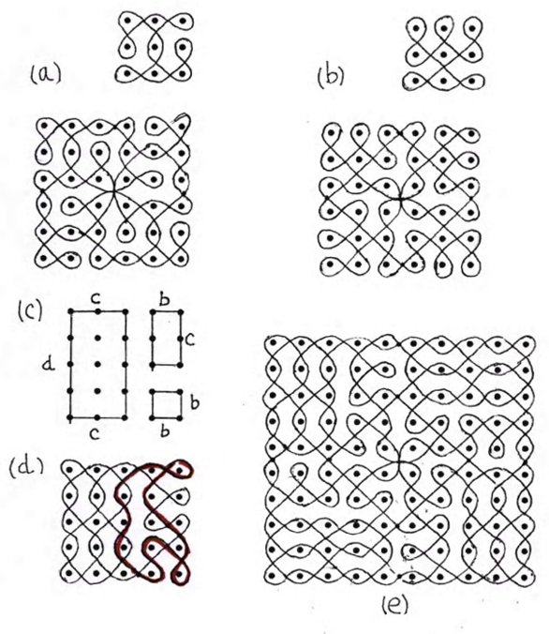
G F Kolams (6 x 6 and 9 x 9)
(0 3 3 6)
(0 5 5 10)

Slide 36
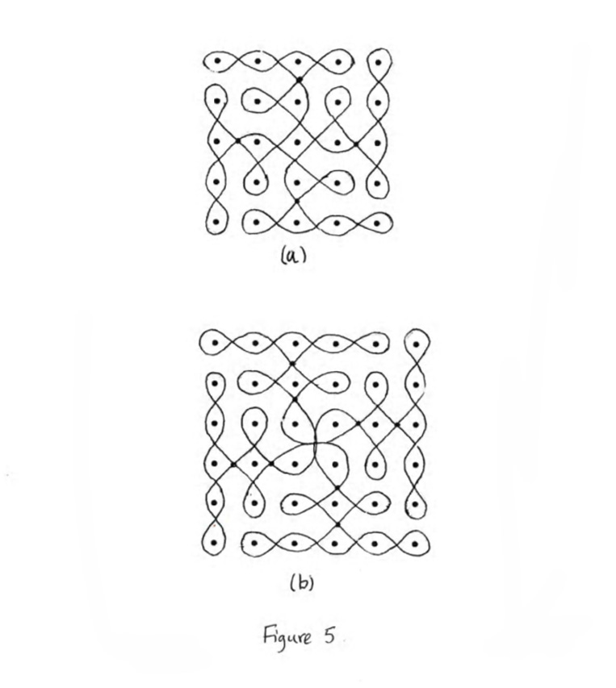
G F Kolam (5 x 5 and 6 x 6)
(4 1 5 6)
(3 1 4 5)

Slide 37
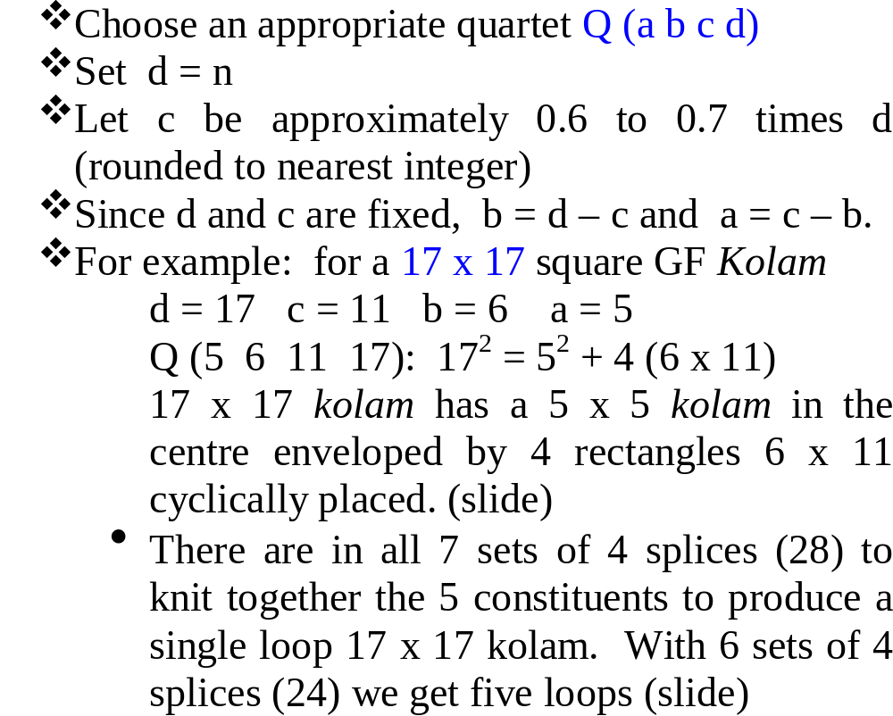
RECIPE FOR GF KOLAM n x n

Slide 38
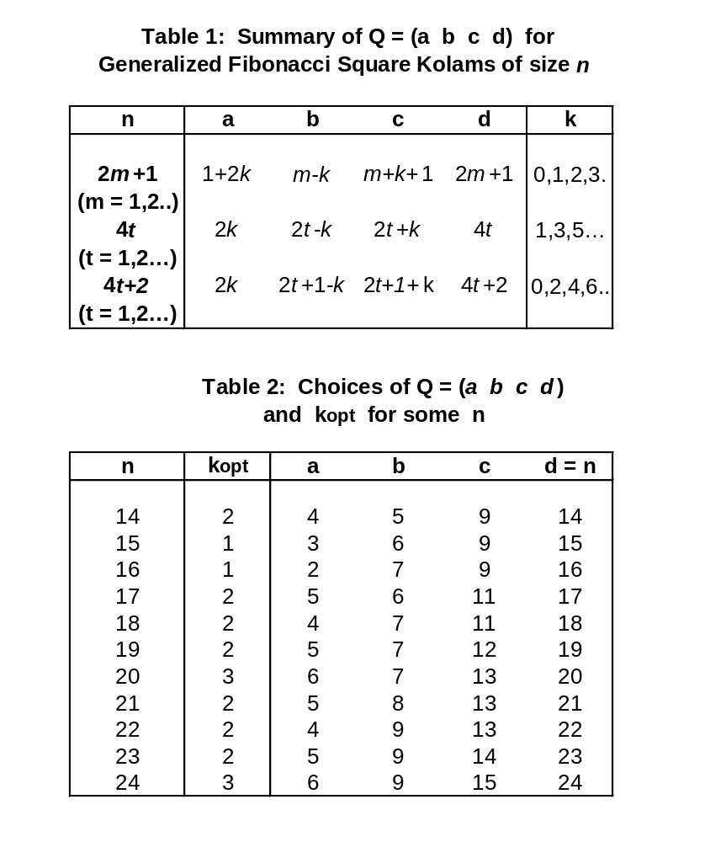

Slide 39
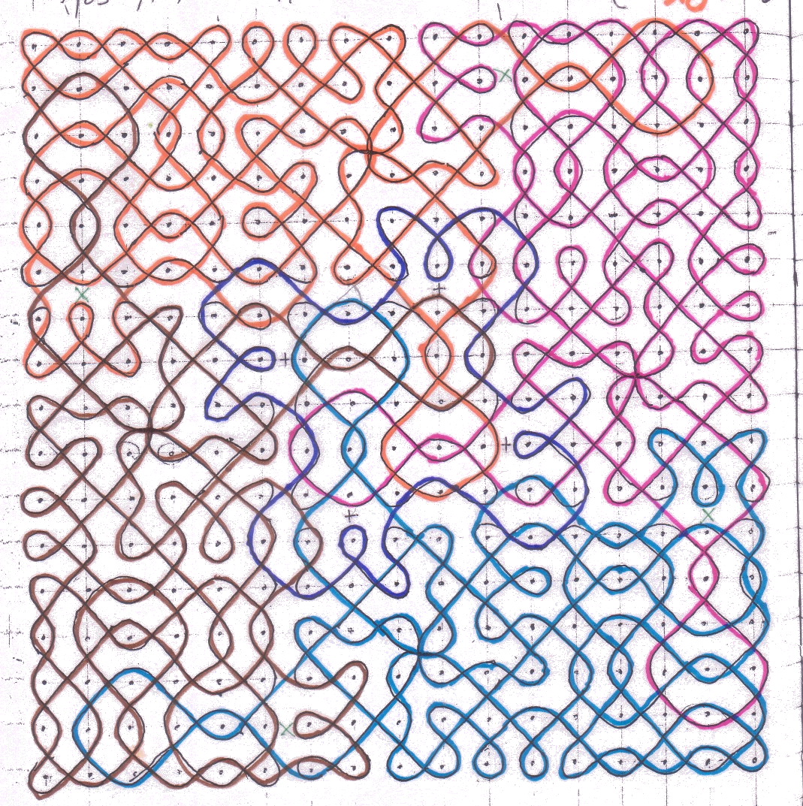
17 x 17 (5 6 11 17) – 5 Loops

Slide 40
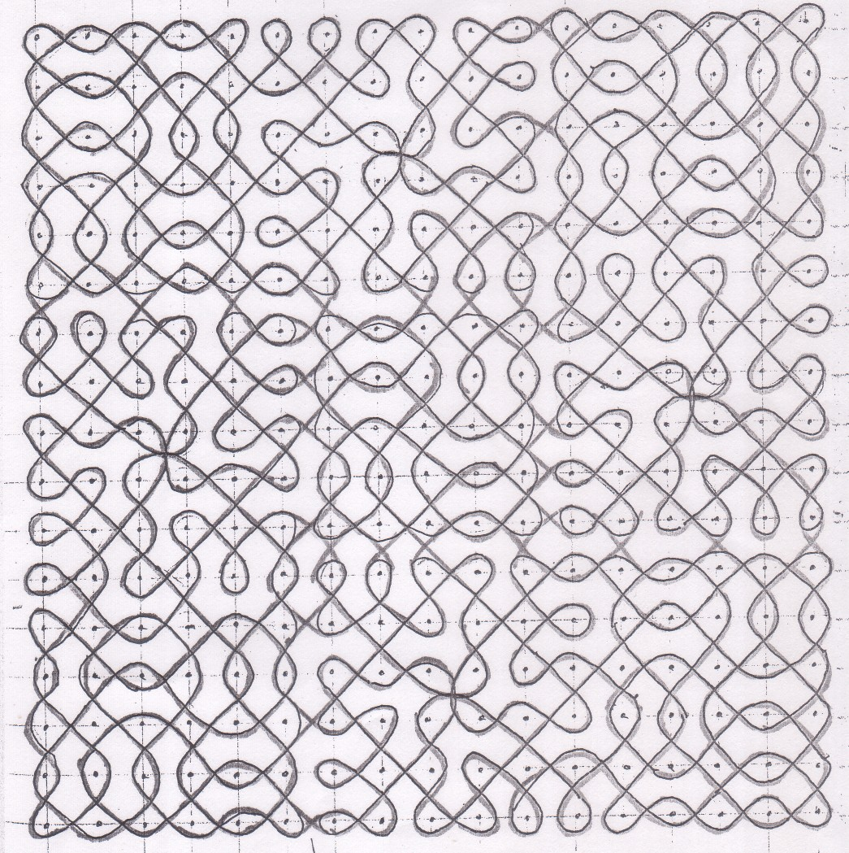
17 x 17 (5 6 11 17) – Single Loop

Slide 41
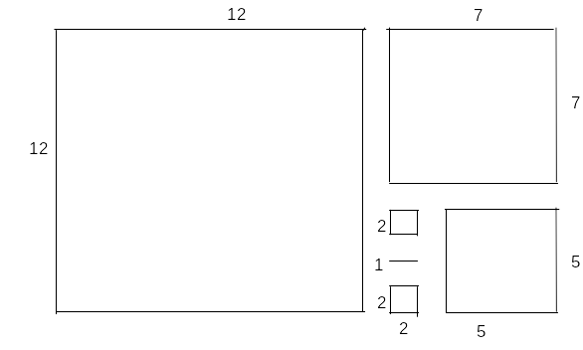
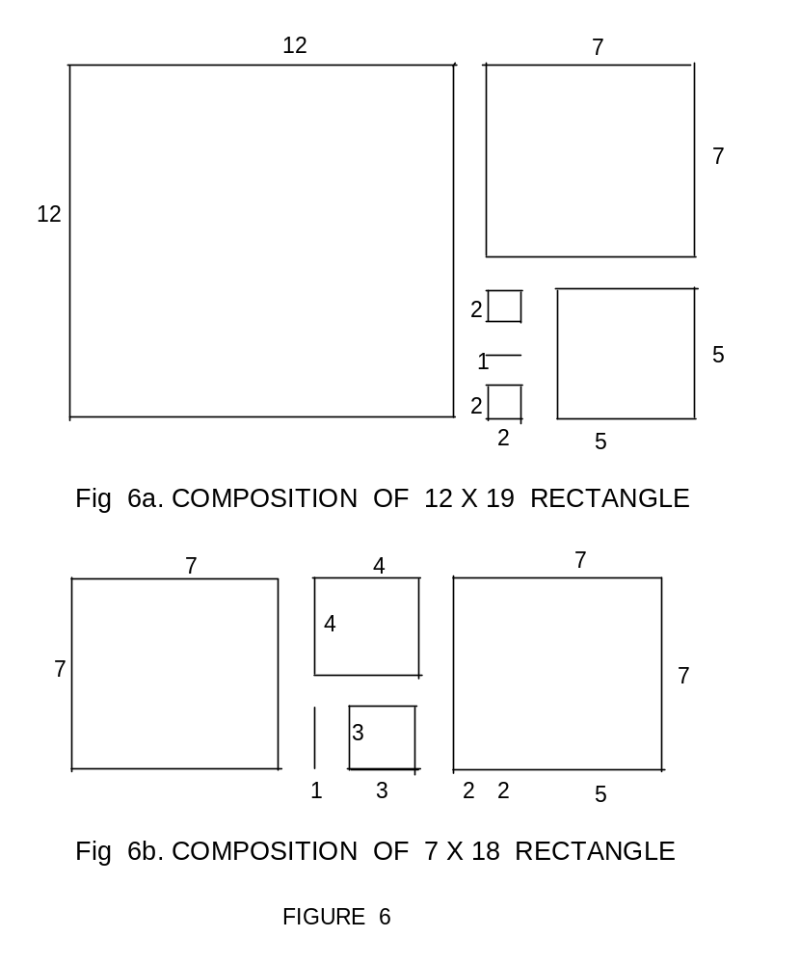
Composition of GFK Rectangles
12 x 19
7 x 18

Slide 42
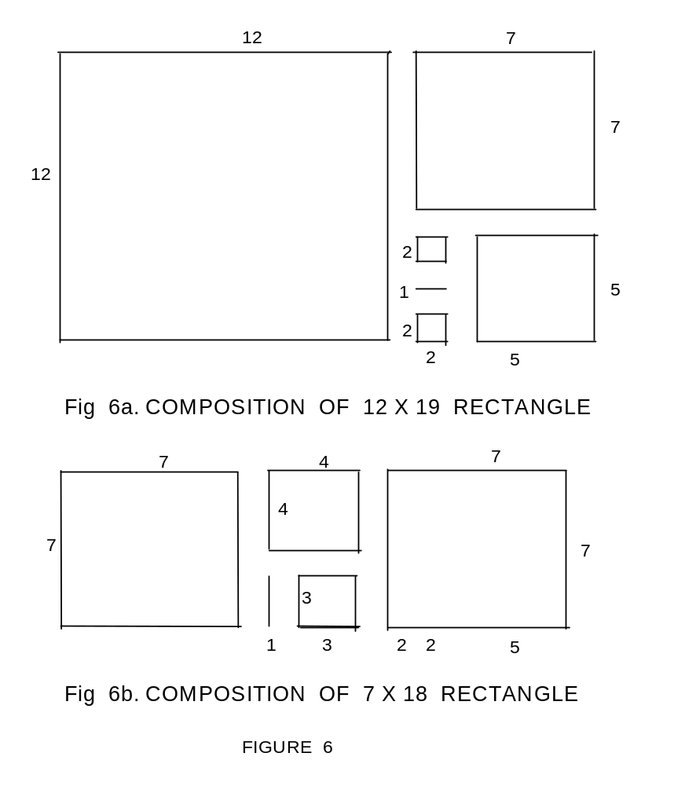
Composition of GFK Rectangles

Slide 43
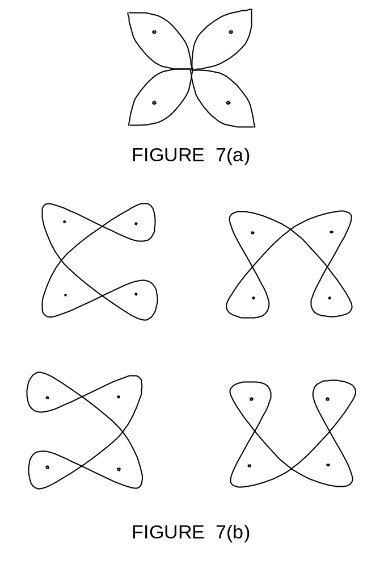
Fibonacci Kolam ( 2 x 2, Single Loop)

Slide 44
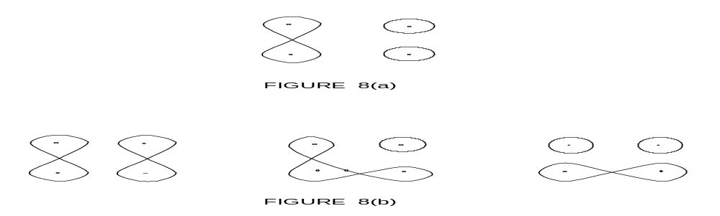
Fibonacci Kolam ( 2 x 2, Multiple Loop)

Slide 45
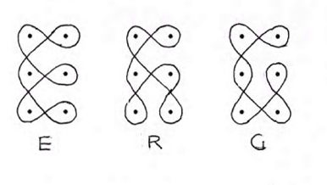
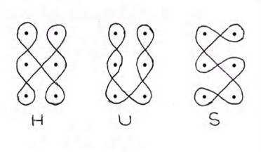
Fibonacci Rectangular Kolams ( 2 x 3)
E
R
G
H
U
S

Slide 46
5 x 5 (1 2 3 5)

Slide 47
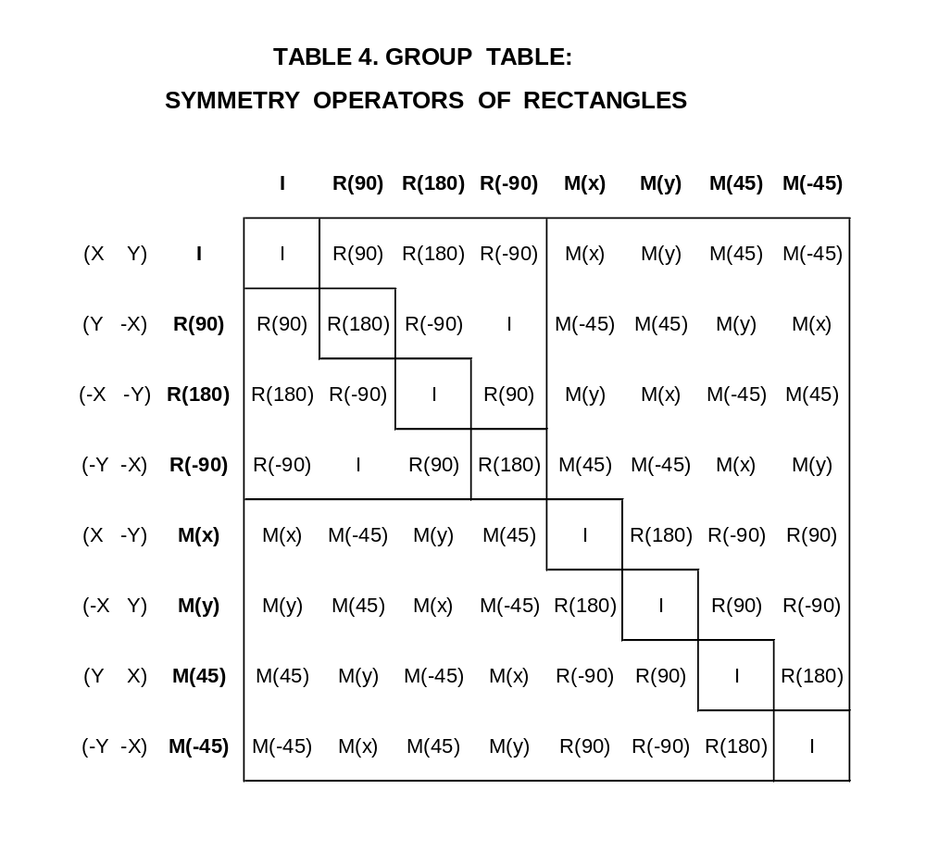

Slide 48
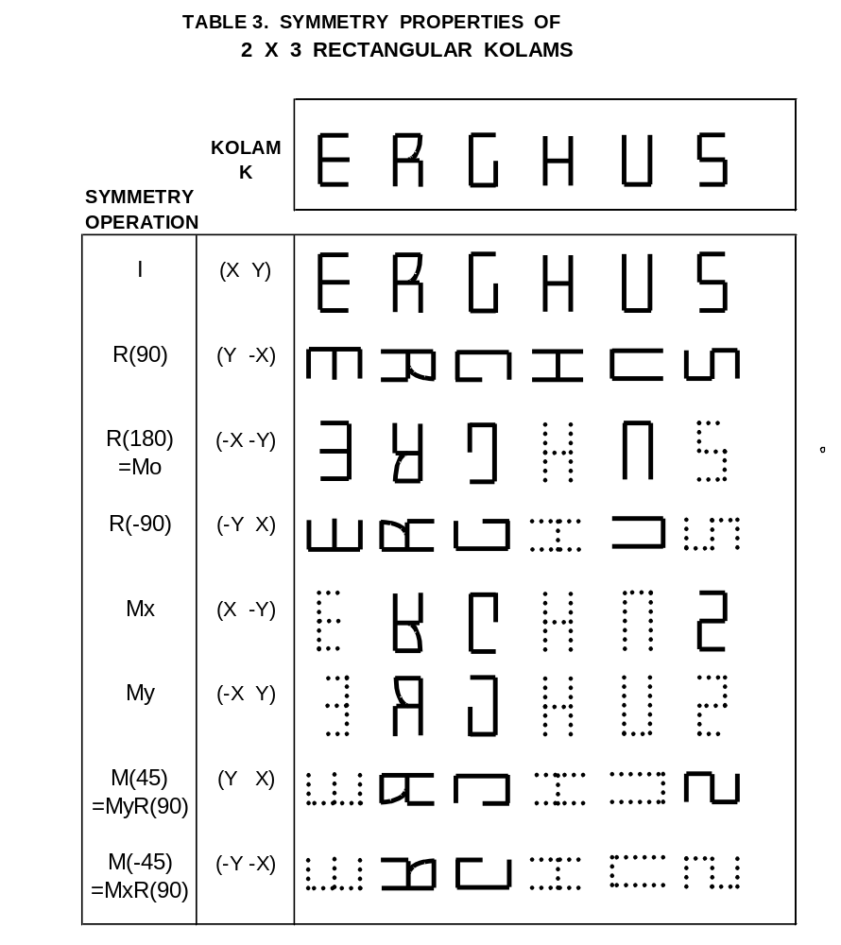

Slide 49
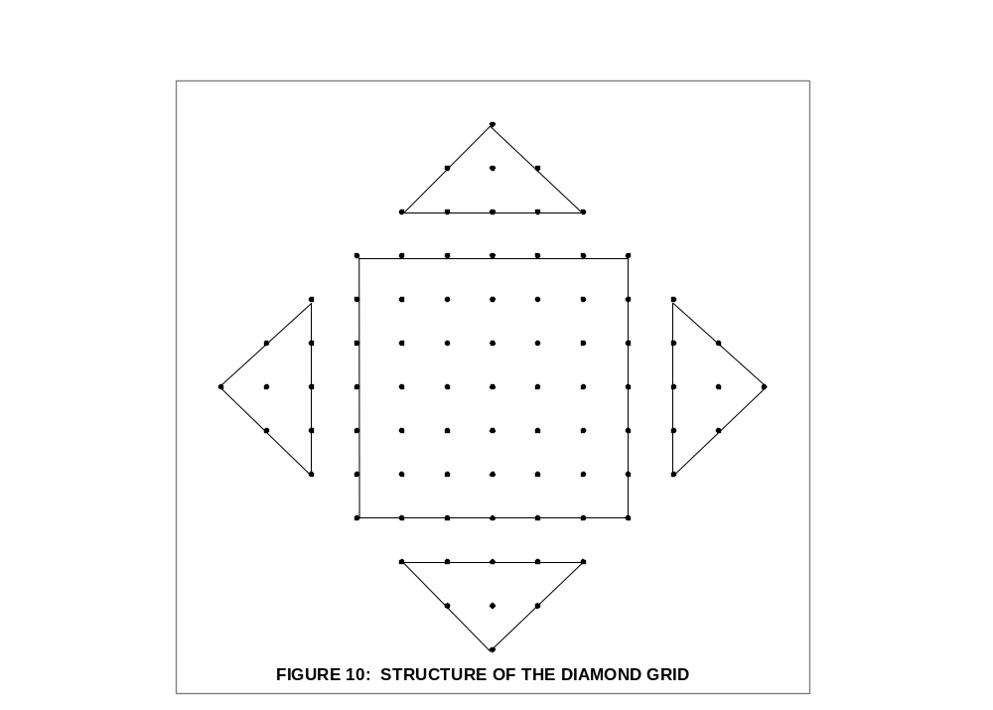
Diamond Grid Kolam D (13)

Slide 50
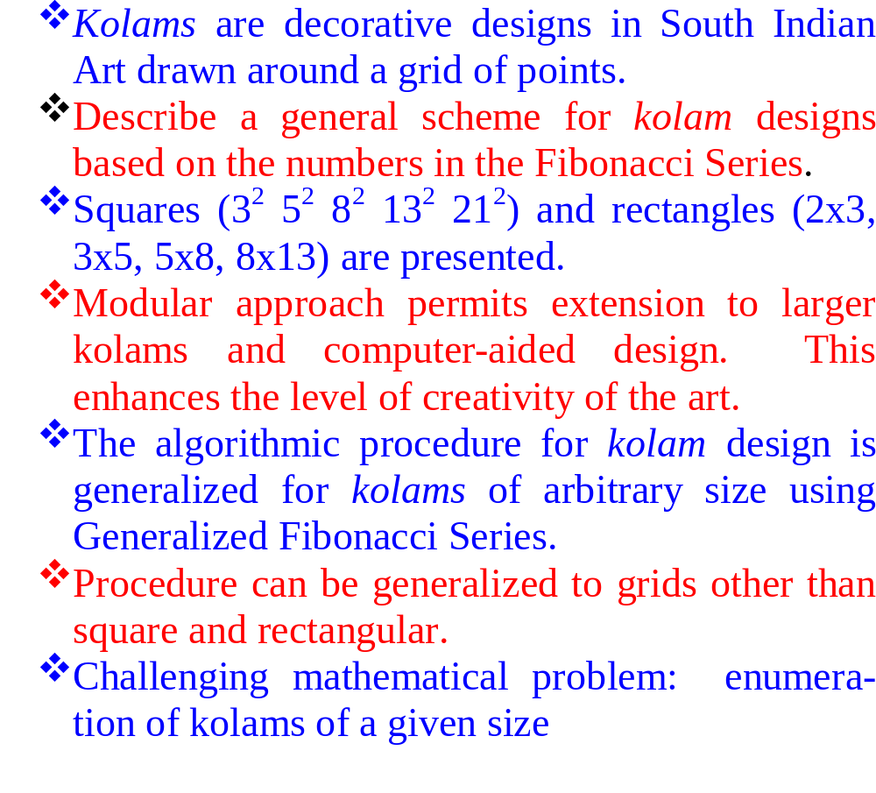
CONCLUSION AND SUMMARY

