Slide 1
SPECIAL KOLAMS
The Generalized Fibonacci Numbers permit a wide
choice for the rectangles that go into the square
designs.
With the standard “Fibonacci Numbers”, the
rectangles are “Golden rectangles” with sides equal
to consecutive Fibonacci numbers and their ratio
approaching the Golden Ratio φ (=1.61803...).
The explanations for the 6 designs along with the
actual kolams follow. All these kolams have a
single loop, except the last one.

Slide 2
(7 4 11 15) Design
This code implies that a 15² kolam is made up of
a central square 7² surrounded by four rectangles
4 x 11.
The code for 7² is (3 2 5 7); or the 7² contains
a central 3² surrounded by four rectangles 2 x 5.
Each 4 x 11 rectangle is made up of three
modules: 4², 4 x 3 and 4².

Slide 3
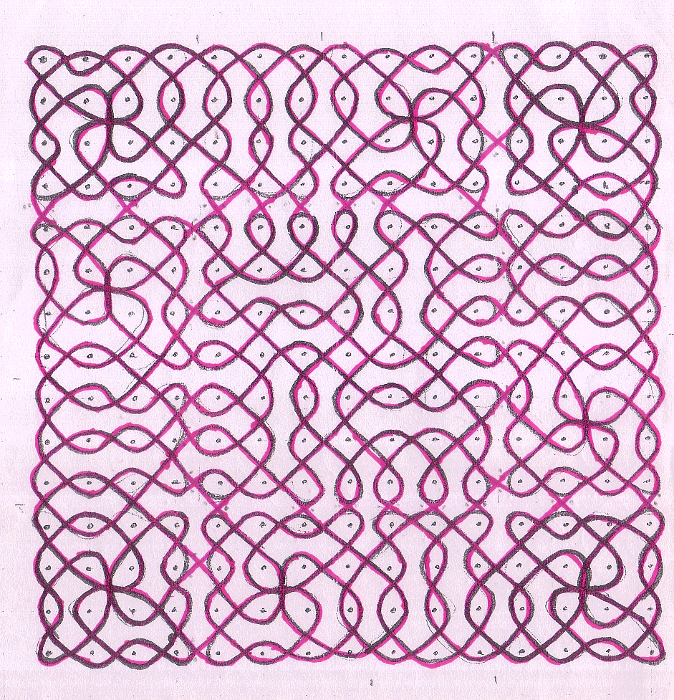
(7 4 11 15) Kolam

Slide 4
(13 4 17 21) Design
Since 21 is a Fibonacci Number, the canonical quartet
code for 21² is (5 8 13 21), The “Golden rectangles”
are 8 x 13, two consecutive Fibonacci Numbers. But
here we consider 21 as a “Generalized Fibonacci Number”
and the quartet code is (13 4 17 21). The 21² is made up
of a 13² surrounded by four rectangles 4 x 17.
Now, the 13² has the code (5 4 9 13), again different
from the canonical (3 5 8 13). Each 4 x 17 rectangle is
made up of 5 modules 4², 4², 4 x 1, 4², 4².

Slide 5
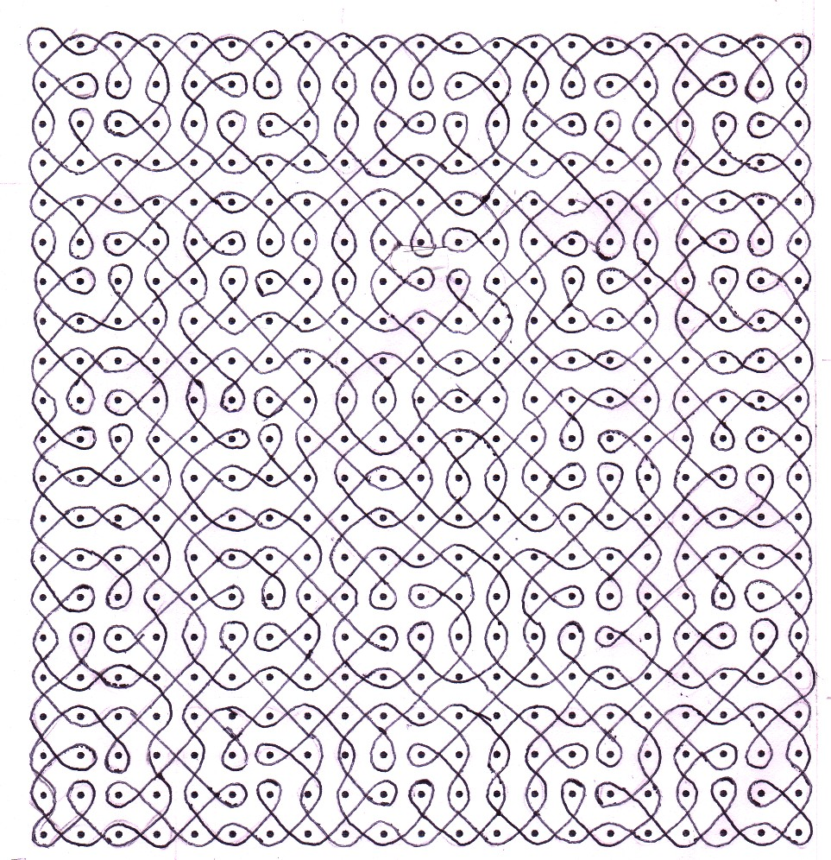
(13 4 17 21) Kolam

Slide 6
(12 7 19 26) Design
This square kolam, we name it “a e-kolam”, e
representing the Euler’s constant (2.7182818), the
base for natural logarithms. The code implies that a
26² kolam has a central 12² enveloped by four
rectangular kolams 7 x 19. The ratio of the sides
19/7 = 2.714.., differs from e by 0.004 or < 0.15 %
of e. So this kolam has “e-rectangles” instead of the
Golden rectangles.
The central 12² has the code (8 2 10 12) – i.e. a
central 8² surrounded by four rectangles 2 x 10.
In turn the 8² has the canonical code (2 3 5 8). The
3 x 5s are Golden rectangles. So, this kolam features
both the Golden rectangles and the e-rectangles.

Slide 7
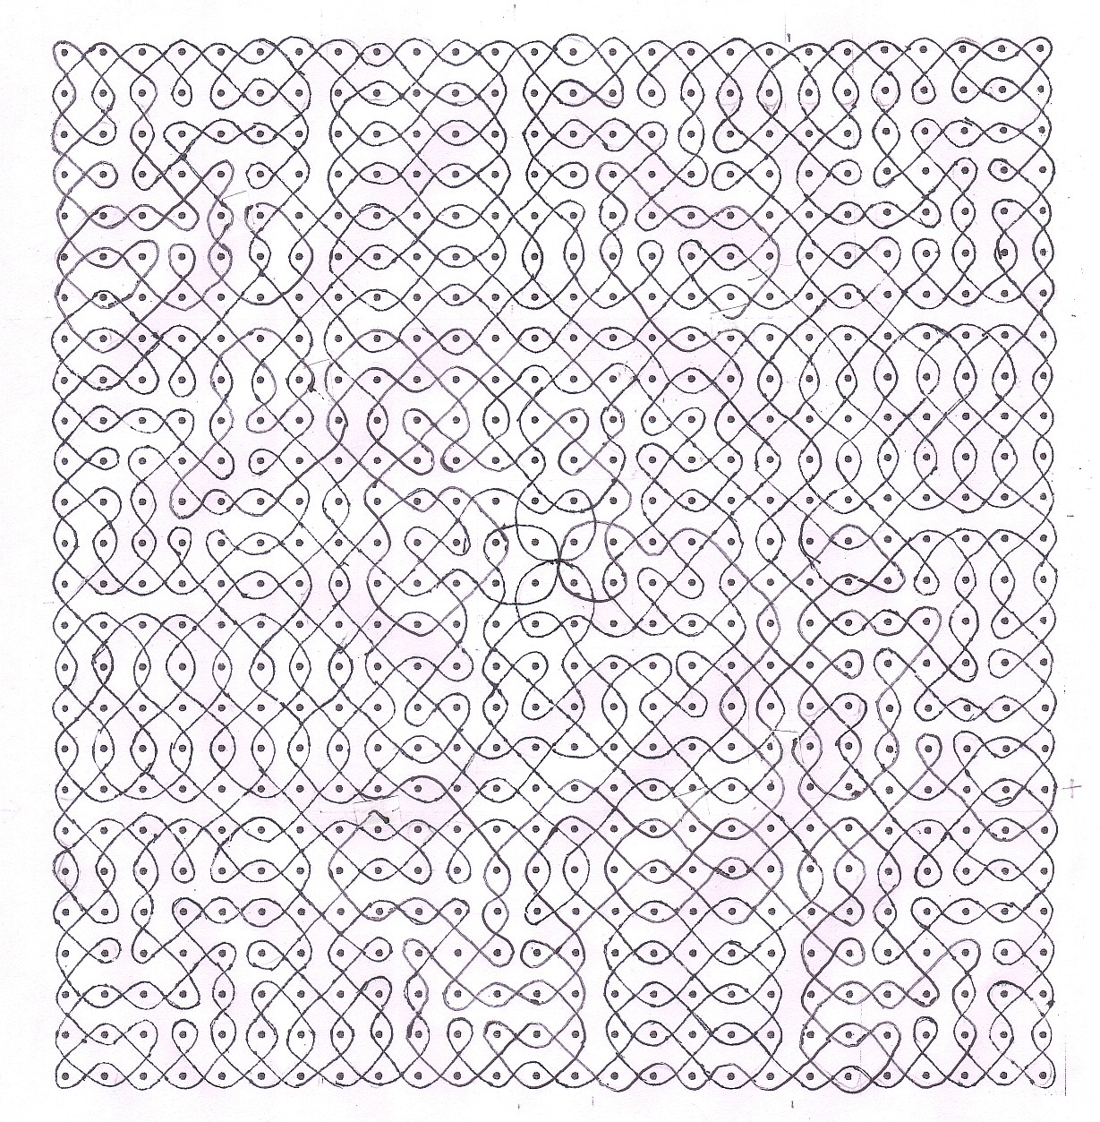
(12 7 19 26) Kolam

Slide 8
(7 19) Design
This rectangle of sides 7 x 19 with ratio approximately
equal to e, the Euler’s constant, was used in the in 26²
kolam above.
It is made up of three modules, a 7 x 5 rectangle
sandwiched between two squares 7².
The three modules are spliced together at 6 points,
indicated by dots. If splices at the points A and B (see
the kolam on the next slide) added then the single
loop kolam splits into three loops.

Slide 9
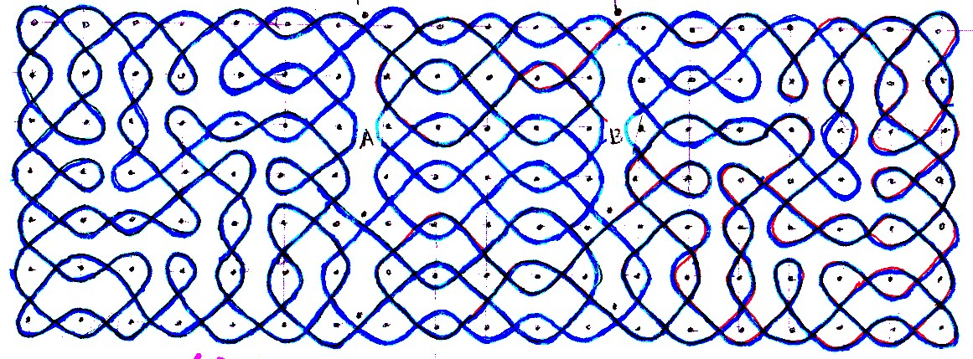
(7 x 19) Kolam

Slide 10
(15 7 22 29) Design
This square kolam, we name it “a pi-kolam”. The code
(15 7 22 29) implies that 29² kolam contains a smaller 15²
kolam at the center surrounded by four rectangles 7 x 22. The
ratio of the sides of the rectangle 22/7 is the commonly used
approximation for pi, the ratio of the perimeter to diameter
of a circle.
Now, 22/7 = 3.14285…differs from pi (=3.14159 . . .) by
0.0013, which is < 0.04 % of pi.
The code for 15² is (7 4 11 15) and the code for 7² is (3 2 5 7).
Each 7 x 22 rectangle is composed of 4 modules 7², 4 x 7, 4 x 7,
7² that are spliced together at 15 places to produce a 3-loop
design.
This 29² kolam is built with 33 modules and 111 splicing
points to produce a single loop traversing 841 (29²) dots
or grid points.

Slide 11
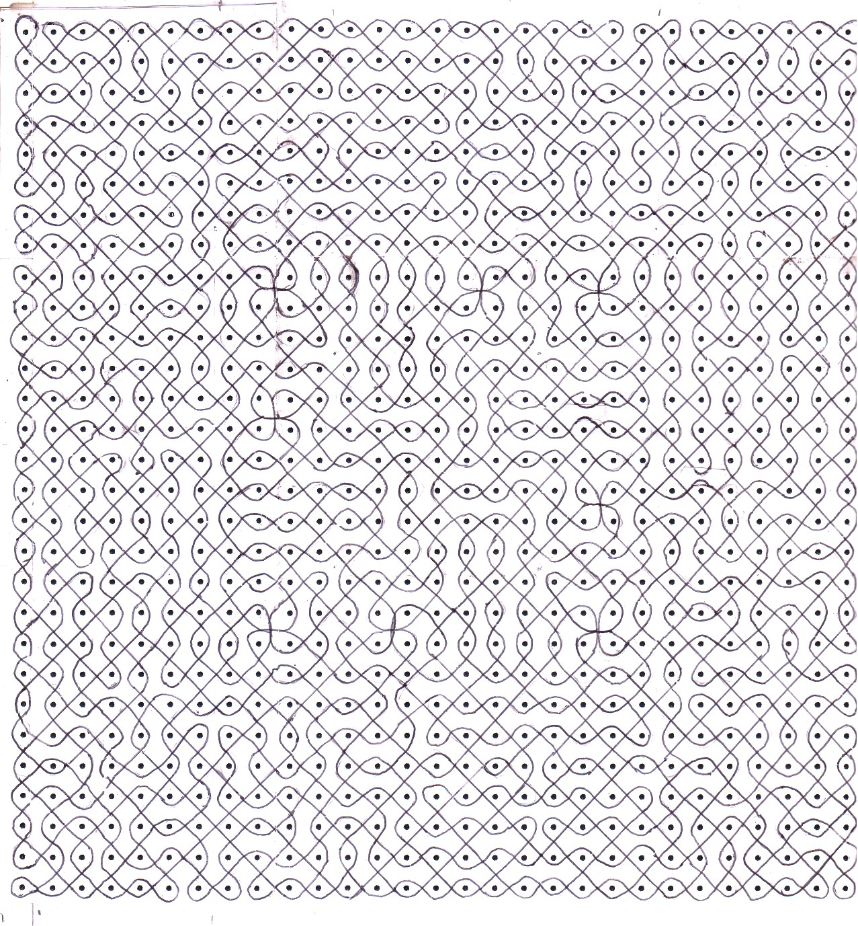
(15 7 22 29) Kolam

Slide 12
(7 22) Design.
This shows the 7 x 22 “pi-rectangle” used in
the 29² square kolam above.
The 15 splicing points come in three sets of 5
indicated by dots in the direction of arrows.
The three loops are shown in different colors.
It is possible to convert this into a single-loop
kolam by removing the two splices at A and B.

Slide 13
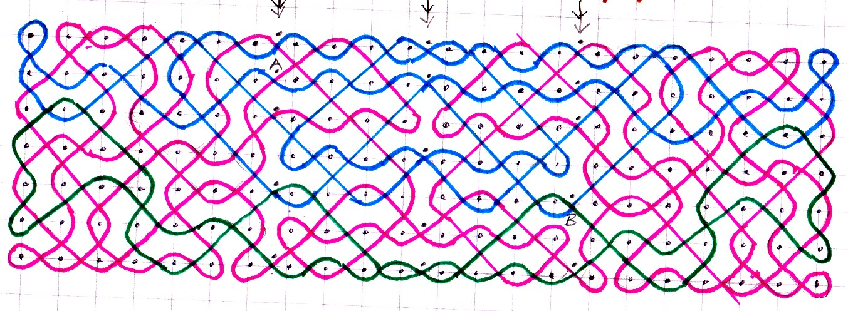
(7 22) Kolam

