Slide 1
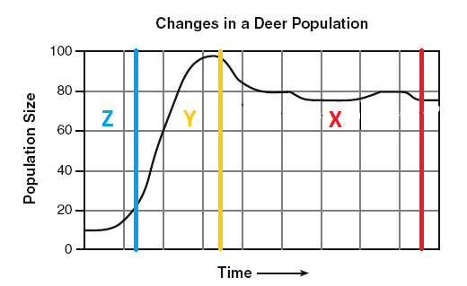
1. Estimate the carrying capacity for the deer.
2. Explain why part X of the graph fluctuates and is not a flat horizontal line.

Slide 2
CLAIM
EVIDENCE
REASONING
= CER

Slide 3
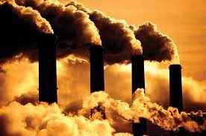
What is a claim?
A statement of something as a fact; an assertion of truth.
example: Burning fossil fuels is harmful to the environment.

Slide 4
What makes a good CLAIM?
Identifies what you know from evidence
Identifies the question for the reader
A clear statement that answers the original question
Uses specific language
Does not include reasoning

Slide 5
Make a claim based on this question...
Which professional sport is the most exciting to watch?
Practice making a claim on your notes

Slide 6
CER
Claims are made after analyzing evidence
Evidence = observations, measurements, data (from tables, graphs), etc.

Slide 7

What is Evidence?
Scientific data that supports the claim
Relevant (directly related) to the claim
Cites specific data, describes trends in data, or compares & contrasts data

Slide 8
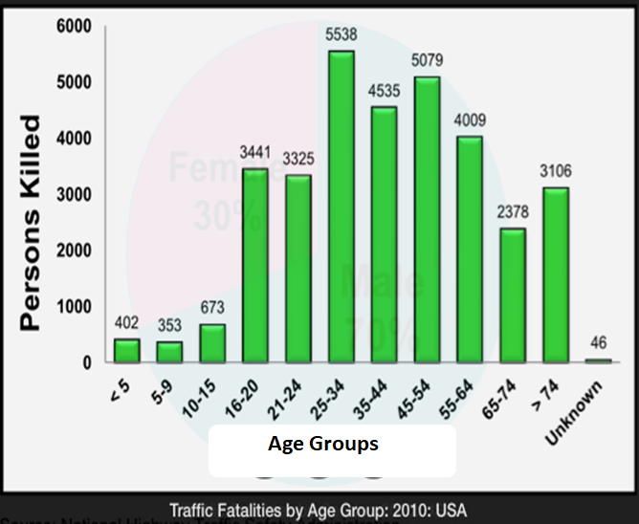
How does age affect traffic fatalities?
Analyze the data, select your evidence, and write a claim on your notes

Slide 9
How does age affect traffic fatalities?
Evidence:
  Ages 5-9 = 353 deaths
  All other known age groups > 353 deaths
Claim
  People ages 5-9 are least likely to die from auto accidents.

Slide 10
What makes good REASONING?
Your justification for the claim
Connects the Evidence to the Claim
Uses scientific principles
Incorporates previous knowledge

Slide 11
Question: How does age affect traffic fatalities?
Claim: People between the ages of 25-34 are the most likely to get in a fatal traffic accident.
Evidence: Age 25-34 = 5,538 All other ages < 5,538 | Reasoning: People between the ages of 25-34 are more likely to get in fatal car accidents than any other age group because people between the ages of 25-34 are more likely to be in a car and commuting than the younger age groups. They are also less likely to have a child in the car with them than older people, which means they engage in riskier driving behavior than those in groups older than them. All of these factors lead to this group having the highest rate of traffic fatalities. This is backed up by the data in the graph which show that the age 25-34 group had the highest rate of traffic fatalities (5,538) over one year.

Slide 12
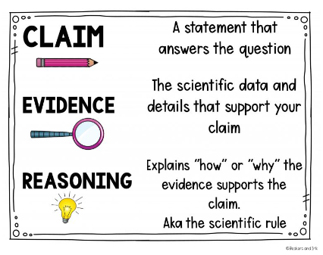

Slide 13
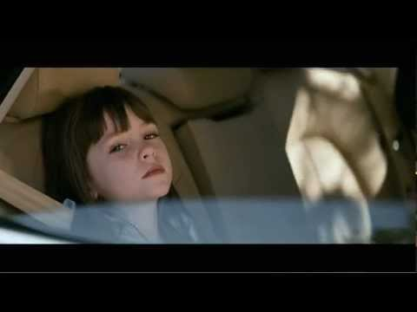
Alien video

Slide 14
Directions: Classify each statement below as either the claim, the evidence, or the reasoning (one for each scenario).
Video Games and Violence
According to Elizabeth Eisentein's article, “Video Games and Violence," 85% of kids that play violent video games are more aggressive.
Video games contribute to youth violence
Kids that play violent video games become more aggressive. This can lead to more hostility directed toward their peers, such as bullying, verbal abuse, and even physical abuse.

Slide 15
Plant Growth & Fertilizer
Plants grow better with fertilizer
Fertilizer is full of nutrients like nitrogen that give plants the energy they need to grow and reproduce
The group of plants that was given a supplemental diet of fertilizer was an average 7.5 cm taller than the control group plants after 2 weeks.

Slide 16
Is bottled water worth the cost of plastic pollution?
Many areas of the world need bottled water to survive. If they don’t have bottled water, then they won’t have clean water to drink from or to use for taking baths. Therefore, communities should not ban bottled water.
According to the article “ Around the world, 780 million people do not have access to safe water; if they drink tap water, they can get sick.”
Communities should not ban bottled water.

Slide 17
Carbon Dioxide & Human Actions
Cars, trucks, and airplanes are the leading sources of pollution in the United States producing over 44 tons of carbon annually
Scientists state that there is more carbon in the atmosphere now than any other time in Earth’s history
Humans are the primary offenders responsible for increasing the amount of carbon dioxide in the atmosphere

Slide 18
Water in Space
Water in space will form into a sphere (circular) shape.
Therefore, the claim that water will form into a sphere in a weightless environment is correct because of surface tension. A force pulls on each water molecule with an equal amount of force from all sides to the center, which creates a perfect circle.
The video shows that water particles cling to each other when they are released from the container. This reaction formed a spherical shape which remained intact even when the surface of the water was broken.

