Slide 1
Topology optimization

Slide 2
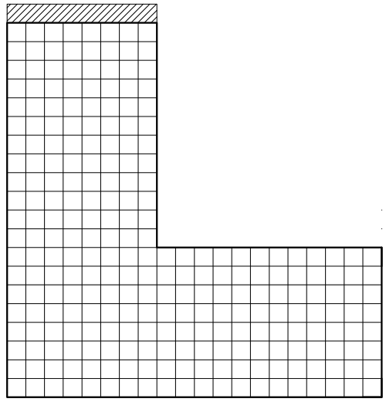
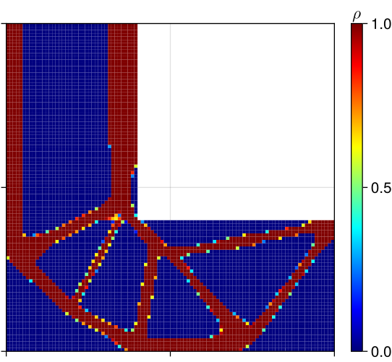
Generating dataset
Training
Topology optimization
Prediction
Input
Output

